Slide 1
Interstate Compact on Military Students WA STATE COUNCIL OESD 114, Bremerton October 14, 2021 10:00 to 11:30
GREGORY J. LYNCH | Commissioner
Superintendent | Olympic Educational Service District 114 105 National Avenue North | Bremerton, WA | 98312 glynch@oesd114.org| ph 360.478.6880

Slide 2
Meeting Agenda – September 24, 2020, 9:00 AM to 11:30 AM OESD 114 hosted via Zoom - Registration Link: https://zoom.us/meeting/register/tJUpceurpjIrGteGSswSKJGwP8bo0FJO4nTK.
10:00 – 10:30 Welcome and MIC3 Overview Greg Lynch, WA MIC3 Commissioner
MIC3 WA Brief Review
National Guard & Compact Support
WA MIC3 Commissioner Succession Planning
10:30 – 10:50 Office of the Superintendent of Public Instruction Dixie Grunenfelder, Executive Director, ED Student Engagement & Support School District Compact Survey
Military Identifier
Recurring Compact Challenges in WA
School Choice and Virtual Learning
Advanced Enrollment
10:50 – 11:00 Department of Defense Liaison Tammie Perreault, NW Region DoD Liaison
11:00 -11:30 Discussion, Questions & Updates All
Senators Rolfes, & Rivers Representative Paul
Randy Spaulding, Executive Director, State Board of Education
Mick Hoffman, Executive Director, WA Interscholastic Activities Association
Andrew Estep, Executive Director, WA PTA
Norma Melo, Kelly Scheese, Military Liaisons
Tim Ames, Ron Banner, Aaron Leavell, & Erin Prince, SD Superintendents

Slide 3
Washington Compact Involvement & History
WA MIC3 Task Force submitted a recommendation to Legislature in Dec. 2008 recommending WA join the Compact.
Washington State joined the Interstate Compact on Educational Opportunity for Military Children (MIC3) in 2009.
Substitute Senate Bill 5248 (2009) was passed, placing the major components of the Compact into Washington State Law legislation included a “sunset” clause for potential renewal during the 2015 legislative session.
State MIC3 Committee submitted report and recommendation in Dec. 2014 to Legislature to sustain Compact – “approved” during the 2015 legislative session.

Slide 4
Why the Interstate Compact?
The Goal: To remove barriers to educational success imposed upon children of federal uniformed families because of frequent moves and deployment of parents.

Slide 5
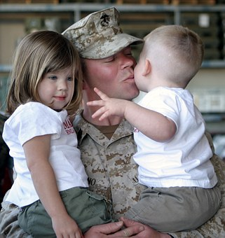
The Compact Applies To Children of:
Active duty members of uniformed services (includes activated Guard and Reserves)
Medically discharged members and veterans (for 1 year)
Members who die on active duty (for 1 year)
Does NOT apply to children of:
Inactive members of the national guard and military reserves
Members of the uniformed services now retired
Veterans of the uniformed services
Other U.S. DoD personnel and other federal agency civilian and contract employees

Slide 6
Military Connected School Age Children US Armed Forces
1.1 Million Children Ages 5-18
630,000 Children of Active Duty Parents
75% of Children with Active Duty Parents are Under Age 12
76%
8%

Slide 7
* ~29,000
* ~824
* ~116
* ~8
Uniformed
Services WA
*indicates # of uniformed/military connected students in each branch

Slide 8
Compact Focus Areas RCW28A.705.010
Educational Records
Immunizations
K and 1st Grade Eligibility
Extracurricular Activities Eligibility
Educational Course and Program Placement
Absences Related To Parent/Guardian Deployment
Graduation
https://www.mic3.net/publications.html

Slide 9
State Council
(September 2021)
Legal Counsel
Optional
Governor Rep
Commissioner
Legislators
Carrie Basas, Director, Office of Education Ombuds
Greg Lynch,
Superintendent, OESD 114
Christine Rolfes, Senator
Ann Rivers Senator
Dave Paul, Representative
_________ Representative
Head Dept. of Education
School District (SD) Superintendents (High % Military Children)
Chris Reykdal, State Superintendent of Public Instruction
Tim Ames, Medical Lake SD (Fairchild AFB)
Aaron Leavell, Bremerton SD (NBK/PSNS/Keyport Naval Undersea Warfare Center
Erin Prince, Central Kitsap SD (NBK)
Ron Banner, Clover Park SD (JBLM)
Military DoD Rep
Ex-Officio Members
Military/Uniform Family Liaison
JBLM Garrison Commander
Randy Spaulding, Exec. Director SBE
Mick Hoffman, Exec. Director WIAA
Andrew Estep, Exec. Director PTA
Norma Melo, JBLM
Kelly Scheese, NRNW
advisory & advocacy body of policy makers and subject matter experts
council composition outlined in WA SSB 5248 & Article VIII, RCW 28A.705.010 28A.705.

Slide 10
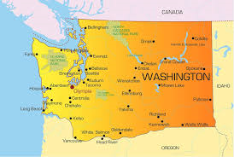
WA Military and Family Members Department of Defense
A
Military | 56,215
Military Spouses | 26,072
Children 0-4 | 16,715
Children 5-18+ | 27,232
Total | 126,234
Reference: DoD database 2019

Slide 11
WA Military Connected Families
70,213 Virginia
60,006 Texas
57,863 California
43,672 North Carolina
39,293 Florida
31,292 Georgia
29,740 Washington (Spring 2021)

Slide 12
Defense Spending by Top Ten States Economic Military Impact
1: California, $49B
2: Virginia, $46.2B
3: Texas, $37.7B
4: Maryland, $21.1B
5: Florida, $19.2B
6: Washington, $15.2B
7: Connecticut, $15B
8: Georgia, $13.2B
9: Pennsylvania, $12.1B
10: Alabama, $10.9 B
6. $15.2B Washington
Source: FY 2017 - U.S. Department of Defense Office of Economic Adjustment - Revised March 2019
https://www.oea.gov/resource/fiscal-year-2017-defense-spending-report-state

Slide 13
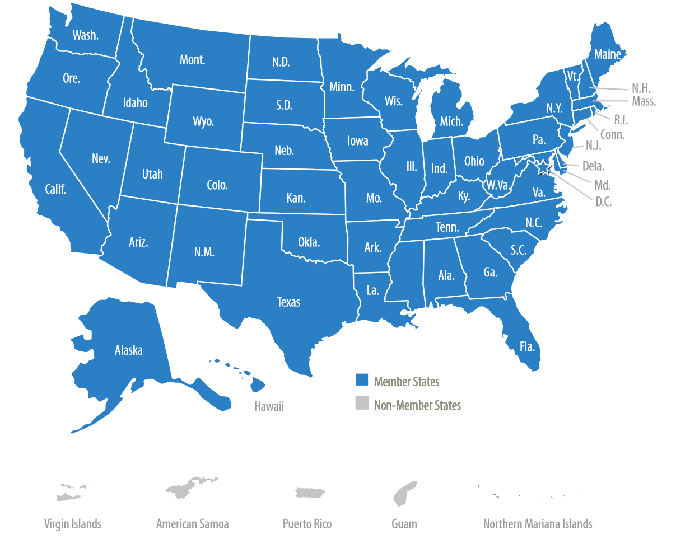
MIC3 Website www.mic3.net
May 1, 2021
WA Commissioner Greg Lynch
RE: FY 2022 State Dues Assessment –
Washington
INVOICE
For: FY 2022 State Dues Assessment
25,860 Students x $1.15/Student =
$29,740.00
FY 2019 TOTAL: $27,499.00

Slide 14
National Guard Proposal For MIC3 Compact Inclusion
 | Option | Needs/Concerns | Proposed Solution(s) | Projected Cost | Fiscal Impact
1 | Amend Compact Statute | Current staffing insufficient to oversee long-term effort. | Contract CSG to oversee project (4-years). | 760,656.03 | Would nearly deplete the reserve.
2 | Amend State Codes Outside of the Compact | Need legal assistance to develop the model statute. | Referral to AR and KY language that expands compact coverage to DOD civilians and NGR dependents. (one year) | 2,000 | Increase line item budget
3 | Create an Enhanced Compact | Need legal assistance to develop the model enhanced compact and conduct a legal review. Current staff would oversee compact. | Work with legal to develop the enhanced compact language. (would this require CSG services to introduce and track?) (three years) | 3,000-5,000 | Increase line item budget
4 | Adopt a Memorandum of Agreement | Need legal assistance to develop the model agreements and conduct legal review of each. Current staff would oversee and track agreements. | Work with legal to develop the MOA. (three years) | 3,000-8,000 | Increase line item budget
5 | Take No Action at This Time Need More Info | None | None | None | None

Slide 15
WA State Commissioner Questions National Guard Proposal
Describe the impact to WA Full Time Guard Members and their Children.
How many full-time WANG Members are in WA, how many members have school age children and what SDs do those children attend?
Have students of full-time WANG members been disadvantaged by the WA public schools system as a result of a parent/guardian work related move/requirement?
Contingent upon the numbers of WANG full-time members and their children, and examples of unresolved issues, what are the full range of remedies that can be implemented in WA?
WA Commissioner National “vote” Recommendation: Take no action at this time, need more information.
WA Commissioner Recommendation For WA State: Work with the WA National Guard to determine facts.

Slide 16
RCW 28A.705.010 Compact provisions.
ARTICLE VIII
STATE COORDINATION
A. Each member state shall, through the creation of a state council or use of an existing body or board, provide for the coordination among its agencies of government, local education agencies, and military installations concerning the state's participation in, and compliance with, this compact and interstate commission activities. While each member state may determine the membership of its own state council, its membership must include at least: The state superintendent of public instruction, a superintendent of a school district with a high concentration of military children, a representative from a military installation, one representative each from the legislative and executive branches of government, and other offices and stakeholder groups the state council deems appropriate. A member state that does not have a school district deemed to contain a high concentration of military children may appoint a superintendent from another school district to represent local education agencies on the state council.
B. The state council of each member state shall appoint or designate a military family education liaison to assist military families and the state in facilitating the implementation of this compact.
C. The compact commissioner responsible for the administration and management of the state's participation in the compact shall be appointed by the governor or as otherwise determined by each member state. The governor is strongly encouraged to appoint a practicing K-12 educator as the compact commissioner.
D. The compact commissioner and the military family education liaison designated herein shall be ex officio members of the state council, unless either is already a full voting member of the state council.

Slide 17
WA MIC3 Commissioner Duties
Coordinate & communicate with State Commissioner Counterparts and the National Headquarters for resolution of Compact issues relating to WA students and their families.
Coordinate with OSPI, MIC3 WA Executive Agent, for appropriate support.
Author and submit WA annual MIC3 compliance report.
Represent WA and cast appropriate votes for Compact additions and changes during the National Meetings.
Coordinate Compact issues with other state and national agencies impacting WA students and their families.
Plan and host annually at least one state council meeting to update the Council, discuss and take guidance from the Council.
Member of the MIC3 National Finance and Leadership Development Committees. Provide guidance, draft procedures and make recommendation to the National Headquarters and state commissioners.
When appropriate, lead Commissioner groups at the National MIC3 meeting and provide guidance and best practice examples to other state commissioners. Mentor new MIC3 State Commissioners.
Recruit WA State Council candidates, recommend candidates for approval by the MIC3 State Council, and work with the WA legislative Caucuses to ensure Senate/Representative representation opportunities.
Plan and host National Meetings when appropriate.

Slide 18
OSPI Military Compact Presentation Dixie Grunenfelder, Executive Director Student Engagement & Support

Slide 19
Presentation Points
District Survey
Military Indicator Data
Frequently Asked Questions

Slide 20
District Survey
Record Transfer
K-1st Entrance
Program/Course Placement
Graduation
Absences
Enrollment
Immunization
Military Compact Implementation (alchemer.com)
10/17/2021 | 20

Slide 21
Response Criteria
Partial Implementation
Not Implemented
Substantial Implementation
10/17/2021 | 21
Notes:
We have a variety of ways to connect to the field.

Slide 22
Sample Question

Slide 23
Sample Question

Slide 24
Survey Process
Target Audience
Recruitment
October 2021
Electronic
Compile & Analyze
December 2021
Summarize
Post
High Impact Districts
All Districts
Administration
November 2021
OSPI Bulletin

Slide 25
2020-21 Student Military Identifier Data
Active Duty 25,074
Reserves 4,304
WA National Guard 2,838
Both Parent Affiliated 1,510

Slide 26
Student Military Identifier Data Over Time
2019
2021

Slide 27
Frequently Asked Questions to OSPI
Educational & Other Services
Grade/Program Placement
Virtual Programming
Out-of-State Participation
Prior to moving to WA
Pre-Enrollment
10/17/2021 | 27

Slide 28
Department of Defense K-12 School Initiatives
Advance Enrollment: Completed Washington and 30 other States
Open Enrollment Flexibility: New Issue, Established in California and Florida.
Purple Star Schools Program: 28 statewide programs. Established as a local program at Medical Lake SD

