Slide 1
Pathways to Graduation
OSPI-WSAC Wednesday Webinar Series
December 4, 2019
Linda Drake, SBE
Director, Career & College Ready Initiatives
Kim Reykdal, OSPI
Program Supervisor Lead, School Counseling
Office of Superintendent of Public Instruction
Chris Reykdal, State Superintendent
Notes:
Introduction of staff.
Awareness of two room constraints and how we will be managing that.

Slide 2
Who’s On the Line…?
Who’s here?
Building Administrator
School Counselor
Teacher
CTE Director
ESD staff
District staff
State Agency
CIP
Education Association
Other
How familiar are you with the new Graduation Pathways?
I’ve received some training and/or info about the final rules already but want to hear it again
I know the basics but haven’t gotten the new details about the final rules
I’ve heard there are new graduation requirements but haven’t received any info yet
Notes:
We like to get to know our audience so that we can tailor our content to your needs.
We’re adding a question today about if you’re from a school that’s been identified for comprehensive and targeted supports because we are focused on supporting the mission of system and school improvement.
As we go along today we will pause at polling questions to answer audience questions, so please use the questions button at any time to ask our presenters more and we’ll either answer live or reply.
Next up we have Kim Reykdal with us

Slide 3
So many questions!
What counts for a CTE Graduation Pathway?
How are we supposed to know if our seniors can graduate?
Why did the legislature do this?
Who is supposed to make sure a student’s HSBP lines up with their grad pathway?
What if we can’t offer all the pathways?
How do we convince students to take the assessment now?
Notes:
We know there are a lot of questions.
Our goals for today:
You leave understanding the “thou shalts” or clear lines
What counts?
What are we required to do?
And that you leave with more questions that only you and your communities back home can answer.
We’ll talk specifically about HSBPs and the two most significant areas of change – how we will serve students with IEPs, and how we will fully leverage the CTE opportunity.
The through line to all of this is how we will keep equity at the center of our work in serving students and preparing them for life after high school.
Your questions help us get better. Please type questions in the chat box. We will answer as many as we can during this webinar, and collect the rest to inform an update to OSPIs FAQ.

Slide 4
Today’s Objectives
The Why of HB1599
Graduation Pathways overview
Other Graduation Requirement changes
Next Steps for Implementation
Support and Resources

Slide 5
Values
Vision
All students prepared for postsecondary pathways, careers, and civic engagement.
Mission
Transform K–12 education to a system that is centered on closing opportunity gaps and is characterized by high expectations for all students and educators. We achieve this by developing equity-based policies and supports that empower educators, families, and communities.
Notes:
Grad pathways were built to deliver on the promise of our vision:

Slide 6
OSPI Equity Statement
Each student, family, and community possesses strengths and cultural knowledge that benefit their peers, educators, and schools.
Ensuring educational equity:
Goes beyond equality; it requires education leaders to examine the ways current policies and practices result in disparate outcomes for our students of color, students living in poverty, students receiving special education and English Learner services, students who identify as LGBTQ+, and highly mobile student populations.
Requires education leaders to develop an understanding of historical contexts; engage students, families, and community representatives as partners in decision-making; and actively dismantle systemic barriers, replacing them with policies and practices that ensure all students have access to the instruction and support they need to succeed in our schools.
Notes:
Always see our equity statement – ensure we are making it live and breathe in our work. Zoom in on two ideas.

Slide 7
“…requires education leaders to examine the ways current policies and practices result in disparate outcomes for our students…
“…actively dismantle systemic barriers, replacing them with policies and practices that ensure all students have access to the instruction and support they need…”
Notes:
HB 1599 is absolutely built off of these values, and built to deliver on our promise that all students are prepared for life after high school.
Graduation rates class of 2018:
81% all, but 60% for our native kids, 75% for our black

Slide 8
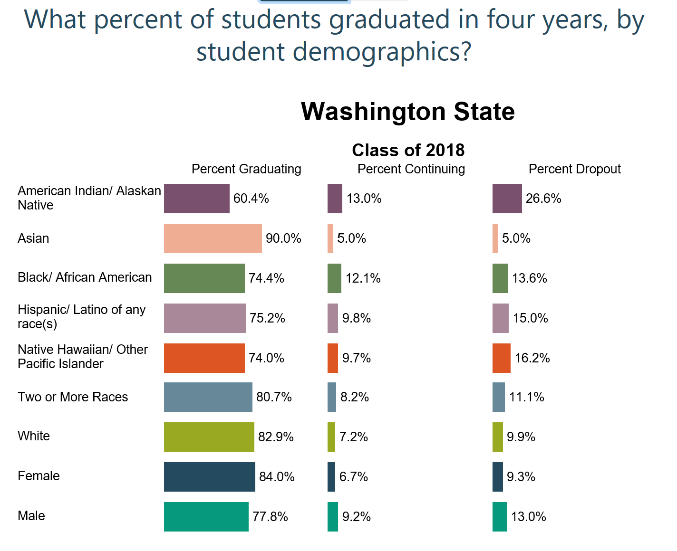
Graduation:
All means all.

Slide 9
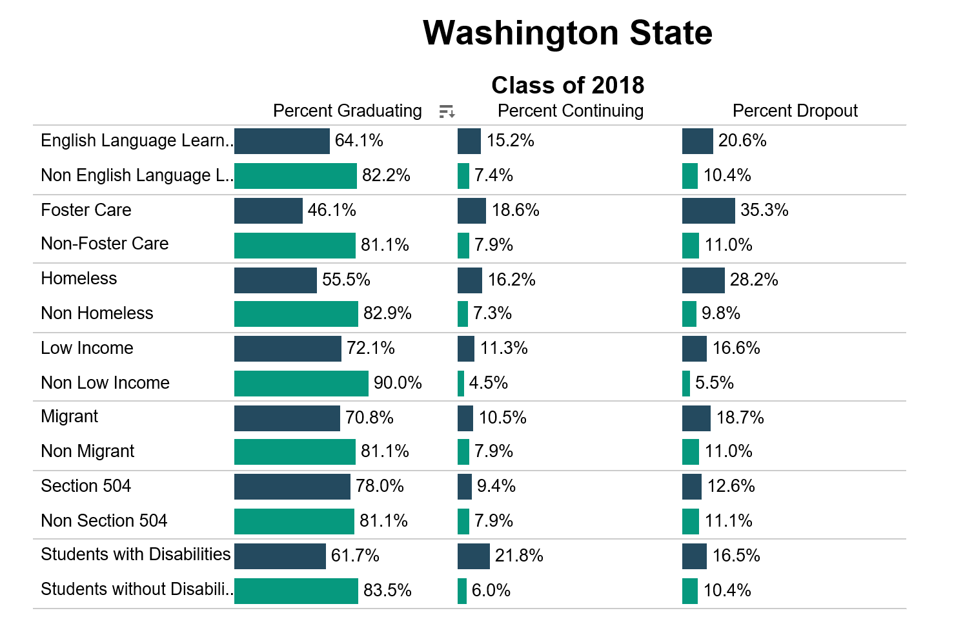
Graduation:
All means all.

Slide 10
Notes:
A lot of this requires us to shift our thinking as adults in buildings and adults running the systems that support students.
This is a system change. While it will be hard in some areas, in others it is simply asking us to do more of what we know is already working.
There are several different paths that will ensure students can get a running start into their adult lives that will lead to them being self-sufficient and able to take care of themselves, their families and their communities.
And supporting students in building agency in designing their high school experience, and connecting it to what they hope for after high school, can only lead to good things.
University-for-all doesn’t serve our students, our communities, or our economy very well.
Have to solve for this year’s seniors while thinking about the future: master schedules, middle school transitions, budgets, messaging post-high school options beyond university or nothing.
We have to do both – we have to work for the kids right in front of us and we have to work for the kids who are on their way to us.

Slide 11
How do we make sure each and every student has a clear path for after high school, starting with the first year after graduation?
Notes:
HB 1599 is built off of all these values, and built to deliver on our promise that all students are prepared for life after high school.
This is the question that is at the heart of everything we should do as it relates to implementing the requirements and the aspiration of the graduation pathways policy.
I haven’t met an educator who doesn’t worry about whether their students will be successful when they’re 20, 20, 30…. We know we are building the next generation and we want them to be great.
When we think about our sphere of influence, and where we as K12 educators can have the most impact for students as they leave our schools, we know that it is that first year after graduation. That is where we can have the biggest impact around making sure our young adults are set up for success.
Graduation pathways are built as an answer to this question.

Slide 12
Class of 2020 Graduation Requirements
High School & Beyond Plan
(HSBP)
High School Instruction
(24 credits)
Graduation Pathway(s)
Notes:
The new pathways are built off of things already in place that we believe in.
First, the HSBP. 1599 clarifies and strengthens the role of the HSBP in helping students have agency in their HS career and ensuring that the courses they take and the pathways they choose line up with their goals for after high school. More on changes to HSBP later.
Second, pathways is built off the belief that learning happens in the classroom with teachers and students, and that the core instruction that all our students receive matters. Particularly those 17 credits of core instruction…. More flexibility was built into the 24 credit requirement, which I’ll touch on later as well.
4 credits of ELA, 3 of math, 3 of science, 3 of social studies….
.

Slide 13
All means all.
All students can use new pathways, including student receiving special education supports
Certificate of Individual Achievement through Class of 2021
WA-AIM remains available for students with significant cognitive challenges
WAC 180-51-115: Graduation credit and subject area reqs. may be substituted with comparable
content per the HSBP, if determined necessary by the student’s IEP team

Slide 14
Graduation Pathways Are…
Equal in value and expectations
Connected to students’ post-high school goal(s) = HSBP
Built to prepare students for a meaningful first step after high school

Slide 15
Graduation Pathways Are Not…
Ways to “track” students
New “boxes to check” for graduation
“Alternatives” to the high school state assessment

Slide 16
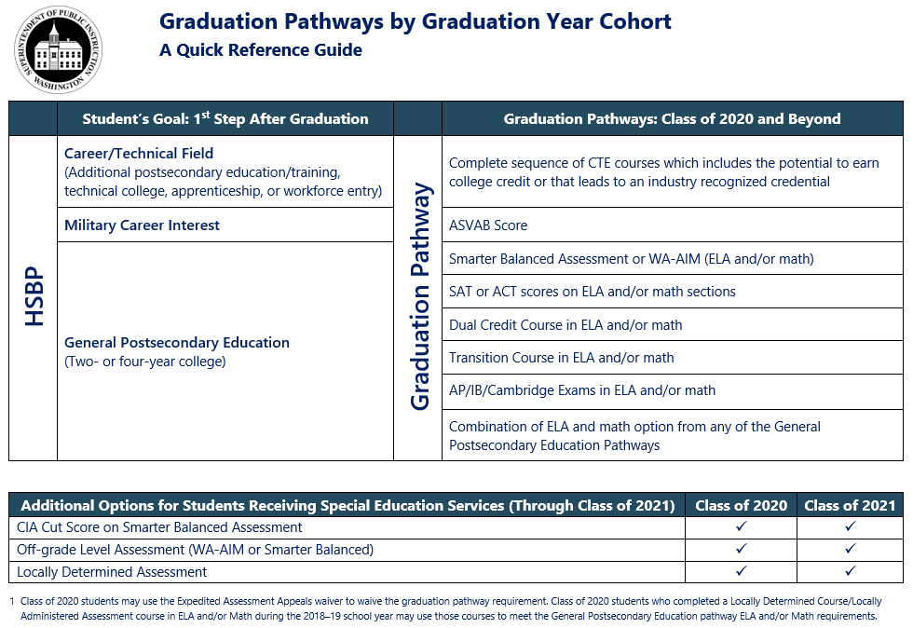
Graduation
Pathways:
A Meaningful 1st Step After High School
Notes:
An overview –this handout is in the OSPI Graduation Pathway Toolkit as well.

Slide 17
CTE Graduation Pathways
2 High School Credits in CTE courses
Same CTE Program Area or approved local sequence
Includes dual credit opportunity and/or leads to a credential
Or
Complete a Core Plus program
Notes:
CTE Grad Pathways are sequences of courses, resulting in two or more HS credits in CTE, in the same program area, that lead to an industry recognized credential or includes the opportunity to earn dual credit.
OSPI will administer a process for reviewing and approving local sequences including more than one CTE Program Area, developed by individual districts.
Core Plus programming meets the definition of the CTE Grad Pathway in almost all cases, but it is also called out specifically in the law. “Complete the curriculum requirements of a Core Plus program” means completing Core Plus course work, and earning the Core Plus certificate which demonstrates readiness for entry level employment with Core Plus employer partners.

Slide 18
Local CTE Grad Pathway Sequences (using more than 1 CTE program area)
2 High School Credits in CTE courses
Locally approved
(board or designee, and/or CTE advisory committee)
Approved by OSPI
(45 day turnaround)
Approved local sequences available statewide
(notify OSPI if using)
Notes:
OSPI has developed a form that will be made available and must be used to apply for sequence approvals.

Slide 19
Military Pathway (ASVAB)
SBE posts minimum score annually
Students not required to meet other enlistment criteria
Meet or exceed minimum score to serve (year taken or any year after, before student turns 21)
Notes:
Smarter, ACT/SAT don’t change from prior iterations.
Dual Credit exam scores don’t change – course option is new (next slide)

Slide 20
Smarter Balanced Assessment or WA-AIM (ELA and Math)
Graduation scores set by SBE
WA-AIM still available for “significantly cognitively challenged” students
Notes:
Smarter, ACT/SAT don’t change from prior iterations.
Dual Credit exam scores don’t change – course option is new (next slide)

Slide 21
College Admission Exams (ELA and Math)
ACT
Minimum score set by SBE
ACT w/ writing
Math section
SAT
Minimum score set by SBE
SAT w/ writing (recommended, not in ELA score)
Math section
Notes:
Smarter, ACT/SAT don’t change from prior iterations.
Dual Credit exam scores don’t change – course option is new (next slide)

Slide 22
Dual Credit Exams (ELA and Math)
Advanced Placement
Minimum score = 3
List of acceptable exams
Cambridge International
Minimum score = E
List of acceptable exams
International Baccalaureate
Minimum score = 4
List of acceptable exams
SL or HL exams
A or AS exams
Notes:
Smarter, ACT/SAT don’t change from prior iterations.
Dual Credit exam scores don’t change – course option is new (next slide)

Slide 23
Dual Credit Courses (ELA and Math)
Advanced Placement
Must earn a C+ or higher each term
Same list as exams
Cambridge International
Must earn a C+ or higher each term
Same list as exams
International Baccalaureate
Must earn a C+ or higher each term
Same list as exams
1.0 HS credit (can combine courses)
Notes:
Smarter, ACT/SAT don’t change from prior iterations.
Dual Credit exam scores don’t change – course option is new (next slide)

Slide 24
Dual Credit Courses, Cont. (ELA and Math)
Career and Tech Ed
Must meet HS reqs. for ELA/Math
100 level or higher college course
Running Start
College in the High School
Must meet HS reqs. for ELA/Math
1.0 HS credit
Must meet HS reqs. for ELA/Math
1.0 HS credit
100 level or higher
“Paying” for college credit not required
Articulation agreement
100 level or higher
1.0 HS credit
Notes:
Smarter, ACT/SAT don’t change from prior iterations.
Dual Credit exam scores don’t change – course option is new (next slide)

Slide 25
Transition Courses (ELA and Math)
SBE Rules
Must result in college-level course placement (100 level or above)
Local agreement must be in place with college
Must meet HS core or elective credit requirement
Bridge to College
State approved
Math and English courses available
College course placement with a B grade or higher
Notes:
Smarter, ACT/SAT don’t change from prior iterations.
Dual Credit exam scores don’t change – course option is new (next slide)

Slide 26
Combining ELA and Math Pathways
Students use any combination of assessments or courses from any of the ELA and math pathways
Notes:
Smarter, ACT/SAT don’t change from prior iterations.
Dual Credit exam scores don’t change – course option is new (next slide)

Slide 27
Class of 2020
Expedited Assessment Appeal (EAA) waiver still available
Students not required to attempt “alternatives” prior to using EAA waiver
Any pathway(s) connected to HSBP goals

Slide 28
SBE 1599 Follow-Up Survey / Leg Report
Modify existing pathways
Barriers to implementation
Additional grad pathways
Due to Legislature by December, 2022

Slide 29
OSPI’s Role is Changing
Notes:
HB 1599 changes OSPI’s role in graduation.
We are no longer “box checkers”. Our job isn’t to check that students can OSPI no longer determines if a student is eligible to graduate through meeting the requirement of a Certificate of Academic Achievement (CAA) or Certificate of Individual Achievement (CIA).
OSPI does not determine whether a student has fulfilled the requirements of a pathway as specified in a students’ High School and Beyond Plan (HSBP).

Slide 30
OSPI’s Graduation Role: Data and Reporting
Counts of students in each pathway
Student participation in pathways, disaggregated
Pathway options at each district
Notes:
Although OSPI will no longer inform school districts about an individual student’s progress towards graduation, OSPI will provide districts information about student pathways to support their work with students.
OSPI’s goal is to capture the required data in a manner that minimizes the administrative burden on districts, but still enables OSPI to create a report for districts that allows them to: (1) know which pathways students have met, especially important for transfer students; and (2) know how OSPI is compiling pathways participation data to meet the HB 1599 reporting requirements.
Majority of pathways are already in CEDARS. DSAs with College Board, IBO, ACT, Cambridge are necessary to get the data – districts will always have it earlier. ASVAB scores collected in grad alts until CEDARS change for next year.

Slide 31
OSPI Graduation Role: Programmatic Supports
Closing opportunity gaps through resourcing pathway access, expansion
Support assessment practices: formative, interims, summative
Build local data use and practices
Notes:
Our role is to partner with districts as they identify where they need to grow pathway access and use our programmatic resources to improve delivery and access to pathways. This is a cross-agency lift: our learning and teaching team are growing access to transition courses and standards based instruction that supports ELA and math proficiency; our CTE team obviously has a bigger and brighter role in helping districts deliver valuable CTE programming; our dual credit team has to help figure out closing significant gaps in dual credit access; our special education team is working to increase inclusionary practices earlier in a our systems so students served by IEPs aren’t prevented from accessing the pathways; our counseling team is strengthening HSBP use; our data team is working to make sure we can grow data practices in the field while meeting our state requirements for data and reporting; and our assessment team is getting to focus assessment practices that are deeply imbedded in learning and teaching, and helping educators use assessment data.
This means that district and building roles that have been focused on compliance regarding graduation will also change.

Slide 32
What else changed for our students?

Slide 33
High School and Beyond Plans
FAFSA / WASFA information
Electronic HSBP available by Fall 2020
SBA scores inform 11th grade course choices
HSBP/IEP Transition Plan alignment

Slide 34
Credit Earned Before High School
Students/families can request non-numerical grades for courses by end of 11th grade
Local districts should plan on reviewing/updating a policy
Credit automatically added to HS transcript; students/ families must opt out by end of 11th grade
Notes:
The SBE rules state that students have until the end of 11th grade to either opt out or change to a non-numerical grade any of the high school credits taken in middle school that were automatically added to their high school transcript. The rules do not address adding credits back that were removed; however, it is recommended that this process remain an opt out process only, as per the statute. Local districts should plan to adopt a policy that provides a consistent and clear procedure for this process. OSPI will be updating current WACs and guidance resources soon.

Slide 35
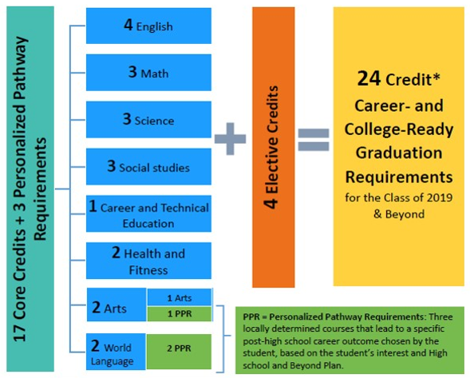
24-Credits Required for Graduation

Slide 36
Two Credit Waiver
Local districts must adopt a policy
Up to 2 credits waived for “student circumstances”
Cannot be 17 core credits

Slide 37
Changes to Social Studies Credits
1.0 credit of “Elective”
0.5 credit Civics must be stand-alone course
0.5 credit of Contemporary World History / Geography
Still 3.0 credits total

Slide 38
Academic Acceleration
Automatically enrolled courses must align to HSBP
Amends existing statute; requires districts to adopt policy by 9/2021
Meeting / exceeding standards on SBA assessments results in auto enrollment, leading to dual credit

Slide 39
Next Steps
What do we need to grow our options?
Current district / building capacity in pathways
Address opportunity gaps
Add/Update Board Policies
Notes:
Remember the Class of 2020 has the waiver.
Use your data: which of these pathways would your students have qualified last year? How many of your students haven’t yet met the requirements of at least one pathway? Will they need the waiver?
What about your junior class? What additional access does your district need to secure for 2021?
Remember what it will take to make sure students with IEPs have equitable access to the pathways.
Think ahead: what story does your district want the data to tell? When OSPI has to report on disaggregated data about which of our students are accessing which of the pathways, how do you want that to look?
How can you leverage this move district goals around equity, access to CTE, equivalencies, enhanced community relationships?

Slide 40
Available State Resources
State Board of Ed
Graduation Pathways: rules and general information
ASVAB specific resources
Class of 2020 grad reqs information
OSPI
HB1599 General Information / FAQ
Graduation Pathways Toolkit (update Jan 2020)
CTE Course Sequence approval form
HSBP/IEP Transition Plan alignment tools
Career Guidance Wa curriculum
HSBP template (9 languages!)
WSAC
Financial Aid Resources / Information

Slide 41
Questions & Answers
THINK → What questions do you need to get answer to back at your district / building?
What else can we help you answer? Type in the chat….

Slide 42
Please let us know how we can support you!
our
Kim Reykdal, OSPI
Program Supervisor Lead,
School Counseling
Kim.Reykdal@k12.wa.us
Linda Drake, SBE
Director, Career and College
Ready Initiatives
Linda.Drake@k12.wa.us

Slide 43
Creative Commons
Except where otherwise noted, this work by the Office of Superintendent of Public Instruction is licensed under a Creative Commons 4.0 International License.
Many of our images come from Canva.com and TheNounProject.com.
Notes:
We like to give credit where it is due. If you liked an image from GATE Equity Webinar, we use images that are provided by schools we work with, are in the creative commons, or are from the Noun Project.

Slide 44
Regional School Counseling Networks Follow-up Web Chat
What still need clarifications?
What are your Hopes and Fears with implementing these new graduation requirements?
You’ll be assigned a chat room to discuss the following 2 topics:
Please choose a recorder and a person to report out….

