Slide 1
“
POSTSECONDARY ADMISSIONS
A GUIDE FOR GRADE 8
‘
CAREER GUIDANCE
WASHINGTON
Notes:
This presentation can be used by a school counselor or teacher to help students in 8th grade start thinking about college.
It is crucial that students understand that the Minimum College Admission Standards for Washington State’s four-year public colleges and universities require students to take specific courses beginning freshman year in high school. These standards are recommended for students enrolling in community and technical colleges as well, meaning that ALL students should plan to meet these standards, no matter what they plan to do after high school.

Slide 2
HUSKY OR COUGAR OR…?
Washington State has six four-year public colleges
University of Washington
Washington State University
Western Washington University
The Evergreen State College
Eastern Washington University
Central Washington University
There are also 34 community and technical colleges
What else is available?
Notes:
Ask your students if they can name Washington State’s six public four-year colleges and universities. They are: University of Washington, Washington State University, Western Washington University, The Evergreen State College, Eastern Washington University, and Central Washington University.
Tell students that there are also 34 community and technical (two-year) colleges in Washington State. Which of these colleges can they name?

Slide 3
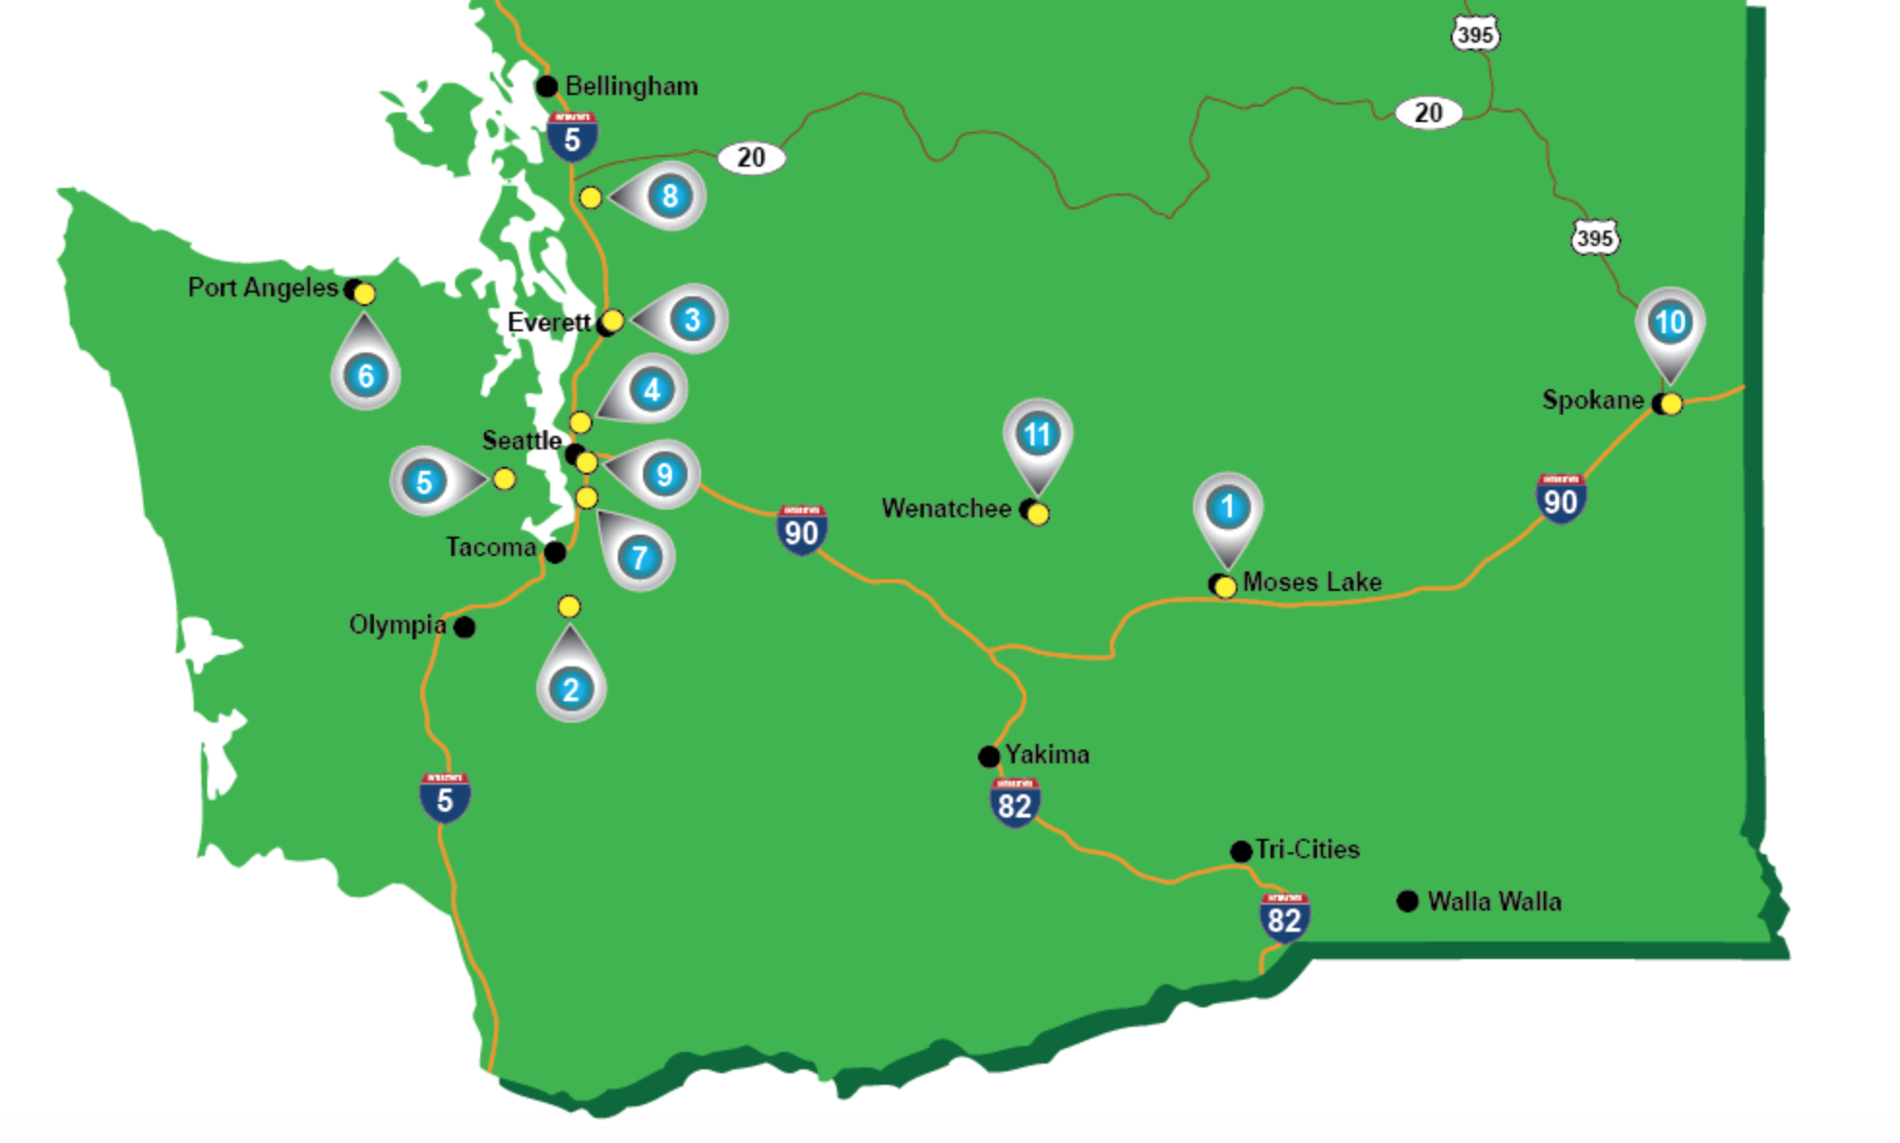
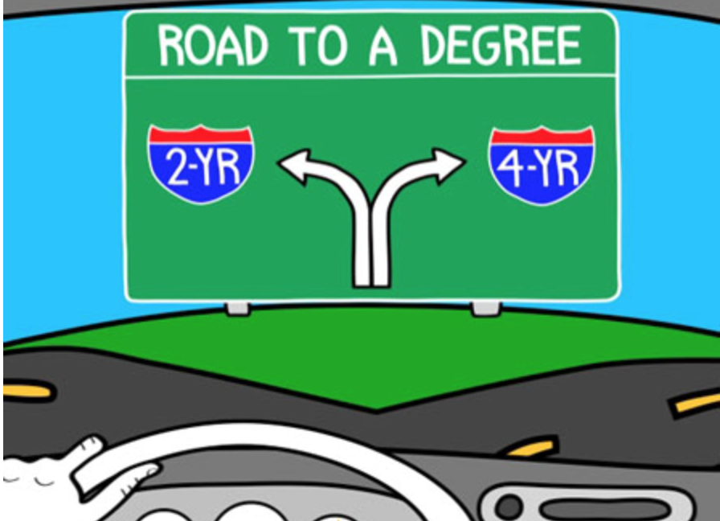
Postsecondary Options
4-Year Colleges
There are also 34 community and technical colleges
Military Training
Industry Standard Certificate Programs
Apprenticeships
Internships
On the Job Training
Where do you want to go?
Notes:
In addition to 4-year and 2-year colleges there are many other options for students that include:
Military training
Industry Standard Certificate Programs
Apprenticeships
Internships
On the Job Training
Many of these options can connect while students are still in high school through CTE classes, skills centers, or dual credit programs in Running Start, College in the High School, Tech Prep, and CTE Advanced Placement.

Slide 4
WILL YOU BE READY?
Work hard in high school
Apply during Fall of senior year
Graduate in good standing
Meet college admission requirements
Notes:
Tell students that if they want to attend a four-year or two-year college, they need to start preparing during high school. Their four years of high school will be very important, and they will need to work hard during high school, taking rigorous courses and getting good grades.
Students who want to attend a four-year or two-year college will apply during the Fall of their senior year. Then, they must graduate from high school in good standing. They must meet all the college admission requirements (these are required for a public four-year college and recommended for a two-year college).

Slide 5
ADMISSION REQUIREMENTS
College Academic Distribution Requirements (these are MORE than HS graduation requirements)
2.0 minimum GPA
Official SAT/ACT test scores sent directly to the college
Notes:
Tell students that Washington State’s four-year public colleges and universities have set Minimum College Admission Standards that all students must meet. These are REQUIRED for four-year public colleges and RECOMMENDED for two-year community and technical colleges.
To meet the admission requirements: Students must meet the College Academic Distribution Requirements, a series of courses that are more than required simply to graduate from high school. They must also maintain a 2.0 minimum grade point average (GPA) out of a 4.0 scale. And when they are a high school junior or senior they must take a college entrance exam – either the SAT or ACT – and have their scores sent directly to the college.

Slide 6
COLLEGE ACADEMIC DISTRIBUTION REQUIREMENTS
SUBJECT | REQUIREMENTS (Note that requirements may change)
ENGLISH 4 credits | Including 3 credits of college prep composition or literature
MATH 3 credits | Algebra I & II + Geometry or Integrated Math I, II, III Must take a math-based quantitative course senior year
SCIENCE 2 credits | One credit must be in an algebra-based science course One credit must be in biology, chemistry, or physics
SOCIAL STUDIES 3 credits | History or other social science
WORLD LANGUAGE 2 credits | 2 credits must be earned in the same language 1 credit may be earned during middle school
ARTS 1 credit | Fine, visual, or performing arts
Notes:
Review this list of College Academic Distribution Requirements with students. Remind them that ALL of Washington State’s public four-year colleges and universities require these minimum course requirements, and that our state’s community and technical colleges recommend them to ensure that students are well prepared.
To meet these requirements, students need to start working freshman year in high school. Remind students also that these requirements are HIGHER than the minimum high school graduation requirements.

Slide 7
CLUBS, SPORTS, ACTIVITIES
In addition to academics, show colleges your interests and skills:
Join clubs
Participate in activities
Play a sport
Volunteer at school or in your community
Notes:
Tell students that in addition to working hard in their classes, they should also get involved in extracurricular activities. Colleges want to know about their interests and skills. So, students should join clubs, participate in activities, play a sport, or volunteer at school or in the community.

Slide 8
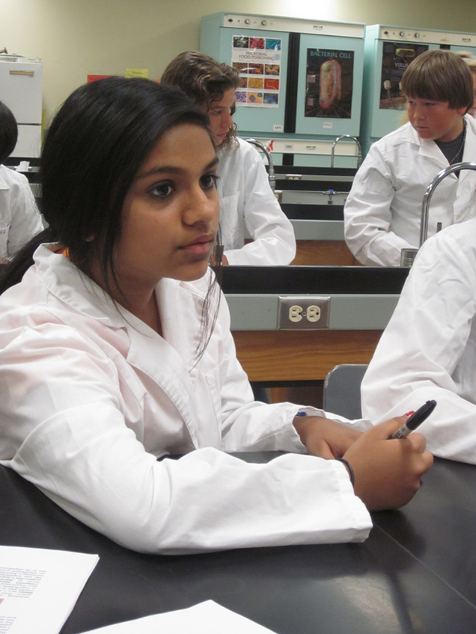
LEARN MORE ABOUT COLLEGE
Ask your school counselor about summer programs:
WSU Cougar Quest
UW Summer Classes for Teens
WWU College Quest
And more…
Live on campus
Try out a college major
Scholarships available!
WSU Cougar Quest
Notes:
Students might want to know how they can learn more about college. There are many ways to learn more, including researching on the internet. If they want to spend time on a college campus, many colleges in our state offer summer classes or camp programs. These programs give high school students the chance to take classes on a college campus. Some of the programs even give students the chance to live in a college dorm for a week while they are taking classes. Your high school guidance counselor can provide more information. Many of these programs offer scholarships for students who qualify.

Slide 9
HOW WILL YOU GET THERE?
Take rigorous classes in high school
Join activities, clubs, and sports teams
Research majors and careers
Visit colleges
Decide where to apply!
Notes:
Students probably think that high school graduation is a long way away. But, it is important that they use all four years of high school to prepare. They should take rigorous classes and work hard. They should join activities, clubs, and sports teams. They should research career interests and postsecondary programs. They should visit different colleges, either in person or through the internet. And then they will be able to decide where to apply!

