Slide 1
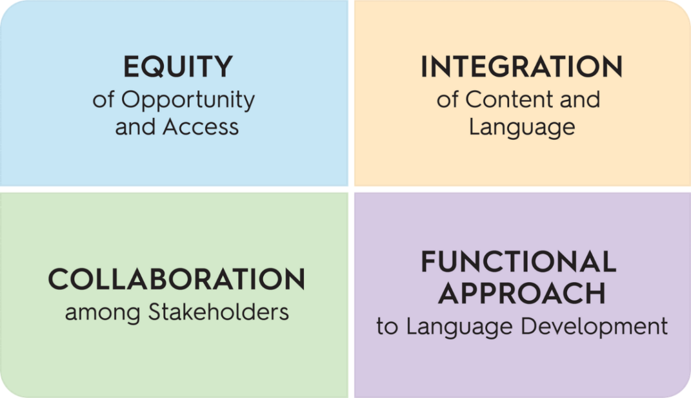
Module 6: Proficiency Level Descriptors
Learning Targets:
Explore ways that language typically develops within a certain dimension of language.
Use the Proficiency Level Descriptors to guide conversations about language growth over time.
BIG Ideas:
Functional Approach to Language Development
Collaboration among Stakeholders
Notes:
In Module 6 of the WIDA ELD Standards Framework: A Collaborative Approach, the focus is on using the Proficiency Level Descriptors to explore ways that language typically develops and to guide conversations about language growth over time. The Proficiency Level Descriptors are key to the big ideas of collaboration among stakeholders and supporting a functional approach to language development.

Slide 2
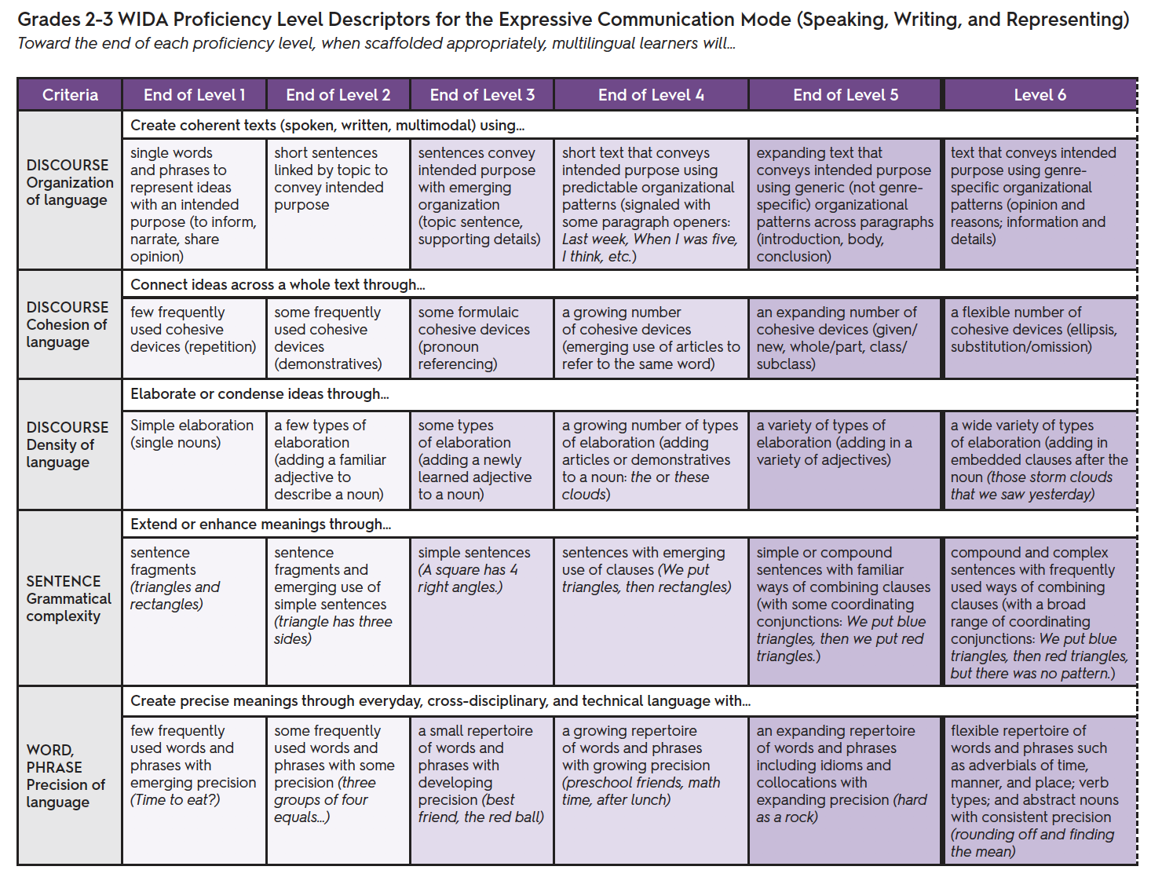
Proficiency Level Descriptors (PLDs)
Proficiency Level Descriptors for…
Interpretive Mode
Expressive Mode
…are found at the end of each grade band section in the WIDA ELD Standards Framework
Notes:
Proficiency Level Descriptors illustrate a continuum of language development for multilingual learners across six levels of English language proficiency for each grade-level cluster. The descriptors span three dimensions of language: discourse, sentence, and word/phrase. PLDs are both the interpretive and expressive modes of communication are found at the end of each grade band section in the WIDA ELD Standards Framework.

Slide 3
Characteristics of the PLDs
In the Proficiency Level Descriptors:
The word “text” includes oral, visual, and written forms.
Each of the six language proficiency levels builds on the others.
Descriptions of language use refer to how it is used at the end of each language proficiency level.
Appropriate scaffolding is needed for students to move through the proficiency levels.
Notes:
There are a few key characteristics of the Proficiency Level Descriptors. In the PLDs:
The word “text” includes oral, visual, and written forms.
Each of the six language proficiency levels builds on the others.
Descriptions of language use refer to how it is used at the end of each language proficiency level.
Appropriate scaffolding is needed for students to move through the proficiency levels.

Slide 4
Breakout Room Discussion
Look at the Proficiency Level Descriptors for the Expressive Mode for one grade band:
What do you notice about how discourse develops across the 6 levels?
What are some language features that students at this grade level will need to reach proficiency at the sentence and word/phrase level?
How might teachers use these PLDs to support multilingual learners to meet grade-level expectations?
Notes:
Now we will take 5-10 minutes to look at the Proficiency Level Descriptors for one grade band. (Read the text on the slide.)

Slide 5
Let’s Practice
Unit Overview: This unit focuses on the idea that sound energy produces vibrations that travel in waves and are transferred through air particles.
Essential Question: How do sound waves produce and transfer energy?
Content Standard: NGSS-4PS3.2 Make observations to provide evidence that energy can be transferred from place to place by sound, light, heat, and electric currents.
Summative Assessment: Students will demonstrate comprehension of these concepts by writing explanations of how a singer breaks a glass with their voice.
4th Grade Science Unit
How can we use the Proficiency Level Descriptors for grades 4-5 to establish criteria for the summative assessment task?
Notes:
Now we are going to review the unit we examined in the previous sessions. Using the summative assessment task as an example, look at the Proficiency Level Descriptors for Grades 4-5 in the Expressive Communication Mode.
How can we use the Proficiency Level Descriptors for grades 4-5 to establish criteria for the summative assessment task?

Slide 6
Let’s Practice
Unit Overview: Students read excerpts from two texts (nonfiction and fiction), Rilke’s Letters to a Young Poet and Mitchell’s Black Swan Green. These two texts are juxtaposed, allowing for a study of key ideas and characters across texts.
Essential Question: How is language used to convey central ideas in works of fiction and informational texts?
Content Standard: CCSS.ELA-LITERACY.RI.9-10.3
Analyze how the author unfolds an analysis or series of ideas or events, including the order in which the points are made, how they are introduced and developed, and the connections that are drawn between them.
Summative Assessment: Students write a formal, multi-paragraph response to the following prompt: Identify similar central ideas in Letters to a Young Poet and Black Swan Green. How do Rilke and Mitchell develop these similar ideas?
9th Grade ELA Unit
How can we use the Proficiency Level Descriptors for grades 9-12 to establish criteria for the summative assessment task?
Notes:
Looking at the summative assessment in this 9th grade ELA Unit:
How can we use the Proficiency Level Descriptors for grades 9-12 to establish criteria for the summative assessment task?

Slide 7
Breakout Room Discussion
Choose a unit example:
Review the Language Expectations, Functions and Features that you identified previously as essential for meeting the success criteria for the unit.
Review the Proficiency Level Descriptors for that grade band.
How can we use the Proficiency Level Descriptors to establish criteria for the summative assessment task?
Notes:
With your group, choose a unit example:
Review the Language Expectations, Functions and Features that you identified previously as essential for meeting the success criteria for the unit.
Review the Proficiency Level Descriptors for that grade band.
How can we use the Proficiency Level Descriptors to establish criteria for the summative assessment task?

Slide 8
Collaboration Planning
How can the Proficiency Level Descriptors be used to notice and monitor students’ language development across the year?
Notes:
Discuss with your group: How can the Proficiency Level Descriptors be used to notice and monitor students’ language development across the year?

