Slide 1
Enrollment Reporting for the
2018–19 School Year
ESD Enrollment Training
August 2018
Becky McLean
Supervisor, Enrollment and Categorical Funding
OSPI – School Apportionment and Financial Services
360-725-6306 — becky.mclean@k12.wa.us

Slide 2
Agenda
Change to the FTE Calculation for the 2018–19 School Year
Updates on the NEW Enrollment Application
Work Based Learning (WBL) Enrollment Reporting
Claiming Suspended and Expelled Students
Basics of Enrollment Reporting

Slide 3
  Changes to the FTE Calculation for 2018–19
RCW 28A.150.260 (13c) states that OSPI is to, in rule, define a FTE based on the minimum instructional hours required in RCW 28A.150.220 which states:
  At least 1,080 annual instructional hours for students enrolled in grades 9−12.
  At least 1,000 annual instruction hours for students enrolled in grades K−8.
  Annual instructional hours can be averaged across grades – 1,027.
    This requirement has been delayed for two school years (2016−17 and 2017−18).
    Starting with the 2014−15 school year, approximately $96 million was allocated in SSB 6652 targeted towards high school students only.
      Funding did not flow through to vocational and skill center programs.
    Beginning with 2018–19, FTE calculation will change:
      From 720 annual hours for grades K–3 and 900 annual hours for grades 4–12.
      To 1,000 annual hours for all grades.

Slide 4
  Rule Change Process
      The following WACs were revised and permanently adopted on August 2, 2017.
        WAC 392-121-122 – Definition – Full-time equivalent student
        WAC 392-121-133 – Definition – Annual average full-time equivalent students
        WAC 392-121-136 – Limitation on enrollment counts
        WAC 392-121-137 – Full-time equivalent enrollment of students with a disability
        WAC 392-122-225 – Definition – State institutional education program – Institutional education FTE students
        WAC 392-122-421 – Full-day kindergarten program – Definition
        WAC 392-169-057 – Enrollment – Extent of combined high school and running start enrollment
        WAC 392-700-155 – Annual reporting calendar for Open Doors
        Public hearing was held on July 28, 2017.

Slide 5
  What does this mean?
1,000 annual hours ÷ 180 school days = 5.55 hours which translates to:
Grades K−3 FTE is diluted by 28%, Grades 4 − 12 by 10%.
Examples:
  A 1-hour high school class changes from 0.20 FTE to 0.18 FTE.
  A 1st grader enrolled for 2 daily hours changes from 0.50 FTE to 0.36 FTE.
 | From |  | To
 | For Gr K–3 | For Gr 4–12 | For All Grades
Daily Hours | 4 hours | 5 hours | 5 hours & 33 minutes
Daily Minutes | 240 minutes | 300 minutes | 333 minutes
Weekly Hours | 20 hours | 25 hours | 27 hours & 45 minutes
Weekly Minutes | 1,200 minutes | 1,500 minutes | 1,665 minutes

Slide 6
  What does this mean for CTE enhanced funding?
CTE FTE will be reduced by 10%.
Additional non-CTE FTE can be claimed.
For example,
  A high school schedule has six classes per day that meet one hour a day/five days a week. Each class has 300 weekly minutes.
  Student is enrolled in one CTE class and 5 non-CTE class.
School Year | Weekly Minutes | CTE Class FTE | Non-CTE Class FTE | Total FTE
2017−18 | 1,500 | 0.20 | 0.80 | 1.00
2018−19 | 1,665 | 0.18 | 0.82 | 1.00

Slide 7
  What does this mean for Skill Center enhanced funding?
Skill Center FTE will be reduced by 10%.
Claimable high school FTE will not increase.
For example,
  A Skill Center class meets three hours a day/five days a week – for 900 weekly minutes.
  The high school schedule has six classes per day that meet one hour a day/five days a week. Each class has 300 weekly minutes.
  Student is enrolled in the Skill Center class and 3 high school classes.
School Year | Weekly Minutes | Skill Center Class FTE | High School Class FTE | Total FTE
2017−18 | 1,500 | 0.60 | 0.60 | 1.20
2018−19 | 1,665 | 0.54 | 0.54 | 1.08

Slide 8
Methods To Determine FTE
FTE is the measurement of student’s enrollment and is used to fund most of a district’s apportionment.
Claiming FTE is based on:
  Seat-time instruction: enrolled hours in a classroom.
  Running Start (RS) class: enrolled college credits.
  ALE program: estimated hours of learning in written student learning plan.
  Work based learning (WBL): actual hours in a WBL program.
  Ancillary services: actual hours of services.
  Open Doors (OD) program: program’s total planned hours of instruction (below 100 level classes) or enrolled college credits (college level classes).

Slide 9
  Seat-time Instruction
Middle and high schools’ bell schedules must be reviewed and FTE recalculated for the 2018−19 school year − using 1,665 enrolled weekly minutes – instead of 1,500.
  Look at a weekly schedule – include any regular late starts or early releases.
  “Regular” means occurring at least once every two weeks.
  If late starts or early releases occur every other week, you would need to calculate FTE based on a two week schedule and using 3,330 (1,665 x 2) minutes.
  Passing time:
    For every 50 minutes of instruction, up to 10 minutes of actual passing time can be claimed – 20% of total instruction.
    Before and after school passing can be claimed if students and busses are expected to arrive before or remain at school during the passing time and passing time is part of a published school schedule.
    Time for meals cannot be claimed as passing time.

Slide 10
  Seat-time Instruction continues
    Advisory time can be claimed as unused passing time and applied proportionately to the other daily classes provided:
      Advisory is supervised by a teacher,
      All students at school are expected to attend,
      Attendance is taken, and
      Credit is not awarded for the advisory time.
Part-time students whose FTE is not based on a per class FTE (i.e., elementary students or Special Ed students in a self contained classroom) will need to have their FTE recalculated using the 1,665 weekly minutes factor. For example:
  A 1st grade student attends one hour or 60 minutes a week. FTE would be 0.04 (60 ÷ 1,665).
  A 4th grade student attends two hours a day/5 days a week for 600 (120 x 5) weekly minutes. FTE would be 0.36 (600 ÷ 1,665).

Slide 11
  ALE Enrollment
ALE enrollment is based on the estimated hours of learning in a Written Student Learning Plan (WSLP).
Estimated hours of learning will need to be increased in order for an ALE programs to claim the FTE that was previously reported.

Slide 12
  Open Doors
Open Doors programs must increase their program’s annual hours from 900 to 1,000.
Open Doors programs must submit an annual reporting calendar to the reporting districts at the beginning of each school year. See WAC 392-700-155.
For 2018−19, these calendars must show 1,000 annual hours.

Slide 13
  Super FTEs
  There is no change to the Super FTEs.
  A student attending both high school and Running Start can be claimed for up to a 1.20 FTE in any month – except for January, and only when the winter college quarter and high school first semester overlaps.
  A student attending both high school and skill center can be claimed for up to a 1.60 FTE in any month.
  However, students will need to attend more hours to reach the Super FTE limitation.

Slide 14
  Running Start
Running Start (RS) formula will not change.
  15 college credits continue to equal 1.0 FTE.
  Students attending only RS will not be eligible for more than 15 credits.
However, in some cases, a student enrolled in high school and RS may be eligible for additional RS credits.
  Dependent on the high school schedule and student’s high school load.

Slide 15
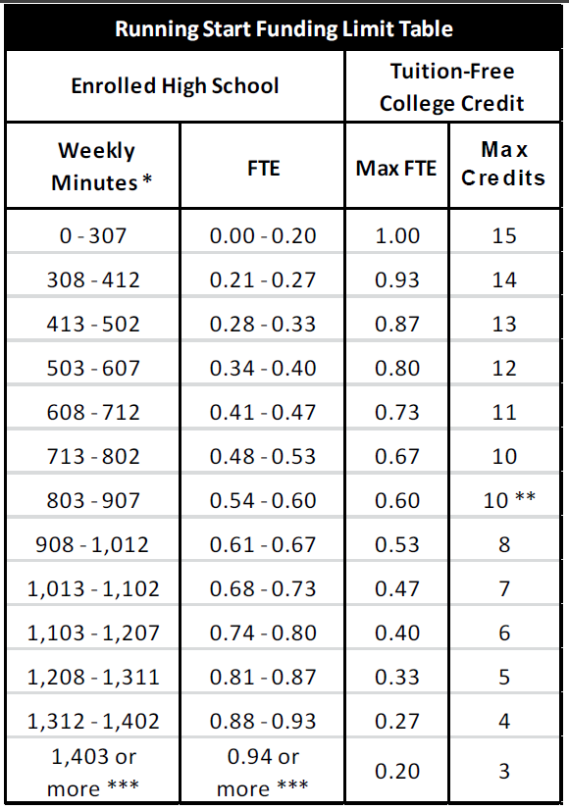
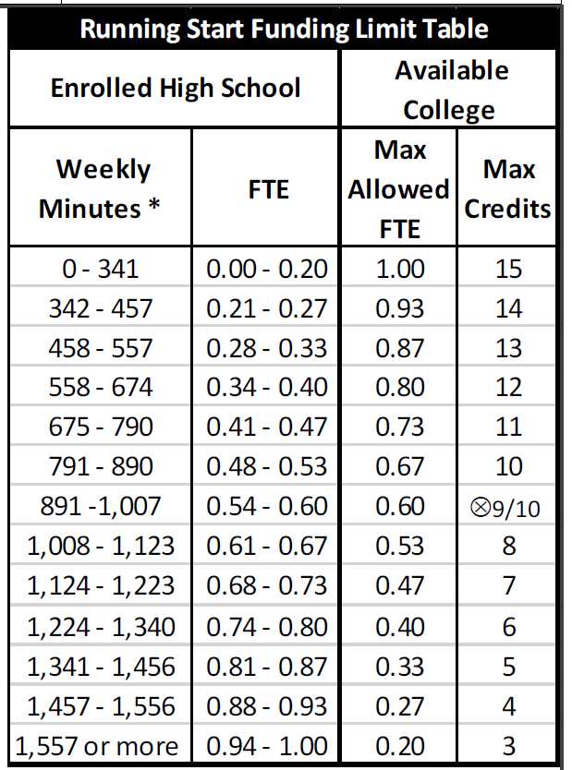
  Running Start continues
For Fall 2018 planning, make sure counselors are using the updated RSEVF form posted here: http://www.k12.wa.us/BulletinsMemos/bulletins2018/B038-18AttachB.pdf and the bell schedule FTE for 2018−19.
From To

Slide 16
  Summer and Ancillary Services
  Summer (P223S) and Ancillary Services (P240) AAFTE will be based on 1,000 hours for all grades.
  AAFTE will be calculated by dividing actual hours by 1,000.
  FTE change begins September 2018.
    Summer 2018 AAFTE will continue to be calculated by dividing actual hours by 900.
    Summer 2019 AAFTE will be based on 1,000.
  Work Based Learning
  No change to Work Based Learning calculation.
  Cooperative WBL will be calculated by dividing actual hours by 200.
  Instructional WBL will be calculated by dividing actual hours by 100.

Slide 17
  Caseload Forecast Analysis
  The Caseload Forecast Council asked us to project what we will see when the FTE changes.
  Based on data submitted by several districts, our analysis shows – assuming actual enrollment does not grow and remains:
OVERALL
Grades | % Reduct-ion
K | 0.03%
1st | 0.01%
2nd | 0.02%
3rd | 0.03%
4th | 0.01%
5th | 0.02%
6th | 0.09%
7th | 0.21%
8th | 0.12%
9th | 0.15%
10th | 0.25%
11th | 0.97%
12th | 1.86%
Total | 0.28%
Vocational
Types | % Reduct-ion
Gr 7–8 CTE | 9.91%
Gr 9–12 CTE | 9.90%
Skill Center | 9.90%
Running Start
Types | % Increase
Gr 11 | 1.76%
Gr 12 | 1.03%
Total | 1.13%

Slide 18
Updates on the NEW Enrollment Application
Remember you can upload your data by:
Creating a TXT file of your data and uploading using the IMPORT tab.
For Skyward users, by exporting your data through the FTP process.
If data does not show up in NEW Enrollment application, contact me to see if the file processor is working (needs to be woken up).
When uploading data, the data submitted will only overwrite the fields for the data submitted.
Enrollment reports are run at a district level only.
No school level reports are created. The Extract provides the school level data.
The following reports are available in the NEW Enrollment:
  1251 – FTE Summary
  1251H – HC Summary
  1735T – Special Ed District Summary
  1251SR – Serving District FTE by Resident District
  1251HSR – Serving District HC by Resident District
  1735SR – Serving District Special Ed by Resident District
  1251RS – Resident District FTE by Serving District – NEW
  1735RS – Resident District Special Ed by Serving District – NEW

Slide 19
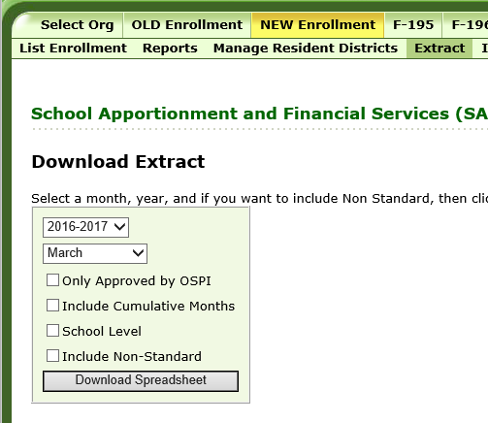
Updates on NEW Enrollment Application continues
Data Extracts provides a way to see School Level detail.
Creating an Excel spreadsheet of the enrollment reported.
Extracts can be run:
  For a specific month or the entire school year.
  For the data that is “Accepted by OSPI” status or data that is in the most recent non-”Accepted by OSPI” file.
  For the district level or at the school level.
Use the Filter function to look up rows.
Use Pivot Table function to create the school level reports needed.

Slide 20
Work Based Learning (WBL) Enrollment Reporting
WBL opportunities can be claimed for Basic Ed state funding when:
  A student’s WBL experience earns additional credit.
  There is a completed learning plan.
  There is an agreement between the district and the workplace, and
  Student has participated in a program orientation.
WBL opportunities can be claimed for CTE enhanced funding when:
  The WSL is a state-approved vocational class, and
  The instructor who is either teaching or coordinating the WSL has a valid vocational endorsement for the subject area.
WBL opportunities can be claimed for Skill Center enhanced funding when:
  The WBL is a preparatory and part of a state-approved skill center course, and
  The instructor who is either teaching or coordinating the WBL has a valid skill center endorsement for the subject area.
  WBL done through an Open Doors program cannot be claimed as an additional FTE or reported for enhanced CTE funding.
  WBL done in association with an ALE class can generate enhanced CTE funding.

Slide 21
Types of WBL
WBL can be either cooperative or instructional.
Cooperative WBL is one that is:
  Coordinated by an instructional staff,
  Typically an employer/employee relationship, and
  Could include salary for the student.
Instructional WBL is one that is:
Embedded in a high school class,
Taught by an instructional staff, and
Student does not earn a salary.
Limitation on the Amount of Claimable Hours
No more than 360 hours of cooperative WBL for each 1 credit awarded.
No more than 180 hours of instructional WBL for each 1 credit awarded.
If the credit awarded are less or more than 1 credit, the amount of WBL hours is adjusted proportionally.
  For example, a ½ credit of cooperative WBL would be limited to 180 hours.

Slide 22
Calculating WBL as an FTE
Depending on the type of WBL, FTE for WBL is calculated as follows:
  Cooperative – divide the monthly actual hours by 200.
  Instructional – divide the monthly actual hours by 100.
  WBL FTE is reported monthly for the month that the WBL occurred. Will require revising that month’s P223.
  For example:
    Student had 40 hours of cooperative WBL in January. The FTE is 0.20 (40 ÷ 200). The available FTE should be reported on the January P223.
    Student had 40 hours of instructional WBL in October. The FTE is 0.40 (40 ÷ 100). The available FTE should be reported on the October P223.

Slide 23
Understanding the FTE Limitation as It Applies to WBL
When claiming WBL hours, a student cannot exceed the allowable FTE limitation.
  High school WBL:
    A student cannot be claimed for more than a 1.0 FTE in any month for Basic Ed funding (K–12 FTE field). WBL hours may not be able to be claimed if the student is already claimed as a 1.0 FTE for his high school enrollment.
    If the WBL qualifies for CTE enhanced funding, the WBL hours may be included in the 9–12 Vocational FTE field, provided the student does not exceed the 1.0 FTE in this field.
  Skill Center WBL:
    A student cannot be claimed for more than a 1.0 FTE by a skill center – for both the Basic Ed funding (K–12 FTE field) and for Skill Center enhanced funding (Skill Center FTE field).
    When enrolled in both a high school and skill center, a student cannot be claimed for more than a combined 1.60 FTE.
    WBL hours can be claimed provided the student does not exceed these limitations in any month.

Slide 24
Claiming Suspended and Expelled Students
2016 HB 1541 requires districts to provide educational services for students who have been suspended or expelled as soon as reasonably possible and comparable, equitable, and appropriate to the regular education the student received prior to being suspended or expelled.
As a result, WAC 392-121-108 – Enrollment Exclusion has been revised to remove the prohibition to claim suspended or expelled students for state funding.
However, the 20 days of consecutive absence school days remains an exclusion.
Therefore, a student who has been suspended or expelled but who has not received education services within 20 school days of the monthly count day, cannot be claimed.

Slide 25
Claiming Suspended and Expelled Students continues
Some options for these students:
  Enrollment in an ALE program. FTE is based on the estimated hours in a Written Student Learning Plan.
  Alternative classroom setting where student attends classes outside of the school. FTE is based on the student’s enrolled weekly minutes in the alternative classroom setting.
  Enrollment in an Open Doors program.
  Agreement in place with the parents that the student will continue his education progress while temporarily absent from school.
    Student can be claimed for two monthly count days but must return to school prior to the end of the school year.
    Caution should be taken to make sure this option meets the comparable, equitable, and appropriate requirements.

Slide 26
Basics of Enrollment Reporting

Slide 27
Resources for Enrollment Reporting
2018–19 Enrollment Reporting Handbook found here: http://www.k12.wa.us/safs/INS/ENR/1819/EnrollmentHandbook2018-19.docx.
NEW – the Enrollment Reporting Applications User Guide found here: http://www.k12.wa.us/safs/INS/ENR/1819/UserGuide.docx. Contains instructions on how to navigate:
  NEW Enrollment (P223/P223H) application
  K–3 Class Size application
  SAFS ALE application
ESD enrollment contact.
Rules regarding enrollment – WAC 392-121-106 through 188.
Becky McLean, OSPI
  360-725-6306
  becky.mclean@k12.wa.us

Slide 28
Why is Enrollment Reporting Important?
Monthly enrollment drives school funding.
How enrollment is reported can affect district’s funding.
Mistakes in reporting can result in audit findings.
Data used for forecasting future enrollment and the state’s funding obligations.
High interest area with the public and Legislature.

Slide 29
2017–18 State Summary Average
Per Funding Levels as of July 2018
 | Annual Allocation
Basic Education | $6,869 | Per AAFTE
Special Education | $6,714 | Per Average Headcount
Enhanced MS CTE | $324 | Per AAFTE
Enhanced HS CTE | $318 | Per AAFTE
Enhanced Skill Center CTE | $994 | Per AAFTE
TBIP | $1,008 | Per Average Headcount
Exited TBIP | $633 | Per Average Headcount

Slide 30
Enrolled Student
Resident of district or attending pursuant to:
  Choice transfer.
  Interdistrict agreement.
  Under 21 years of age before September 1st for the new school year.
  Enrolled on or before the monthly count day.
  Participated in a course of study on or before the monthly count day.
  Does not meet any enrollment exclusions.
  WAC 392-121-106 defines enrolled student.

Slide 31
Count Date
A Snapshot.
Count date is:
  4th school day in September.
  1st school day of October through June. For Open Doors (OD) programs, July and August.
  Running Start is 1st school day of October through June.
  For WAKids, there are two options:
    Count the parent/teacher/student conference days.
    Count the first four days of actual FDK classes.
  For schools or programs that end before June and seniors that graduate before June, the last day of school in May can be the June count day, provided a published school/program calendar reflects that the last day is in May.
  Count date can be determined by an individual school or grade’s start date or calendar.
  WAC 392-121-119 defines enrollment count dates.

Slide 32
Enrollment Exclusions
A student shall not be counted as an enrolled student if any of the following are met:
  Consecutively absent for > 20 consecutive school days.
    Allowance exists when an agreement is in place with the parent and the district that states the student will continue his educational progress while absent and the student returns to school before the end of the school year to be counted for two additional count days.
    Dropped out or transferred.
    Met high school graduation requirements before the beginning of the school year (September 1st).
    Paying tuition – F1 Visa.
    Claimed by an institution.
    Resident of either the Washington State School for Blind or Washington School for the Deaf, also known as Center for Childhood Deafness and Hearing Loss. Refer to Bulletin # 037-17.
    WAC 392-121-108 defines enrollment exclusions.

Slide 33
Course of Study Includes
Basic education instruction
Special education
Alternative Learning Experience (ALE)
Open Doors (OD) programs
Running Start (RS)
Direct-funded technical college
Ancillary service
Work Based Learning (WBL)
UW transition
WAC 392-121-107 defines course of study.

Slide 34
Course of Study Does Not Include
Home-based instruction
Private school instruction
Adult education – over 21 years old after September 1st
Out-of-state residents
GED prep instructions when:
  Additional adult education state/federal dollars are generated or
  Instruction does not earn high school credit.
  Extra-curricular activities
  College enrollment not earning dual credit at a high school

Slide 35
Full-Time Equivalent – FTE
FTE is the measurement of student’s enrollment and is used to fund districts.
Claiming FTE is based on:
  Seat-time traditional class: enrolled hours in a classroom.
  Running Start (RS) class: enrolled college credits.
  ALE program: estimated hours of learning in written student learning plan.
  Work based learning (WBL): actual hours in a WBL program.
  Ancillary Services: actual hours of services.
  Open Doors (OD) program: program’s total planned hours of instruction (below 100 level classes) or enrolled college credits (college level classes).

Slide 36
FTE Calculations
Seat-time and ALE FTE is calculated as follows:
1.0 FTE is defined as 1,665 weekly minutes (27 weekly hours and 45 minutes).
Running Start (RS) FTE is:
15 college credits equals 1.0 FTE.
(# of enrolled credits ÷ 15).
WBL FTE is actual hours of WBL:
  Divided by 200 for cooperative WBL.
  Divided by 100 for instructional WBL.
  Ancillary services and Summer enrollment is claimed as an AAFTE. Divide actual hours by 1,000.

Slide 37
Super FTE –
Exceptions to the 1.0 FTE Limitation
As a general rule, students are limited to 1.0 FTE and 1.0 AAFTE.
Exceptions:
  Running Start (RS) – up to a combined 1.2 FTE.
    Neither High School nor RS enrollment may exceed 1.0 FTE.
  Skill Center (SC) – up to a combined 1.6 FTE.
    Neither High School nor SC enrollment may exceed 1.0 FTE.
    What about a student enrolled in High School, RS, and Skill Center?
    When a student’s enrollment in both High School and SC exceeds 1.0 FTE, the available RS is limited to 0.20 FTE.
    When a student’s enrollment in both High School and SC is less than 1.0 FTE, the standard 1.2 FTE limitation applies.
    WAC 392-121-136 defines limitation
    on enrollment count.
 | Student A | Student B
High School FTE | 1.00 FTE | 0.18 FTE
Skill Center FTE | 0.54 FTE | 0.54 FTE
Total HS/SC FTE | 1.54 FTE | 0.72 FTE
Available RS FTE | 0.20 FTE | 0.48 FTE

Slide 38
Headcount
A count of enrolled students.
Amount of instructional or service hours is not a factor.
Each student is 1. No partial numbers.
Used for:
  Special education funding (P223H).
  Transitional Bilingual Instructional Program (TBIP) and Exited TBIP funding.
  State Budgeting and Caseload Forecast.
  School Construction Assistance Program.
  October reporting is critical.

Slide 39
Types of Districts
Resident District:
The district where the student lives.
For students from a nonhigh district, the high district.
For students that “choiced” into a nonresident district.
  WAC 392-121-106 defines resident district.
  WAC chapter 392-137 defines nonresident attendance.
Serving District:
The district that provides instruction or service.
Home District:
District where student lives regardless of Choice Transfer.
Used for ALE enrollment reporting on the SAFS ALE application.

Slide 40
Choice Transfers & Interdistrict Agreements
One of these agreements must be in place in order for a district to claim a nonresident student for state funding excluding Skill Center enrollment for consortium districts:
Choice Transfer:
Student released 100% by resident district.
Resident district released financial liability for the student.
Serving (Choice) district is responsible for all services.
Student is reported on P223/P223H as resident of Choice district.
Interdistrict Agreement:
For students that attend another district part-time.
Responsibility for student remains with the resident district.
Serving district reports partial FTE on P223/P223H as a student of their resident district.
Basic education $ flow to the serving district.
Special education $ flow to the resident district.

Slide 41
Choice Transfers & Interdistrict Agreements continues
No choice transfers are required for students attending:
  Charter schools.
  Tribal compact schools.
  High district coming from a nonhigh district.
Effective dates must be stated – beginning and end dates.
Recommendation that transfers/agreements span for only one school year.
Both districts must sign the transfers/agreements before the enrollment can be counted.
Bulletin No. 035-18 dated April 25, 2018, provides:
Additional guidance on choice transfers and interdistrict agreements.
Information on the Standard Choice Transfer System (SCTS) application.
Required for all students who choice into a nonresident district’s ALE program.
Available to be used for all students’ choice transfers and interdistrict agreements.

Slide 42
Requirements for Claiming a Special Education Student
Enrolled in the school district,
Based on the student’s age on September 1, has one of the following in place:
Birth to 2 – an individualized family service plan (IFSP) per IDEA Part C – Washington Early Support of Infants and Toddlers (ESIT) requirements.
Ages 3 to 21 – a current and in effect IEP.
Evaluation is current, and
Receiving special education services as defined under WAC 392-172A-01175 and -01155.
Documentation to Support Reported Enrollment
Refer to Section 10 of 2018–19 Enrollment Handbook for detailed guidance.
Documentation must be retained for ALL CLAIMED ENROLLMENT including for enrollment provided under contract with an outside agency or college.

Slide 43
Revising Enrollment
During school year:
  Districts may make revisions directly in EDS.
  Effects to funding will appear on the end of month’s apportionment.
  Enrollment will be used for Levy Authority and LEA calculation.
After August 20, 2018, through November 19, 2018:
  Districts may revise prior year enrollment in EDS.
  Effects to funding will be a prior year adjustment in January 2019 apportionment.
  Enrollment will not be used for Levy Authority and LEA calculation.
After November 19, 2018: Revisions are submitted by paper.
  Cover letter with:
    Authorizing signature.
    State the status of audit for the specific school year.
    If in the midst of audit, the auditor must be notified of the revision.
  Marked-up 1251 or 1735 report with the changes needed, as well as detail information on which school’s enrollment needs revising.
After auditor’s exit meeting: Districts cannot revise their enrollment.

Slide 44
Questions ?

