Slide 1
Meal Pattern Training: Part 3
Spring 2014

Slide 2
Welcome
Wendy Barkley, RD
OSPI CNS School Meal Programs Supervisor
Leanne Eko, RD
OSPI CNS Training Specialist

Slide 3
Implementing New Meal Patterns
Hardest / easiest part of implementation
Your best strategy to “Keep Calm”

Slide 4
New Meal Patterns: Phase in
SY 2012-13
Grade Groups
Food based menu planning
Lunch Meal Patterns
½ of grains must be whole grain rich
SY 2013-14
Breakfast Meal Patterns
SY 2014-15
All Grains must be whole grain rich
1 cup fruit at breakfast
Sodium Target 1
Notes:
The new meal patterns were planned to be phased in over multiple years.
In SY 2012-13 we were introduced to:
Grade Groups
Food Based Menu Planning
And ½ of all grains had to be whole grain rich
In SY 2013-14
The Breakfast Meal Patterns were introduced.
And finally phased in requirements that become effective SY 2014-15 include:
All Grains must be whole grain rich
1 cup of fruit at breakfast
Sodium Target 1

Slide 5
Changes along the way
Meat/Meat Alternate and Grains maximums removed
Frozen Fruit with added sugar
Notes:
During the phase in period, USDA monitored implementation of the meal patterns and made some adjustments to help operators and industry.
The most notable of these changes include
Meat/Meat Alternate and Grains maximums were removed
Frozen Fruit with added sugar

Slide 6
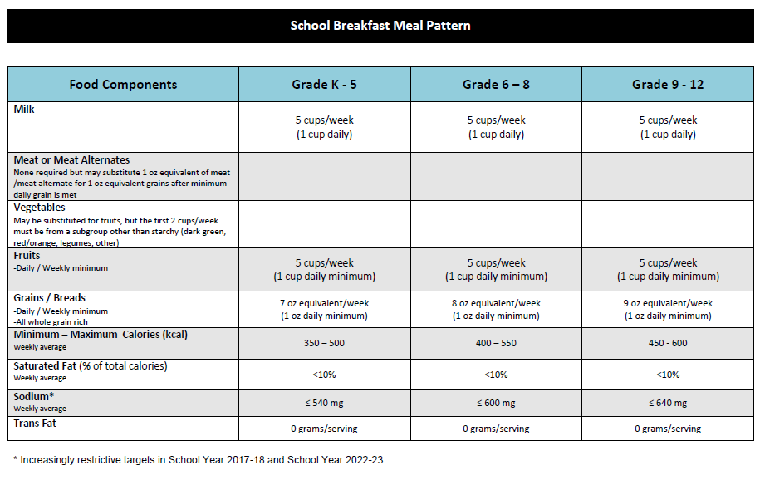
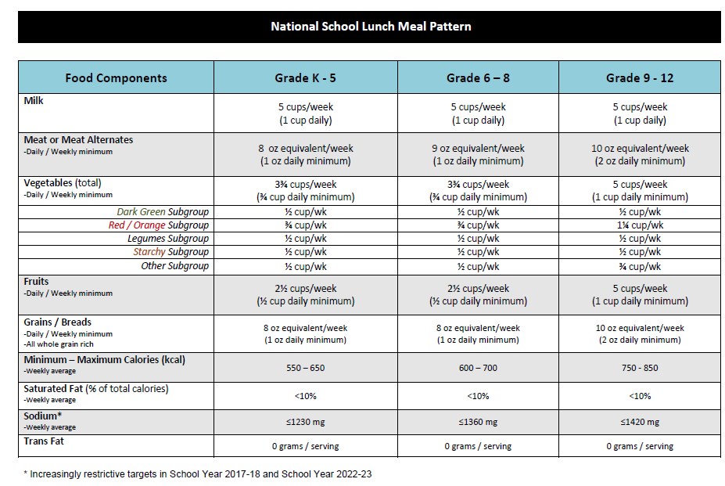
Meal Pattern Charts
Notes:
OSPI Meal Pattern Charts – both the Breakfast and Lunch meal pattern charts designed by OSPI have been updated to reflect the phase in and changes.
You can find electronic copies of the meal pattern charts at: http://www.k12.wa.us/ChildNutrition/Programs/NSLBP/NewMealPatterns.aspx

Slide 7
Milk
Breakfast and Lunch
Food Components | Grade K - 5 | Grade 6 – 8 | Grade 9 - 12
Milk | 5 cups/week (1 cup daily) | 5 cups/week (1 cup daily) | 5 cups/week (1 cup daily)
Allowable milk options:
-Fat-free (unflavored or flavored)
-Low-fat (unflavored only)
-Lactose-reduced or lactose-free low-fat or fat-free
Must offer at least two choices
Does not alter nutrition standards for milk substitutes
Provisions also apply to children ages 3-4
Notes:
The first component is Milk
1 cup daily.
Schools must also offer at least two choices from a variety of milk including- fat-free (unflavored or flavored), low-fat (unflavored only), and fat-free or low-fat (lactose reduced or lactose-free).
There is no change to the requirements for the nutritional content of optional non-dairy beverages offered to students with special dietary needs.
Lastly, the milk fat and flavor restrictions established by this final rule also apply to meals for children in the 3-4 year-old age group. ( reference SP-29-2011).

Slide 8
Grains / Breads
Breakfast and Lunch
Breakfast
Food Components | Grade K - 5 | Grade 6 – 8 | Grade 9 - 12
Grains / Breads -Daily / Weekly minimum -All whole grain rich | 7 oz eq/week (1 oz daily min) | 8 oz eq/week (1 oz daily min) | 9 oz eq/week (1 oz daily min)
Lunch
Food Components | Grade K - 5 | Grade 6 – 8 | Grade 9 - 12
Grains / Breads -Daily / Weekly minimum -All whole grain rich | 8 oz eq/week (1 oz daily min) | 8 oz eq/week (1 oz daily min) | 10 oz eq/week (2 oz daily min)
Notes:
Second component = grains/breads
• For all age groups there is a 1 oz. daily minimum, for breakfast and lunch..
• For breakfast: for grade group K-5 the weekly requirements are 7 oz., for grade group 6-8 its 8 oz., and for grade 9-12 is 9oz.

Slide 9
Grains / Breads
Notes:
We are introducing two new resources that you received today.
You can find a link to this resource on our web pages if you would like to print additional copies.
http://www.fns.usda.gov/tn/whole-grain-resource
The first is a Whole Grain Resource form USDA. We are going to use this in just a bit.

Slide 10
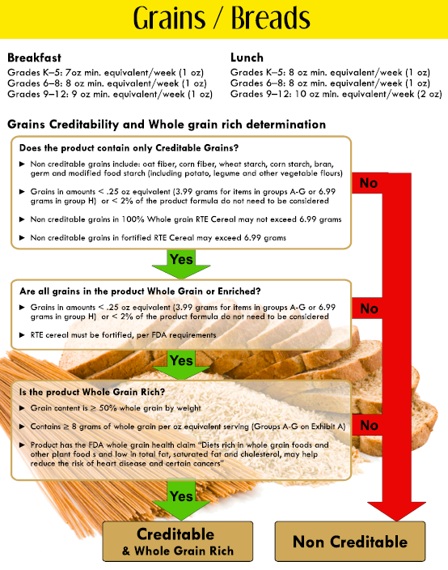
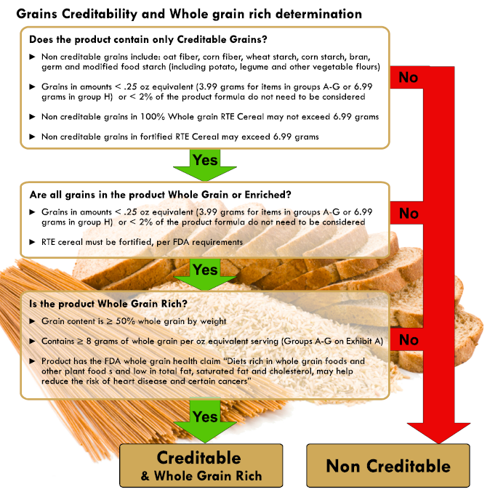
Grains / Breads
Notes:
We also made updated the grains page of your menu builder tool.
Let’s pull this out and take a look at the flow chart for determining grains creditability and whole grain rich determination.
The full “Menu Builder Tool” can be found at: http://www.k12.wa.us/ChildNutrition/Programs/NSLBP/pubdocs/MenuBuilderTool.pdf

Slide 11
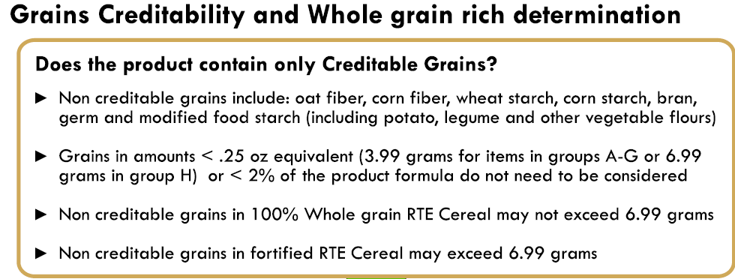
Grains / Breads
Ingredients: whole wheat flour, water, wheat bran, salt, malt, brown sugar, yeast, salt.
Notes:
For the Grains Component we must meet the whole grain requirements and the serving amount and size requirements.
Let’s start with a quick review of the Whole grain Requirements.
Grains must be creditable
non-creditable grains: oat fiber, corn fiber, wheat starch, corn starch, bran, germ and modified food starch (unless less than 2% of the product)
Lets look at an example….what ingredient is a non-creditable grain.
What would you need to do next? Request info from manufacturer regarding how much.

Slide 12
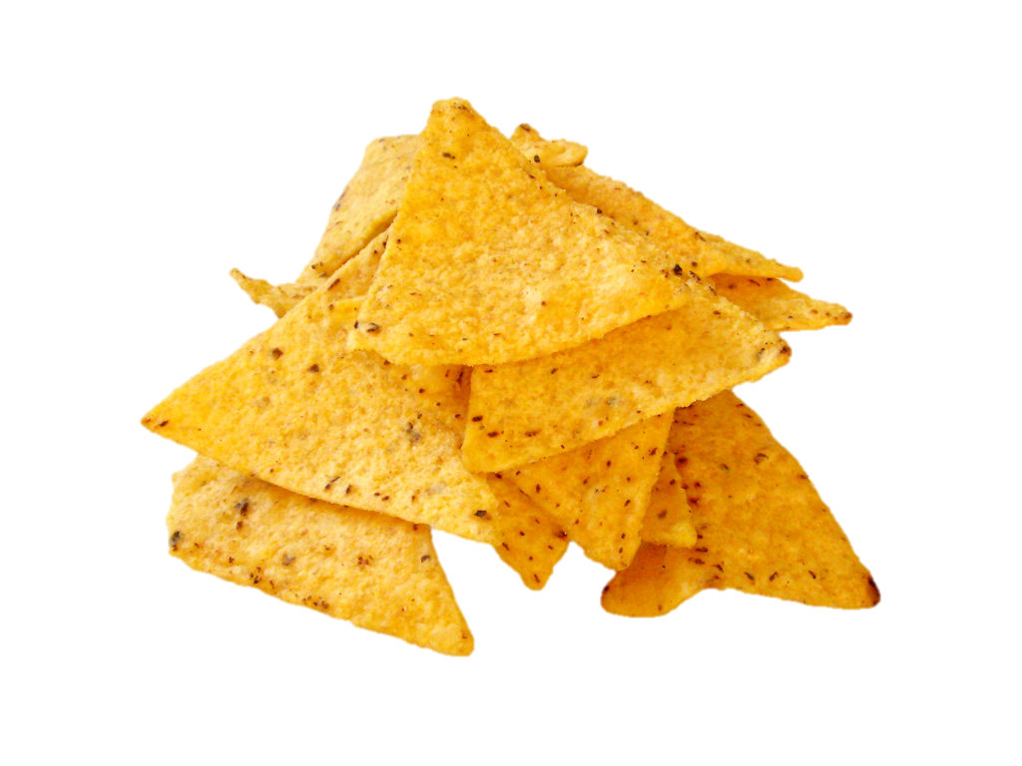
Grains / Breads
Ingredients:
Corn, Vegetable Oil, and Salt.
Notes:
Next in the flow chart we need to check that all grains in the product are whole grain or enriched.
All grain ingredients must be whole grain OR enriched (or be less < 2% of the product).
Lets look at example of corn tortilla chips.
What ingredient are we concerned about? Corn…needs to be Whole corn or Enriched corn

Slide 13
Grains / Breads
Ingredients:
Whole wheat flour, enriched flour, sugar, vegetable shortening, eggs, molasses, baking soda, salt, spices.
Notes:
Next we need to see if the items meets the requirements for whole grain rich.
SY 2014 – 15:all offerings must be whole grain rich*
Meet at least one of the following:
A) Whole grains per oz eq must be ≥ 8 grams
B) Product includes FDA’s whole grain health claim on its packaging
C) Product ingredient listing lists whole grain first
OR
Recipe – whole grain or combination of whole grains heavier in weight than other grains
Page 10 of Whole Grains Resource

Slide 14
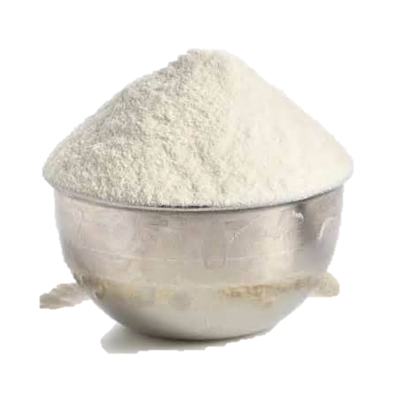
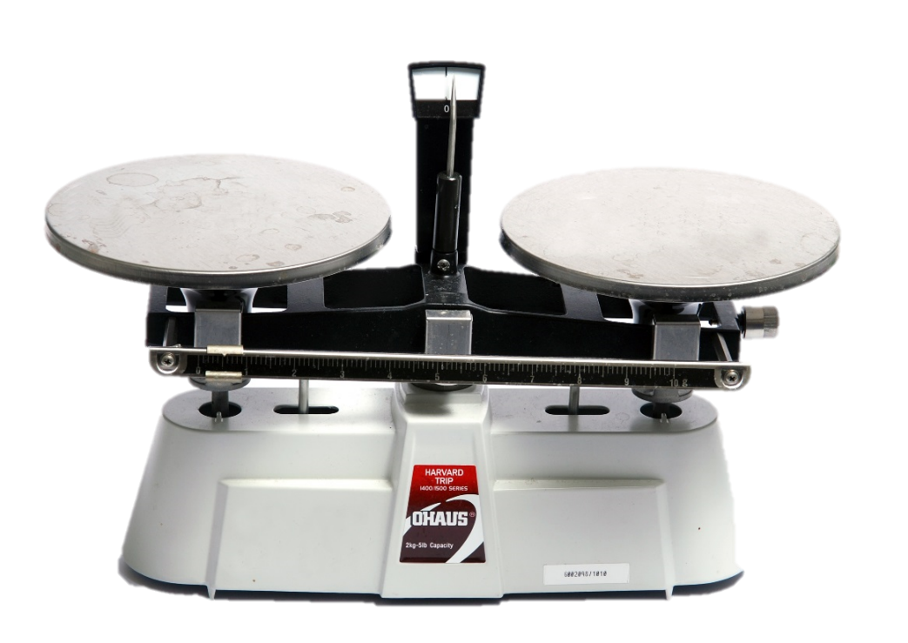
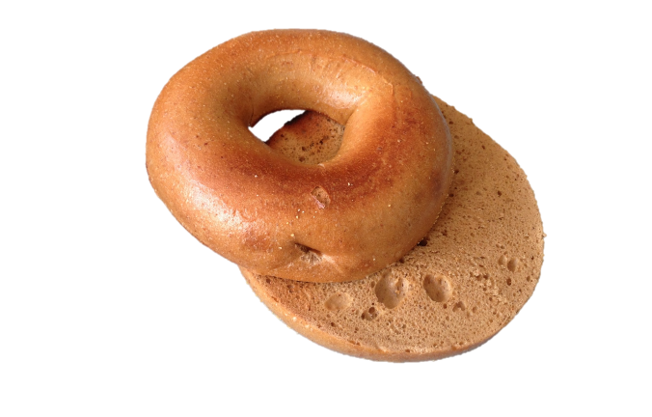
Determining oz Equivalency
OZ Equivalency based on weight of creditable grains
(documented by a CN label on a mixed dish OR product formulation statement)
OZ Equivalency based on weight of product using
Exhibit A
(documented by a product label and Exhibit A)
Notes:
There are two methods for determining Oz. Equivalency for grains/breads.

Slide 15
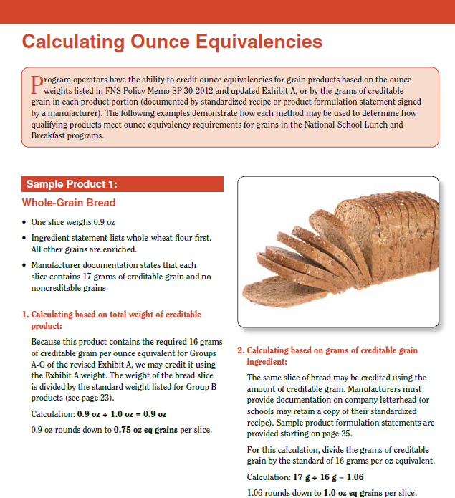
Grains / Breads
Notes:
Pg 21 of Whole Grain Resource book for example of oz eq weight of product vs weight of grains

Slide 16
Grains / Breads
Crediting and Rounding
< ¼ oz eq = Do Not Count
Always round down for oz eq
Add grains together and then round
Examples
Recipes: Add grain ingredients first – then round
Sandwich: Add two slices of bread – then round
Multiples of same item: Add items together – then round
Notes:
Additionally – remember the nuances of grain crediting and rounding.

Slide 17
Grains / Breads
Grain-Based Desserts
Lunch:
Grain-based Desserts limited to 2oz eq
Breakfast:
No Grain-based Desserts limit
BUT
Some grain products are NOT allowed
Notes:
Also note the foot notes on exhibit A regarding grain based desserts.

Slide 18
Grains / Breads
Apple Cinnamon Muffin
Serving Size: 57 grams
INGREDIENTS: WHOLE WHEAT FLOUR, SUGAR, EGGS, WATER, ENRICHED BLEACHED FLOUR (BLEACHED WHEAT FLOUR, MALTED BARLEY FLOUR, NIACIN, IRON, THIAMINE MONONITRATE, RIBOFLAVIN, FOLIC ACID), INVERT SUGAR, APPLES, SOYBEAN OIL, CONTAINS 2% OR LESS OF: PALM OIL, CANOLA OIL, WHEAT GLUTEN, OAT FIBER, PROPYLENE GLYCOL MONO- AND DIESTERS OF FATS AND FATTY ACIDS, LEAVENING (BAKING SODA, SODIUM ALUMINUM PHOSPHATE, MONOCALCIUM PHOSPHATE), MONO- AND DIGLYCERIDES, CINNAMON, MODIFIED CORN STARCH, POTASSIUM SORBATE (PRESERVATIVE), SODIUM ALGINATE, SALT, PROPYLENE GLYCOL MONOSTEARATE, SODIUM STEAROYL LACTYLATE, SOY LECITHIN, NATURAL FLAVOR, CARAMEL COLOR,
Notes:
Does this item contain Non-Creditable Grains? ….Yes Oat fiber… But less than 2% so OK
All grains whole grain or enriched?…Yes
Whole Grain Rich? Yes
Now how about oz eq….at this point all we have is the package information ..so what method are we going to use? Oz equivalency based on the weight of the product (using Exhibit A)
What group on Exhibit A? Group D
At 57 grams….how many Oz Eq? 1 oz eq
What do I need to keep on hand for product documentation?
Package label

Slide 19
Grains / Breads
Whole Wheat Bagel
Serving Size: 56.5 grams
Ingredients: whole wheat flour, water, wheat bran, salt, malt, brown sugar, soy flour, yeast, corn meal.
Notes:
Does this product contain non-Creditable Grains? ….YES Wheat bran and soy flour - need to find out how much
Are all grains whole grain or enriched?…No corn meal need to be enriched or need to find out how much
Whole Grain Rich? YES
Need a Product Formulation statement
Now how about oz eq….at this point all we have is the package information ..so what method are we going to use? Oz equivalency based on the weight of the product (using Exhibit A)
What group on Exhibit A? Group B
At 56.5 grams….how many Oz Eq? 2 oz eq

Slide 20
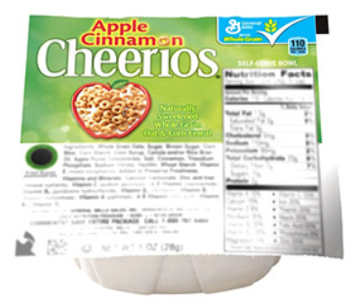
Grains / Breads
Apple Cinnamon Cheerios
Serving Size: 1 oz
Whole Grain Oats, Sugar, Brown Sugar, Corn Meal, Corn Starch, Corn Syrup, Canola and/or Rice Bran Oil, Apple Puree Concentrate, Salt, Cinnamon, Trisodium Phosphate, Sodium Citrate, Vanillin, Wheat Starch. Vitamin E (mixed tocopherols) Added to Preserve Freshness.Vitamins and Minerals: Calcium Carbonate, Zinc and Iron (mineral nutrients), Vitamin C (sodium ascorbate), A B Vitamin (niacinamide), Vitamin B6 (pyridoxine hydrochloride), Vitamin B2 (riboflavin), Vitamin B1 (thiamin mononitrate), Vitamin A (palmitate), A B Vitamin (folic acid), Vitamin B12, Vitamin D3.
Notes:
Does this product contain non-Creditable Grains? ….YES
But note the third and fourth bullets on our flow chart.
What do we need to know next…is this a fortified cereal? How do we know? Vitamin and minerals listed in ingredient label.
Are all grains whole grain or enriched…NO Corn meal not enriched
But see bullet on the second box on our flow chart. Non – whole grains or non-enriched OK because cereal is fortified… somewhere on the label will state “fortified cereal”
Whole Grain Rich? YES
Now how about oz eq….at this point all we have is the package information ..so what method are we going to use? Exhibit A
What group on Exhibit A? Group I
how many Oz Eq? 1 oz eq

Slide 21
Grains / Breads
INGREDIENTS:
CRUST (flour blend [enriched wheat flour {bleached flour, malted barley flour, niacin, reduced iron, thiamine, mononitrate, riboflavin, folic acid}, whole grain wheat flour, soy flour], water soybean oil, dextrose, baking powder, yeast, salt, dough conditioner)
Notes:
Let’s take a look at a mixed dish : Breakfast Pizza
You have to really watch the brackets
Does this product contain non-Creditable Grains or unenriched / non whole grains? ….Yes soy flour
Whole Grain Rich? NO… at least not with this ingredient list alone.
Now how about oz eq….Can’t use Exhibit A for mixed product – will need information from manufacturer

Slide 22
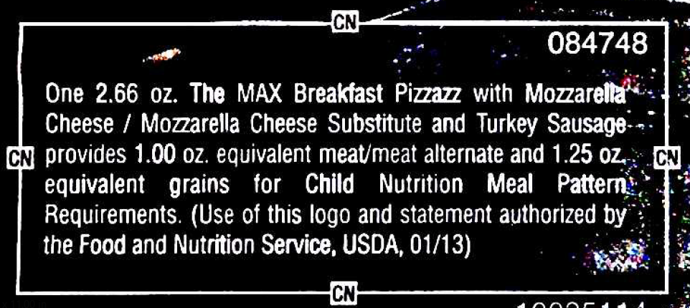
Grains / Breads
Notes:
Ah – but look at this…this product has a CN label AND
A CN label trumps ALL…verification that product has been reviewed by USDA.
Just make sure that label is current.
If CN label uses the term GRAINS…product has met creditable grains, enriched AND whole grains requirements.

Slide 23
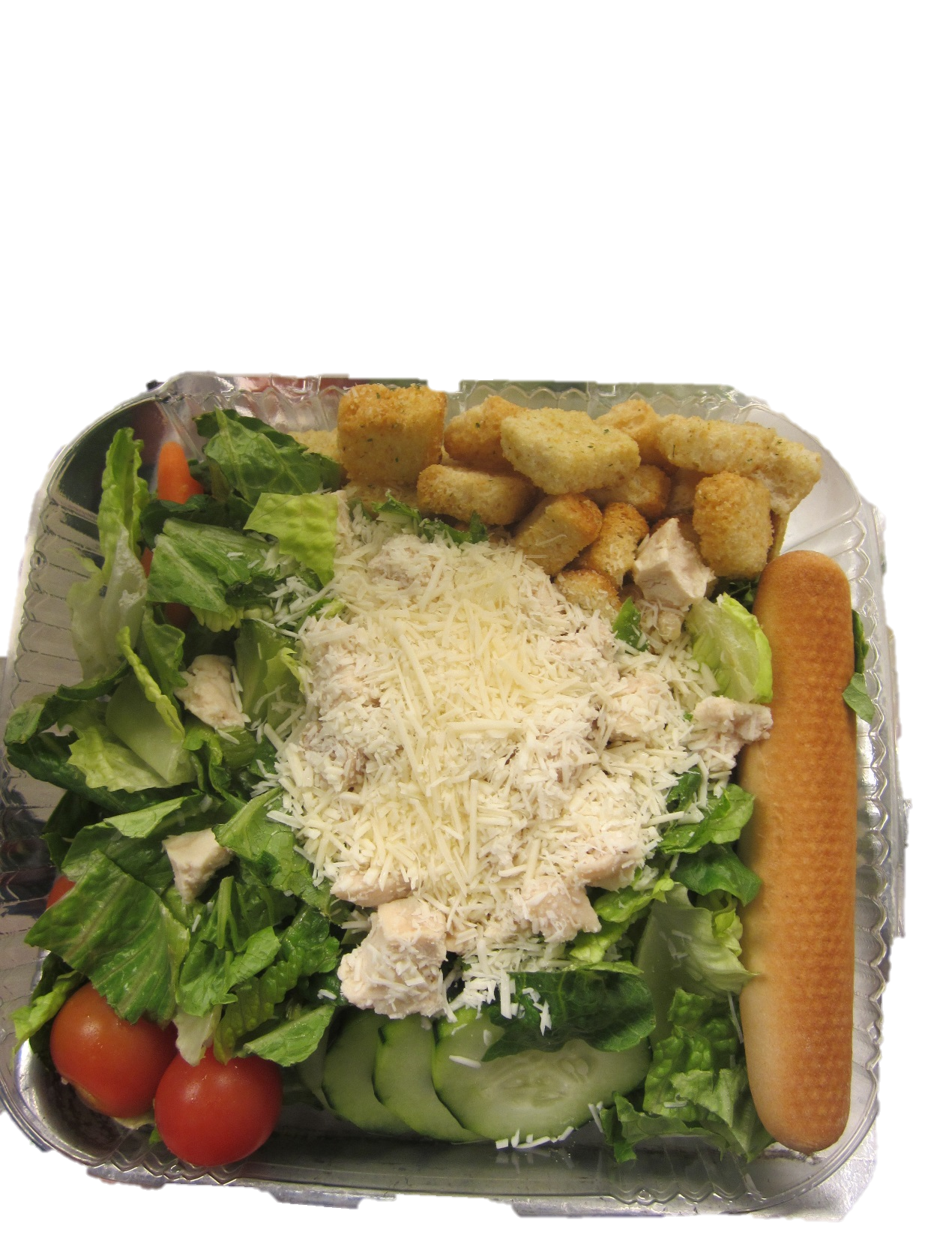
Grains / Breads
Chicken Cesar Salad w/ Whole Grain rich bread stick
What about the croutons?
Notes:
Make sure the croutons serving size is less than .25 oz eq (3.99 grams) and then they would not need to meet the whole grains specifications but would still be included in the dietary specification (same as a condiment)

Slide 24
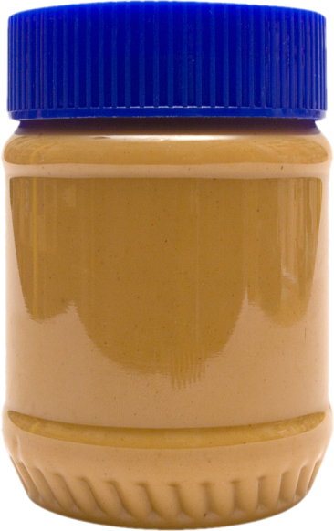
Meat or Meat Alternate
Breakfast
Food Components | Grade K - 5 | Grade 6 – 8 | Grade 9 - 12
Meat / Meat Alternate | None required but may substitute 1 oz eq of meat/ meat alternate for 1 oz eq of grains after minimum daily grain is met OR count as “extra”
Lunch
Food Components | Grade K - 5 | Grade 6 – 8 | Grade 9 - 12
Meat / Meat Alternate -Daily and weekly minimum | 8 oz eq/week (1 oz daily minimum) | 9 oz eq/week (1 oz daily minimum) | 10 oz eq/week (2 oz daily minimum)
Notes:
NEXT COMPONENT: MEAT/MEAT ALTERNATE
The Meat / Meat Alternate group is different depending on what meal you are planning.
For Breakfast: No meat is required.

Slide 25
Meat or Meat Alternate
Nuts and seeds may be used to meet no more than 50% of the M/MA component
Another M/MA must be served to meet the full requirement
Notes:
Not new with the new meal patterns – but as a reminder.
(from 201.10)
(B) Nuts and seeds. Nuts and seeds and their butters are allowed as meat alternates
in accordance with FNS guidance. Acorns, chestnuts, and coconuts may not be used because of their low protein and iron content. Nut and seed meals or flours may be used only if they meet the requirements for Alternate Protein Products established in appendix A to this part. Nuts or seeds may be used to meet no more than one half (50 percent) of the meats/meat alternates component with another meats/meat alternates to meet the full requirement.

Slide 26
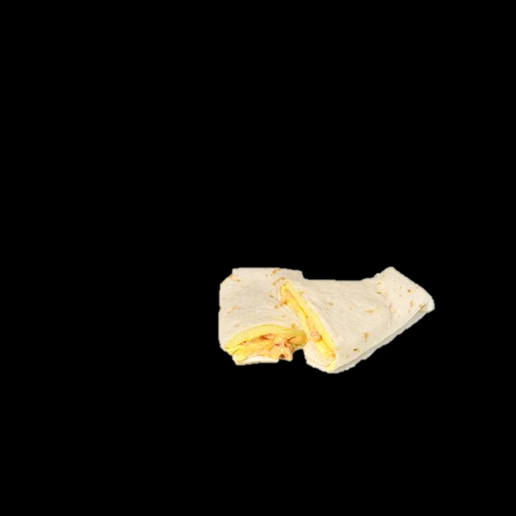
Meat or Meat Alternate
at Breakfast
1 oz grain eq
+
1 oz M/MA (as a grain) =
2 oz grain eq
1 oz grain eq
+
1 oz M/MA (as an extra)
=
1 oz grain eq
OR
Notes:
Lets look at an example. This egg burrito has a 1oz eq. tortilla and a 1 oz eq of egg
If you count a M/MA as a grain is counts towards your weekly minimum
OR you may count the M/MA as an “extra”
It doesn’t get counted toward meal pattern components
It’s important to note that you would include the “extra” item in the dietary specifications (Calories, Sat fat. And sodium)
Also note that an “extra” item does NOT count for OVS

Slide 27
Meat or Meat Alternate
at Breakfast
Breakfast Menu
Bagel & yogurt
Toast & cereal
Pancake & Sausage
Egg patty & sausage
Yogurt Parfait
Notes:
Take a look at this breakfast menu?
Do you notice any problems?
-Can’t menu egg and sausage together as an entrée choice –must have a min of 1 oz grain
-Yogurt parfait OK IF includes at least 1 oz eq grain in granola

Slide 28
Fruit
Breakfast and Lunch
Breakfast
 | Grade K - 5 | Grade 6 – 8 | Grade 9 - 12
Fruits | 5 cups/week (1 cup daily minimum) | 5 cups/week (1 cup daily minimum) | 5 cups/week (1 cup daily minimum)
Lunch
 | Grade K - 5 | Grade 6 – 8 | Grade 9 - 12
Fruits | 2½ cups/week (½ cup daily minimum) | 2½ cups/week (½ cup daily minimum) | 5 cups/week (1 cup daily minimum)

Slide 29
Fruit
Fresh, frozen, canned in juice/light syrup, or dried fruit options
Frozen fruit with added sugar allowed
¼ cup of dried fruit = ½ cup of fruit
(Refer to Food Buying Guide for crediting)
No more than half of fruit offerings may be in the form of juice 100% juice only
Notes:
A couple of quick reminders for fruit:
Fresh, frozen, canned in juice/light syrup, or dried fruit options
Frozen fruit with added sugar made permanent in final 6 cent rule
¼ cup of dried fruit = ½ cup of fruit
Refer to Food Buying Guide for crediting
No more than half of fruit offerings may be in the form of juice (effective SY 14-15)
100% juice only

Slide 30
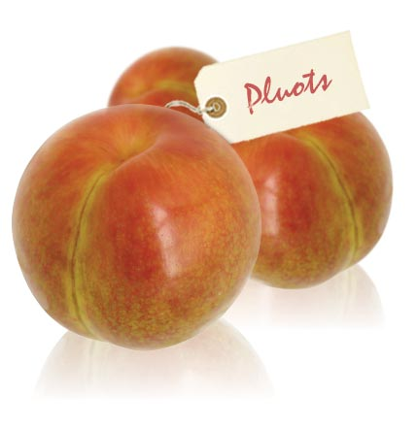
Fruit
Notes:
Make sure to check your figures…some crediting amounts were adjusted in the newest version of the Food Buying Guide. (located at: http://www.fns.usda.gov/tn/food-buying-guide-school-meal-programs)
What do you do if you have a fruit you can not locate in the FBG?
For example Pluots…look in FBG
You could…
-Check with your specialist
-Use equitable fruit/ size of fruit and document
-Cut up a pluot in measure and document
This flexibility is only allowed for fruit!

Slide 31
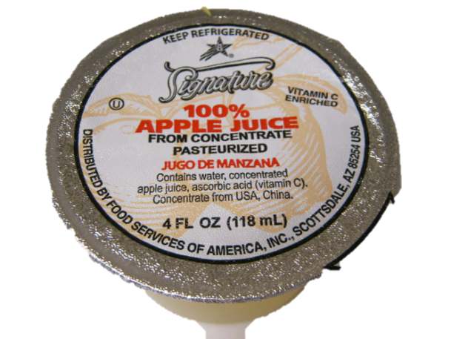
Fruit – Juice Limit
No more than half of the fruit offerings may be in the form of juice for the week
(“offering” is the amount of fruit the child is able to select regardless of number of variety choices)
Notes:
No more than half of the fruit offerings may be in the form of juice for the week
(“offering” is the amount of fruit the child is able to select regardless of number of variety choices)

Slide 32
Smoothies
Milk and Fruit can be credited
Yogurt may credit towards M/MA (only at breakfast)
Pureed fruit = juice (juice limit)
Type of milk must meet standards
Fluid milk must also be offered to meet milk variety requirements
Commercially prepared smoothies only credit toward fruit
Notes:
Milk and fruit can be credited in a smoothie.
Meat/meat alternate in the form of yogurt may be credited.
The type of milk used must be consistent with CNP guidance. For National School Lunch and School Breakfast Programs, the milk fat content must be 1% or less and flavored milk must be fat-free.
Pureed fruit added to smoothies must be considered juice and the rule of no more than half of all weekly fruit offerings can be in the form of juice applies.
When smoothies are on the menu, fluid milk and must also be offered as a choice to meet the variety of milk requirement.
Commercially prepared smoothies may only credit toward the fruit component (the milk does not meet standard of identity requirements).
Smoothies with nutritional and/or herbal supplements added are not creditable in CNPs.

Slide 33
Vegetables
Breakfast and Lunch
 | Grade K - 5 | Grade 6 – 8 | Grade 9 - 12
Vegetables | None required but may be substituted for fruits, but the first 2 cups/week must be from a subgroup other than starchy
Breakfast
Lunch
 | Grade K - 5 | Grade 6 – 8 | Grade 9 - 12
Vegetables (total ) -Weekly minimum | 3¾ cups/week (¾ cup daily minimum) | 3¾ cups/week (¾ cup daily minimum) | 5 cups/week (1 cup daily minimum)
Dark Green Subgroup | ½ cup/wk | ½ cup/wk | ½ cup/wk
Red / Orange Subgroup | ¾ cup/wk. | ¾ cup/wk | 1¼ cup/wk
Legumes Subgroup | ½ cup/wk | ½ cup/wk | ½ cup/wk
Starchy Subgroup | ½ cup/wk | ½ cup/wk | ½ cup/wk
Other Subgroup | ½ cup/wk | ½ cup/wk | ¾ cup/wk.

Slide 34
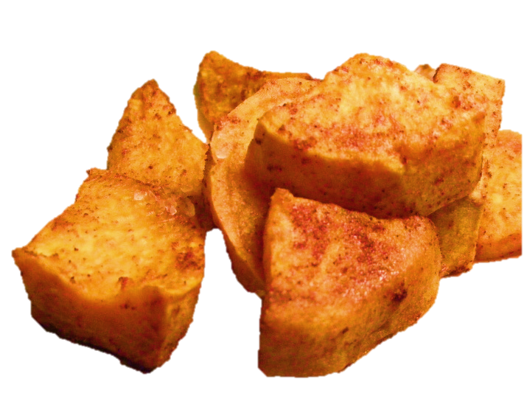
Vegetables
Breakfast
 | Grade K - 5 | Grade 6 – 8 | Grade 9 - 12
Vegetables | None required but may be substituted for fruits, but the first 2 cups/week must be from a subgroup other than starchy OR As an “EXTRA”
OR
½ cup vegetables = ½ cup fruit
½ cup vegetables = Extra
(no component but must include in dietary specifications)
Notes:
FOR BREAKFAST –
Vegetables can substitute for a fruit (BUT must menu 2 cups for vegetable from sub group other than starchy before you can offer starchy veggies)
The other option for vegetables is to not count them as a component and count them as an EXTRA
Remember that “extra” must be included in the dietary specifications and do not count in OVS

Slide 35
Vegetables
Lunch
 | Grade K - 5 | Grade 6 – 8 | Grade 9 - 12
Vegetables (total ) -Weekly minimum | 3¾ cups/week (¾ cup daily minimum) | 3¾ cups/week (¾ cup daily minimum) | 5 cups/week (1 cup daily minimum)
Dark Green Subgroup | ½ cup/wk | ½ cup/wk | ½ cup/wk
Red / Orange Subgroup | ¾ cup/wk. | ¾ cup/wk | 1¼ cup/wk
Legumes Subgroup | ½ cup/wk | ½ cup/wk | ½ cup/wk
Starchy Subgroup | ½ cup/wk | ½ cup/wk | ½ cup/wk
Other Subgroup | ½ cup/wk | ½ cup/wk | ¾ cup/wk.
Notes:
Vegetables at lunch

Slide 36
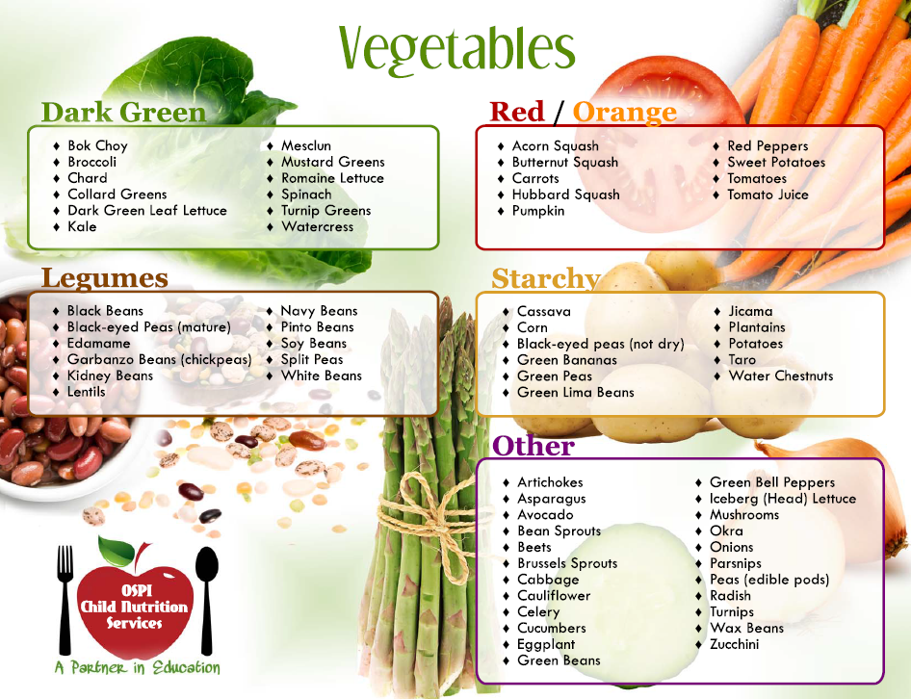
Vegetables
Notes:
This handout can be found at http://www.k12.wa.us/ChildNutrition/Programs/NSLBP/pubdocs/VegetableSubgrouphandout.pdf
Other versions of the chart, including posters can be found at: http://www.k12.wa.us/ChildNutrition/Programs/NSLBP/NewMealPatterns.aspx

Slide 37
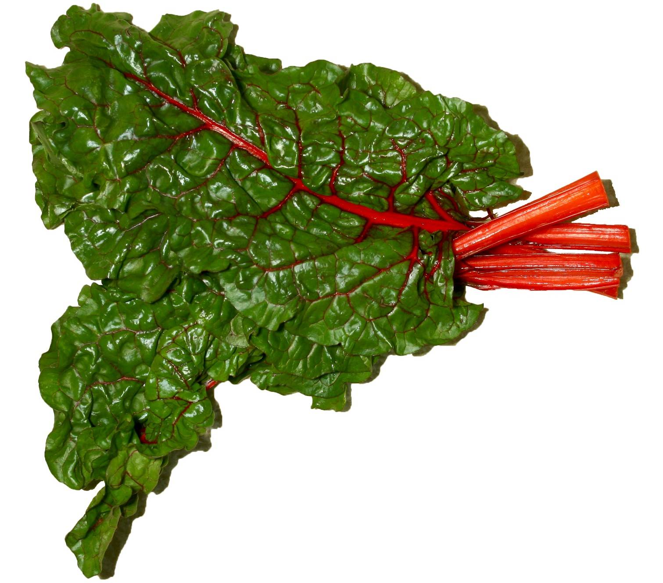
What Sub Group?
Notes:
Swiss Chard: Dark Green

Slide 38
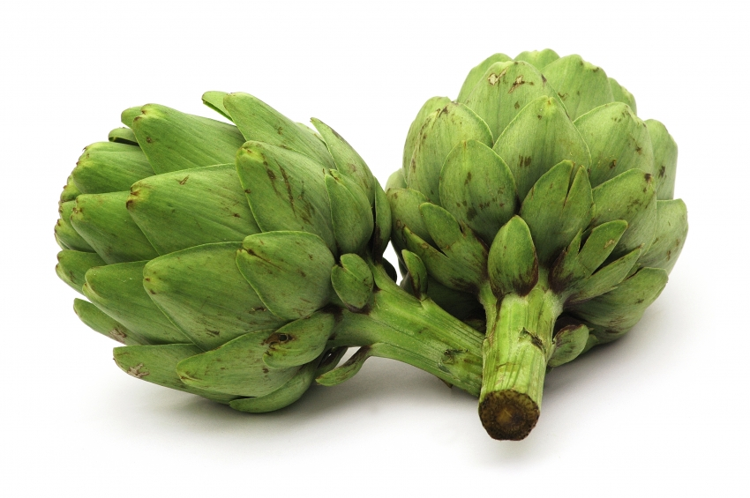
What Sub Group?
Notes:
Artichoke: Other

Slide 39
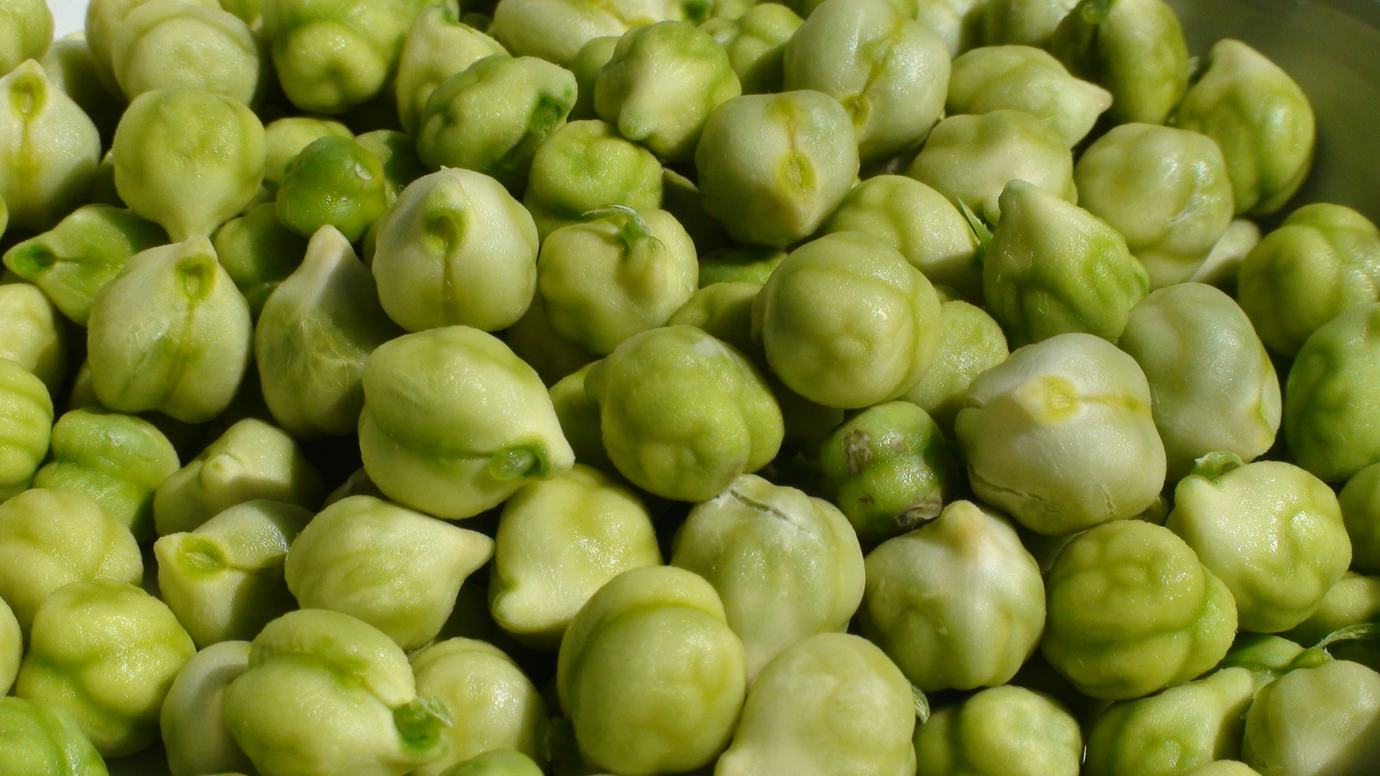
What Sub Group?
Notes:
Fresh green garbanzo beans
Originally we thought it would be classified at a starchy vegetable. USDA recently provided guidance that due to it’s unique nutrient profile, fresh green garbanzo beans should be classified as a legume.

Slide 40
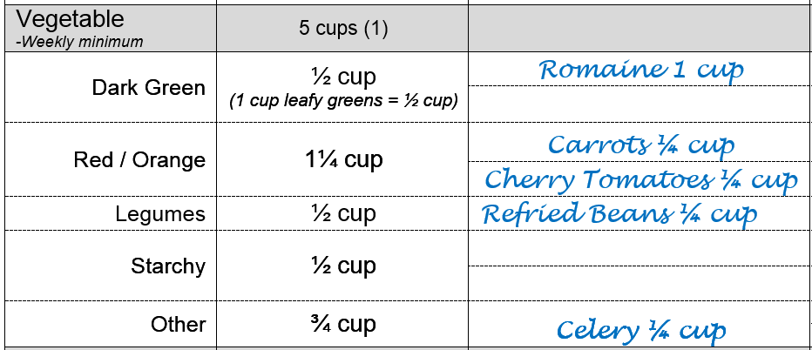
Vegetables
Chicken Caesar Salad w/ WG Roll | OR | Beef & Bean Burrito
Carrots / Celery / Cherry Tomatoes
Apple
Milk
1¾ cup
1cup
Notes:
Lets look at a menu and evaluate for vegetable servings and vegetable sub groups.
For the student who selects the Chicken Caesar Salad (recipe indicates each serving contains 2 cups of romaine lettuce) they have a total of 1¾ cups of vegetables available to them on this day.
For the student who selects the Beef and Bean Burrito (recipe indicates each serving contains beef and cheese for meat/meat alt crediting AND ¼ cup of legumes for vegetable crediting) they have a total of 1 cup of vegetables available to them on this day.

Slide 41
Vegetables
Chicken Caesar Salad w/ WG Roll | OR | Beef & Bean Burrito
Carrots / Celery / Cherry Tomatoes
Apple
Milk
Notes:
Now let’s consider what vegetables can be included in your weekly count of sub groups.
Only the carrots, cheery tomatoes, and celery. T
he romaine and refried beans can count towards you weekly sub groups because they were not available to all students.

Slide 42
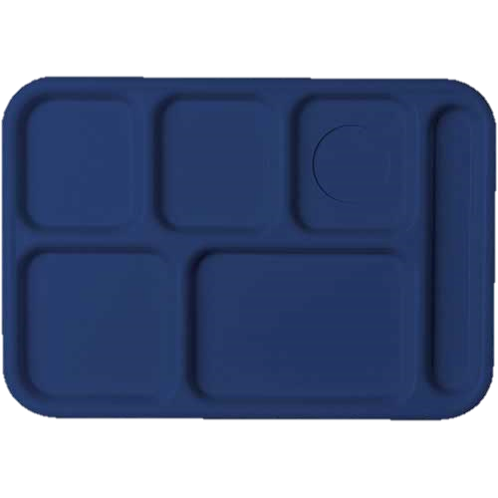
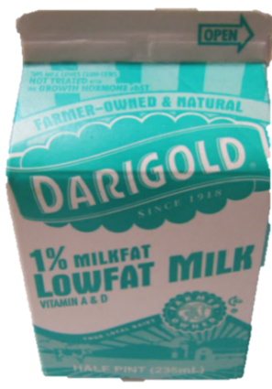
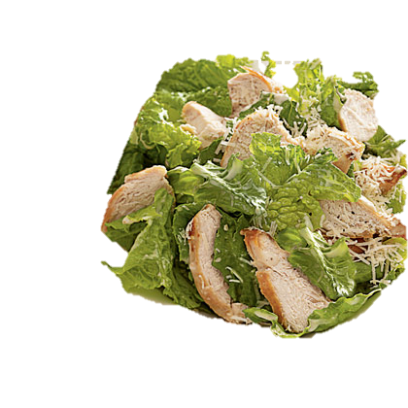
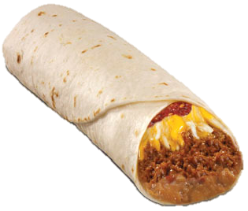
Vegetables
Notes:
Remember that planned menu is a separate issue from offer vs serve (which we talk about later).
Daily vegetable and weekly sub groups are for the planned menu (not what students actually select).

Slide 43
Dietary Specifications
Calories
Sodium
Saturated Fat
Trans Fat
Notes:
There are four dietary specifications that are reviewed for . These specifications are calories, sodium, saturated fat, and trans fat.
The standards for calories, sodium, and saturated fat are to be met on average over the school week.
However, with regard to trans fat, food products and ingredients used daily will have to contain zero grams of trans fat per serving.

Slide 44
Dietary Specifications – Calories
Minimum and Maximum calorie levels
Weekly average
Breakfast
Lunch
 | Grade K - 5 | Grade 6 – 8 | Grade 9 - 12
Minimum – Maximum Calories (kcal) Weekly average | 350 – 500 | 400 – 550 | 450 - 600
 | Grade K - 5 | Grade 6 – 8 | Grade 9 - 12
Minimum – Maximum Calories (kcal) Weekly average | 550 – 650 | 600 – 700 | 750 - 850
Notes:
The first dietary specification is calories.
• Calorie ranges are to be met ON AVERAGE over the school week.
• Requirements became effective SY 2013-14 for both breakfast and lunch.
• Intent is not to reduce the amount of food but to avoid excessive calories. The meal patterns provide more fruits, vegetables and whole grains and should result in nutrient-dense meals. The required maximum calorie levels are expected to drive menu planners to offer nutrient dense foods and ingredients to prepare meals, and avoid products that are high in fats and added sugars.

Slide 45
Dietary Specifications – Calories
Breakfast
Calorie Overlap
 | Grade K - 5 | Grade 6 – 8 | Grade 9 - 12
Minimum – Maximum Calories (kcal) Weekly average | 350 – 500 | 400 – 550 | 450 - 600
400-500
450-550
K-12 overlap: 450 - 500
Notes:
Breakfast: there is a calorie overlap in the K-5 and grade 6 -8 groups – and K-12.
Of course the challenge is that the range of allowed calories becomes quite small.

Slide 46
Dietary Specifications –Calories
Lunch
Calorie Overlap
600-650
No Overlap
Notes:
There is calorie overlap for K-8 at lunch – unfortunately there is no overlap for grade groups 6-8 and 9-12 at lunch.

Slide 47
Dietary Specifications – Sodium
Weekly Average
Target 1: School Year 2014 – 15
Target 2: School Year 2017 - 18
Final Target: School Year 2022 - 23
 | Grade K - 5 | Grade 6 – 8 | Grade 9 - 12
Breakfast | ≤ 540 mg* | ≤ 600 mg* | ≤ 640 mg*
 | Grade K - 5 | Grade 6 – 8 | Grade 9 - 12
Lunch | ≤ 1230 mg* | ≤ 1360 mg* | ≤ 1420 mg*
Notes:
The final rule requires schools to make a gradual reduction in the sodium content of the meals, as recommended by the IOM.
The initial target is what is featured on the Meal Pattern Chart.
Like calories, sodium is a weekly average
Prior to the implementation of Target 2 and the Final sodium targets contained in this rule, USDA will evaluate relevant data on sodium intake and human health, as required by Section 743 of the Consolidated and Further Continuing Appropriations Act of 2012.

Slide 48
Determining your Sodium budget
Determine how many sodium mg you have to “spend” on your entrée
Hash brown sticks at 400 mg?
Breakfast - Grade K – 5 Sodium
Total | ≤ 540 mg
Milk | 100 mg
½ cup fruit | 5 mg
Available for entrée (Grain and M/MA) | 435
Notes:
How about determining our Sodium budget…
It is helpful to think about how many grams of sodium you have to “spend” on an entrée.

Slide 49
Dietary Specifications – Saturated Fat
Weekly Average
Breakfast and Lunch
Notes:
The next dietary specification is saturated fat.
• The standard – less than 10% of calories -- is the same as the one in the past regulations.
• The saturated fat requirement is a weekly average.
• Note that this rule does not require schools to meet a total fat standard.

Slide 50
Dietary Specifications – Trans Fat
Nutrition label or manufacturer’s specifications must specify zero grams of trans fat per serving
(less than 0.5 gram per serving)
Naturally-occurring trans fat excluded
e.g. beef, lamb, dairy products
Notes:
The fourth dietary specification is trans fat.

Slide 51
Verifying you meet Meal Pattern
Planned Menus
Production Records
Product Documentation
Nutrient Information
Notes:
So how exactly do your “Assure” or “Prove” that you are meeting meal pattern.
There are four areas you need to give attention to
Planned Menus
Production Records
Product Documentation
Nutrient Information

Slide 52
Product Documentation
CN label
OR
Product Formulation Statement
USDA Fact Sheet
Standardized Recipe with Meal Pattern Contribution
Ingredient List
Notes:
The next step to assuring meal pattern is in regards to product documentation.
This includes:
CN label OR Product Formulation Statement
USDA Fact Sheet
Standardized Recipe with Meal Pattern Contribution
Ingredient List

Slide 53
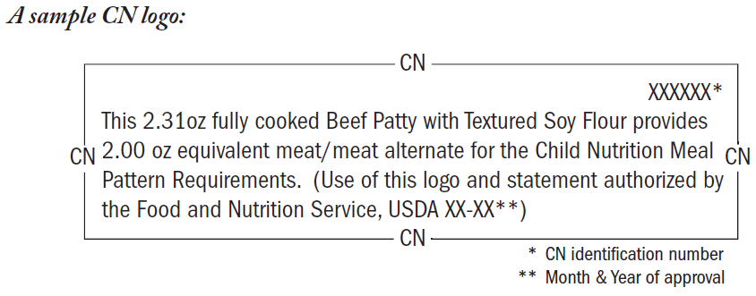
CN Labels
CN labels are only available for items that contribute to the meat/meat alternate component
Notes:
Let’s first look at CN Labels.
CN labels are used for items that contribute to the M/MA component
From TA 02-2012 “The Food and Nutrition Service (FNS) would like to remind school food authorities and other program operators that the CN Labeling Program is limited to entrée items and 50-percent juice drinks and juice drink products.
Because of an increase in requests for CN Labels for bakery and fruit/vegetable products such as cookies and 100-percent fruit/vegetable purees and juices that are not intended for the CN Labeling Program, it is important to remind school food authorities and other program operators that the CN Labeling Program is limited to the following two food categories:
Main dish products which contribute a minimum of 0.5 ounces equivalent meat/meat alternate toward meal pattern requirements. Examples of these products include but are not limited to beef patties, cheese or meat pizzas, meat or cheese and bean burritos, egg rolls, and breaded fish portions.
Juice drink and juice drink products which contain at least 50 percent full-strength juice by volume. This includes such products as grape drink, fruit punch, and juice bars.”

Slide 54
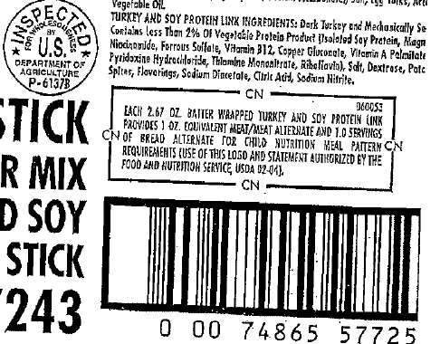
Product Documentation
-Ideally should be removed or copy taken from actual purchased product
-Expire 5 years from original approval date
Notes:
CN labels ideally:
Must be removed or copy taken from actual purchased product
Also – make sure and check expiration dates
Expire 5 years from original approval date

Slide 55
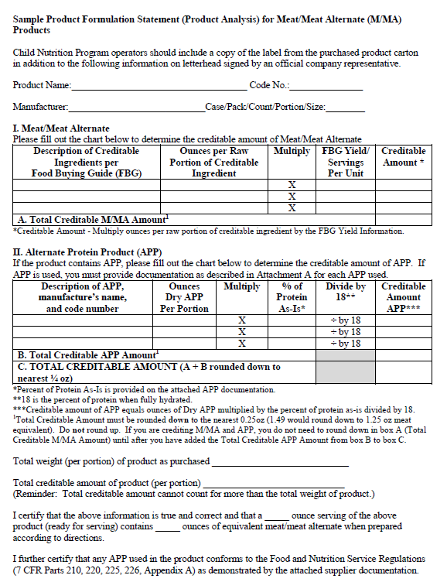
CN Labels and Product Documentation
Product Formulation Statement (PFS)
Notes:
USDA has Product Formulation templates (see USDA resources at: http://www.k12.wa.us/ChildNutrition/Programs/NSLBP/Resources.aspx)
Not required to use – but helpful in getting the correct information from manufacturers

Slide 56
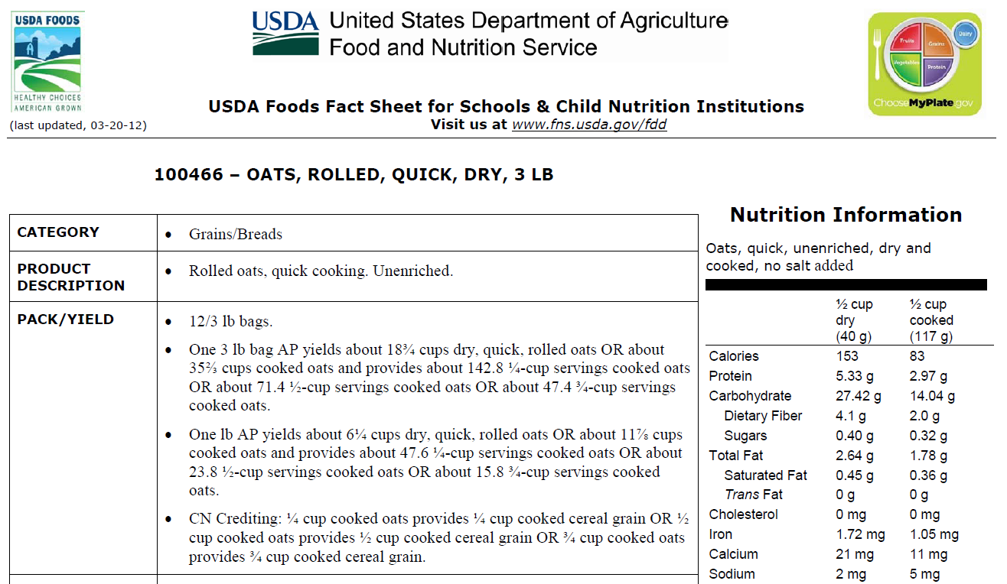
USDA Fact Sheet
Notes:
You can also use USDA Fact sheets for those applicable foods.
Link found on our Food Distribution web page: http://www.k12.wa.us/ChildNutrition/programs/FoodDistribution/default.aspx

Slide 57
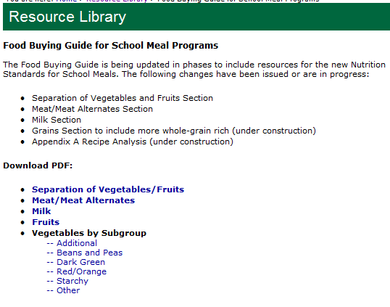
Food Buying Guide
Notes:
The Food Buying Guide can be used to demonstrate that adequate product was purchased and prepared.
Remember that food items must match the description and form EXACTLY as listed in the Food Buying Guide.
Make sure to update your copy of the Food Buying guide as sections become available and to train new employees on how to use the Food Buying Guide
http://www.fns.usda.gov/tn/food-buying-guide-school-meal-programs

Slide 58
Recipes
For menu items that combine two or more ingredients
Must be standardized
Meal Pattern contribution must be figured
(Food Buying Guide – Appendix A)
Notes:
Recipes are another important tool in demonstrating meal pattern is being met.
For menu items that combine two or more ingredients
Must be standardized
Worksheet for figuring Meal Pattern contribution are found in the Food Buying Guide – Appendix A. However, they have not been updated as of 5/30/14.
Use the OSPI CNS versions, found at
http://www.k12.wa.us/ChildNutrition/Programs/NSLBP/NewMealPatterns.aspx

Slide 59
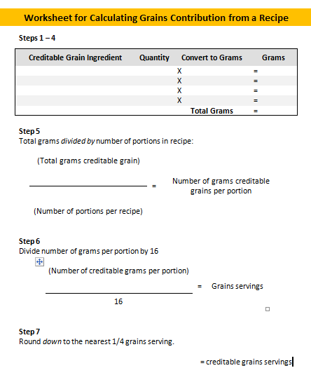
Meal Pattern Contribution
Notes:
USDA is still in the process of updating these sections…so in the mean time we have updated to of the worksheets for figuring meal pattern contribution.
The first one is a worksheet for calculating grains contribution from a recipe.
Who bakes any of their own grain products?
This worksheet can help you figure out the grains contribution of your item. It has been updated to reflect the 16oz of creditable grains/oz eq
You can find the worksheet at:
http://www.k12.wa.us/ChildNutrition/Programs/NSLBP/NewMealPatterns.aspx

Slide 60
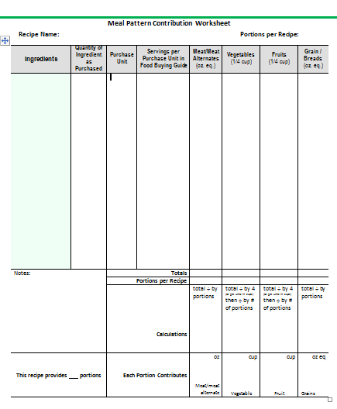
Meal Pattern Contribution
Notes:
The second worksheet is the “Meal Pattern Contribution Worksheet.
It can be used for many items.
You can find the worksheet at:
http://www.k12.wa.us/ChildNutrition/Programs/NSLBP/NewMealPatterns.aspx

Slide 61
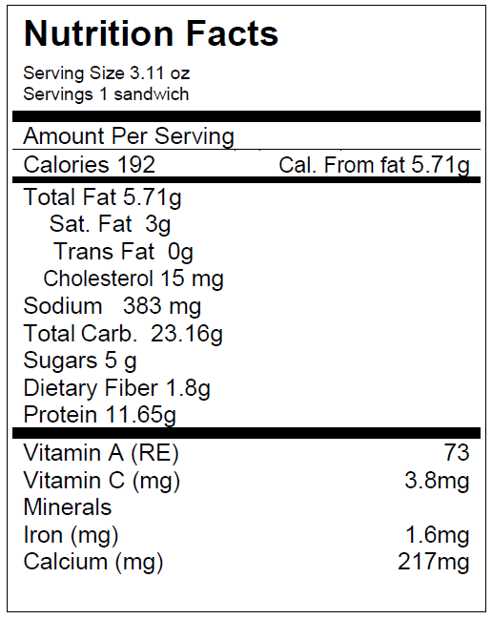
Nutrient Information
Notes:
And don’t forget that nutrient information is need to confirm nutrient specifications (calories, sat fat, sodium and trans fat)

Slide 62
Your turn!
Evaluate menu for meal pattern requirements
AND
product documentation

Slide 63
Production Records
Complete and Accurate
Must show how the meals planned/offered meet or contribute to the meal pattern.
Meal Pattern:
-food components
-food quantities/portion size
-age/grade group
Match what is menued AND served
Notes:
From USDA Administrative review guidance:
The State Agency must evaluate production records to ensure the following:
Records include all information necessary to support the claiming of reimbursable meals (i.e., all menu items are listed and all required meal components are offered)
Records are used for proper planning (e.g., evaluate for consumption and leftovers)
Records document food prepared is creditable for the total number of portions served, including adult meals and a la carte sales from the reimbursable line
Records document required weekly quantity requirements for grains, meat/meat alternates, vegetables, fruit and milk. Records align with standardized recipes

Slide 64
Production Records
What weighs more?
A pound of cheese
OR
A pound of spinach

Slide 65
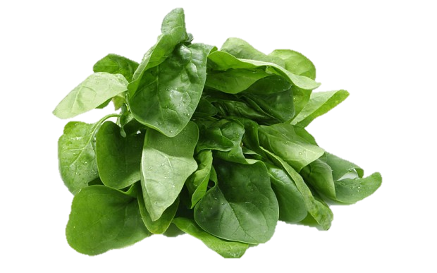
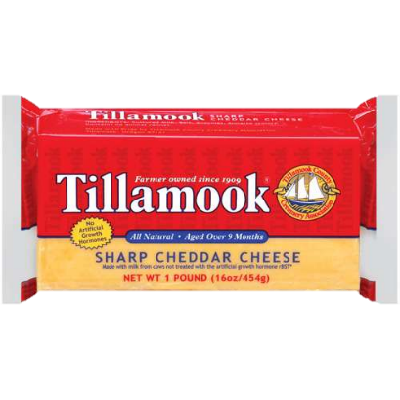
Production Records

Slide 66
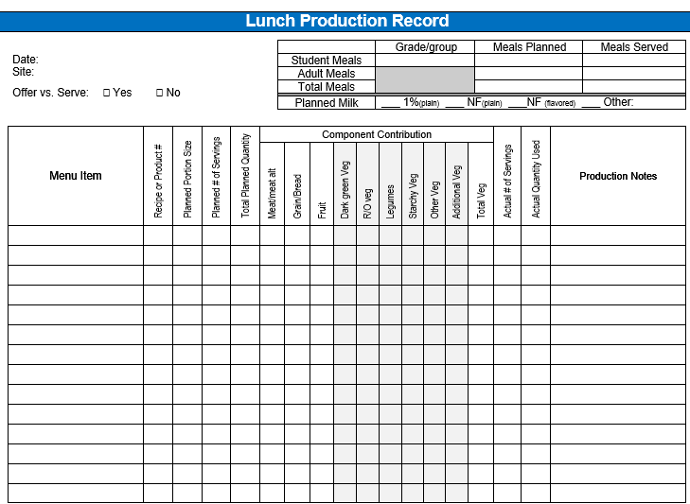
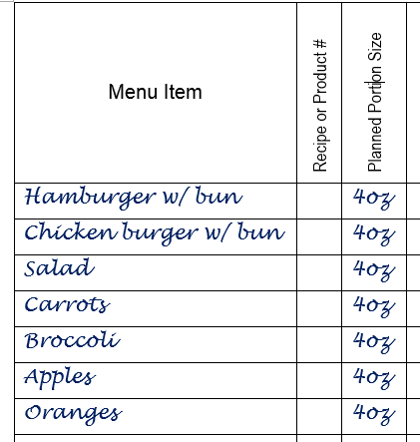
Production Records
Notes:
Planned portion sizes should match products / recipes (for entrées / grains) and measures i.e. cups for fruits and vegetables.

Slide 67
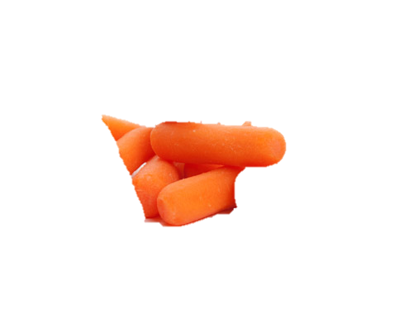
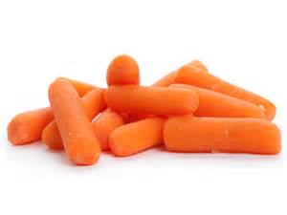
Production Records
Weight
≠
Measure
4 oz
=
> ¾ cup
Notes:
4 oz does NOT mean ½ cup!!
Someone might envision that this is what 4 oz of carrots looks like.
CLICK
But the reality is 4 oz of carrots equals more than ¾ cup!

Slide 68
Production Records
Weight
≠
Measure
4 oz
=
⅞ cup
Notes:
4 oz does NOT mean ½ cup!!
Someone might envision that this is what 4 oz of celery looks like.
CLICK
But the reality is 4 oz of celery equals more than 7/8 cup!

Slide 69
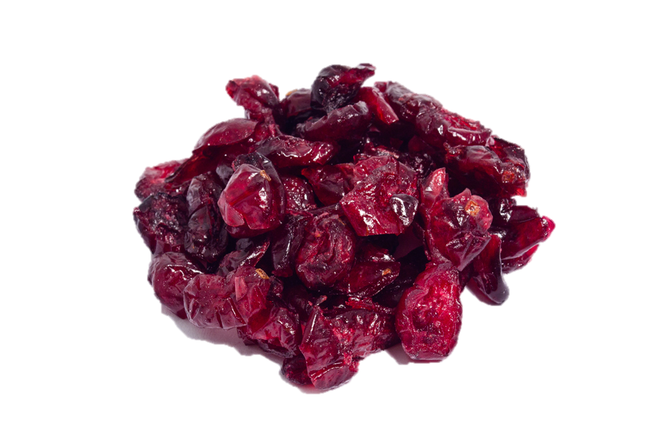
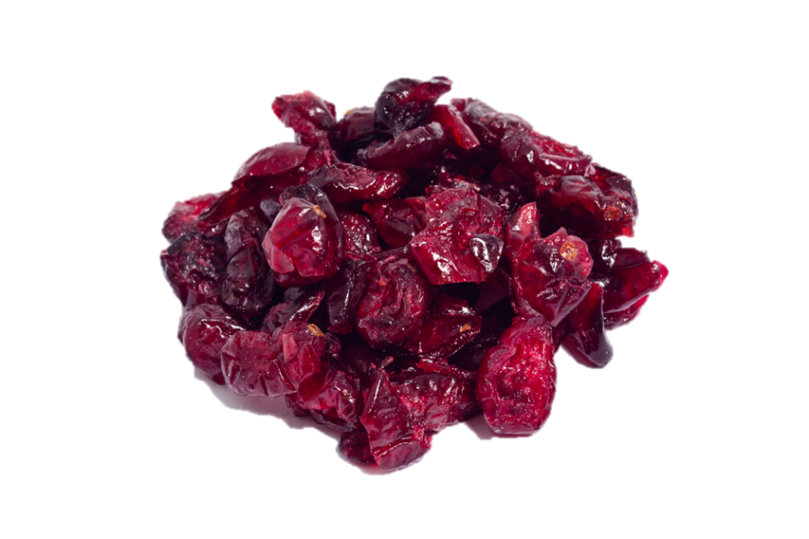
Production Records
Weight
≠
Measure
4 oz
=
⅞ cup
Notes:
4 oz does NOT mean ½ cup!!
Someone might envision that this is what 4 oz of dried cranberries looks like.
CLICK
But the reality is 4 oz of dried cranberries equals more than 7/8 cup!
Think about how that difference would affect your dietary specifications!

Slide 70
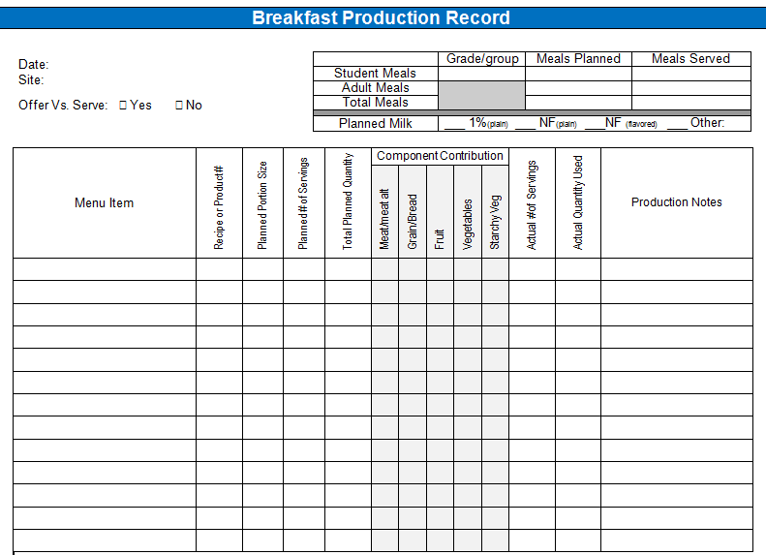
Verifying Meal Pattern
Production Records
Notes:
Activity: menu + production record
Samples of production records can be found at:
http://www.k12.wa.us/ChildNutrition/Programs/NSLBP/NewMealPatterns.aspx

Slide 71
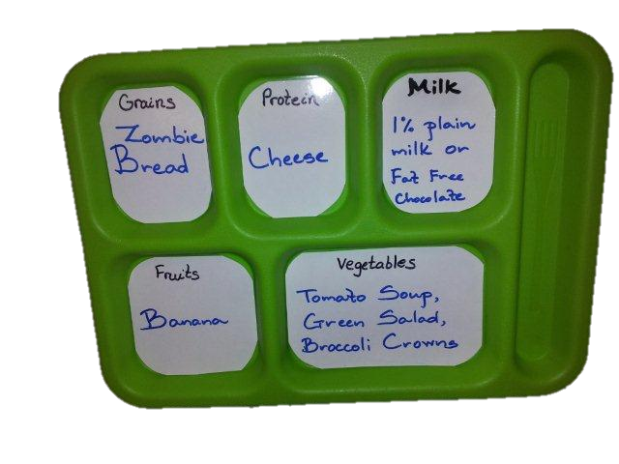
Identify Reimbursable Meal
“ Schools must identify near or at the beginning of the serving line(s) the food items that constitute the unit priced reimbursable meal”
Schools have discretion on how to identify these foods
Notes:
A quick reminder that ID of a reimbursable meal is also required at breakfast.
Resources are available at: http://www.k12.wa.us/ChildNutrition/Programs/NSLBP/NewMealPatterns.aspx

Slide 72
Offer vs Serve
Breakfast
and
Lunch

Slide 73
Offer vs Serve
Lunch
Offer vs. Serve in NSLP
-Required for senior high schools
-Optional for lower grades
-Student’s option to decline item(s)
-Same price if child declines item(s)
-Full amount of each component must be available to choose
Notes:
•OVS is required for senior high schools (9 – 12) and is optional for lower grades.
•The option to decline items remains with the child - although must take at least ½ cup of fruit or vegetable which we’ll discuss later.
•Meal is still priced as a unit and the price is the same whether the child takes the full reimbursable meal or declines one or two items.
•Full amount of each component must be made available to choose.
•And students are always encouraged to not only take the full planned serving for the fruit and vegetable components but for all components as only the full meal provides the nutritional benefits needed for each grade grouping of students.

Slide 74
Offer vs Serve
Lunch
What’s required in OVS?
- Must take at least 3 of 5 components
- Must take at least ½ cup serving of the fruit OR vegetable component
Notes:
First we will look at OVS at LUNCH:
•Under OVS at lunch students are required to select 3 of 5 components. One selection must be ½ cup of fruit or vegetables.
•In order for the fruit or vegetable component to be credited under OVS, the student must take at least ½ cup serving of the fruit or vegetable component. This smaller portion size is only credited under OVS as meeting the fruit or vegetable component. Students must select the full serving of all other food components.

Slide 75
Offer vs Serve
Lunch
The ½ cup minimum serving from the fruit or vegetable component may be:
A mix of different fruits
A mix of different vegetables
A mix of fruits and vegetables
Notes:
Although fruits and vegetables are separate components in the meal patterns, the OVS requirement to select at least ½ cup of fruits or vegetables may be
-a mix of different fruits
- a mix of different vegetables
-a mix of fruits and vegetables

Slide 76
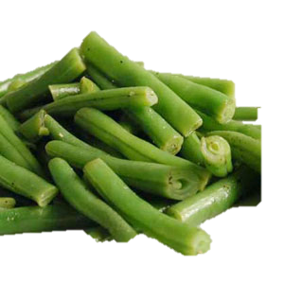
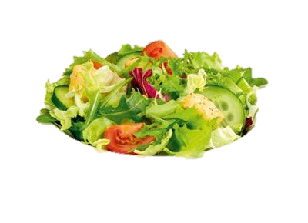
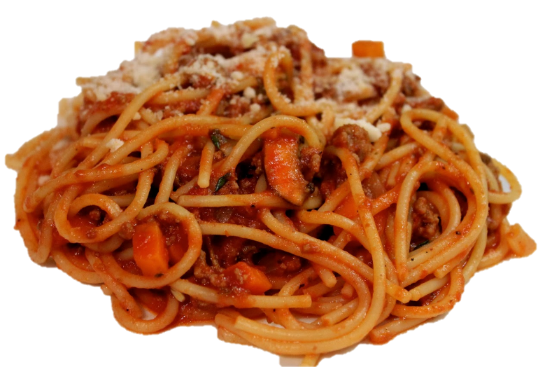
Offer vs Serve - Lunch
1 cup fruit
½ cup Veg.
1 cup milk
½ cup Veg.
2 M/MA + 2 Grain
Notes:
Here is our planned meal: Spaghetti w/meat sauce), ½ fresh green beans, 1 cup mixed salad (that credits as what??? ½ cup), 1 cup fresh grapes and milk.
For this tray:
-How many components: 5
-Is there a minimum of ½ cup fruit or vegetable? Yes
-Is this tray reimbursable: Yes

Slide 77
Offer vs Serve - Lunch
Notes:
The student declines the salad
For this tray:
-How many components: 5
-Is there a minimum of ½ cup fruit or vegetable? Yes
-Is this tray reimbursable: Yes

Slide 78
Offer vs Serve - Lunch
Notes:
For this tray:
-How many components: 4
-Is there a minimum of ½ cup fruit or vegetable? Yes
-Is this tray reimbursable: Yes

Slide 79
Offer vs Serve - Lunch
Notes:
For this tray:
-How many components: 3
-Is there a minimum of ½ cup fruit or vegetable? Yes
-Is this tray reimbursable: Yes

Slide 80
Offer vs Serve - Lunch
Notes:
For this tray:
-How many components: 3
-Is there a minimum of ½ cup fruit or vegetable? Yes
-Is this tray reimbursable: Yes
(This tray is OK because there is a full component of fruit)

Slide 81
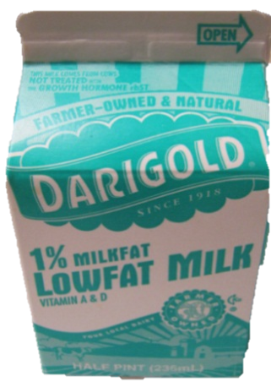
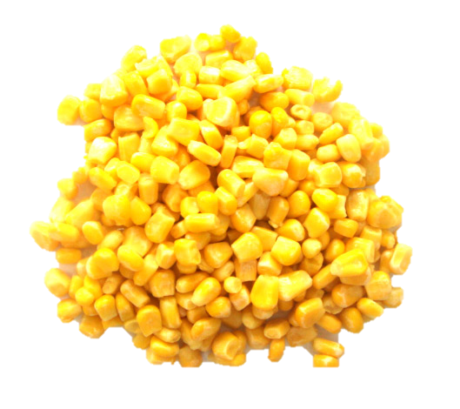
Offer vs Serve - Lunch
1 cup fruit
½ cup Veg.
1 cup milk
½ cup Veg.
2 M/MA + 2 Grain
Notes:
The planned meal for the day : a beef and bean burrito, ½ c corn, ½ cup of broccoli florets, 1 cup of watermelon, and milk.
How many components: 5
-Is there a minimum of ½ cup fruit or vegetable? YES
-Is this tray reimbursable: YES

Slide 82
Offer vs Serve - Lunch
Notes:
How many components: 3
-Is there a minimum of ½ cup fruit or vegetable? YES
-Is this tray reimbursable: YES

Slide 83
Offer vs Serve - Lunch
Notes:
How many components: 3
-Is there a minimum of ½ cup fruit or vegetable? No
-Is this tray reimbursable: No

Slide 84
Offer vs Serve - Lunch
Notes:
How many components: 3
-Is there a minimum of ½ cup fruit or vegetable? YES
-Is this tray reimbursable: YES

Slide 85
Offer vs Serve - Lunch
Notes:
How many components: 2
-Is there a minimum of ½ cup fruit or vegetable? YES
-Is this tray reimbursable: No (not enough components)

Slide 86
Offer vs Serve - Breakfast
Offer vs Serve is optional at Breakfast for all grade groups
OVS works differently at Breakfast than it does at Lunch
Notes:
Offer vs Serve is optional at Breakfast for all grade groups
OVS works differently at Breakfast than it does at Lunch…

Slide 87
Offer vs Serve - Breakfast
Important Meal Pattern Reminders that affect OVS
Fruit component is 1 cup... 1 cup = 1 item
Meat/ Meat Alternates (M/MA) can substitute as a Grain OR count as an Extra
Vegetables can substitute as a Fruit OR count as an extra
(Extra = Not counted as a component or item)
Notes:
READ SLIDE.

Slide 88
Offer vs Serve - Breakfast
Must offer / menu at least 4 food items
Student must select at least 3 food items
Student must take at least ½ cup fruit (and/or vegetable)
Items selected: -Must be in the required minimum servings.

Slide 89
Offer vs Serve - Breakfast
The ½ cup minimum serving of fruit may be:
A mix of different fruits
A mix of fruits and vegetables
Minimum creditable amount is ⅛ c.

Slide 90
Offer vs Serve - Breakfast
Component
One of three food groups that comprise a reimbursable breakfast
(grains or meat/meat alternate; fruit or vegetable; milk)
Item
A specific food offered within the three food components.
Notes:
For breakfast OVS it important to understand the difference between a component and an item:

Slide 91
Offer vs Serve
Counting Items
The Menu Planner Decides how to count the items!
1 Item

Slide 92
Offer vs Serve
Counting Items
1 Item
1 oz grain eq
Notes:
For some items – it is pretty simple to determine how many items it represents.
For example:
This 1 oz grain equivalent piece of toast = 1 item

Slide 93
Offer vs Serve
Counting Items
2 Items
1 oz grain eq
1 oz grain eq
Notes:
Two items can count as 2 items; 2 slices of toast is an example of this.

Slide 94
Offer vs Serve
Counting Items
OR
2 Items
1 Item
2 oz grain eq
2 oz grain eq
Notes:
Large items can count as 1 or 2 items.
Here is a 2 oz eq muffin as an example.
This muffin can count as 1 OR 2 items.
It is up to the menu planner!

Slide 95
Offer vs Serve
Counting Items
2 Items
1 Item
OR
2 Items
1 oz grain eq + 1 oz M/MA = 2 oz grain eq
1 oz grain eq + 1 oz M/MA = 1 oz grain eq
Notes:
Mixed dish entrees item count depends on if you count the M/MA as a grain or as an extra.

Slide 96
Offer vs Serve
Counting Items
4 Items
2 Items
OR
2 oz grain eq + 2 oz M/MA = 4 oz eq
2 oz grain eq +
2 oz M/MA (extra) = 2 oz eq
2 oz M/MA: Egg=1 oz eq; Cheese=.5 oz eq; Sausage=.5 oz eq
Notes:
Mixed dish entrees item count depends on if you count the M/MA as a grain or as an extra.

Slide 97
Offer vs Serve – Breakfast
1 oz Grain
½ cup Fruit
1 oz Grain
1 cup milk
½ cup Fruit
1 oz Grain
Notes:
Here is our planned menu with 1 cup of milk, 1 oz eq of cereal, 1 oz eq of toast and ½ cup of fruit and ½ cup of fruit juice

Slide 98
Offer vs Serve – Breakfast
Notes:
How many items on this tray? 3 items
-Is there a minimum of ½ cup fruit or vegetable? No
-Is this tray reimbursable? NO

Slide 99
Offer vs Serve – Breakfast
Notes:
How many items on this tray? 3 items
-Is there a minimum of ½ cup fruit or vegetable? YES
-Is this tray reimbursable? Yes

Slide 100
Offer vs Serve – Breakfast
Notes:
How many items on this tray? 3 items
-Is there a minimum of ½ cup fruit or vegetable? No
-Is this tray reimbursable? No

Slide 101
Offer vs Serve – Breakfast
Notes:
How many items on this tray? 3 items
-Is there a minimum of ½ cup fruit or vegetable? YES
-Is this tray reimbursable? Yes

Slide 102
Offer vs Serve – Breakfast
½ cup fruit
½ cup fruit
1 cup milk
1 oz Grain
1 oz M/MA= 1 oz Grain
Notes:
Let’s look at several trays where we count the M/MA (yogurt) counted as a grain
So the planned menu is 1 cup of milk, a carton of yogurt that counts as a 1 oz grain, a mini bagel that is 1oz eq of grain, ½ cup of fruit, and ½ cup juice:
The yogurt that is 1 oz equivalent of M/MA is an counted as a grain

Slide 103
Offer vs Serve – Breakfast
Notes:
How many items on this tray? 3 items
-Is there a minimum of ½ cup fruit or vegetable? No
-Is this tray reimbursable? No

Slide 104
Offer vs Serve – Breakfast
Notes:
How many items on this tray? 3 items
-Is there a minimum of ½ cup fruit or vegetable? YES
-Is this tray reimbursable? Yes

Slide 105
Offer vs Serve – Breakfast
Notes:
How many items on this tray? 3 items
-Is there a minimum of ½ cup fruit or vegetable? YES
-Is this tray reimbursable? Yes

Slide 106
Offer vs Serve – Breakfast
Notes:
How many items on this tray? 2 items (a FULL cup of fruit/juice is considered an item)
-Is there a minimum of ½ cup fruit or vegetable? YES
-Is this tray reimbursable? No (not enough items)

Slide 107
Offer vs Serve – Breakfast
Notes:
How many items on this tray? 3 items (2 x ½ cup oranges = 1 item and 2 x ½ cup juice= 1 item)
-Is there a minimum of ½ cup fruit or vegetable? YES
-Is this tray reimbursable? Yes

Slide 108
Offer vs Serve – Breakfast
½ cup Fruit
1 cup milk
2 oz G + 2 oz M/MA =2 G
½ cup Fruit
Notes:
The breakfast sandwich can count as
4 ITEMS: Count both grains oz eq AND count the 2 oz M/MA as grains
2 ITEMS: Count both grains oz eq and count the 2oz M/MA as EXTRA
1 ITEM: Count the 2oz grains as 1 item and count the 2oz M/MA as EXTRA
The planned menu is 1 cup of milk, a breakfast sandwich that is 2oz eq of grain and 2 oz equivalent of M/MA that we are counting as 2 items and ½ cup of juice and ½ cup of fruit

Slide 109
Offer vs Serve – Breakfast
Notes:
How many items on this tray? 3 items
-Is there a minimum of ½ cup fruit or vegetable? No
-Is this tray reimbursable? No

Slide 110
Offer vs Serve – SY 2014-15
Notes:
How many items on this tray? 3 items
-Is there a minimum of ½ cup fruit or vegetable? YES
-Is this tray reimbursable? Yes

Slide 111
Offer vs Serve – SY 2014-15
Notes:
How many items on this tray? 2 items (a FULL cup of fruit/juice is considered an item)
-Is there a minimum of ½ cup fruit or vegetable? YES
-Is this tray reimbursable? No (not enough items)

Slide 112
Offer vs Serve
Counting Items
The Menu Planner Decides how to count the items!
Consider making all planned menus contain the same # of items!
Notes:
You can see how there is the potential for it to be confusing for students and cashiers alike…
Remember – the menu planner decides how to count the items!
Consider how you can make all of your entrees contain the same # of items.

Slide 113
1
2
Each of these planned menus CAN count as 4 ITEMS!
3
4
Notes:
Here is an example where we put together 4 different menus that can all be counted as 4 items.
Tray 1: (1 cup milk; ½ cup juice, ½ cup fruit; entrée with a 2 oz grain eq and 2 oz eq M/MA entrée)
Can count as:4 items (Grain and M/MA combination is counted as 2 items
4 items (M/MA is counted as an extra)
6 items (M/MA is counted as grains)
Tray 2: (1 cup milk; ½ cup juice, ½ cup fruit; entrée with 1oz grain eq and 1oz eq M/MA)
Can count as: 4 items (Grain and M/MA combination is counted as 2 items;
4 items (M/MA is counted as a grain)
Tray 3: (1 cup milk; ½ cup juice, ½ cup fruit; 1 oz grain and 1 oz grain)
4 items
Tray 4: (1 cup milk; ½ cup juice, ½ cup fruit; 2 oz grain eq and 2 oz eq M/MA)
Can count as: 4 items (2 oz Grain is counted as 1 item and M/MA is counted as a grain)
4 items (M/MA is counted as an extra)
4 items (2 oz grain is counted as 1 item and M/MA is counted as a grain)
5 items (2 oz grain is counted as 2 items and M/MA is counted as a grain)
How can you set up your menu to help students and staff identify what and how much they need to take?

Slide 114
Resources
Notes:
USDA continues to develop and update resources.
See all they have to offer at: http://www.fns.usda.gov/tn/team-nutrition

Slide 115
Competitive Foods Smart Snacks
“Nutrition Standards for all Foods Sold in School”
Part of the Healthy Hungry Free Kids Act
Effective July 1, 2014
Notes:
On June 28, 2013, the United States Department of Agriculture (USDA) released the Interim rule: Nutrition Standards for all Foods Sold in School.
This interim rule was released after USDA reviewed the nearly 250,000 comments they received from the proposed rule.
These are MINIMUM requirements. Districts that have stronger standards than what is being proposed will be able to maintain their own policies.
Requirements take effect July 1st 2014 (USDA encourages informal input during implementation)
Find OSPI Smart Snack Resources at: http://www.k12.wa.us/ChildNutrition/Programs/NSLBP/ProgramApp.aspx
Find USDA Smart Snack Resources at: http://www.fns.usda.gov/school-meals/smart-snacks-school

Slide 116
Smart Snacks in Schools
Improving the nutrition of ALL foods sold in school is critical to:
Improve the diet and overall health of all children
Ensure children from all income levels adopt healthy eating habits that will enable them to live productive lives
Help children make healthier choices and reduce their risk of obesity

Slide 117
Smart Snacks in Schools
How has the Smart Snacks rule been communicated?
Joint letter from USDA and Department of Education
OSPI CNS communication to Superintendents and Principals
Washington Association of School Business Officials conference
WASBO Small School Business manager committee

Slide 118
Smart Snacks in Schools
How has the Smart Snacks rule been communicated?
Action for Healthy Kids Training
Career and Technical Education Conference
Washington School Marketing Advisors
Washington Educators Conference
FBLA and DECCA Marketing Conference

Slide 119
Smart Snacks
What foods does this rule apply to?
All food/beverage sold “outside School Meals Programs”
Entire “School Campus”
During the School Day
Notes:
The rule will set minimum standards for all foods sold outside school meal programs; on school campus; and at any time during the school day. Let’s look a little close at how the USDA defined these.
Outside school meal programs is defined as foods sold a la carte, in school stores, snack bars and vending machines. (Take a minute What areas that will need to be considered for your district? )
Entire School Campus ( School Campus is defined as all areas of the property under the jurisdiction of the school that are accessible to students during the school day.)
During the School Day (At any time during the school day is the period from midnight before to 30 minutes after the end of the official school day. Because it is based on the each schools “school day” – there will be variances between districts and perhaps even between schools within the district.)
These 3 requirements will really help you answer many questions about the smart snacks rule…let’s try it with some of the questions we have been receiving about Smart Snacks

Slide 120
Smart Snacks
What foods does this rule apply to?
Do the Smart Snacks rules apply to foods and beverages given to students as rewards?
Notes:
Do the Smart Snacks rules apply to foods and beverages given to students as a reward? For example a pizza party for reaching reading goals or a root beer float party for doing well on a test?
Is it sold out side the School Meals program – NO…
So our answer is NO – food and beverages that are not sold do not fall under the Smart Snack rule

Slide 121
Smart Snacks
What foods does this rule apply to?
Do the Smart Snacks rules apply to foods and beverages sold in the staff break room?
Notes:
Do the Smart Snacks rules apply to foods and beverages sold in the staff break room?
Again, lets review our three points to check if the smart snacks rule applies to this situation
Is it sold out side the School Meals program – Yes…
Is it sold on the school campus – yes…technically it does – but the question we need to ask – is do students have access? If the answer is Yes – students can come and go as they please in the staff break room then Yes, the smart snack rules apply.
If the answer is NO, the students do not have access to this room – and the items sold there – then No the smart snack rules would not apply.

Slide 122
Smart Snacks
What foods does this rule apply to?
Do the Smart Snacks rules apply to foods and beverages sold in concession stands at Sporting Events?
Notes:
Do the Smart Snacks rules apply to foods and beverages sold in concession stands at Sporting Events?
Lets review our three points to check if the smart snacks rule applies to this situation
Is it sold out side the School Meals program – yes…so it applies for this one
Is it sold on the school campus – yes…so it applies for this one
Is it sold during the school day - ..if the sporting events is held later than one half hour after the school day then the smart snacks rule would NOT apply –so our answer is NO – the smart snack rules do not apply to foods and beverages sold in concession stands IF it is held at least ½ hour AFTER the end of the school day

Slide 123
Smart Snacks
What foods does this rule apply to?
Do the Smart Snacks rules apply to foods and beverages sold as fundraisers?
Notes:
Do the Smart Snacks rules apply to foods and beverages being sold as a Fundraisier, say cookie dough or a bake sale
Again, lets review our three points to check if the smart snacks rule applies to this situation
Is it sold out side the School Meals program – Yes – these items are being SOLD so the smart snacks rules would apply…
Is it sold on the school campus? And 3)Is it sold during the school day –
These take a little more looking into -
The cookie dough is not intended for consumption on the school campus or during the school day. Students may be returning order forms and picking up the cookie dough – but (hopefully ) not actually eating the cookie dough
So NO in this example – the smart snack rules do not apply.
For the bake sale it all depends on if the sale is held during the school day on campus
Yes and the smart snack rules apply
No and the smart snack rules do NOT apply
Lets talk a little more about Fundraisers

Slide 124
Smart Snacks - Fundraisers
No restrictions on food items that meet the competitive foods standards
Standards do not apply to non-school hours
No State exemption for fundraisers at this time
Notes:
No restrictions on food items that meet the competitive foods standards
Standards do not apply to non-school hours
Special Exemption for “infrequent” fundraisers – “State agencies may determine the frequency with which fundraising activities take place that allow the sale of food and beverage items that do not meet the nutrition standards.” Washington State has not set a policy at this point – therefore there are no fundraiser examptions.

Slide 125
Smart Snacks
Standards for Foods
Applies to All Grade Levels
Includes General AND Specific Nutrient Standards
Provides exemptions for some Specific Foods
Meet GENERAL standards
Meet NUTRIENT standards
May be sold as a competitive food
Notes:
Standards for Foods
Apply to All Grade Levels
Include General Standards AND Specific Nutrient Standards
Provide exemptions to Nutrient Standards for Specific Foods
Allow broader exemptions for fruits and vegetable and some SNLP/SBP foods

Slide 126
Smart Snacks
Notes:
Take out Smart Snacks Reference Sheet
There are a couple of tools that I would like to introduce you to today.
The first is a reference sheet that helps walk us thru how an item qualifies as a smart snack.
The nutrient standards are quite technical and I will show you a helpful tool for that step a little later.
So let’s try our hand at evaluate some items to see if they qualify as a Smart Snack

Slide 127
Smart Snacks
Notes:
How about this apple?
Remember, we want to first evaluate those very first criteria… they are listed in the very first sentence of your Smart Snack Reference Sheet..
Is the item “sold on school campus, during the school day”
Let’s imagine our student store would like to sell apples.
Let’s start with Step 1….Does the item meet one of the following exemptions (refer to reference sheet)
YES So this item meets the Smart Snack Standards and may be sold – there is no need to evaluate further

Slide 128
Smart Snacks
Smart Snacks
Notes:
How about this pizza?
Remember, we want to first evaluate those very first criteria… they are listed in the very first sentence of your Smart Snack Reference Sheet..
Let’s imagine that this is Little Cesar Pizza that the school student store would like to sell.
Let’s start with Step 1….Does the item meet one of the following exemptions (refer to reference sheet)
No.. So we must move on to Step 2
Step 2… Does the Pizza meet ONE of the general standards? (refer to reference sheet)
If No to all of these…NO item does not meet / can not be sold
If YES to at least one of these…then we would need to continue on to step 3.. We are going to go in to the details of Step 3 in a bit. For right now lets just know that for the student store to sell pizza it would have to first meet the general standards and then the nutrient standards

Slide 129
Smart Snacks
Smart Snacks
Notes:
How about this pizza? Now this pizza was sold as part of a reimbursable meal in the NSLP the day before.
Let’s start with Step 1…. Note the 4th bullet (refer to reference sheet)
IF bullet 4 applies - Can be sold anywhere in the school.
Remember it must be the same pizza (same brand, type, size, etc)

Slide 130
Smart Snacks
Notes:
How about Cup of Noodles?
Remember, we want to first evaluate those very first criteria… they are listed in the very first sentence of your Smart Snack Reference Sheet..
Is the item “sold on school campus, during the school day”
Let’s imagine that this school student store would like to sell this item.
Let’s start with Step 1….Does the item meet one of the following exemptions (refer to reference sheet)
No.. So we must move on to Step 2
Step 2… Does the cup of noodles meet ONE of the general standards? (refer to reference sheet)
If No to all of these…NO item does not meet / can not be sold

Slide 131
Smart Snacks
Notes:
What about a whole wheat bagel?
Before we evaluate …let’s talk about an important note that we have not yet covered.
Items must be evaluated as sold.
This means that if we sell a whole wheat bagel with cream cheese.
Regulations tell us that items must be evaluated “per portion, as packaged” and that “accompaniments such as cream cheese, salad dressing and butter must be included in the nutrient profile as part of the food item sold.
So let’s move thru our steps
Is the item “sold on school campus, during the school day”
Let’s start with Step 1….Does the item meet one of the following exemptions (refer to reference sheet)
No.. So we must move on to Step 2
Step 2… Does the bagel meet ONE of the general standards? (refer to reference sheet)
Lets imagine that this is a whole wheat bagel, with whole wheat being listed first on the ingredient statement. YES it meets this step so now we would need to continue on to step 3..
We are going to wait for the details of Step 3 but let’s remember that when we evaluate the nutrient standards we will need to evaluate the combine nutrient standards of bagel AND the cream cheese

Slide 132
Smart Snacks
Ingredients: Pears from Concentrate, Sugar, Maltodextrin, Corn Syrup, Partially Hydrogenated Cottonseed Oil, Contains 2% or less of Carrageenan, Citric Acid, Acetylated Monoglycerides, Sodium Citrate, Malic Acid, Xanthan Gum, Locust Bean Gun, Vitamin C, Potassium Citrate, Natural Flavor, Color yellow 5, red 40, blue 1)
Notes:
Step 1: does not meet exemptions…must move to next step
Step 2: Does it meet any of the General
But we see in the notes that juice from concentrate or puree does NOT meet the standards…so does not meet the standards and no need to evaluate further

Slide 133
Smart Snacks
Ingredients: Fruit juice blend from concentrate, Corn syrup, Sugar, Modified Corn Starch Contains 2% or less of Fruit Pectin, Citric Acid, Vitamin C, Dextrose, Sodium Citrate, Vegetable and Fruit juice added for color, Malic Acid, Potassium citrate, Mineral oil, Natural Flavor, Camauba Wax, Beeswax)
Notes:
How about these fruit snacks – the package says it is made from real fruit and vegetable juice?
Step 1: does not meet exemptions…must move to next step
Step 2: Does it meet any of the General
But we see in the notes that juice from concentrate or puree does NOT meet the standards…so does not meet the standards and no need to evaluate further

Slide 134
Smart Snacks
Nutrition Facts
Serving Size 1 oz (28 g)
Amount Per Serving
Calories |  | 130
Calories from fat |  | 45
 | % Daily Value*
Total Fat 5g |  |  |  | 8%
Saturated Fat 1g |  |  |  | 4%
Trans Fat 0 g
Cholesterol 0 mg |  |  |  | 0%
Sodium 220 mg |  |  |  | 9%
Total Carbohydrates |  |  | 6%
Dietary Fiber 3g |  |  |  | 13%
Sugars less than 1 mg
Protein 3g
Notes:
Step 1: does not meet exemptions…must move to next step
Step 2: YES… in Smart Snacks…popcorn is considered a whole grain.
So we can move on to step 3..
First standard. Is calories – this is snack – so is it less than 200 calories? YES
Sodium

Slide 135
Smart Snacks
Nutrition Facts
Serving Size 1 oz (28 g)
Amount Per Serving
Calories |  | 130
Calories from fat |  | 45
 | % Daily Value*
Total Fat 5g |  |  |  | 8%
Saturated Fat 1g |  |  |  | 4%
Trans Fat 0 g
Cholesterol 0 mg |  |  |  | 0%
Sodium 220 mg |  |  |  | 9%
Total Carbohydrates |  |  | 6%
Dietary Fiber 3g |  |  |  | 13%
Sugars less than 1 mg
Protein 3g
 | Entree | Snack
Calories | ≤ 350 | ≤ 200
Sodium | ≤ 480 | ≤ 230
Total Fat | ≤ 35% of calories
Saturated Fat | < 10% of calories
Trans Fat | 0 grams
Sugar | ≤ 35% (of weight from total sugars)
Notes:
First standard.
Calories – this is a snack or entree – so is it less than 200 calories? YES
Sodium – is it less than 230? YES
Lets skip down and look at Total Fat / Saturated Fat and Sugar…we need to do a little figuring

Slide 136
Smart Snacks
To calculate the percentage calories from fat (choose either method – each method may provide slightly different results)
 | OR
34.6%
Nutrition Facts
Serving Size 1 oz (28 g)
Amount Per Serving
Calories |  | 130
Calories from fat |  | 45
 | % Daily Value*
Total Fat 5g |  |  |  | 8%
Saturated Fat 1g |  |  |  | 4%
Trans Fat 0 g
Cholesterol 0 mg |  |  |  | 0%
Sodium 220 mg |  |  |  | 9%
Total Carbohydrates |  |  | 6%
Dietary Fiber 3g |  |  |  | 13%
Sugars less than 1 mg
Protein 3g
Notes:
For Calories from Fat we can figure it two ways
One way is to use the “calories from fat”
You will find the equation on your Reference sheet…which is to divide the calories from fat and then multiply by 100.
We get 34.6%

Slide 137
Smart Snacks
To calculate the percentage calories from fat (choose either method – each method may provide slightly different results)
 | OR
34.6%
Nutrition Facts
Serving Size 1 oz (28 g)
Amount Per Serving
Calories |  | 130
Calories from fat |  | 45
 | % Daily Value*
Total Fat 5g |  |  |  | 8%
Saturated Fat 1g |  |  |  | 4%
Trans Fat 0 g
Cholesterol 0 mg |  |  |  | 0%
Sodium 220 mg |  |  |  | 9%
Total Carbohydrates |  |  | 6%
Dietary Fiber 3g |  |  |  | 13%
Sugars less than 1 mg
Protein 3g
Notes:
For Calories from Fat we can figure it two ways
Another way is to use the “calories from fat”
You will find the equation on your Reference sheet…which is to multiply the total fat grams by 9 then divide by total calories and then multiply by 100.
We get the same answer of 34.6% (occasionally you will get slight different figures – either is acceptable to use.)

Slide 138
Smart Snacks
Nutrition Facts
Serving Size 1 oz (28 g)
Amount Per Serving
Calories |  | 130
Calories from fat |  | 45
 | % Daily Value*
Total Fat 5g |  |  |  | 8%
Saturated Fat 1g |  |  |  | 4%
Trans Fat 0 g
Cholesterol 0 mg |  |  |  | 0%
Sodium 220 mg |  |  |  | 9%
Total Carbohydrates |  |  | 6%
Dietary Fiber 3g |  |  |  | 13%
Sugars less than 1 mg
Protein 3g
6.9%
To calculate the percentage of calories from Saturated Fat
Notes:
For Calories from saturated fat
You use find the equation on your Reference sheet…which is to multiply the saturated fat grams by 9 then divide by total calories and then multiply by 100.
We get the 6.9% which meets the standard.
We see that sugars are less than 1 mg – so This snack meets the Smart Snack Standards and can be sold!

Slide 139
Smart Snacks - Beverages
Standards for Beverages
Varies by Grade Level
Identifies specific types of beverages
Based on size
Notes:
Vary by Grade Level
Identify Specific Types of Beverages
Address Container Size

Slide 140
Smart Snacks - Beverages
Ingredients: Pure fruit juice from grape, apple, orange acerola and lemon juice concentrate, sparkling water, natural flavors, natural colors, vitamin C, calcium, vitamin D.
Nutrition Facts
Serving Size 8 fl oz
Amount Per Serving
Calories |  | 95
 | % Daily Value*
Total Fat 0g |  |  | 0%
Sodium 17 mg |  |  | 1%
Total Carbohydrates 24 |  |  | 8%
Sugars 23g |  |  | 23%
Protein 3g
Notes:
This item qualifies

Slide 141
Smart Snacks - Beverages
Nutrition Facts
Serving Size 16 fl oz
Amount Per Serving
Calories |  | 190
 | % Daily Value*
Total Fat 0g |  |  | 0%
Sodium 15 mg |  |  | 1%
Total Carbohydrates 46 |  |  | 15%
Sugars 45g
Protein 0g
ingredients:
FILTERED WATER, SUGAR, KIWI JUICE CONCENTRATE, CITRIC ACID, STRAWBERRY JUICE CONCENTRATE, NATURAL FLAVORS, ACACIA GUM, VEGETABLE JUICE CONCENTRATE (FOR COLOR), ESTER GUM
Notes:
Does not qualify

Slide 142
Smart Snacks - Beverages
Nutrition Facts
Serving Size 20 fl oz
Amount Per Serving
Calories |  | 62.
 | % Daily Value*
Total Fat 0g |  |  | 0%
Sodium mg |  |  | 1%
Total Carbohydrates 46 |  |  | 15%
Sugars 45g
Protein 0g
Notes:
Does not qualify (in this size container)

Slide 143
Smart Snacks - Beverages
Nutrition Facts
Serving Size 20 fl oz
Amount Per Serving
Calories |  | 0
 | % Daily Value*
Total Fat 0g |  |  | 0%
Sodium 15 mg |  |  | 1%
Total Carbohydrates 46 |  |  | 15%
Sugars 45g
Protein 0g
Notes:
Qualifies – you can choose to not allow at a district level – address in wellness policy.

Slide 144
Smart Snacks
Evaluate Products
Notes:
Alliance for a Healthier Generation has a “Smart Snack” Calculator that can help you evaluate products. It has been approved by USDA.
You can find a link to the calculator an the OPSI CNS web page: http://www.k12.wa.us/ChildNutrition/Programs/NSLBP/ProgramApp.aspx

Slide 145
Smart Snacks
What do we do?
Involve / collaborate with ALL
Review policies
Notes:
There are some steps you can take now:
Bring the proposed rule to the attention of all that may be potentially affected, this may include:
-Administration, school board, wellness policy committee, student clubs and leaders, sports teams, facilities, etc.
Begin to review policies:
-open vs closed campus, where and when food is sold, who sells food, who is the governing person, wellness policy.
What other groups and policies can you think of?

Slide 146
Smart Snacks
What do we do?
Engage Students

Slide 147
Smart Snacks
What do we do?
Engage Students
Senior project
Decca clubs
Business classes
Clubs

Slide 148
Smart Snacks
What do we do?
Decca class project
Can you still make a profit selling “Smart Snacks” in place of “traditional” snack items?

Slide 149
Smart Snacks
What do we do?
Business class project
What promotional strategies work to influence students purchase choices

Slide 150
Smart Snacks
What do we do?
Senior project
Can the student store be redesigned to sell items that promote student health and wellness?

Slide 151
Smart Snacks What do we do?
Explore Healthy Fundraising Options
Activity based fundraisers
Events as fundraisers
School promotional items
Sell ad space
Notes:
Activity based fundraisers: walk-a- thons / fun runs / jump rope competitions / team sport tournaments
Events as fundraisers: talent show / craft fairs / art shows (feature student works)
School promotional items: water bottles / clothing articles / sports equipment
Sell ad space: local businesses advertisements in school newsletters or school newspapers

Slide 152
Notes:
Study published in the Journal of Public Health, conducted by the Cornell Center for Behavioral Economics in Child Nutrition Programs (B.E.N. Center).
Demonstrated that healthy choices could successfully be sold at concession stands.

Slide 153
Changes coming from OSPI-CN
Washington Integrated Nutrition System
(Replacement of Colyar/CNP2000 System)
-Will include: Program applications, claims, October building data, Verification Summary data
-Improve User Friendliness
-Projected Rollout: SY 2014-15

Slide 154
Thank you for your time!
Please fill out an evaluation

