Slide 1
Adaptive/Inclusive Technology and Digital Navigation Grants 2023/2024
KC Merchant Digital Equity & Inclusion Program Supervisor Ana Ketch
Digital Navigation Program Manager
Notes:
We’ve got the closed captions on but you can turn them off if you want to. We’re recording this meeting, but that’s mainly in case we have to go back and check something. We’re going to record a more concise version of this presentation to post on the OSPI YouTube site.
Please put questions in the Chat—if we can’t answer all of them today, there will be a Q&A on the website—we’ll share the link at the end.

Slide 2
Agenda
Introductions
Overview of grant programs
FP 280 Digital Navigation
FP 282 Adaptive/Inclusive Technology
How to apply
Other considerations
Q & A

Slide 3
Digital Navigation Grant (FP 280)
What is digital navigation?
Digital Navigation involves providing students and their families with the skills needed to navigate the online environment, including help with acquiring internet connectivity, and locating affordable devices. Supporting digital navigation can provide families with access to benefits such as affordable (or free) internet, access to email and school platforms, childcare, healthcare, and government programs that have moved online and require online skills.
Digital Navigator Model - National Digital Inclusion Alliance
Digital Navigator 101
Affordable Connectivity Program - National Verifier (getinternet.gov)

Slide 4
Digital Navigation Grant (FP 280)
Capacity and Sustainability
Legislation to "Develop district-based and school-based capacity to assist students and their families in accessing and using technology to support student learning."
1.1M available for state
This funding goal is to increase the capacity and sustainability of digital navigation for students and student’s families in school districts.

Slide 5
Digital Navigation Grant (FP 280)
Non-competitive:
List "Phases" of program.
Priority status given to rural/remote, districts with high percentages of FRP, and districts with high readiness to implement.
Applications available now until December 20, 2023

Slide 6
Digital Navigation (pg. 2)
What types of projects can be funded?
Create a student digital navigator program (individual or club) for student and family support, including staff oversight.
Provide support for staff and marketing for creating community asset inventories (identifying community organizations and resources) for digital navigation, connectivity, and acquisition of devices (and related equipment) for students and families.
Acquire resources to establish a student/family-accessible space.
Provide digital navigation nights/events at your district for students and families.
Others as applicable to your school or district.
I.e. positions, maybe some hardware: (printers/faxes/tablets/kiosks/interpretation devices) to engage the stakeholders in the program can be covered.

Slide 7
What the Digital Nav grant is not:
Not for classroom tech help
Not a device focused grant (however, if a device is needed for translation, or a kiosk to provide services, it would be an allowable expense)

Slide 8
What the Adaptive/Inclusive grant is not:
Aimed at Student/Individualized Classroom support –
Not at the same scope and scale as previous DEI program grants such as FP 188/186.
Not district or school site level scope.
Should be supporting students with specific needs.

Slide 9
Adaptive/Inclusive Tech Grant Overview (FP 282)
Adaptive Technologies: Devices that usually support one student being able to come to the table for equitable learning
Inclusive Technologies: Devices that allow multiple students to come to the table in various ways for equitable learning
$1.1 Million set aside with max awards of $25,000
Non-competitive, based on need, previous work establish by DEI grants, quality of grant, and clearly developed plan.

Slide 10
Sample Purchases
TTS software
Captioning and Translation services
Assistive Listening Systems
FM Systems (to support individual students)
Sip & Puff Systems (alternative device inputs)
Brail Printers/Embosser District Level
Site licenses for adaptive technology software
Communication Board license
Augmented reality tools
iPads for communication/adaptive use
Translator Pens
Adaptive switches, mounts, or adaptive hardware needed to support technology
Outside the box ideas such as 3D Printing to create adaptive tools

Slide 11
Sample PD
Supporting General Ed Teachers with the tools and skillsets to support inclusionary tools.
Ideally, GenEd teachers can support these inclusionary tools even when trained SpEd or paras are not available.
UDL workshops to foster support of these technologies and tools

Slide 12
How to apply
Not sure who in your district has access? Your District Security Manager should know (https://eds.ospi.k12.wa.us/SecurityManagerList.aspx)
You’ll need a fiscal agent: They will receive funds from OSPI & distribute them to people who are getting paid
You’ll need a lead partner: They will be the main point of contact with OSPI re: reports, etc.
Make sure contact info is up to date in EDS/iGrants
Notes:
Share link to District Security Manager List in chat: https://eds.ospi.k12.wa.us/SecurityManagerList.aspx

Slide 13
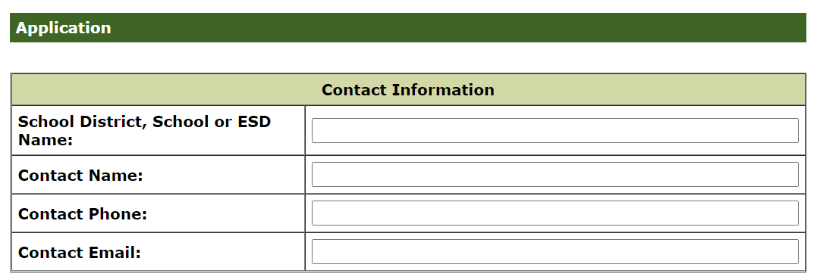
How to apply
Someone with access to iGrants has to log in to view and then fill out the application (https://eds.ospi.k12.wa.us/iGrants)
Form Packages: 280, 282
Notes:
Share link to iGrants in chat: https://eds.ospi.k12.wa.us/iGrants

Slide 14
How to apply
Be ready to submit:
Who else will be involved & what they will do
Implementation Plan document needed for FP 282 (What you have and where do you want to be?) Templates available in iGrants profile page.
Two types of budgets. Narrative and for fiscal withdrawal. Make sure both match. Make sure grant application explains everything on the budgets. (If it’s on the budget, make sure you’ve talked about it)

Slide 15
Who should apply?
Previously, DEI grants, assumed application would be from IT/EdTech departments, but these grants really should have Special Ed, Special Services, Family Services, or Migrant/ELL/Title IA liaison as lead, with support from IT instead.

Slide 16
Things to consider:
Grant requests are within the guidelines and scope of the grant.
A well thought out plan and showing collaboration with all stakeholders and other departments.
Questions are fully answered in all parts.
Feel free to contact us during your grant application process regarding any questions or for any input.
Review all state procurement guidelines and make sure you are in compliance for using state funds.
Grant funds can be spent from the award dated through June 30th, 2024.
Notes:
What are the obstacles preventing students from learning about media literacy or digital citizenship?

Slide 17
Q & A
Questions for us?

Slide 18
Contacts
Contacts:
Adaptive/Inclusive Technology Grant
KC Merchant, Program Supervisor kc.merchant@k12.wa.us
Ph: 360-918-4565
Digital Navigation Grant
Ana Ketch, Program Manager
ana.ketch@k12.wa.us
Ph: (564) 999-0503

