Slide 1
Presenter Instructions
Purpose: The purpose of these materials is to help schools train school employees about their civil rights obligations under state law.
Legal requirement: Under WAC 392-190-020, each school district and public charter school in Washington is required to provide training to all administrators and certificated and classroom personnel to ensure they are aware of the above-described obligations and to eliminate bias based on protected classes under Washington law.
Time needed for training: Approximately 30 minutes.
Intended audience: All school district and charter school administrators and all certificated and classroom staff.
Before you begin:
Carefully review the slides and presenter notes on each slide.
Insert requested information for your school or district, such as contact information for compliance coordinators or policy and procedure numbers. Areas that require school- or district-specific information are noted as follows: [red ink and yellow highlighted text].
Provide a copy of the slide deck and any referenced school or district policies or procedures to all participants.
Don’t forget to delete this slide before you deliver the training or provide the slide deck to participants!

Slide 2
Protecting Students from Discrimination and Eliminating Bias in Washington Public Schools
Prepared by OSPI’s Equity and Civil Rights Office
2024
These materials are for informational purposes only. They do not provide legal advice or establish an attorney-client relationship. Please contact an attorney for legal advice specific to the facts and circumstances of your individual situation.
Notes:
PRESENTER NOTES
This training module is called Protecting Students from Discrimination and Eliminating Bias in Washington Public Schools.

Slide 3
Topics Covered
This training is required under state law. It provides a basic introduction to:
Preventing & Recognizing Discrimination
Responding to Discrimination
Eliminating Bias
Notes:
PRESENTER NOTES
This required training provides a basic introduction to three key topics:
Preventing and recognizing discrimination.
Responding to discrimination
Eliminating bias
For more in-depth information on these and other civil rights topics, please review the resources listed at the end of the module.

Slide 4
Today’s Focus: Protecting Students
While federal and state laws also protect school employees from discrimination, today’s focus is on protecting students.
For more information about employment discrimination, including our LEA’s policies and procedures:
Nondiscrimination policy and complaint procedure: [Policy # | Procedure #]
Sex discrimination policy and complaint procedure: [Policy # | Procedure #]
Other agencies that focus on employment discrimination:
U.S. Equal Employment Opportunities Commission | www.eeoc.gov
Washington State Human Rights Commission | www.hum.wa.gov
Notes:
INSTRUCTIONS
Update slide with following employee policy and procedure numbers and delete the yellow highlighting.
You can also provide copies of the referenced policies and procedures to participants (as handouts), or you can insert links on the slide itself so that participants can easily access them.
PRESENTER NOTES
Even though state and federal nondiscrimination laws and complaint procedures also apply to school employees, today’s focus is on protecting students.
You can learn more about employment discrimination and complaint procedures by reviewing our nondiscrimination and sexual harassment policies and procedures for employees.
You can also reach out to an agency that specializes in employment discrimination investigations, such as the U.S. Equal Employment Opportunities Commission or the Washington State Human Rights Commission.

Slide 5
Preventing and Recognizing Discrimination
What is discrimination? What are some common forms of discrimination that are seen in schools? What is the difference between Harassment, Intimidation & Bullying (HIB) and discriminatory harassment? What is sexual harassment?
Notes:
PRESENTER NOTES
All school districts and charter schools must provide students with a learning environment that is free from discrimination.
As school employees, we all have a role to play in preventing discrimination. But, we can’t prevent discrimination unless we recognize what we are looking for.
This section will help us better understand the legal definitions of discrimination, discriminatory harassment, and sexual harassment and learn to distinguish between harassment, intimidation, and bullying (or HIB) and discriminatory harassment.
So, let’s get started.

Slide 6
Discrimination
Discrimination is the unfair or unequal treatment of a person or group because they are part of a protected class.
Notes:
PRESENTER NOTES
The first term we need to understand is discrimination, which is generally defined as the unfair or unequal treatment of a person or group because they are part of a protected class.
The key thing to remember here is this: There are probably many things that our students experience at school that may feel unfair or unequal. However, to meet the legal definition of discrimination, the unfair or unequal treatment has to be based on or motivated by protected class.

Slide 7
Protected classes in Washington are:
Race
Color
National origin
Religion
Creed
Sex
Sexual orientation
Gender identity
Gender expression
Disability
Use of a service animal
Veteran or military status
RCW 28A.642.010
Notes:
PRESENTER NOTES
So, what is a protected class?
A protected class is a group of people who share common characteristics and who are protected from discrimination under federal and state law.
In Washington, the following groups are protected classes under state law:
Race, color, and national origin;
Religion and creed;
Sex, sexual orientation; gender identity, and gender expression;
Disability and use of a trained service animal; and
Veteran or military service
ADDITIONAL BACKGROUND/CONTEXT (for presenter review only)
Additional Protected Classes (in some contexts)
In some contexts, local, state, and federal laws cover additional protected classes. For example:
Federal employment discrimination laws also prohibit discrimination based on genetic information.
The Washington Law Against Discrimination (RCW 49.60) additionally prohibits discrimination in employment on the basis of age (40+) and marital status.
Some city and county ordinances also include additional protected classes.
Some school districts and charter schools also include additional protected classes in their nondiscrimination policies and procedures.
Definitions (use if there are questions about what each protected class covers)
National origin: a person’s ethnicity, country of origin, or ancestry, which may include persons with limited English proficiency
Creed: Defined broadly and includes religion, observance, practice, and belief
Sex: Sex assigned at birth. Includes pregnant and parenting students.
Gender expression: A person’s external expression of their own gender (e.g., masculine, feminine, androgynous, both, neither, other, fluid). Gender expression could also refer to the manner in which a person represents or expresses gender to others, often through behavior, clothing, hairstyles, activities, voice, or mannerisms
Gender identity: A person’s internal sense of their own gender (e.g., male, female, both, neither, other, genderfluid)
Disability: The presence of a sensory, mental, or physical impairment that is medically cognizable or diagnosable; exists as a record or history; or is perceived to exist whether or not it exists in fact. This includes students covered under Section 504 of the Rehabilitation Act of 1973, the Individuals with Disabilities Education Act (IDEA), and the Americans with Disabilities Act (ADA)
Service animal: A dog or miniature horse that is trained to do work or perform tasks for a person with a disability. The tasks must be directly related to the person’s disability.
Veteran or military status: A person who is a veteran, as defined in RCW 41.04.007, or an active or reserve member in any branch of the armed forces of the United States.

Slide 8
Two common forms of discrimination seen in schools involve:
Discriminatory & Sexual Harassment
Access to School Programs & Activities
Notes:
PRESENTER NOTES
Two common forms of discrimination that we find in schools involve:
Access to school programs and activities; and
Discriminatory and sexual harassment.
Let’s talk about each one in turn, starting with access to school programs and activities.

Slide 9
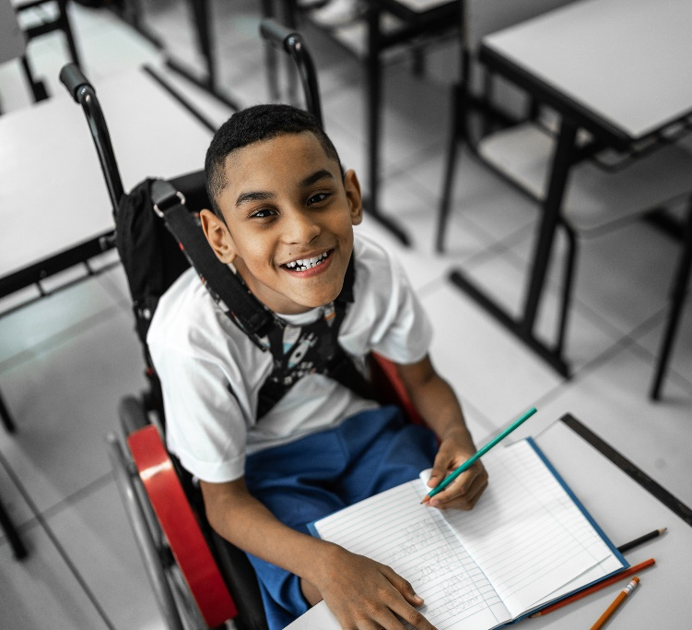
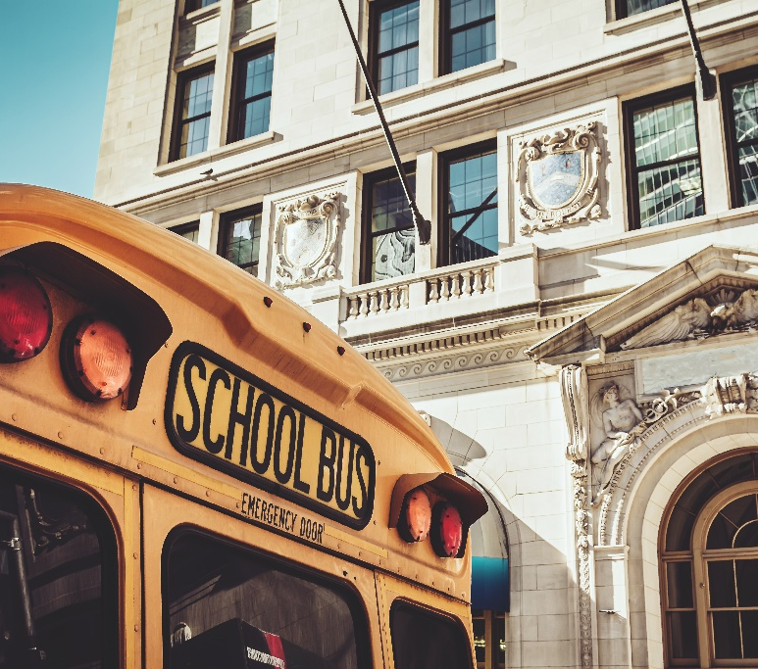
Access to School Programs & Activities
Every student should have equal access to any of their school’s programs and activities.
Academics
Extracurriculars
Transportation
Notes:
PRESENTER NOTES
The general rule is that every student should have equal access to any of their school’s programs and activities.
In other words, schools cannot limit or deny a student’s participation in school programs or activities because of protected class.
A school’s programs and activities include any and all:
Academic programs, courses, or pathways, including field trips;
Extracurricular activities, clubs, and interscholastic athletics; and
Transportation.
ADDITIONAL CONTEXT
Some programs or activities have entrance criteria. For example, many school sports teams have a “cut” policy based on skill, and many advanced courses require that students first take certain prerequisites.
Entrance criteria are allowable if they are:
Justified by the nature of the program or activity;
Applied equally to all students; and
Subject to modification when necessary to avoid discrimination (e.g., providing disability-related accommodations, allowing a student to take an entrance exam in their home language). Schools may not, for example, categorically deny admission to a program because the student needs English language development services, special education, or health services.

Slide 10
Equal access to school programs and activities includes:
Allowing all students an opportunity to benefit from different types of academic programs, e.g., Highly Capable, dual credit, Career and Technical Education, etc.
Providing necessary accommodations, aids, and services for students with disabilities.
Offering equitable athletic opportunities.
Providing language assistance services for multilingual learners and parents with limited English proficiency.
Learn more! Visit the Equity and Civil Rights Office’s Equity in Courses & Programs webpage.
Notes:
PRESENTER NOTES
To ensure that all students have equal access to any of our school programs or activities, we need to take steps such as:
Allowing all students an opportunity to benefit from different types of academic programs, e.g., Highly Capable, dual credit, Career and Technical Education, etc.
Providing necessary accommodations, aids, and services for students with disabilities.
Evaluating our interscholastic athletics program to make sure we are offering equitable athletic opportunities to girls and boys; and
Providing language assistance services for multilingual learners and parents with limited English proficiency.
These are just a few examples.

Slide 11
Discriminatory Harassment
Harassing conduct or communication becomes a form of discrimination when it:
Is based on or motivated by protected class; and
Creates a hostile environment.
WAC 392-190-0555
Notes:
PRESENTER NOTES
Another form of discrimination that we often see in schools is discriminatory harassment. Harassment can become a form of discrimination when it:
Is based on or motivated by protected class; and
Creates a hostile environment.
Let’s break this down a bit further.

Slide 12
Conduct that is based on or motivated by a protected class can look like:
Threats & intimidation
“Jokes,” memes, & videos
Physical assault
Rumors, slurs, or pejoratives
Graffiti or vandalism on school property
Notes:
PRESENTER NOTES:
Let’s start with what is meant by “conduct or communication that is based on or motivated by protected class.” This can include a wide range of actions and words. For example:
Graffiti or vandalism on school property
The use of rumors, slurs, or pejoratives
“Jokes,” memes, and videos
Threats and intimidation
Physical assault
Of course, all these examples can also occur without being based on or motivated by protected class. In that case, they are not discriminatory in nature and would not rise to the level of discriminatory harassment. Instead, they might be considered “harassment, intimidation, or bullying, or HIB,” which we will talk about in a moment.

Slide 13
A “hostile environment” is created when:
Conduct or communication is so severe, persistent, or pervasive that it affects a student’s ability to participate in or benefit from the school’s programs, services, or activities.
WAC 392-190-0555
Notes:
PRESENTER NOTES
If we have established that the harassment is based on or motivated by protected class, we turn to the second element, which is that the harassment must also create a hostile environment, either for the targeted student or other students—for example, witnesses or bystanders.
A hostile environment is created when harassment is so severe, persistent, or pervasive that it limits a student’s ability to participate in or benefit from any of the school’s programs or activities. In other words, the harassment is so bad that it’s essentially preventing the student(s) from being able to get an education.
Two things to note:
First, the harassment can either be severe, persistent, OR pervasive—it doesn’t need to be all three.
Second, the harassment must impact the student’s ability to participate in OR benefit—it doesn’t need to impact both.

Slide 14
Signs of a hostile environment can include:
Lack of interest in school or in a preferred class or activity
Deteriorating mental or physical health
Increased absences or school refusal
More frequent discipline referrals or behavior issues
Slipping grades
A desire to avoid certain people or places at school
Notes:
PRESENTER NOTES
How can we tell if a student may be experiencing a hostile environment at school? This can sometimes be challenging, because no two students are alike.
However, there are some common signs that are often present, and which we can look for, such as:
A lack of interest in school or in a preferred class or activity
Deteriorating mental or physical health
Increased absences or school refusal
More frequent discipline referrals or behavior issues
Slipping grades
A desire to avoid certain people or places in the school building
Note that this is not an exhaustive list.

Slide 15
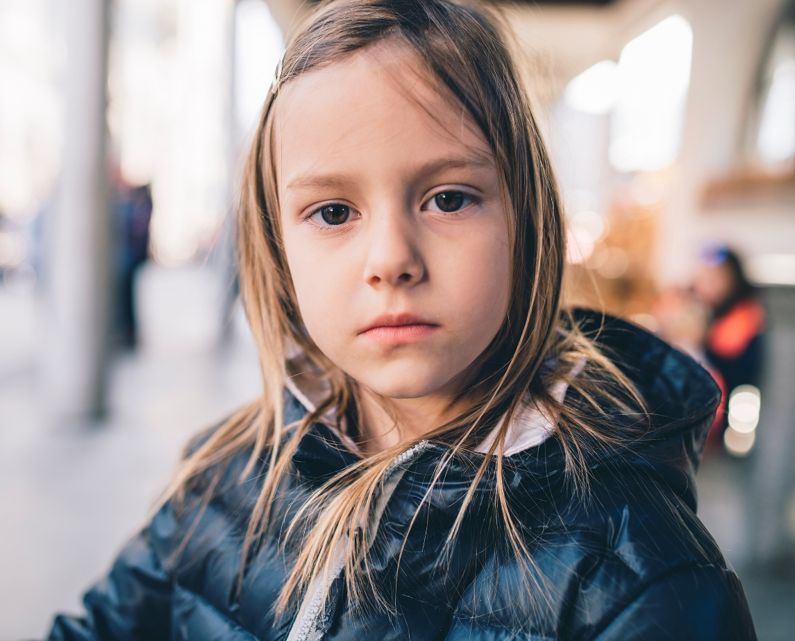
Harassment, Intimidation, & Bullying
Student-on-student harassment, intimidation, or bullying (HIB) can be based on any characteristic, including protected class.
Notes:
PRESENTER NOTES
We also need to talk about harassment, intimidation, and bullying, or HIB, and its overlap with discriminatory harassment. As school employees, we are all familiar with our school’s Harassment, Intimidation, and Bullying (or HIB) policy and procedure, which cover student-on-student bullying based on any characteristic, including protected class.

Slide 16
HIB v. Discriminatory Harassment
Ask: | Harassment, Intimidation, & Bullying (HIB) | Discriminatory Harassment
What is the basis or motivation for the harassment? | Can be based on any characteristic | Must be based on protected class
Which LEA employee should be notified? | HIB Coordinator: [Name, phone, email address] | Civil Rights Coordinator: [Name, phone, email address]
Which policy and procedure should be applied? | HIB Policy & Procedure [HIB Policy # | HIB Procedure #] | Nondiscrimination and/or Sexual Harassment Policies & Complaint Procedures [Policies # | Procedures #]
What should the scope of our response be? | Student-specific | Both systemic and student-specific
Notes:
INSTRUCTIONS
Update slide with following policy and procedure numbers and delete the yellow highlighting.
Harassment, Intimidation, and Bullying (HIB)
Sex-Based Harassment (students)
Nondiscrimination (students)
Gender-Inclusive Schools
You may also add the name and contact information for your district or charter school’s compliance coordinators (HIB, Civil Rights, Title IX, Section 504, and Gender Inclusive Schools).
You may add a link to the policies and procedures on the slide itself or provide the policies and procedures referenced on the slide as handouts for participants.
PRESENTER NOTES
Because there is often overlap between incidents of HIB and discriminatory harassment, it is important to be able to tell the difference between the two—especially if you are someone who has a role in your school’s HIB process.
1. The biggest difference between the two is the basis or motivation behind the conduct.
As we just talked about, HIB can be based on any characteristic. For example, a student’s height or weight, or the brand of clothing they wear.
On the other hand, discriminatory harassment involves conduct or communication that is based on a protected class. For example, a student’s sex, race, religion, or sexual orientation.
2. Another key difference is that different LEA employees need to be notified.
For incidents of HIB, you are going to want to notify the HIB Coordinator, if they are not already aware.
For incidents of discriminatory harassment, you need to notify the Civil Rights Coordinator.
3. Next, different district policies and procedures will apply.
For incidents of bullying or harassment that DO NOT involve protected class, the HIB policy and procedure should be applied. That procedure provides for a building-level complaint with a shorter investigative timeline.
For incidents of bullying or harassment that DO involve protected class, the nondiscrimination or sexual harassment policy and procedure should be applied. Both provide for a district-level complaint with a longer investigative timeline.
4. Finally, the scope of the school’s response will likely differ.
When addressing incidents of HIB, the response is often student-specific and more limited in nature.
In other words, the school typically asks: Did the conduct occur, and if so, how should we discipline the perpetrator?
When addressing incidents of discriminatory harassment, however, the response often needs to be systemic in addition to student-specific.
In other words, the school asks: Did the conduct occur, and if so, how should we discipline the student, and could this incident indicate a broader problem in this school or district?

Slide 17
Sexual Harassment
Sexual harassment between students:
Unwelcome conduct or communication that is
Sexual in nature and
Creates a hostile environment.
WAC 392-190-0555
Notes:
PRESENTER NOTES
School employees also need to be able to tell when an incident meets the definition of sexual harassment, which is a form of discriminatory harassment.
For purposes of this training, we are going to focus on sexual harassment that occurs between students, and we will use the definition found in state law, which is:
Unwelcome conduct or communication that is
Sexual in nature and
Creates a hostile environment.
ADDITIONAL CONTEXT
Employees also need to receive training on their obligation to recognize and respond to sex-based harassment under federal law (Title IX). For more information on school employees’ obligations under federal law, you can access and view OSPI’s training module covering sex-based harassment under Title IX, which can be accessed on OSPI’s Sexual Harassment in Washington K–12 Public Schools (ospi.k12.wa.us) webpage.

Slide 18
Sexual Harassment
Unwelcome conduct or communication that is
Sexual in nature and
Creates a hostile environment.
Conduct is unwelcome if the student did not request or invite it and considered it to be offensive or undesirable.
WAC 392-190-0555
Notes:
PRESENTER NOTES
When analyzing whether sexual harassment may have occurred, we need to start with the first element: Was the conduct or communication “unwelcome?”
Conduct or communication is considered “unwelcome” if the student did not request or invite it and perceived the conduct as offensive or undesirable.
Additional factors to consider are the student’s age, the nature and severity of the conduct or communication, and whether the student was capable of welcoming the sexual conduct or communication.
Remember: just because a student submits to the conduct or fails to object does not mean that the conduct was welcome.
As just one example, consider a situation where a male high school student willingly kisses a female student on one occasion. When the he subsequently attempts to kiss her again, she objects, but he kisses her anyway. This subsequent kiss would be considered “unwelcome” even though the student welcomed the first kiss.

Slide 19
Sexual Harassment
Unwelcome conduct or communication that is
Sexual in nature and
Creates a hostile environment.
For example:
Touching or grabbing a student’s body
Catcalling or whistling
Making sexual jokes or remarks
Spreading rumors about a student’s sexual history
Pressuring a student for sexual favors
Sending sexually explicit texts, emails, or photos
Forcible sexual contact or rape
WAC 392-190-0555
Notes:
PRESENTER NOTES
If the conduct was unwelcome, we next analyze the second element: Whether it was sexual in nature.
For example:
Touching or grabbing a student’s body
Catcalling or sexually-suggestive whistling
Making sexual jokes or remarks
Spreading rumors about a student’s sexual history
Pressuring someone for sexual favors
Sending sexually explicit texts, emails, or photos
Forcible sexual contact or rape

Slide 20
Sexual Harassment
Unwelcome conduct or communication that is
Sexual in nature and
Creates a hostile environment.
When the conduct or communication is so severe, persistent, or pervasive that it limits a student’s ability to participate in or benefit from the school’s programs or activities.
WAC 392-190-0555
Notes:
PRESENTER NOTES
Finally, we analyze the third element: Whether, because of the conduct, a hostile environment was created for the targeted student or other students.
As we covered earlier in the training, a hostile environment is created when conduct is so severe, persistent, or pervasive that it affects a student’s ability to participate in or benefit from the school’s programs or activities.

Slide 21
It is up to us to recognize when conduct is potentially discriminatory.
Harassment
Taunting
Bullying
Assault
Teasing
Sexting
Cyberbullying
Threatening
Name calling
Notes:
PRESENTER NOTES:
We can’t expect students or parents to necessarily understand the legal definitions we just covered, or to know when or if the conduct or communication they are experiencing is discriminatory.
Instead, we may hear them using any of the following words to describe their experience:
Harassment
Bullying
Taunting
Assault
Teasing
Sexting
Cyberbullying
Name calling
Threatening
That is why it is our job and responsibility, as school employees, to listen to what they are describing. We have to be able to assess the nature of the conduct itself, even if the student or parent isn’t using the words “discrimination,” “discriminatory harassment,” or “sexual harassment.” If the conduct is based on any protected class, we must identify it as a possible civil rights/discrimination issue.
[CLICK]
The bottom line is that it is up to us to recognize when conduct may be discriminatory.
The next section of this module will help us understand what to do when that happens.

Slide 22
Responding to Discrimination
What do schools need to do once “on notice” of potential discrimination? What is a discrimination complaint? What should a school do in response to a verbal or written discrimination complaint? What about a complaint that alleges HIB and discriminatory harassment?
Notes:
PRESENTER NOTES:
The second section of this training module is focused on responding to potential discrimination. In other words, if a school employee sees or hears about possible discrimination, what must they do in response? Similarly, if a school receives a discrimination complaint, how should it respond?

Slide 23
Schools Have A Duty To Respond
Once on notice of potential discriminatory or sexual harassment, a school must:
Investigate; and
Take prompt and effective steps to:
Stop the conduct
Eliminate the hostile environment
Prevent it from recurring
Remedy its effects.
Schools must take these steps even if no one has filed a complaint or asked the school to respond.
WAC 392-190-0555
Notes:
PRESENTER NOTES
Most importantly, as school employees, we need to remember that we all have a duty to respond to all potential discrimination, including discriminatory and sexual harassment. The general rule is once on notice a school must:
Investigate to determine what happened and the resulting impact upon students, and
If the school finds that discrimination has occurred, it must take prompt and effective steps to:
Stop the conduct.
Eliminate the hostile environment for the targeted student and any other students impacted,
Prevent the conduct from recurring, and
Remedy the effects of the conduct on the targeted student and any other students impacted
The school must take these steps regardless of whether anyone has filed a complaint or asked the school to respond.

Slide 24
When is a school on notice?
A school is on notice when any employee knows or should have known about potential discrimination, including discriminatory and sex-based harassment.
For example:
A complaint is received
A student or parent tells a school staff member about the conduct
A school staff member witnesses the conduct
A school staff member hears about the conduct (e.g., through social media, word of mouth, etc.)
Notes:
PRESENTER NOTES
What does it mean to be “on notice?”
The term “on notice” is quite broad, meaning any time a school employee knows or should have known about the potential discrimination. For example, a school would be considered “on notice” when:
A complaint is received;
A student or parent tells a school staff member;
A school staff member witnesses the conduct; or
A school staff member hears about the conduct indirectly, such as through social media or word of mouth.

Slide 25
Promptly Notify the Civil Rights Coordinator
Once on notice of possible discrimination, including discriminatory or sexual harassment, school employees should promptly notify the Civil Rights Coordinator.
Notes:
PRESENTER NOTES
The bottom line is that if any school employee witnesses or otherwise becomes aware of possible discriminatory harassment, they must promptly notify the civil rights coordinator. The civil rights coordinator will then partner with the administrator in the building where the incident occurred to ensure that a prompt and thorough investigation is conducted, the correct policy and procedure are applied, and that the school’s response appropriately addresses the conduct.

Slide 26
Discrimination Complaints
Verbal (Informal)
School employee is told about an incident of possible discrimination or discriminatory harassment—usually over the phone or in person.
Written (Formal)
Any school or district administrator receives specific allegations of discrimination in writing—either via email, fax, U.S. mail, or hand delivery.
Notes:
PRESENTER NOTES:
We have just discussed what to do when a school employee is on notice of potential discrimination. But what do school employees have to do after receiving a discrimination complaint?
Before we talk about required responses, let’s first distinguish between the two different types of discrimination complaints we could receive. The first is a verbal, or informal, complaint, and the second is a written, or formal, complaint.
A verbal complaint occurs when a school employee is told about an incident of possible discrimination or discriminatory harassment. Usually, this happens during a phone call or conversation.
Note that for verbal complaints alleging sex-based discrimination or harassment, there may be some additional obligations to respond, so make sure to touch base with the Title IX Coordinator!
A written complaint has a specific legal definition under Washington law.
First, it must be in writing.
This means it must be sent by mail, fax, email, or hand-delivery.
It does not need to include the words “complaint” or “discrimination.”
Second, it must be sent to any school or district administrator.
For example, the superintendent, a compliance coordinator, or a principal.
Finally, it must allege discrimination.
In other words, it must describe specific conduct that, if true, would violate nondiscrimination laws, rules, or guidelines.
Additionally, the allegations must be specific enough that a reasonable person would understand it to be a complaint and know what to investigate.
Importantly a written complaint can be filed by anyone—including a parent, student, community member, advocate, or employee.
The reason why it is important to know whether a discrimination complaint was verbal or written is because the school’s required response differs, depending upon what type of complaint is received.

Slide 27
Responding To Verbal Complaints
Upon receipt of a verbal discrimination complaint, school employees must:
Notify the civil rights coordinator.
The civil rights coordinator will then partner with an appropriate school administrator to:
Investigate and respond.
Notify the complainant of their right to file a written complaint.
Provide the complainant with a copy of the discrimination complaint procedure.
Notes:
PRESENTER NOTES:
When any school employee receives a verbal complaint, they must notify the civil rights coordinator. The civil rights coordinator will then partner with the appropriate building administrator to:
Investigate and respond.
Notify the complainant of their right to file a written complaint.
Provide the complainant with a copy of the discrimination complaint procedure.

Slide 28
Responding To Written Complaints
Upon receipt of a written discrimination complaint, school employees must:
Notify the civil rights coordinator.
The civil rights coordinator will then partner with an appropriate school administrator to:
Apply the LEA’s formal discrimination complaint procedure: [Procedure #3210P]
Provide the complainant with a copy of the discrimination complaint procedure.
Notes:
INSTRUCTIONS
Insert the procedure number for the LEA’s discrimination complaint procedure, WSSDA’s 3210P or equivalent.
PRESENTER NOTES:
When any school employee receives a written complaint, they must notify the civil rights coordinator. The civil rights coordinator will then partner with the appropriate building administrator to:
Apply the LEA’s formal discrimination complaint procedure in response.
Provide the complainant with a copy of the discrimination complaint procedure.
The key distinction here is that in response to a written complaint, the LEA must apply its formal discrimination complaint procedure, which includes different timelines and procedural requirements that must be followed.

Slide 29
Discrimination Complaint Procedure Written Complaints Only
Step | Brief Description | Legal Authority
1. Complaint to District | Upon receipt, the LEA must complete a neutral investigation and respond to the complainant in writing within 30 calendar days. | WAC 392-190-065
2. Appeal | The complainant can appeal the LEA’s written decision if they are dissatisfied. Appeals usually go to the school board or similar entity. | WAC 392-190-070
3. Complaint to OSPI | The complainant can file a complaint with OSPI if they are dissatisfied with the LEA’s or school board’s response. OSPI may investigate whether the LEA responded appropriately. | WAC 392-190-075
Learn more by visiting OSPI’s Complaints and Concerns webpage.
Notes:
PRESENTER NOTES
This chart outlines the discrimination complaint procedure under state law. It is a three-step process.
The first step is the complaint to the school district.
Once the LEA receives a written discrimination complaint, it must respond using its discrimination complaint procedure. Broadly speaking, this procedure requires the LEA to complete the following actions within 30 calendar days:
Conduct an investigation,
Complete an investigative report, and
Respond in writing to the complainant.
The written response must, at a minimum, include:
An investigative summary
Whether a violation was found
Any corrective actions put in place
Notice of the complainant’s right to appeal.
The school must send a copy of the written response to OSPI.
The second step is the appeal.
After receiving the school’s written decision, the complainant can choose to file an appeal. In most districts, these types of appeals are sent to the school board. The board has 30 calendar days to consider the appeal and to provide the complainant with a written decision on appeal. At that time, the board must also send a copy of its decision to OSPI.
The final step is a complaint to OSPI.
After receiving the board’s decision on appeal, the complainant can choose to file a complaint with OSPI. OSPI will evaluate the complaint and if grounds exist to open it, will open it for further investigation.
ADDITIONAL INFORMATION
OSPI has many more resources about the discrimination complaint procedure on its Complaints and Concerns About Discrimination (ospi.k12.wa.us) webpage.

Slide 30
Complaints Involving HIB and Discriminatory Harassment
Stop the conduct & make sure students are safe
Make sure both coordinators (HIB & Civil Rights) have been notified
Partner with the coordinators to ensure conduct is addressed under both procedures (HIB & nondiscrimination)
Notes:
PRESENTER NOTES
You may remember that earlier, we talked about the differences between HIB and discriminatory harassment. Now, it is time to talk about how to respond to an incident that includes conduct that could meet the definition of HIB and discriminatory harassment. For example, let’s say that a principal receives a HIB complaint and notices that the bullying appears to be related to the student’s race. What should the principal do next?
First, let’s compliment the the principal for making a critical observation, which is that the bullying appears to be related to a protected class—race. This means that applying the school’s HIB procedure is not enough. This HIB complaint also needs to be assessed for civil rights implications. Here is what the principal should do next:
First, they should make sure the conduct has stopped, and that students are safe.
Supportive measures may need to be put in place to ensure student safety.
Next, they should notify both coordinators (HIB and Civil Rights).
Finally, they will likely need to partner with the coordinators to ensure that the conduct is properly addressed under both procedures.

Slide 31
Have questions? Contact a compliance coordinator.
Civil Rights
[Name]
Title IX
Section 504
[Name]
Gender Inclusive Schools
[Name]
[Email]
[Phone]
[Photo] Optional
[Name]
[Title]
[Email]
[Phone]
[Photo] Optional
[Title]
[Email]
[Phone]
[Photo] Optional
[Title]
[Email]
[Phone]
[Photo] Optional
[Title]
Notes:
INSTRUCTIONS
Insert the name, title, email, phone number, and photo (optional) of each of the district coordinators:
Civil Rights Coordinator
Title IX Coordinator
Section 504 Coordinator
Gender Inclusive Schools Coordinator
PRESENTER NOTES
This concludes the second section of our training module. If you have questions or concerns, either now or later, remember that you can always reach out to any of our school’s compliance coordinators!

Slide 32
Eliminating Bias in Schools
How can schools eliminate bias in instructional materials, counseling and guidance, and student discipline?
Notes:
PRESENTER NOTES:
The third section in this training module is on eliminating bias in schools.
What is bias, and why is it important to eliminate it?
Bias is commonly understood as prejudice or a strong feeling in favor of or against one thing, person, or group when compared to another, usually in a way considered to be unfair.
We can often identify bias by looking at whether any particular groups—for example, a protected class—are being overrepresented, underrepresented, or omitted entirely from a given situation.
Such representations or omissions can imply that certain groups are more or less important in our school community, which has a tremendous impact on students.

Slide 33
Schools Must Eliminate Bias In:
Instructional Materials
Counseling & Guidance
Student Discipline
WAC 392-190-055
WAC 392-190-010
WAC 392-190-048
Notes:
PRESENTER NOTES:
Under Washington law, schools must identify and address bias in three key educational areas:
First, in the selection and use of instructional materials such as textbooks, primary and supplemental sources, reference materials, and audio-visual materials.
Second, in the counseling and guidance of students, which includes the assessments, materials, and information provided for purposes of academic, career, or vocational counseling.
Finally, in the administration of student discipline, in particular, with regard to classroom removals.
Let’s explore each of these areas briefly.

Slide 34
Eliminating Bias in Instructional Materials
Schools must adopt and consistently apply an instructional materials policy that includes screening and selection criteria designed to identify and eliminate bias based on protected class.
If biased instructional materials are identified, but cannot be replaced immediately, schools must acquire supplemental materials and use them to counter the biased content.
Consider using OSPI’s Screening for Biased Content in Instructional Materials Tool.
Notes:
PRESENTER NOTES:
Let’s start with instructional materials. To ensure that they are not discriminating against any protected classes when selecting and using instructional materials, schools are required to adopt and consistently apply an instructional materials policy that includes screening and selection criteria designed to eliminate bias based on protected class.
If biased instructional materials are identified through this process, but cannot be replaced immediately, schools must then acquire and concurrently use supplemental materials to counter the biased content.
ADDITIONAL CONTEXT
In the interest of eliminating bias, the Washington Legislature passed a bill, now codified at RCW 28A.320.233, that prohibits school boards from refusing to approve or prohibit the use of any instructional material on the basis that it relates to or includes the study of the role and contribution of any individual or group who is part of a protected class.
OSPI has developed a tool to help schools screen their instructional materials for bias. It is available here: Washington Screening for Biased Content (ospi.k12.wa.us).

Slide 35
Eliminating Bias in Counseling & Guidance
Schools’ counseling and guidance practices cannot result in students being directed toward certain academic, vocational, and career paths because of their protected class.
Reviewing specialized course and program enrollment data helps schools determine whether students in certain protected classes are over- or under-represented in any specialized courses or programs, such as AP/IB, dual credit, CTE, and Hi-Cap.
If a substantial disproportionality is identified, schools should analyze whether biased counseling or guidance practices could be a root cause.
Notes:
PRESENTER NOTES
Next, let’s discuss counseling and guidance practices. Washington schools are not permitted to discriminate in the counseling and guidance of students. Broadly speaking, this means that each school should take steps to make sure that all students are being counseled toward appropriate courses of study or career paths based on their strengths, challenges, and interests—not on their membership in a certain protected class or stereotypes based on protected class.
Reviewing specialized course and program enrollment data is one way that schools can identify potential bias in their counseling and guidance practices. This required annual review asks schools to compare building-level specialized course and program enrollment data with their total enrollment data to see whether there are any substantial disproportionalities based on race, sex, EL status, or disability. Specialized courses and programs include anything the school offers that not all students take, such as honors, AP, IB, CTE, Hi-Cap, or dual credit courses and programs.
If the data shows a substantial disproportionality in any specialized course or program, the school must conduct a root cause analysis to ensure it is not due to discrimination. Possible root causes that should be examined include counseling and guidance practices such as:
How students are being identified or selected for certain courses/programs;
Course/program enrollment criteria;
Tests and appraisal instruments;
Academic, career, and vocational guidance materials;
Educational scheduling or placement.
ADDITIONAL CONTEXT
OSPI has a number of different tools available to help schools structure their review and analyze their data. Please visit OSPI’s Equity in Courses and Programs (ospi.k12.wa.us) webpage for more information!

Slide 36
Eliminating Bias in Student Discipline
Schools must administer student discipline without discrimination.
Regularly reviewing student discipline data helps schools prevent, identify, and correct any discipline disparities based on protected class.
If a substantial disproportionality is identified, schools should analyze whether biased discipline policies, procedures, or practices could be a contributing factor.
Notes:
PRESENTER NOTES:
Finally, let’s discuss student discipline. Washington law requires schools to administer student discipline without discrimination based on protected class. However, we are all aware that across the nation—and also here in Washington—data shows that schools tend to discipline students in certain groups more than others. For example, students with disabilities and students of color are suspended and expelled more frequently than their peers. These trends raise concerns about equal educational opportunities.
Reviewing student discipline data is one way that schools can identify whether they may be disciplining students in a discriminatory manner. This required annual review asks schools to compare building-level student discipline data with their total enrollment data to see whether there are any substantial disproportionalities based on race, sex, EL status, or disability.
If the data show a substantial disproportionality based on protected class, the school must conduct a root cause analysis to ensure it is not due to bias or discrimination. Possible root causes to examine include whether a school’s discipline policies, procedures, or practices are being administered differently for different student groups, whether a neutral policy is being selectively enforced against students in a certain protected class, and whether staff need additional training.
ADDITIONAL RESOURCES
OSPI’s 2019 discipline guidelines are available for schools to use as they apply a more critical lens to their discipline policies, procedures, and practices: Publication Title (ospi.k12.wa.us)
OSPI also has many other tools available to help schools structure their review and analyze their data. Please visit OSPI’s Equity in Student Discipline (ospi.k12.wa.us) webpage for more information!

Slide 37
Additional Resources
Notes:
PRESENTER NOTES
Before we end, here are some additional resources.

Slide 38
For Additional Information
Equity and Civil Rights Office
Washington State OSPI
State and federal civil rights laws, rules, guidelines, and resources for schools, families, and community members
Complaints and Concerns About Discrimination (ospi.k12.wa.us)
Discrimination Dispute Resolution Information Sheet
Screening for Biased Content in Instructional Materials Tool
Office for Civil Rights
U.S. Department of Education
Federal civil rights laws, regulations, policy interpretation, and sample complaint resolutions.
Reading Room
File a Discrimination Complaint
Notes:
PRESENTER NOTES
For more information on any of the topics we have discussed—and many more—please visit the OSPI Equity and Civil Rights Office’s website or the U.S. Department of Education Office for Civil Rights’ website.

Slide 39
Contact us!
OSPI’s Equity and Civil Rights Office
(360) 725-6162 | TTY: (360) 664-3631 | equity@k12.wa.us
Equity and Civil Rights (ospi.k12.wa.us)
Notes:
PRESENTER NOTES
OSPI’s Equity and Civil Rights team can be reached by phone at (360) 725-6162 (or TTY: (360) 664-3631) and by email at equity@k12.wa.us.
Their website is also linked for you on this slide: www.ospi.k12.wa.us/policy-funding/equity-and-civil-rights
They welcome your questions!

Slide 40
Notes:
PRESENTER NOTES
You can also connect with OSPI on a variety of social medial platforms, including Instagram, Facebook, YouTube, Twitter, and Linked In.

