Slide 1
Attendance Staff Training Template
Name, Department

Slide 2
Directions for Use of Slide Deck
This slide deck is designed to help you create attendance training sessions for individuals in your district who support attendance.
Please note that some slides are duplicated with slight variations. This allows you to select the content most relevant to your training needs.
Download the content and delete, reformat or re-arrange slides to meet your district’s individual need and style. Please do not modify slides with the OSPI logo, as they contain essential statewide policy and practices.
Notes:
This slide is intended for providing information only

Slide 3
School district’s vision, mission, and values
Vision:
Mission:
Values:
Notes:
This can be a slide about the school district’s vision, mission, and values (strategic plan).

Slide 4
Equity Statement
Equity Statement
Notes:
This slide is for the district’s equity statement.

Slide 5
Meet the Team
Meet the Team
Notes:
This slide can be used as an introduction slide to a team or can be used as a template for a photo introduction to yourself.

Slide 6
Agenda:
Notes:
Including an agenda for your meeting allows the individuals attending the presentation to prepare for what is coming up.

Slide 7
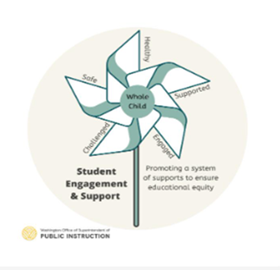
OSPI Attendance Guiding Principles
Attendance and engagement are foundational to student learning
Absences tells us when a student has not accessed instruction, and therefore all absences matter
Absences are a critical early warning indicator that:
can reflect inequities that are caused by or perpetuated by our systems or
when a student and family might need more support
We have an opportunity to get curious about why students aren’t attending
Students and families are our best partners to understand the barriers to attendance
The purpose of attendance and truancy interventions are to reduce barriers to attendance and support students to engage; not to punish
Schools and districts have lots of opportunity for prevention and intervention before involving the Court
Notes:
Use this slide to ground staff in OSPI’s Attendance Guiding Principles. This slide is not made for edits or adaptation.

Slide 8
Education is a basic, constitutional right for all children in Washington
Notes:
Education is a Right
Education is a basic, constitutional right in Washington for all children. Schools and districts have specific responsibilities to enroll students and provide access to public education.

Slide 9
Why Does Attendance Matter?
“Reestablishing a routine of daily attendance- recognizing that students might miss a day on occasion – in school is crucial to nurturing an educated, healthy and skilled next generation with the hard and soft skills needed for a strong economy”
~Attendance Works
Attendance Works Policy Brief 2024

Slide 10
Attendance is part of an Early Warning System
Data system that integrates these three data points to provide early intervention:
Attendance
Behavior
Course Performance
Notes:
Attendance along with behavior and course performance is part of the early warning system suggesting that a student could need additional supports.

Slide 11
State Requirements – Compulsory Attendance
Notes:
The next group of slides provides information on State Requirements for Compulsory Attendance.

Slide 12
The Becca Bill: 28A.225.RCW
Community Engagement Boards
All school districts must designate and coordinate a board of volunteers to address excessive absenteeism and truancy
“Becca” Rebecca Hedman
Becca’s chronic truancy and running away from home led to her murder at the age of 12.
1993
1995
2016
Becca’s parents and legislators lobbied to pass the Becca Bill, requiring children 8 to 18 to attend public school regularly, with few exceptions.
Notes:
This slide is a timeline of the Becca Bill. This also provides information on Community Engagement Boards.

Slide 13
State Requirements – Compulsory Attendance
Notes:
The next group of slides provides information on State Requirements for Compulsory Attendance.

Slide 14
Purpose of the Becca Law
The purpose of the Becca Law is to provide a safety net for youth and to prevent students from disengaging from school. It is not intended to punish students for past absences.
The Compulsory Attendance laws are a tool for early detection and intervention for youth at risk of disengaging. The goal is to provide intentional supports for youth to reengage them with their education, address barriers to attendance, and increase access to opportunities.
Notes:
Historically, truancy has been treated as a punishment. However, the purpose of the Becca law is really support. It's there to provide safety for students and help for families. It is there to encourage communication between schools and families.

Slide 15
Chapter 28A.225 RCW
Mandatory attendance ages 8 – 18
Interventions to reduce absences
Parent conferences
Assessment/screener
Data-based interventions
Attendance agreement
Referral for IEP/504
Truancy petition after 7 unexcused/month or 15 unexcused/year
Petition is STAYED
Referred to a Community Engagement Board, continued efforts to reengage students
SB 5290 (2019)
Eliminated the Valid Court Order (VCO) which enabled courts to place youth in juvenile detention for violation of a court order
Notes:
We are trying to shift culture and mindset around truancy from a punitive mindset to that of what is the root cause, and how can we support you and your family to address it?

Slide 16
State law requires districts to take steps when students are absent
# of Unexcused Absences
After 1 | Notify parents when students are absent
After 3 in a month | Schedule a conference with student and parent to identify barriers and make a plan
Between 2 and 7 in a year | Take data informed steps Administer an assessment to identify barriers Convene the IEP or 504 team
Not later than 7 in a month | Enter into an agreement with student and parent or Refer student to a Community Engagement Board (CEB) or File a truancy petition
After 7 in a month and not later than 15 in a year | File a truancy petition; petition is stayed Refer parent and student to community engagement board
Elementary Attendance & Truancy Required Steps
Secondary Attendance & Truancy Required Steps
Notes:
School districts are required to intervene early such as providing notice that a student is missing school, conferencing with the family, and working with them to identify barriers as well as offer interventions to improve attendance prior to filing a truancy petition. Schools also refer families to community engagement boards which is an intensive intervention with community partners to develop an intervention plan and wrap around supports.
The law also outlines several steps that districts must take when students have unexcused absences. This table is a summary of those steps. Linked in the slide is the Elementary Attendance & Truancy Required Steps and Secondary Attendance & Truancy Required Steps. These are a helpful tool regarding the summary of the required steps.

Slide 17
Districts’ Required Steps when Students are Absent Unexcused
Notify parents after 1 unexcused absence
Schedule a conference with student and parent to identify barriers and make a plan
Administer an assessment to identify barriers
Provide data-based interventions
File a truancy petition
Refer the student or parent to Community Engagement Board
Attendance & truancy interventions and outreach must be attempted prior to withdrawing or filing a petition
Elementary Attendance & Truancy Required Steps
Secondary Attendance & Truancy Required Steps
Notes:
School districts are required to intervene early such as providing notice that a student is missing school, conferencing with the family, and working with them to identify barriers as well as offer interventions to improve attendance prior to filing a truancy petition. Schools also refer families to community engagement boards which is an intensive intervention with community partners to develop an intervention plan and wrap around supports.
The law also outlines several steps that districts must take when students have unexcused absences. This is a summary of those steps. Linked in the slide is the Elementary Attendance & Truancy Required Steps and Secondary Attendance & Truancy Required Steps. These are a helpful tool regarding the summary of the required steps.

Slide 18
Chapter 392-401 WAC
Definition of absence
Excused absences
Safety
Migrant, homeless, foster care
Cultural or religious participation
Physical or mental health
Suspensions or expulsions
Districts define through policy
Requires outreach and attempts to reengage if student is withdrawn
Statewide Definition of Absence, Excused and Unexcused
Notes:
Absences due to the following reasons must be excused:
(a) Physical health or mental health symptoms, illness, health condition or medical appointment for the student or person for whom the student is legally responsible. Examples of symptoms, illness, health conditions, or medical appointments include, but are not limited to, medical, counseling, mental health wellness, dental, optometry, pregnancy, and behavioral health treatment (which can include in-patient or out-patient treatment for chemical dependency or mental health);
(b) Family emergency including, but not limited to, a death or illness in the family;
(c) Religious or cultural purpose including observance of a religious or cultural holiday or participation in religious or cultural instruction;
(d) Court, judicial proceeding, court-ordered activity, or jury service;
(e) Post-secondary, technical school or apprenticeship program visitation, or scholarship interview;
(f) State-recognized search and rescue activities consistent with RCW 28A.225.055;
(g) Absence directly related to the student's homeless or foster care/dependency status;
(h) Absences related to deployment activities of a parent or legal guardian who is an active duty member consistent with RCW 28A.705.010;
(i) Absences due to suspensions, expulsions or emergency expulsions imposed pursuant to chapter 392-400 WAC if the student is not receiving educational services and is not enrolled in qualifying "course of study" activities as defined in WAC 392-121-107;
(j) Absences due to student safety concerns, including absences related to threats, assaults, or bullying;
(k) Absences due to a student's migrant status;
(l) Absences due to an approved activity that is consistent with district policy and is mutually agreed upon by the principal or designee and a parent, guardian, or emancipated youth; and
(m) Absences due to the student's lack of necessary instructional tools, including internet access or connectivity.

Slide 19
Chapter 392-401 WAC
Defines absence from in-person and remote instruction (synchronous & asynchronous)
Defines reasons absences should be excused
Requires daily attendance taking & defines data reporting requirements
Requires districts to use an MTSS as a framework for addressing absences including…
A process for outreach and reengagement for students who have been withdrawn due to nonattendance
Notes:
Provides information regarding Washington Administrative Code regarding attendance.

Slide 20
Outreach and Intervention Requirements
WAC 392-401-045 states:
A district must have a process for outreach and reengagement for students who have been withdrawn due to nonattendance and there is no evidence that the student is enrolled elsewhere.
Notes:
WAC 392-401 states:
(i) A school and/or district point person/people to maintain the list, keep it updated, and coordinate the outreach;
(ii) School or district staff assigned to conduct the outreach and attempts at reengagement in coordination with community partners or other programs;
(iii) Multiple methods of communication and outreach in a language or mode of communication that the parent understands including phone calls, texts, letters, and home visits;
(iv) Referral to community-based organizations;
(v) Documentation of the attempts to reach student and family; and
(vi) Follow the required steps to address unexcused absences in chapter 28A.225 RCW

Slide 21
OSPI Guidance

Slide 22
Where do attendance requirements come from?
Statute
Chapter 28A.225
Legislature
Administrative Rule
Chapter 392-401 WAC
OSPI
Elementary Attendance & Truancy Required Steps
Secondary Attendance & Truancy Required Steps
Truancy screener guidance

Slide 23
Everything else is local control
If it’s a requirement, we will use language like “must”
If it’s not in statute or rule, it’s a recommendation
WSSDA model board policy can be adopted and altered by your Board
There’s a lot of practice that isn’t covered by any of these
For example:
Withdrawing students
Tardies
Makeup work
Responses to excused absences

Slide 24
Hot topic: Excessive Excused Absences
Districts have authority to create policies addressing excused absences.
Recommendations:
Does not solely place responsibility on the students (e.g. Dr.’s note after 15 excused absences)
District actions and interventions that seek to understand barriers and provide support
Consider truancy only after made reasonable effort to address excused absences (or there’s valid reasons for continued absences.)
Resource: Attendance & Truancy FAQ
Notes:
If you have a team who has access to data and is supporting a continuum of tiered supports, then a policy that articulates when you’re going to stop excusing absences doesn’t have to be used as much.

Slide 25
Policies & Procedures

Slide 26
What does OSPI say about Excused vs. Unexcused?
WAC 392-401 – Absences
Sets the floor of what should be considered excused
Districts have considerable flexibility to operationalize
Notes:
One of the questions I get asked a lot is: are vacations excused or unexcused? To which I have an answer, it depends on what your district policy and school procedures are.

Slide 27
Policies & Procedures
Are they:
Consistent?
Reasonable?
Communicated effectively?
Other Considerations:
Dr.’s Notes
Process for students absent for 20 days
Vacations & Other Parent Excused

Slide 28
Why are we focused on attendance?
Notes:
In addition to it being our job😊, we firmly believe that attendance is essential to student learning and success. We define attendance as “accessing instruction”. When our students are not accessing instruction, and the suite of supports, extracurriculars and relationships, that our schools offer, they are missing out on an opportunity for a successful future.

Slide 29
Parents/guardians and children have a legal responsibility to enroll in education and attend
Ages 8 – 18
Public, private or home-based instruction (homeschool)
With some exceptions
RCW 28A.225.010

Slide 30
What is chronic absenteeism?
OSPI measures Chronic Absence and reports the inverse on Report Card as: “Regular Attendance”
10% or more of school days
Chronic Absenteeism
Excused
Unexcused
Notes:
OSPI’s Report card reflects the number of students who are in regular attendance, which means that 70% of students are attending 90% or more of their school days. Just a reminder on definitions, when we talk about chronic absenteeism, we are talking about a student missing 10% or more of their school days for any absence, excused or unexcused, it measures missed learning time.

Slide 31
What is Chronic Absenteeism?
10% or more of school days = 2 days a month
Chronic Absenteeism
Excused
Unexcused
11/1/2024 | 31
Notes:
Just a reminder on definitions, when we talk about chronic absenteeism, we are talking about a student missing 10% or more of their school days for any absence, excused or unexcused, it measures missed learning time.

Slide 32
Regular Attendance
Chronic absence in PreK – 2nd grade: less likely to read at grade level by 3rd grade ->
4 times more likely than proficient peers to not graduate
Chronic absence in any 2 years between 8th – 12th grade: 50% chance of not finishing high school
Regular attendance is critical to student success
Attendance in the Early Grades: Why it Matters for Reading
Utah Data Alliance – Chronic Absenteeism Research Brief
Notes:
What we know about attendance is that when students miss 10% or more of their school days in kindergarten and 1st grade, they are significantly more likely to not be reading at grade level by the third grade. And reading at grade level by the third grade, is a significant building block to future success, so much so that a student not reading at grade level by the third grade is four times more likely to not graduate than their peers. The impact of not attending in middle and high school is also significant, a student who is chronically absent any two years between 8th and 12th grade is 50% more likely to not graduate from high school.

Slide 33
Differentiating Terms
Chronic Absence
Excused and unexcused absences: a student missing 10% or more of their school days, excused and unexcused
Truancy & Compliance
Unexcused absences: 7 unexcused absences in a month or 15 unexcused absences in a year.
Shared Goal
Regular attendance, students accessing their education.

Slide 34
Differentiating Terms
Chronic Absence
A student missing 10% or more of their school days, excused and unexcused
Truancy
Unexcused absences
7 unexcused absences in a month or 15 unexcused absences in a year
Notes:
All absences matter

Slide 35
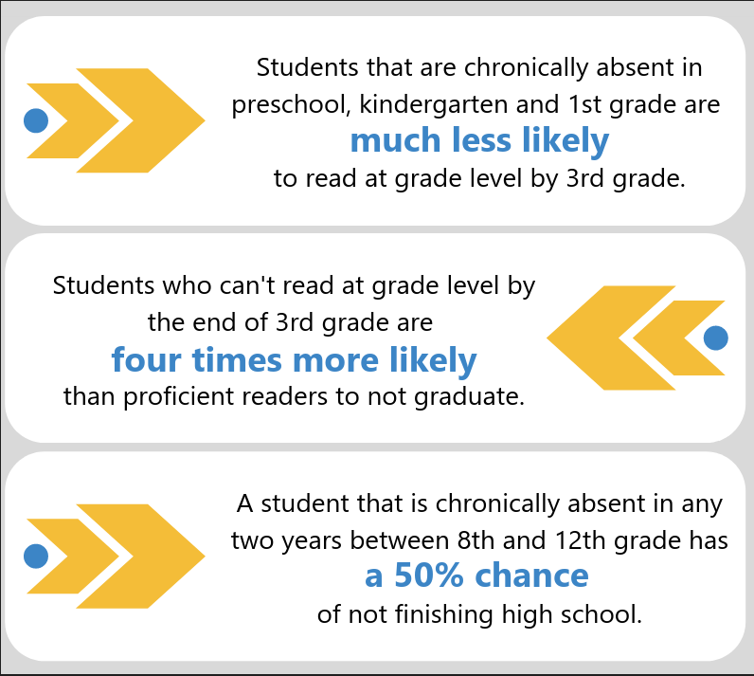
Chronic Absence: Research Highlights
Chronic Absence:
Research Highlights
Attendance in the Early Grades: Why it Matters for Reading
Utah Data Alliance – Chronic Absenteeism Research Brief

Slide 36
Attendance Matters
10 percent of the school year is 18 days in most school districts- That is an average of missing two days a month.
Students who live in communities with high levels of poverty are four times more likely to be chronically absent than others often for reasons beyond their control, such as unstable housing, unreliable transportation and a lack of access to health care.
Poor attendance can influence whether children read proficiently by the end of 3rd grade.
By 6th grade, chronic absence becomes a leading indicator that a student will drop out of high school.
9th grade attendance can be a better predictor of dropout rates that 8th grade test scores
Attendanceworks.org

Slide 37
Partnerships

Slide 38
Connect with your Student Information Systems Administrator Team
It is good to connect with your SIS Administrator/Team to co-facilitate any trainings for setting up attendance letters to run.
Provide support on reports for Attendance Teams to run regarding chronic absenteeism and truancy.
Review attendance code entry

Slide 39
Guest Speakers
Consider inviting key partners to discuss attendance:
Principals in schools that are teaming around attendance
McKinney Vento Specialist
Special Education Team
Student Information Systems Administrator/Team
ESD Attendance Support

Slide 40
Why do students miss school?

Slide 41
Absenteeism has many influencing factors
Physical illness
Experiencing homelessness
Anxiety or depression
Student
Community
School
Family
Caring for siblings
Transportation
Do not feel welcome or belong at school
Have fallen behind in learning
Unsafe or challenging home environment
Notes:
Why are students absent? Attendance is an indicator that can tell us any number of things! When a student is absent it could be because they have to go to the dentist, it could be because they are feeling anxiety or depression, the student might have responsibilities at home like taking care of their siblings, transportation may be a big issue, parents might be undervaluing regular attendance because they just don’t know the research and how many days missed are putting their students at risk, students could be experiencing bullying at school, or maybe they don’t feel socially connected, and staying home feels safer than braving the loud, busy, crowded comprehensive high school where they don’t have many friends or an adult who notices when they’re gone.
Don’t take my explanation to mean that we don’t believe students and parents have choice or influence over their attendance, it’s just that the context of their experience matters greatly to their attendance, which is a behavior, we can think about it like we think about behavior, as communication, what are the needs they are trying to communicate, and what can we do to understand them and meet them?

Slide 42
Absenteeism Underlying Causes
Absenteeism is an indicator with many underlying causes
Physical illness
Anxiety or depression
Caring for Siblings
Feeling unwelcome or lack of belonging at school
Transportation
Feeling academically behind
Unsafe or challenging home environment
Notes:
Why are students absent? Attendance is an indicator that can tell us any number of things! When a student is absent it could be because they have to go to the dentist, it could be because they are feeling anxiety or depression, the student might have responsibilities at home like taking care of their siblings, transportation may be a big issue, parents might be undervaluing regular attendance because they just don’t know the research and how many days missed are putting their students at risk, students could be experiencing bullying at school, or maybe they don’t feel socially connected, and staying home feels safer than braving the loud, busy, crowded comprehensive high school where they don’t have many friends or an adult who notices when they’re gone.
Don’t take my explanation to mean that we don’t believe students and parents have choice or influence over their attendance, it’s just that the context of their experience matters greatly to their attendance, which is a behavior, we can think about it like we think about behavior, as communication, what are the needs they are trying to communicate, and what can we do to understand them and meet them?

Slide 43
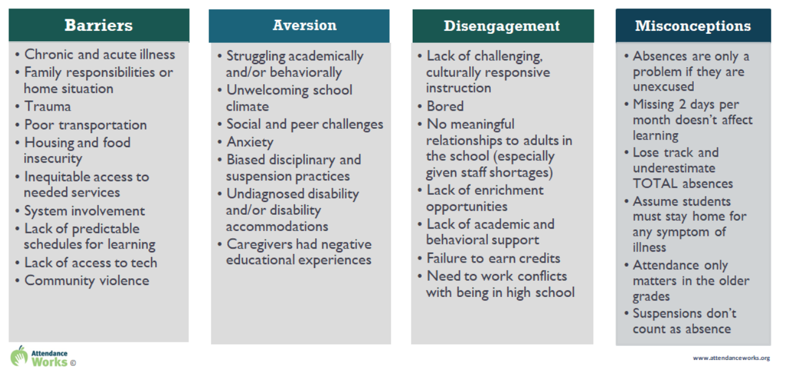
Root Causes that Impact School Attendance
Root Causes that Impact School Attendance
Root Causes
Notes:
There are many root causes to why a student is missing school. Attendance struggles are a symptom of barriers that a family is facing. Connecting with a family with curiosity allows us to identify supports and resources that can help to turn a student’s attendance around.

Slide 44
Potential underlying causes of absences
Unsafe school or community
Mental Health
Disability: diagnosed or undiagnosed
Transportation
Illness – Health Issues
No relationships or connection at school
Unwelcoming school climate
Access to secure housing
Instruction is not rigorous, relevant or engaging
Perceptions that attendance is not important
Lack of clean clothes and other barriers
Notes:
There are many root causes to why a student is missing school. Attendance struggles are a symptom of barriers that a family is facing. Connecting with a family with curiosity allows us to identify supports and resources that can help to turn a student’s attendance around.

Slide 45
What can we do to impact attendance?

Slide 46
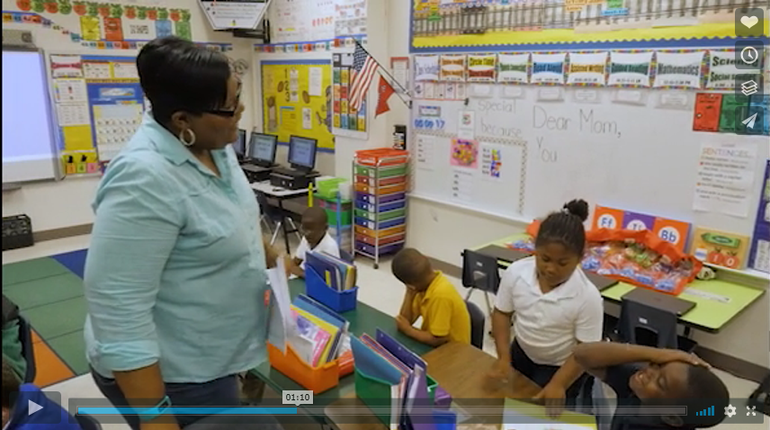
Teaching Attendance
https://vimeo.com/230450975

Slide 47
Greetings at the Door
Making Connections with Greetings at the Door

Slide 48
4 Ways to Start Connecting with Students in the First Week Back

Slide 49
How do we communicate about absences?
Tone
Letters
Acknowledging absences in a supportive manner
In person
We miss you postcards
Notes:
What tone do we use when we are talking to students and families about missing school or being late? Take a second to reflect on the last time you discussed absences with a student or their caregiver – what was the tone? You don’t have to share it. OR maybe you can remember a time when your child was late or absent – what was the tone of the conversation from the school? You don’t have to share. But out of curiosity, if you’re willing, how many of you reflected that the tone was a little judgey, or maybe shameful, or maybe a little dismissive, or guilt? How many of you recall a supportive conversation? How many of you could not think of a conversation? We, in this room, and all people really, do not respond well when someone tries to shame us, threaten us, dismiss us, ignore us, judge us – so we need to think deeply about how we are communicating to students and families when they are absent or late. We have an opportunity to build relationships – and offer support – absences are that kind of signal. Let’s not squander it.
Our school is a better place when you’re here – even if it’s not true

Slide 50
How are We Talking to Parents About Attendance?
Approach the issue of absences out of concern, rather than compliance
Frame the discussion around “absences” rather than “attendance”
Connect parents to the class curriculum to help them understand what their child may be missing
California Communications Toolkit
Notes:
Part of a toolkit created by the California Attorney General’s Office, the Ad Council, and the California Endowment, they sent communications experts to talk to nearly 1,000 parents of elementary school children who missed 10+ school days in the previous year. The website has a number of communication guides for teachers, secretaries, administrators, and nurses with these helpful tips.
1. Approach the issue of absences out of concern, rather than compliance
✓✓ Make parents feel supported, rather than guilty and in trouble
2. Refer to absences by month, rather than by year.
✓✓ Point out that just “2 days missed per month” has consequences, instead of “18 days missed per year”
5. Frame the discussion around “absences” rather than “attendance”
✓✓ Talking about “attendance” validates what parents already believe they do; talking
about “absence” focuses their attention on what they’re missing
7. Give parents specific reasons why absences matter, rather than making vague statements
✓✓ Say things like…
“You cannot make up for too many absences with homework or take-home assignments”
“Too many absences will allow them to fall behind in reading, writing and math”
“Too many absences now can actually make them less likely to graduate high school”
8. Connect parents to the class curriculum to help them understand what their child may
be missing
✓✓ Say things like…
“We are learning to identify numerators and denominators this week. Please make sure your
child does not miss school because his/her understanding of this lesson will make him better
prepared for next week’s lesson on adding fractions with common denominators”\

Slide 51
From “Parent Conference” to “Conversation” From “Contract” to “Commitment”
Conversation like: “Tell me more about what’s going on with your classes, and at home. Can you tell me more about why your missing school?”
Use research to show impacts of absences as opposed to an accountability message
Motivational Interviewing – what will drive the student to engage and change behavior?
Agreement that includes commitments from school, student, and family if necessary

Slide 52
“Be Curious, Not Judgmental”
Notes:
Stay curious. What we know about attendance is that the reasons a student is absent can because of multiple factors, some of those can originate in the school building, some of those might be at home. But we don’t know until we explore it with the student and family. We have an opportunity to stay curious. Not make assumptions.
Balancing accountability with support. We do believe that everyone has responsibility, including students, parents, but also educators, administrators, and us.

Slide 53
Learning
What are you learning about why students are absent?
Notes:
This is a good slide for a check in around the room, so that people can share either in a large group what they have learned, or in small groups. It is an opportunity to clarify that the information provided is understood, and answer questions that might be developing.

Slide 54
Attendance Awareness Campaign 2024
Social Media Campaign
Newspaper and/or Radio
Community partners to promote attendance
Plan for back-to-school events
Superintendent Call to Action

Slide 55
Attendance Works

Slide 56
Attendance Data

Slide 57
Chronic Absenteeism 2022-2023 School Year Data for Washington State
Notes:
You can add comparison charts for your local school district data. Copy chart into another blank slide, and select Chart Design and then edit data- you can add your data in to give a comparison.

Slide 58
2022-23 Percent of Washington State Students Chronically Absent by Federally Reported Race/Ethnicity
Notes:
You can add comparison charts for your local school district data. Copy chart into another blank slide and select Chart Design and then edit data- you can add your data in to give a comparison.

Slide 59
2022-23 Percent of Washington State Students Chronically Absent by Program and Characteristic
Notes:
You can add comparison charts for your local school district data. Copy chart into another blank slide and select Chart Design and then edit data- you can add your data in to give a comparison.

Slide 60
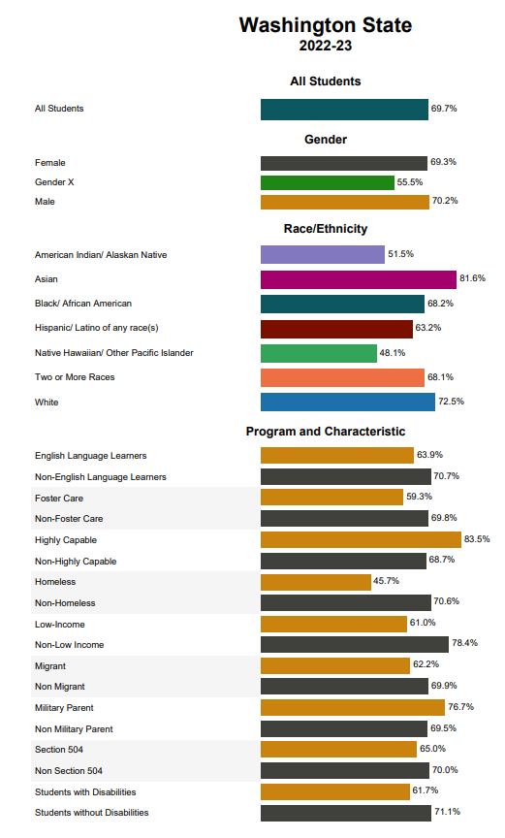
Chronic Absenteeism 2022-2023 School Year Data
OSPI Report Card provides data on positive attendance, or 69.7% of students achieved regular attendance.
Washington state 30.3% of students were chronically absent.
Add your school district data
OSPI Report Card | 11/1/2024

Slide 61
Statewide Trends from Washington Report Card (22-23)
Chronic Absence 30%
Regular Attendance 70%
70%
Students attended 90% or more of their school days
OSPI Report Card | 11/1/2024
Notes:
Current statewide trends show that 70% of students across the state are in regular attendance, which means that 70% of students are attending 90% or more of their school days. This is in line with national trends, we are not unique, and the good news is together we know a lot about how to improve attendance.

Slide 62
Placeholder for your District’s Regular Attendance data
Note – OSPI Report Card shows Regular Attendance, to show Chronic Absence data, subtract the Regular Attendance rates from 1

Slide 63
Attendance is Part of MTSS

Slide 64
Multi-Tiered Responses to Attendance
Multi-Tiered Response to Attendance
Tier 1: All Students
Engaging school climate & positive relationships with students and families
Define and teach “good attendance”
Celebrate good and improved attendance
Awareness efforts that educate parents about impact of absences
Absence data is monitored frequently
Proactive & positive messaging for absences
Address common barriers to attendance like transportation
Tier 2: Students with At-risk Attendance
Personalized early outreach
Group skill building (attendance advisory)
Action plan addresses barriers and increases engagement
Check in Check Out
Nudge letters
Tier 3: Students that are Chronically Absent
Coordinated school and interagency response
Home visitors, graduation & family support specialists
Check & Connect
Community Engagement Boards

Slide 65
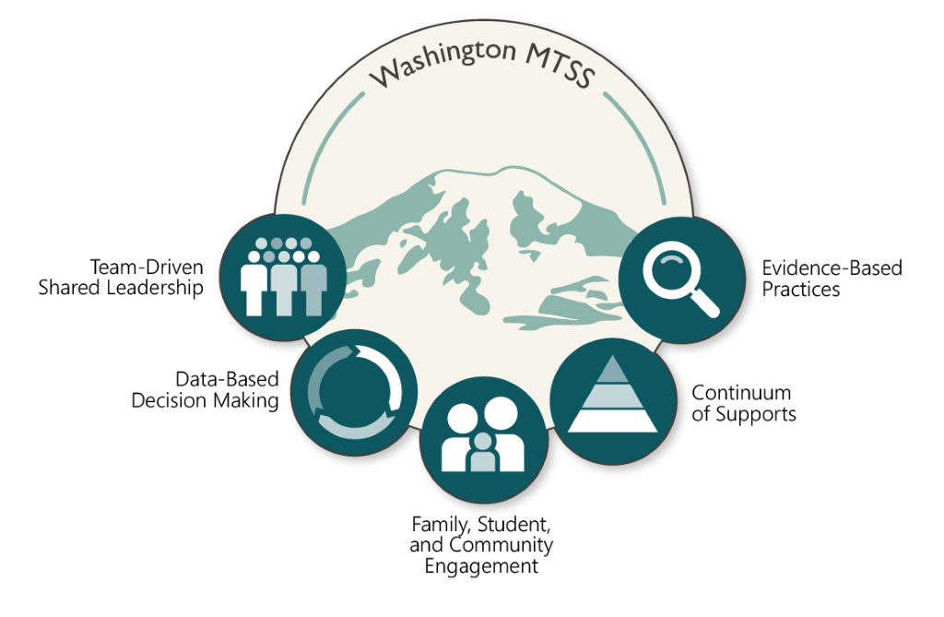
Washington MTSS
Attendance is a critical part of MTSS

Slide 66
Washington MTSS
Notes:
As part of the MTSS structure is teaming

Slide 67
Washington MTSS

Slide 68
The Three A’s of Data Literacy – Principal’s Role
Access
Broadening access to democratize data
Analysis & Sense-making
Know the levels: coarse to fine
Action Planning
Lead the change through progress monitoring
Help people make sense

Slide 69
Data-based Decision Making
Guiding questions to keep asking:
Who is missing?
Why are they missing?
What other information do we need to answer these two questions?
Are we ready to hear it's us, not them?
This Photo by Unknown Author is licensed under CC BY-SA

Slide 70
Team Data Literacy Capacity
What other data sources (besides attendance) can help you answer these questions?
Qualitative data (empathy interviews, student voice, focus groups, surveys, etc.)
Screening data (SEB, Academic, Attendance, Incident)
Health, safety data, transportation Data
Systems/practices fidelity data (PBIS, Attendance, Shape)
Students and families are critical contributors to this knowledge

Slide 71
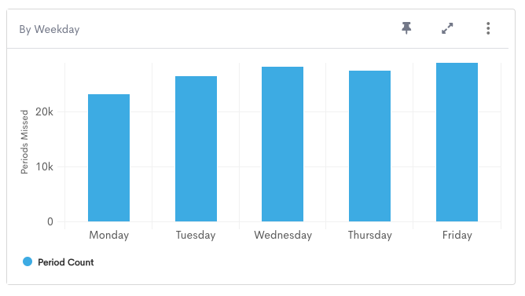
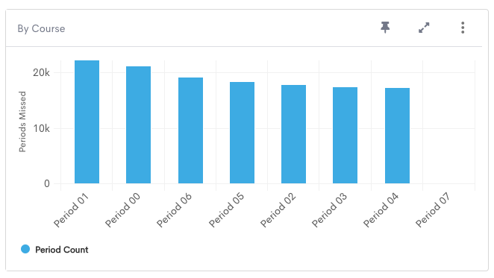
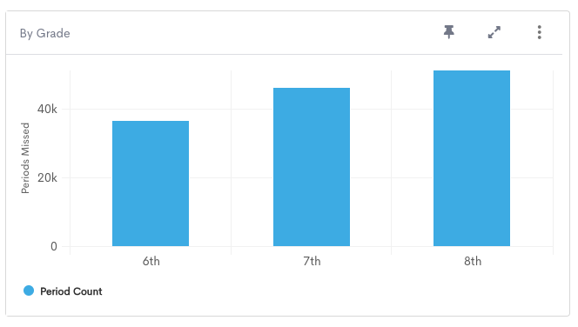
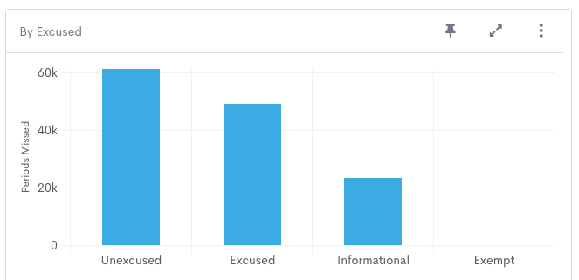
Tier 1 Attendance Data – Prevention
PBIS/Attendance Teams
Big 3 - Who, When, Why
Precision Problem Solving

Slide 72
Data, Prevention & Barriers, Interventions
Data
Prevention & Barriers
Interventions

Slide 73
Washington MTSS

Slide 74
Guiding Question
Is this practice beloved or predatory?
Does this practice maintain dignity, or does it shame?
Notes:
As a leader: always asking yourself is this practice

Slide 75
Teaming Around Attendance

Slide 76
Teams
Who could be on the team?
Principal/Assistant principal
Attendance clerk/front office
Counselor(s)
Nurse
School Psychologist
Parent

Slide 77
Teams
What does the team do?
Use qualitative/quantitative data
Plan tier 1 activities
Monitor student data weekly
Coordinate interventions to support students that are chronically absent or at-risk
Connect families and students to resources
Monitor progress.

Slide 78
Teaming for Better Attendance
Team(s) Functions
Analyze schoolwide and student group attendance trends
Organize an attendance continuum of support
Tier 1 - Establish universal prevention each month
Tier 2 - Define and Monitor Intervention Groups
Tier 3 - 1:1 Case Management
Leveraging student voice
Tips
Functions may not be the fulfilled by the same team
Functions may fit or be added to existing teams
Teams might be 2 people!
Principal’s Role
Authorize, sponsor and support teaming on attendance.
Notes:
Team can be embedded
Mobilize the school and greater community to address attendance
This aligns with the AWSP Leadership framework – which calls out Planning with Data and Closing the Gap

Slide 79
Teaming for Better Attendance
Principal’s Role
Authorize, sponsor and support teaming on attendance.
Counselor’s Role
Multiple options: team lead, data champion, always brings a school counselor lens
Tips
Functions may not be the fulfilled by the same team
Functions may fit or be added to existing teams
Teams might be 2 people!
Team(s) Functions
Analyze schoolwide and student group attendance trends
Organize an attendance continuum of support
Tier 1 - Establish universal prevention each month
Tier 2 - Define and Monitor Intervention Groups
Tier 3 - 1:1 Case Management
Leverage student voice
Notes:
I know in many of your districts you wear many hats and some of you may even be the Principal and the Counselor at your school. The Principal is a key role for authorizing, sponsoring, and supporting the teaming on attendance. A counselor’s role is to be a team lead, a data champion, and the person who always brings a school counselor’s lens of the whole child.

Slide 80
Tier 1 Attendance Strategies
Awareness & communication
Do parents know how to excuse absences?
Are schedules and attendance expectations communicated clearly and consistently?
Impact of attendance on the whole child is widely understood – families, students, and educators
Clear expectations of teachers
Incentives, celebrations & fun competitions
Connection to caring adult in the school
Notes:
Personalized communication to families when students are absent that sustains dignity like “Welcome back” and “We missed you” messages

Slide 81
Welcoming communication
Front office communication
Welcome back environment after school breaks
Follow up post-cards
How to talk to parents about attendance-communication that works

Slide 82
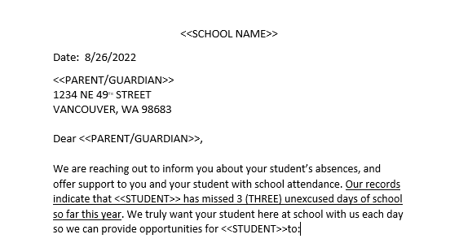
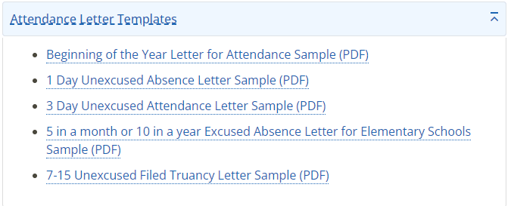
Tier 1 – Real World Examples
Human-Centered Attendance Communications
OSPI Letter Templates
Resource: OSPI Attendance Resources & Materials
Notes:
Universal means data driven too.
As a leader this practice is: supportive or harmful. Is it shame and blame or supportive

Slide 83
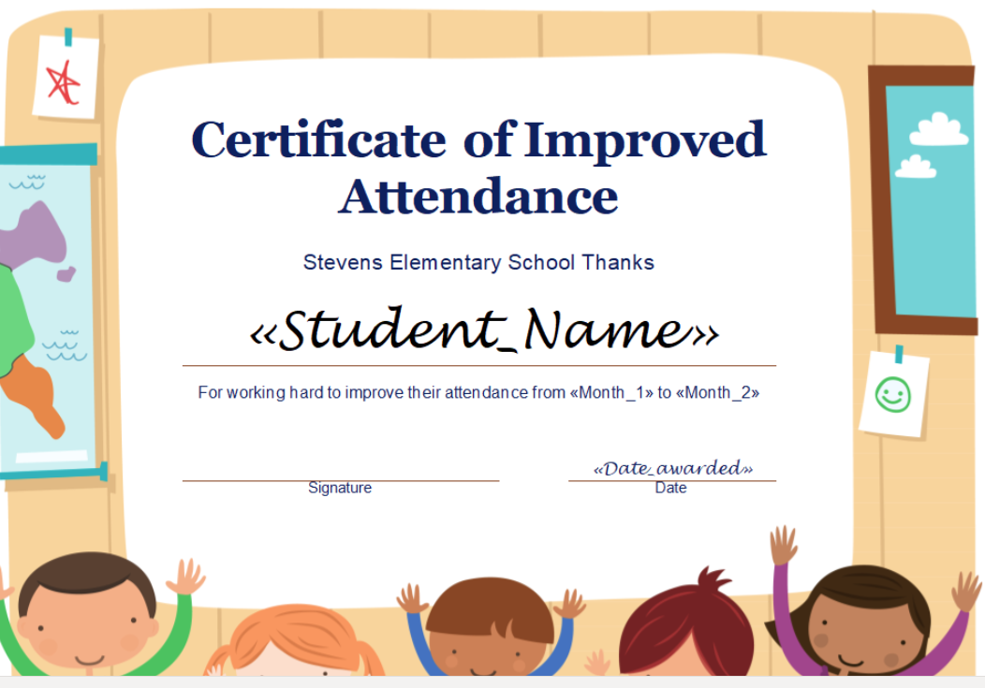
Tier 1 – Real World Examples
Improved Attendance Awards & Incentives
Attendance Challenges
Notes:
No perfect attendance, recognize improved attendance, lots of opportunities for individuals and whole classrooms or grades
Asking students what would incentive them?

Slide 84
Nudge Letters
Notes:
It is a researched based method to impact change. What are you nudging?

Slide 85
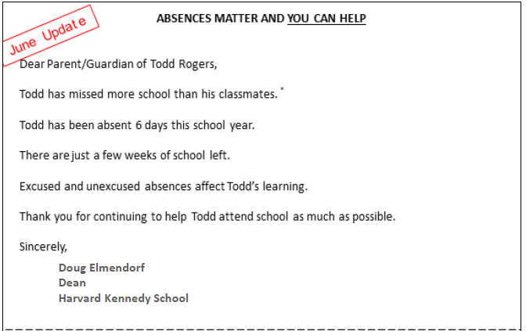
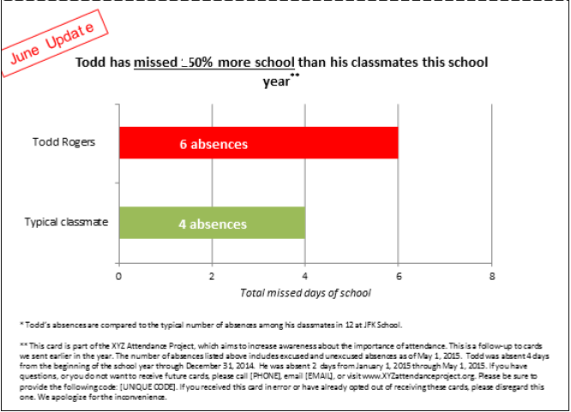
Nudge Letters
Todd Rogers, PhD, Harvard S3Labs
11/1/2024
85

Slide 86
Closing Slide
Consider adding links to resources your audience will refer to.
Provide your contact information and preferred form of contact

