Slide 1
Active Listening, Empathetic Listening & 80/20 Pareto Principle

Slide 2
Introduction
Effective communication involves clear and concise exchanges of information, ensuring the message is understood as intended.
The communication tools in this presentation are vital to fostering a collaborative environment that supports student success.

Slide 3
What is Active Listening?
Active listening is the practice of fully concentrating, understanding, responding, and remembering what is being said.
Key Techniques:
Be fully present
Use non-verbal cues
Reflect and paraphrase
Ask open-ended questions
Avoid interrupting
Withhold judgment

Slide 4
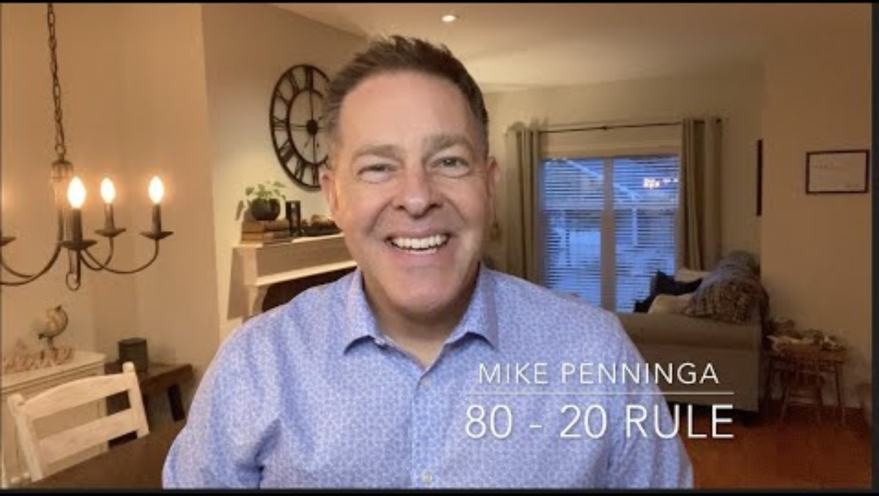
Learning to Talk Less & Listen More- My 80-20 Rule: Mike Penninga

Slide 5
Benefits of Active Listening
Improves Relationships: Builds trust and rapport
Enhances Understanding: Ensures accurate comprehension of messages.
Increases Engagement: Keeps conversations productive and meaningful.
Reduces Misunderstandings: Minimizes conflicts and errors

Slide 6
What is Empathetic Listening?
Empathetic listening involves understanding the speaker’s feelings, thoughts and perspectives.
Key Techniques:
Show genuine concern
Validate emotions
Use reflective listening
Be patient and non-judgmental

Slide 7
Benefits of Empathetic Listening
Builds Emotional Connections: Strengthens relationships by showing empathy.
Enhances Trust: Creates a safe space for open communication.
Improves Conflict Resolution: Helps in understanding underlying issues.
Promotes Healing: Provides emotional support and validation

Slide 8
What is the Pareto Principle or the 80/20 rule?
The Pareto Principle, also known as the 80/20 rule, states that 80% of effects come from 20% of causes.
Named after Italian economist Vilfredo Pareto, who observed that 80% of Italy’s land was owned by 20% of the population.

Slide 9
Applications of the Pareto Principle
Communication: Listen 80% of the meeting and contribute 20%.
Student and Family plan: Develop a plan that will support in the family receiving 80% success outcomes with 20% of the effort.
80% of problems are caused by 20% of the situations.
Prioritize activities that bring the most value.

Slide 10
Integrating the Concepts
Active and Empathetic Listening: Use both to enhance communication and understanding.
Pareto Principle: Apply it to prioritize listening efforts and focus on key conversations.
Overall Impact: Improved relationships, productivity, and personal growth.

Slide 11
Conclusion
Questions?
Practice these skills in additional areas of your life to support your conversations in the board spaces.

