Slide 1
Community Engagement Board Training Template

Slide 2
Vision
Add in your district vision.
Mission
Add in your district mission statement
Values
Add in your district values

Slide 3
Equity Statement
Add in your district equity statement

Slide 4
Tribal Land Acknowledgement
I would like to acknowledge the Indigenous people who have stewarded this land since time immemorial and who still inhabit the area today, the Steh-Chass Band of Indigenous people of the Squaxin Island Tribe.

Slide 5
Agenda
State Requirements – Compulsory Attendance
Review of RCW 28A.225, WAC 392-401, and the Becca Law
Community Engagement Board Trainings
Links to Videos and PowerPoint Trainings
Why Do Students Miss School?
Root Causes for Absences
What is Your Role as a Volunteer?
Connection with Student and Family, Building an Attendance Agreement

Slide 6
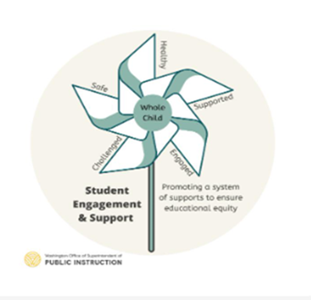
OSPI Attendance Guiding Principles
Attendance and engagement are foundational to student learning
Absences tells us when a student has not accessed instruction, and therefore all absences matter
Absences are a critical early warning indicator that:
can reflect inequities that are caused by or perpetuated by our systems or
when a student and family might need more support
We have an opportunity to get curious about why students aren’t attending
Students and families are our best partners to understand the barriers to attendance
The purpose of attendance and truancy interventions are to reduce barriers to attendance and support students to engage; not to punish
Schools and districts have lots of opportunity for prevention and intervention before involving the Court

Slide 7
Why Does Attendance Matter?
“Reestablishing a routine of daily attendance- recognizing that students might miss a day on occasion – in school is crucial to nurturing an educated, healthy and skilled next generation with the hard and soft skills needed for a strong economy”
~Attendance Works
Attendance Works Policy Brief 2024

Slide 8
State Requirements – Compulsory Attendance

Slide 9
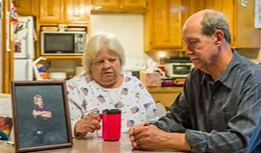
The Becca Bill: 28A.225.RCW
Community Engagement Boards
All school districts must designate and coordinate a board of volunteers to address excessive absenteeism and truancy
“Becca” Rebecca Hedman
Becca’s chronic truancy and running away from home led to her murder at the age of 12.
1993
1995
2016
Becca’s parents and legislators lobbied to pass the Becca Bill, requiring children 8 to 18 to attend public school regularly, with few exceptions.

Slide 10
Parents/guardians and children have a legal responsibility to enroll in education and attend
Ages 8 – 18
Public, private or home-based instruction (homeschool)
With some exceptions
RCW 28A.225.010

Slide 11
Differentiating Terms
Chronic Absence
Excused and unexcused absences: a student missing 10% or more of their school days, excused and unexcused
Truancy & Compliance
Unexcused absences: 7 unexcused absences in a month or 15 unexcused absences in a year.
Shared Goal
Regular attendance, students accessing their education.

Slide 12
Attendance Matters
10 percent of the school year is 18 days in most school districts- That is an average of missing two days a month.
Students who live in communities with high levels of poverty are four times more likely to be chronically absent than others often for reasons beyond their control, such as unstable housing, unreliable transportation and a lack of access to health care.
Poor attendance can influence whether children read proficiently by the end of 3rd grade.
By 6th grade, chronic absence becomes a leading indicator that a student will drop out of high school.
9th grade attendance can be a better predictor of drop out rates that 8th grade test scores
Attendanceworks.org

Slide 13
Chronic Absenteeism 2023-2024 School Year Data
OSPI Report Card provides data on positive attendance, or 72.7% of students achieved regular attendance.
Washington state 27.3% of students were chronically absent.
Add your school district data

Slide 14
Districts’ Required Steps when Students are Absent Unexcused
Notify parents after 1 unexcused absence
Schedule a conference with student and parent to identify barriers and make a plan
Administer an assessment to identify barriers
Provide data-based interventions
File a truancy petition
Refer the student or parent to Community Engagement Board
Attendance & truancy interventions and outreach must be attempted prior to withdrawing or filing a petition
Elementary Attendance & Truancy Required Steps
Secondary Attendance & Truancy Required Steps
Notes:
If these steps have not occurred or been attempted, withdrawing them makes it much harder to reduce barriers, get in touch. If a student is withdrawn, the school and district are still responsible for these steps. Withdrawing them does not eliminate that requirement.

Slide 15
What is a Community Engagement Board?
What is a Community Engagement Board (CEB)?
A Community Engagement Board (CEB), as outlined in RCW.28A.225.026, addresses truancy through other coordinated interventions aimed at identifying barriers to school attendance. The CEB is intended to connect students and their families with community services, culturally appropriate promising practices, and evidence-based services such as functional family therapy. Ideally the school district shall use the CEB as a tool to foster partnerships among families, educators, and the broader community to address attendance barriers. These meetings are intended to bring families and school districts together to facilitate collaborative discussions aimed at developing comprehensive strategies to increase attendance rates and enhance school engagement.
This Photo by Unknown Author is licensed under CC BY-NC

Slide 16
Community Engagement Board Trainings

Slide 17
Core Components
80/20 Pareto Principle
Confidentiality
FERPA
Science of Hope
Motivational Interviewing
Notes:
-It is important to review Confidentiality and FERPA laws with volunteers. Identifying what their role is in the board, and that student information is private is key to a successful board.
-80/20 Pareto Principal- attached is a video that can provide information for volunteers to have a tool in their pocket for supporting volunteers to focus on the key barriers and a strategic approach to achievement. It is recommended to remind volunteers that the Pareto Principle also applies to listening to families – families should do 80% of the talking and board members 20% of the talking. Or in other words listen 80% (not thinking about reply) and then talking 20% of the time.
-Science of Hope is another tool to offer board members. Determining if the student/family is struggling with the motivation for attendance, or if there is a barrier that they need to determine the pathway to navigate is a tool that is highly successful, and can improve a students attendance, grades, and overall success.
-Motivational Interviewing video- this video talks about clinician and client but letting your board members know that they can change clinician to the board, and client to the student and family these skills can be very effective in supporting school attendance.

Slide 18
Core Components
Active Listening
Resources
Alternative Learning Education Opportunities
School District Attendance Policies & Procedures

Slide 19
Board Member Expectations
Attendance
Regular attendance and communication if unavailable to attend
Training
Motivational Interviewing
What is Hope Science?
Active, Comprehensive, Empathetic Listening
Three Ways to Be a Better Listener
Curiosity
Be Curious Not Judgmental
Dignity and Belonging
Youth voices: Locating Identity, Agency, & Belonging in all Learning Spaces
Confidentiality & Privacy
School Volunteers and FERPA

Slide 20
Roles & Responsibilities
Start each meeting
Identify three board members for each role
On weeks that you are not in a role, you are still an active key member of providing support for building the attendance plan
Introductions
Discussion guidance
Keep conversation on track
Promote open dialogue
Encourage participation
Foster collaboration
Facilitator
Timekeeper
Time management
Provide reminder of time
Discreetly signal facilitator
Attendance plan development
Attendance contract preparation
Review attendance contract with student, family, and board members
Notetaker

Slide 21
Why Do Students Miss School?

Slide 22
Absenteeism is an indicator with many underlying causes
Physical illness
Anxiety or depression
Caring for Siblings
Feeling unwelcome or lack of belonging at school
Transportation
Feeling academically behind
Unsafe or challenging home environment

Slide 23
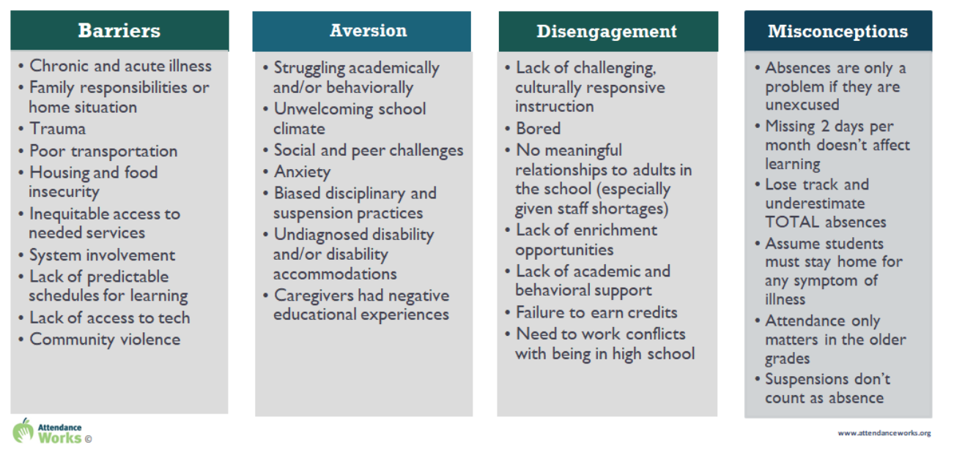
Root Causes that Impact School Attendance
Root Causes

Slide 24
What is your role as a volunteer?

Slide 25
Students Want to Learn
Parents Want Their Student to Be Successful in School
Listen with open ears, clear eyes, and a curious mind

Slide 26
Keys to Supporting Increased Attendance
Advocacy
Encouragement
Listening
Realistic Agreement
Relationship
Support
This Photo by Unknown Author is licensed under CC BY-NC-ND

Slide 27
Recommendations
Student
Parent
Adjusted schedule for capacity Building
Connect with school counselor
Daily check in for two weeks with student’s choice
Educational Supports- Tutoring
Extra-Curricular Activities- Clubs, Sports, Theatre
Communication plan (connect parent with one correspondent in school for follow up)
Connection to local resources
Parenting support
Routine support
*Remember: Most of the students and family’s you will meet with just need somebody to:
Cheer in their corner
Help them
Listen to them

Slide 28
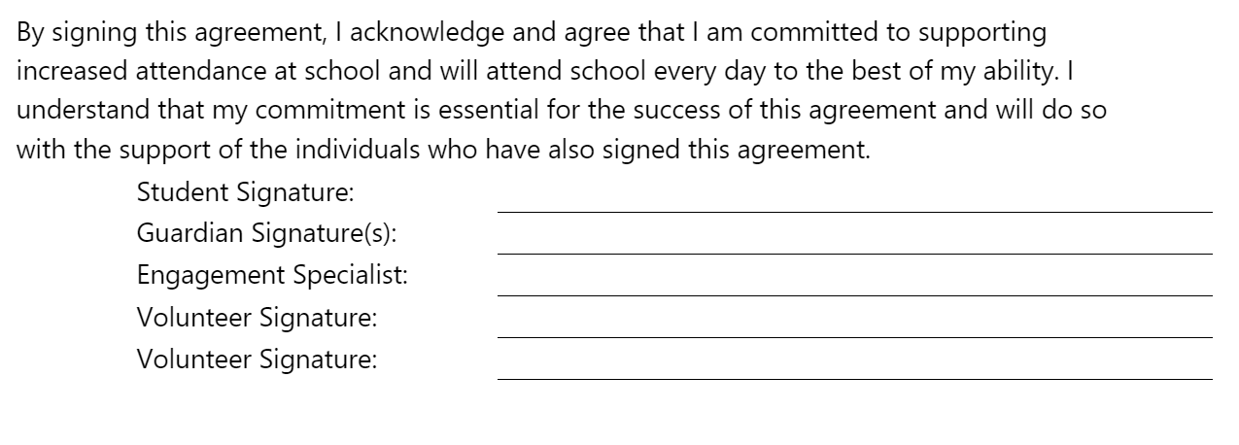
Community Engagement Board Agreement
Actionable realistic tasks to reduce or eliminate absences
Student
Parent/Guardian
School
Review agreement with all parties
Adjust and confirm all actions
Request signatures from all people in room
Provide family with a copy of the agreement
Community Engagement Board Agreement

Slide 29
There’s Nothing Stronger Than The Heart of A Volunteer. ~ Jimmy Doolittle

