Slide 1

FERPA & Maintaining student Confidentiality

Slide 2
Introduction
Understanding FERPA
Importance of Student Confidentiality

Slide 3
What is FERPA?
Family Educational Rights and Privacy Act (FERPA)
Protects the privacy of student education records
All schools receiving funds from the U.S. Department of Education must honor FERPA Laws.

Slide 4
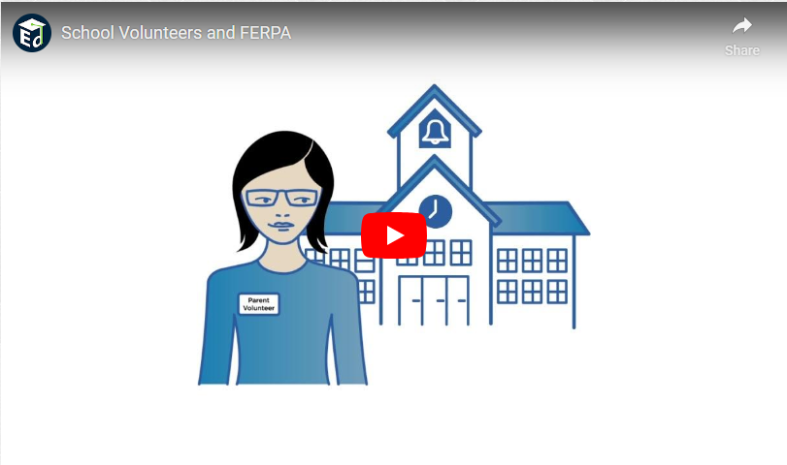
School Volunteers & Ferpa
Notes:
Hold Control Key and click on picture to start the video.

Slide 5
Rights under FERPA
Parents and eligible students can inspect and review education records
Correct records believed to be inaccurate or misleading
Written permission required to release information

Slide 6
Maintaining Confidentiality
Return all agendas and any student information at end of Community Engagement Board.
Share information only with authorized personnel.
Avoid discussing student information outside of Community Engagement Board.
Notify Community Engagement Board lead if confidentiality is compromised.

Slide 7
Conclusion
Questions & Concerns

