Slide 1

MIC3 WA State Council Meeting 14 Oct 2025 9:00 –11:00 AM Via Zoom
Please Enter Your Name & Organization In Chat
GREGORY J. LYNCH | Commissioner glynch@oesd114.org| ph 360.286.4712

Slide 2


Meeting Agenda – October 14, 2025 9:00 AM to 11:00 AM Zoom: https://us02web.zoom.us/j/82500215760
9:00 - 9:05 Agenda & MIC3 Overview WA MIC3 Commissioner Greg Lynch
9:05 - 9:15 Welcome & OSPI Update State Superintendent Chris Reykdal
9:15 - 9:30 State Council Update & MIC3 National Meeting Preparation WA MIC3 Commissioner Greg Lynch
9:30 - 9:45 JBLM Update JBLM Garrison Commander Col Joe Handke
9:45 - 9:50 WA National Guard Update Commander WA Air NG BG Ken Borchers
9:50 - 9:55 WA State Board of Education (SBE) Update SBE Executive Director Randy Spaulding
9:55 - 10:00 WA Interscholastic Activities Association (WIAA) Update WIAA Executive Director Mick Hoffman
10:00 – 10:30 WA MIC3 Compact Lessons Learned & Improvements
School Liaisons Kelly Scheese and Antoinette Walker
Dixie Gruenfelder (OSPI)
Superintendents Prince, Banner, Weight, Leavell, Headrick, Kuss-Cybula
10:30 - 10:35 Final Q&A and Wrap-up WA MIC3 Commissioner Greg Lynch
MIC3 Annual National Business Meeting 50 State Commissioners + DC Indianapolis, Indiana 22 – 24 Oct 2025

Slide 3
WA MIC3 State Council
(August 2025)
Legal Counsel
Optional
Governor Rep
Commissioner
Legislators
Major General Welsh
WA Adjutant General (TAG)
Chair, Greg Lynch
Vice Chair, Erin Prince
CKSD Superintendent
Tina Orwall, Senator
Leonard Christian, Senator
Dave Paul, Representative
Hunter Abell, Representative
Head Dept. of Education
School District (SD) Superintendents (High % Military Children)
Chris Reykdal, State Superintendent of Public Instruction
Kimberly Headrick Medical Lake SD (Fairchild AFB)
Aaron Leavell, OESD 114 (NBK)
Erin Prince, Central Kitsap SD (NBK)
Ron Banner, Clover Park SD (JBLM)
Michelle Kuss-Cybula, Oak Harbor SD (NAS Whidbey Island)
Kathi Weight, Steilacoom (JBLM)
Military DoD Rep
Ex-Officio Members
Military/Uniform Family Liaison
Col Joseph Handke
Commander JBLM
Randy Spaulding, Exec. Director SBE
Mick Hoffman, Exec. Director WIAA
Christine Rolfes, Kitsap County Commissioner
New Members
Antoinette Walker, JBLM
Kelly Scheese, NRNW

Slide 4

MIC3 Dues Revenue National Planning Considerations
State dues provides 99% of MIC3 revenue
MIC3 does not have taxing authority
Inflation must be accounted for
Student enrollment is subject to significant fluctuation
State fiscal processes & Commissioner involvement is variable
Plan for every 2 - 3 years to discuss dues increases with appropriate details
Commissioner lead planning times for a dues increase are very different

Slide 5


National MIC3 Proposed Dues Increase Inflation Catch-up FY 27 + 4 % Annual Increase FY 28 – FY 31
MIC3
State Council
WA MIC3 Students 24,739 | FY 26 | FY 27 | FY 28 | FY 29 | FY 30 | FY 31
Dues/Student | $1.15 | $1.78 | $1.85 | $1.92 | $2.00 | $2.08
Total Dues | $28,450 | $44,036 | $45,767 | $47,498 | $49,478 | $51,457
Total Annual Increase | $0.00 | $15,586 | $1,731 | $1,731 | $1,980 | $1,979

Slide 6
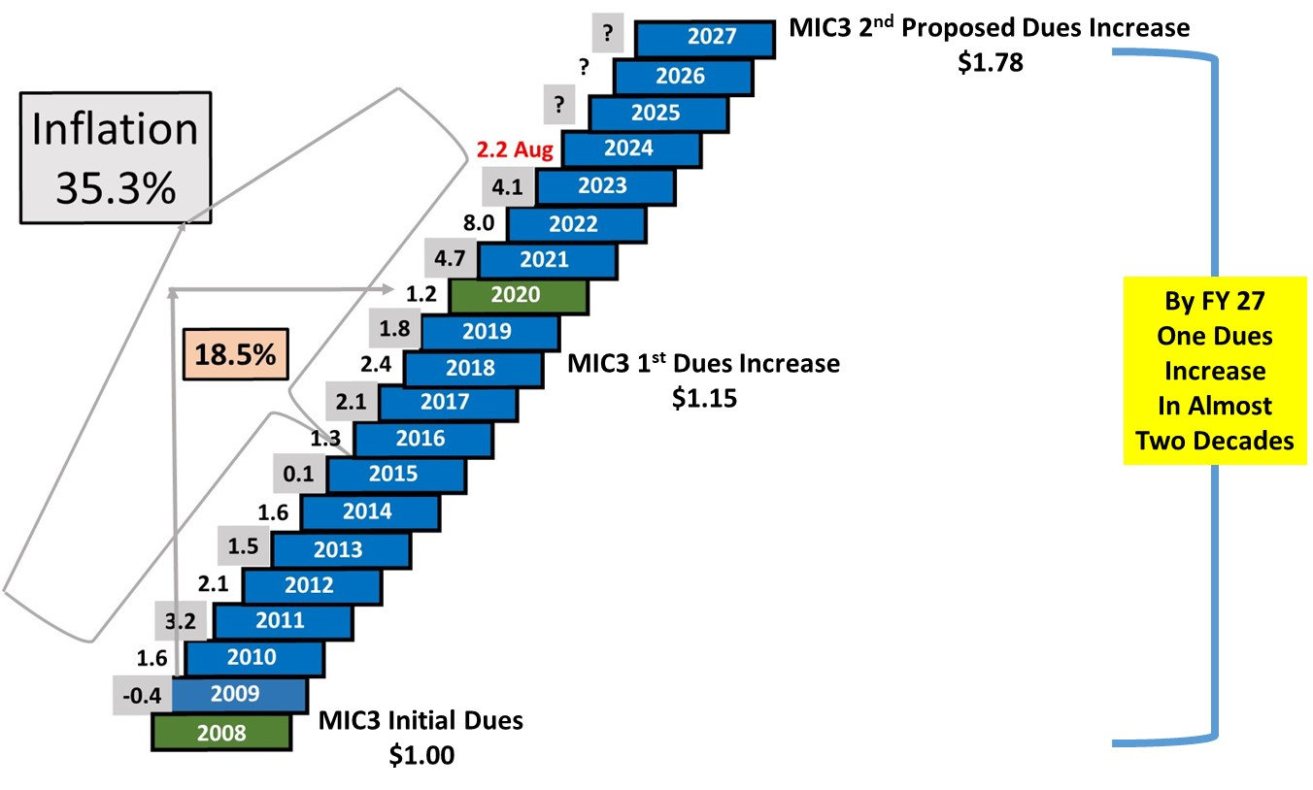
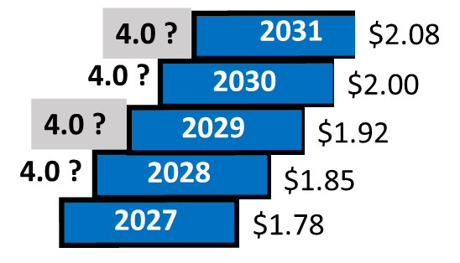
MIC3 Inflation & Dues Increases 2027 - 2031
Next MIC3 #3 Proposed Dues Adjustment
FY 32

Slide 7
Dues Increase National Survey All Commissioners ABM New Mexico Fall 2024
MIC3 Formal Dues Increase Vote By All Commissioners During The National Annual Business Meeting (ABM)
October, 2025 Indianapolis, Indiana
Will Your State
Support A Dues
Increase?
80% YES
2% NO
18% DON’T KNOW

Slide 8
National Dues Supports
Member State Benefits
National Office and Administration
State Compact Professional Development
State Compact Program Administration and Support
Technical and Legal Advisement
MIC3 National Advocacy and Education
Advertising and Promotion Materials
Annual Business Meeting – Travel Expenses
https://www.mic3.net/publications.html

Slide 9
Interstate Compact on Educational Opportunities for Military-Connected Students Results of Implementation Survey
Dixie Grunenfelder, Executive Director of Student Engagement & Support
Office of Superintendent of Public Instruction
October 2, 2024

Slide 10
Military Compact Implementation Survey
The Survey was conducted in Spring 2024.
Participants included district representatives/Superintendents from 24 districts serving large number of military-connected students. Participation rate = 100%
Questions centered on implementation of Compact components.

Slide 11
Report of Implementation

Slide 12
Compact Provision #1: Unofficial or “Hand-Carried" Education Records
Level of Implementation | 2024 Percentage | 2014 Percentage
The provision is being SUBSTANTIALLY implemented. | 100% | 100%
The provision is currently being PARTIALLY implemented. | 0% | 0%
The provision is NOT AT All being implemented. | 0% | 0%
Notes:
In the event that official education records cannot be released to the parents, for the purpose of transfer, the custodian of the records in the sending state shall prepare and furnish, to the parent, a complete set of unofficial educational records containing uniform information as determined by the Interstate Commission. Upon receipt of the unofficial education records by a school in the receiving state, the school shall enroll and appropriately place the student based on the information provided in the unofficial records pending validation by the official records, as quickly as possible.
May reach out for additional info while waiting for official records.

Slide 13
Compact Provision #2: Kindergarten and First Grade Entrance Age
Level of Implementation | 2024 Percentage | 2014 Percentage
The provision is being SUBSTANTIALLY implemented. | 100% | 90%
The provision is currently being PARTIALLY implemented. | 0% | 10%
The provision is NOT AT All being implemented. | 0% | 0%
Notes:
Students shall be allowed to continue their enrollment at grade level in the receiving state commensurate with their grade level (including Kindergarten) from a local education agency in the sending state at the time of transition, regardless of age. A student that has satisfactorily completed the prerequisite grade level in the local education agency in the sending state shall be eligible for enrollment in the next highest grade level in the receiving state, regardless of age. A student transferring after the start of the school year in the receiving state shall enter the school in the receiving state in their validated level from an accredited school in the sending state.

Slide 14
Compact Provision #3: Course Placement
Level of Implementation | 2024 Percentage | 2014 Percentage
The provision is being SUBSTANTIALLY implemented. | 100% | 90%
The provision is currently being PARTIALLY implemented. | 0% | 10%
The provision is NOT AT All being implemented. | 0% | 0%
Notes:
When the student transfers before or during the school year, the receiving state school shall initially honor placement of the student in educational courses based on the student's enrollment in the sending state school and/or educational assessments conducted at the school in the sending state if the courses are offered. Course placement includes, but is not limited, to Honors, International Baccalaureate, Advanced Placement, vocational, technical, and career pathways courses. Continuing the student's academic program from the previous school, promoting placement in academically, and career challenging courses should be paramount when considering placement. This does not preclude the school in the receiving state from performing subsequent evaluations to ensure appropriate placement and continued enrollment of the student in the course(s).
Match with best available courses.

Slide 15
Compact Provision #4: Placement Flexibility
Level of Implementation | 2024 Percentage | 2014 Percentage
The provision is being SUBSTANTIALLY implemented. | 100% | 85%
The provision is currently being PARTIALLY implemented. | 0% | 15%
The provision is NOT AT All being implemented. | 0% | 0%
Notes:
Local education agency administrative officials shall have flexibility in waiving course/program prerequisites or other preconditions, for placement in the courses/programs offered under the jurisdiction of the local education agency. Identify the degree to which this provision of the compact is currently being implemented in your district.

Slide 16
Compact Provision #5: Absences Related to Deployment
Level of Implementation | 2024 Percentage | 2014 Percentage
The provision is being SUBSTANTIALLY implemented. | 100% | 95%
The provision is currently being PARTIALLY implemented. | 0% | 5%
The provision is NOT AT All being implemented. | 0% | 0%
Notes:
A student whose parent or legal guardian is an active-duty member of the uniformed services, as defined by the compact, and has been called to duty for, is on leave from, or immediately returning from deployment to a combat zone or combat support posting, shall be granted additional excused absences at the discretion of the local education agency superintendent to visit with their parent or legal guardian relative to such leave or deployment of the parent or guardian.
Up to 5 additional days “Military Block Leave”.

Slide 17
Compact Provision #6: Eligibility for Enrollment
Level of Implementation | 2024 Percentage | 2014 Percentage
The provision is being SUBSTANTIALLY implemented. | 100% | 90%
The provision is currently being PARTIALLY implemented. | 0% | 10%
The provision is NOT AT All being implemented. | 0% | 0%
Notes:
A military child, placed in the care of a non-custodial parent or other person standing in loco parentis, who lives in a jurisdiction other than of the custodial parent, may continue to attend the school in which they were enrolled while residing with the custodial parent.
Monitor and ensure have additional resources as needed.

Slide 18
Compact Provision #7: Waiver Requirements of #1 - Course Waivers
Level of Implementation | 2024 Percentage | 2014 Percentage
The provision is being SUBSTANTIALLY implemented. | 100% | 90%
The provision is currently being PARTIALLY implemented. | 0% | 10%
The provision is NOT AT All being implemented. | 0% | 0%
Notes:
Waiver requirements #1: In order to facilitate the on-time graduation of children of military families, states and local education agencies shall incorporate the following procedures: Local education agency administrative officials shall waive specific courses required for graduation if similar course work has been satisfactorily completed in another local education agency or shall provide reasonable justification for denial.

Slide 19
Compact Provision #8: Waiver Requirements #2 – Alternatives to Graduation
Level of Implementation | 2024 Percentage | 2014 Percentage
The provision is being SUBSTANTIALLY implemented. | 100% | 95%
The provision is currently being PARTIALLY implemented. | 0% | 5%
The provision is NOT AT All being implemented. | 0% | 0%
Notes:
In order to facilitate the on-time graduation of children of military families, states and local education agencies shall incorporate the following procedures: Should a waiver not be granted to a student who would qualify to graduate from the sending school (subject to waiver requirement described in question 14 above), the local education agency shall provide an alternative means of acquiring required coursework so that graduation may occur on time.

Slide 20
Compact Provision #9: Transfer During Senior Year
Level of Implementation | 2024 Percentage | 2014 Percentage
The provision is being SUBSTANTIALLY implemented. | 92% | 95%
The provision is currently being PARTIALLY implemented. | 8% | 5%
The provision is NOT AT All being implemented. | 0% | 0%
Notes:
Should a military student transferring in their senior year be ineligible to graduate from the receiving local education agency after all alternatives have been considered, the sending and receiving local education agencies shall ensure that receipt of a diploma from the sending local education agency, if the student meets the graduation requirements of the sending local education agency. In the event that one of the states in question is not a member of this compact, the member state shall use best efforts to facilitate the on-time graduation of the student in accordance with Sections A and B of this Article (these 'sections' of the compact are represented by waiver requirements described in questions 14 and 16 above).
Other states prove difficult to work with at times to meet requirement.

Slide 21
Compact Provision #10: Official Education Records/Transcripts
Level of Implementation | 2024 Percentage | 2014 Percentage
The provision is being SUBSTANTIALLY implemented. | 100% | 90%
The provision is currently being PARTIALLY implemented. | 0% | 10%
The provision is NOT AT All being implemented. | 0% | 0%
Notes:
Official education records/transcripts: Simultaneous with the enrollment and conditional placement of the student, the school in the receiving state shall request the student's official education record from the school in the sending state. Upon receipt of this request, the school in the sending state will process and furnish the official education records to the school in the receiving state within ten (10) days or within such time as is reasonably determined under the rules promulgated by the Interstate Commission.

Slide 22
Compact Provision #11: Immunizations
Level of Implementation | 2024 Percentage | 2014 Percentage
The provision is being SUBSTANTIALLY implemented. | 100% | 85%
The provision is currently being PARTIALLY implemented. | 0% | 15%
The provision is NOT AT All being implemented. | 0% | 0%
Notes:
Compacting states shall give thirty (30) days from the date of enrollment, or within such time as is reasonably determined under the rules promulgated by the Interstate Commission, for students to obtain any immunizations(s) required by the receiving state. For a series of immunizations, initial vaccinations must be obtained within thirty (30) days or within such time as is reasonable determined under the rules promulgated by the Interstate Commission.

Slide 23
Compact Provision #12: Education Program Placement
Level of Implementation | 2024 Percentage | 2014 Percentage
The provision is being SUBSTANTIALLY implemented. | 100% | 95%
The provision is currently being PARTIALLY implemented. | 0% | 5%
The provision is NOT AT All being implemented. | 0% | 0%
Notes:
The receiving state school shall initially honor placement of the student in the educational programs based on the current educational assessments conducted at the school in the sending state or participation/ placement in like programs in the sending state. Such programs include, but are not limited, to 1) gifted and talented programs and 2) English as a second language (ESL). This does not preclude the school in the receiving state from performing subsequent evaluations to ensure appropriate placement of the student.

Slide 24
Themes of Inquiries to OSPI
Kindergarten Enrollment
Graduation Requirements
Pre-enrollment in Special Services

