Slide 1
K–12 Washington State Learning Standards for Mathematics (2025)
Data Science Standards Overview
Notes:
Welcome!
Today we're going to take you through an overview of the new data science standards in mathematics for Washington state! Thanks for joining us!

Slide 2

Vision
All students prepared for post-secondary pathways, careers, and civic engagement.
Mission
Transform K–12 education to a system that is centered on closing opportunity gaps and is characterized by high expectations for all students and educators. We achieve this by developing equity-based policies and supports that empower educators, families, and communities.
Values
Ensuring Equity
Collaboration and Service
Achieving Excellence through Continuous Improvement
Focus on the Whole Child
Notes:
OSPI's vision for student success in postsecondary pathway, careers and civic engagement propels the new data science standards in mathematics into action as students use these tools to problem solve and think flexibly about mathematics. Students will then be equipped to consider data and information in the world around them as they engage in society each day.

Slide 3
Equity Statement
Each student, family, and community possesses strengths and cultural knowledge that benefits their peers, educators, and schools.
Ensuring educational equity:
Goes beyond equality; it requires education leaders to examine the ways current policies and practices result in disparate outcomes for our students of color, students living in poverty, students receiving special education and English Learner services, students who identify as LGBTQ+, and highly mobile student populations.
Requires education leaders to develop an understanding of historical contexts; engage students, families, and community representatives as partners in decision-making; and actively dismantle systemic barriers, replacing them with policies and practices that ensure all students have access to the instruction and support they need to succeed in our schools.
Notes:
As we consider OSPI's equity statement, providing data science teaching and learning opportunities for all students across the state supports equitable access to mathematics for all students, mathematics that is meaningful in students lives, and communities, and connected to things they are curious about. Teaching mathematics through data science creates opportunities for partnership with families, organizations in the community, and educators across the school. In this way, math moves away from a subject whose only real world connection is word problems, toward a subject that is fluid, connected, and is closer to the form that mathematics takes in science, industry, and research, preparing Washington students for any path beyond high school.

Slide 4
Mathematics is contextual, connected, and meaningful.
Mathematics is contextual,
connected, and meaningful.
Engage in data science inquiry
Apply the Standards for Mathematical Practice
Develop efficient, flexible, and accurate strategies
Learn mathematics through four broad domains
Notes:
The shifts in the revised standards focus on relevance, connection and sense making to help students develop the skills necessary to investigate data science, embrace multiple ways to demonstrate what they know and what they bring to mathematics learning while encouraging a deeper understanding of the interconnectedness of math concepts.

Slide 5
Why Data Science?
Interdisciplinary
Application of mathematics, information science, and can include computer science principles.
Data Driven Society
Analyze and understand data in everyday life.
Make decisions based on data and data analysis.
Content Integration
Data science connects math to social studies (history and civics), science, English language arts, computer science, etc.
Math in Context
Data science inquiry to examine important issues like spread of invasive species, access to resources in the community, etc.
Career and Industry
Data science skills are in demand in the job market.
Data science is increasingly a component of college coursework.
Prepared for the Future
Inquiry and problem-solving skills to consider, question, and be critical consumers of data.
Notes:
So why add data science and why now?
First and foremost, data science is an application of mathematics and statistics, information science like data visualizations, and computer science (particularly in college and university spaces) to collect and analyze data to define or understand an issue, and to work toward a recommendation or solution. We'll define this a bit more in the next slide.
Our society has been a data driven society for many years with the presence of streaming, news, and social media platforms, among others, collecting and analyzing consumer data in order to efficiently reach more users.
As these shifts have happened outside of school, there is value in understanding how data can connect learning inside school through content integration of mathematics and other subjects in meaningful and authentic ways. Data science provides an onramp for deeply discussing issues of importance within a classroom, school, and community and connects learning across content areas naturally. This could include asking questions about hot topics like chronic wasting disease in local deer populations, or an analysis of the local infrastructure and whether it has the capacity to address flooding control as the community grows,
Additionally, across industries, data is increasingly a foundational skill folded into job descriptions. This shift is not isolated to careers in computer science, but includes marketing, the health care industry, and commercial manufacturing to name a few.
As consumers of information from a wide variety of forms and services, people are constantly being shown data that indicates a story or conclusion. Washington’s students need access to skills in data science not only to be adequately equipped to enter college and career pathways, but also to critically consider data and information they are faced with.

Slide 6
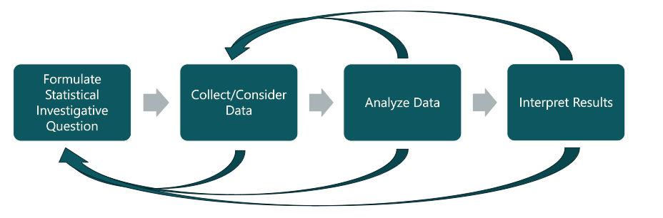
Data Science Inquiry
Notes:
To address student skills in data science and data literacy:
The new data science standards help students ask meaningful statistical questions, collect and analyze data, and interpret results. The data science inquiry cycle and data science standards includes understanding principles of data collection, data maintenance, data analysis, data visualizations, inference, and interpretation and communication of results from the given data set. Data science inquiries can be explored with the assistance of technology as appropriate for the given grade.
The new standards focus on fostering creativity and critical thinking, allowing students of all ages to engage in data inquiries, from basic statistical questions in early grades to more complex analysis at higher levels.
The data science standards are written to be used in real-world applications across subjects.
It is important to note that the arrows on this graphic emphasize the iterative nature of the data science inquiry cycle, and as students engage in the process they can revise their questions, their conclusion, choose to collect more data, etc, further supporting data science as a way of engaging in mathematics that builds and supports critical thinking and problem solving.

Slide 7

Standards for Mathematical Practice
Continually engaged in problem-solving through:
  Perseverance
  Looking for and making use of patterns and structure
  Examining relationships, contexts, and causality
  Reasoning about process and results
  Using tools to visualize and model data
  Attending to precision in data collection and modeling
  Constructing viable arguments to justify conclusions
Notes:
The revised mathematics learning standards are structured to demonstrate the interconnected mathematics concepts, with the standards for mathematical practice serving as a foundation from which mathematics teaching and learning is built.
By centering/emphasizing math in meaningful contexts with data science the standards for mathematical practice are elevated, engaging students in reasoning, communication, use of technology, and the development of resilient problem-solving skills they will carry into college and careers.

Slide 8
Data Literacy vs. Data Science
Data Literacy
Read, interpret, understand data and data visualizations
Limited to Analyze and Interpret parts of the Data Science inquiry cycle
Important for all students across all grades
Data Science
All four parts of the Data Science inquiry cycle
Essential for all students across all grades and automatically includes Data literacy
Facilitates greater depth of creativity and problem-solving than Data Literacy alone
Notes:
Often the phrases data literacy and data science are used interchangeably. However, the math standards are intentional is focusing on data science.
Data literacy is still an important skill that students must have. This skill is used when analyzing and interpreting data visualizations like graphs and charts in places like the news or during sports games. Data literacy requires and understanding of data and statistics at a foundational level but does not necessarily require students to apply their understanding of different mathematical calculations.
Data science, because it is grounded on all four parts of the data inquiry cycle, not only includes teaching students about data literacy, but also builds students understanding in the creativity and curiosity of collecting and analyzing data sets from a question of their own making, and formulating an interpretation from that data. From here students can be tasked to make clear and convincing arguments about their conclusion that other students then apply data literacy skills to interpret and potentially question. While data literacy and data science are both important, data science prepares Washington students for postsecondary careers through equipping them to be knowledgeable and discerning data consumers.

Slide 9
Data Science is for Everyone
All students can engage in:
Curiosity
Asking questions
Consider what data/information is needed to explore the question
Collect and count data
Think about what the data means
Draw a conclusion from the data
Consider “Now what?” from the data
Notes:
Across all grades, with educator guidance as needed in different contexts, data science creates the space in mathematics teaching for students to delve deeply into topics that are driven by curiosity. The curiosity connects to mathematics content standards across all grades, whether that is kindergarten students collecting data about the number of sunny or rainy days in a month, and comparing each month, to students in middle school analyzing student's favorite college team and determining which players from across different colleges would make the perfect team, toward more complex data science inquries in high school like working with the city or county to analyze storm water run-off over time compared against land use, land use changes, and development to determine if the municipal infrastructure can redirect stormwater runoff and mitigate road closures in extreme weather conditions.
Curiosity and data science skills equip students to be civically engaged and ready for their postsecondary aspirations.

Slide 10
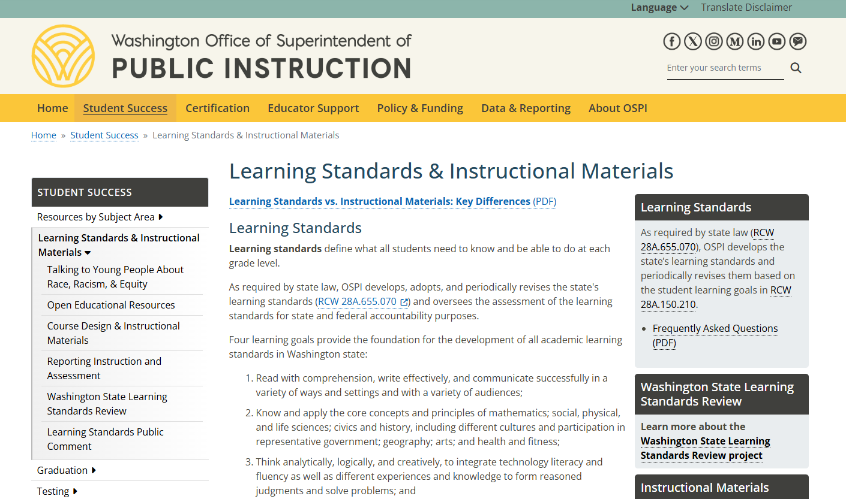
Where to find information on the learning standards review project
Where to Find Information on the Learning Standards Review Project
Notes:
You can find more information on the learning standards review page. To get there first go to ospi.k12.wa.us
Click on the yellow ribbon across the top and hover over student success
A drop down menu will appear, select Learning Standards and Instructional materials
The learning standards review page will be in the grey box on the right, as indicated in the arrow on this slide
We hope this information has been helpful as you explore the revised mathematics standards for Washington state.
Thank you for joining us today!

Slide 11
How to connect with OSPI

