Slide 1
K-12 Washington State Learning Standards for Mathematics (2025)
Fluency in the Standards
Notes:
Welcome!
Today we're going to take you through an overview of fluency in the standards for mathematics in Washington state! Thanks for joining us!

Slide 2

Vision
All students prepared for post-secondary pathways, careers, and civic engagement.
Mission
Transform K–12 education to a system that is centered on closing opportunity gaps and is characterized by high expectations for all students and educators. We achieve this by developing equity-based policies and supports that empower educators, families, and communities.
Values
Ensuring Equity
Collaboration and Service
Achieving Excellence through Continuous Improvement
Focus on the Whole Child
Notes:
When students develop fluency, we’re supporting their ability to think, reason, and problem-solve independently, preparing them for post-secondary pathways, careers, and civic engagement. This aligns with the agency’s vision for equity-centered systems that support the whole child and hold high expectations for every student.

Slide 3
Equity Statement
Each student, family, and community possesses strengths and cultural knowledge that benefits their peers, educators, and schools.
Ensuring educational equity:
Goes beyond equality; it requires education leaders to examine the ways current policies and practices result in disparate outcomes for our students of color, students living in poverty, students receiving special education and English Learner services, students who identify as LGBTQ+, and highly mobile student populations.
Requires education leaders to develop an understanding of historical contexts; engage students, families, and community representatives as partners in decision-making; and actively dismantle systemic barriers, replacing them with policies and practices that ensure all students have access to the instruction and support they need to succeed in our schools.
Notes:
As we consider OSPI's equity statement, Focusing on fluency as efficient, flexible, and accurate expands access to meaningful mathematics. When students are supported to use strategies that build from understanding, rather than speed or memorization, they are better able to engage, persist, and demonstrate their thinking. This approach reduces barriers created by one-size-fits-all methods and affirms that every student can develop strong mathematical understanding.

Slide 4
Mathematics is contextual,
connected, and meaningful.
Engage in data science inquiry
Apply the standards for mathematical practice
Develop efficient, flexible, and accurate strategies
Learn mathematics through four broad domains
Notes:
The shifts in the revised standards focus on relevance, connection and sense making and fluency is a critical throughline across all of these shifts.
As students engage in data science inquiry, fluency supports their ability to reason with quantities, analyze data efficiently, and focus on interpretation rather than getting stuck in computation.
Through the Standards for Mathematical Practice, fluency shows up in choosing strategies, persevering, checking for reasonableness, and making sense of problems—not just executing steps.
Developing efficient, flexible, and accurate strategies makes fluency explicit. It clarifies that fluency is about thoughtful strategy use grounded in understanding, not speed.
And by organizing learning through four broad domains, students experience mathematics as connected ideas rather than isolated topics—allowing fluency to develop across contexts and over time.
Together, these shifts position fluency as something students use to make sense of mathematics, not something they practice in isolation.

Slide 5
Fluency
Flexibility
Efficiency
Accuracy
Notes:
Historically, fluency in mathematics has been misunderstood. In practice, it often became associated with speed, how quickly students could produce answers, rather than how well they understood and used mathematics.
As a result, fluency was frequently interpreted as “fast and correct,” leading to widespread use of timed tests and memorization-focused practice. While these approaches may measure speed, they do not capture how students reason, choose strategies, or make sense of problems.
Research and experience show that speed alone is not fluency. In fact, an overemphasis on speed can mask misunderstandings, increase anxiety, and limit students’ opportunities to develop strong mathematical thinking.
The revised standards intentionally clarify fluency as efficient, flexible, and accurate—shifting the focus away from how fast students work and toward how thoughtfully and effectively they use mathematics.

Slide 6
Fluency
Selects an appropriate strategy.
Trades out or adapts a strategy.
Solves in a reasonable amount of time.
Efficiency
Notes:
When we talk about efficiency, we are not focusing on speed or how fast a student can solve a problem. We are talking about making smart choices.
Efficient students select an appropriate strategy for the problem in front of them. They look at the numbers, the structure and the context of the task and choose a method that makes sense, rather than automatically defaulting to a single procedure.
Efficiency also means solving in a reasonable amount of time. That doesn’t mean rushing or racing. It means students are not getting stuck, bogged down, or working through unnecessary steps. The strategy they choose allows them to move forward productively.
And finally, efficient students are able to trade out or adapt a strategy if or when their first approach isn’t working. They recognize when a method is becoming inefficient or overly complex and are able to make a deliberate decision to adjust. This flexibility in the moment is a hallmark of true fluency and mirrors how problem solving works outside the classroom.

Slide 7
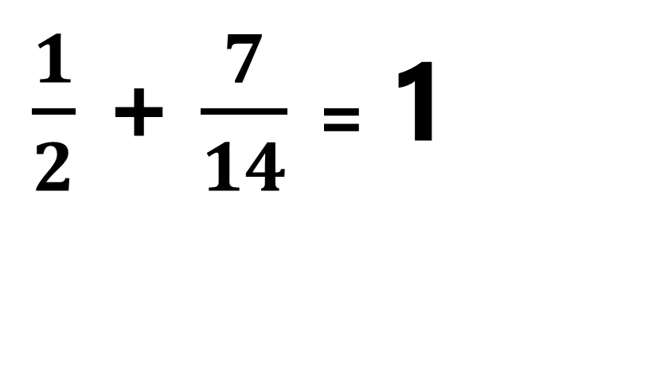
Efficiency
6 x 7
1000 – 7 = 993
Repeated addition
Skip counting by 7s
3 groups of 7 and double
5 groups of 7 and add 1 more group
$\frac{1}{2}$ + $\frac{7}{14}$ = 1
Notes:
For a student who is unsure about what six groups of seven is they could add 7 six times. Or perhaps skip count by 7s. A more efficient strategy may be taking a known fact like 3 groups of seven and doubling it, or knowing that 5 groups of seven is 35 and adding one more group.
It would not be efficient for a student to use the standard algorithm for a problem of this type.
Nor for a problem like this.

Slide 8
Fluency
Trades out or adapts a strategy.
Applies a strategy to a new problem type.
Flexibility
Notes:
It also takes us to our next component of fluency, flexibility.
When students do decide to switch out or adapt a strategy they are able to adjust their thinking in response.
Flexiblity also shows up when students apply a strategy to a new problem type. They are able to generalize what they know, using familiar strategies in unfamiliar situations. For example, a strategy that works with whole numbers can be adapted to fractions, decimals, or algebraic expressions.
This ability to transfer and adapt strategies illustrates a deep understanding. It shows that students are not just following memorized steps but making sense of mathematics and using it flexibly across contexts.

Slide 9
Flexibility
4 x 7
2 groups of 7 and double
4 x 9
2 groups of 9 and double
10 groups of 4 and subtract 4
Notes:
This ability to trade out a strategy might look like this. A student may efficiently apply the doubling strategy when multiplying 4 groups of seven. But when they apply that strategy to four groups of nine they may find that it’s not efficient to double 18. The student may then take a known fact like ten groups of four and subtract a group.

Slide 10
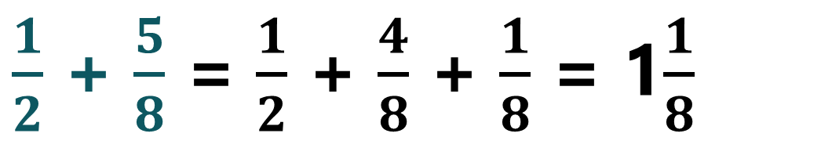
7 + 9 = 6 + 10 = 16
Flexibility
Enduring
Strategies
Making Tens
395 + 786 = 400 + 781 = 1181
4.9 + 1.8 = 5 + 1.7= 6.7
$\frac{1}{2}$ + $\frac{5}{8}$ = $\frac{1}{2}$ + $\frac{4}{8}$ + $\frac{1}{8}$ = 1$\frac{1}{8}$
-24 + 38 = -24 + 24 +14 =14
Notes:
This ability to flexibly apply strategies to new problem types is supported by explicitly teaching students enduring strategies that extend to other types of numbers.
One example begins with the early addition strategy of making a ten. Over time, that same idea expands as students make a hundred with larger numbers, make a whole with decimals and fractions, and eventually make zero when working with integers.

Slide 11
Fluency
Completes steps accurately.
Gets the correct answer.
Accuracy
Notes:
And accuracy… When we talk about accuracy, we are talking about correctly carrying out a strategy or procedure and arriving at a correct result.
Accurate students complete steps correctly. They attend to details, use mathematical conventions appropriately, and follow through on their chosen approach.
Historically, accuracy has been the component of fluency that receives the most attention in classrooms and assessments. In many cases, it is the only component that is explicitly measured. While accuracy is essential, it does not, by itself, represent full fluency.
True fluency requires accuracy alongside efficiency and flexibility. When all three are developed together students are better prepared to reason, problem-solve, and make sense of mathematics in meaningful ways.

Slide 12
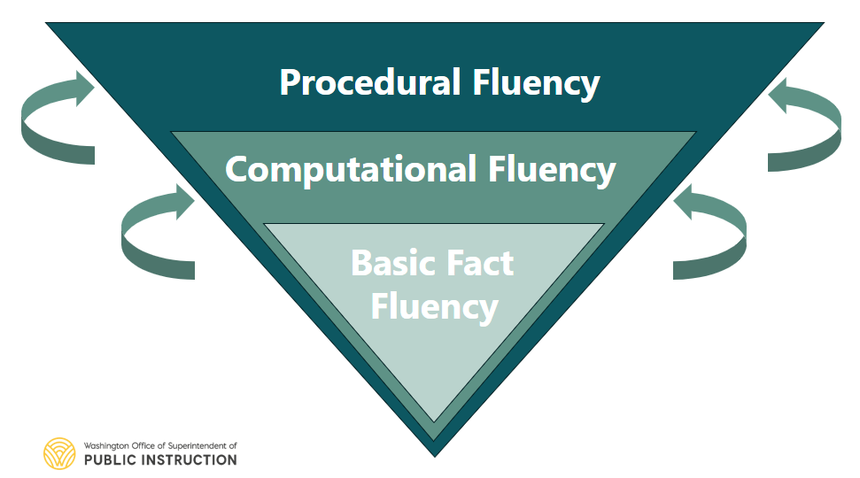
Notes:
Fluency develops over time. It begins with basic fact fluency, like single-digit addition and subtraction. It expands into computational fluency, where students use efficient strategies with multi-digit operations. And ultimately, it becomes procedural fluency, the ability to apply procedures, such as solving equations, with understanding. These layers are not separate or sequential checkboxes, they are interconnected, with each one strengthening the next.
Procedural fluency goes far beyond rote memorization or speed. It is defined as the ability to apply procedures efficiently, flexibly, and accurately. That means students have a repertoire of strategies grounded in conceptual understanding. Fluent students can evaluate different approaches, choose methods that makes sense for the problem at hand, and continually check their work for reasonableness. These actions mirror real world problem solving not just in school mathematics.
And this is where instruction plays a critical role. Fluency does not develop automatically. All students, regardless of background or ability, need intentional opportunities to build fluency through strong conceptual foundations, explicit strategy instruction, and meaningful practice. When these conditions are in place fluency becomes an access point, supporting confidence, strategic thinking, and efficient problem solving.

Slide 13

Fluency in the Standards
Old 3.OA.C.7: “Fluently multiply and divide within 100, using strategies such as the relationship between multiplication and division (e.g., knowing that 8 × 5 = 40, one knows 40 ÷ 5 = 8) or properties of operations. By the end of Grade 3, know from memory all products of two one-digit numbers.”
New M.3.Q.OA.7: “Efficiently, flexibly, and accurately multiply and divide within 100, using strategies such as the relationship between multiplication and division (e.g., knowing that 8 × 5 = 40, one knows 40 ÷ 5 = 8) or properties of operations.
Notes:
This is just one example of a revised fluency standard at third grade.
If you haven’t already I would invite you to walk through the standards with a lens on fluency.
Highlight or note where you see:
language related to strategy use,
references to efficiency or reasonableness,
evidence of flexibility or multiple approaches,
and language that goes beyond “correct answers.”

Slide 14

Where to Find Information on the Learning Standards Review Project
Notes:
You can find more information on the learning standards review page. To get there first go to ospi.k12.wa.us
Click on the yellow ribbon across the top and hover over student success
A drop down menu will appear, select Learning Standards and Instructional materials
The learning standards review page will be in the grey box on the right, as indicated in the arrow on this slide
We hope this information has been helpful as you explore the revised mathematics standards for Washington state.
Thank you for joining us today!

Slide 15
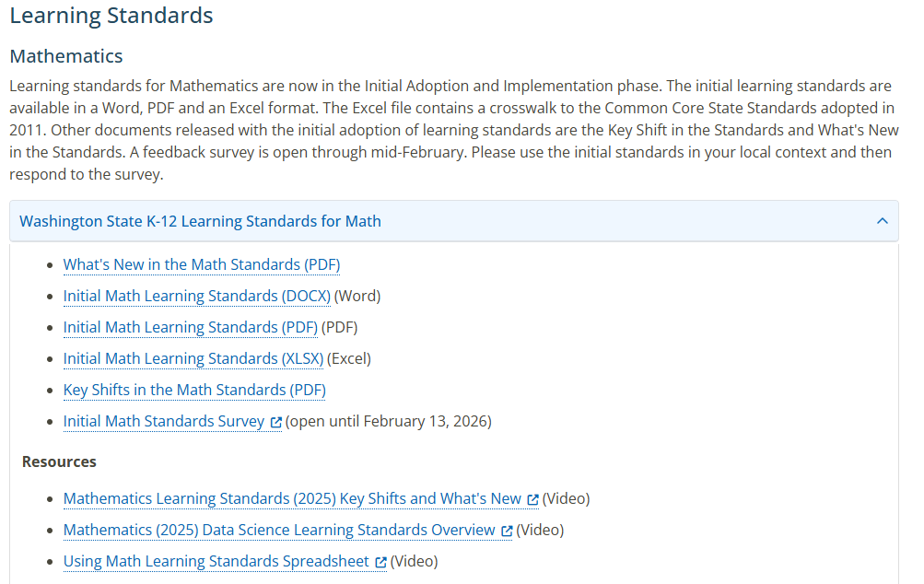
Where to Find Information on the Initial Math Learning Standards
Notes:
Walk through how to find the learning standards review page on our website.

Slide 16
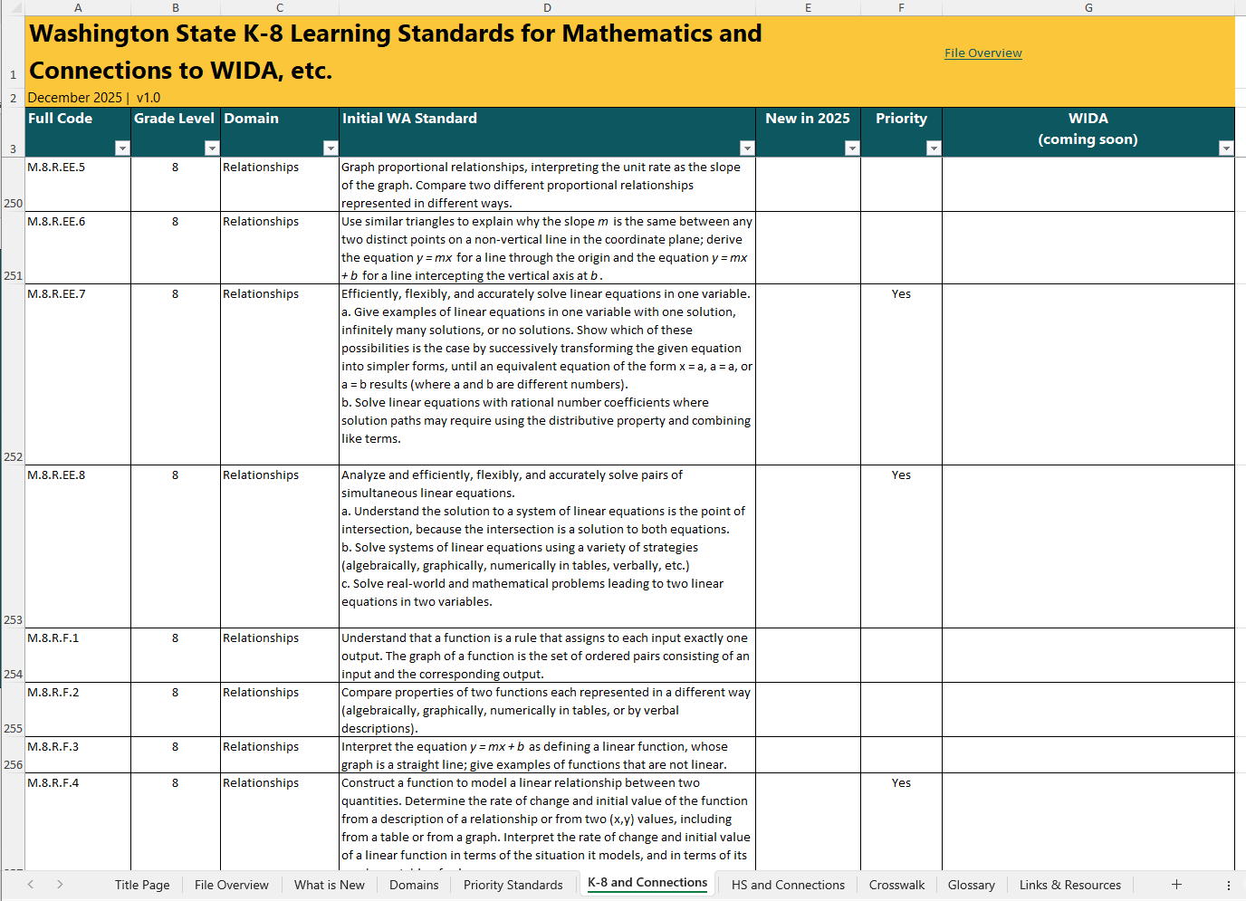
Notes:
Walk through how to find the learning standards review page on our website.

Slide 17
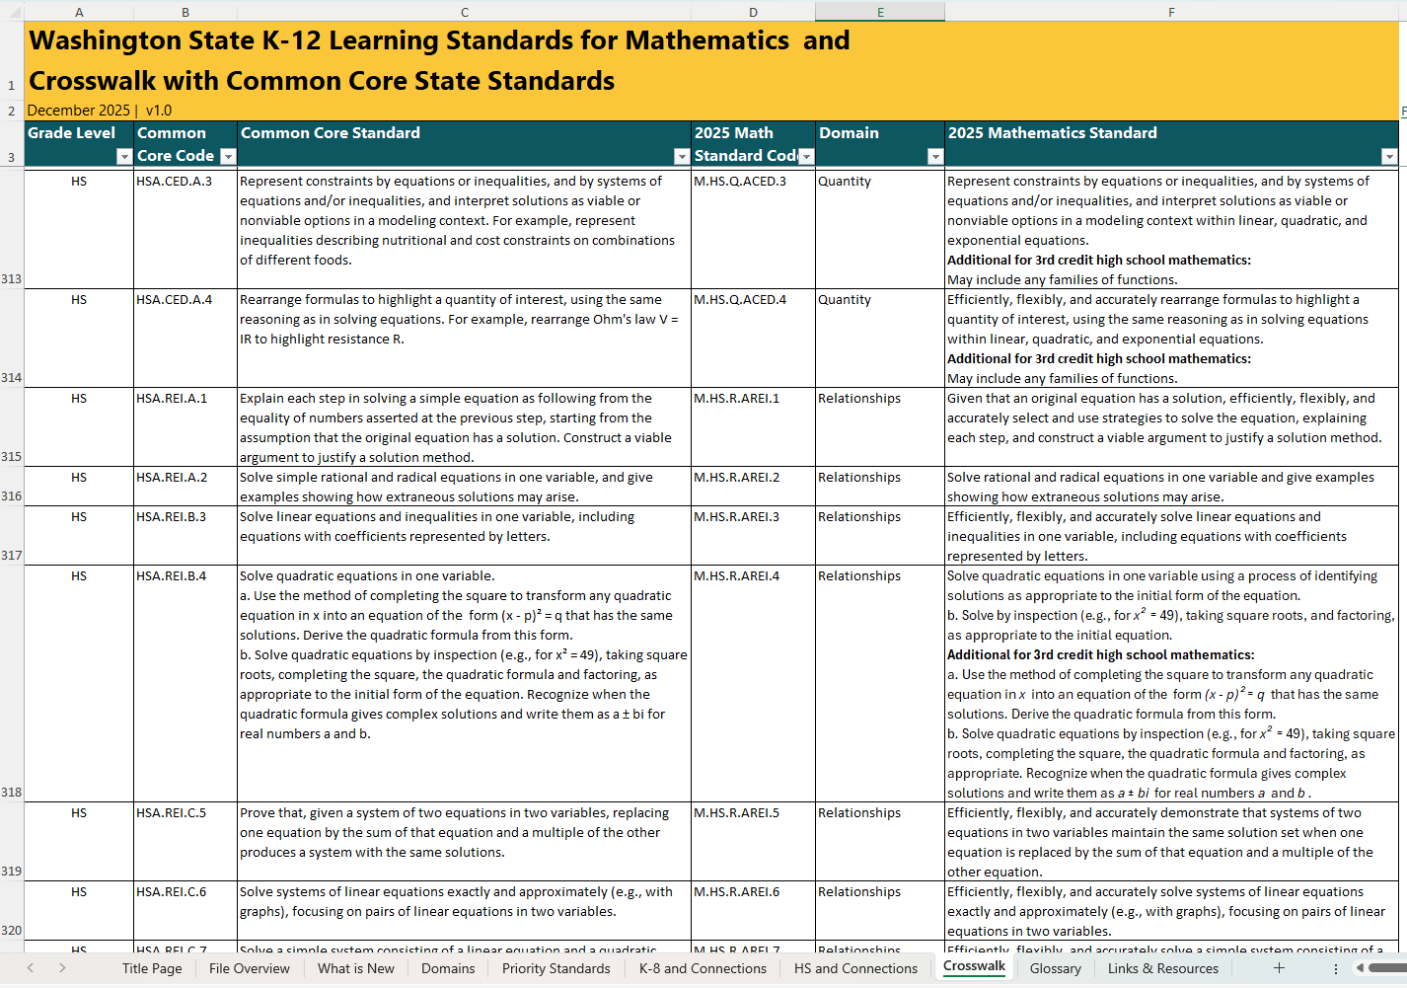
Notes:
Walk through how to find the learning standards review page on our website.

