Slide 1
K–12 Washington State Learning Standards for Mathematics (2025)​
Updates to High School Learning Standards
Notes:
Welcome! Today we are going to walk through the updates to the revised Washington state standards for mathematics specific to HS content.

Slide 2

Vision
All students prepared for post-secondary pathways, careers, and civic engagement.
Mission
Transform K–12 education to a system that is centered on closing opportunity gaps and is characterized by high expectations for all students and educators. We achieve this by developing equity-based policies and supports that empower educators, families, and communities.
Values
Ensuring Equity
Collaboration and Service
Achieving Excellence through Continuous Improvement
Focus on the Whole Child
Notes:
The work of OSPI is to close opportunity gaps and ensure equity for every student and this was front and center throughout the work of the standards review in mathematics and HS math standards updates.

Slide 3
Equity Statement
Each student, family, and community possesses strengths and cultural knowledge that benefits their peers, educators, and schools.
Ensuring educational equity:
Goes beyond equality; it requires education leaders to examine the ways current policies and practices result in disparate outcomes for our students of color, students living in poverty, students receiving special education and English Learner services, students who identify as LGBTQ+, and highly mobile student populations.
Requires education leaders to develop an understanding of historical contexts; engage students, families, and community representatives as partners in decision-making; and actively dismantle systemic barriers, replacing them with policies and practices that ensure all students have access to the instruction and support they need to succeed in our schools.
Notes:
As we worked through the review and revision process we continually centered students, their identities, strengths, and life experiences that they bring into teaching and learning everyday. We sought to increase opportunities for students, families, and communities to engage with day-to-day learning in the classroom to connect mathematics to students and families’ lives, increasing relevance and equitable outcomes for students.

Slide 4
Mathematics is contextual,
connected, and meaningful.
Engage in data science inquiry
Apply the Standards for Mathematical Practice
Develop efficient, flexible, and accurate strategies
Learn mathematics through four broad domains
Notes:
The shifts in the revised standards focus on relevance, connection and sense making. Math is and has always been a contextual exploration of the world around us. In the revision we are lifting the beauty of mathematics as an interconnected and fluid academic discipline to help students develop the skills necessary to engage in data science inquiries, reason deeply and problem solve through the standards for mathematical practice, use strategies flexibly to solve problems, and connect mathematics through 4 broad domains that are the same across all grades.

Slide 5
Clarifying Standards in High School
Identified by Course Sequence
Geometry, Algebra 1, and Algebra 2
Integrated Math 1, 2, and 3
Supports CTE-math equivalency alignment
Identifying the Content Standards for Credits 1 & 2
Math understanding all students need after they graduate
Priority standards are broad understandings applicable to any career
Clarify math content that occurs in the first two math credits and what is in the third credit
Notes:
High school content standards in mathematics have been revised to more clearly show the math learning all students should engage in by the time they complete their second credit of mathematics.
This is demonstrated more specifically in Algebra and Functions standards that previously addressed content that pertained to all families of functions. OSPI worked with educators across the state to identify what are concepts every student should engage with in their first two credits of HS math no matter what a student's postsecondary goals may be. The standards have been revised to clarify that the first two years of high school math should include linear, exponential, and quadratic families of functions, while additional functions can be approached in a student’s third credit of high school math aligned with their High School and Beyond Plan. We will get into this in a little bit, the prioritization of the HS standards highlight skills students will use no matter their postsecondary goals as well.
To be explicitly aligned to state law guiding high school graduation requirements or equivalencies (RCW 28A.230.090 and WAC 180-51-068) the high school standards have been broken out to parallel locally determined high school math sequences.
Structuring the standards to align with course sequence also helps both state-level and locally created CTE-math equivalencies as the standards for each math course are clearly delineated.

Slide 6

The Sequence of HS Standards
By course
  Aligned to Washington Administrative Cod. (WAC) 180-51-068 to support locally determined math sequence.
By content
  Organized in new domains.
  Related ideas/concepts are together as much as possible.
Notes:
While still Common Core in content, the revised HS standards have a completely different structure to aid districts in selecting high quality instructional materials and to aid educators and students in teaching mathematics as connected concepts and ideas. These goals are facilitated in the restructuring of the HS standards by grouping standards by course sequence including Integrated Math 1, 2, and 3 and Geometry, Algebra 1 and Algebra 2, and reorganizing the standards within the four broad domains which we will talk about shortly.
It is important to note that the sequence of the standards themselves within a given domain connects related concepts. As an example, standards that address interpreting expressions and equations are grouped with standards that graph and compare properties of functions, as each of these skills is an onramp to the larger skill of understanding quantities in a relationship. Grouping related ideas and concepts together in the new structure facilitates multiple access points for students and educators to engage with an idea, loop teaching throughout the year, and address multiple standards in teaching and learning at the same time.
It is also important to note that while the individual standards are organized in this way, OSPI is not delineating the standards as an instructional sequence, meaning the standards are not assumed to be taught in their given order.

Slide 7
Priority Learning Standards
Endurance: Will this skill or knowledge still be valuable beyond a single test, school year, or post-high school?
Leverage: Is this skill or knowledge useful across multiple subjects?
Readiness: Does this skill or knowledge prepare students for success in the next grade level, course, or post-high school option?
Notes:
Priority learning standards were selected to ensure that all students have equitable access to the knowledge and skills they need—both for success in school and for opportunities beyond it. The remaining standards play a supporting role, reinforcing and extending those priority areas.
Because state standards include many learning goals across every subject and grade, OSPI partnered with educators from kindergarten through 12th grade over a two-year period to identify which standards are high leverage and enduring understandings. This work was grounded in national best practices, and educators had multiple opportunities to review, refine, and provide feedback throughout the process.
The result is a set of Priority Learning Standards that reflect both research and the professional judgment of educators, ensuring a clear and coherent focus for teaching and learning.
Additionally, high school standards were prioritized to emphasize skills students will take with them no matter their postsecondary aspirations.

Slide 8
Four Broad Domains
Data Analysis
Quantity
Relationships
Spatial Reasoning
DA
R
Q
SR
Notes:
The revised standards are now organized into four groups of related concepts—what we call domains—that span all grade levels. These domains reflect the skills students need to use mathematics in meaningful ways:
analyzing data, which lives in the Data Analysis domain;
reasoning with quantities, which sits in the Quantity domain;
understanding real-world patterns through the Relationships domain;
and exploring spatial ideas like graphing and aspects of shape and space in the Spatial Reasoning domain.
Reorganizing the standards this way shifts us away from treating math as a set of isolated topics. Instead, it emphasizes how interconnected mathematical ideas really are, helping students build deeper conceptual understanding and more flexible problem-solving skills.
And importantly, this structure mirrors how math shows up in careers and in everyday life. Rather than separating algebra, geometry, and statistics into silos, these domains encourage students to approach real-world problems through multiple mathematical lenses—just like professionals do when they analyze data, design structures, or make informed decisions.
Some concepts transcend across domains. For example, standards involving expressions and equations often require attention to both numerical magnitude (Quantity) and structural relationships (Relationships).
The new domains are an effort to step away from rigid classifications and the siloing of the standards, to provide a framework for educators to teach the interconnected nature of the standards and support instructional decision making. Teachers may emphasize quantity or relationships depending on instructional goals, student needs, and the ideas being foregrounded.

Slide 9
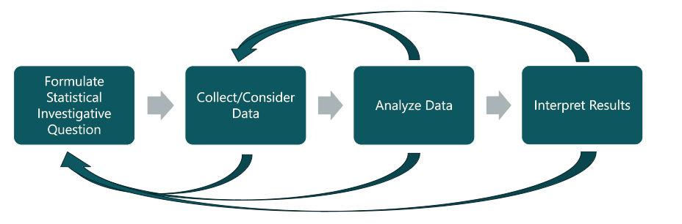
Data Science Inquiry
Notes:
To strengthen students’ skills in data science and data literacy, the new standards bring together mathematics, information science, and computer science. They’re designed to help students ask meaningful statistical questions, collect and analyze data, and make sense of what they find.
These standards also emphasize creativity and critical thinking. Students—at every grade level—are encouraged to engage in data investigations, starting with simple statistical questions in the early grades and growing into more complex analyses as they progress.
And importantly, the data science standards are meant to be used in real-world contexts and across subjects. They support interdisciplinary learning, helping students see how data informs decisions in science, social studies, the arts, and everyday life.
The data science standards are the same throughout the high school experience with the understanding that students will participate with data science differently in courses like Geometry, Alg 1, and Alg 2.

Slide 10
What Every Student Should Know and Do
OSPI recognizes that:
“school districts may choose different curricula/adopted instructional materials and some additional content (for example, absolute value functions or completing the square with quadratic functions) may be present in the first two credits of math. While there is locally determined flexibility of how and when the standards are addressed in the first two credits of high school math, the standards listed for Algebra 1 and Geometry, Integrated Math 1 and Integrated Math 2, represent the math content all students should engage with before their 3rd credit of high school math.” (pg. 9)
Notes:
We have received

Slide 11
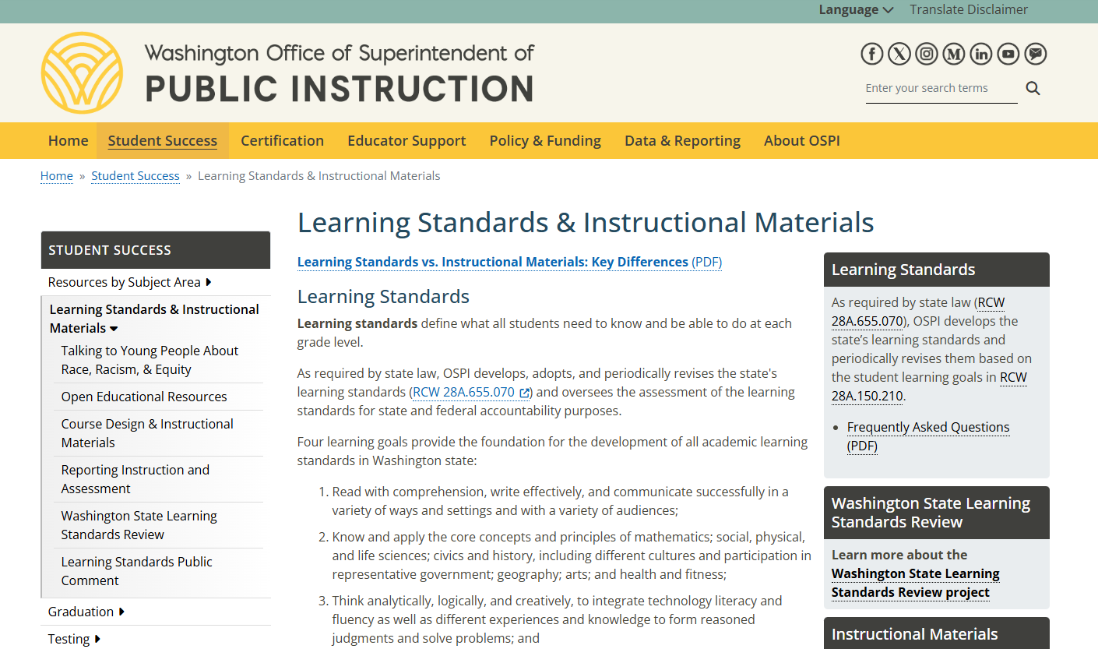
Where to find Information on the Learning Standards Review Project
Notes:
Walk through how to find the learning standards review page on our website.

Slide 12
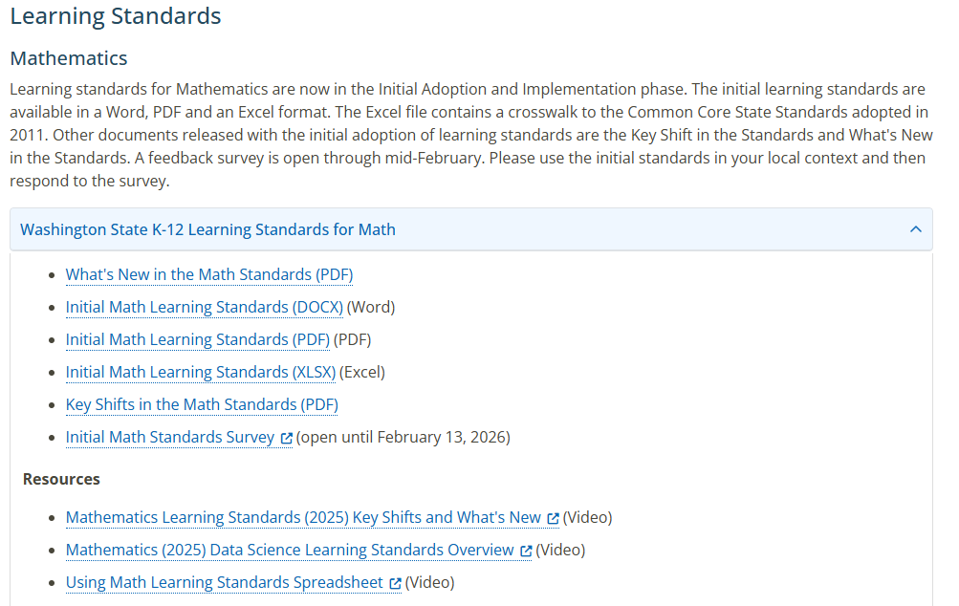
Learning Standards Review Project
Notes:
Walk through how to find the learning standards review page on our website.

Slide 13
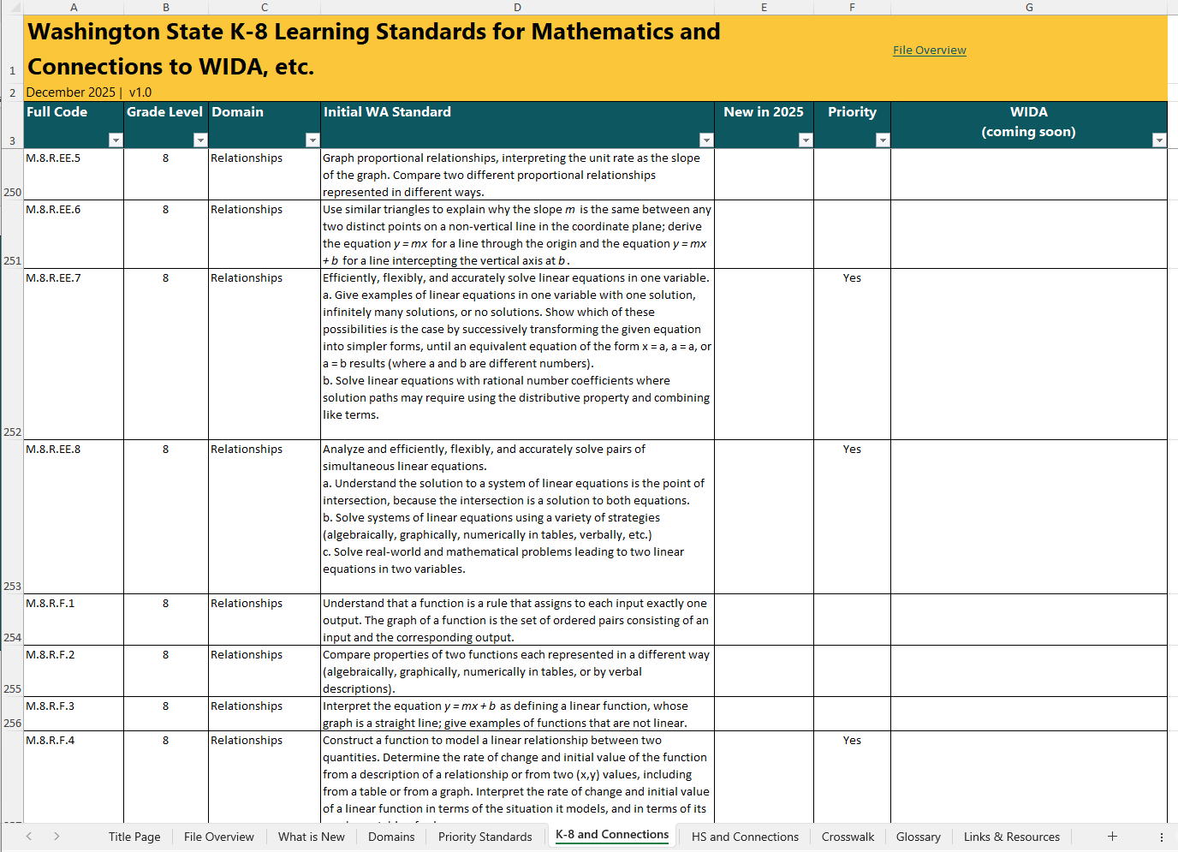
How to access learning standards review project
Notes:
Walk through how to find the learning standards review page on our website.

Slide 14
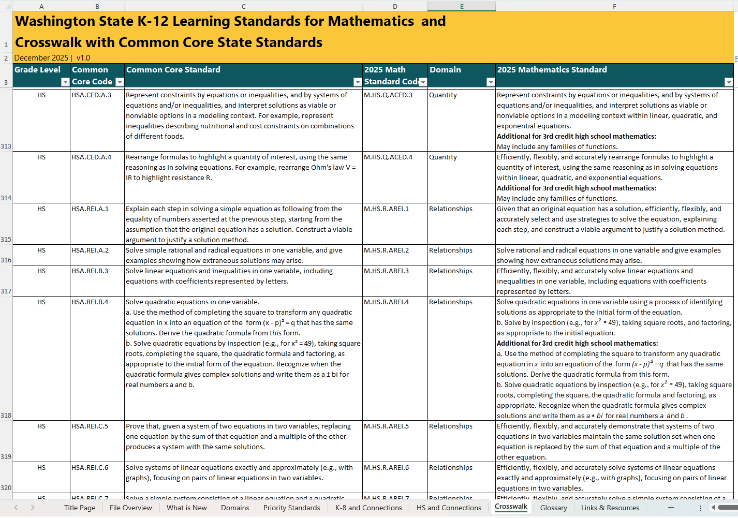
Washington State K–12 Learning Standards for Mathematics and Crosswalk with Common Core State Standards
Notes:
Walk through how to find the learning standards review page on our website.

Slide 15
Connect with us

