Slide 1
Key Shifts and What’s New
K–12 Washington State Learning Standards for Mathematics (2025)
Notes:
Welcome today we're going to take you through the key shifts and whats new in the new standards.

Slide 2

Vision
All students prepared for post-secondary pathways, careers, and civic engagement.
Mission
Transform K–12 education to a system that is centered on closing opportunity gaps and is characterized by high expectations for all students and educators. We achieve this by developing equity-based policies and supports that empower educators, families, and communities.
Values
Ensuring Equity
Collaboration and Service
Achieving Excellence through Continuous Improvement
Focus on the Whole Child
Notes:
The 2025 Washington State learning standards for Mathematics align with OSPI’s mission by supporting educators with equity-based policies and supports to prepare students for postsecondary pathways, careers, and civic engagement.

Slide 3
Equity Statement
Each student, family, and community possesses strengths and cultural knowledge that benefits their peers, educators, and schools.
Ensuring educational equity:
Goes beyond equality; it requires education leaders to examine the ways current policies and practices result in disparate outcomes for our students of color, students living in poverty, students receiving special education and English Learner services, students who identify as LGBTQ+, and highly mobile student populations.
Requires education leaders to develop an understanding of historical contexts; engage students, families, and community representatives as partners in decision-making; and actively dismantle systemic barriers, replacing them with policies and practices that ensure all students have access to the instruction and support they need to succeed in our schools.
Notes:
The revisions to the math standards align with the agency's equity statement through a shared vision of mathematics education that affirms student strengths, ensures access to rigorous and meaningful learning, and prepares all students to participate in their communities, careers, and society.

Slide 4
Mathematics is contextual,
connected, and meaningful.
Engage in data science inquiry
Apply the Standards for Mathematical Practice
Develop efficient, flexible, and accurate strategies
Learn mathematics through four broad domains
Notes:
The shifts in the revised standards focus on relevance, connection and sense making to help students develop the skills necessary to investigate data science, embrace multiple ways to demonstrate what they know and what they bring to mathematics learning while encouraging a deeper understanding of the interconnectedness of math concepts.

Slide 5
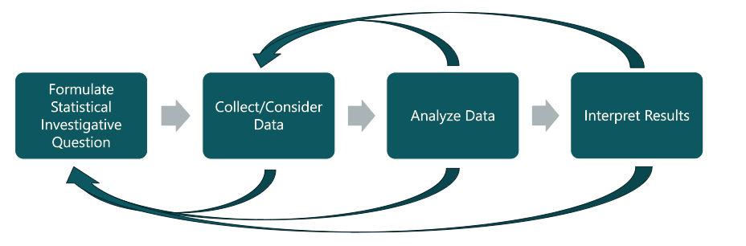
Data Science Inquiry
Notes:
To strengthen students’ skills in data science and data literacy, the new standards bring together mathematics, information science, and computer science. They’re designed to help students ask meaningful statistical questions, collect and analyze data, and make sense of what they find.
These standards also emphasize creativity and critical thinking. Students—at every grade level—are encouraged to engage in data investigations, starting with simple statistical questions in the early grades and growing into more complex analyses as they progress.
And importantly, the data science standards are meant to be used in real-world contexts and across subjects. They support interdisciplinary learning, helping students see how data informs decisions in science, social studies, the arts, and everyday life.

Slide 6

Standards for Mathematical Practice
Make sense of problems and persevere in solving them.
Reason abstractly and quantitatively.
Construct viable arguments and critique the reasoning of others.
Model with mathematics.
Use appropriate tools strategically.
Attend to precision.
Look for and make use of structure.
Look for and express regularity in repeated reasoning.
Notes:
The revised learning standards are structured to demonstrate the interconnected mathematics concepts with the standards for mathematical practice serving as a foundation from which mathematics teaching and learning is built. As concepts gain depth and relevance through contextualization, students have multiple means to access and demonstrate their knowledge. By centering/emphasizing math in meaningful contexts the standards for mathematical practice are elevated, engaging students in reasoning, communication, and the development of resilient problem-solving skills they will carry into college and careers.

Slide 7
Basic Fact, Computational, and Procedural Fluency
Efficient
Flexible
Accurate
Notes:
Research shows that math fluency isn’t just about being fast or memorizing facts. When students are truly fluent, they can choose strategies that make sense for the problem in front of them, adjust those strategies when things shift, and use them to get to correct answers.
That’s why, in the revised standards, the term “fluency” has been updated to “efficiently, flexibly, and accurately.” It better captures what we actually mean when we talk about fluency in mathematics.
Fluency also develops over time. It starts with basic fact fluency—like single-digit addition. It grows into computational fluency—using efficient strategies for multi-digit operations. And eventually it becomes procedural fluency—applying procedures, like solving equations, with understanding. These layers are interconnected; each one supports the next.
And importantly, instruction plays a critical role. All students, regardless of background or ability, need opportunities to build fluency through conceptual understanding, explicit strategy instruction, and meaningful practice. At its core, fluency is an equity issue—because developing these skills helps students build confidence, agency, and a sense of belonging in mathematics.

Slide 8
Four Broad Domains
Data Analysis
Quantity
Relationships
Spatial Reasoning
DA
R
Q
SR
Notes:
The revised standards are now organized into four groups of related concepts—what we call domains—that span all grade levels. These domains reflect the skills students need to use mathematics in meaningful ways: analyzing data, which lives in the Data Analysis domain; reasoning with quantities, which sits in the Quantity domain; understanding real-world patterns through the Relationships domain; and exploring spatial ideas in the Spatial Reasoning domain.
Reorganizing the standards this way shifts us away from treating math as a set of isolated topics. Instead, it emphasizes how interconnected mathematical ideas really are, helping students build deeper conceptual understanding and more flexible problem-solving skills.
And importantly, this structure mirrors how math shows up in careers and in everyday life. Rather than separating algebra, geometry, and statistics into silos, these domains encourage students to approach real-world problems through multiple mathematical lenses—just like professionals do when they analyze data, design structures, or make informed decisions.

Slide 9
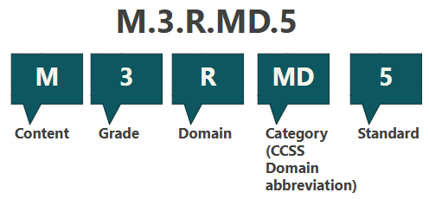
Reading the Standards
Notes:
The standards build on the structure of the Common Core State Standards for Mathematics. It’s important to remember is that the order in which standards, domains, or categories appear on the page does not represent the order in which they should be taught.
Each standard begins with a content code, which tells you the content area. In the revised standards, all math standards use the letter “M.”
Next is the grade level or grade band.
Kindergarten uses “K.”
Grades 1 through 8 simply use the grade number.
High school standards use “HS.”
Then we have the domains—the broad, interconnected areas of mathematics that run across grade levels. In WA Math 2025, the domains are:
DA for Data Analysis,
Q for Quantities,
R for Relationships, and
SR for Spatial Reasoning.
Within each domain are categories, which group related standards. In grades K–8, these categories align with the original Common Core domains, and in the Word version of the standards, you’ll also see the corresponding Common Core cluster headings. At the high school level, categories align with the Common Core conceptual categories and domains.
And finally, some standards include lettered indicators, which add an additional layer of specificity—though not every standard includes them.
All of these pieces work together to create a structure that’s clear, coherent, and aligned with how math develops across grade levels.

Slide 10
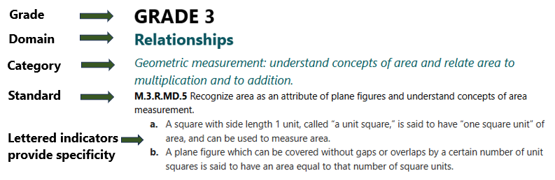
Reading the Standards Continued
Notes:
This key shows how the coding applies when looking at the pdf of the mathematic standards
While the numbering of the standards may look different, educators will still be able to align them to their current curriculum and national resources aligned with the Common Core State Standards by either referencing the grade, category, and standard number, or by sorting them by category within a grade level in the Excel format standards document.

Slide 11
Priority Learning Standards
Endurance: Will this skill or knowledge still be valuable beyond a single test, school year, or post-high school?
Leverage: Is it useful across multiple subjects (for example, writing or critical thinking)?
Readiness: Does it prepare students for success in the next grade level, course, or post-high school option?
Notes:
Priority learning standards were selected to ensure that all students have equitable access to the knowledge and skills they need—both for success in school and for opportunities beyond it. The remaining standards play a supporting role, reinforcing and extending those priority areas.
Because state standards include many learning goals across every subject and grade, OSPI partnered with educators from kindergarten through 12th grade over a two-year period to identify which standards are most critical to focus on. This work was grounded in national best practices, and educators had multiple opportunities to review, refine, and provide feedback throughout the process.
The result is a set of Priority Learning Standards that reflect both research and the professional judgment of educators, ensuring a clear and coherent focus for teaching and learning.

Slide 12
Clarifying Standards in High School
Identified by Course Sequence
Geometry, Algebra 1, and Algebra 2
Integrated Math 1, 2, and 3
Supports CTE-math equivalency alignment
Identifying the Content Standards for Credits 1 & 2
Math understanding all students need after they graduate
Priority standards are broad understandings applicable to any career
Clarify math content that occurs in first two math credits and what is in the third credit
Notes:
High school content standards in mathematics have been revised to more clearly show the math learning all students should engage in by the time they complete their second credit of mathematics. This is demonstrated more specifically in Algebra and Functions standards that previously addressed content that pertained to all families of functions. The standards have been revised to clarify that the first two years of high school math should include linear, exponential, and quadratic families of functions, while additional functions can be approached in a student’s third credit of high school math aligned with their High School and Beyond Plan.
Additionally, to be explicitly aligned to state law guiding high school graduation requirements or equivalencies (RCW 28A.230.090 and WAC 180-51-068) the high school standards have been broken out to parallel locally determined high school math sequences. The Office of Superintendent of Public Instruction (OSPI) recognizes that school districts may choose different curricula/adopted instructional materials and some additional content (for example, absolute value functions or completing the square with quadratic functions) may be present in the first two credits of math. While there is locally determined flexibility of how and when the standards are addressed in the first two credits of high school math, the standards listed for Algebra 1 and Geometry, Integrated Math 1 and Integrated Math 2, represent the math content all students should engage with before their 3rd credit of high school math.

Slide 13
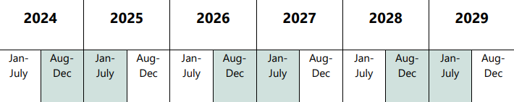








Timeline
Mathematics
(including Data Science)
Adopted 2011
Jan-July Standards under review
2024–25 Aug-July Engagement & Revision
2025–26 Aug-Dec Initial Adoption & Implementation
Jan-July Final State Adoption
2026–27 Aug-July Professional Learning and Transition
2027–28 Aug-July Full implementation in Schools
2028–29 Spring Statewide Summative Assessment
Notes:
The timeline posted on the OSPI website outlines the stages of the standards revision process. In early 2024 the work of reviewing the standards began and a process of engagement and revision has brought us through December of 2025. The standards for math have now been initially adopted for implementation and feedback, with final state adoption targeted by July 2026. 2026-2027 will focus on professional learning on the standards and a transition to the new math standards, with full implementation in schools beginning 2027-2028 School year. Statewide summative assessment of the 2025 Washington State Learning standards for mathematics will begin in the 2028-2029 school year.

Slide 14
What can you do now?:
Dig into the standards and share with your educator colleagues.
Begin to use the updated standards and resources to provide feedback through the Math Initial Adoption survey.
Plan on joining us during scheduled office hours.

Slide 15
Upcoming office hours:
Tuesday, December 9, 7:00-7:30 am
Wednesday December 10, 4:00-4:30 pm
Tuesday , December 16, 4:00-4:30 pm
Wednesday, December 17, 7:00-7:30 am
Find links to join us on the OSPI website Learning Standards or Mathematics webpages.
Notes:
Check the

Slide 16
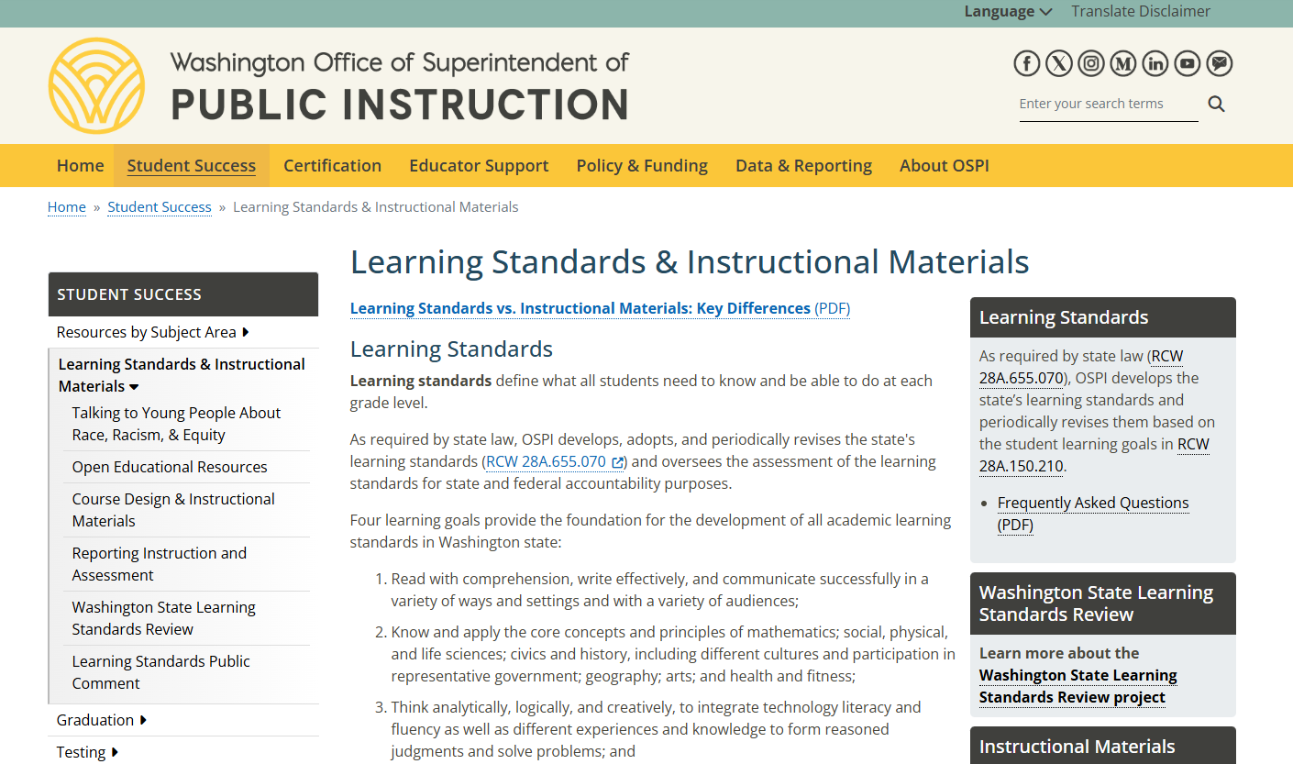
Where to Find Information on the Learning Standards Review Project
Notes:
Walk through how to find the learning standards review page on our website.

Slide 17
Connect with us

