Slide 1

Welcome!
Natural Helpers: Reimagined

Slide 2

Goals of Natural Helpers
To identify, support, and expand the peer helping network in schools.
To improve the culture and climate of schools by making them kinder, more welcoming, and more inclusive.
To improve the quality of and increase the number of helping interactions in schools.
To intervene earlier and increase the number of peer referrals to appropriate sources for serious mental health problems.

Slide 3
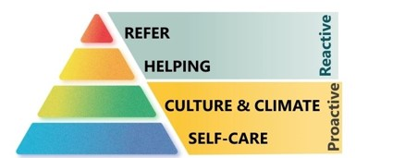
Roles of Natural Helpers
The roles of Natural Helpers can be broken into the four categories shown by the pyramid.

Slide 4
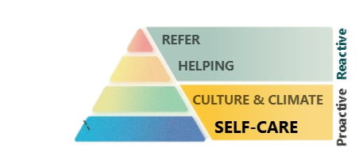
Self-Care
Strategy:
Self-Care Kit
Positive Self-Talk
Positive Peers (in person and online)
Trusted Adult
Access to Mental Health Resources

Slide 5
Masks Poem
Don’t be fooled by the face I wear, for I wear a thousand masks,
And none of them are me.
Don’t be fooled, please don’t be fooled.
I give you the impression that I’m secure, that confidence is my name and coolness is my game,
And that I need no one. But don’t believe me.
Beneath dwells the real me, a person scared to be vulnerable.
That’s why I create a mask to hide behind, to shield me from the glance that knows,
But such a glance is precisely my salvation.
That is, if it’s followed by acceptance, if it’s followed by love.
It’s the only thing that can liberate me from my own self-built prison walls.
I’m afraid that deep down I’m not good enough.
And that you will reject me.
And so begins the parade of masks, I idly chatter to you.
I tell you everything that’s really nothing
And nothing of what’s everything, of what’s crying within me.
Please listen carefully and try to hear more than my words.
I’d really like to be genuine and spontaneous, and me.
But you’ve got to help me. You’ve got to hold out your hand.
Each time you’re kind and gentle, and encouraging,
Each time you try to understand because you really care,
My heart begins to grow wings.
With your sensitivity and sympathy, and your power of understanding,
You can release me from my shallow world of uncertainty.
It will not be easy for you. The nearer you approach me,
The blinder I may strike back.
But I’m told that Love is stronger than strong walls,
And in this lies my only hope.
Please try to beat down these walls with firm but gentle hands.
Who am I, you may wonder.
I am every man you meet, and also every woman that you meet,
And I am you, as well.

Slide 6
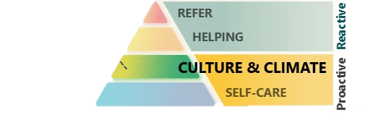
Culture & Climate
Strategy:
Building Assets with friends and classmates

Slide 7
Developmental Assets
External Asset Categories:
Support
Empowerment
Boundaries & Expectations
Constructive Use of Time
Physical Health
Internal Asset Categories:
Commitment to Learning
Positive Values
Positive Identity
Social Competencies
Emotional Competencies

Slide 8
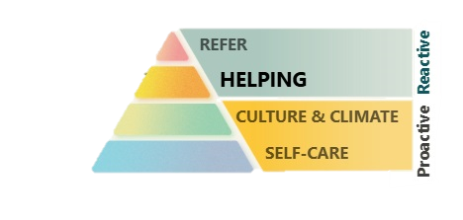
Helping
Strategy:
Building Assets with friends and classmates

Slide 9
Tips for Active Listening
Verbal:
Avoid interrupting
Ask open ended questions like “Tell me more about the last time you felt that way”, or “What are the main challenges you are dealing with right now?”
Avoid planning what you are going to say next
Listen without judging
Paraphrase by restating what the speaker said in your own words
Reflect when the speaker is finished to ensure that you understand their thoughts, ideas, and emotions
Empathize—especially with an emotional topic
Nonverbal:
Turn off all devices
Make comfortable eye contact
Lean in
Focus
Notice the speaker’s nonverbal communication, facial expressions, posture, and hand gestures
Smile and nod to show you are engaged

Slide 10
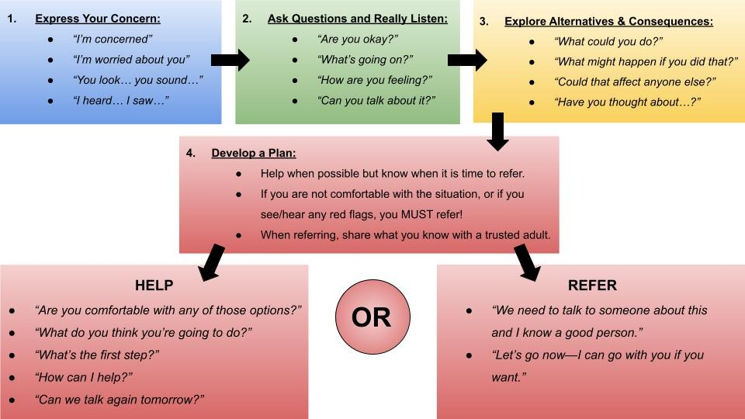
Helping 101 Steps

Slide 11
Scenarios for Practice Session 1
You are angry because your parents took your phone away for using it after hours.
You are upset because you got a failing grade on a math assignment. The teacher says you didn’t turn it in, but you know you did.
You are really torn about hanging out with your old friends because some of them are vaping. You don’t want to, but you still want to be friends.
You are upset because you found out that your crush was texting a former love interest.
You are upset because a group of friends didn’t invite you to a party this Friday night.

Slide 12
Helping 101 Steps

Slide 13
Scenarios for Practice Session 2
You are depressed because your parents are talking about splitting up.
You spend too much time in front of a screen and it’s limiting your relationships with old friends. You want to cut back but you don’t know how.
You are failing Spanish, and you are upset because you need a foreign language credit to graduate and apply for college.
There’s talk of a big fight after school, and you are concerned that someone is going to get hurt.
You are feeling lonely—lots of classmates ignore you and it’s depressing.

Slide 14
Helping 101 Steps

Slide 15
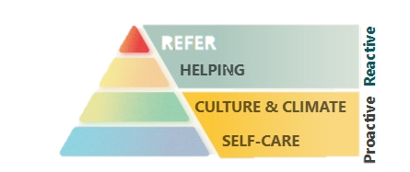
Refer
Strategy:
Refer to a Trusted Adult

Slide 16
Signs of Mental Health Challenges
In any situation where you believe a person could harm themselves or others, you must refer! The following are potential signs of underlying mental health challenges.
Feeling anxious or worried
Not attending school
Being quieter and more withdrawn than usual
Changes in sleep patterns
Feeling depressed or unhappy
Weight or appetite changes
Emotional outbursts
Feeling guilty or worthless
Neglecting their appearance
Lack of interest in school and other activities
Engaging in high-risk behaviors
Use of alcohol or other drugs
Bizarre or strange thoughts
Giving away possessions
Suicidal thoughts

Slide 17
Helping 101 Steps

Slide 18
Scenarios for Practice Session 3
You are afraid because your stepdad has been threatening you and you think he is capable of hurting you and your younger sibling.
You are really depressed about the situation of the world and everything going on around you. It’s making it very hard for you to focus on school.
You know that some friends are experimenting with illicit drugs, and you know that fentanyl is on the streets in your community, so you are very concerned for their health.
You heard from a friend that someone he knows has a gun at school for protection.
You are upset because a group of kids are making fun of you and the way you look and dress on social media.
You are really struggling right now, you haven’t been sleeping, you are feeling depressed, and you have been thinking often about how and when you might stop the pain by killing yourself.

Slide 19
Helping 101 Steps

Slide 20
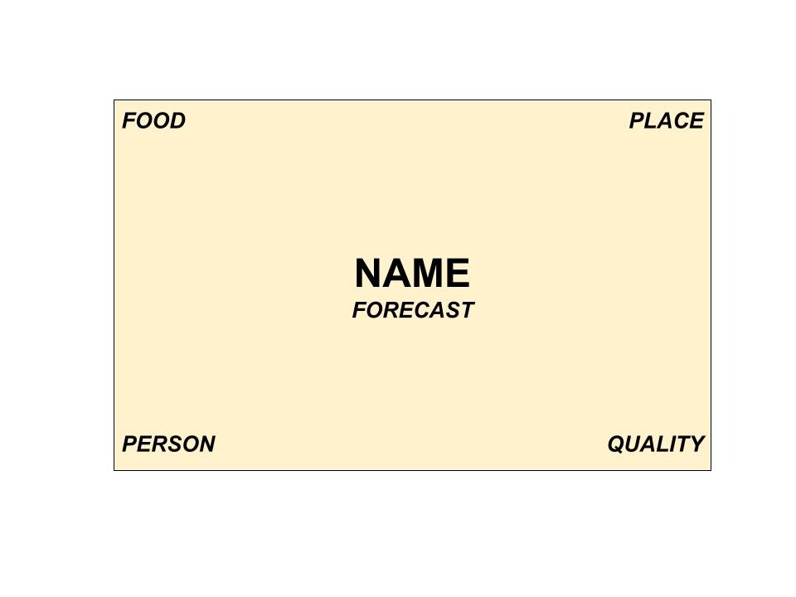
My Personal Business Card

