Slide 1
K-12 Washington State Learning Standards for Mathematics (2025)
Overview of New Domains
Notes:
Welcome!
Today we're going to take you through an overview of the new domains in mathematics for Washington state! Thanks for joining us!

Slide 2

Vision
All students prepared for post-secondary pathways, careers, and civic engagement.
Mission
Transform K–12 education to a system that is centered on closing opportunity gaps and is characterized by high expectations for all students and educators. We achieve this by developing equity-based policies and supports that empower educators, families, and communities.
Values
Ensuring Equity
Collaboration and Service
Achieving Excellence through Continuous Improvement
Focus on the Whole Child
Notes:
OSPI's vision for student success in postsecondary pathways, careers and civic engagement is actualized through mathematics teaching and learning that is student and community centered, with high expectations for all students and educators. The revised mathematics standards support systemic change and ensure equity through teaching interconnected mathematics ideas. This moves math from a list of separate concepts students and educators must check off over the course of the year, and toward math connected to additional content areas, student interest, and curiosity.

Slide 3
Equity Statement
Each student, family, and community possesses strengths and cultural knowledge that benefits their peers, educators, and schools.
Ensuring educational equity:
Goes beyond equality; it requires education leaders to examine the ways current policies and practices result in disparate outcomes for our students of color, students living in poverty, students receiving special education and English Learner services, students who identify as LGBTQ+, and highly mobile student populations.
Requires education leaders to develop an understanding of historical contexts; engage students, families, and community representatives as partners in decision-making; and actively dismantle systemic barriers, replacing them with policies and practices that ensure all students have access to the instruction and support they need to succeed in our schools.
Notes:
As we consider OSPI's equity statement, providing interconnected mathematics teaching and learning opportunities for all students across the state supports equitable access to mathematics for all students, mathematics that is meaningful in students lives, and communities, and connected to things they are curious about.
Teaching mathematics as a vehicle for connection is a seismic move toward equitable, relevant, and tangible math learning for all students. In this way, one core idea or skill is not divorced from the standards that are related to it. Rather one core idea or skill has lots of on-ramps to understanding through the 3 or more related math standards that address the same skill in a slightly different way. Teaching math through the lens of interconnection increases opportunities for connecting math to students and families lives, events in the community, and engages folks outside of the math classroom inviting folks into day to day mathematics teaching and learning.

Slide 4
Mathematics is contextual,
connected, and meaningful.
Engage in data science inquiry
Apply the Standards for Mathematical Practice
Develop efficient, flexible, and accurate strategies
Learn mathematics through four broad domains
Notes:
The shifts in the revised standards focus on relevance, connection and sense making to help students develop the skills necessary to embrace multiple ways to demonstrate what they know and what they bring to mathematics learning while encouraging a deeper understanding of the interconnectedness of math concepts.

Slide 5
Why Did the Domains Change?
“Traditionally, mathematics learning is seen as a series of isolated processes intended to build upon each other. This approach often makes it difficult for students to develop their understanding of the concept or see the connections between concepts.” NCTM Principals to Actions
Notes:
The four domains of the 2025 mathematics standards focus on Data Analysis, Spatial Reasoning, Quantities, and Relationships within the mathematics of the grade and across grade levels which will position students to develop conceptual understanding of math ideas in the same ways people in society interact with mathematics across careers and experiences. The National Council of Teachers of Mathematics has stated, “Traditionally, mathematics learning is seen as a series of isolated processes intended to build upon each other. This approach often makes it difficult for students to develop their understanding of the concept or see the connections between concepts.” The 2025 Washington State Standards in Mathematics embody the opportunity to see and explore connections within and across grades through the reorganization of the standards within Data Analysis, Spatial Reasoning, Quantities, and Relationships.
Mathematics is an academic discipline steeped in history and tradition, with Calculus as the implicit end goal of secondary mathematics. The Common Core State Standards in Mathematics adhered to tradition by grouping related standards by domain, and sub-disciplines in mathematics. Domains morphed progressively through the K-HS standards to best identify the math sub-disciplines in each grade or grade band.

Slide 6
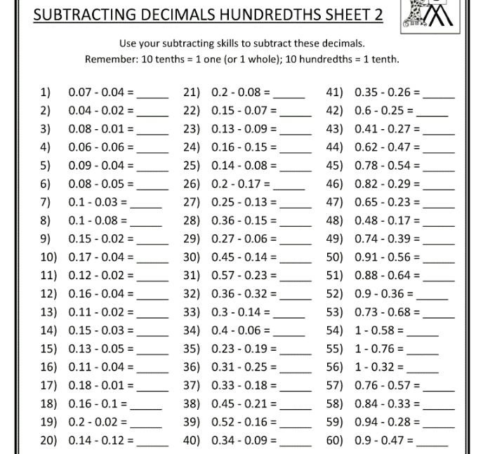
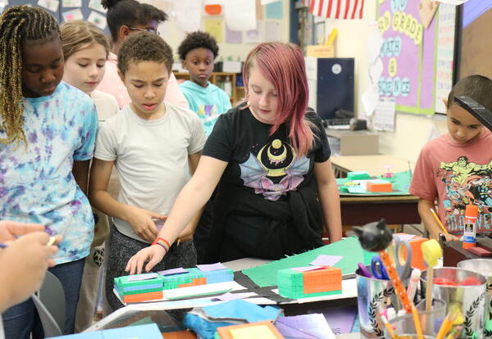
Why Did the Domains Change?
“Traditionally, mathematics learning is seen as a series of isolated processes intended to build upon each other. This approach often makes it difficult for students to develop their understanding of the concept or see the connections between concepts.” NCTM Principals to Actions
Notes:
Now, more than ever, students need not only to develop mathematical and data skills that allow them to calculate and compute, but they also need to be able to ask meaningful questions and evaluate their findings. For this reason, and to prepare Washington students for diverse careers and postsecondary goals that are not exclusively in service of Calculus, the domains across K-HS have been changed to connect broad concepts students will interact with over their K-12 math career. This shift connects related math concepts that were separated in the Common Core mathematics standards and works to equip students with deeper mathematical fluency and reasoning strategies. Teaching mathematics as interconnected concepts increases flexible problem solving, and critical examination of mathematics and data that are an ever-present element of society.

Slide 7
Naming Structure-Need
DA:Cr1.1.K 1B-AP-15 HSF-LE.A.4
RI.7.2 2.CD.1 H7.W2.8b
PE2.4.3 5-LS1-1 H2.6-8.6
Notes:
Restructuring mathematics standards into four broad domains supports both an instructional shift and a shift toward clarity for folks who support students across content areas including parents, teachers of multiple content areas, school administrators, and district leadership.
The current learning standards have different kinds of coding systems across content areas, noting this sample shown here.
This creates a challenge for parents when they are seeking to understand and support their students in the content of their grade.
DA:Cr1.1.K = Dance, Creating, Anchor Standard 1.1, Kindergarten (Arts)
1B-AP-15 = grades 3-5, Algorithms and Programming, standard number 15 (Computer Science)
HSF-LE.A.4 = high school functions, Linear, Quadratic& Exponential Models, group A, standard 4 (Math)
RI.7.2= reading for informational text, grade 7, standard 2 (ELA)
2.CD.2 = grade 2, credit and debt, standard 1 (Financial Ed)
H7.W2.8b = health standard 7 , wellness topic 2, grade 8, second indicator (Health)
PE2.4.3 = Physical education standard 2, topic 4, grade 3 outcome (PE)
5-LS1-1 = grade 5, Life Science 1, performance expectation 1 (Science)
H2.6-8.6 = learning standard and discipline history, performance standard 2, grade band 6-8, component 5 (Social Studies)
As we highlight the grade level in this collection of standards it’s really all over the map!
DA:Cr1.1.K = Dance, Creating, Anchor Standard 1.1, Kindergarten (Arts)
1B-AP-15 = grades 3-5, Algorithms and Programming, standard number 15 (Computer Science)
HSF-LE.A.4 = high school functions, Linear, Quadratic& Exponential Models, group A, standard 4 (Math)
RI.7.2= reading for informational text, grade 7, standard 2 (ELA)
2.CD.2 = grade 2, credit and debt, standard 1 (Financial Ed)
H7.W2.8b = health standard 7 , wellness topic 2, grade 8, second indicator (Health)
PE2.4.3 = Physical education standard 2, topic 4, grade 3 outcome (PE)
5-LS1-1 = grade 5, Life Science 1, performance expectation 1 (Science)
H2.6-8.6 = learning standard and discipline history, performance standard 2, grade band 6-8, component 5 (Social Studies)

Slide 8
Naming Structure-Need
DA:Cr1.1.K (Dance) 1B-AP-15 (CompSci) HSF-LE.A.4 (Math)
RI.7.2(ELA) 2.CD.1(Financial Ed) H7.W2.8b (Health)
PE2.4.3 (PE) 5-LS1-1 (Science) H2.6-8.6 (SocStudies)
Notes:
As we think about how standards represent what a student should know and be able to do at the end of a grade, clarity in knowing which standards are which across content areas and grades is important and helpful for all interest holders in a student’s life.
DA:Cr1.1.K = Dance, Creating, Anchor Standard 1.1, Kindergarten (Arts)
1B-AP-15 = grades 3-5, Algorithms and Programming, standard number 15 (Computer Science)
HSF-LE.A.4 = high school functions, Linear, Quadratic& Exponential Models, group A, standard 4 (Math)
RI.7.2= reading for informational text, grade 7, standard 2 (ELA)
2.CD.2 = grade 2, credit and debt, standard 1 (Financial Ed)
H7.W2.8b = health standard 7 , wellness topic 2, grade 8, second indicator (Health)
PE2.4.3 = Physical education standard 2, topic 4, grade 3 outcome (PE)
5-LS1-1 = grade 5, Life Science 1, performance expectation 1 (Science)
H2.6-8.6 = learning standard and discipline history, performance standard 2, grade band 6-8, component 5 (Social Studies)

Slide 9
Solution: Standardized Naming Structure
Structure that is as similar as possible for all sets of learning standards.
Content: ELA, M, FE, S, PE, H, WL, SS, A, CS
Grade: a single grade, if a grade band show range of the band: middle school (MS), Kindergarten to second grade (K-2)
Domain: ex R = Reading, Q = Quantity, PS = Physical Science
Category: a capital number or letter (some content areas will not have this level)
Standard: a number, and may include a lowercase letter as an indicator
Notes:
Washington State’s solution is to develop a coding and naming system so they are as similar as possible across content areas to support usability by families and educators across a variety of school and district roles.
Coding in each content will provide the content abbreviation, the grade level, domain, category and standard number.
ELA = English Language Arts, M= Math, FE=Financial Education, S= , PE= Physical Education, WL= World Languages, SS= Social Studies, A= Art, CS= Computer Science

Slide 10
Results of the simplification of the standard coding
CCSS Math (2011) Domains and Conceptual Categories | WA Math 2025 Domains | WA Math 2025 Categories
36 domains across K–12 mathematics: 6 Elementary 6 Middle School 24 High School | Four domains that are the same across all grades in K–12 mathematics | The root numbering within the mathematics standards grounded in the original 36 domains and conceptual categories found in the CCSS.
Notes:
As a result of this simplification of the standard coding, we’ve gone from 36 to four domains with a structure that supports educators’ ability to track vertical alignment and alignment to national resources and curricula.

Slide 11
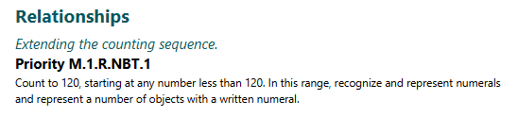
Standardized Naming Structure - Math
M.1.R.NBT.1
M
1
R
NBT
1
Content
Grade
Domain
Category (CCSS Domain abbreviation)
Standard
Notes:
The new naming structure now clearly reflects the content, grade level, an overarching domain as well as the Common Core domain abbreviation, we’re now referring to as a category, and standard number.

Slide 12
Seeking a coherent naming structure provided an opportunity to highlight the attempt to de-silo mathematics.
Notes:
When we examined how standards were labeled, we realized that naming shapes perception. When standards are organized strictly by traditional sub-disciplines, it can unintentionally reinforce silos, geometry here, algebra there, statistics somewhere else, even when the mathematics itself is deeply interconnected.
Now the code itself reflects broader conceptual domains. That shift signals that mathematical ideas are not meant to live in isolation. Quantitative reasoning supports algebraic thinking. Spatial reasoning informs proportional reasoning, and data analysis draws from, and strengthens understanding of quantities and relationships.
The new domains become a lever encouraging educators to looks across strands, to plan across domains, and to recognize that the same big ideas develop over time in connected ways. This is about supporting students to experience mathematics as a unified system rather than a collection of disconnected chapters.
This reorganization creates an opportunity without disrupting vertical alignment. The original root coding from the Common core remains embedded, which means the backbone of the progression has not changed. What has changed is that the opportunity for connections across that progression are made more explicit. This allows educators to preserve the stability of vertical alignment while exploring opportunities around how ideas can grow, connect, and reinforce one another over time.

Slide 13
Four Broad Domains
Data Analysis
Quantity
Relationships
Spatial Reasoning
DA
R
Q
SR
Notes:
The new domains now organize the learning standards into four groups of related concepts that span all grade levels. These domains reflect the skills students need to use mathematics in meaningful ways: analyzing data, which lives in the Data Analysis domain; reasoning with quantities, which sits in the Quantity domain; understanding real-world patterns through the Relationships domain; and exploring spatial ideas in the Spatial Reasoning domain.

Slide 14

Acknowledging Overlap and Flexibility
Acknowledging Overlap and Flexibility
Many of these standards could be reasonably situated in more than one domain, for example, quantitative reasoning and relational understanding are deeply interconnected. Standards involving operations often require attention to both numerical magnitude (Quantity) and structural relationships (Relationships).
The new domains are not intended as rigid classifications, but rather as a framework for flexible grouping that supports instructional decision-making. Teachers may emphasize Quantity or Relationships depending on instructional goals, student needs, and the mathematical ideas being foregrounded, while still maintaining coherence across domains.
This flexibility reinforces the intent of the standards: to support deep, connected mathematical understanding across grades.
Notes:
Some concepts transcend across domains. For example, standards involving expressions and equations often require attention to both numerical magnitude, the Quantity. and structural meaning, the Relationships.
The new domains are an effort to step away from rigid classifications and the siloing of the standards, to provide a framework for educators to teach the interconnected nature of the standards and support instructional decision making.
Because quantitative reasoning and relational understanding are deeply connected, many standards could reasonably live in more than one domain. The placement highlights mathematical thinking, but not just one way of thinking mathematically and encourages flexibility. Teachers may emphasize quantity or relationships depending on instructional goals, student needs, and the ideas being foregrounded.

Slide 15

Data Analysis
Big Ideas like:
Sorting and describing data
Measuring and comparing data
Representing multivariable data
Plotting patterns
Telling a story from data
Variability in data
Shape and distribution of data
Populations and sampling
Exploring and examining probability
Constructing, exploring, interpreting graphs of data
Investigating and modeling statistical relationships
Notes:
Math standards in the data analysis domain involve formulating statistical investigative questions, collecting and considering data including measurements, creating data visualizations (ranging from bar graphs and histograms to scatterplots and complex representations as appropriate for the grade), and interpreting results and communicating justification for conclusions.

Slide 16
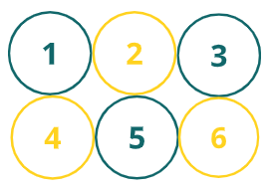

Quantity
Big ideas like:
Patterns in four operations
Number flexibility for all four operations
Factors and groups
Explore number systems (whole, rational, integer, etc.) through operations
Dig into magnitude of numbers through scientific notation and perform operations in context
Examine and create equivalent expressions
Compare properties and constraints of different functions
Connect and interpret different forms of a function in context including equations, tables, graphs.
Make interpretations and conclusions from a function for analysis or prediction
Notes:
Math standards in the Quantity domain involve analysis of magnitude and comparison of quantities, flexibly efficiently and accurately using operations and strategies, place value, and examining number systems (real, integers, rational, irrational, etc).

Slide 17

Relationships
Big ideas like:
Number strategies
Modeling with numbers
Fractions as relationships
Powers and place value
Exploring proportionality and rates
Graphing rates and proportional relationships
Modeling real world relationships
Reorganizing and representing relationships in different ways including equivalent expressions and equations, graphs, tables, pictures, communicated descriptions, etc.
Examining families of functions that best describe relationships in the real world
Notes:
Math standards in the Relationships domain are those that develop strategic reasoning strategies and understanding of quantities as parts of a relationship. And support interpreting and communicating about the relationship in context.

Slide 18
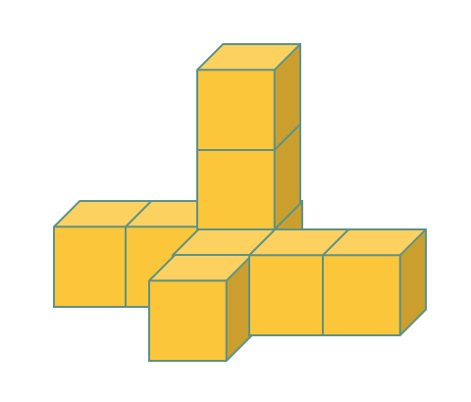
Spatial Reasoning
Big ideas like:
Composing and decomposing
Reasoning with shape and measurement
Shapes on a plane
Explore shape capacity and surface attributes
Explore shape transformations (rigid, dilations)
Examine, understand, and measure related parts of shapes and lines to draw conclusions
Extend understanding of spatial attributes toward complex applications (triangle trig toward trig functions)
Examine the connection between the graph of functions and where functions are equivalent and what that means in context
Notes:
Math standards in the Spatial Reasoning domain are those that involve understanding shape and spread, both in geometry and data analysis (graphing).

Slide 19
Why is one standard from OA in Data Analysis and another standard from OA in Relationships?
Just like Cross Cutting Concepts in Next Generation Science Standards
Math standards frequently overlap domains
Are interconnected
Are not mutually exclusive
Overlap in practice and application
4 broad domains support teaching and learning concepts from multiple conceptual lenses in different applications
Modeling
Understanding a relationship
Understanding quantities in the relationship in context
Creating and interpreting graph of relationship
Notes:
At first glance, it might feel strange that two standards from the same previous domains, Operations and Algebraic Thinking, ended up in two different new domains.
But the new domains are not organized by topic labels. They're organized by the type of thinking students are doing.
For example, in 5.OA.B.3, students generate patterns, organize ordered pairs, graph them, and look for trends. Even though it came from an algebraic cluster, students are essentially creating and analyzing a dataset. There're using representations to notice patterns and make interpretations, that's Data Analysis thinking.
In 5.OA.A.1, students use parentheses and grouping symbols to determine meaning in an expression. Here the numbers don't change, the relationships between them do. Students are reasoning about structure and how parts of an expression interact. That's Relationships thinking.
This is similar to the Crosscutting Concepts in the Next Generation Science standards. Math standards from previous domains will frequently overlap in the new domains. They are not mutually exclusive. And they'll overlap in practice and application.
For example, students might model a situation, understand the relationship involved, reason about the quantities within that relationship in context, and create and interpret a graph representing that relationship. And each of those perspectives could align to a different domain depending on which thinking is being emphasized, supporting flexible placement rather than a fixed single category.
So, the shift is intentional. We’re moving away from grouping standards by historical topic headings, and toward grouping them by the mathematics reasoning they develop. And importantly, this doesn't separate the mathematics, It helps teachers highlight the purpose of the lesson. Are students analyzing data? Or are they reasoning about structure?

Slide 20
What about vertical articulation of the standards?
Vertical articulation embedded in CCSSM
Domains do not confine growth of a concept over time
Domain understandings overall, grow and adapt over grades
Notes:
Let's talk about vertical articulation in the standards. This reorganization creates an opportunity without disrupting vertical alignment. The original root coding from the Common core remains embedded, which means the backbone of the progression has not changed. What has changed is that the opportunity for connections across that progression are made more explicit. This allows educators to preserve the stability of vertical alignment while exploring opportunities around how ideas can grow, connect, and reinforce one another over time.

Slide 21
How to Connect with OSPI

