Slide 1
Annual CACFP Required Staff Training Resource
This train-the-trainer resource has been developed as a basic outline to assist institutions with CACFP annual required staff training
Customization of this PowerPoint will be needed to reflect how your organization operates its CACFP program
This training resource must be updated at least annually by your organization to ensure that it meets current CACFP requirements
Staff Training Reference sheets are available on the OSPI Child Nutrition website to provide guidance
Annual Staff Training for Independent Centers Reference Sheet (www.k12.wa.us)
Annual Staff Training for Sponsoring Organizations Reference Sheet (www.k12.wa.us)
Notes:
OSPI Child Nutrition has developed a training for you to use and make your own for the annual CACFP required training.
This train the trainer resource has been developed as a basic outline to assist institutions with CACFP annual required training
Customization of this Power point will be needed to reflect how your organization operates its CACFP program – there are places in the training slides that are highlighted that you can add your own resources and if you are an independent you will need to remove the sponsoring organization info/slides
This training resource must be updated at least annually by your organization to ensure that it meets current CACFP requirements
Staff Training Reference sheets are available on the OSPI Child Nutrition website to provide guidance

Slide 2

USDA CNS
Provides updates and training to the State Agency who has a permanent agreement with USDA.
OSPI CNS
State Agency trains sponsors who have a permanent agreement with OSPI to operate the CACFP.
Sponsors
Must train the staff who work at the site(s) where the CACFP is operated.
Notes:
This slides show that USDA provides updates and training to the State Agency which is OSPI Child Nutrition.
OSPI Child Nutrition/State Agency has a permanent agreement with USDA to administer CACFP in Washington state therefore it is OSPI’s responsibility to
Provide training to Institutions/Sponsors annually…that is you!
In turn Institutions/Sponsors have a permanent agreement with OSPI Child Nutrition an you must train current and new staff on required CACFP topics at the sites where CACFP is operated.

Slide 3
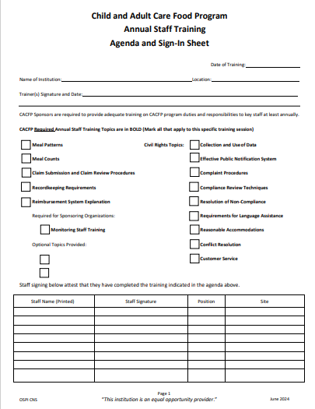
Required Annual CACFP Staff Training Documentation
Annual CACFP Training and Civil Rights Training Agenda and Sign In Sheet
CACFP Attendance Roster
Notes:
OSPI Child Nutrition has developed an Agenda and Sign in Sheet for your use and to be provided during CACFP Admin Reviews to ensure compliance with CACFP training requirements.
This agenda and sign in sheet can be used for to document both CACFP Required Annual Training and Civil Rights Training
Add the date of the training
Name or your Institution and the location of the training
Name of the trainer
Any additional topics related to CACFP that you are going to cover
Check the Training topics that are going to be covered
If just a few topics are going to be covered check only those and at another training the others will need to be covered
Remember you will need to train on all topics within the year so tracking this is important
Be sure your staff prints their name; signs with their signature; lists their position and the site they work at.
When staff signs in and they are attesting to attending annual CACFP training

Slide 4

Required Annual CACFP Staff
Annual CACFP Training Customizable PowerPoint for your use!
cacfp-sponsor-staff-training-sponsor-shareable-version.pptx
Notes:
This customizable power point presentation may be used for your organization’s annual required training and as needed for new hires! Edit this slide to reflect the Trainer’s name title and your organization!

Slide 5
Annual CACFP Staff Training
Trainer’s Name and Title
Organization
Notes:
First slide in the Annual CACFP Staff Training PPT.
ADD THE TRAINER’S NAME AND TITLE AND THE ORGANIZATION’S NAME

Slide 6
Required Annual CACFP Staff Training Documentation
Annual CACFP Training and Civil Rights Training Agenda and Sign In Sheet
Our organization needs to ensure that staff that have CACFP related roles and duties receive CACFP annual required training annually
Print your name; signature; position and site you work at
Signing your name certifies you were in attendance and received the required CACFP annual training
CACFP Attendance Roster
Notes:
EDIT THIS AS NEEDED
Our organization needs to ensure that staff that have CACFP roles and duties received the required CACFP annual training annually. Please print your name, sign, list your position and the site you work at.
When you sign and print your name on the agenda you are certifying you were in attendance today and received training on the marked CACFP required topics.

Slide 7
Annual Staff Required Training Topics
To ensure compliance with CACFP there are six required training topics that you will be receiving training on today:
Meal Pattern
Meal Counts
Claims Submission and Review Procedures
Recordkeeping Requirements
Reimbursement Process
Civil Rights
*Sponsoring Organizations: Add training for Staff with Monitoring Responsibilities
Annual Staff Training for Independent Centers Reference Sheet (www.k12.wa.us)
Annual Staff Training for Sponsoring Organizations Reference Sheet (www.k12.a.us)
Notes:
EDIT THIS SLIDE AS NEEDED
To ensure compliance with USDA CACFP program there are six required topics that you will be receiving training on today.
These include: CACFP Meal Pattern, Meal Counts, Claims Submission and Review Procedures, Recordkeeping Requirements, Reimbursement Process and Civil Rights
For Sponsoring Organizations monitoring staff there will be one more topic Training for Staff with Monitoring Responsibilities – Highlighted – remove for independent sponsors and leave but remove highlight for Sponsoring Organizations.

Slide 8
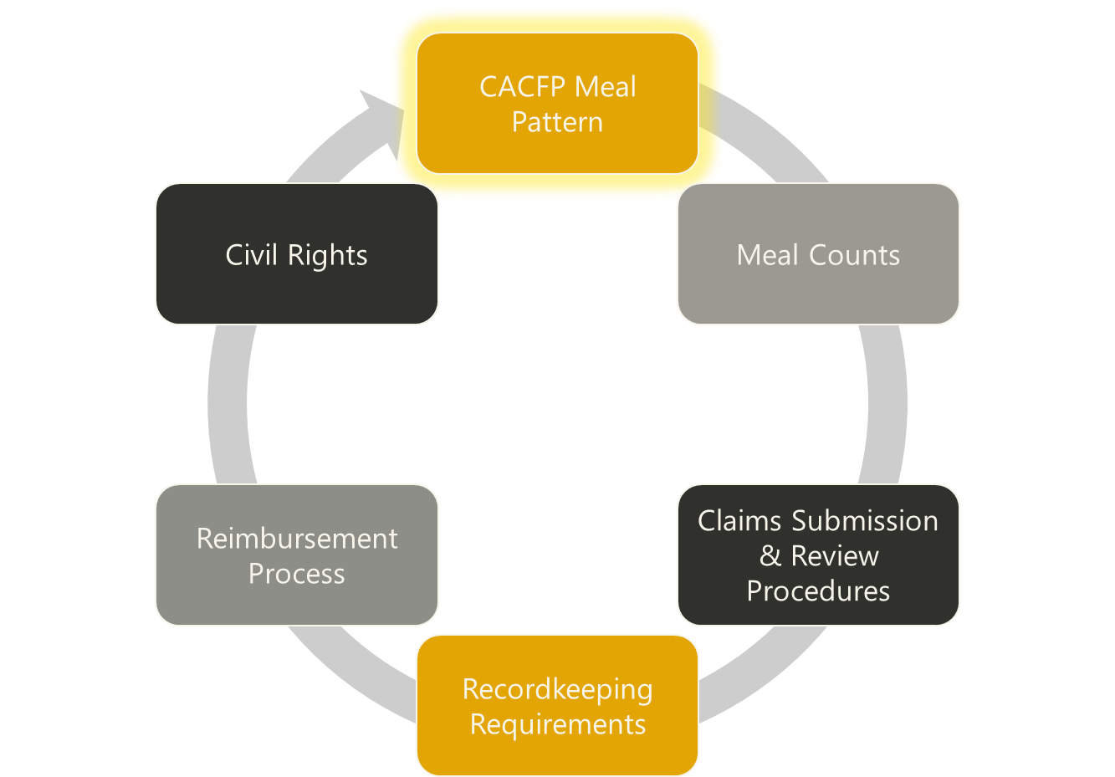
Staff Training
Notes:
LET’S START WITH THE CACFP MEAL PATTERN

Slide 9
CACFP Meal Pattern
What you need to know:
Ensure the Meal pattern on the menu is being followed
How much food is required to be offered or served at the meal or snack to each participant
The timeframe meals/snacks are served in
What meal style is used
CACFP Meal Requirements Reference Sheet
Infant Feeding— Meal Requirements Reference Sheet
Notes:
CACFP Meal Pattern
What you need to know:
Ensure the Meal pattern on the menu is being followed
How much food is required to be offered or served at the meal or snack for each participant
What is the timeframe that meals/snacks need to be served in
What meal style is used

Slide 10
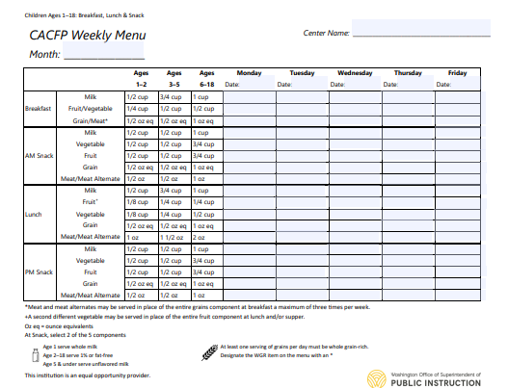
CACFP Meal Pattern and The Menu
Why do you need to understand the Meal Pattern and the Menu?
You need to know the meal pattern to ensure all components are served to the participants and in the required minimum amounts
Feedback is appreciated!
OPSI provides required menu templates for use. Here is an example shown here
Meal Patterns and Menu Planning
Notes:
GO TO THE LINK ON THE SLIDE AND CHOOSE WHICH REQUIRED OSPI MENU TEMPLATE BEST FITS YOUR PROGRAM AND CHANGE THE MENU ON THE SLIDE
Why do you need to have knowledge about the Menu and meal pattern
Since you are serving the meals/snacks to participants and have knowledge of the meal pattern you can ensure all components are being served –if one is missing you can let the cooks know.
Feedback is appreciated! If there are food items participants aren’t enjoying perhaps there is another way to offer or prepare those items or if there are some new items that you think participants would like share so we can research a standardized recipe that meets CACFP requirements.

Slide 11
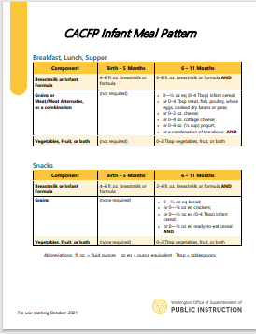
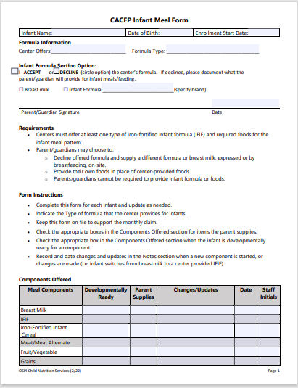
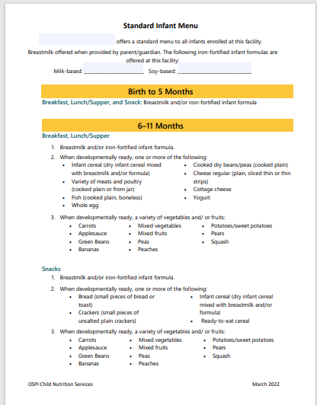
Infant Meal Pattern, Infant Meal Form and Standard Infant Menu
CACFP Requirements and Materials
Notes:
DELETE THIS SLIDE IF YOU DO NOT HAVE INFANTS IN YOUR CENTER
Infant Meal Patterns
CACFP Infant Meal Pattern Requirements are found on this first handout
The Infant Meal pattern is broke down into 2 groups: Birth – 5 months and 6 – 11 months.
Formula or Breastmilk or portions of both must be served at all meals and snacks; Infant Cereal and other infant foods are to be offered as developmentally appropriate.
Fruit juices are not creditable for infants
All grains served must be made with enriched or whole grain meal or flour.
Infant formula and dry infant cereal must be iron fortified
CACFP Infant Meal Form – the second handout –
This must be posted in the infant classroom so it can be referenced
Must be completed for each infant enrolled and updated as needed; it tracks and documents developmental readiness for each infant
Type of formula center provides must be indicated on form – center needs to provide only one iron fortified infant formula and parent may choose to decline and supply another formula and/or provide breastmilk.
Parents are allowed to provide one food item and center is still allowed to claim meal/snack; or parents can supply more than one component and then the meals/snacks are not claimable
Parent/guardians cannot be required to provide infant formula or food
Infant feeding documentation is required regardless of claiming infant meals or not
Standard Infant Menu – third handout
This Standard Infant Menu must be posted in the infant room and needs to have the center identified and list the milk based and/or soy based formula that is offered at the center
This Standard menu is divided into 2 age groups Birth – 5 months and 6 -11 months
Use this menu along with the CACFP Infant Meal Form to ensure that infants are fed at their developmental readiness
A serving of a component is required to be offered when the infant is developmentally ready to accept it. All components must be offered in the full minimum portion.

Slide 12

Infant Meal Pattern Resources
Infant Feeding Resources are found on the OSPI Child Nutrition website as well as at the below links:
Feeding Infants in the Child and Adult Care Food Program | Food and Nutrition Service (usda.gov)
Infant Feeding— Meal Requirements Reference Sheet (www.k12.wa.us)
Notes:
DELETE THIS SLIDE IF YOU DO NOT HAVE INFANTS IN YOUR CENTER
Great resource to take a look at!

Slide 13
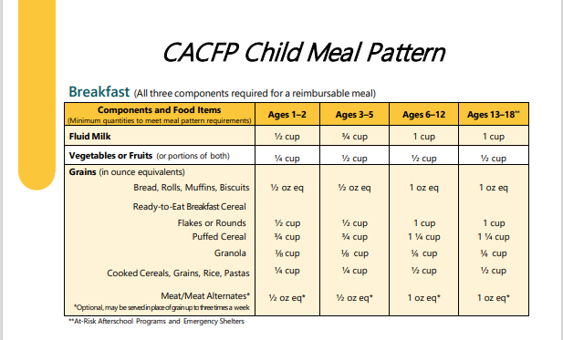
CACFP Meal Pattern - Breakfast
A reimbursable breakfast must include:
Fluid Milk
Grain (Bread/Cereal) OR a Meat/Meat Alternate (Scrambled Eggs/Yogurt)
Fruit or Vegetable or a combo of both
All components must be offered in at least the minimum portion as outlined by CACFP for that age group
Notes:
Let’s check out the CACFP Child Meal Pattern
What is required for a reimbursable Breakfast?
Fluid Milk
1 % for children 2 and older
Whole for children under 2
Grain (Bread/Cereal) OR a Meat/Meat Alternate (Scrambled Eggs/Yogurt)
And a Fruit or Vegetable or a combo of both
And all components must be offered in at least the minimum portion outlined by CACFP for that age group (you can see those on the meal pattern handout provided)

Slide 14
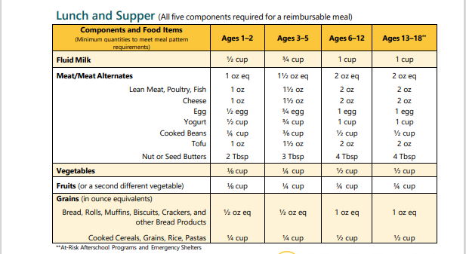
CACFP Meal Pattern – Lunch/Supper
A reimbursable lunch/supper must include all 5 components:
Fluid Milk
Meat/Meat Alternate
Grain (Bread, Rice, Noodles)
Fruit
Vegetable
All components must be offered in at least the minimum portion outlined by CACFP for that age group
Notes:
What’s required for a reimbursable Lunch/Supper
Fluid Milk
Meat/Meat Alternate
Grain (Bread, Rice, Noodles)
Fruit
Vegetable (a combination of two different vegetables may be offered instead of a fruit and a vegetable at a lunch or supper)
All components must be offered in at least the minimum portion outlined by CACFP for that age group

Slide 15
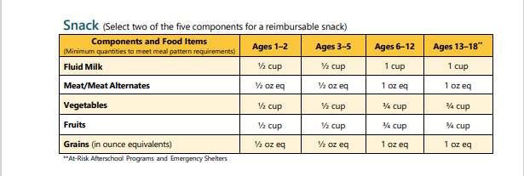
CACFP Meal Pattern Snack
A reimbursable snack must include:
Two of the five components
Cannot offer two items from the same group
(carrot rounds and celery sticks; would need to offer another item such as a cracker)
All components must be offered in at least the minimum portion outlined by CACFP for that age group.
Notes:
What’s required for a reimbursable snack
A reimbursable snack incudes two of the five components and it must be offered in at least the minimum portion outlined by CACFP for that age group
Cannot offer two items from the same group (ie carrot rounds and celery sticks; would need to offer another item like a cracker)
all components must be offered in at least the minimum portion outlined by CACFP for that age group

Slide 16
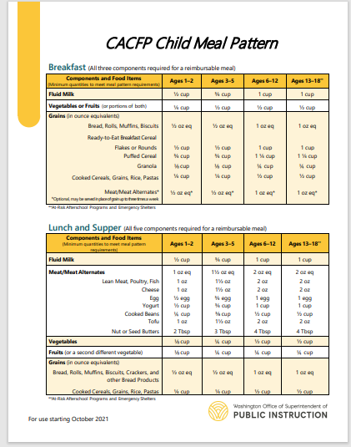
CACFP Meal Pattern Charts
Post these CACFP Meal Pattern charts in your classrooms for your reference to ensure reimbursable meals and snacks are offered.
CACFP Child Meal Pattern Handout
CACFP Infant Meal Pattern Handout
Notes:
Post these CACFP Meal Pattern charts in your classrooms for your reference to ensure reimbursable meals and snacks are offered and they meet the meal pattern.
Serving sizes on the charts are the minimum required serving sizes for the CACFP meal pattern; you can always serve more but not less.

Slide 17

CACFP Meal Pattern - Milk
CACFP Requirements for milk:
It must be served in fluid form
1 year old: Whole milk (including lactose-free options)
2 years and older: Fat Free/Skim or 1% milk (including lactose-free options)
Ensure that the cup holds the entire required minimum portion of milk
During family style if a child does not serve the required minimum portion of milk then a second offering is required to allow for child to serve more milk
If the milk is pre-served it must meet the required minimum portion the first serving
Notes:
CACFP Requirements for milk:
It must be served in fluid form
1 year old: Whole milk (including lactose-free options)
2 years and older: Fat Free/Skim or 1% milk (including lactose-free options)
Ensure that the cup holds the entire required minimum portion of milk
During family style if a child does not serve the required minimum portion of milk then a second offering is required to allow for child to serve more milk
If the milk is pre-served it must meet the required minimum portion the first serving

Slide 18
CACFP Meal Pattern – Non-Dairy Substitutions for Milk
Non-Dairy Beverages are creditable ages 1 year and older when a Request for Fluid Milk Substitution is on file for the approved OSPI Non-Dairy Beverages list.
OSPI Child Nutrition Services Milk Substitutes Handout (www.k12.wa.us
If the substituted item is not on the approved list then a Request for Special Dietary Accommodation form is required.
Special Dietary Needs Reference Sheet (www.k12.wa.us)
Notes:
EDIT THIS SLIDE TO OUTLINE YOUR PROCESS – HOW YOU HANDLE NON DAITY SUBS AT YOUR CENTER(S)
Non-Dairy Beverages are creditable ages 1 year and older when a Request for Fluid Milk Substitution is on file for the approved OSPI Non-Dairy Beverages list.
Request for Special Dietary Accommodations (www.k12.wa.us)
OSPI Child Nutrition Services Milk Substitutes Handout (www.k12.wa.us
If the substituted item is not on the approved list then a Request for Special Dietary Accommodation form is required.
Special Dietary Needs Reference Sheet (www.k12.wa.us)

Slide 19
CACFP Meal Pattern – Special Dietary Needs
Children requiring special diets will need the Request for Special Dietary Accommodations completed and signed by the parent and a State Recognized Medical Authority or Registered Dietitian.
Meals/Snacks that do not meet the meal pattern for parent preference or when there is not a documented Special Dietary Needs/Fluid Milk sub form must not be counted in the meal counts
Special Dietary Needs Reference Sheet (www.k12.wa.us)
Request for Special Dietary Accommodations (www.k12.wa.us)
Notes:
EDIT THIS SLIDE TO OUTLINE YOUR PROCESS – HOW YOU HANDLE SPECIAL DIETARY NEEDS AT YOUR CENTER(S)
Children requiring special diets the Request for Special Dietary Accommodations will need to be completed and signed by the parent and a State Recognized Medical Authority
Special Dietary Needs Reference Sheet (www.k12.wa.us)
Request for Special Dietary Accommodations (www.k12.wa.us)

Slide 20

Test your menu knowledge!
Does this meal meet the CACFP Meal Pattern?
Today’s lunch menu:
Milk
Chicken
Zucchini and Corn
Strawberries
No. What is missing? Right! The Grain Component!
What should you do? Call the kitchen and request a grain item so the meal can be counted for reimbursement!
Notes:
Read the slide
Do you think this meal meets the CACFP Meal Pattern?
Today’s lunch menu:
Milk
Chicken
Peas
Strawberries
No. What is missing? Right the Grain Component!
What should you do? Call the kitchen and request a grain item so the meal can be counted for reimbursement!

Slide 21
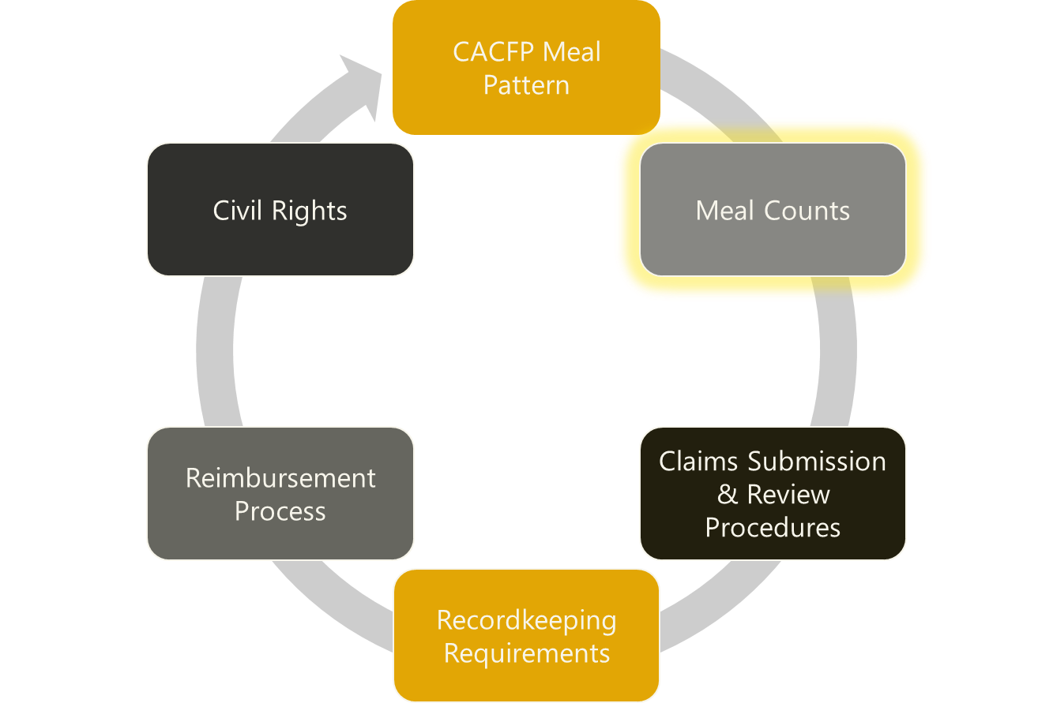
Staff Training
Notes:
NOW WE WILL TALK ABOUT MEAL COUNTS

Slide 22
Meal Counts – Times of Meals/Snacks
Ensures meals and snacks are served at approved times; these times are approved by the OSPI CACFP Specialist in WINS
Meals/Snacks served at approved times are reimbursable
Only two meals and one snack is served daily
We offer ______ meals and _____ snacks per day (add your info to this sentence and edit the chart below)
Edit this schedule to reflect YOUR center’s meals and meal times.
Breakfast 7:00 am – 8:00 am
Morning Snack 9:00 am – 10:00 am
Lunch 11:00 am – 12:30 pm
Afternoon Snack 2:00 pm – 3:00 pm
Supper 4:30 pm – 5:30 pm
Notes:
UPDATE THIS SLIDE TO MATCH YOUR MEALS/SNACKS AND TIMEFRAMES THAT YOU HAVE BEEN APPROVED FOR IN WINS.
Remember meals and snacks must be served within these approved timeframes or the meals and snacks are not reimbursable.
Ensures meals and snacks are served at approved times; these times are approved by our assigned OSPI CACFP Specialist
Meals/Snacks served at approved times are reimbursable
Only two meals and one snack is served daily
In order to offer more than 3 feedings must be approved by OSPI (Additional requirements)
Review meal count requirements – by name meal counts

Slide 23

Meal Style Pre-portioned
Pre-portioned:
All food components are pre-portioned for each participant
Meal components are served on a plate or in a bowl
Fluid milk is provided in a cup
Minimum portion sizes of each required component must be served together to each participant at the beginning of the meal.
Meal counts must be done once each participant has been served their meal/snack
CACFP Meal Service Styles
Notes:
DELETE THIS SLIDE IF YOU DON’T DO PRE-PORTIONED MEAL STYLE
Pre-portioned:
All food components are pre-portioned for each participant
Meal components are served on a plate or in a bowl
Fluid milk is provided in a cup
Minimum portion sizes of each required component must be served together to each participant at the beginning of the meal.
Meal counts must be done once each participant has been served their meal/snack

Slide 24
Meal Style: Family Style
All required meal components must be placed on the table at the same time
Adequate amounts of each food item must be placed on the table to provide at least the minimum portions for each participant to be served
If adults are participating in the meal, there must be enough portions for the adults to role model
Participants may serve themselves from the serving dishes
Supervising adults may assist participants. If the adult serves the item it must meet the full minimum portion.
Allows participants to make food choices base on individual appetites and food preferences
CACFP Meal Service Styles
Notes:
DELETE THIS SLIDE IF YOU DON’T DO FAMILY MEAL STYLE

Slide 25
Meal Style: Family Style
Family Style continued:
Supervising adults must be seated at each table to actively encourage participants to take the full required portion of each food component
The supervising adult must offer the food item again to the participant if they initially refused or took a very small portion. This is called the “Second Offering”. The Second Offering must be done in order to claim the meal.
Second meals cannot be claimed for reimbursement.
Meal counts are completed at the Point of Service once each child has served themselves and a "Second Offering" has been done for those needing it
CACFP Meal Service Styles
Notes:
DELETE THIS SLIDE IF YOU DON’T DO FAMILY MEAL STYLE
Supervising adults must be seated at each table to actively encourage participants to take the full required portion of each food component
The supervising adult must offer the food item again to the participant it they initially refused or took a very small portion. This is called the “Second Offering”. The Second Offering must be done to claim the meal.
Second meals cannot be claimed for reimbursement.
Meal counts are completed at the Point of Service once each child has served themselves and a Second Offering has been done for those needing it

Slide 26

Meal Style: Cafeteria
Cafeteria:
Participants are served from a cafeteria line, considered pre-plated
Participants must be served the minimum required amounts of all components their first time through the line
Adults must supervise and ensure that minimum
portion requirements are met
Meal counts are completed as the participant
takes the pre-plated items
CACFP Meal Service Styles
Notes:
DELETE THIS SLIDE IF YOU DON’T DO CAFETERIA MEAL STYLE – THIS IS COMMON FOR AT RISK PROGRAMS

Slide 27

Meal Style: Offer vs Serve
Offer vs Serve:
Meals must be consumed on the premises
Not allowed at snack under any Child Nutrition Programs
Meal counts are completed as the participant takes the meal items
CACFP Meal Service Styles
At-Risk Afterschool Meals - A CACFP Handbook
Notes:
DELETE THIS SLIDE IF YOU DON’T DO OFFER VS SERVE MEAL STYLE – THIS IS COMMON FOR AT RISK PROGRAMS THAT SERVE MEALS PREPARED BY LEAS PARTICIPATING IN NSLP AND SBP

Slide 28
Point of Service Meal Count Reminders
Meal counts must be taken at the Point of Service
Do not use attendance to record meal counts
Daily meal count for any meal type should never exceed the daily attendance
Meal counts need to be double checked for accuracy daily
CACFP Meal Service Styles
Notes:
Point of Service Meal Count Tips
Meal counts must be taken at the Point of Service (not before or after)
Do not use attendance to record meal counts
Daily meal count for any meal type should never exceed daily attendance
Meal counts need to be double checked for accuracy daily

Slide 29
Electronic Meal Count Systems
Electronic/online system for keeping records
Staff must take a Point of Service meal count
Double check counts prior to closing out of program or leaving classroom to ensure the numbers are correct and be sure to save
Be sure to have paper meal count sheets readily available in case of power outage, no internet, etc.
Notes:
DELETE IF YOU DON’T DO ONLINE MEAL COUNTS OR EDIT THIS PAGE WITH YOUR PROCESS IF YOU HAVE ONLINE MEAL COUNT SYSTEMS

Slide 30
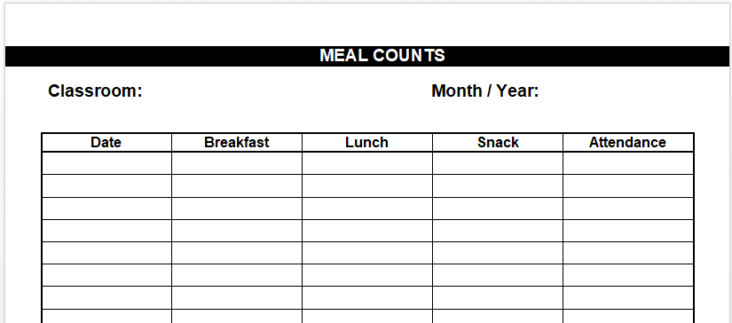
Head Count for Meal Counts
Count the total number of children at the meal service receiving a reimbursable meal at the Point of Service
Used since the center is approved for three meal services or less
Use numbers or tick marks in each column
This sheet is used for all CACFP participants including infants
May add an example of your own meal count sheet
mealcountrecord3meals.doc
Notes:
DELETE IF NOT USING HEAD COUNT METHOD OR EDIT PLACING YOU OWN FORM AND ANY NOTES. AT RISK PROGRAMS USE THIS FORM ALSO – ADD YOUR OWN MEAL COUNT SHEET
Head Count
Count up the total number of children at the meal service receiving a reimbursable meal at the Point of Service
Used since the center is approved for 3 meal services or less
Use numbers of tick marks in each column

Slide 31

At-Risk Meals and Snacks Counting
At-Risk only programs:
May only claim one meal and one snack
after the school day has ended or
on breaks during the school year.
A head count meal count or a by name meal count may be used.
Child Care programs who are approved to operate At-Risk:
May only claim one meal and one snack served to school-age children
after the school day has ended or
on breaks during the school year.
A third feeding may be counted as a childcare meal/snack.
A by-name meal count form must be used.
Notes:
EDIT OR DELETE SLIDE IF YOU DON’T HAVE AN AT RISK PROGRAM
At-Risk only programs
May only claim one meal and one snack
after the school day has ended or
on breaks during the school year.
A head count meal count or a by name meal count may be used.
Child Care programs who are approved to operate At-Risk
May only claim one meal and one snack served to school-age children
after the school day has ended or
on breaks during the school year.
A third feeding may be counted as a childcare meal/snack.
A by-name meal count form must be used.

Slide 32
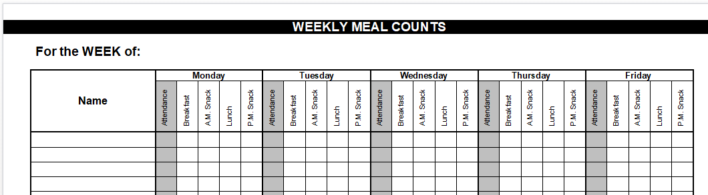
By Name Meal Counting
By name meal count is used because we offer more than three meal services
List the participants name and check off the meal/snack at the Point of Service
Only 2 meals and 1 snack or 2 snacks and 1 meal can be claimed per participant per day.
This sheet is used for all CACFP participants including infants
May add your own meal count sheet
mealcountrecord5daywk4meals.doc
Notes:
DELETE OR EDIT THIS SLIDE – ADD YOUR OWN MEAL COUNT SHEET
By name meal count is used because we offer more then 3 meal services
List the participants name and check off the meal/snack at the Point of Service
Only 2 meals and 1 snack or 2 snacks and 1 meal can be claimed per participant per day.
This sheet is used for all CACFP participants including infants

Slide 33
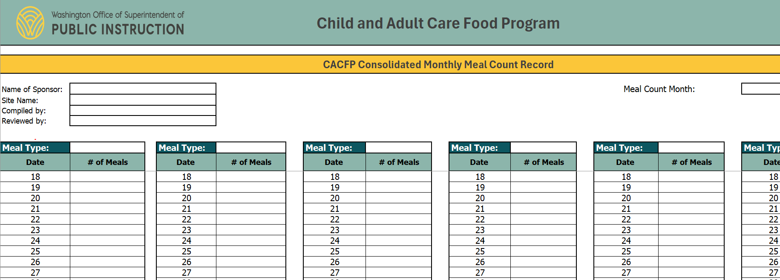
Meal Count Summary Sheet
Meal count summary sheet is
used to compile and double
check meals and snacks prior
to input for the monthly claim
submission
May add your own sheet
consolidated_meal_count-childcareadultcare.xlsx
Notes:
DELETE OR EDIT THIS SLIDE ADD YOUR OWN SUMMARY SHEET
Meal count summary sheet is used to compile and doublecheck meals and snacks prior to input for the monthly claim submission

Slide 34
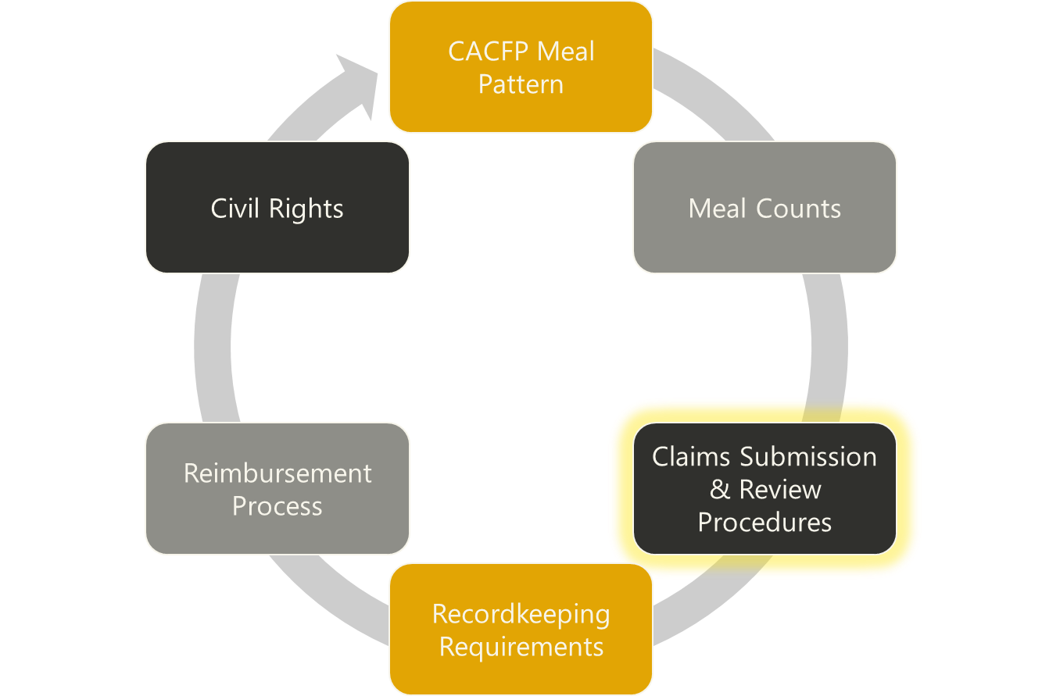
Staff Training
Notes:
NEXT IS CLAIM SUBMISSION AND REVIEW PROCEDURES

Slide 35
Claim Submission
Claim submission:
A monthly claim will be submitted to OSPI when all meal and snack counts for the month have been compiled and verified for accuracy via edit checks.
Edit checks of meal counts need to be done by the following:
Classroom staff - daily
Office staff/Kitchen staff - weekly
Person responsible for entering the monthly claim - monthly
An authorized point person from the organization will input those numbers into the OSPI approved data system (WINS) that is used for reimbursement.
Claims are due in WINS on the 15th of each month by no later than 2 pm
Claims are filed in WINS so that the Sponsor can be reimbursed for the meals and snacks that are served to the participants that meet CACFP requirements
Back up staff will be trained on our process
Claims, Fiscal Information and Resources
Notes:
MAY EDIT THIS SLIDE AS NEEDED
Claim submission
A monthly claim will be submitted to OSPI when all meal and snack counts for the month have been compiled and verified for accuracy via edit checks.
Edit checks of meal counts need to be done by the following:
Classroom staff - daily
Office staff/Kitchen staff - weekly
Person responsible for entering the monthly claim - monthly
An authorized point person from the organization will input those numbers into the OSPI approved data system (WINS) that is used for reimbursement.
Claims are due in WINS on the 15th of each month by no later than 2 pm
Claims are filed in WINS so that the Sponsor can be reimbursed for the meals and snacks that are served to the participants that meet CACFP requirements
Back up staff will be trained on our process

Slide 36
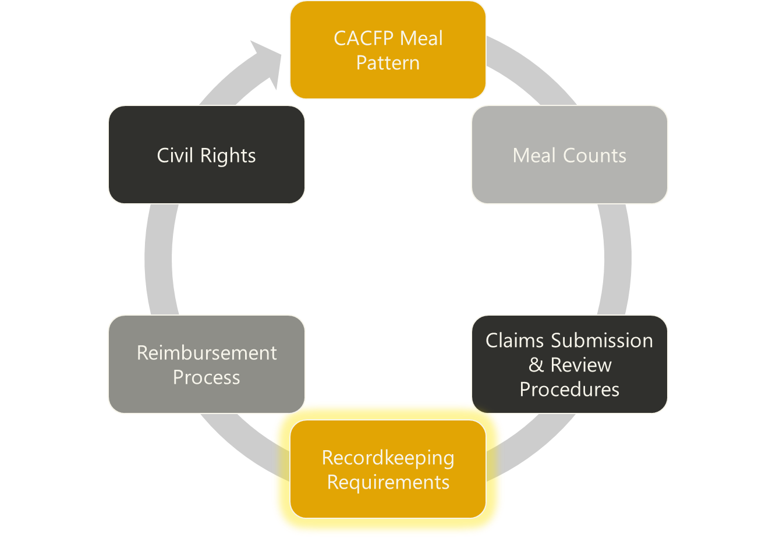
Staff Training
Notes:
THIS SECTION IS ABOUT RECORDKEEPING REQUIREMENTS

Slide 37

Recordkeeping Requirements
All CACFP records must be kept 3 years plus the current year
Where are CACFP Records are kept?
need to be easily accessible for Administrative
Reviews and Audits
Records include but are not limited to:
Menus EIEAs/Enrollment Claims
Financial Records Receipts
Who is responsible for which CACFP records?
We will identify person(s) responsible for which CACFP records
CACFP Reference Sheet - Organizing Records
CACFP - Record Keeping Requirements (www.k12.wa.us)
cacfp-roles-and-responsibilities-template.pdf
Notes:
MAY EDIT THIS SLIDE AS NEEDED
All CACFP records must be kept 3 years plus the current year
Where are CACFP Records are kept? (you can identify where CACFP records are kept)
need to be easily accessible for Administrative Reviews and Audits
Records include but are not limited to: (can list your organization’s additional CACFP records below)
Menus
EIEAs/Enrollment
Financial Records
Claims
Receipts
Who is responsible for which CACFP records? (can identify who is responsible for what records or make an internal list to hand out)
We will identify person(s) responsible for which CACFP records
CACFP - Record Keeping Requirements (www.k12.wa.us)

Slide 38
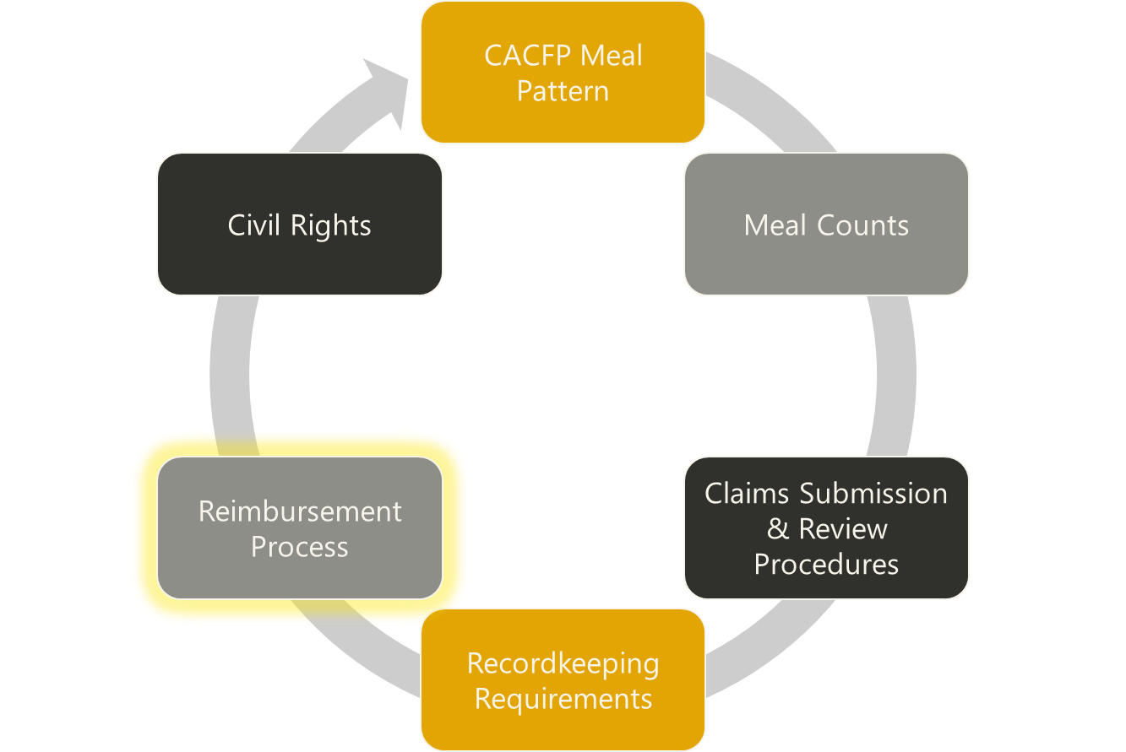
Staff Training
Notes:
AND LAST IS THE REIMBURSEMENT PROCESS

Slide 39
CACFP Reimbursement
Every year in July, the USDA assigns reimbursement rates to each meal type by eligibility category.
Free, Reduced Price or Paid (Above Scale)
We compile the Monthly Participant Eligibility Roster that is based on attendance in that month
This information is entered into WINS by total number of each category (Free, Reduced Price and Paid (Above Scale) each month
This determines our unique reimbursement percentage rate for each month
Meal | Free | Reduced-Price | Paid (above-scale)
Breakfast | $2.46 | $2.16 | $0.40
Lunch/Supper | $4.60 | $4.20 | $0.44
Supplements | $1.26 | $0.63 | $0.11
*this rate chart does not include the cash-in-lieu amount for CACFP participants receive for Lunch/Supper
Claims, Fiscal Information and Resources
Notes:
EDIT THIS SLIDE ANNUALLY TO REFLECT REMIMBURSEMENT RATES – ALSO HEAD START AND ECEAP GRANTEES NEED TO EDIT THIS SLIDE TO REFLECT ALL MEALS AND SNACKS ARE REIMBURSED AT THE FREE RATE NO STUDY MONTH
Every year in July, the USDA assigns reimbursement rates to each meal type by eligibility category.
Free, Reduced Price or Paid (Above Scale)
We compile the Monthly Participant Eligibility Roster that is based on participants eligibility that have attended in that month
This information is entered into WINS by total number of each category (Free, Reduced Price and Paid (Above Scale) each month
This determines our unique reimbursement percentage rate for each month

Slide 40

CACFP Reimbursement
CACFP reimbursement is the money that the
organization receives from OSPI after the monthly claim is
submitted in WINS for the meals and snacks served the prior month
CACFP expenditures must be documented to ensure reimbursement is spent appropriately and Sponsor is a non-profit foodservice
Reimbursement is used in the organization for:
Offsetting Food Costs
Offsetting Operating costs (cooks wages)
Administration costs (sponsoring organizations)
Enhancing staff knowledge about nutrition and feeding participants
Enhancing the menu by offering foods that meet program requirements
ospi-operating-expense-worksheet.xlsx
Allowable Costs in the CACFP Reference Sheet
Notes:
MAY EDIT THIS SLIDE AS NEEDED
CACFP reimbursement is the money that the organization receives after the monthly claim is submitted in WINS for meals and snacks served the prior month.
Reimbursement is used for: (choose which items in this example list that your organization uses reimbursement for – delete the others)
Offsetting Food Costs
Offsetting Operating costs (cooks wages)
Administration costs (sponsoring organizations)
Enhancing staff knowledge about nutrition and feeding participants
Enhancing the menu by offering foods that meet program requirements

Slide 41
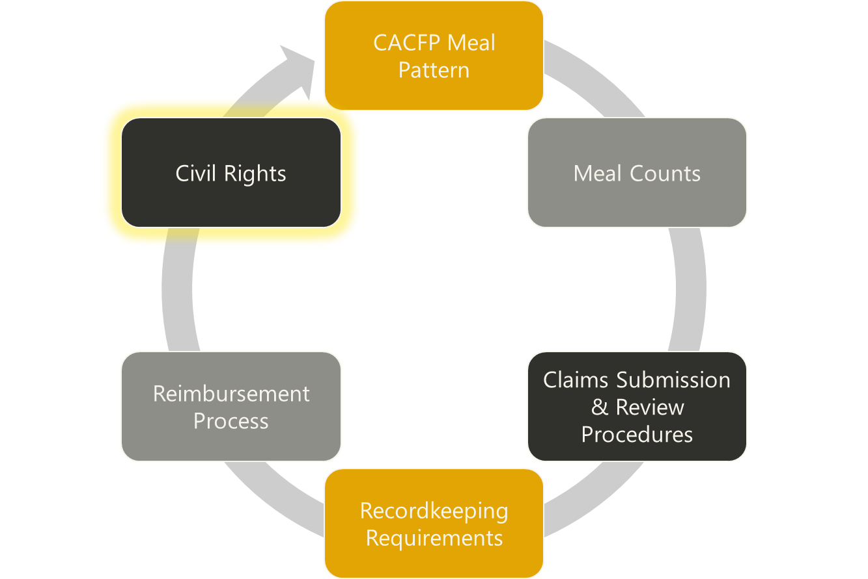
Staff Training
Notes:
CIVIL RIGHTS TRAINING

Slide 42

Civil Rights Training
We are required to train you annually on the topics listed:
Collection and use of racial and ethnicity data
Effective public notification systems
Civil Rights complaint procedure and form
Complaint Log
Civil Rights compliance review
Resolution of non-compliance
Requirements for reasonable accommodation of persons with disabilities
Requirements for language assistance
Conflict resolution
Customer service
OSPI Child Nutrition Civil Rights Reference Sheet
Notes:
YOU ARE ABLE TO USE THE ICN CIVIL RIGHTS ON LINE TRAINING – BE SURE STAFF SIGN IN AND ARE PRESENT IN THE TRAINING’S ENTIRITY.
ALSO FILL IN GAPS IN THE CIVIL RIGHTS TRAINING BY REVIEWING YOUR ORGANIZATION’S PROCESSES SUCH AS THE CIVIL RIGHTS COMPLAINT PROCEDURE; FORM AND THE COMPLAINT LOG.

Slide 43
Civil Rights Training Required Training Link
We will have each of you take this annual required Civil Rights Training in Bright Track (choose current program year):
OSPI | Bright Track Online CACFP Training – OSPI | Bright Track Online CACFP Training
Choose to enroll in the course(s) needed
There is one email for all staff to use when logging into Bright Track
When asked for the enrollment password, enter “cacfp”
If you need assistance enrolling and creating an account
Tutorial – How to Create a New User Account and Register for an Online Course – OSPI | Bright Track Online CACFP Training
Child and Adult Care Food Program Training
Notes:
Civil Rights Training Required – Training Link for Bright Track
We will have each of you take this annual required Civil Rights Training in Bright Track:
OSPI | Bright Track Online CACFP Training – OSPI | Bright Track Online CACFP Training

Slide 44
Staff Training
Administrative Reviews Training
Notes:
This section is to prepare your staff for an OSPI CACFP Administrative Review and what to expect to lessen anxiousness.

Slide 45
CACFP Administrative Reviews by OSPI
CACFP Administrative Reviews occur at a minimum of once every three years for Independent Centers and once every two years for Sponsoring Organizations
Meal observations are a portion of the review as well as the Administrative Review these may be announced or unannounced
OSPI Child Nutrition Staff must introduce themselves and show employees photo ID
Visits must be during regular business hours
CACFP Review Requested Records Checklist
Notes:
IMPORTANT YOUR STAFF KNOWS ABOUT ADMIN REVIEWS CONDUCTED BY OSPI CHILD NUTRITION This slides shares information about these OSPI Admin Reviews
We are reviewed by the state through an Administrative Review.
If, for any reason someone from the state agency drops by to observe a meal or to perform a review, we must allow them onsite with the following conditions:
OSPI Child Nutrition Staff must introduce themselves and show employees their photo id
Visits must be during regular business hours
Meal observations are portion of the review as well as the Administrative Review these may be announced or unannounced
Administrative Reviews occur at a minimum of once every 3 years for Independent Centers and once every 2 years for Sponsoring Organizations
CACFP Review Requested Records via a emailed records checklist

Slide 46
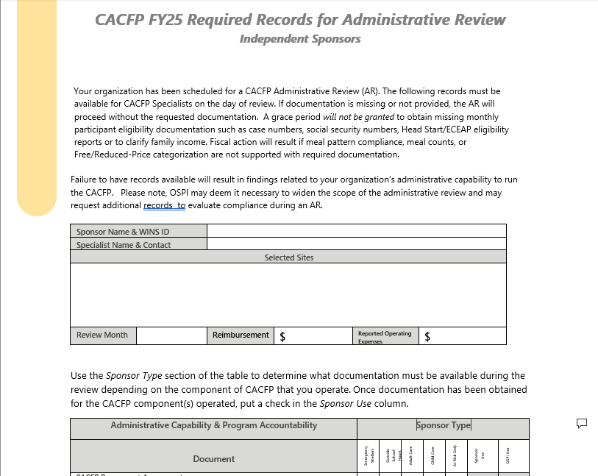
CACFP Administrative Reviews by OSPI
A CACFP Required Records Checklist will be emailed to us prior to the Administrative Review so that the records can be collected and ready when the OSPI CACFP Specialist arrives on-site
We will make a plan to collect and ready these reocrds
It is important for us to have these records ready at the time of review the Admin Review will continue proceed without them and may findings may result
FY25 Administrative Review Documentation Checklist
Notes:
IMPORTANT YOUR STAFF KNOWS ABOUT ADMIN REVIEWS CONDUCTED BY OSPI CHILD NUTRITION This slides shares information about these OSPI Admin Reviews
A CACFP Required Records Checklist will be emailed to us prior to the Administrative Review so that the records can be collected and ready when the OSPI CACFP Specialist arrives on-site
We will make a plan to collect and ready these reocrds
It is important for us to have these records ready at the time of review the Admin Review will continue proceed without them and may findings may result

Slide 47
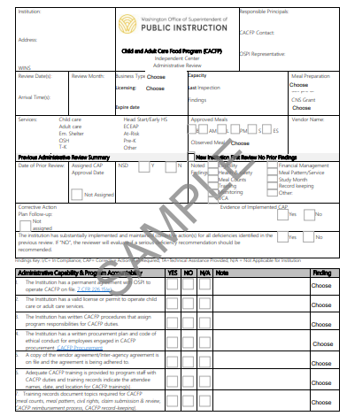
CACFP Administrative Reviews Monitoring Form for Independent Sponsors
Independent Sponsor Administrative Review Form
Notes:
IMPORTANT YOUR STAFF KNOWS ABOUT ADMIN REVIEWS CONDUCTED BY OSPI CHILD NUTRITION This slides shares information about these OSPI Admin Reviews
If you are a Sponsoring Organization – delete this form and keep the Sponsoring Organization AR Sample
This is a copy of the form that OSPI CACFP will use to review our program.

Slide 48
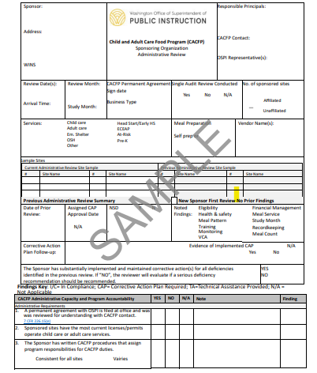
CACFP Administrative Reviews Monitoring Form for Sponsoring Organizations
CACFP Sponsoring Organization Administrative Review Form - Sample
Notes:
IMPORTANT YOUR STAFF KNOWS ABOUT ADMIN REVIEWS CONDUCTED BY OSPI CHILD NUTRITION This slides shares information about these OSPI Admin Reviews
If you are an Independent Sponsor delete this slide and use the Independent Sponsor slide
This is a copy of the form that OSPI CACFP will use to review our program.

Slide 49
Administrative Reviews by OSPI
Required Postings:
Current Dated Menu
Current License from DCYF, Tribal or government authority
And Justice for All Poster
WIC Program Information – English
¡WIC: ALIMENTACIÓN SALUDABLE Y MUCHO MÁS!
Building for the Future CACFP Informational Flyer - English
Building for the Future CACFP - Spanish
CACFP Requirements and Materials
Notes:
IMPORTANT YOUR STAFF KNOWS ABOUT ADMINISTRATIVE REVIEWS CONDUCTED BY OSPI CHILD NUTRITION
Required Postings:
Current Dated Menu
Current License from DCYF, Tribal or government authority
And Justice for All Poster
WIC Program Information – English
¡WIC: ALIMENTACIÓN SALUDABLE Y MUCHO MÁS!
Building for the Future CACFP Informational Flyer - English
Building for the Future CACFP - Spanish

Slide 50
Administrative Reviews by OSPI
Required Financial Records:
Receipts for food
Monthly Operating Costs Worksheet
Labor costs/Timecards/Timesheets
Administrative Costs Documentation (if applicable)
EIEAs/Enrollment Forms, Monthly Participant Eligibility Roster & Participant Eligibility Report
Claim Documentation
CACFP - Record Keeping Requirements
CACFP Reference Sheet - Organizing Records
Notes:
IMPORTANT YOUR STAFF KNOWS ABOUT ADMINISTRATIVE REVIEWS CONDUCTED BY OSPI CHILD NUTRITION
Required Financial Records:
Receipts for food
Monthly Operating Costs Worksheet
Labor costs/Timecards/Timesheets
Administrative Costs (if applicable)
EIEAs/Enrollment Forms and Monthly Participant Eligibility Roster
Claim Documentation

Slide 51
Administrative Reviews by OSPI
Kitchen Observation and Required Kitchen Records:
Meal preparation records – not required
Food inventory/storage
Refrigerator/Freezer temperature logs
Valid Food Handlers Cards
Food Safety and Sanitation Records
Standardized Recipes
CN labels and/or Product Formulation Statements
Menus with substitutions noted
Open food or leftovers dated
Also check to be sure Food Safety practices are met in accordance with state and local food safety practices
Notes:
IMPORTANT YOUR STAFF KNOWS ABOUT ADMINISTRATIVE REVIEWS CONDUCTED BY OSPI CHILD NUTRITION
Kitchen Observation and Required Kitchen Records:
Meal preparation records – not required
Food inventory/storage
Refrigerator/Freezer temperature logs
Valid Food Handlers Cards
Food Safety and Sanitation Records
Standardized Recipes
CN labels and/or Product Formulation Statements
Menus with substitutions noted
Open food or leftovers dated
Also check to be sure Food Safety practices are met in accordance with state and local food safety practices

Slide 52
Administrative Reviews by OSPI
Required Records:
Consolidated Meal Counts consolidated_meal_count-childcareadultcare.xlsx
Required CACFP Staff Training Documentation cacfp-sponsor-staff-training-sponsor-shareable-version.pptx
Required CACFP Staff Training Agenda and Sign In Sheet CACFP Attendance Roster
CACFP Infant Meal Form (if applicable) CACFP Infant Meal Form
Operating Expense Worksheet ospi-operating-expense-worksheet.xlsx
Menus Meal Patterns and Menu Planning
Request for Special Dietary Needs Accommodations
Request for Special Dietary Accommodations
Request for Special Milk Request for Fluid Milk Substitution - Child Care
Monthly Eligibility Records: Monthly Participant Eligibility Reference Sheet Child Care
Attendance Roster Monthly Participation Eligibility Roster – Child
Monthly Eligibility Report Monthly Participation Eligibility Report - Child
EIEA Enrollment and Income Eligibility Application and/or
Enrollment Forms form-enrollmentform.docx
Notes:
IMPORTANT YOUR STAFF KNOWS ABOUT ADMINISTRATIVE REVIEWS CONDUCTED BY OSPI CHILD NUTRITION
Required Records:
Consolidated Attendance Records consolidated_monthly_attendance_report_0.xlsx
Consolidated Meal Counts consolidated_meal_count-childcareadultcare.xlsx
Required CACFP Staff Training Documentation cacfp-sponsor-staff-training-sponsor-shareable-version.pptx
Required CACFP Staff Training Agenda and Sign In Sheet CACFP Attendance Roster
CACFP Infant Meal Form (if applicable) CACFP Infant Meal Form
Request for Special Dietary Needs Accommodations
Request for Special Dietary Accommodations
Request for Special Milk Request for Fluid Milk Substitution - Child Care
Monthly Eligibility Records: Monthly Participant Eligibility Reference Sheet Child Care
Attendance Roster Monthly Participation Eligibility Roster – Child
Monthly Eligibility Report Monthly Participation Eligibility Report - Child
EIEA Enrollment and Income Eligibility Application and/or
Enrollment Forms form-enrollmentform.docx

Slide 53
Meal Observations conducted by OSPI
Meal Observations:
Independent Sponsors- meal observations will be conducted as part of our unannounced OSPI CACFP Specialist visit
Sponsoring Organizations – meal observations will be scheduled with the OSPI CACFP Specialist so they can go to the center with the monitor and conduct an unannounced meal observation visit. This is so OSPI can observe the our monitor.
Sponsor Use Site Monitoring Instructions forms
Notes:
IMPORTANT YOUR STAFF KNOWS ABOUT ADMINISTRATIVE REVIEWS CONDUCTED BY OSPI CHILD NUTRITION
Independent Sponsors – DELETE SPONSORING ORGANIZATION BULLET
Sponsoring Organizations – DELETE INDEPENDENT SPONSOR BULLET

Slide 54
What to Expect During a Meal Observation by OSPI
Did the participants wash their hands with soap and water?
Is the meal served during the approved meal service time?
Did the foods served match the foods listed on the menu?
Are all components of a creditable meal served at the same time?
Is the correct portion available for each participant?
Were point of service meal counts taken properly?
Notes:
IMPORTANT YOUR STAFF KNOWS ABOUT ADMIN REVIEWS CONDUCTED BY OSPI CHILD NUTRITION
It can be stressful for you as staff in the classroom during a meal observation is conducted by OSPI
The Reviewers are looking evidence that you are aware of CACFP requirements that we are going over in this training.
Here are some items the reviewer will be looking at:
Did the participants wash their hands with soap and water?
Is the meal served during the approved meal service time?
Did the foods served match the foods listed on the menu?
Are all components of a creditable meal served at the same time?
Is the correct portion available for each participant?
Were point of service meal counts taken properly?

Slide 55
Infant Classroom/Meal Observation by OSPI
Infant Feeding Practices
Center provided formula and foods
Documentation Reviewed
CACFP Infant Meal Form
Meal Count Records
Standard Infant Menu
Infant Feeding— Meal Requirements Reference Sheet (www.k12.wa.us)
Notes:
DELETE THIS SLIDE IF YOU DO NOT CLAIM INFANTS
The reviewer will look for availability of center provided formula and foods as well as documentation on each child's developmental readiness, communication with parents, meal count records and the posted menu.

Slide 56
Results of the Administrative Review
Technical Assistance and/or Corrective Action
Review Findings related to meal count errors and study month errors result in Corrective Action and Fiscal Action
Fiscal Action = Money owed back to OSPI or Money paid to sponsor
Notes:
At the end of a review, the reviewer will go over the results with the owner/ responsible principal.
There may be findings with areas of technical assistance while other findings may deem corrective action assigned to the institution.
When errors are made in the operation of the CACFP there is a possibility that we will have to pay money back or in some cases money may actually be owed to us.
Examples of how this relates to you and your job:
During the meal observation, the reviewer noticed that 2% milk was being served to pre school age children. 2% milk is not creditable.
The reviewer will inform you that you cannot count any of the meals served with 2% milk.
You may feel embarrassed, upset, and worried you will be in trouble, yet in this example, who all had a part in the error?
The person who plans the menu?
The person who orders the milk?
The person who validates allowable costs with CACFP funds?
The person who serves the milk?
If any one of these individuals knew the meal pattern they could have raised the issue and prevented an error that resulted in meal disallowances. CACFP is everyone's responsibility.
This is a good example why we all need CACFP training so we feel confident when we are reviewed.

Slide 57
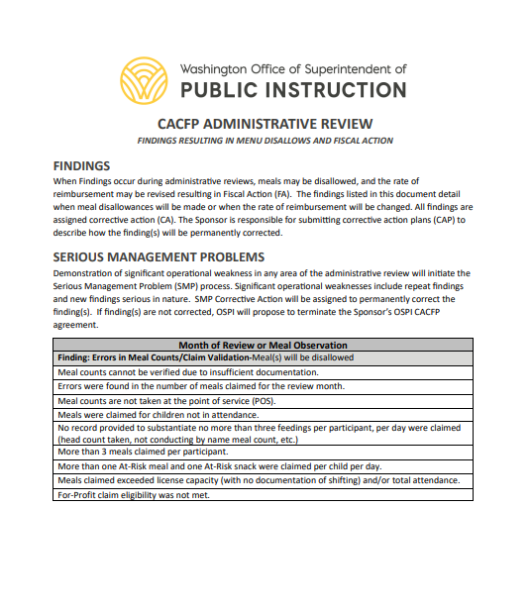
CACFP Administrative Reviews by OSPI Common Findings
These are some Common Findings during a CACFP Administrative Review that results in Fiscal Action
Findings Resulting in Menu Disallows and Fiscal Action
Notes:
IMPORTANT YOUR STAFF KNOWS ABOUT ADMIN REVIEWS CONDUCTED BY OSPI CHILD NUTRITION This slides shares information about these OSPI Admin Reviews
These are some Common Findings during a CACFP Administrative Review that results in Fiscal Action

Slide 58
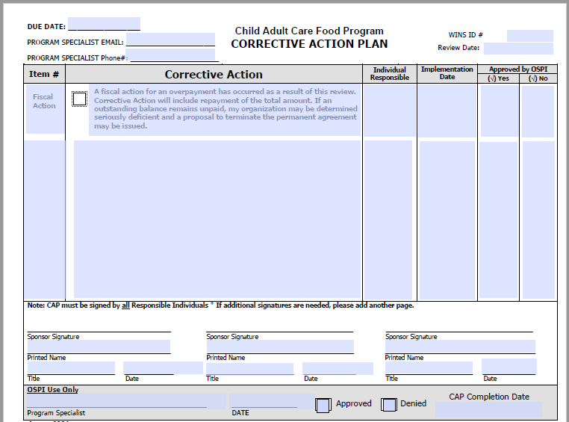
Administrative Reviews by OSPI
If there are findings:
They will be identified during the Administrative Review Exit
There will be a Corrective Action Plan Form that will need to be completed and it will need be submitted back to the OSPI CACFP Specialist for approval
There may be other documentation that will identified to be sent along with the Corrective Action Plan Form
There will be a due date set for us at this exit
Corrective Action Plan
Notes:
IMPORTANT YOUR STAFF KNOWS ABOUT ADMINISTRATIVE REVIEWS CONDUCTED BY OSPI CHILD NUTRITION
If there are findings:
They will be identified during the Administrative Review Exit
There will be a Corrective Action Plan Form that will need to be completed and it will need be submitted back to the OSPI CACFP Specialist
There may be other documentation that will identified to be sent along with the Corrective Action Plan Form
There will be a due date set for us at this exit

Slide 59
Questions?
Notes:
Thank you – are there any questions?

Slide 60
Monitor Staff Training
Monitoring Review Training
for Sponsoring Organizations
Notes:
THIS SECTION IS FOR SPONSORING ORGANIZATIONS ONLY FOR THE MONITORS AND MONITORING SUPERVISOR– INDEPENDENTS DELETE THIS SLIDE AND THOSE THAT FOLLOW THIS ONE.

Slide 61
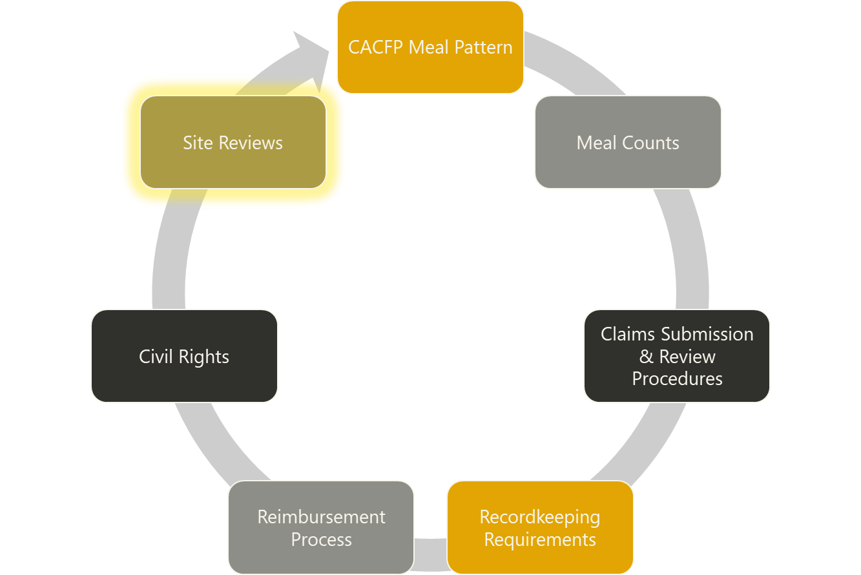
Monitor Staff Training
Notes:
MONITOR STAFF TRAINING FOR SPONSORING ORGANIZATIONS (SPONSORS WITH MORE THAN ONE SITE)

Slide 62
Sponsoring Organizations Monitoring
Management Plan outlines monitoring for our organization
Monitoring Reviews:
Monitors may introduce yourselves and show site employees your photo ID
Monitoring must be completed during regular business hours
CACFP Monitoring for Sponsoring Organizations Reference Sheet (www.k12.wa.us)
Notes:
SPONSORING ORGS – EDIT AND INDEPENDENTS DELETE THIS SLIDE
Management Plan outlines monitoring for our organization
Monitoring Reviews:
Monitors may introduce yourselves and show site employees your photo ID
Monitoring must be completed during regular business hours
CACFP Monitoring for Sponsoring Organizations Reference Sheet (www.k12.wa.us)

Slide 63
Sponsoring Organizations Monitoring
We will develop a Monitoring Tracking Calendar to ensure:
Three visits are completed each year
Will identify the type of visit Unannounced or Announced
List at least two visits must be unannounced
We may list at least one unannounced visit must include a meal observation
Ensure that not more than 6 months may elapse between reviews
Set dates of monitoring visits
Ensure that a variety of meal types are observed
Notes:
SPONSORING ORGS – EDIT AND INDEPENDENTS DELETE THIS SLIDE
We will develop a Monitoring Tracking Calendar to ensure:
Three visits are completed each year
Will identify the type of visit Unannounced or Announced
List at least two visits must be unannounced
We may list at least one unannounced visit must include a meal observation
Ensure that not more than 6 months may elapse between reviews
Set dates of monitoring visits
Ensure that a variety of meal types are observed

Slide 64

Sponsoring Organizations Monitoring
Prior to visiting the site we need to:
Double check our monitoring calendar to ensure type of visit and meal type
Check our prior reviews for Findings and/or Corrective Action and document the info on the monitoring form
Check WINS:
To confirm the time of meal to be observed
Check non-operating days to ensure site will be open
Notes:
SPONSORING ORGS – EDIT AND INDEPENDENTS DELETE THIS SLIDE
Prior to visiting the site we need to:
Double check our monitoring calendar to ensure type of visit and meal type
Check our prior reviews for Findings and/or Corrective Action and document the info on the monitoring form
Check WINS:
To confirm the time of meal to be observed
Check non-operating days to ensure site will be open

Slide 65
Sponsoring Organizations Monitoring
Prior to conducting monitoring:
Let’s go through all the questions on the review form together.
We need to ensure that we all understand the questions in the same manner and our answers are consistent. Let’s go section by section and talk about it.
Meal Observation
Reconciliation of meal counts
Review of required paperwork
What constitutes imminent threat to health or safety during a review
Follow up reviews and serious deficiencies
Our objective is to ensure we are in compliance with the CACFP
Sponsor Use Site Monitoring Instructions forms
Notes:
SPONSORING ORGS – EDIT AND INDEPENDENTS DELETE THIS SLIDE
Management Plan outlines monitoring for our organization
Monitoring Reviews:
Monitors may introduce yourselves and show site employees your photo ID
Monitoring must be completed during regular business hours
CACFP Monitoring for Sponsoring Organizations Reference Sheet (www.k12.wa.us)

Slide 66
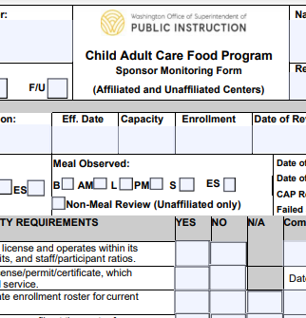
Sponsoring Organizations Monitoring
We will complete OSPI’s Monitoring Form during each review
If we add a new site we need to complete a Pre-Approval visit and email it to our OSPI CACFP Specialist and then conduct a monitoring visit within the first 4 weeks of opening
Action/Technical Assistance to ensure that follow-up has been completed and has continued
Provide Technical Assistance or assign Corrective Action as needed during monitoring review
If you have identified during the review that you need to use Household Contacts Procedure – follow our procedure and document accordingly
Must ensure that the Site rep and ourselves must sign and date form
Follow up
Corrective Action must be reviewed and assessed
Keep all documentation
Sponsor Use Site Monitoring Instructions forms
SFSP New Site Pre-Approval Monitoring Form
Notes:
SPONSORING ORGS – EDIT AND INDEPENDENTS DELETE THIS SLIDE
We will complete OSPI’s Monitoring Form during each review
If we add a new site we need to complete a Pre-Approval visit and email it to our OSPI CACFP Specialist and then conduct a monitoring visit within the first 4 weeks of opening
Action/Technical Assistance to ensure that follow-up has been completed and has continued
Provide Technical Assistance or assign Corrective Action as needed during monitoring review
If you have identified during the review that you need to use Household Contacts Procedure – follow our procedure and document accordingly
Must ensure that the Site rep and ourselves must sign and date form
Follow up
Corrective Action must be reviewed and assessed
Keep all documentation
Sponsor Use Site Monitoring Instructions forms
SFSP New Site Pre-Approval Monitoring Form

Slide 67
Household Contacts
Sponsoring organizations, as part of their monitoring of facilities, must comply with the household contact requirements 7 CFR 226.16(d)(5).
The purpose of the contact:
Verify the attendance and enrollment of the participant
Specific meal service(s) the participant routinely receives while in care
The intent of the household contact system is to investigate potentially inflated meal counts or other questionable CACFP documentation.
Notes:
SPONSORING ORGS – EDIT AND INDEPENDENTS DELETE THIS SLIDE
Sponsoring organizations, as part of their monitoring of facilities, must comply with the household contact requirements 7 CFR 226.16. Household contact means a contact made by a sponsoring organization to an adult member of a household with a participant in care. The purpose of the contact is to verify the attendance and enrollment of the child and the specific meal service(s) the participant routinely receives while in care. The intent of the household contact system is to investigate potentially inflated meal counts or other questionable CACFP documentation.

Slide 68
Household Contacts
Sponsoring organizations should contact households when:
Meal counts are inconsistent with attendance records.
Meal counts and attendance are not consistent with enrollment forms.
Information on the income eligibility forms is not current or has been altered
Records were completed in advance.
A large number of weekend, night meals and snacks are claimed for reimbursement.
Prior day’s meals counts are significantly higher than attendance on day of monitoring
Discrepancies in recordkeeping and claim validation.
The sponsoring organization received a complaint regarding meal claiming.
The sponsoring organization questions validity of a site’s reimbursement claim
Any other time deemed necessary by the sponsoring organization.
Notes:
SPONSORING ORGS – EDIT AND INDEPENDENTS DELETE THIS SLIDE
Sponsoring organizations CACFP Program Administrator must contact households when one or more of the following situations occur:
Meal counts are inconsistent with attendance records.
Meal counts and attendance are not consistent with the information on the enrollment forms.
Information on the income eligibility forms is not current or has been altered in any fashion (e.g., white out, erased, etc.).
Records were completed in advance.
A large number of weekend, night, and/or holiday meals and snacks are claimed for reimbursement.
Prior day’s meals counts are significantly higher than the attendance on the day of monitoring visit without good reason (for example, sickness, vacation days or field trip).
Discrepancies in recordkeeping and other various reasons that cause a sponsoring organization to question the claim.
The sponsoring organization received a complaint regarding meal claiming.
The sponsoring organization questions the validity of a site’s reimbursement claim.
Or Any other time deemed necessary by the sponsoring organization.

Slide 69
Questions?
Notes:
Thank you

Slide 70

Creative Commons License
Except where otherwise noted, this work by the Office of Superintendent of Public Instruction is licensed under a Creative Commons Attribution License. All logos and trademarks are property of their respective owners.
This presentation may contain or reference links to websites operated by third parties. These links are provided for your convenience only and do not constitute or imply any affiliation, endorsement, sponsorship, approval, verification, or monitoring by OSPI of any product, service, or content offered on the third party websites. In no event will OSPI be responsible for the information or content in linked third party websites or for your use of or inability to use such websites. Please confirm the license status of any third-party resources and understand their terms of use before reusing them.
Photos not marked are used with permission and not included in the open license.

