Slide 1

WA ELA 2026 Learning Standards Office Hour Session #1 - What's New and Key Shift March 19, 2026 4:00pm- 5:00pm
Carey Kirkwood, Associate Director of Elementary ELA & Content Integration
Praxia Apostle, Associate Director of Secondary ELA
Lesley James, Media Literacy and Digital Citizenship Program Supervisor
Notes:
This is a recording of the slides that were presented during Office Hour Session #1 for the Washington English Language Arts 2026 Learning Standards, focusing on What’s New in the standards and the Key Shift
The team working on the revised standards includes…

Slide 2
WA ELA 2026 | Session Agenda
Broader Goals of WA ELA 2026 Revisions
Technical Support & Initial Adoption Resources
What’s New in WA ELA 2026
Key Shift, Key Understandings & Literacy Practices
Notes:
In this session, we’ll look at
The broader goals of the revision process
What’s new in the revised standards
The Key Shift, Key Understandings, and Literacy Practices that guided the revisions
And finally some of the additional resources you can access

Slide 3
Broader Goals: WA ELA 2026 Standards Revisions
Notes:
Let’s start with those broader goals of the revision process

Slide 4
WA ELA 2026 | Goals of Revisions
Media Literacy and Digital Citizenship — Integrate media literacy and promote responsible digital citizenship.
Critical Thinking — Emphasize critical thinking skills, encouraging students to analyze, evaluate, and synthesize information effectively.
Research-Based — Reflect literacy research and scholarship.
Usability — Reduce repetition to become more user-friendly.
Process-Oriented Learning — Focus on the process of literacy development to scaffold students’ learning experiences.
Prioritized — Priority standards to provide context and purpose.
Notes:
The team was tasked with integrating media literacy into the standards, as well as promoting responsible digital citizenship.
We wanted to emphasize critical thinking skills, encouraging students to analyze, evaluate, and synthesize information effectively.
Critical thinking involves thinking about how we think, as well as analyzing new information with healthy skepticism, open-mindedness, and acceptance of uncertainty.
The revised ELA standards reflect research and evidence-based practices by integrating insights from the science of reading, composition studies, linguistics, literacy studies, and education research.
Another goal was usability: reducing repetition to make the standards more user-friendly.
The revised standards emphasize process-oriented learning, recognizing literacy as a developmental and recursive process rather than a set of isolated skills.
They are organized for literacy development that scaffolds learning experiences.
Instead of splitting literary and informational texts, reading standards now address genre features and multimodal texts holistically, which better reflects the texts that students encounter in various contexts.
Finally, prioritized learning standards have been identified across the five domains.

Slide 5
What's New in WA ELA 2026
Notes:
With those broad goals in mind, let's take a look at what’s new in the ELA standards.

Slide 6
WA ELA 2026 | Revisions to Strands – 2026 Domains
ELA CCSS (2011): Strands
WA Revision: Domains
Reading
Literary Text
Informational Text
Foundational Skills
Writing
Speaking & Listening
Language
Reading
Writing
Speaking, Listening, & Digital Forums
Language
Research & Media Literacy
Notes:
Some of the big changes involve revising the Common Core strands into what are now called domains.
The Common Core has a Reading strand that is broken into three sub-strands.
Standards for literary texts are separate from standards for informational texts, which are separate from standards for foundational skills, which in the Common Core only cover grades K-5.
In the revised standards, these three sub-strands are collapsed into a single unified reading domain.
The Common Core Writing strand is still called Writing in the revised standards, and the Common Core Language strand is still called Language.
However, the Common Core Speaking and Listening strand is now called Speaking, Listening, and Digital Forums.
This is because digital forums can function like conversations even when they involve writing.
This also provides a place for standards related to digital citizenship.
Finally, there is a new domain in the revised standards: Research & Media Literacy.
Standards related to both research and media literacy have been pulled out of the Common Core Writing, Reading, and Speaking & Listening strands so they can be grouped together in this new domain.
Research does involve writing, but students also give presentations about research, cite research in discussions, and use research to inform creative work, to make decisions, and to better understand what they read.
Research also involves applying media literacy skills, but research is not the only context in which these skills are needed.
Media literacy skills are essential for students encountering media messages in many different contexts.

Slide 7
WA ELA 2026 | Streamlined Structure
455 standards → 291 standards
Unified, genre-based reading and writing standards
Clear domain progressions
Notes:
Based on input and feedback we received from educators across the state, we have organized standards into a streamlined structure that reduced the total number of standards from 455 to 291.
We have unified the text types into genre-based reading and writing standards
And each domain has a clear progression of standards within the domain.

Slide 8
What’s New in WA ELA 2026
Digital citizenship embedded in Writing and SLDF domains
Use of AI for writing addressed in Writing domain
Use of AI as information source addressed in RML domain
Priority standards for focus and transfer of learning
Consistent formatting, coding, and naming across content areas
Foundational reading skills continue after Grade 5
Notes:
Here are some key highlights of what's new in the revised standards:
Digital citizenship skills are embedded in the Writing domain and the Speaking, Listening & Digital Forums domain
The use of AI tools for writing is addressed in the Writing domain and the use of AI as an information source is addressed in the Research & Media Literacy domain
Note that we don’t use the term “AI”; instead we use terms like “appropriate use of technology”
This is because we wanted to make room for whatever AI evolves into and whatever comes next, as well as non-AI technology tools that are currently in use
Priority standards have been identified to help focus instruction on transferable skills.
We have included consistent formatting, coding, and naming for ease of use
Finally, reading foundational skills, which are now part of the Reading domain, continue after Grade 5, up to Grade 12

Slide 9
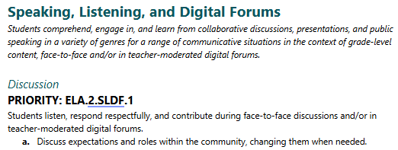
WA ELA 2026 | Standardized Naming Structure
ELA.2.SLDF.1
ELA
2
SLDF
1
Content
Grade
Domain
Standard
Notes:
Here is an example of the standardized naming structure of the revised standards
The standards code is comprised of four elements
The content area is first, in this case ELA for English language arts.
Then there’s the grade level, in this case second grade,
Then the domain, in this case SLDF
Finally we have the number of the standard itself
If a standard is designated as a priority standard, then the word priority will precede this learning standard code.

Slide 10
Prioritized Learning Standards
Priority Learning Standards are the most essential academic skills and concepts students need to succeed from one grade level to the next.
The Priority Learning Standards identify the universal set of standards that each and every student should have the opportunity to learn and be able to do.
Priority Learning Standards were identified using the following criteria:
Endurance: Will this skill or knowledge still be valuable beyond a single test, school year, or post-high school?
Leverage: Is it useful across multiple subjects (for example, writing or critical thinking)?
Readiness: Does it prepare students for success in the next grade level, course, or post-high school option?
Notes:
Priority learning standards can be described as the most essential academic skills and concepts students need to succeed as they progress through the grades.
The priority learning standards identify a universal set of standards that every student will have the opportunity to learn
The process was guided by national best practices. When selecting priority learning standards the following criteria were used:
Enduring concepts, skills and knowledge that are valuable beyond a single grade level.
Leverage, meaning usefulness across disciplines or subject areas.
Readiness, in terms of helping prepare students for future grades, courses, and post high school options.
Other learning standards serve to support and reinforce the priority learning standards.

Slide 11
WA ELA Key Shift, Key Understandings & Student Literacy Practices
Notes:
Now let’s take a look at
the key shift in the revised standards
the key understandings
and student literacy practices

Slide 12
WA ELA 2026 | Key Shift in WA ELA 2026
Students are active decision-makers.
This recognizes and builds on students’ capacity to make thoughtful, purposeful choices as they read write speak, listen, and engage with media – positioning them as active agents in their own learning.
The key shift is supported by six key understandings and six student literacy practices.
Notes:
It’s helpful to be aware of this key shift as you’re reviewing the revised ELA standards: the idea that students are active decision-makers.
This is a lens that can be used to make sense of what’s in the revised standards.
Students develop decision-making skills not by following rigid steps, but by engaging in authentic choices—supported by tools, strategies, and learning environments that nurture critical thinking and effective communication.
Students will navigate complex communication demands in their careers, education, and personal lives. While no curriculum can anticipate every scenario, we can equip students with the skills and confidence to make informed, purposeful decisions—so they’re ready to respond thoughtfully and effectively in any context.
This key shift is made possible and is supported by six key understandings of literacy and six student literacy practices.

Slide 13
WA ELA 2026 | Six Key Understandings of Literacy
Students’ experiences matter
Language is social
Domains are interdependent and integrated
Literacy is more than isolated skills
All texts are multimodal
Literacy connects to histories, identities, futures
Notes:
The revised standards are built upon six key understandings that reflect enduring insights from scholarship across literacy studies, linguistics, education, and the social sciences.
These understandings serve as conceptual anchors for interpreting, unpacking, and implementing the standards.
These key understandings are
Students’ experiences matter
Language is social
The standard domains are interdependent and integrated
Literacy is more than isolated skills and concepts taken out of context from authentic experience
All texts are multimodal
Literacy connects to histories, identities, and unknown futures

Slide 14
WA ELA 2026 | Six Student Literacy Practices
Use literacy for their own purposes
Think about the communicative situation
Use and adapt genres to create multimodal texts
Use flexible, recursive processes
Make meaning through experiences and perspectives
Critically examine texts through various lenses
Notes:
Those key understandings are enacted by students through six literacy practices that are woven throughout the revised standards.
The practices guide students in making decisions as they use literacy in authentic ways.
When students are active decision-makers, they:
1. Use literacy for their own purposes.
2. Think about the communicative situation.
3. Use and adapt genres to create multimodal texts.
4. Use flexible, recursive processes.
5. Make meaning through their own experiences and perspectives.
6. Critically examine texts through various lenses.

Slide 15
WA ELA 2026 Initial Adoption Resources & Technical Support
Notes:
Here are some of the additional resources you can access during the initial adoption period

Slide 16
WA ELA 2026 | Feedback Survey
Find the survey link in the ELA section of the website and encourage staff to fill it out.
Open from March 12 to May 3, 2026
Notes:
During the initial adoption phase, OSPI is collecting feedback about the ELA standards via a survey that will be open until May 3, 2026

Slide 17
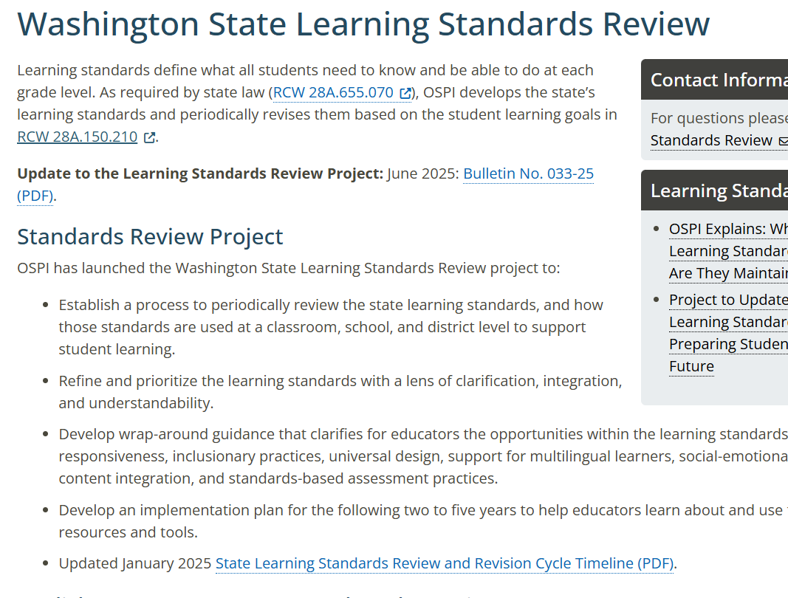
WA ELA 2026 | OSPI Webpage
Learning Standards & Instructional Materials
Washington State Learning Standards Review
Notes:
You can find a link to the survey, as well as other resources, on the Washington State Learning Standards Review page of the OSPI website
This page addresses the standards review project as a whole, not just the ELA standards

Slide 18
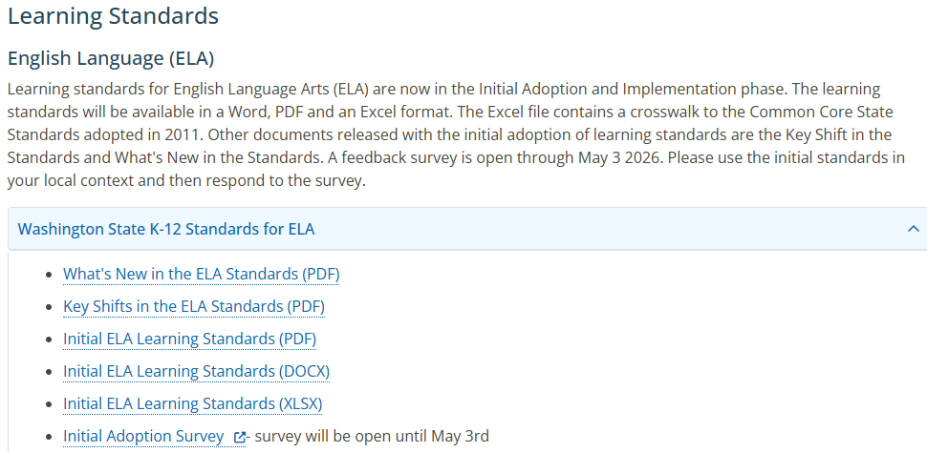
WA ELA 2026 | OSPI Learning Standards Webpage
Notes:
Find the part that focuses on the ELA standards by scrolling down to this section of the page
You’ll find documents that go into more detail about what’s new and the key shifts that were mentioned in this presentation
You’ll find the standards themselves in three different formats
The Word and PDF versions of the standards include introductions that also address what’s new and the key shifts
The Excel version includes helpful information across several tabs, such as a glossary of important terms used in the standards, crosswalk connections to the common core standards, and more.
There’s also that link to the Initial Adoption Survey, where you can share your feedback until the survey closes on May 3rd, 2026.

Slide 19
Connect with us.

