Slide 1

WA ELA 2026 Learning Standards Office Hour Session #2 – Reading Domain March 24, 2026 9:00am- 10:00am
Carey Kirkwood, Associate Director of Elementary ELA & Content Integration
Praxia Apostle, Associate Director of Secondary ELA
Lesley James, Media Literacy and Digital Citizenship Program Supervisor
Notes:
This is a recording of some of the slides that were presented during Office Hour Session #2 for the Washington English Language Arts 2026 Learning Standards
This session focuses on the Reading domain
The team working on the revised standards includes…

Slide 2
What's New in Reading (WA ELA 2026)
Notes:
Here’s what’s new in the Reading domain of the revised ELA standards

Slide 3
WA ELA 2026 | Revisions to Strands – 2026 Domains
ELA CCSS (2011): Strands
WA Revision: Domains
Reading
Literary Text
Informational Text
Foundational Skills
Writing
Speaking & Listening
Language
Reading
Writing
Speaking, Listening, & Digital Forums
Language
Research & Media Literacy
Notes:
One big change involves revising one of the Common Core strands, which are called “domains” in the revised standards.
The Common Core has a Reading strand that is broken into three sub-strands.
Standards for literary texts are separate from standards for informational texts, which are separate from standards for foundational skills, which in the Common Core only cover grades K-5.
In the revised standards, these three sub-strands are collapsed into a single unified reading domain.

Slide 4
WA ELA 2026 | Reading Domain
Foundational skills and comprehension develop at the same time.
Literary and informational texts are combined and reorganized around genre, including emerging genres.
Text features expand into grades 6–12, teaching students to “decode” genre-specific visual elements.
Student selection of texts supports student interest, experience, and prior knowledge.
Emphasis on linking reading to research, discussion, writing projects, and real-life applications
Notes:
Here are some other changes in the Reading domain:
Foundational skills and comprehension are designed and organized to develop at the same time, in alignment with the latest research on foundational skills
Literary and informational texts are combined and reorganized around genre study, including emerging genre types.
In grades six through 12, educators will see students learning to decode genre-specific visual elements, including text features.
The revised learning standards include student selection of texts supporting student interest, experience, and prior knowledge
And there’s an intentional emphasis on linking the reading domain to research, discussion, writing projects, and real-life applications

Slide 5
WA ELA 2026 | Domain Progression (K-6)
R.2. Phonemic Awareness: Hear and manipulate sounds in words.
R.3. Decoding: Use phonics to read words accurately.
R.4. Comprehension/Interpretation: Understand and make meaning within the text.
R.5. Analysis: Make connections between texts, between texts and themes, etc.
R.1. Print Awareness: Understand how print is organized.
R.7. Using and Interacting: Interact with and apply learning from texts.
R.6. Evaluation: Judge and explain opinions about text.
Notes:
For grades K through 6, the reading domain progresses in a structured way that tells a story within the domain
Reading standards 1, 2, and 3 relate to foundational skills.
Students begin with reading standard 1, print awareness, focusing on students’ understanding of how print is organized.
Students move on to reading standard 2 with an emphasis on phonemic awareness, which is the ability to hear and manipulate sounds and words.
In second and third grade, there's an intentional focus on connecting phonemic awareness to support spelling and decoding.
Reading Standard 2 is not included in grades 4, 5, or 6.
Reading standard 3 focuses on decoding, using phonics to read words accurately, applying grade level phonics and word analysis skills.
Fluency bridges between standard 3 –decoding; and standard 4 –comprehension.
Reading standard 4 focuses on students using a variety of strategies that support comprehension and interpretation within the text, including literary and information texts.
Reading standard 5 asks students to analyze texts by making connections between multiple texts and between a text and larger things outside of the text, such as themes.
Reading standard 6 asks students to evaluate aspects of texts such as how effectively they engage readers.
Reading standard 7 asks students to apply their learning from texts so they can explore questions, issues, and skills that are relevant to them.

Slide 6
WA ELA 2026 |Domain Progression (7– 12)
R.4 Comprehension/Interpretation: Understand and make meaning from text itself.
R.1. Print Awareness: Know and use text/visual features.
R.7 Using and Interacting: Interact with and apply learning from the text.
R.5 Analysis: Connect meaning from the text with the world outside the text.
R.6 Evaluation: Judge and explain opinions about the text.
Notes:
Grades 7-12 tell a similar story, but some standards do not appear in the older grades, specifically Reading standards 2 and 3.
Reading standard 1 is different in the older grades: it focuses on print awareness in terms of students knowing and using text and visual features that provide necessary information or add meaning to the text.
The other Reading standards are progressions of the standards in Grades K-6.
Reading standard 4 still focuses on comprehension and interpretation as students make meaning from the text itself.
Reading standard 5 still asks students to analyze the text by making connections to the world outside the text.
In the older grades this includes attributing evidence from the text, when relevant.
Reading standard 6 still asks students to evaluate the text by making informed opinions about its effectiveness.
And Reading standard 7 still asks students to use texts to explore questions, issues, and skills that are relevant to them.

Slide 7
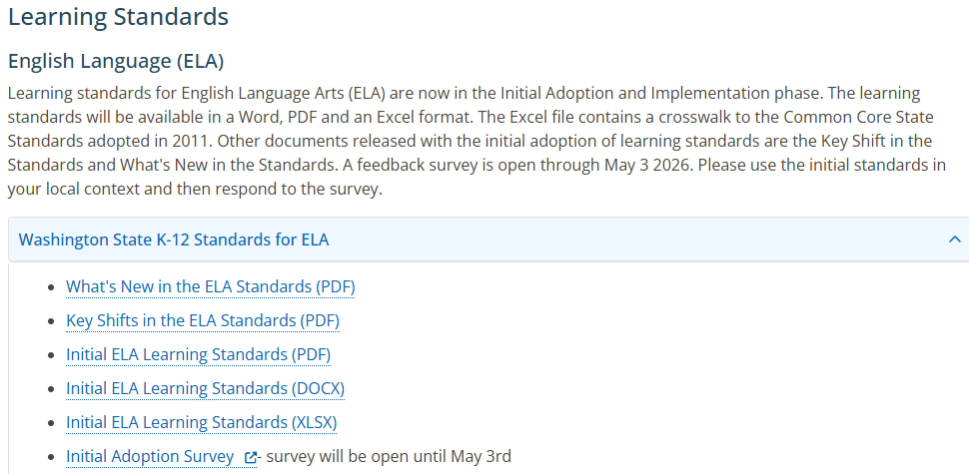
WA ELA 2026 | OSPI Learning Standards Webpage
Notes:
More information about the revised ELA standards can be found on the Learning Standards Review page of the OSPI website
Find the part that focuses on the ELA standards by scrolling down to this section of the page
You’ll find the standards themselves in three different formats, as well as documents that provide additional information
You’ll also find link to a survey where you can share your feedback until May 3rd, 2026.

Slide 8
Connect with us!

