Slide 1
WA ELA 2026 Learning Standards Office Hour Session #3 – Writing Domain March 31, 2026 4:00pm- 5:00pm
Carey Kirkwood, Associate Director of Elementary ELA & Content Integration
Praxia Apostle, Associate Director of Secondary ELA
Lesley James, Media Literacy and Digital Citizenship Program Supervisor
Notes:
This is a recording of some of the slides that were presented during Office Hour Session #3 for the Washington English Language Arts 2026 Learning Standards
This session focuses on the Writing domain
The team working on the revised standards includes…

Slide 2
WA ELA 2026 | Session Agenda
What’s New in the WA ELA 2026 Writing Domain
Digital Citizenship and AI in the Writing Domain
What's New in the WA ELA 2026 Standards
Notes:
In this session, we’ll briefly revisit the Key Shift, Key Understandings, and Key Student Literacy Practices that guided the revision of the standards so we can have them in mind as we go through what’s new in the Writing domain
Then we’ll go through those new things in the writing domain, which includes the integration of some Dig Cit skills and making room for AI tools

Slide 3
What's New in the WA ELA 2026?
Notes:
Before zooming in on writing, it’s helpful to situate the work inside the broader updates.
The revised standards build on the Common Core by prioritizing transfer, relevance, and real communication.

Slide 4
WA ELA 2026 | Key Shift in WA ELA 2026
Students are active decision-makers.
Notes:
One of the most important shifts in the revised standards is that students are positioned as active decision-makers.
Rather than following rigid steps or formulas, students learn to make purposeful decisions based on audience, context, purpose, and constraints.
Writing instruction becomes about equipping students with tools and strategies they can flex because we can’t anticipate every writing situation they’ll encounter beyond school, but we can prepare them to adapt and navigate
It can help to think of the term “shift” as describing a continuum of student learning and teacher practice. It’s not about leaving behind everything that has come before, it’s about building on it and moving along that continuum.

Slide 5
WA ELA 2026 | Six Key Understandings of Literacy
Students’ experiences matter
Language is social
Domains are interdependent and integrated
Literacy is more than isolated skills
All texts are multimodal
Literacy connects to histories, identities, futures
Notes:
These six understandings anchor all of the ELA standards.
The two that are most relevant in the Writing domain are: language is social, and literacy is more than isolated skills.
Writing doesn’t happen in isolation. It’s connected to identity, experience, audience, and opportunity and that perspective drives how the writing domain is structured.

Slide 6
WA ELA 2026 | Six Student Literacy Practices
Use literacy for their own purposes
Think about the communicative situation
Use and adapt genres to create multimodal texts
Use flexible, recursive processes
Make meaning through experiences and perspectives
Critically examine texts through various lenses
Notes:
Students enact the key shift of being active decision-makers through these six literacy practices.
You’ll see these literacy practices show up repeatedly in the writing domain.
Practices like using flexible, recursive processes, adapting genres, and considering the communicative situation are not add-ons; they’re the throughline of the writing standards from kindergarten through grade 12.

Slide 7
WA ELA 2026 | What’s new in the Writing domain?
Notes:
Let’s now zoom in on what’s new in the writing domain.

Slide 8
WA ELA 2026 | Writing Domain Standards Progression (Grades K-12)
W.1 (Purpose & Genre): Write for different purposes and audiences
W.2 (Planning): Plan ideas with purpose and audience in mind
W.3 (Drafting): Generate and develop ideas into writing
W.4 (Organization): Structure ideas clearly
W.5 (Revising & Editing): Improve meaning and mechanics
W.6 (Publishing): Share writing with others
Notes:
The Writing domain is organized as a developmental progression, from purpose and planning through to publishing.
The standards emphasize that this process is recursive, not linear, and that writing develops through purposeful communication, not isolated skill practice.
In fact, let’s look at the 6 standards in the Writing domain another way…

Slide 9
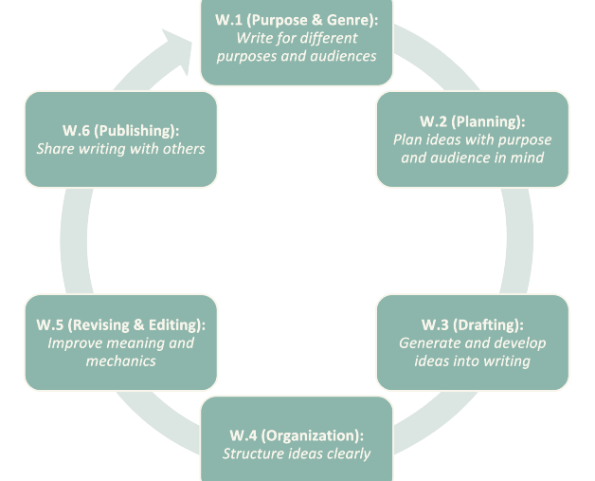
WA ELA 2026| The Recursive Nature of Writing
Example:
Writing Standard 2
Students plan and complete writing projects.
Notes:
This view reinforces that students move back and forth through the Writing process.
Writing standard 1 asks students to consider their purpose for writing, which will guide many of their later decisions—but in the process of writing, they may revisit that purpose
Writing standard 2 focuses on planning and managing writing projects—but those plans might change as they get deeper into the process.
Writing standard 3 is all about drafting content by generating and gathering ideas—it does not just apply to the first draft, but to later drafts which may have gotten all the way around the circle and come back to this point.
Writing standard 4 focuses on organizing all those things that were generated or gathered in standard 3, which might entail going back and forth between the two activities.
Writing standard 5 takes students to the revising and editing phase, which involves getting feedback from others—it’s easy to see how this step might lead back to one or more of the previous steps.
And Writing standard 6 is about sharing and publishing compositions, which is not just about hitting that “send” button—it’s about pausing to consider what might happen after you hit that “send” button.

Slide 10
WA ELA 2026 | Elementary grade level progression of Writing Standard 2
PRIORITY: ELA.2.W.2
Students plan and complete shared and independent writing projects.
Connect the task to their interests, experiences, or topics they know about.
Recognize that writing shares ideas with specific readers or listeners.
Identify and sequence steps to complete the writing project or task.
PRIORITY: ELA.4.W.2
Students plan and complete writing projects.
Connect the task to interests, experiences, or relevant topics.
Determine the audience and what they may already know, think, and/or feel about the topic.
Sequence and organize the process for completing a writing project or task, adjusting plans as needed.
Notes:
Let’s zoom in even closer and take a look at how one of the standards progresses through the grades.
Writing standard 2 is the one about planning writing projects—but it’s about more than just making a timeline.
This standard asks students to consider how the project connects to other things they already know about, who their audience will be, and a meta-awareness of all the things a writing project entails.
Let’s look at some of the progressions from grade 2 to grade 4:
One progression is from “shared and independent” writing projects to just writing projects
Another progression is from connecting to familiar topics to connecting to relevant topics, which might present opportunities to connect to something new
Second graders are grappling with the idea that what they write will be read by other people, while fourth graders are digging into what’s going on with those readers, what they may already know, think, and/or feel about a topic
For example, if they’re writing a story about Miffy, they will need to make sure everyone knows Miffy is their pet rabbit
And then we have the sequencing indicator: Second graders might be given cards with the steps in the writing process and asked to put them in an order that makes sense to them, while fourth graders might keep track of their writing process, including any adjustments they make, and reflect on why they made those adjustments
There’s an emphasis not just on the process of writing, but on an awareness of why those steps in the process matter—and not just because the teacher is telling you to do them!

Slide 11
WA ELA 2026 | Secondary Grade level progression of Writing Standard 2
ELA.7.W.2 Students manage and complete writing projects, connecting to interests, experiences, needs, or perspectives.
Analyze the prompt to determine the purpose of the project and how to meet it.
Determine who the audience is and what they may already know, think, and/or feel about the topic.
Determine the process or steps and plan the time needed to complete the project.
Adjust to feedback and shifts in focus and timeline when needed.
ELA.11-12.W.2 Students manage and complete writing projects, connecting to interests, experiences, needs, or perspectives.
Analyze the prompt and communicative situation to determine the purpose of the project and how to meet it.
Analyze the intended audience’s background knowledge, expectations, perspectives, beliefs, and/or values as they relate to the topic.
Determine the process or steps and plan the time needed to complete the project.
Adjust to feedback and shifts in focus and timeline when needed.
Notes:
Here are some of the things that show up in the secondary grades in this same standard:
They’re considering the communicative situation within which they will be composing
They’re considering the potential perspectives of their audiences, as well as their own perspectives
They’re considering how much time each step entails
And they’re adjusting based on feedback and shifting goals.
This mirrors how writing functions in academic, civic, and professional contexts.

Slide 12
WA ELA 2026| What’s new in Writing?
1. Students compose genres that integrate text types (argumentative, informative, narrative) with flexibility.
2. Persuasion broadened beyond argument.
3. Intentional alignment to WIDA’s English Language Development (ELD) Standards.
4. Emphasis on applying the writing process to unfamiliar genres and real-world writing tasks, as well as in other content areas.
5. Digital citizenship skills are integrated and room is made for AI.
Notes:
Here’s an overview of some specific things that are new in the Writing domain.
We’ll go through each of these in turn.

Slide 13
Writing in the WA ELA 2026 | Composing genres that integrate text types
The Writing domain is designed for flexible integration of narrative, informative/explanatory, and persuasive/argumentative elements.
ELA.4.W.1 Students compose multimodal texts in a variety of genres across content areas for sense-making and/or to communicate with others.
K–2: Compose a poem that’s intended to persuade.
6–8: Support an argument in a satirical version of an opinion piece.
3–5: Explain a scientific process by telling a story.
9–12: Blend reporting and analysis in a feature article.
Key Literacy Practice:
Students use and adapt genres to create multimodal texts.
Notes:
The revised standards intentionally move away from treating text types as separate silos.
When working on standard 1, which is…in grade 4
Students in grades K-2 might…
This reflects the key literacy practice of using and adapting genres.

Slide 14
Writing in the WA ELA 2026 | Expanding persuasion beyond argument
Persuasion includes not just arguments, claims, and counterclaims, but proposals, advocacy, storytelling, and rhetorical choices, emphasizing purpose and audience.
ELA.6.W.1d Persuade others through arguments, evaluations, and appeals to emotion and reason.
ELA.6.W.3g Support claims with relevant and credible evidence connected by sound and valid reasoning.
K–2: Persuade classmates to recycle by creating a poster with images.
6–8: Use both evidence and emotional appeals in a public service announcement.
3–5: Argue in favor of a school improvement by presenting facts and reasons in a speech.
9–12: Write an op‑ed, policy brief, or grant proposal.
Key Literacy Practice:
Students consider the communicative situation.
Notes:
The revised standards introduce persuasion in grades K-5 and build towards more formal argumentative composition using evidence and reasoning in grades 6-12.
In the revised standards…
When working on standard 1d, which is…in grade 6
Students in grades K-2 might…
This reflects the key literacy practice of considering the communicative situation.

Slide 15
Writing in the WA ELA 2026 | Intentional alignment to WIDA ELD standards
Students engage in joint construction of language, oral rehearsal, sentence frames, explicit language analysis, and multiple drafts.
These strategies support multilingual learners in ways that also benefit all learners.
ELA.5.W.5 Students evaluate, revise, and edit their compositions using a variety of strategies, including use of appropriate technology.
K–2: Shared writing with oral rehearsal and visuals to support language development.
6–8: Collaborative drafting and revision with explicit language objectives.
3–5: Structured paragraph frames that still allow choice and voice.
9–12: Genre-specific language analysis to support academic and professional writing.
Key Literacy Practice:
Students use literacy for their own purposes.
Notes:
Another new feature of the writing domain is an intentional alignment with WIDA’s English Language Development standards.
When working on standard 5, which is…in grade 5
Students in grades K-2 might use…
This reflects the key literacy practice of students using literacy for their own purposes.

Slide 16
Writing in the WA ELA 2026 | Writing process applied to unfamiliar and real-world genres, and across content areas
The writing process is accessed across content areas such as science, social studies, and CTE, and in many different multimodal genres, using common language for the process and expectations.
ELA.6.W.2 Students manage and complete writing projects, connecting to interests, experiences, needs, or perspectives.
K–2: Draft a letter to a local politician about a community issue.
6–8: Organize the script of a podcast connected to a social studies inquiry.
3–5: Gather ideas for a comic book about a scientific process.
9–12: Revise technical explanations in a CTE course.
Key Literacy Practice:
Students use and adapt genres to create multimodal texts.
Notes:
The writing domain is designed for students apply the full writing process to unfamiliar genres and real-world tasks, as well as in other content areas.
When working on standard 2, which is…in grade 6
Students in grades K-2 might…
This reflects the key literacy practice of using and adapting genres to create multimodal texts.

Slide 17
Writing in the WA ELA 2026 | Digital Citizenship and AI in Writing
Notes:
Digital citizenship is intentionally embedded in the writing domain where it fits naturally.

Slide 18
Digital Citizenship
Our definition:
The status of being a participant in the digital world, which comes with the responsibility to participate in ways that are as ethical, inclusive, empowering, kind, healthy, safe, and proactive as possible.
Notes:
There are a lot of different definitions of Digital Citizenship out there.
This is the one we’ve been using…
“Ethical” and “empowering” are highlighted because those are the aspects of Dig Cit that show up in the Writing domain
Other aspects show up in the SLDF domain; those will be covered in the session focused on SLDF

Slide 19
Why Digital Citizenship in the ELA standards?
Only included where it fits organically.
Topics that don’t fit not included: responding to cyberbullying, balancing screen time, sharing responsibly, protecting data, etc.
Intended to solve existing problem: “I know this is important, but when are we supposed to teach it?”
Notes:
A question some people might ask is…
One thing to know is that we…
There are other Dig Cit topics that are super important but they don’t fit organically in the ELA classroom; they work better in Health or some other subject area
We also integrated Dig Cit in order to…

Slide 20
Does Digital Citizenship instruction increase student screen time?
No ☺
Instruction can happen offline
What does increase: Students making informed decisions when they’re doing what they’re already doing online
Notes:
Another question people might ask is…
A very short answer is…
Keep in mind we’re talking about Dig Cit instruction, and…
There are lots of great ways to engage students in thinking about what they do when they go online without actually going online

Slide 21
Digital Citizenship shows up in two ways in the Writing standards:
Empowering digital identities
Ethical use of other people’s creative work

Slide 22
Empowering digital identities
Writing instruction guides students to consider their:
audience
NOT NEW
See Common Core W.4, W.10, and others
Notes:
Considering the audience for their compositions has always been part of Writing instruction

Slide 23
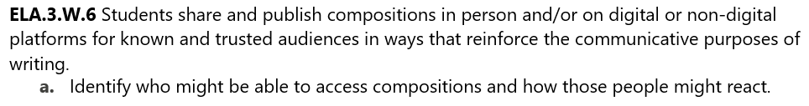
Revised Standard Example:
who might access
NEW EMPHASIS
Notes:
Here’s an example of a revised standard: Writing standard 6 for grade 3, which addresses sharing and publishing compositions
Indicator A says…
This adds a new emphasis to considering your audience: who might access your work
When a composition is published online, there is less control over who can access it
This does not mean all third grade teachers are going to be posting kids’ stuff on the internet!
This indicator is here because some third graders are definitely “publishing” things, like YouTube videos, on their own
And for those who aren’t publishing online yet, it is never too early to start thinking about how to do so in ways that present empowering digital identities

Slide 24
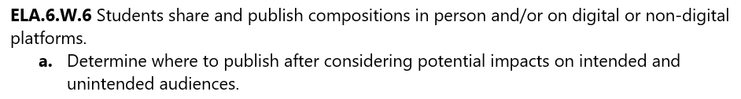
Revised Standard Example:
unintended audiences
NEW EMPHASIS
Notes:
In grade 6, the indicator evolves into…
Again, there’s a new emphasis, this time on unintended audiences
This is something else that comes with the territory of publishing things online
A student may have put a lot of thought into how their intended audience might react to their composition
But on the internet, there are all kinds of unintended audiences to consider as well

Slide 25
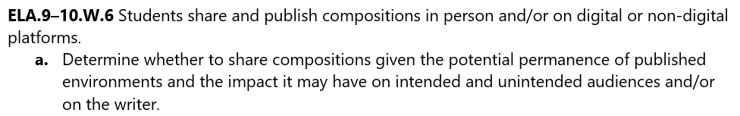
In grades 9-10, the indicator is…
impact of permanence
NEW
Notes:
In grades 9-10, the indicator is…
Here’s something else that’s not just a new emphasis but totally new: the permanence of the digital world
We want students to consider not just intended and unintended audiences, but potential future audiences as well
This is a key Digital Citizenship skill: thinking about your digital footprint

Slide 26
Ethical use of others’ creative work
Writing instruction guides students to consider their:
use of others’ creative work
NOT NEW
See “avoiding plagiarism” in Common Core W.8
Notes:
Ethical use of others’ creative work is another way in which Dig Cit shows up in the Writing domain
This is also not entirely new since the Common Core addresses “avoiding plagiarism”

Slide 27
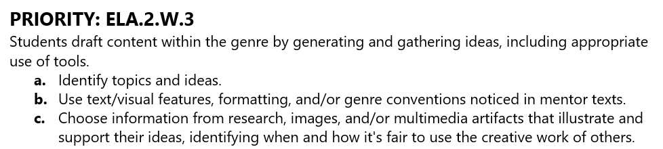
Writing standard 3 for grade 2
images & multimedia
NEW EMPHASIS
Notes:
Here’s Writing standard 3 for grade 2, which addresses drafting content by generating and gathering ideas
Indicator C is about gathering ideas and actual material created by others to use in your own work
A new emphasis is on thinking, not just about how you use other people’s ideas or words, but about how you use other people’s images or songs or other creations

Slide 28
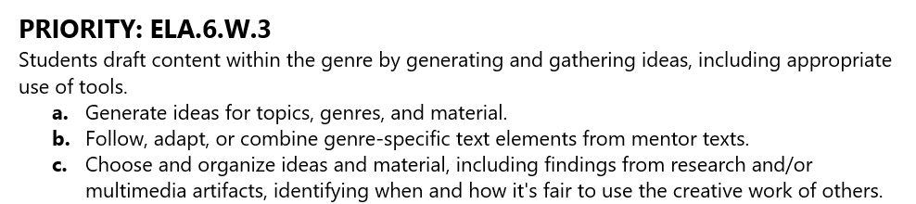
The standard and indicator in grade 6
Educational setting (fair use) vs. outside of education setting, e.g., using copyrighted songs in YouTube videos
when and how it’s fair to use
NEW
Notes:
The standard and indicator are fairly similar in grade 6
The indicator includes the phrase, “identifying when and how it’s fair to use the creative work of others”
This is new and it has to do with considering whether your use is happening…

Slide 29
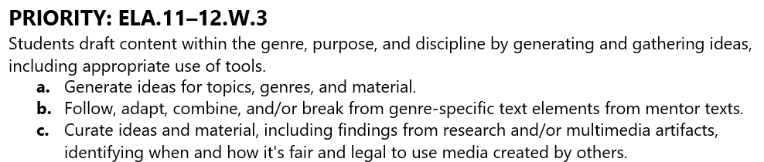
Grades 11-12
laws
NEW
ethics of AI tools’ use of creative work
NEW
Notes:
In grades 11-12, the indicator includes not just “when and how it’s fair” but “when and how it’s legal”
This is very new—learning about things like copyright—but it’s essential for students who are navigating the digital world
This brings up something else that’s new…
We tell students that it’s not OK to use other people’s creative work in certain circumstances without asking permission or offering compensation—and then they see the AI companies doing exactly what they were told not to do
This could be a super interesting discussion topic or a topic for a persuasive essay
It’s also a segue to our next topic

Slide 30
AI Literacy
The revised standards do not prescribe how AI should be used as part of the Writing process.
They make room for educators to engage students in using AI as a writing tool in whatever way works best for their students and their context.

Slide 31
AI Literacy
The term “AI” was intentionally not used so the wording of the standards can remain relevant no matter what happens with the current iterations of AI--and no matter what technology comes along next.
The broad, inclusive term “technology” (or “tools”) is used wherever there is an opportunity to plug in learning about generative AI.
This also makes room for current types of non-AI technology that are relevant in the ELA classroom, such as spell-checking tools in word processing programs.

Slide 32
AI Literacy
AI Literacy shows up in two ways in the Writing standards:
Generating and gathering ideas
Evaluating, revising, and editing

Slide 33
Generating and gathering ideas
tools
NEW EMPHASIS
Example: Gathering ideas on index cards
Notes:
Here’s Writing standard 3 again, which is all about generating and gathering ideas
It includes the phrase “including appropriate use of tools”
This is something that educators incorporate into Writing instruction all the time, but is now getting called out in the standards
One way to interpret “tools,” especially in the younger grades, is…

Slide 34
Grade 6 Standard
tools include AI
NEW EMPHASIS
Notes:
The standard itself doesn’t change much by grade 6, but the tools students are using might change quite a lot
Those tools might include AI as a tool for generating ideas for a first draft
Again, this is not prescribing that teachers make students use AI to generate first drafts
It’s making room for teachers to engage students in considering the pros and cons of doing so

Slide 35

Evaluating, revising, and editing
technology includes AI
NEW EMPHASIS
Notes:
The same is true of the use of AI for evaluating, revising, and editing drafts
Writing standard 5 includes the phrase “including use of appropriate technology”
This is a grade 4 standard, which is very likely not a grade in which teachers are having their students edit their drafts using AI
But this is a good example of why we used the broad term “technology”: it is possible that fourth grade teachers are showing their students how to use spell-check or other technology tools built into word processing software

Slide 36
In closing…
What students learn in the classroom can be relevant outside the classroom…
…where they’re composing and publishing in many mediums, using many tools, for many audiences, all day long
Notes:
In closing…

Slide 37
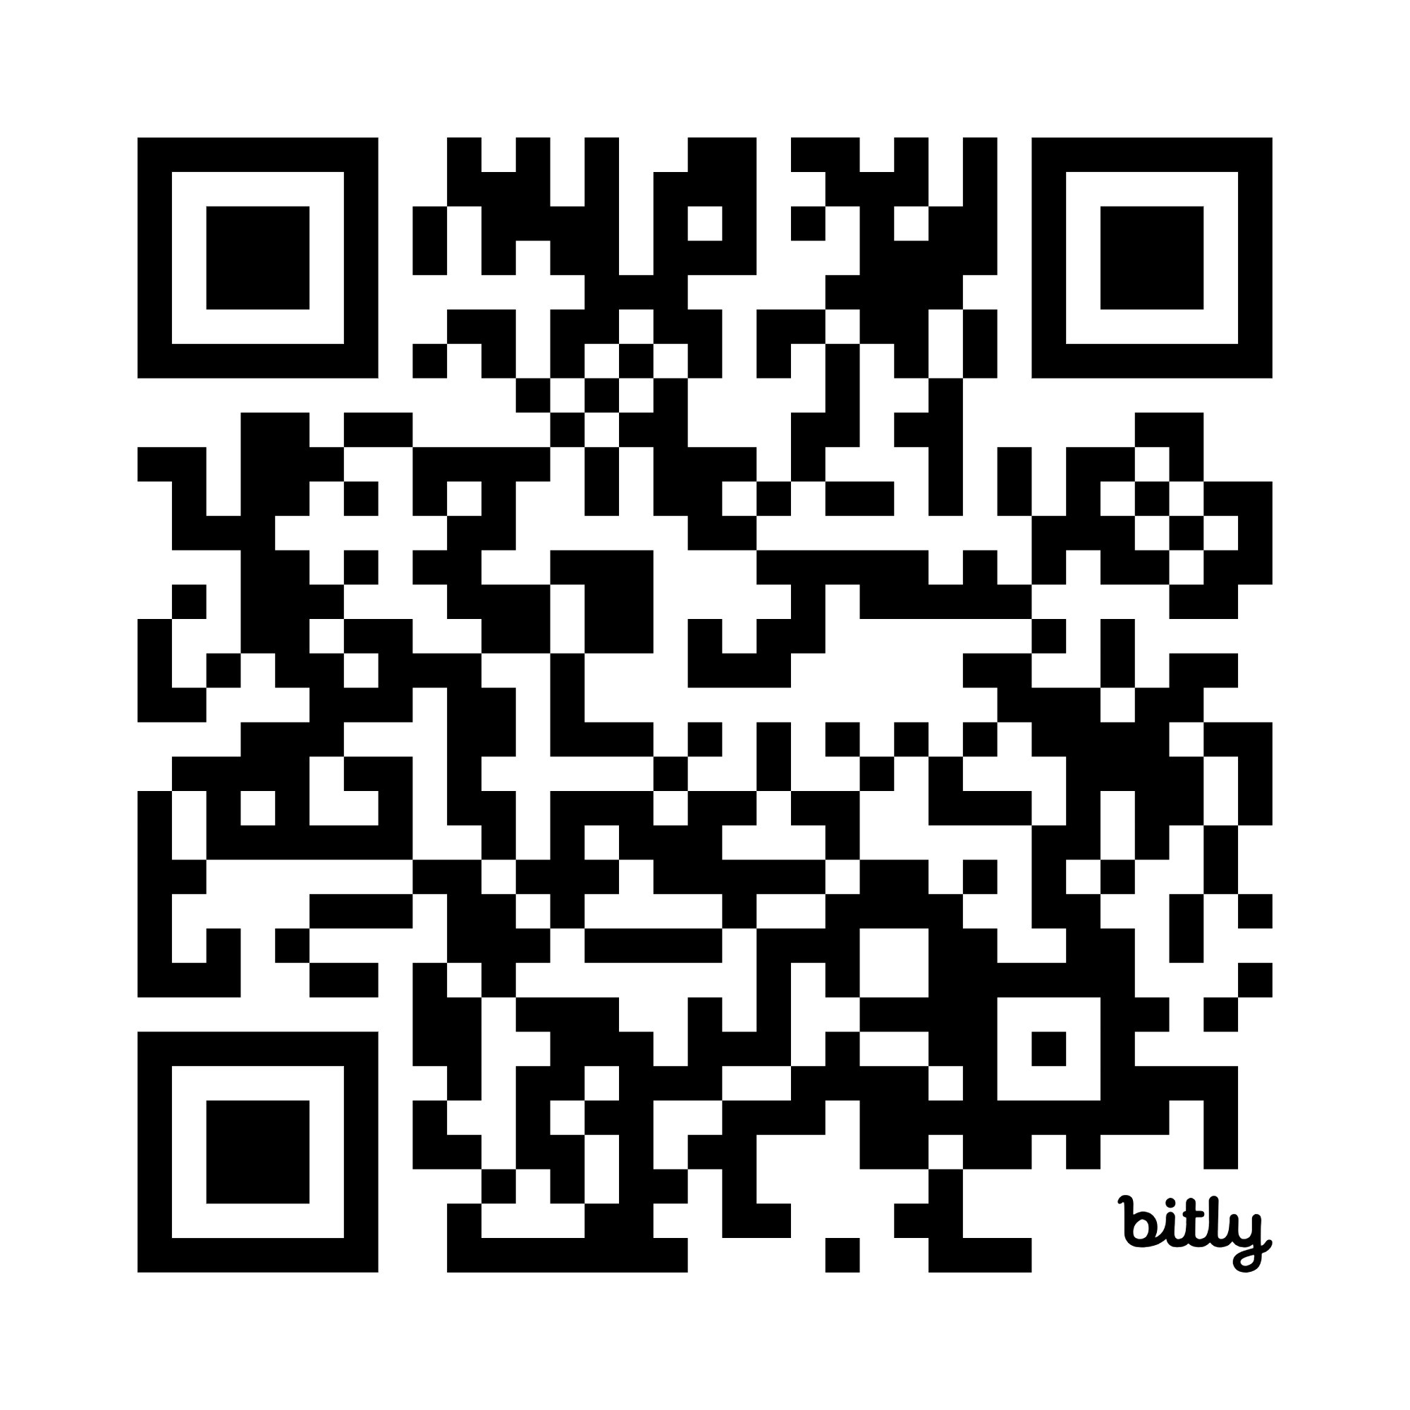
Resources
bit.ly/4d2ndOi
Notes:
Here’s a link to a curated list of resources that support the aspects of the revised standards related to Digital Citizenship and AI, as well as Research & Inquiry and Media Literacy

Slide 38
Connect with us!
Notes:
Thank you again for joining us today.
Please continue to reach out, attend future office hours, and share feedback as we move through this implementation together.

