Slide 1
K–12 Washington State Learning Standards for Mathematics (2025)
WIDA Connections in the Standards
Notes:
Welcome!
Today we're going to take you through an overview of the WIDA English Language Development standards connections in the revised Mathematics Standards for Washington state! Thanks for joining us!

Slide 2
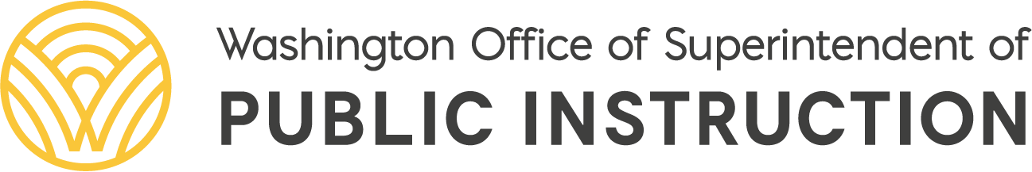
Vision
All students prepared for post-secondary pathways, careers, and civic engagement.
Mission
Transform K–12 education to a system that is centered on closing opportunity gaps and is characterized by high expectations for all students and educators. We achieve this by developing equity-based policies and supports that empower educators, families, and communities.
Values
Ensuring Equity
Collaboration and Service
Achieving Excellence through Continuous Improvement
Focus on the Whole Child
Notes:
Aligning the WIDA language standards with the Washington mathematics standards directly supports our agency’s vision of preparing all students for post-secondary pathways, careers, and civic engagement.
Mathematics requires students to reason, explain, and justify their thinking. By making the language of mathematics visible, we help ensure that multilingual learners have equitable access to rigorous mathematical learning.
This work reflects our mission to close opportunity gaps while maintaining high expectations for all students. It also reflects our values—ensuring equity, collaborating across disciplines, continuously improving our instructional systems, and supporting the development of the whole child as a thinker, communicator, and problem solver.

Slide 3
Equity Statement
Each student, family, and community possesses strengths and cultural knowledge that benefits their peers, educators, and schools.
Ensuring educational equity:
Goes beyond equality; it requires education leaders to examine the ways current policies and practices result in disparate outcomes for our students of color, students living in poverty, students receiving special education and English Learner services, students who identify as LGBTQ+, and highly mobile student populations.
Requires education leaders to develop an understanding of historical contexts; engage students, families, and community representatives as partners in decision-making; and actively dismantle systemic barriers, replacing them with policies and practices that ensure all students have access to the instruction and support they need to succeed in our schools.
Notes:
Aligning the WIDA language standards with the Washington mathematics standards reflects our agency’s commitment to educational equity. By making the language of mathematics visible—how students inform, explain, and argue—we help ensure multilingual learners can fully participate in mathematical thinking and discourse. This work helps remove barriers to rigorous learning and affirms that every student brings strengths, experiences, and perspectives that enrich our mathematics classrooms.

Slide 4
Mathematics is contextual, connected, and meaningful.
Engage in data science inquiry
Apply the Standards for Mathematical Practice
Develop efficient, flexible, and accurate strategies
Learn mathematics through four broad domains
Notes:
Aligning the WIDA language standards with Washington’s revised math standards highlights how students use language to make sense of problems, interpret data, and connect mathematical ideas. This alignment supports relevance, sense-making, and multiple ways for students to demonstrate their thinking.

Slide 5
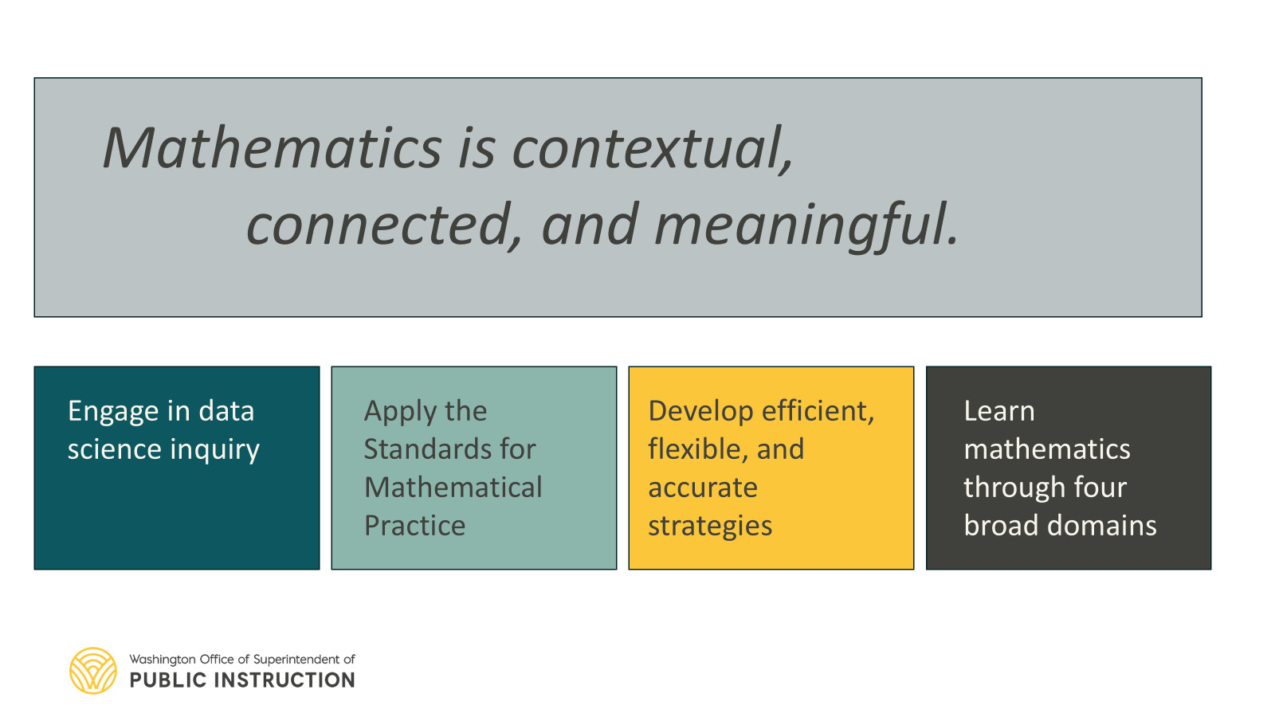
Math is language rich!!!
Notes:
This reminds us that the language of mathematics is rich!
Students learn mathematics through reasoning, explaining, and argumentation • The WIDA framework helps make these language demands visible and intentional • Alignment supports multilingual learners’ access to rigorous mathematics

Slide 6

Standards for Mathematical Practice
Make sense of problems and persevere in solving them.
Reason abstractly and quantitatively.
Construct viable arguments and critique the reasoning of others.
Model with mathematics.
Use appropriate tools strategically.
Attend to precision.
Look for and make use of structure.
Look for and express regularity in repeated reasoning.
Notes:
Aligning the WIDA language standards with the mathematics content standards also provides an opportunity to elevate the Standards for Mathematical Practice.
In particular, it highlights practices such as constructing viable arguments, critiquing the reasoning of others, and justifying conclusions using mathematical evidence.
When we recognize the language embedded in these practices, we can more intentionally support students in explaining their thinking, evaluating ideas, and participating in meaningful mathematical discourse. This alignment helps ensure that reasoning and communication remain central to how students learn and do mathematics.

Slide 7
NCTM's Mathematics Teaching Framework
Facilitate meaningful mathematical discourse
Pose purposeful questions
Elicit and use evidence of student thinking
Use and connect mathematical representations
The National Council of Teachers of Mathematics. (2015). Principles to Actions: Ensuring Mathematical Success for All
Notes:
The alignment of the WIDA language standards with the mathematics standards is also supported by the work of the National Council of Teachers of Mathematics and its mathematics teaching framework in Principles to Actions. That framework highlights several teaching practices that help students learn mathematics deeply, including facilitating meaningful mathematical discourse, posing purposeful questions, eliciting and using evidence of student thinking, and connecting mathematical representations.
These practices help create classroom environments that are rich in mathematical language, where every student is positioned to participate. They support the development of positive mathematical identities and help establish shared mathematical authority in the classroom. They also recognize that students bring multiple forms of language and discourse with them, and that these are valuable resources that strengthen mathematical learning.

Slide 8
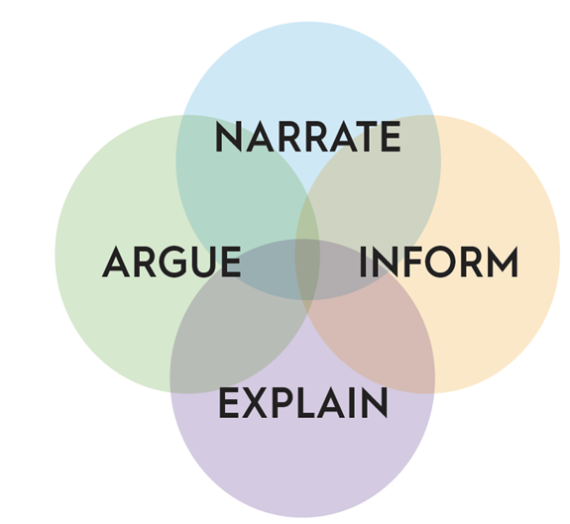
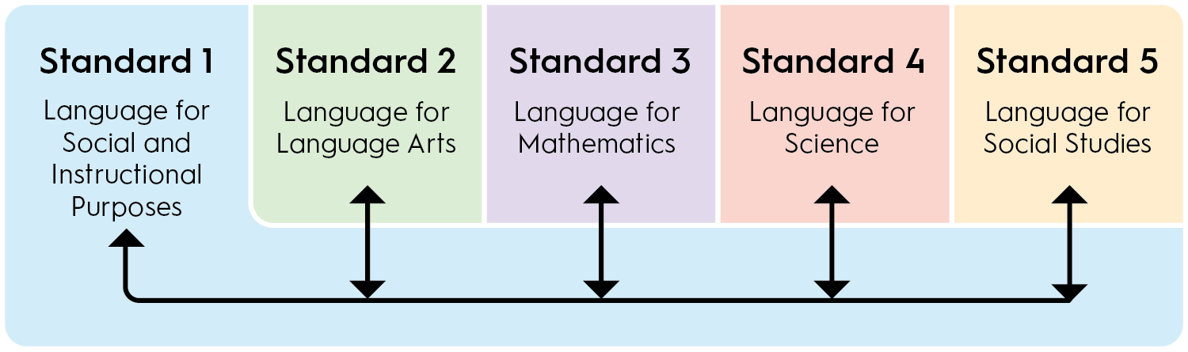

WIDA ELD Standards Framework
Key Language Uses
Students use language to:
Narrate – describe events or procedures
Inform – share information and observations
Explain – describe relationships and reasoning
Argue – justify claims and evaluate reasoning
Notes:
The WIDA English Language Development Standards Framework helps educators understand how language is used for learning across content areas.
One of the key features of the framework is the idea of Key Language Uses, which describe the different ways students use language when engaging in academic work. These include using language to narrate, inform, explain, and argue.
The framework is also organized into a set of standards that connect language development to different disciplinary contexts.
For example, Standard 3 focuses on the language of mathematics, highlighting the ways students communicate mathematical ideas, describe relationships, explain their reasoning, and justify conclusions.

Slide 9
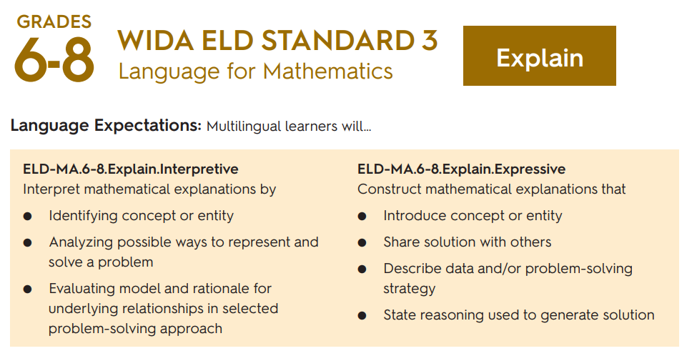
Where Inform Language Appears in WA Standards
When students:
Engage with new concepts
Recognize
Apply
Understand
Know
WIDA standard connection is flexible!!!
Notes:
One place we see strong connections to the WIDA standards in the Washington math standards is when students are asked to engage with new concepts or demonstrate understanding.
In the standards, this often appears through language such as recognize, apply, understand, or know. In these moments, students could be communicating mathematical information about ideas, quantities, or relationships.
This aligns with the WIDA language use Inform, where students share observations and describe mathematical thinking.
It’s important to remember that this connection is flexible, depending on how the standard is enacted in instruction and classroom discourse.

Slide 10
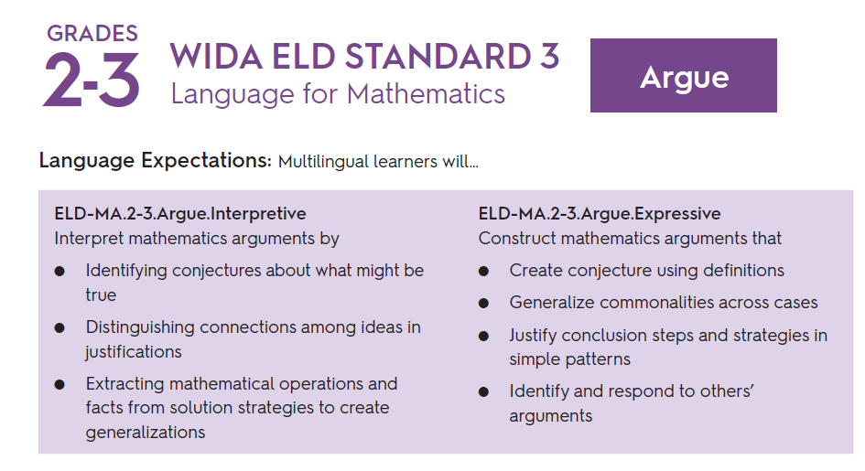
Where Argumentation Language Appears in WA Standards
When students:
Extend concepts
Represent
Develop/Describe definitions
Determine/Prove/Verify
Predict
WIDA standard connection is flexible!!!
Notes:
We also see opportunities for argumentation language throughout the Washington math standards. This often appears when students are asked to extend concepts, represent ideas, develop or describe definitions, determine, prove, verify, or make predictions.
In these situations, students are doing more than reporting an answer, they are justifying their reasoning, connecting evidence, and evaluating mathematical ideas. These are moments where the WIDA language use Argue can emerge in mathematics classrooms.
And as with Inform, the connection to the WIDA standard is flexible, depending on how the standard is implemented through tasks, discussion, and classroom discourse.

Slide 11
Important Framing
Not a one-to-one alignment!!!
Use and application of WIDA standards changes with context of math application
The language practices embedded in mathematics The ways students communicate mathematical reasoning
Notes:
An important piece of framing for this work is that this is not a one-to-one alignment between the WIDA standards and the mathematics standards. The way language is used changes depending on the mathematical context and the task students are engaging in.
Rather than being separate from mathematics, the WIDA language practices are embedded in the work of doing mathematics. They help us recognize the ways students communicate their ideas, explain relationships, and share their mathematical reasoning.

Slide 12
Making Sense of Fractions Through Discourse
Lesson Objective: Work collaboratively to solve a real-world problem involving fractions.
Description: 5th grade DL teacher Kris Carey and co-teacher Jessica Hegg engage students in a challenging fractions task.
Number talk prepares students for the story problem.
Bilingual pairs strategize how they might solve the problem.
Students move to larger groups to tackle the problem and create posters with models of their work.
The next day students finish the task and share out.
Notes:
This example shows what mathematical discourse can look like in practice. In this 5th grade dual language classroom, the lesson objective is for students to work collaboratively to solve a real-world problem involving fractions.
The lesson begins with a number talk to activate prior knowledge and prepare students for the story problem. Students then work in bilingual pairs to discuss possible strategies and make sense of the task together.
As they move into larger groups, students create posters that represent their thinking using models and representations. The following day, they return to the task and share their solutions with the class.
Throughout the lesson, students are using language to explain their reasoning, interpret representations, and build on each other’s ideas—demonstrating how mathematical understanding develops through discourse.

Slide 13
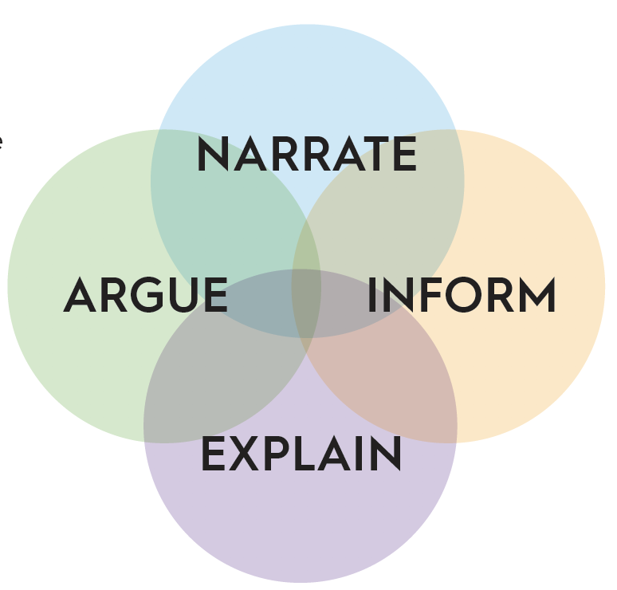
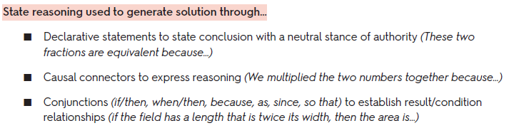
Elementary Example (5th grade)
Content Standard: CCSS.Math.Content.5.NF.B.6: Solve real world problems involving multiplication of fractions and mixed numbers, e.g., by using visual fraction models or equations to represent the problem.
Language Standard: ELD-MA.4-5.Explain.Expressive: Construct mathematical explanations that…state reasoning used to generate solution using declarative statements and connectors.
Notes:
Kristin
The math content standard focuses on solving real-world problems involving the multiplication of fractions and mixed numbers. Students use visual fraction models or equations to represent and solve the problem.
Alongside the content standard, we see a clear connection to the WIDA language standard for grades 4–5, where students construct mathematical explanations that state the reasoning used to generate a solution.
The language function here is explaining reasoning. Students use declarative statements to state their conclusions and causal connectors, such as because or so, to explain how they arrived at their solution.
This combination of mathematical reasoning and language use helps make students’ thinking visible and supports deeper understanding of the mathematics.

Slide 14
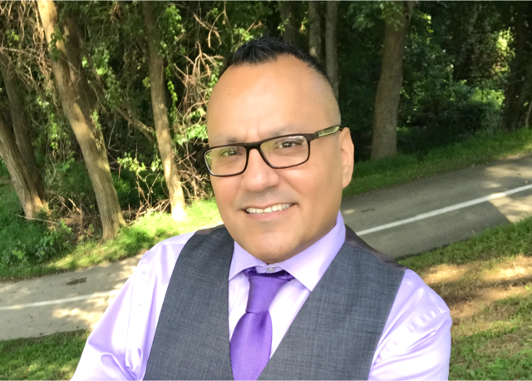
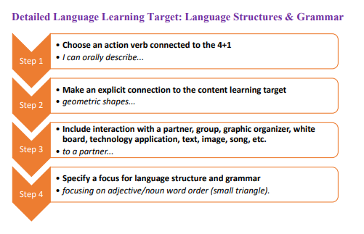
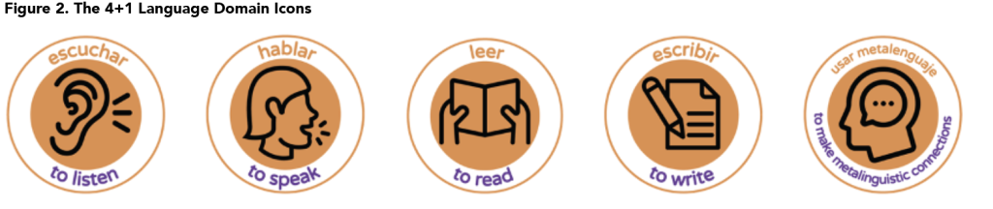
Integrated Learning Targets
Dr. Jose Medina
Notes:
Simplified Language Target Planning Template.docx
One way to make these connections between mathematics and language more intentional is through developing integrated learning targets. Dr. Jose Medina outlines a four-step process for identifying the language students will need to engage in a mathematical task.
This process helps teachers look closely at the language function, the structures students will use to communicate their reasoning, and the grammar that supports those structures.
By identifying these elements, educators can design learning targets that support both the mathematical thinking and the language students use to express that thinking, making the expectations for discourse more visible and accessible for all learners.

Slide 15
Language Learning Target Example
I can orally explain my thinking…
about how to solve a fractions problem…
to my partner or group…
Using full sentences and connectors to explain my reasoning.
“I multiplied the fraction by because…”
Notes:
Here is an example of a language learning target developed from the lesson we just discussed. The process begins by choosing an action verb that reflects the language function students will use. In this case, the target begins with “I can orally explain my thinking.”
Next, the language target is explicitly connected to the content learning target, in this case explaining how to solve a fraction problem.
The target also specifies an interaction, such as sharing thinking with a partner or group.
Finally, it identifies the language structures and grammar students will use, such as speaking in full sentences and using connectors to explain reasoning.
An example might sound like: “I multiplied the fraction because…” which helps students clearly communicate their mathematical thinking.

Slide 16
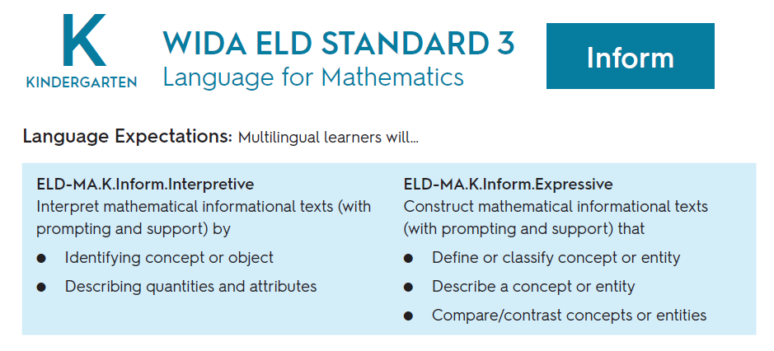
Kindergarten
Example
M.K.R.OA.3
Decompose numbers less than or equal to 10 into pairs in more than one way, e.g., by using objects or drawings, and record each decomposition with a drawing or equation (e.g., 5 = 2 + 3 and 5 = 4 + 1).
Notes:
Let’s look at an early elementary example.
In this kindergarten standard, students explore how numbers can be composed and decomposed.
While the mathematics focuses on number relationships, students are also communicating information about quantities.
This connects to the WIDA mathematics language use Inform, where students focus on the expressive in sharing observations and mathematical ideas.

Slide 17
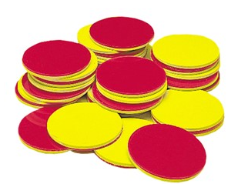
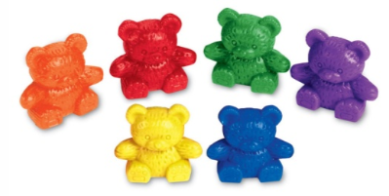
What Students do:
Kindergarten
Example
Students investigate different ways to make a number.
Example task:
How many ways can you make a 5?
Students use:
Counters
Bears
Drawings
Students share their representations with a partner.
M.K.R.OA.3
Decompose numbers less than or equal to 10 into pairs in more than one way, e.g., by using objects or drawings, and record each decomposition with a drawing or equation (e.g., 5 = 2 + 3 and 5 = 4 + 1).
Notes:
Students might use counters or drawings to show different combinations that make five.
They then share what they found with a partner.
For example, a student might say:
“I made five with two and three.”

Slide 18
What Teachers are Listening for:
Kindergarten
Example
M.K.R.OA.3
Decompose numbers less than or equal to 10 into pairs in more than one way, e.g., by using objects or drawings, and record each decomposition with a drawing or equation (e.g., 5 = 2 + 3 and 5 = 4 + 1).
Evidence that students:
Understand numbers can be composed in different ways.
Can communicate their observations about quantities.
Notes:
Teachers are not only checking whether students found correct combinations.
They are also listening for how students describe what they notice about numbers

Slide 19
Kindergarten
Example
M.K.R.OA.3
Decompose numbers less than or equal to 10 into pairs in more than one way, e.g., by using objects or drawings, and record each decomposition with a drawing or equation (e.g., 5 = 2 + 3 and 5 = 4 + 1).
I can share my thinking about how numbers can be broken into sets.
I can use words like together, total and difference.
Example: I made five with two and three because two and three together make five.
Notes:
So, if we're developing a language learning target we want to highlight that students are learning to communicate mathematical information.
Even in kindergarten, students are building the language they need to participate in mathematical discourse.

Slide 20
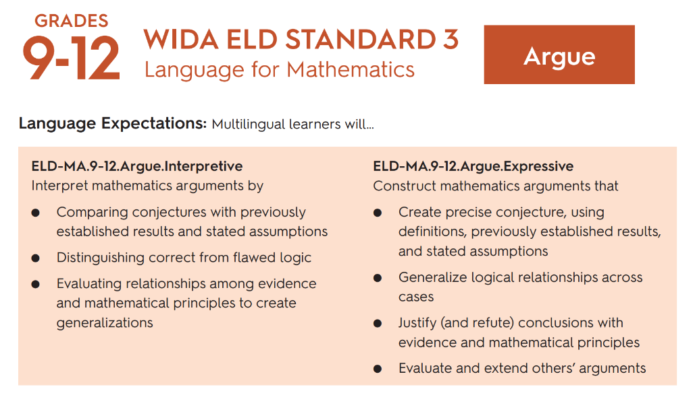
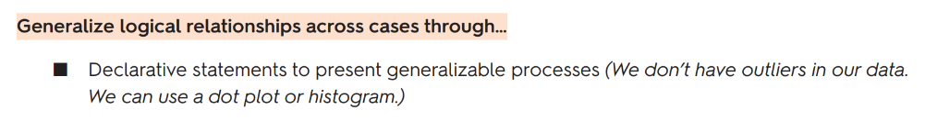
High School Example
M.HS.Q.ACED.3
Represent constraints by equations or inequalities, and by systems of equations and/or inequalities, and interpret solutions as viable or nonviable options in a modeling context.
Notes:
Let's look at a high school example of how this alignment shows up in practice.

Slide 21
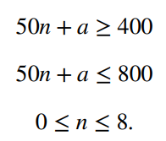
What Students do:
High School Example
From Illustrative Mathematics:
Sara's doctor tells her she needs between 400 and 800 milligrams of folate per day, from a multi-vitamin or a supplement.
M.HS.Q.ACED.3
Represent constraints by equations or inequalities, and by systems of equations and/or inequalities, and interpret solutions as viable or nonviable options in a modeling context.
Notes:
In this high school example, students are working with a real-world modeling situation. They are given a context, in this case, a recommendation about daily folate intake, and asked to represent constraints using equations or inequalities.
Students translate the situation into a mathematical representation, identifying the quantities involved and expressing the constraints symbolically.
This reflects the content standard, but it also sets the stage for something more, students will need to make sense of what these mathematical representations mean in context.

Slide 22
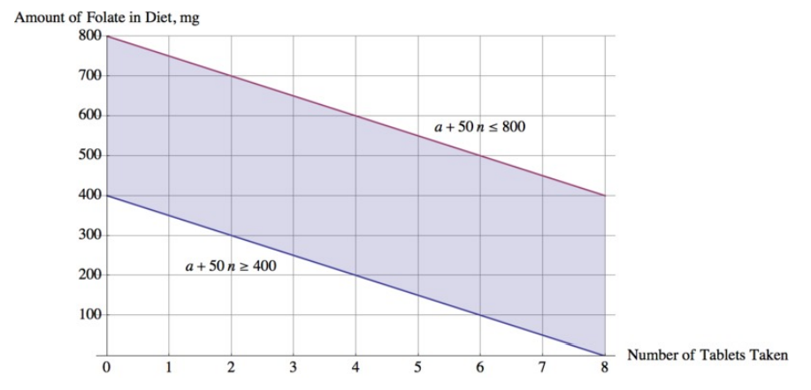
What Students do:
High School Example
From Illustrative Mathematics:
Sara's doctor tells her she needs between 400 and 800 milligrams of folate per day, from a multi-vitamin or a supplement.
M.HS.Q.ACED.3
Represent constraints by equations or inequalities, and by systems of equations and/or inequalities, and interpret solutions as viable or nonviable options in a modeling context.
Notes:
Students then move from a symbolic representation to a graphical model.
Here, they are representing the same constraints visually, identifying a range of possible solutions that meet the conditions of the problem.
This movement between representations, symbolic to graphical, is an important part of mathematical sense-making.
It also creates opportunities for students to explain how these representations are connected and what they show about the situation.

Slide 23
What are Teachers Assessing:
High School Example
Do the students’ constraints represent the context accurately?
How do the students justify their reasoning regarding viable solutions in this question?
M.HS.Q.ACED.3
Represent constraints by equations or inequalities, and by systems of equations and/or inequalities, and interpret solutions as viable or nonviable options in a modeling context.
Notes:
At this point, teachers are looking beyond whether students can create correct equations or graphs.
They are asking: Do the student’s constraints accurately represent the context? And how do students justify their solutions?
This is where the Standards for Mathematical Practice come into play, particularly constructing viable arguments and justifying conclusions using mathematical evidence.
The focus shifts from producing an answer to making and defending mathematical claims.

Slide 24
High School Example
M.HS.Q.ACED.3
Represent constraints by equations or inequalities, and by systems of equations and/or inequalities, and interpret solutions as viable or nonviable options in a modeling context.
I can share my thinking about why my equations and graphs make sense in context
I can justify why Sara could or could not take a certain amount of folate each day
Example: “Two folate tablets each day is not a viable solution because…”
Notes:
This is where we see a strong connection to the WIDA ELD Standards for Mathematics, specifically the language use Argue.
Students are expected to share their thinking about why their equations and graphs make sense in context and to justify whether a solution is viable or not.
The language here includes making claims, supporting those claims with evidence, and using reasoning to explain their conclusions.
For example, a student might say, “Two folate tablets each day is not a viable solution because…” and then connect that reasoning back to the constraints of the problem.
This illustrates how language and mathematics work together—students are not just solving a problem, they are justifying their reasoning within a real-world context.

Slide 25
What WIDA Alignment Means
Does mean:
Support for ALL students
Embedded in Mathematically Productive Instructional Routines
All students are developing language skills, including students for whom English is their first language
Clear opportunities to integrate English language arts standards through speaking, listening, writing standards
Facilitates student discourse in day-to-day teaching and learning
Notes:
When we talk about aligning the WIDA standards with the mathematics standards, it’s important to clarify what that means in practice.
First, this alignment supports all students, not only multilingual learners. Every student is developing language as they learn mathematics, including students whose first language is English.
These language opportunities are embedded in mathematically productive instructional routines—the kinds of routines that engage students in articulating their thinking, interacting with others, and making sense of mathematical ideas together.
This alignment also creates clear opportunities to integrate English language arts standards, particularly through speaking, listening, and writing, while facilitating student discourse as a regular part of day-to-day teaching and learning.

Slide 26
What WIDA Alignment Does NOT Mean
Does NOT mean:
Sentence stems are the day-to-day support for language skills
Students are in ability groupings based on language skills
Students receive different access to standards, or instruction of the standards
Notes:
It’s also important to clarify what aligning the WIDA standards with mathematics does not mean.
It does not mean that sentence stems become the primary or daily support for language development. While they can be helpful tools, the goal is to create authentic opportunities for students to use language as they reason about mathematics.
It also does not mean grouping students by perceived language ability or providing different access to the standards.
Instead, this work ensures that all students have access to the same rigorous mathematical standards, while intentionally supporting the language needed to engage in mathematical thinking and discourse.

Slide 27

WIDA Amplifies Key Shifts to make math Contextual, Connected, and Meaningful
Notes:
The key shifts of adding data science, flexible, efficient, and accurate strategies, demonstrating the interconnected nature of math through the new domains, and lifting the standards for mathematical practices throughtout, identifying foundational and flexible connections to the WIDA standards support all students toward a mathematics experience that is meaningful, collaborative, and driven by curiosity.
Image from the Dana Center
https://www.utdanacenter.org/blog/developing-math-identity

Slide 28
Additional Resources:
WIDA Website: ELD Standards Framework (main WIDA website for the ELD Standards Framework)
Self-Paced Workshop: The WIDA Standards Framework: A Collaborative Approach
Self-Paced Workshop: Developing Language for Learning in Mathematics
WIDA Website: Standards in Action (The content of this website provides a real classroom example of implementation of the ELD Standards Framework. As a bonus, it’s a math example!)
WIDA Recorded Webinar: Partners in Language: collaborating to Implement the WIDA ELD Standards Framework (example of ways of collaborating across roles to deliver language-rich lessons rooted in the WIDA ELD Standards Framework. The content area used in the webinar is math.)
WIDA Focus Bulletin: Scaffolding Learning for Multilingual Students in Math

Slide 29
Contact us:
Laura Grant
Associate Director of Elementary Mathematics and Content Integration
laura.grant@k12.wa.us
Serena O'Neill
Associate Director of Secondary Mathematics
serena.oneill@k12.wa.us

Slide 30
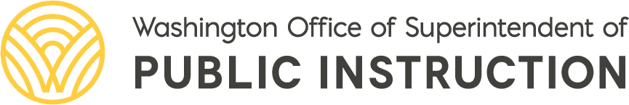
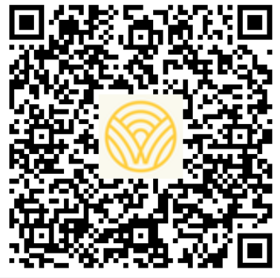
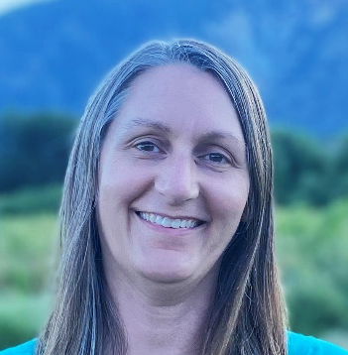
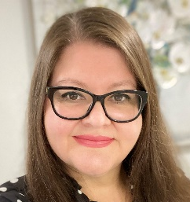
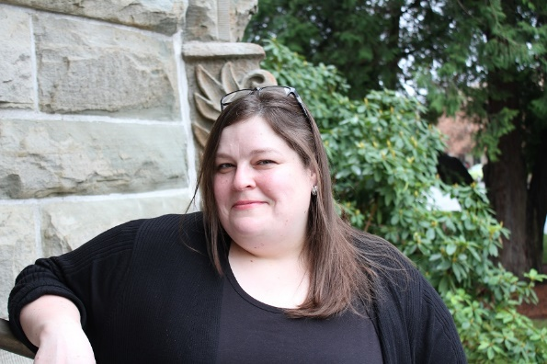
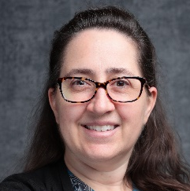
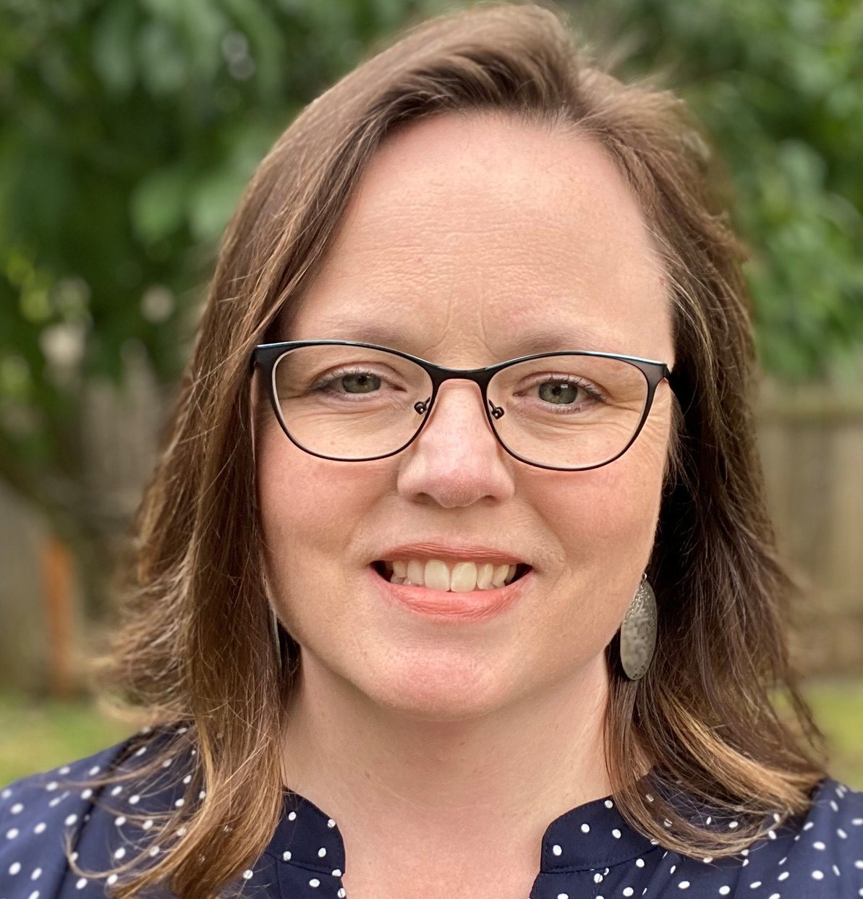
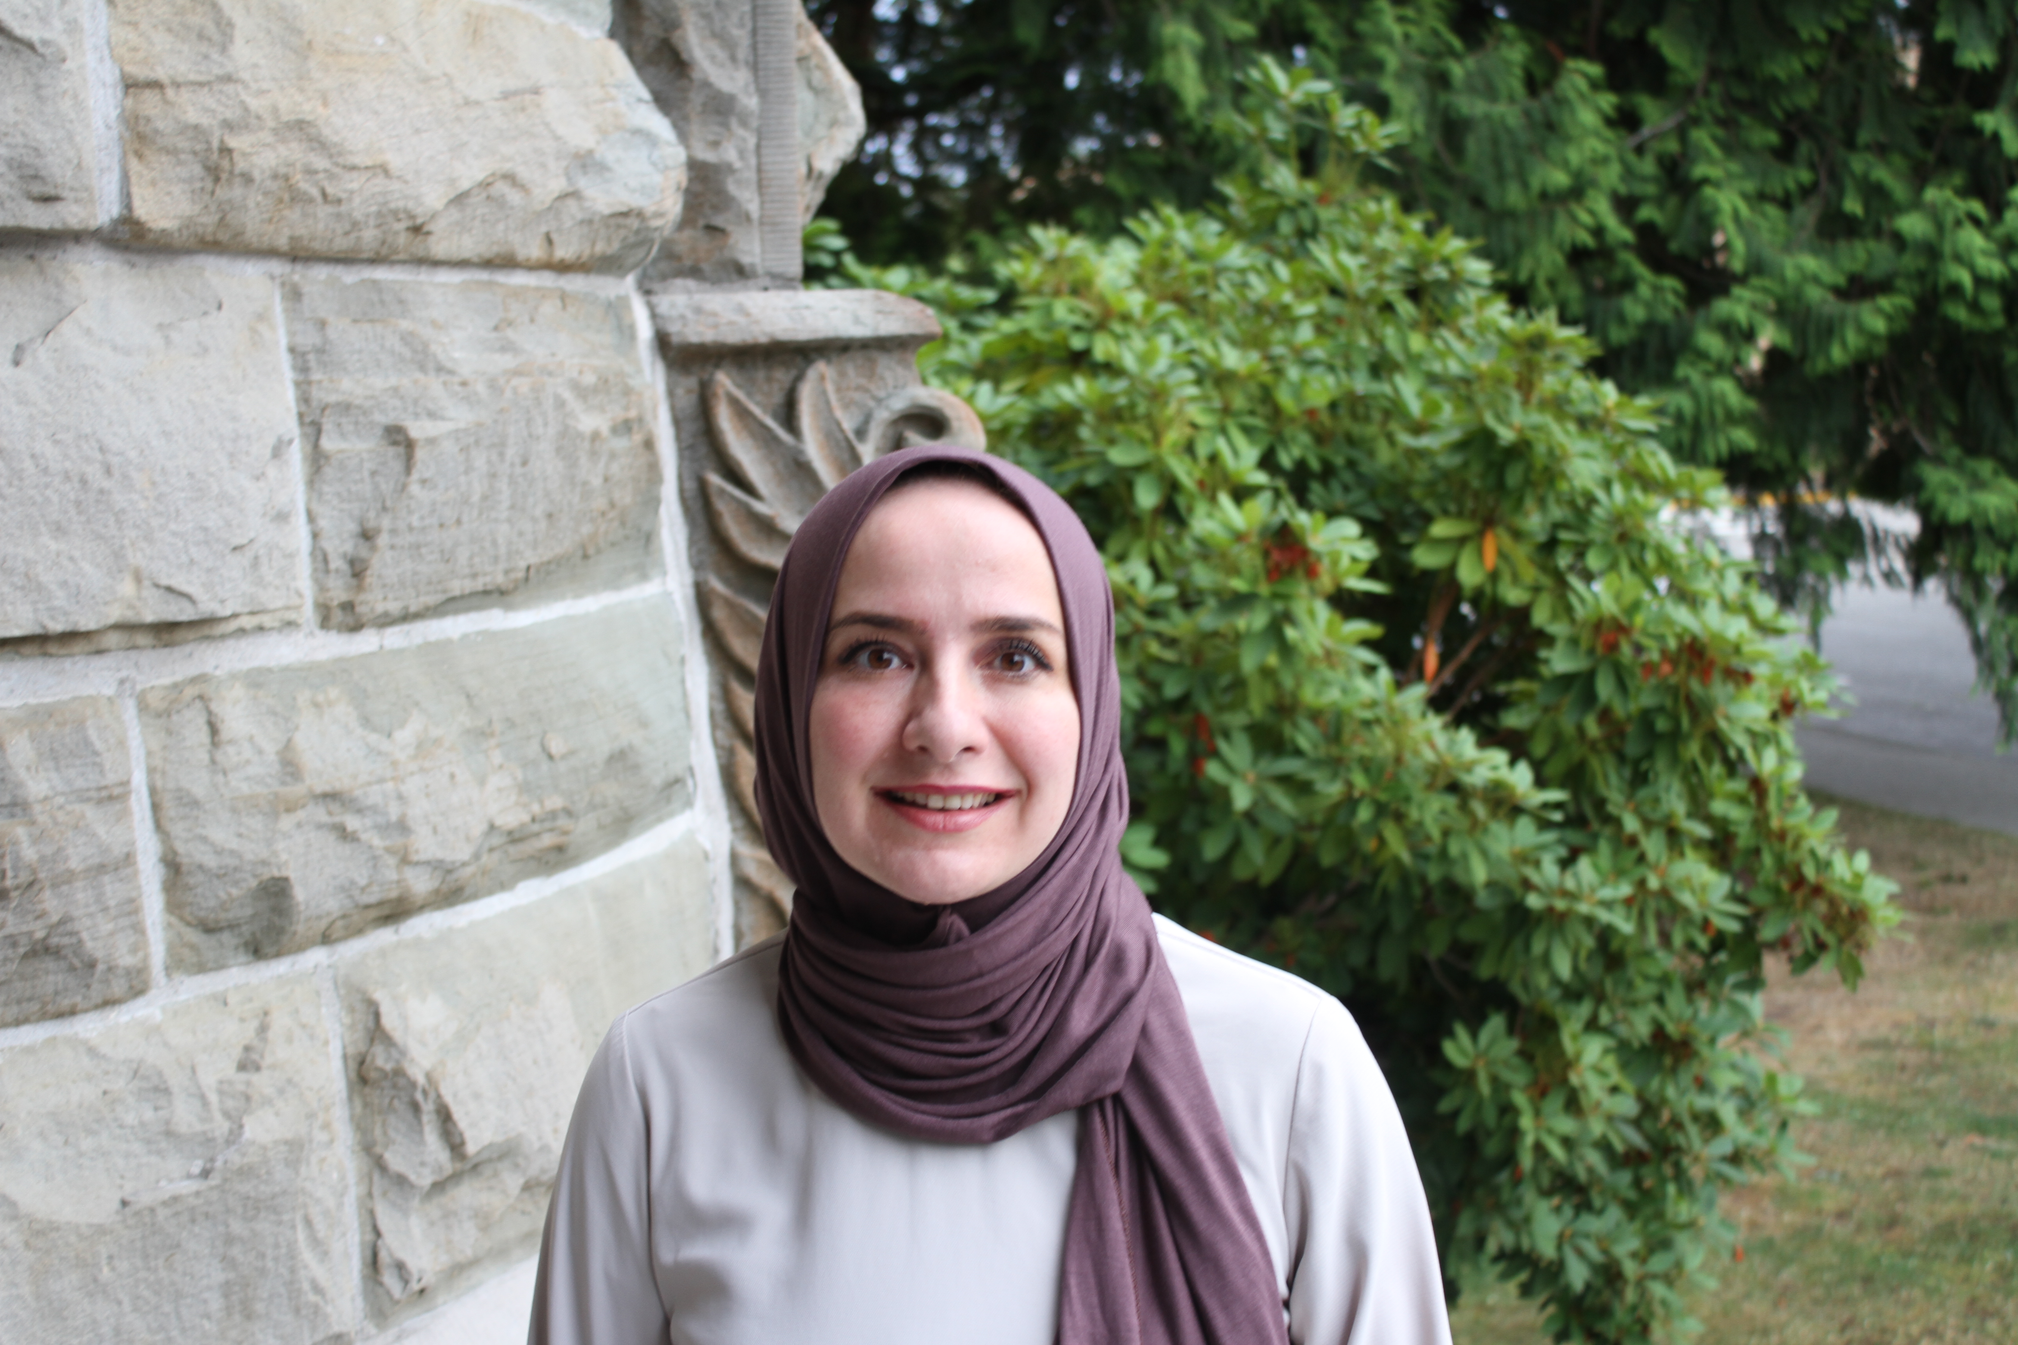
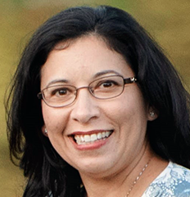
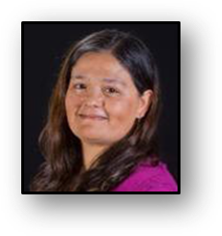
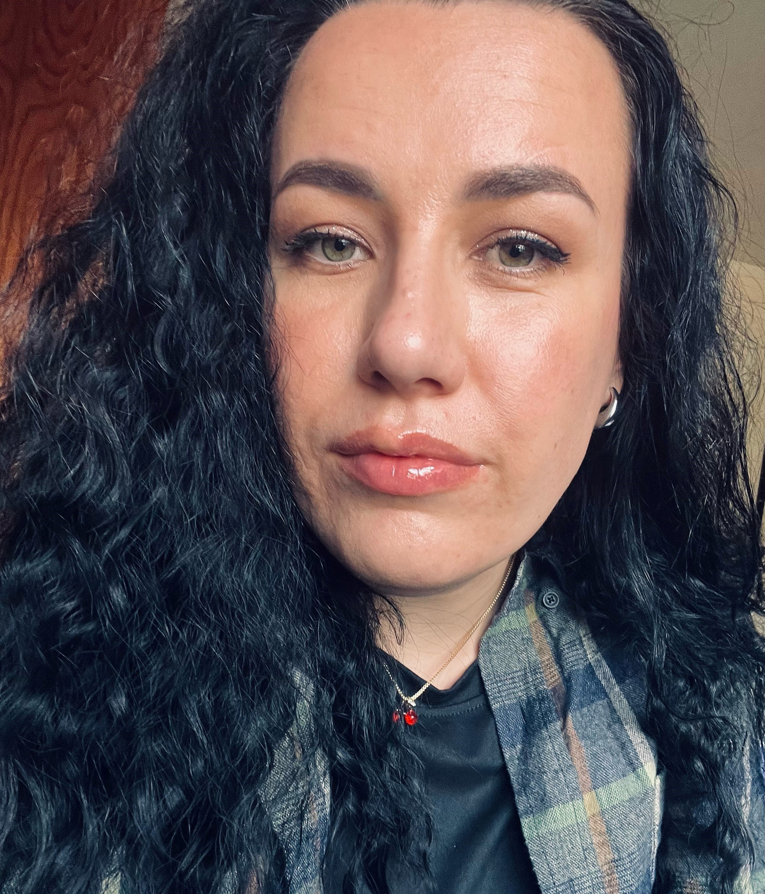

Multilingual Education Team Office of the Superintendent of Public Instruction 600 Washington St. SE | Olympia, WA 98504-7200
Katie Sperling
ML & DL Program Supervisor
ESD 101 & 171
katie.sperling@k12.wa.us
Teresa Mendoza-Casby
Dual Language
Program Supervisor
ESD 105, 112, & 123
teresa.mendoza-casby@k12.wa.us
Dr. Kristin Percy Calaff
Director of Multilingual Education
kristin.percycalaff@k12.wa.us
Shannon Martin
ML Program Supervisor
ESD 113, 114, & 121 (Pierce)
shannon.martin@k12.wa.us
Elizabeth LaFever
Dual Language
Program Supervisor
ESD 121 (King) & 189
elizabeth.lafever@k12.wa.us
Dr. Kadriye El-Atwani
ML Program Supervisor
ESD 105, 112, & 123
kadriye.el-atwani@k12.wa.us
Virginia Morales
Assistant Director of Multilingual Education, ESD 121 (King) & 189
virginia.morales@k12.wa.us
Dr. Patricia Venegas-Weber
Dual Language
Program Supervisor
ESD 113, 114, & 121 (Pierce)
patricia.venegas-weber@k12.wa.us
Anna Fraser
Administrative Assistant
Multilingual Education
anna.bibik@k12.wa.us
Dr. Veronica Trapani-Huebner
World Languages & Language Access Program Supervisor
veronica.trapani@k12.wa.us

Slide 31
How to connect with us:

