Slide 1
Bloodborne Pathogens
OSPI School Health Services
Employee training on protection from bloodborne pathogens in the workplace
Available for download at
Health Services Resources | OSPI (www.k12.wa.us)

Slide 2

Vision
All students prepared for post-secondary pathways, careers, and civic engagement.
Mission
Transform K–12 education to a system that is centered on closing opportunity gaps and is characterized by high expectations for all students and educators. We achieve this by developing equity-based policies and supports that empower educators, families, and communities.
Values
Ensuring Equity
Collaboration and Service
Achieving Excellence through Continuous Improvement
Focus on the Whole Child

Slide 3
Equity Statement
Each student, family, and community possesses strengths and cultural knowledge that benefits their peers, educators, and schools.
Ensuring educational equity:
Goes beyond equality; it requires education leaders to examine the ways current policies and practices result in disparate outcomes for our students of color, students living in poverty, students receiving special education and English Learner services, students who identify as LGBTQ+, and highly mobile student populations.
Requires education leaders to develop an understanding of historical contexts; engage students, families, and community representatives as partners in decision-making; and actively dismantle systemic barriers, replacing them with policies and practices that ensure all students have access to the instruction and support they need to succeed in our schools.

Slide 4
Tribal Land Acknowledgement
I would like to acknowledge the Indigenous people who have stewarded this land since time immemorial and who still inhabit the area today, ….(insert your land acknowledgment here?
untitled (wa.gov)
SD-Nearest Tribe List.pdf (www.k12.wa.us)
Notes:
OSPI Official Agency Tribal Land Acknowledgement
(applies to those hosting, presenting or speaking from the Old Capitol Building or the ancestral lands of the Squaxin Island people)
Squaxin Island Tribe - OSPI
“I would like to acknowledge the indigenous people who have stewarded this land since time immemorial and who still inhabit the area today, the Steh-Chass Band of Indigenous people of the Squaxin Island Tribe.”
Squaxin Island Tribal History – additional history you may wish to include in your acknowledgement and learn more about:
The Squaxin Island Tribe was created by combining seven-bands of indigenous peoples from throughout South Puget Sound. Those seven-bands were originally placed on a reservation in 1854 called Squaxin Island near Thurston and Mason Counties.
Olympia sits on the shores of Budd Inlet. Budd Inlet was known as Steh-Chass, titled after the band of People who lived there since time immemorial.
The Steh-Chass People are one of the seven bands who make up the Squaxin Island Tribe.

Slide 5

Training Requirements
Include information specific to your worksite before conducting the training.
Preview this program and the requirements outlined in WAC 296-823-12005.
Distribute, or make accessible to employees, copies of the Occupational Exposure to Bloodborne Pathogens Chapter 296-823 WAC and your school/school district’s Exposure Control Plan.
You must keep an attendance roster for your records to document training.

Slide 6

How To Use This Presentation
This presentation was largely based on Washington State Department of Labor & Industry, Division of Occupational Safety & Health (DOSH) PowerPoint titled Bloodborne Pathogens: Training for Employees (March 2021). Instructors will need to review the slides and adapt them as necessary for their specific setting.
Additional information is also found in the “Notes” section accompanying the slides. You can read the text found in the Notes section or use your own words.
Please review the training requirements listed in WAC 392-198-015 and 296-823-12005

Slide 7

Why Are We Here?
This training is required initially before school staff engage in duties that may expose them to BBP then annually by law:
Washington State (Chapter 392-198 WAC).
OSHA Bloodborne Pathogen (BBP) Standard (federal law).
Washington Industrial Safety & Health Rules (Chapter 296-823 WAC).
Notes:
“You are attending this training program because it is required by law that school employees in Washington state receive training on HIV and AIDS. Additionally you may be an employee who has been identified as being at greater risk for exposure to blood or other potentially infectious materials that may contain bloodborne pathogens (more about this will be explained during the training). You will also receive refresher training annually.

Slide 8

Purpose of the Training
Educate
Educate school staff regarding bloodborne pathogens (BBP).
Instruct
Instruct staff on ways to protect themselves from occupational exposure to BBP.
Provide
Provide resources.
Notes:
“Briefly, the rules contain requirements for educating staff and protecting you from the risk of exposure to bloodborne pathogens while you perform your work. This includes control methods that have been implemented to minimize or reduce the risk of exposure; Hepatitis B vaccination at no cost to you; procedures for what to do if you are exposed; and records that must be maintained. We’ll also provide resources for you.”

Slide 9

Obtaining a Copy of the ECP and Standard
Washington Industrial
Safety & Health Rules
Chapter 296-823 WAC
A copy of our school’s ECP can be found at: __________
Notes:
Each of you should have received information on how to obtain a copy of the rule Chapter 296-823, Occupational Exposure to Bloodborne Pathogens” (ECP) (If you are not distributing copies, describe where employees can get access to a copy).
Copies of the school’s ECP should be handed out or employees informed where the ECP is located and how they can obtain a copy.

Slide 10

Topics to be Discussed
What are BBPs?
Why are they harmful?
How can I protect myself?
What is our Exposure Control Plan?
Notes:
“In this training program, you are going to learn about what bloodborne pathogens are; some of the important/serious diseases they cause and their symptoms; how they are transmitted, or spread; what you can do to prevent contracting these diseases; and what our Exposure Control Plan is here at (fill in your district name).
“Before we begin discussing bloodborne pathogens, I am going to start with a general overview of HIV and AIDS.”

Slide 11

Confidentiality & Protection from Discrimination
It is against State and Federal law to discriminate against someone because of their HIV or AIDS status in education, housing, employment, insurance, or medical care.
Students and employees cannot be required to:
  Be tested.
  Reveal their HIV/HBV/HCV status.
Sharing of information about a person’s HIV/HBV/HCV status may occur only following written permission.
Medical records must be kept confidential.
Notes:
It’s important to emphasize that several state and federal laws protect persons with HIV/HBV/HCV from discrimination and inappropriate disclosure of confidential information.

Slide 12
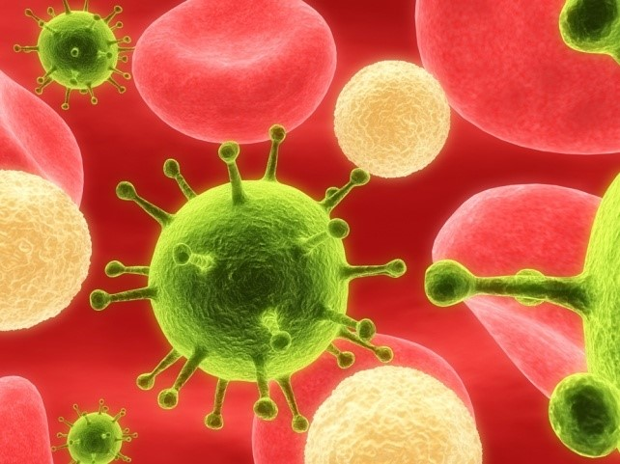
Bloodborne Pathogens (BBPs)
Bloodborne Pathogens are microorganisms such as viruses or bacteria that are carried in the blood or in "Other Potentially Infectious Material" (OPIM) and cause serious diseases
Most common BBP disease concerns in Washington state: Hepatitis B and C, HIV/AIDS
Notes:
We’ve discussed HIV/AIDS and the numbers of people across the world who are affected by the disease. Now let’s examine what causes the disease, other bloodborne pathogens and how we can protect ourselves from these diseases.

Slide 13

Potentially Infectious Body Fluids
Blood
Semen
Vaginal secretions
Cerebrospinal fluid
Vomit
Any body fluids with visible blood
Unknown body fluids
Saliva with blood (dental procedures)
Pleural fluid
Amniotic fluid
Feces/Urine
Blood, organs, and tissues from humans
Notes:
Put the emphasis on POTENTIALLY
If it has visible blood in the fluid, more infectious
Some fluids will be much more likely to encounter than others

Slide 14
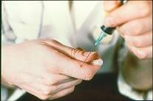
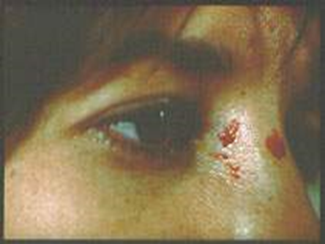
Transmissions of BBPs
Bloodborne pathogens can enter your body through:
Contaminated instrument injuries
A break in the skin (cut, lesion, etc.)
Mucus membranes (eyes, nose, mouth)
Sexual contact
Injection drug use
Notes:
In an infected person, bloodborne pathogens are transmitted to another person when other potentially infectious materials (OPIM) can gain entry through blood, mucus membranes, or by sexual contact. For example: if you get cut with an object (needle, scalpel, glass, etc.) contaminated with infected blood or OPIM, or if infected body fluid splashes into your eyes.
Intact skin will prevent the transmission of bloodborne pathogens because BBPs cannot penetrate intact skin. Non-intact skin – skin that is chapped (cracked) or has cuts, abrasions, lesions, acne, or other openings, or is afflicted with dermatitis – will not prevent transmission. You can, however, become potentially infected if you have infected blood or OPIM on intact skin, for example on your hand, and then you rub your eyes, allowing a route of entry through the eyes.

Slide 15

Transmission of BBPs
Occupational Exposure:
Means reasonably anticipated skin, eye, mucous membrane, piercing of the skin, contact with blood or other potentially infectious materials (OPIM) that may result from the performance of an employee's duties.
Exposure Incident:
Means an actual eye, mouth, other mucous membrane, non-intact skin or skin piercing contact with blood or OPIM while performing your work duties.
Notes:
At the workplace, Occupational Exposure means reasonably anticipated skin, eye, mucous membrane, or parenteral (contact through a piercing of the skin, such as by needlesticks, cuts, or abrasions) contact with blood or OPIM that may result while an employee is doing his or her job duties.
‘Reasonably anticipated’ contact means potential contact as well as actual contact with blood or other potentially infectious materials.
An ‘Exposure Incident’ is a specific contact with blood or OPIM that is capable of transmitting a bloodborne disease.

Slide 16



Common Bloodborne Pathogen Diseases
Hepatitis B (HBV)
Hepatitis C (HCV)
HIV/AIDS
Notes:
Some examples of BBPs are (run through list). There are others and the list may vary based on different geographic locations (eg malaria in tropical countries)
The main bloodborne pathogens of concern that we are going to go over today are Hepatitis B Virus, Hepatitis C Virus, and Human Immunodeficiency Virus (HIV), which causes Acquired Immunodeficiency Syndrome or AIDS.”
(Note: A person can have co-infections - two or more infections in the body at the same time. For example, a person having HIV/HCV co-infection has both HIV and HCV.)

Slide 17
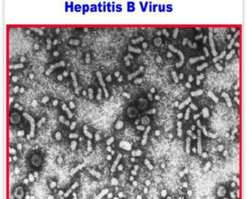
HBV-Hepatitis B Virus
General Information
Can live for 7+ days in dried blood
100 times more contagious than HIV
Can range from a short-term mild illness lasting a few weeks, to a serious lifelong illness
Preventable with a vaccine
Notes:
The Hepatitis B virus can survive outside the body for more than 7 days in a dry state on a surface, for instance on a counter top or discarded hypodermic needle.
HBV is 100 times more contagious than HIV.
There are over one million chronically infected Americans who are carriers. Those with chronic hepatitis infection are at higher risk for liver diseases, such as cirrhosis and liver cancer. Approximately three thousand people die per year from the disease or later complications such as liver cancer in the U.S. There is no cure, but fortunately there is a vaccine that can prevent you from getting infected, and is effective before or after exposure. We will discuss the vaccine later in this presentation.

Slide 18
Symptoms of Hepatitis B Infection
Flu-like symptoms that include:
Fatigue
Fever
Abdominal pain
Loss of appetite
Nausea and vomiting
Joint pain
Jaundice
Dark urine
Hepatitis B can become chronic after 6 months if the virus is not cleared by the immune system.
Chronic Hepatitis B can lead to cirrhosis of the liver or cancer.
Notes:
initial symptoms can range from very mild to severe requiring hospitalization. Some people have no symptoms. Some people can fight the infection and clear the virus out of their body. Others - about 15% to 25% - may develop a chronic condition which can lead to more serious complications up to 30 years later such as liver damage, cirrhosis, liver failure and liver cancer. The disease can be prevented with a vaccine, as mentioned earlier.

Slide 19
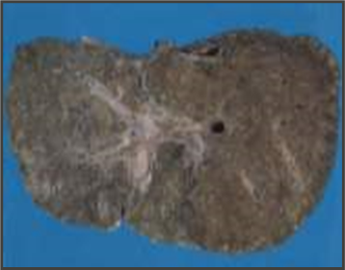
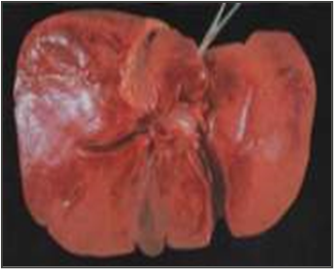
HCV – Hepatitis C Virus
General Facts
Hepatitis C Liver
The most common chronic bloodborne infection in the U.S.
Leading cause of liver transplantation in U.S.
12,000 deaths per year
Can be acute or chronic
Drugs are now available to treat infected people
Hepatitis C liver
Healthy Human Liver
Copyright 1998 Trustees of Dartmouth College
Notes:
Hepatitis C is the most common chronic bloodborne infection in the United States. An estimated 2.4 million people in the U.S. have chronic Hepatitis C infections, and each year about 17,000 new people become infected. It is the leading reason for liver transplants. An estimated 12,000 deaths may be related to chronic Hepatitis C infection each year, about three times the number from chronic Hepatitis B infection (3,000/year). There is no vaccine available yet, but new drugs are becoming more effective in controlling the infection. Drug treatment is intensive

Slide 20
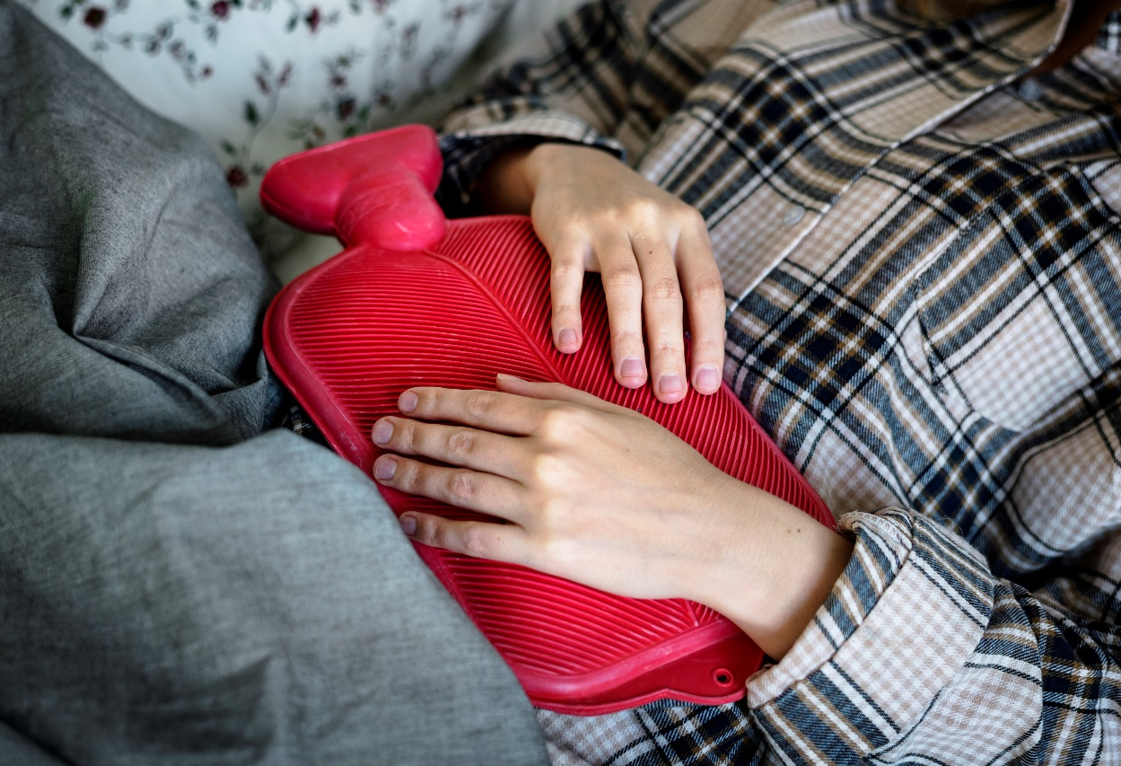
Hepatitis C symptoms
Chronic hepatitis C can lead to serious liver problems, including cirrhosis or liver cancer.
Flu-like symptoms:
Jaundice
Fatigue
Fever
Joint pain
Dark urine
Abdominal pain
Loss of appetite
Nausea
Notes:
Many people with Hepatitis C don't have any symptoms and don't know they are infected until it is detected in the blood with lab tests. Some people may develop an acute infection within 2 weeks to 6 months with the symptoms shown here. Others may develop a chronic infection with no symptoms for up to 30 years. A few will develop symptoms that are often a sign of advanced liver disease.

Slide 21
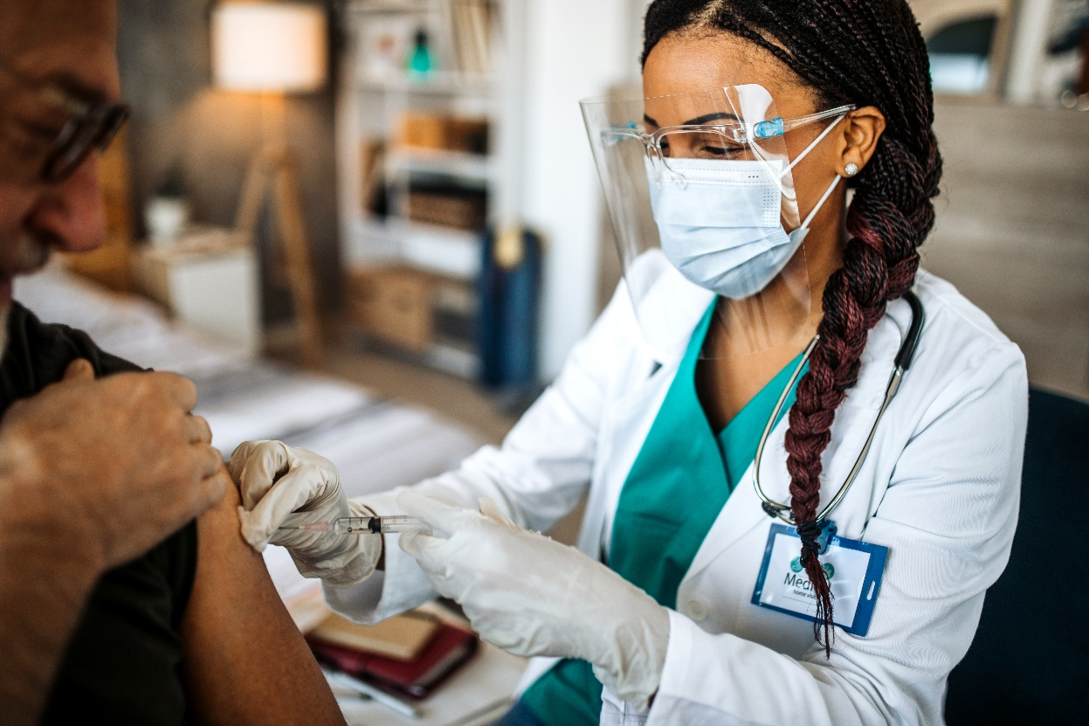
Transmission of Hepatitis B & C
Sharing needles, syringes, or other equipment to inject drugs
Hemodialysis (long-term)
From infected mother to child during birth
Needlesticks on the job
Unprotected sex with an infected partner
Direct contact with blood or open sores of an infected person

Slide 22
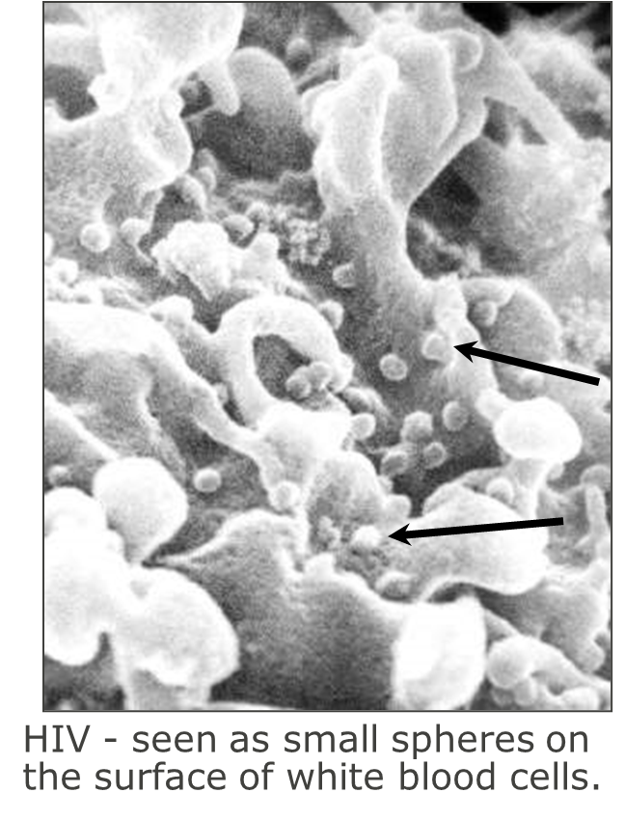
Human Immunodeficiency Virus (HIV)
General Facts:
Fragile – survives only a few hours in dry environment
Attacks the human immune system
Cause of AIDS if untreated
No vaccine available yet but drug treatments have prolonged the lives of infected people
Notes:
The Human Immunodeficiency Virus, HIV, is fragile compared to the hepatitis viruses. It does not survive well outside the body and can live in a dry environment for only a few hours. HIV attacks your body’s ability to protect itself from disease. It destroys the human immune system by attacking certain cells known as T cells, which are part of the first line of defense that our immune system has to fight infection. HIV is the cause of Acquired Immunodeficiency Syndrome, or AIDS. There are now more than one million HIV-infected persons in the US. There is no cure and no vaccine available yet, although current drug treatments have greatly increased survivability of infected people in the U.S. and AIDS is not the killer it used to be.

Slide 23
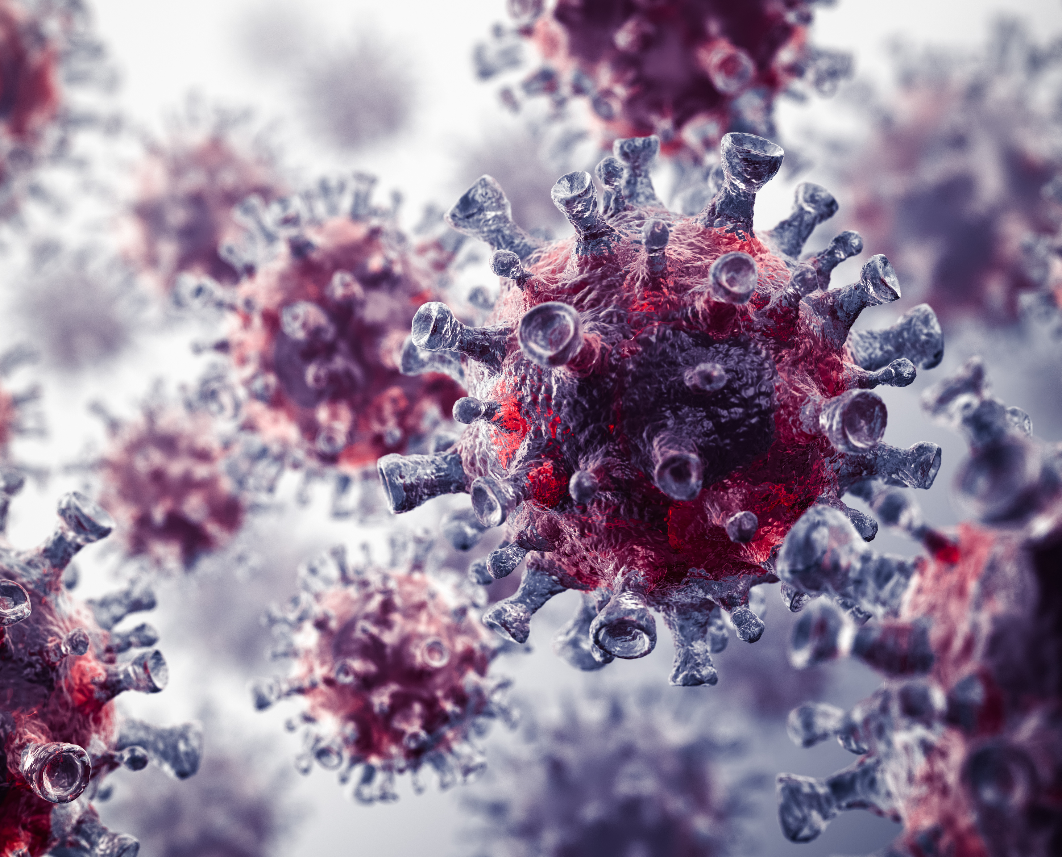
HIV
Lead
Untreated HIV infections can lead to AIDS
Lead
Treatment can lead to viral suppression and result in a viral load so low that it referred to an “undetectable viral load”
Start
If you are exposed to HIV, you must start the PEP (Post-Exposure Prophylaxis) treatment within 72 hours after exposure
Notes:
Most infected with HIV can develop AIDS within 10-12 years if not treated early with antiretroviral drugs.
AIDS-related symptoms include TB, skin tumors, weight loss, mental impairment and many others.
Death from AIDS occurs within 3 years, if no treatment.
Anti-Retroviral Therapy reduces the amount of HIV in the blood (viral load), but it doesn’t cure HIV.
Treatment can lead to viral suppression and result in a viral load so low that it referred to an “undetectable viral load.”
When people living with HIV achieve and maintain an undetectable viral load, they cannot sexually transmit the virus to others

Slide 24
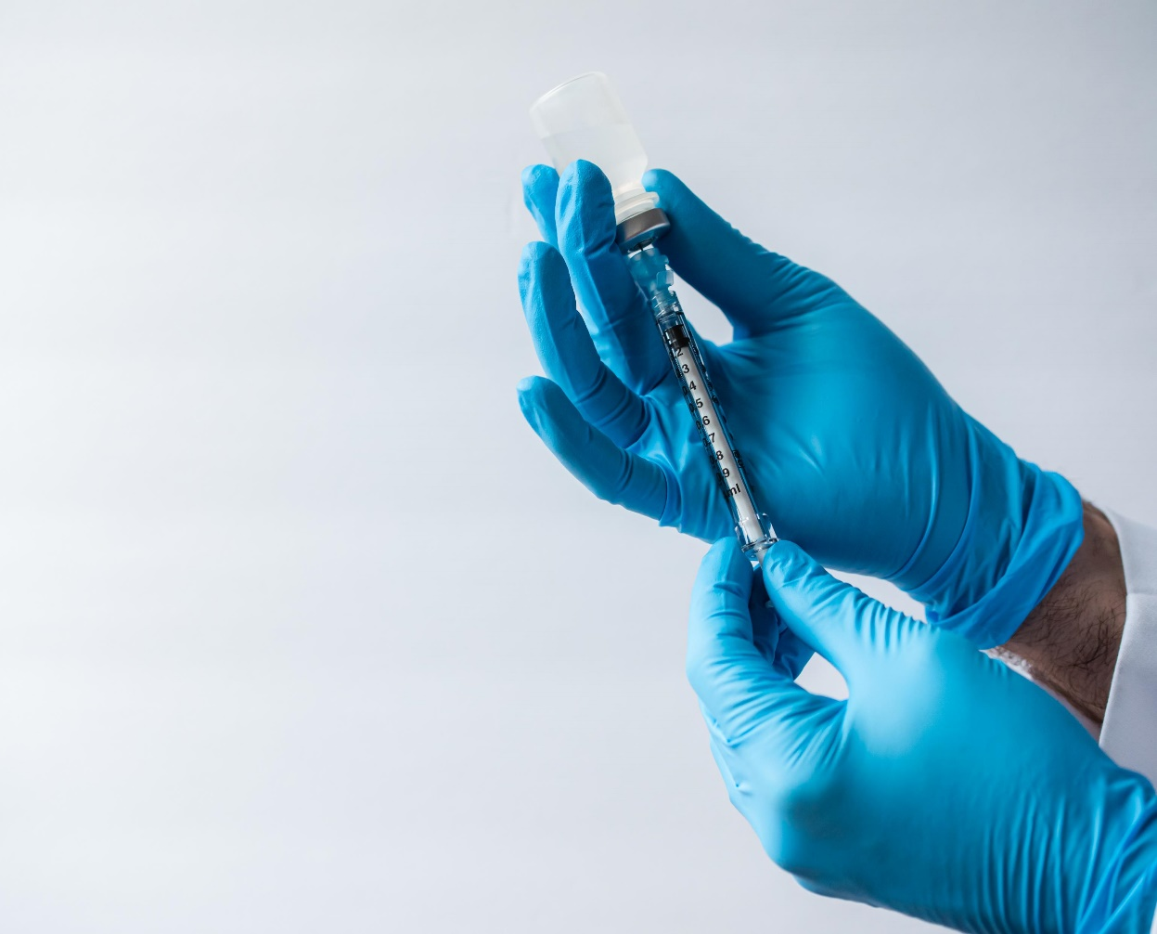
Transmission of HIV
Sharing needles or syringes
Sexual contact without condoms
From HIV-infected parent to the baby during pregnancy or delivery
Breast-feeding
Needlesticks (rare)
Notes:
HIV is spread from one person to another through blood to blood and sexual contact in blood, semen, vaginal fluid, breast milk, and other body fluids containing blood. Transmission through transfusions of infected blood or blood clotting factors is now very rare in the U.S. where blood is screened for HIV antibodies. Fortunately most occupational exposures do not result in HIV infection. There are only a few documented cases of HIV infection from needlesticks. Infections from splashes of blood or other body fluids are also extremely rare. Casual contact is not a risk for transmission of HIV as shown in the poster on the right.

Slide 25
BBP are NOT transmitted by:
Toilet seats
Eating utensils
Drinking fountains
Mosquitoes (except malaria)
Giving blood
Coughing
Notes:
There are still myths that increase fears about how HIV and other BBP are transmitted. It’s important to know that it is NOT transmitted in these ways.

Slide 26

BBP Exposure Controls
Universal precautions (or standard precautions)
Safe work practices
Personal Protective Equipment (PPE)
Handling BBP waste materials
Notes:
There are a number of ways exposure to bloodborne pathogens can be controlled as shown here. We will be discussing these in the next few slides

Slide 27
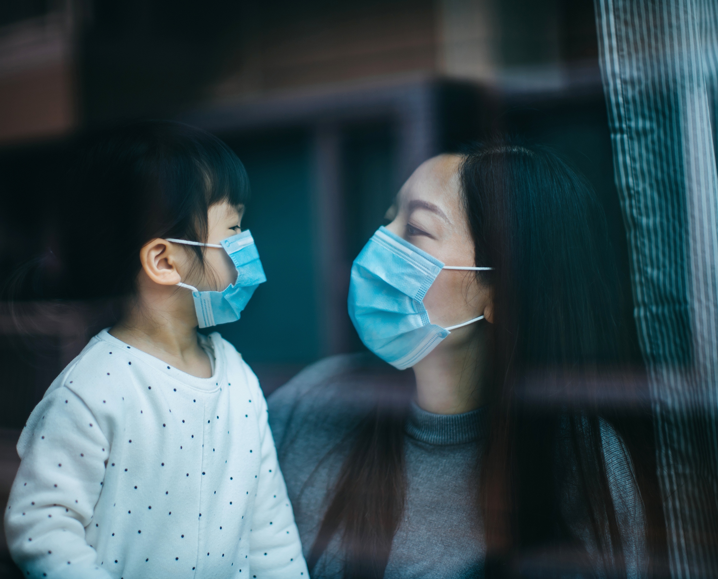
WORKPLACE PROTECTION
Universal precautions (or standard precautions)
Safe work practices
Personal Protective Equipment (PPE)
Handling BBP waste materials
Notes:
Both federal and state laws exist that help protect employees from occupational exposure to BBP. Each school district/employer must have an
Exposure Control Plan.

Slide 28

Exposure Control Plan
To eliminate/minimize your risk of exposure
Exposure determination
Exposure controls
Training and Hazard Communication
Hepatitis B Vaccine
Post-Exposure Evaluation and Follow-up
Recordkeeping
Copies of your school’s plan is located at: _____________
Notes:
A copy of (school district name)’s written Exposure Control Plan is located at (describe the exact location(s) where employees can access it).
The Exposure Control Plan is designed to eliminate or minimize your risk of exposure to BBPs at work. It includes our policies and procedures, and also identifies persons or departments with specific responsibilities. You should familiarize yourselves with it and refer to the procedures to follow if an exposure incident occurs.
If you have any questions concerning the Exposure Control Plan, see (state the name of the responsible person or department).
Briefly, the Exposure Control Plan contains the following elements:
An exposure determination to identify employees who are at risk for exposure
The methods and controls we use to protect you from exposure to bloodborne pathogens
Training and Hazard Communication requirements
Post-exposure evaluation and follow-up procedures if you experience an exposure incident
Record keeping, including documentation of any occupational exposure incidents

Slide 29

Exposure Determination
Job classifications that may be at risk for occupational exposure include:
School nurses and health room assistants
Teachers and instructional aides
Bus drivers
Coaches and assistants
First aid providers
Custodians
Students in health occupations classes
OTs and PTs
Notes:
(You can choose to use this slide. Modify it as needed and fill in the tables.)
(Encourage discussion. Explain how to recognize the tasks and other activities that could involve exposure to blood and OPIM.)

Slide 30

School job duties that can have BBP exposure
Handling
Handling syringes or other sharps
Providing
Providing first aid treatment
Working
Working with escalated students
Handling
Handling laundry contaminated with blood or OPIM
Cleaning
Cleaning surfaces contaminated with blood or OPIM
Disposing
Disposing of bloodborne pathogen hazardous waste
Picking
Picking up discarded syringes in public places
Cleaning
Cleaning up broken containers containing blood or OPIM
Notes:
Ask participants if they can think of other tasks that could lead to exposures?

Slide 31
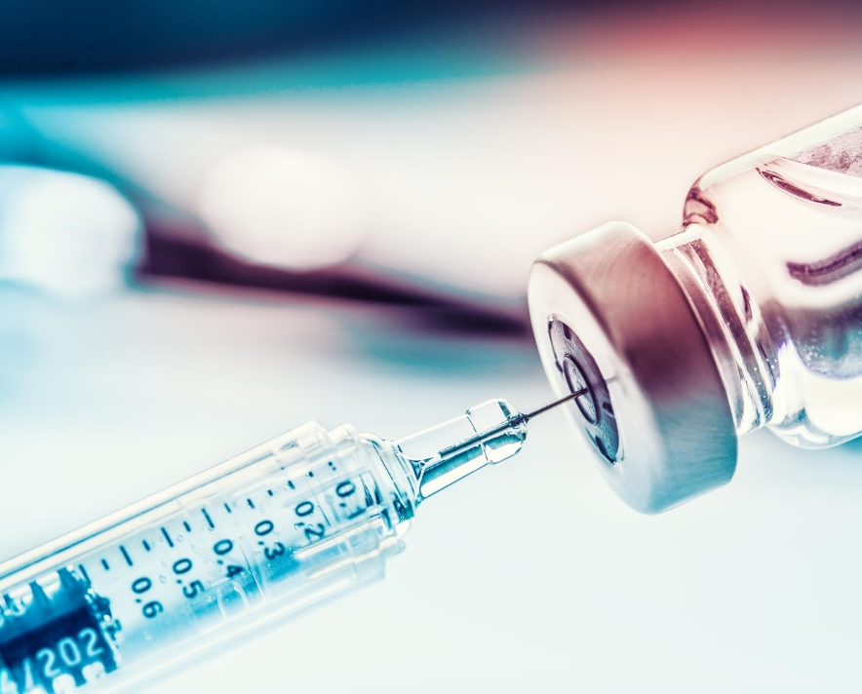
Sharps
  Needles
  Syringes
  Lancets
  Auto Injectors
  Infusion Sets
  Connection needles/sets
  Razors or other blades
  Broken glass or plastic containers
Any item that can puncture or lacerate the skin that is potentially contaminated with OPIM or BBP

Slide 32
Universal precautions/Standard precautions
Universal Precautions means treating all human blood and body fluids as if infected with BBP whether known or not.
Standard Precautions combine the major features of Universal Precautions and Body Substance Isolation and are based on the principle that all blood, body fluids, secretions, and excretions except sweat, may contain transmissible infectious agents. Standard Precautions include a group of infection prevention practices that apply to all patients, regardless of suspected or confirmed infection status, in any setting in which healthcare is delivered.
Notes:
(State your school’s name here) follows Universal Precautions. The concept of universal precautions is an infection control system that considers blood and other potentially infectious materials (OPIM) from all persons as containing a bloodborne disease, whether or not the person has been identified as having a bloodborne disease. Therefore, you must handle all such materials using methods that prevent or reduce the risk of exposure to yourself. Observe and follow Universal Precautions in all situations where there is a potential for contact with blood or OPIM.
(*Modify this slide if your company follows Standard Precautions, Blood-body Fluid Precautions, or Body Substance Isolation system.)
If you use standard precautions you may choose to use the handout on Standard Precautions located in Appendix B in the OSPI’s document Guidelines or Implementation of School Employee Training on HIV/AIDS and Other Bloodborne Pathogens

Slide 33

Exposure Controls
Safe Work Practices
Wash hands after each glove use and immediately or ASAP after exposure.
Notes:
PPE – Personal Protective Equipment. More about both handwashing and PPE shortly.
(Note: If handwashing facilities are not possible or immediately available, waterless antiseptic hand cleanser and towels or towelettes must be available. When hands are visibly contaminated, follow with washing using soap and water as soon as possible.)

Slide 34

Handwashing

Slide 35
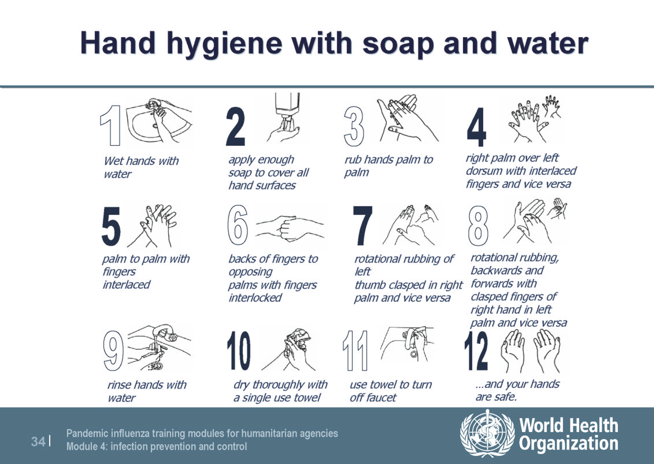
Hand Hygiene with Soap and Water
Notes:
You may wish to provide a demonstration and possible practice if time and facilities allow. You could also supplement this slide with a video. Also you may wish to use this handout on handwashing located in Appendix B in the OSPI’s document Guidelines for Implementation of School Employee Training on HIV/AIDS and Other Bloodborne Pathogens.

Slide 36
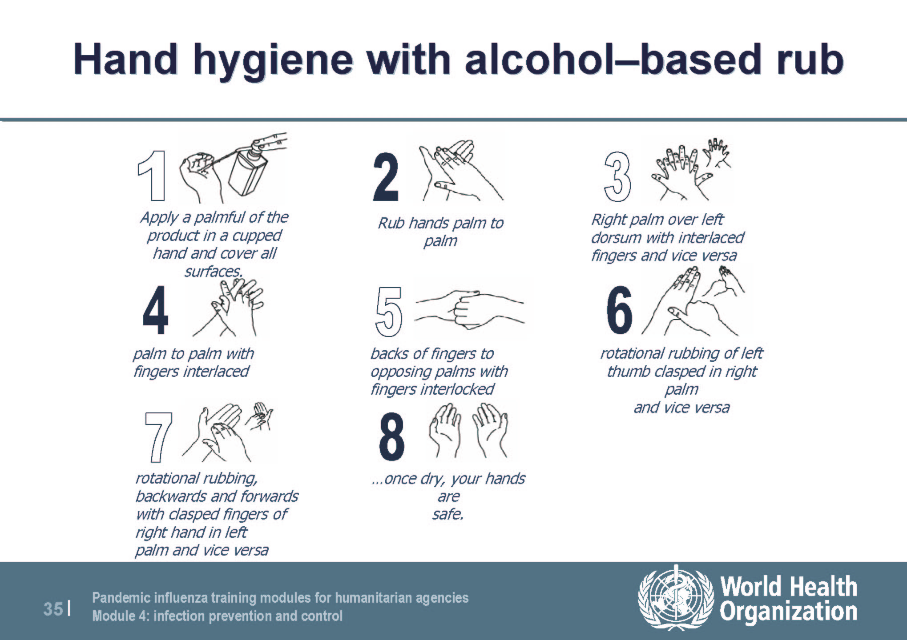
Hand Hygiene with Alcohol-Based Rub
Notes:
You may wish to provide a demonstration and possible practice. Also, you may wish to use this handout on handwashing located in Appendix ___in the OSPI’s document Guidelines for Implementation of School Employee Training on HIV/AIDS and Other Bloodborne Pathogens.

Slide 37

Exposure Controls
Personal Protective Equipment (PPE)
You must wear all required PPE. We provide you with the following PPE at no cost:
  Gloves.
  Face shields or masks and eye protection.
  Resuscitation devices.
Notes:
When equipment, safer devices, and safe work practices do not eliminate exposure, the use of personal protective equipment, or PPE, is required. PPE that is “appropriate” will not permit blood or other OPIM to pass through or reach your clothes, skin, eyes, mouth, or other mucous membranes.
We provide you with these PPE at no cost:
(Adjust this list to reflect what is used in your location. Run through list; include those PPE and any additional types required at you workplace. Mention their locations.)
(State name of responsible person or department) is responsible for maintaining supplies and providing PPE. See (person or department) if you need PPE or have any concerns regarding PPE types, use, sizes, etc.
Make sure you remove all PPE before leaving the work area. Remove contaminated PPE carefully as to avoid contact with contaminated PPE surfaces and dispose in the designated containers (describe/list which containers are used at your workplace)
The procedure for handling used PPE is: (For example, how and where to decontaminate face shields, eye protection, resuscitation equipment.)

Slide 38
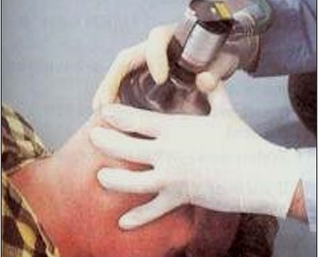
Exposure Controls
Personal Protective Equipment (PPE) List
Gloves
Face shield or Mask
Eye protection
Protective clothing
Resuscitation devices
Notes:
Assess whether these are PPE that are used in your workplace. These may not be used in schools.
Wear appropriate face and eye protection when splashes, sprays, spatters, or droplets of blood or OPIM pose a hazard to the eye, nose, or mouth.
Face shields would be needed if the risk and amount of potential splash or splatter to the face is substantial. The skin as well as the eyes needs to be protected.
If the risk of splash is minimal, glasses with side shields might be adequate.
Splash goggles or the use of a mask in combination with an eye protection device may be required in higher risk situations.

Slide 39
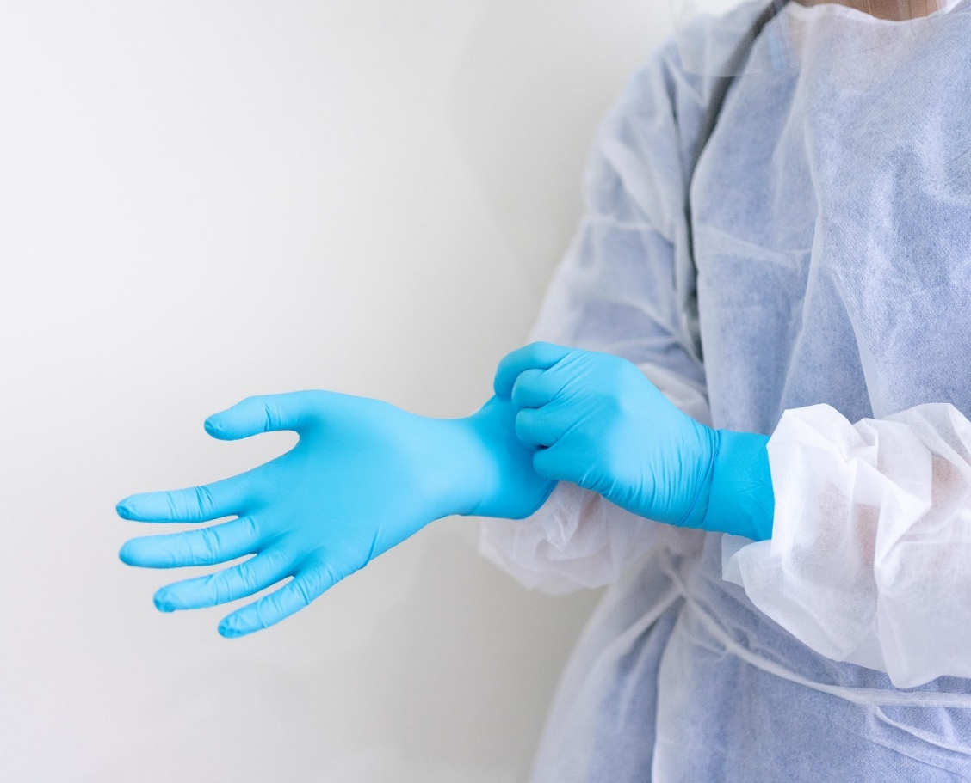
Gloves must be worn whenever:
You have hand contact with blood, OPIM, mucous membranes or non-intact skin
You handle or touch items or surfaces potentially or contaminated with blood or OPIM
    Non-latex
    Utility
Notes:
Gloves must be worn when hand contact with blood or OPIM can be reasonably anticipated or when you handle or touch contaminated items or surfaces. You must wear gloves when doing the following tasks/procedures: (list/describe the tasks/procedures; for example, administering medication by injection, cleaning up blood spills, etc.). Gloves may be found in the health
Gloves should fit properly.

Slide 40
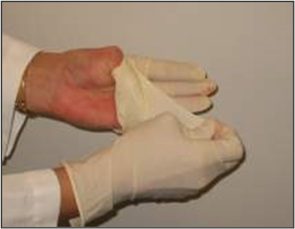
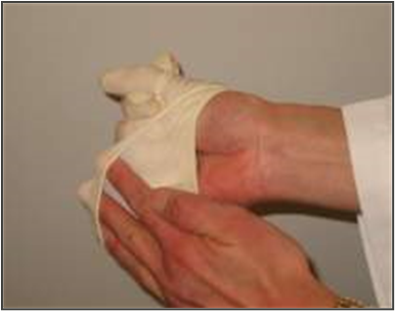
Exposure Controls
Remove gloves safely and properly
Grasp near cuff of glove and turn it inside out. Hold in the gloved hand.
Place fingers of bare hand inside cuff of gloved hand and turn inside out and over the first glove.
Dispose of gloves into proper waste container.
Clean hands thoroughly with soap and water (or antiseptic hand rub product, if handwashing facilities not available).
Notes:
This would be an excellent time to demonstrate the procedure. To safely remove contaminated gloves, remove the glove of one hand with the other by grasping near the cuff and turning the glove inside out. Hold it in the gloved hand. Place the fingers of the bare hand inside the cuff of the gloved hand and turn that inside out and over the first glove. Dispose gloves into the proper waste container. Clean your hands thoroughly after each glove use with soap and water or use a hand sanitizers if hand washing facilities aren’t immediately available.

Slide 41
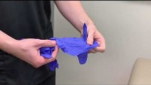
How To Safely Put On And Take Off Gloves

Slide 42
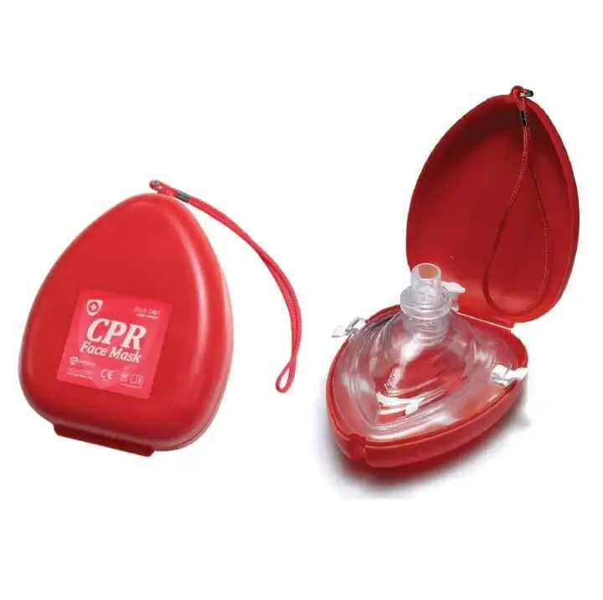
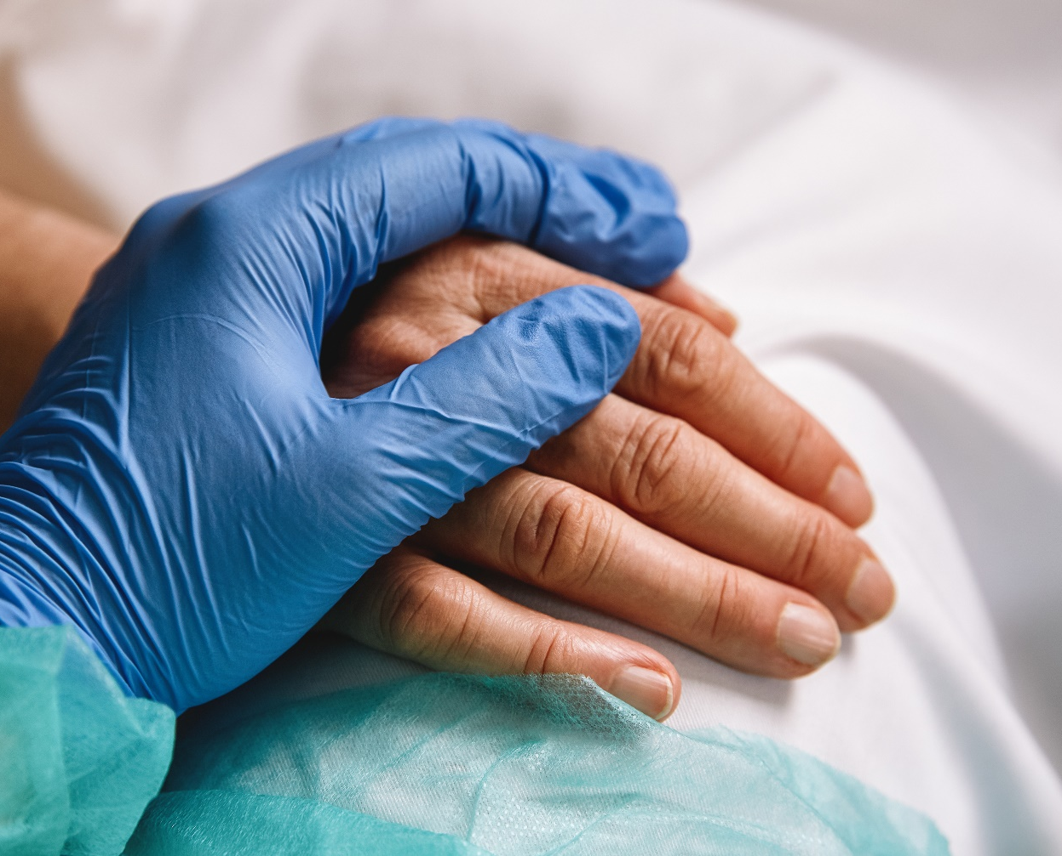
Exposure Controls/
Personal Protective Equipment (PPE)
Notes:
When administering CPR, use gloves and resuscitation devices, such as mouthpieces, resuscitation bags, pocket masks, micro shields, overlay barrier, etc.
Make this specific for your school.

Slide 43
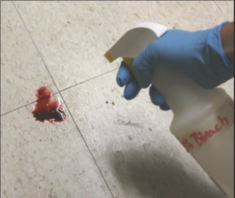
Exposure Controls,
Safe Work Practices
Clean-up of spills and broken glassware/sharps. (continued)
  Clean the area with 10% bleach or EPA-registered disinfectant.
  Saturate the spill area with disinfectant. Leave for 10 minutes (or as specified by product manufacturer) or allow to air dry.
  Properly dispose of paper towels and cleaning materials into proper waste containers.
Notes:
Some schools prohibit the use of bleach because it is asthma-genic and potential of damage to furniture and carpets. Discuss what disinfectant is approved in the specific school building/district.

Slide 44
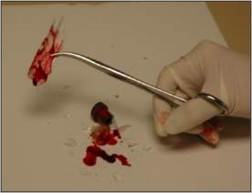
Exposure Controls
Safe Work Practices
During clean-up of spills and broken glassware/sharps contaminated with blood or OPIM, do the following:
  Wear protective eyewear and mask, if splashing is anticipated.
  Remove glass and other sharps materials using a brush and dustpan, forceps, hemostat, etc. Do not use your hands.
  Properly discard all materials into a sharps or puncture-resistant biohazardous waste container.
  Use paper/absorbent towels to soak up the spilled materials
Notes:
This is of particular importance for health staff, custodians and others. If you are addressing school custodians, you should discuss the use of reusable utility gloves.

Slide 45
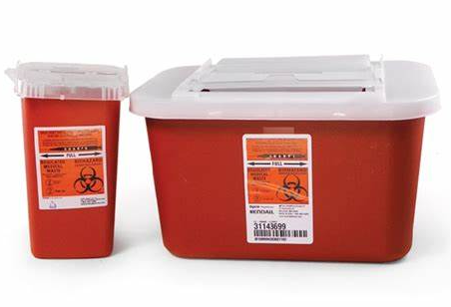
Exposure Controls
Equipment and Safer Medical Devices
Sharps disposal containers are:
  Closable.
  Puncture-resistant.
  Leak-proof.
  Labeled or color-coded.
  Upright, conveniently placed in area where sharps used.
  DO NOT OVERFILL!
Notes:
The use of safer medical devices and equipment will prevent or minimize your exposure to bloodborne pathogens by eliminating, removing, or isolating the BBP hazard from the work area. These include physical guards, barriers, environmental controls, or other devices.
An example of a physical guard is a sharps disposal container. It must be closeable, puncture resistant, leak-proof, and labeled or color coded.
During use, place them as close as feasible to the immediate area where sharps are used or anticipated to be found, keep them upright, and don’t allow them to overfill. Replace them regularly or sooner if necessary.
If they need to be replaced or moved somewhere else, close them securely before you move them and place them in a larger secondary container if leakage is possible.

Slide 46
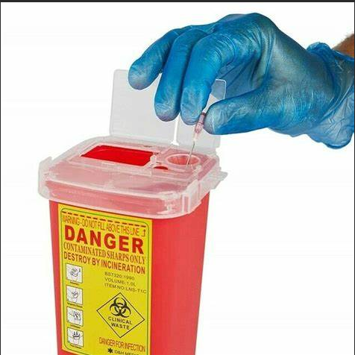
Exposure Controls\
Safe Work Practices
Do the job/task in safer ways to minimize any exposure to blood or OPIM:
  Don’t bend, recap, or remove needles or other sharps.
  Don’t share or break needles.
  Place contaminated reusable sharps immediately in appropriate containers until properly decontaminated.
Notes:
Safe work practices are steps, procedures, or ways in which a job or task can be done more safely to minimize any exposure to blood or OPIM. This is of particular importance to school nurses/health staff.
(Work practices must be specific to each workplace and sets of procedures. Do not use generic language. There must be enough specific directions with different sorts of procedures to ensure uniformity. Every single procedure may not need a separate set of directions; you may combine similar tasks.)

Slide 47
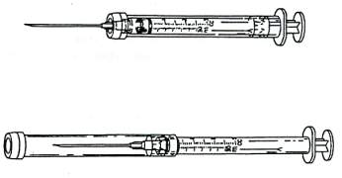
Exposure Controls:
Equipment and Safer Medical Devices
Example of needle guard with protected sliding sheath that is pushed forward after use and locks.
Safer Medical Devices
  Sharps with engineered sharps injury protections (SESIP).
Unprotected position
Protected position
Notes:
Safer medical devices have been developed to help prevent needle-stick injuries. They must be used where they can prevent or minimize occupational exposure to BBPs. Examples of safer medical devices that might be used in schools by school nurses/health staff may include:
Sharps with engineered sharps injury protections, or SESIP. These are non-needle sharps or needle devices that have a built-in safety feature or mechanism that reduces the risk of an exposure incident, e.g., syringes with a hinged or sliding sheath that shields the attached needle after use; needles that retract into a syringe after use.
(It is the employer’s responsibility to keep up to date on feasible and newer devices that prevent needlesticks and other injuries to reduce the risk to employees. Additional Information About Safety Devices Available At… www.med.virginia.edu/~epinetwww.tdict.org
www.osha.gov www.lni.wa.gov/wisha/
[Device drawings courtesy of International Health Care Worker Safety Center, University of Virginia]

Slide 48

Exposure Controls
Housekeeping
Written cleaning and decontamination schedule and procedures.
Approved disinfectant – EPA-approved.
Contaminated waste disposal methods.
Laundry.
Notes:
Adapt this list according to your location. For example – laundry may not be done in schools.
All work areas are to be maintained in a clean and sanitary condition.
A written schedule and detailed procedures for cleaning and decontamination is posted/located at (state location where maintenance schedule is placed in the work areas or in procedure manuals, policies, etc.)
Decontaminate all work surfaces with the appropriate disinfectant after completion of procedures, when surfaces are contaminated, and at the end of each work shift.
The appropriate disinfectant is an *EPA-approved tuberculocidal or HIV/HBV-effective disinfectant, or a diluted (1:10 for spills, 1:100 for routine cleaning) bleach solution made daily.
(Lists of disinfectants are available from the EPA Office of Pesticides, antimicrobial pesticides website at http://www.epa.gov/oppad001/chemregindex.htm .)

Slide 49
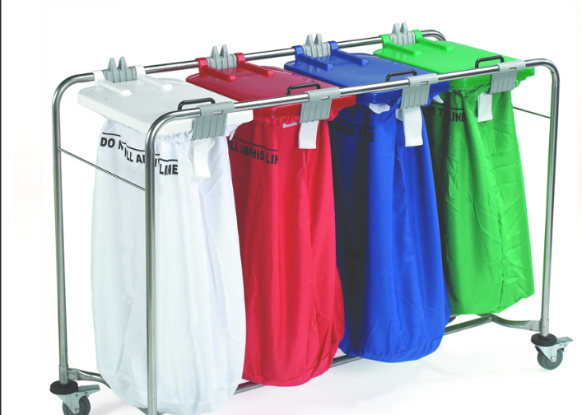
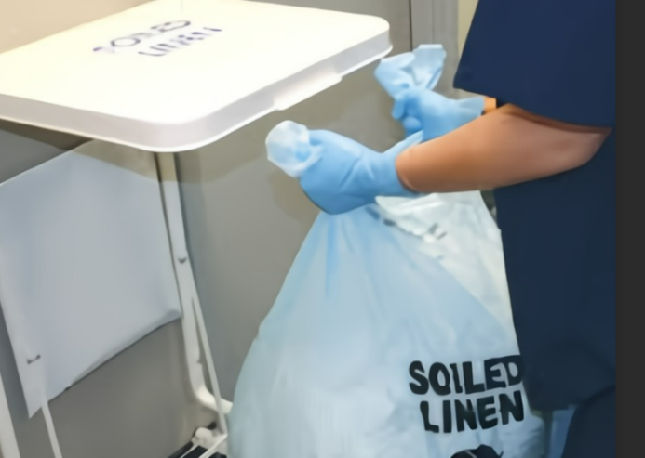
Exposure Controls
Laundry
List of contaminated articles.
Handle as little as possible.
  Bag/contain where used
  Don’t sort or rinse where used
  Place in leak-proof, labeled, or color-coded containers or bags
Wear PPE when handling and/or sorting:
  Gloves
  Gown
Send home contaminated student clothing in a secured bag.
Notes:
Assess whether this slide is applicable. In some schools it may be applicable – in other schools perhaps not.
Contaminated laundry needs to handled as little as possible and bagged or containerized where it was used. Don’t sort or rinse where items were used.
Containers or bags must be labeled or red color-coded.
Wear the following PPE when handling and/or sorting contaminated laundry:
Gloves
Gown
Face shield
Etc.
(If all soiled laundry is handled using universal precautions, then alternative, identifiable color coding may be utilized instead of labels.
(Laundry shipped off-site must be labeled or red color coded unless the receiving facility utilizes universal precautions for all laundry. The receiving laundry must be notified.) (photo from Laundry Carts - Bags - Distribution Carts — Correct Care Products (correct-care.com)

Slide 50
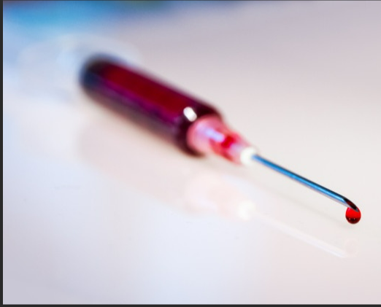
Exposure Controls
Regulated Waste
Liquid or semi-liquid blood or OPIM.
Contaminated items that would release blood or OPIM in a liquid or semi-liquid state if compressed.
Items caked with dried blood or OPIM that are capable of releasing these materials during handling.
Contaminated sharps.
Notes:
Regulated waste poses a significant risk of exposure to workers, including those who may handle the waste downstream.
Regulated waste includes
liquid or semi-liquid blood or OPIM
contaminated items that would release liquid or semi-liquid blood or OPIMs if compressed or compacted
dried caked blood or OPIM that might flake off or be released if handled
contaminated sharps, and pathological and biological items or waste with blood or OPIMs.
This does not include materials that sufficiently absorb blood or OPIM. For example, band aids and feminine hygiene products are not regulated waste.
All contaminated waste must be handled in a sanitary manner. Waste containers must be lined and regularly disinfected.

Slide 51
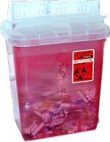
Exposure Controls
Regulated Waste-Containers
Easily accessible.
Labeled or color-coded.
Leak-proof, closeable.
Puncture-resistant for sharps.
Replaced routinely.
(do not overfill!)

Slide 52
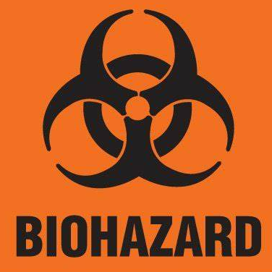

Exposure Controls
Communication of Hazards
Biohazard Labels and Signs
Must have biohazard symbol.
Labels attached securely to any containers or items containing blood/OPIM.
Red bags/containers may substitute for labels.
Signs posted at entrance to specified work areas.
(Lettering and symbol in contrasting color to background.)
(Fluorescent orange or orange/red background.)
Notes:
Containers containing blood or OPIM, or equipment contaminated with blood/OPIM must have this orange/red label with the biohazard symbol. The following must be labeled:
regulated waste disposal
sharps containers
containers used to store, transport or ship (e.g., freezers)
laundry
contaminated equipment, etc.
The labels must be attached with string, wire, adhesive, or other method so they can't become lost or accidentally removed.
Red bags or red containers may be substituted for labels. We use red bags for (list, e.g., laundry, etc.)
Containers containing blood or OPIM, or equipment contaminated with blood/OPIM must have this orange/red label with the biohazard symbol. The following must be labeled:
regulated waste disposal
sharps containers
containers used to store, transport or ship (e.g., freezers)
laundry
contaminated equipment, etc.
The labels must be attached with string, wire, adhesive, or other method so they can't become lost or accidentally removed.
Red bags or red containers may be substituted for labels. We use red bags for (list, e.g., laundry, etc.)

Slide 53
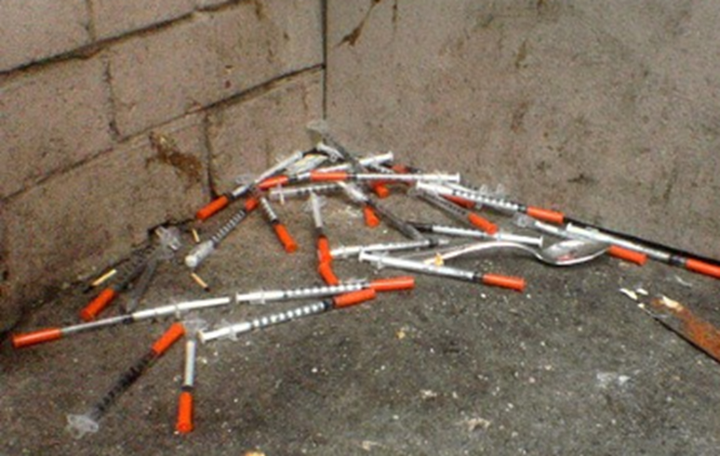
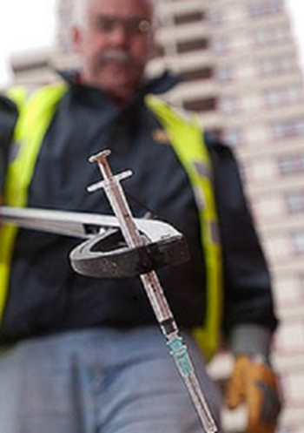
Handling discarded syringes
Photo by Christopher Cotrell in Creative Commons
Photo by Mark Harvey in Creative Commons
Do not handle discarded syringes with bare hands.
Notes:
Custodians, public park workers or other workers who come across discarded needles in public places should never pick up them up with bare hands or toss them into general garbage. Using pliers or tongs to pick them up is safer and they should then be placed in a sharps container or other strong container with a lid. The actual risk of contracting hepatitis or HIV from discarded needles is low, but if you are pricked or scratched with a discarded needle tell your supervisor and get yourself tested for hepatitis or HIV.

Slide 54
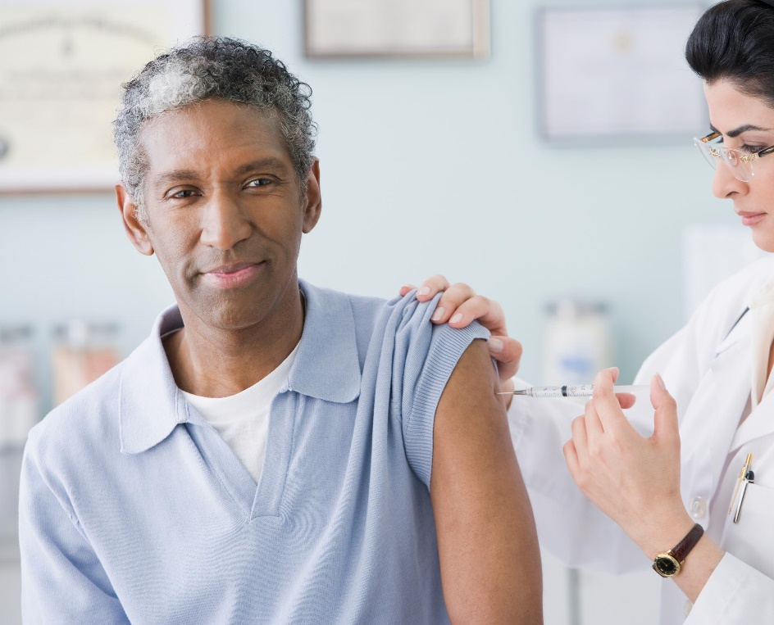
Hepatitis B Vaccine
No cost to you.
Three shots: 0, 1, and 6 months.
Effective for 95% of adults.
Also protects after exposure.
Post-vaccination testing for high-risk HCW.
Post-exposure treatment (if not vaccinated).
Immune globulin
Begin vaccination series
If decline, you must sign a “Declination Form.”
Vaccine available at later date, if desired.
Notes:
Hepatitis B vaccine is provided free of charge to all employees at risk for exposure to BBP. You should make an appointment at (state name and location where employees must go to receive treatment).
The vaccination consists of a series of three different shots given at 0, 1 and 6 months and is highly effective. (Booster shots are not required, unless recommended by CDC in the future.)
Post-vaccination testing will be given 1-2 months after the third vaccine dose for high risk health care workers (i.e., those who are at risk for sharps injury).
If you have had an exposure incident and have not been vaccinated, the treatment will usually include Hepatitis B immune globulin and the vaccination series. Post-exposure prophylaxis is more than 90% effective in preventing HBV infection.
If you choose to decline the vaccination now, you must sign a Declination Statement. However, if you decide later at any time that you would like to have the Hepatitis B vaccination, it will still be available under these same conditions.
The most common side effects from hepatitis B vaccination are pain at the injection site and mild to moderate fever. Studies indicate that these side effects are reported no more frequently among persons vaccinated than among those receiving placebo.
Serious adverse effects from HBIG when administered as recommended have been rare. Local pain and tenderness at the injection site, urticaria and angioedema might occur; anaphylactic reactions, although rare, have been reported following the injection of human immune globulin (IG) preparations .

Slide 55
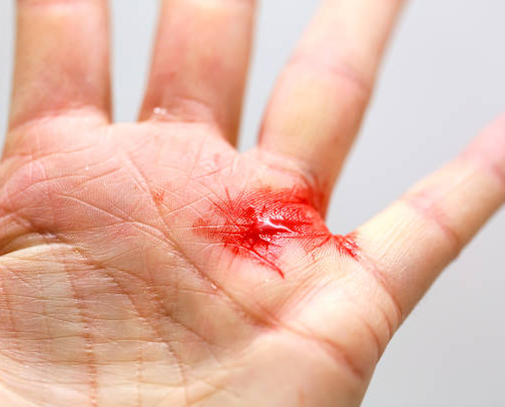
Exposure Incident
If you have an exposure incident to blood or OPIM, immediately do the following:
Thoroughly clean the affected area.
Wash needlesticks, cuts, and
skin with soap and water.
Flush with water splashes to the
nose and mouth.
Irrigate eyes with clean water,
saline, or sterile irrigants.
Report exposure to supervisor, person or department responsible for managing exposures. Fill out an Incident Report Form.
Notes:
(Run through slide)
In the Incident Report Form, try to describe the exposure event in as much detail as possible and submit the report to (your supervisor, responsible person or department, etc.)

Slide 56

Post-Exposure Evaluation
Our School’s Responsibility
Provide immediate post-exposure medical evaluation and follow-up to exposed employee:
At no cost.
Confidential.
Testing for HBV, HCV, HIV.
Preventive treatment, when indicated.
Test blood of source person, if HBV/HCV/HIV status unknown, if possible. Provide results to exposed employee, if possible.
Notes:
Medical evaluation must be provided as soon as possible. Even though there is no clear recommendation as to how soon HIV post-exposure prophylaxis (PEP) must be given to be effective, most health care professionals recommend the HIV PEP be given within hours after exposure.
There is no evidence that HIV PEP is effective if given longer than 24 hours after exposure. HBV immune globulin may be given within 7 days after exposure but is most effective given as soon as possible after exposure. There is no post-exposure preventative medicine that is available for HCV.

Slide 57

Post-Exposure Evaluation
Our School’s Responsibility (continued)
Provide exposed employee with copy of the evaluating healthcare professional’s (HCP) written opinion within 15 days of completion of evaluation.
Provide employee with information about laws on confidentiality for the source individual.
Provide post-exposure treatment as needed, including counseling.
Our HCP is:
Notes:
[State who your HCP is here.]

Slide 58

Recordkeeping
Employee Medical Records
Confidential.
Hepatitis B vaccination and post-exposure evaluations.
HCP’s written opinions.
Information provided to HCP as required.
Maintain for length of employment + 30 years.
Notes:
Medical records maintained by (state your school district’s name) do not contain any confidential medical information, except for the HBV vaccination status and Declination Form, if you choose to waive being vaccinated.
The HCP’s written opinions contain generic information. They may not contain any medical diagnosis or disease testing results; these are in your confidential medical information.

Slide 59

Contact Information
Instructor(s) are available for any questions:
(Insert contact information here.)
Name of School and Date

