Slide 1
The 2016 Washington State
Health Education K-12 Learning Standards: Focus on Sexual Health
January 2017
Notes:
Hello. The following presentation will address New K-12 Learning Standards for Health and Physical Education, which were adopted by OSPI in March, 2016. The specific focus of this overview is the optional grade-level outcomes for sexual health education. My name is Laurie Dils and I serve as the Program Supervisor for Sexual Health Education at OSPI.

Slide 2

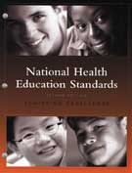
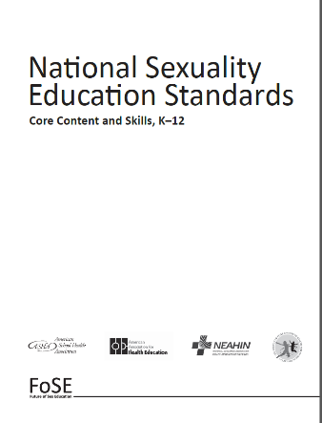
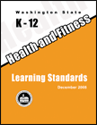
Foundational Documents
Comprehensive
Health and Fitness
Education
2014
2008
Notes:
After the previous Health & Fitness standards were adopted in 2008, three key national standards sets were released – physical education, health education and sexuality education. All of these documents were reviewed and used in Washington’s revision process, as well as student learning standards from a number of other states.

Slide 3
Standards Adoption
Process
1) Identify need and scope for revision
3) Public Review and Input
4) Adoption recommendations/ Supt Adopts
5) Implementation
2) Draft standards
Notes:
The standards review and revision process, which began in 2014, reflects the work of 13 health and physical education teacher leaders over a year and a half, supported by OSPI staff and a contracted facilitator. That group reviewed the 2008 standards, recommended that revision was indeed needed, and then began working on the adoption of new standards. OSPI’s statewide curriculum advisory review committee (CARC), 2 groups of bias & sensitivity reviewers, professional and stakeholder groups, and the public were asked to review drafts at various points during the process. New standards were finalized and adopted in 2016, with full implementation planned for the 2017-18 school year.

Slide 4
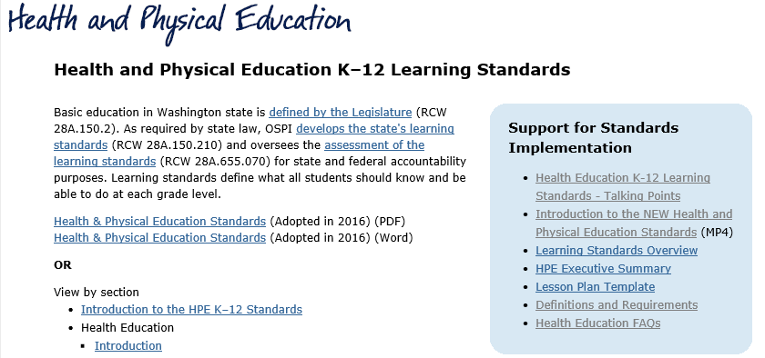
Standards Adoption Process: http://www.k12.wa.us/HealthFitness/Standards.aspx
Notes:
For more information about the Health & Physical Education Standards, including the revision and adoption process, please see OSPI’s website, which is linked here. In addition to links to all standards documents, the blue box on the right contains a number of supportive documents and a 35-minute introductory video. All links in this presentation can be accessed through the PowerPoint document which is posted with this video.

Slide 5
Health Education K-12 Learning Standards
1. Comprehend concepts related to health promotion and disease prevention to enhance health.
2. Analyze the influence of family, peers, culture, media, technology, and other factors on health behaviors.
3. Demonstrate the ability to access valid information and products and services to enhance health.
4. Demonstrate the ability to use interpersonal communication skills to enhance health and avoid or reduce health risks.
5. Demonstrate the ability to use decision-making skills to enhance health.
6. Demonstrate the ability to use goal-setting skills to enhance health.
7. Demonstrate the ability to practice health-enhancing behaviors and avoid or reduce health risks.
8. Demonstrate the ability to advocate for personal, family, and community health.
Notes:
The workgroup recommended adopting the 8 National Health Education Standards, and then adding optional grade-level outcomes to provide specificity on what instruction might look like within typical health units. You’ll notice that with the exception of the first standard, most of these address skill development. These standards are required to be taught.

Slide 6

Health Education Core Ideas
1. Wellness
2. Safety
3. Nutrition
4. Sexual Health
5. Social Emotional Health
6. Substance Use and Abuse
Notes:
Six Core Ideas were chosen that reflect typical units of instruction, as a way of organizing grade-level outcomes. Sexual health was not included in the 2008 standards, as the state’s Healthy Youth Act had just been passed by the legislature and inclusion would have meant a significant delay in finalizing and adopting the standards. This workgroup recommended that sexual health be included in the 2016 revision. While the 8 overarching health standards are required to be taught, all core ideas are optional for health education, with the exception of a few topics required by legislation. These include CPR/AED instruction and HIV and STD prevention. All requirements can be found in Appendix B of the standards, as well as in OSPI’s Health Education FAQ document, which can be found on the webpage page I showed previously.

Slide 7
Sexual Health Education Topic Strands
Anatomy, Reproduction and Pregnancy
Puberty and Development
Self-Identity
HIV Prevention (K-5)
Prevention (6-12)
Healthy Relationships
WA State Laws (6-12)
Notes:
Within sexual health education, a number of topics were included that reflect typical units of instruction, as well as topics addressed in the Healthy Youth Act and related 2005 Guidelines for Sexual Health Information and Disease Prevention. The grade 6-12 “Prevention” topic includes HIV, STD and pregnancy prevention.

Slide 8
Sexual Health Legislative Requirements
Grades 5-12: HIV Prevention annually (AIDS Omnibus Act)
STD Prevention (Common School Curriculum)
If sexual health is taught (Healthy Youth Act):
  Consistent with 2005 Guidelines
  Medically-accurate, age-appropriate, inclusive
  Includes both abstinence and contraception
  Sex crimes when victim is a minor
Notes:
In WA State, the provision of sexual health education is optional. The only required sexual health content areas are HIV and AIDS prevention, as outlined in the 1988 AIDS Omnibus Act, and STD prevention, as outlined in the Common School Curriculum requirements. However, IF sexual health education is provided, it must comply with the Healthy Youth Act of 2007. A 2015 law added the inclusion of information on sexual offenses where the victim is a minor, again only IF sexual health education is provided.

Slide 9
Sexual Health Education Grade Level Outcomes – Key Points
Based on HYA & 2005 Guidelines:
  Sexuality: is a significant aspect of a person’s life consisting of many interrelated factors
  including but not limited to sexual anatomy, physiology, growth and development;
  gender, gender identity and gender role/expression; sexual orientation and sexual
  orientation identity; sexual behaviors and lifestyles; sexual beliefs, values and attitudes;
  body image and self-esteem, sexual health; sexual [thoughts and feelings]; relationship to others; [and] life experiences.
Notes:
In developing the grade level outcomes for sexual health, the revision workgroup relied heavily on the definition of sexuality in the law, as well as the 2005 Guidelines, which outline clearly what comprehensive sexual health education should look like in WA.

Slide 10
Sexual Health Education Grade Level Outcomes – Key Points
Optional and Flexible!
Best Practice
Healthy Youth Act
State & federal equity & civil rights laws
Notes:
To reiterate key points related to the Grade Level outcomes for sexual health:
Because sexual health education is optional in WA, the grade-level outcomes are also optional
They are also flexible – they can and should be modified to reflect district policies, as well as community and classroom needs
They reflect best practice, as defined in peer-reviewed, professional research, Centers for Disease Control guidelines, recommendations from organizations such as the American Academy of Pediatrics, and the national sexuality education standards.
They are based closely on state laws – not only the Healthy Youth Act, but also state and federal equity and civil rights laws.

Slide 11
Sexual Health Education Topic Strands
Anatomy, Reproduction and Pregnancy
Puberty and Development
Self-Identity
HIV Prevention (K-5)
Prevention (6-12)
Healthy Relationships
WA State Laws (6-12)
Notes:
As reviewed previously, the revision team included a number of topics within sexual health for the purpose of organizing grade-level outcomes. Because of an inaccurate and misleading online article about the new standards which appeared in spring of 2016, a number of questions have come up about the “self-identity” topic strand.

Slide 12
Sexual Health Education Grade Level Outcomes – Key Points
Optional and Flexible!
State and federal equity & civil rights laws
Address disproportionate rates of bullying, harassment, suicide among LGBTQ students
Notes:
This topic strand, which is optional – as are all grade level outcomes - was included for several reasons. Districts around the state are grappling with questions related to gender stereotypes, bullying related to sexual orientation, same-sex marriage, and gender identity. If provided, age-appropriate instruction about these topics, with a focus on empathy and understanding, serves to significantly reduce stigma in the learning environment and thereby supports each student’s ability to learn and feel safe at school. The National PTA is one of several groups that recently adopted a resolution supporting this area of instruction. It is available on our website.

Slide 13

Sexual Health Education Grade Level Outcomes – Key Points
Age-appropriate
Culturally relevant
Fits with district/teacher
curriculum
Notes:
All classroom instruction on sexual health should be age-appropriate, culturally relevant, and in line with district policy. A conversation about gender roles and gender stereotypes in a kindergarten or first grade class might, for example, lead to the use of a picture book such as this one. It is not recommended that instruction about gender identity or transgender issues be provided in early elementary grades – unless perhaps a transgender student is being openly supported by the school community in a transition process. A number of resources are available to help schools address such situations and our office is happy to provide them.

Slide 14
Values
Teaching ≠ NOT promoting
Personal/Family values – the role of the FAMILY
Universal Values (need for consent, no sex between adults and children, knowingly spreading disease is wrong)
Notes:
Please note that teaching about topics such as self-identity is not the same as promoting the topics. Classroom teachers should not convey their own values about any sexual health education topic – that is the role of parents and guardians. Universal values such as respect and the importance of consent are appropriate in sexual health education. Sexual health education instruction is not intended to advocate for particular viewpoints or personal realities – rather to provide factual information and the development of skills such as communication and decision-making, as well as a recognition of and support for the wide range of values represented in our state and in our classrooms.

Slide 15
Health Education Standards & Grade Level Outcomes – Resources
Definitions & Requirements
FAQ Document – geared to administrators
Talking Points – geared to parents & community
Professional Learning
Notes:
OSPI has developed a number of resources, including professional learning opportunities, to assist districts in understanding and implementing new standards – many are found on our Health and Physical Education Standards webpage, as shown earlier.

Slide 16
Sexual Health Education Grade Level Outcomes – Resources
HIV/Sexual Health Website
Non-fiction Texts
FAQ – HYA/AOA
Guidance Document – for teachers
Notes:
To support the provision of sexual health education, we have resources on our website, including an extensive list of non-fiction texts and picture books, organized according to the topic strands in the sexual health outcomes. We also provide a frequently asked questions document that covers legislative requirements. And we’re in the process of developing a Sexual Health Education Guidance Document to provide further information for teachers on what exemplary sexual health education might look like in the classroom and how to provide it.

Slide 17
Contacts
Laurie Dils, MSW
Program Supervisor
Sexual Health Education
Office of Superintendent of Public Instruction
360-725-6364
laurie.dils@k12.wa.us
Ken Turner, Ed.D and EMT
Program Supervisor
Health & Physical Education
Office of Superintendent of Public Instruction
360.725-4977
Ken.turner@k12.wa.us
Notes:
For more information about standards, please contact Ken Turner, our program supervisor for Health and Physical Education. For more information about sexual health education, including grade level outcomes, please contact me. I’m passionate about supporting the provision of high-quality sexual health education and love hearing from districts. Thank you for your attention.

