Slide 1
Module 4 & 5: Language Expectations, Functions and Features
Learning Targets:
Understand the benefits of a unit language goal.
Practice identifying Language Expectations, Functions, and Features at a unit level.
Use Language Features to describe how students need to use language for content learning.
BIG Ideas:
Functional Approach to Language Development
Integration of Content & Language
Notes:
In Modules 4 and 5 of the WIDA ELD Standards Framework: A Collaborative Approach, the focus is on identifying and utilizing language expectations, functions, and features to describe how students need to use language for content learning. The Language Expectations are key to the big ideas of integrating content and language and supporting a functional approach to language development.

Slide 2
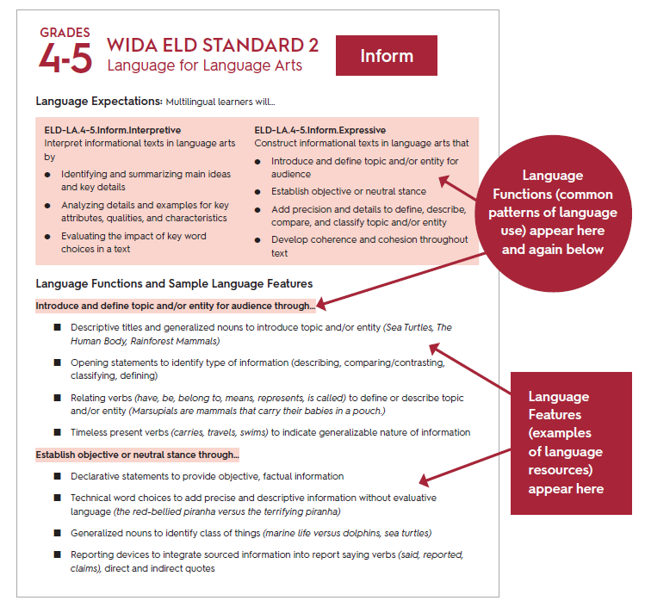
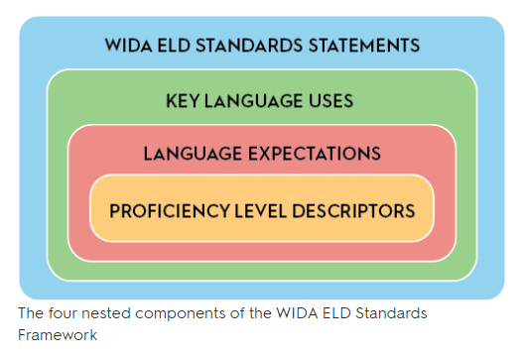
Language Expectations
Notes:
Language Expectations set goals for content-driven language learning. They add specificity to the ELD Standards Statements and Key Language Uses and make visible the language associated with the content areas. Language Expectations are the statements most similar to what educators generally find in academic content standards.

Slide 3
Language Expectations
Notes:
Each Language Expectation has a reference code. Here is the reference code for the 4th and 5th grade Expressive Language Expectation for Narrate for Language Arts. Multilingual learners construct language arts narratives that orient the audience to the context, develop a story with time and event sequences, complication, resolution, or ending, and engage and adjust for the audience.
What are the Language Functions that are embedded in this Language Expectation?

Slide 4
Language Functions
Notes:
The Language Functions that are embedded in this Language Expectation are the specific actions that the student needs to take in using language. For constructing a narrative, the student needs to:
Orient the audience,
Develop the story, and
Engage and adjust for the audience.

Slide 5
Language Features
Notes:
For each Language Function, the framework includes sample Language Features that show the types of language that needs to be used to develop that language function and meet the language expectation of that grade band. In this example, 4th and 5th grade students need to use noun groups to state who or what the narrative is about, use a variety of sentence types to establish the context, use adverbial and prepositional phrases to establish time and location, and use statements and questions to foreshadow or state a complication.

Slide 6
Breakout Room Discussion
Choose one Key Language Use in a grade band:
What do you notice about the Language Expectations for this KLU?
What are the Language Functions and some sample Language Features for this KLU?
How might teachers use these to support multilingual learners to meet grade-level expectations?
Notes:
Now we will take 5-10 minutes to look at Language Expectations, Functions, and Features.
(Read the text on the slide.)

Slide 7
Let’s Practice
Unit Overview: This unit focuses on the idea that sound energy produces vibrations that travel in waves and are transferred through air particles.
Essential Question: How do sound waves produce and transfer energy?
Content Standard: NGSS-4PS3.2 Make observations to provide evidence that energy can be transferred from place to place by sound, light, heat, and electric currents.
Summative Assessment: Students will demonstrate comprehension of these concepts by writing explanations of how a singer breaks a glass with their voice.
4th Grade Science Unit
KEY LANGUAGE USE: Explain
What is our language goal for the unit?
Notes:
Now we are going to practice selecting Language Expectations, Functions, and Features that will support our language goals for a unit. We will revisit the two sample units that we looked at for Module 3 and use the information given to determine the language goals and expectations that will best support students to successfully complete the summative assessment task.
For this 4th grade science unit on sound energy, we selected the Key Language Use of Explain. What is our language goal for this unit?

Slide 8
Let’s Practice
Unit Overview: Students read excerpts from two texts (nonfiction and fiction), Rilke’s Letters to a Young Poet and Mitchell’s Black Swan Green. These two texts are juxtaposed, allowing for a study of key ideas and characters across texts.
Essential Question: How is language used to convey central ideas in works of fiction and informational texts?
Content Standard: CCSS.ELA-LITERACY.RI.9-10.3
Analyze how the author unfolds an analysis or series of ideas or events, including the order in which the points are made, how they are introduced and developed, and the connections that are drawn between them.
Summative Assessment: Students write a formal, multi-paragraph response to the following prompt: Identify similar central ideas in Letters to a Young Poet and Black Swan Green. How do Rilke and Mitchell develop these similar ideas?
9th Grade ELA Unit
KEY LANGUAGE USE: Argue
What is our language goal for the unit?
Notes:
For this 9th grade ELA Unit in which students compare how two authors develop similar central ideas, we selected the Key Language Use of Argue. What is our language goal for this unit?

Slide 9
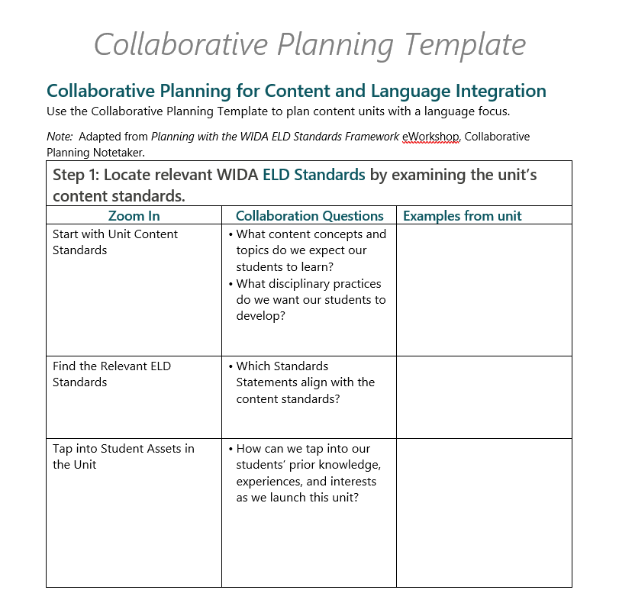
Collaborative Planning
Notes:
WIDA provides a Collaborative Planning Template that can be used to plan for content and language integration in a unit. Let’s use the Collaborative Planning Template questions to select Language Expectations, Functions and Features for this unit.

Slide 10
Breakout Room Discussion
Choose a unit example:
Which Language Expectation best reflects the language focus of the unit?
Which embedded Language Function is essential for meeting content and language goals and success criteria for the summative assessment?
Which of the associated Language Features would contribute to students’ language use on the summative assessment?
Notes:
With your group, choose a unit example:
Which Language Expectation best reflects the language focus of the unit?
Which embedded Language Function is essential for meeting content and language goals and success criteria for the summative assessment?
Which of the associated Language Features would contribute to students’ language use on the summative assessment?

Slide 11
Collaboration Planning
How can the WIDA ELD Standards Framework be used as a tool for planning, instruction, collaboration and reflection to support ALL learners?
Notes:
Discuss with your group: How can the WIDA ELD Standards Framework be used as a tool for planning, instruction, collaboration and reflection to support ALL learners?

