Slide 1
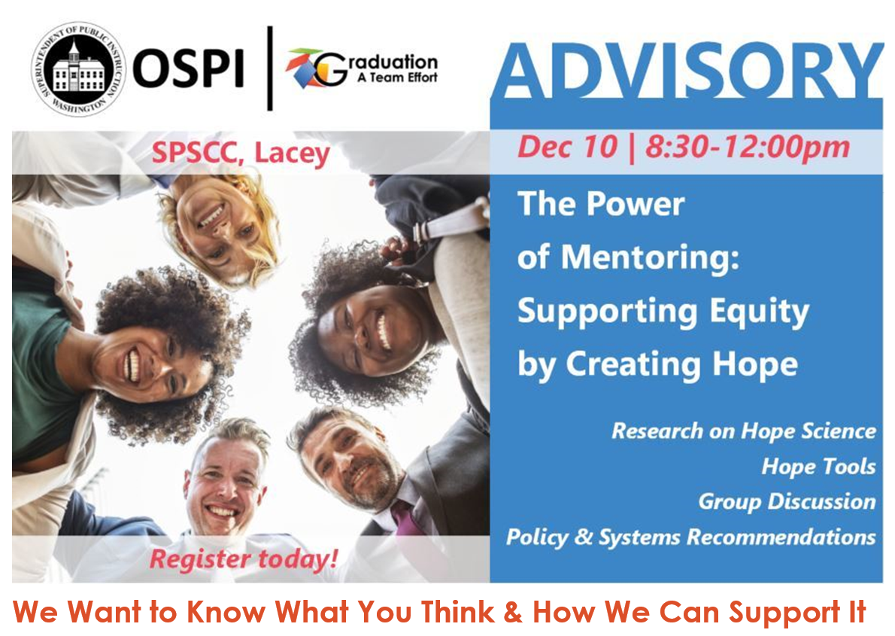
Welcome to GATE Advisory
How are you connected to Hope and/or Mentoring efforts?
What are your hopes for today?
Challenge:
Meet 2 new people!
Notes:
Welcome by Tennille

Slide 2

Welcome
Opening Moves
  Sign-in
  Snacks
  Restrooms
  Materials
  Who’s here?
Notes:
Housekeeping

Slide 3
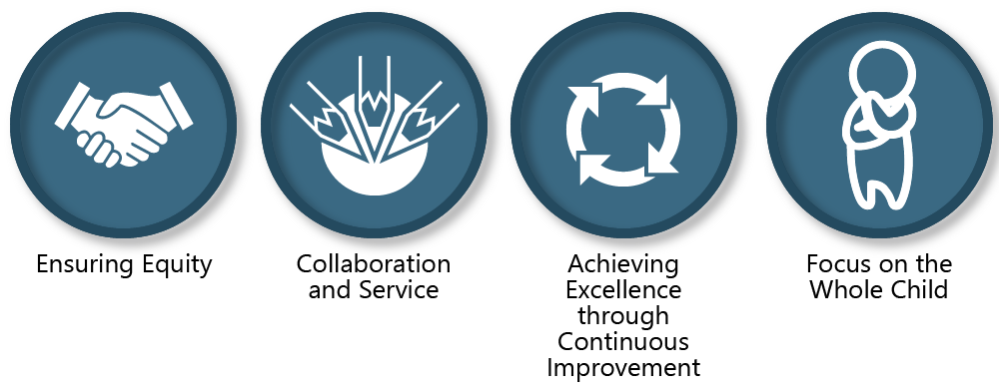
Values:
Vision:
All students prepared for post-secondary pathways, careers, and civic engagement.
Mission:
Transform K–12 education to a system that is centered on closing opportunity gaps and is characterized by high expectations for all students and educators. We achieve this by developing equity-based policies and supports that empower educators, families, and communities.
Notes:
Here at OSPI our vision is all students prepared for post-secondary pathways, careers, and civic engagement.

Slide 4

Equity Statement
it requires education leaders to examine the ways current policies and practices result in disparate outcomes for our:
Requires education leaders to:
Partners in Decision-Making
Actively dismantle systemic barriers
replacing them with policies and practices
that ensure all students have access to the instruction and support they need to succeed in our schools.
Policies & Practices
students of color
students living in poverty
students receiving special education
English Learner services
students who identify as LGBTQ+
highly mobile student populations
develop an understanding of historical contexts
engage students,
families, and
community representatives
as partners in decision-making
Examine Disparate Outcomes
Ensuring educational equity goes beyond equality;
Beyond Equality
Each student, family, and community possesses strengths and cultural knowledge that benefit their peers, educators, & schools.
Notes:
Tapping into the strength of the schools and communities we serve
We need to look for the way our current system is resulting in disparate outcomes
Requires us to engage students, families and community representatives as partners in decision making
Work to dismantle barriers and replace them with policies and practices that ensure access for all students to the supports they need to be successful.

Slide 5

Purpose of GATE Advisory
Graduation: A Team Effort (GATE) is a collective impact initiative to support youth to graduate from high school prepared for life.
GATE Advisory participants include: policy leaders, and representatives from state agencies and statewide youth and family serving organizations.
GATE Advisory provides a forum to discuss cradle to career issues, and formulate recommendations for action.
Notes:
Celebrate a successful year:
Community partnerships and substance abuse
Dual Credit and multiple pathways
Keeping on track thru authentic connections
Promoting regular attendance thru removing barriers and promoting engagement

Slide 6

Agenda – Hope Science and Mentoring
Examples of Hope Efforts and Tools
Mentoring to Nurture Hope
Action Steps to Move Forward
Background and Foundation

Slide 7

After today you will be able to:
Understand the importance of Hope
Identify Hope opportunities & resources
Understand your role in supporting Hope through mentoring
Discuss action steps for yourself as well as agency leaders supporting Hope and Mentoring
Notes:
So by the end of our webinar, we want you to be able to
Understand the importance of access in DC opportunities for EL and migrant students
Identify dual credit opportunities
Get familiar with systems to provide access
Gain awareness of resources you can use to get started

Slide 8
Chan Hellman
Hope Champion, Professor

Slide 9
Jon Tunheim
Thurston County Prosecutor

Slide 10
Hope is the belief that your future will be better than today and you have the power to make it so.
Notes:
Workbook page 2. Have participants write the definition.

Slide 11
How Can We Nurture Hope?
Hope
Goals
Pathways
Agency

Slide 12



The Simplicity of Hope Theory!
Goals: Cognitive endpoint of purposeful behavior.
Can be either short- or long-term in nature.
Must be valued (our goals are not always their goals).
Pathways: Mental roadmaps to goal attainment.
Consider potential barriers with solutions.
Identify multiple pathways.
Agency (Willpower): Mental energy to your pathway pursuits.
Focus your attention and intention on goal pursuits.
Sustained motivation.
*Dr. Chan Hellman
Notes:
Hope explains goal directed processes.
Pathways refers to the ability to identify routes toward goals and to find new routes (problem solve) around obstacles if necessary.
Agency (Willpower) is the ability to sustain motivation to move along these pathways.

Slide 13
“Agency without a pathway is a wish.”
Dr. Chan Hellman

Slide 14
Measuring Hope - CHILDREN’S HOPE SCALE
I think I am doing pretty well.
I can think of many ways to get the things in life that are most important to me.
I am doing just as well as other kids my age.
When I have a problem, I can come up with lots of ways to solve it.
I think the things that I have done in the past will help me in the future.
Even when others want to quit, I know that I can find ways to solve the problem
*Dr. Chan Hellman

Slide 15
Healthy Youth Survey Results 2018:
Hope & Depression
Among 8-12 Grade Youth

Slide 16
Healthy Youth Survey Results 2018:
Hope & Suicidal Ideation Among
8-12 Grade Youth

Slide 17

Statewide Trends
60% of 8th graders
56% of 10 graders
Highly hopeful & have people to turn to for help
58% of 12th graders
3% of 8th graders
4% of 10 graders
No or very low hope & have people to turn to for help
4% of 12th graders
1 out of 2 students were considered “highly hopeful”
2018 Healthy Youth Survey State Sample
Notes:
In 2018, 4 questions from the Children’s Hope Scale were asked on the Healthy Youth Survey to students in 8th to 12th grade. Four rather than 6 questions were asked do to spacing, but researchers noted that just using 4 questions still made the scale valid. Two questions were asked about pathways and two questions were asked about agency. Overall hope scores were then calculated and students whose total scores were 4-8 indicated to have “no or very low hope”, 9-12 indicated slightly hopeful, 13-16 indicated moderately hopeful and 17-24 indicated highly hopeful.
In the State Sample Report of the Healthy Youth Survey, it was found that 1 out of 2 students across all 3 grades, were considered “highly hopeful”.
When you look at students who were considered highly hopeful vs. those whose scores showed that they had “no or very low hope” and cross reference that with the question on the Healthy Youth Survey, that asks students if there are people at school who will help them if they need it, you see that results are drastically different. With over 55% of students who were considered highly hopeful stating that there are people who can help them if they need it at school, and less than 5% of students who have no or very low hope stating there are people who can help them if they need it.
Other questions can be cross referenced with questions regarding to the hope scale.

Slide 18
THE LOSS OF HOPE
HOPE
Anger
Goal is significantly blocked.
DESPAIR
Unable to adjust goal. Pathways are unavailable.
APATHY
(Hopeless)
Loss of Motivation
Source: Dr. Chan Hellman
Notes:
What does apathy look like. What might be the language of someone who is experiencing apathy? Refer participants to workbook page 4.

Slide 19
NURTURING HOPE
HOPE
Creating Future Memories of Success
Progress Reinforces Pathway/Agency Relationship
Viable Pathways
Barriers are Considered and Pathways Adjusted
Goal Setting
Clarifying Goals Increases Agency
*Dr. Chan Hellman
Notes:
Refer participants to page 5 in workbook. Discuss the “language” at each phase/stage. Give an example of encouraging by creating future memories of success.

Slide 20

Notes:
Psychologist, Rick Snyder once said, “If a miracle happened, and you could have your life be exactly the way you want it, what would it be like? Your journey to higher hope begins with an honest appraisal of who you are, how you think about your life, what you want for yourself, and how you can get what you want.”
Mr. Snyder, who was a professor at the University of Kansas went on to create the “Children’s Hope Scale”. A scale that has been used nationally to measure hope.

Slide 21
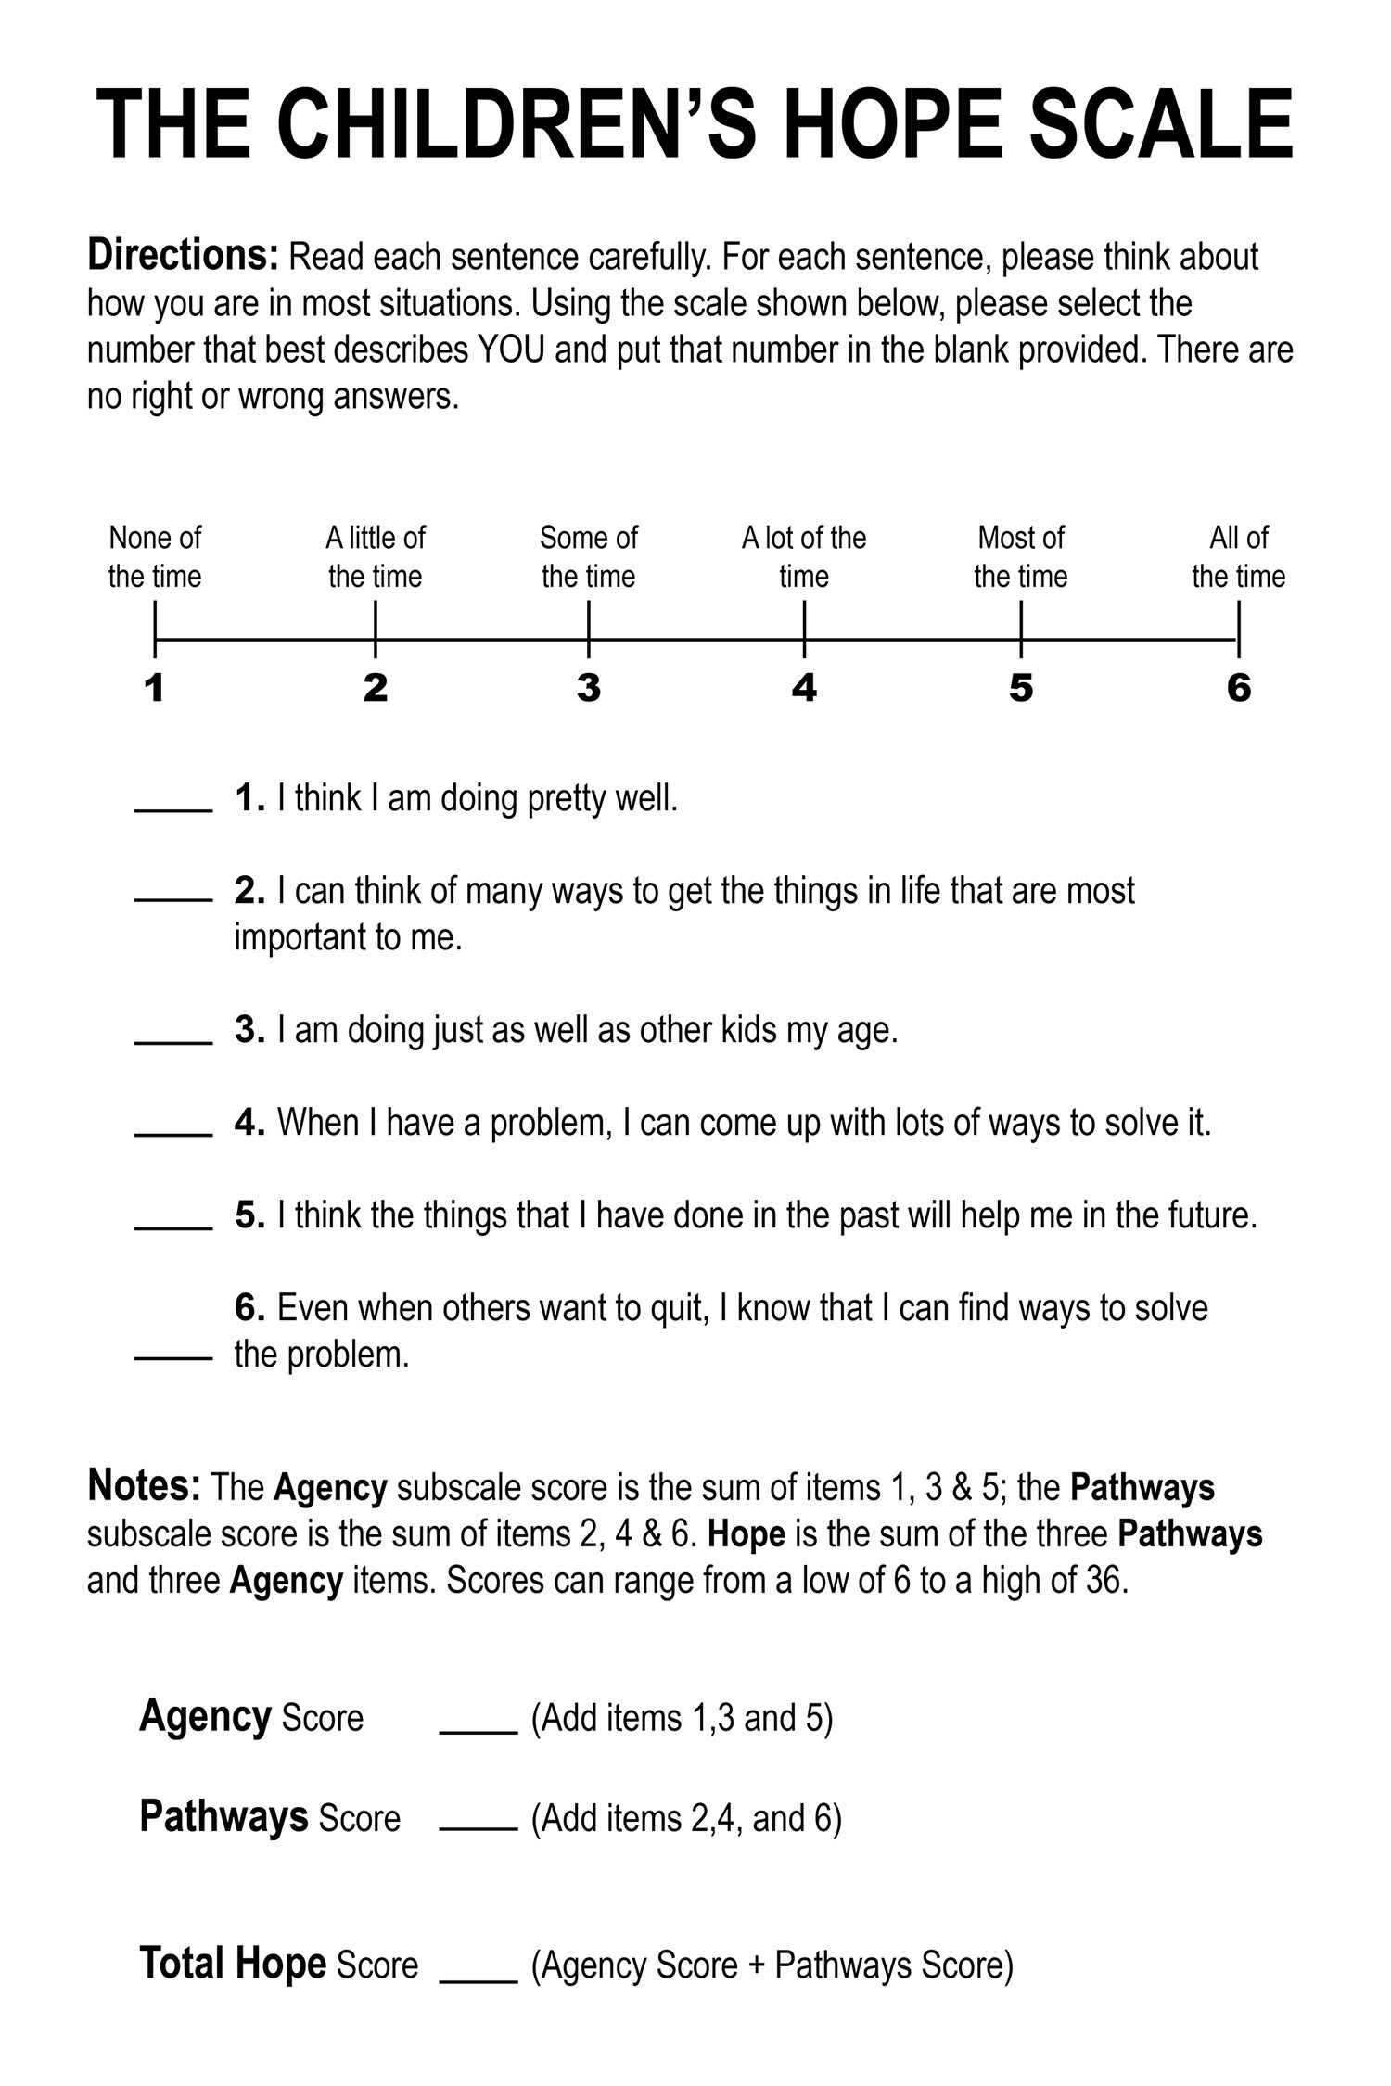
Administering the Hope Scale
Community Toolkit
Notes:
This six question assessment is a tool that can help measure hope in individuals ages 8 to 16. The scale, asks three questions about pathways, a child’s belief in their capacity to find multiple ways to reach their goal, and three questions about agency, which is a child’s self-efficacy and motivation to use multiple ways to reach their goal.
As you can see from the scale shown, the agency questions are:
- I think I am doing pretty well
I am doing just as well as other kids my age.
I think the things that I have done in the past will help me in the future.
And pathway questions are:
- I can think of many ways to get the things in life that are most important to me.
When I have a problem, I can come up with lots of ways to solve it.
Even when others want to quit, I know that I can find ways to solve the problem.
Children rate these questions on a scale of 1 to 6, with 1 being none of the time, and 6 being all of the time.
The results are then added up to create a “Total Hope Score”. Scores range from 6 to 36, and the higher the score the more hopeful a child is considered to be.

Slide 22
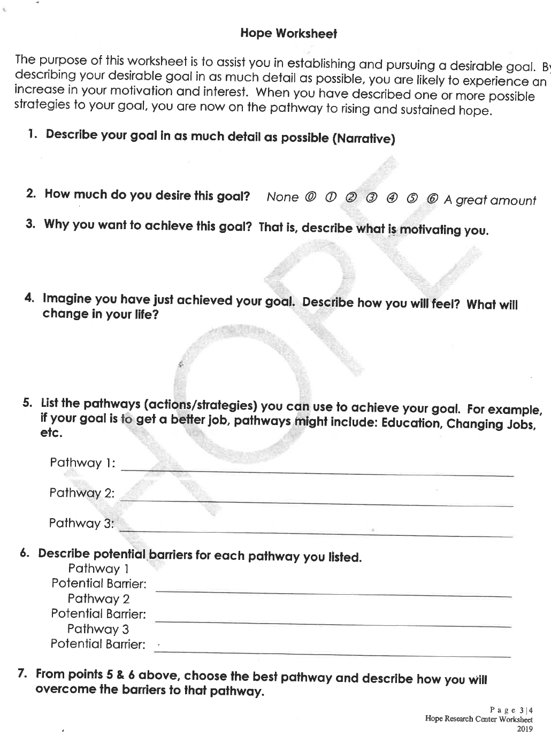
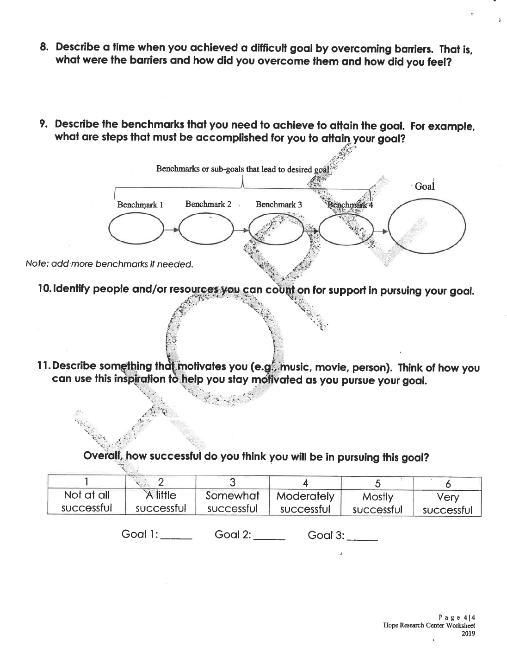
Resource: Hope Worksheets
Source: Dr. Chan Hellman
Notes:
One of my favorite resources to share is this Freshman Success Inventory. It can still be applied to any team level.
It covers categories on Guiding Beliefs, setting conditions, implementation, communication, and instruction.
I highly recommend you check it out even if you aren’t working with high schools right now!

Slide 23

Group Discussion Time
How does Hope connect to your current work?
How can you use the Hope Tools?

Slide 24
Break Time!
Hi, I’m ____________
What’s your name?
What do you think about Hope?
What are you still wondering about?
Bio Break
Get some coffee
Meet 2 New People!

Slide 25
The Role of Mentoring and Community Partnerships in
Nurturing Hope
Louis Guiden, Change Agent

Slide 26
Strategies To Nurture Hope
Introduce Hope
Introduce the concept of hope and discuss its core components (distinguish wishful thinking).
Help develop personally relevant goals.
Pathways
List and discuss potential pathways chosen by the individual.
Willpower
Identify/describe sources of motivation.
Problem Solve
Identify and list obstacles.
Create Hope Visual
Create a Visual Map accessible for the reference.
Re-Goaling
Remember – We have the ability to re-goal.
Goal Setting
*Dr. Chan Hellman

Slide 27

Individual Reflection…Discuss…Record…Report
Notes:
4 minutes for whole group share out and pivot to break
Image source: https://www.videoblocks.com/video/speech-bubbles-on-white-background-animated-flat-design-hij-jn_feizdx3lk8

Slide 28
What are the entry points for embedding Hope Science into your efforts?
What are the barriers to this?
How can we collaborate on building communities of hope?
What can the state do to support the hope effort?

Slide 29
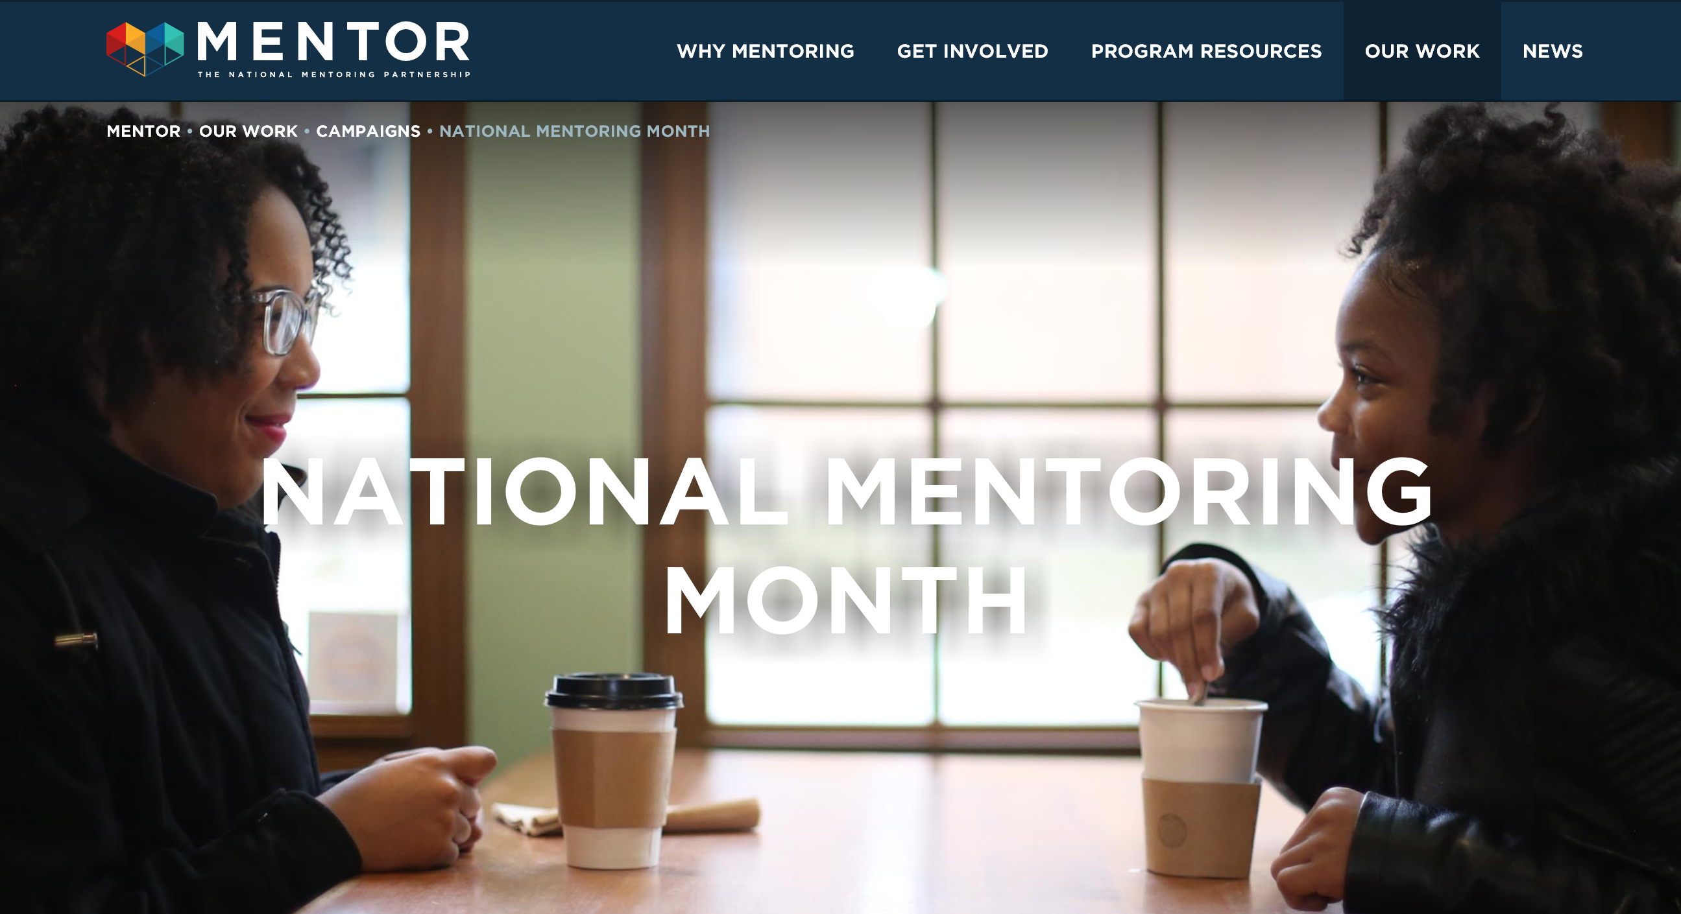
January
Notes:
Besides information on national mentoring month, Mentor has webinars, podcasts, research and more!

Slide 30
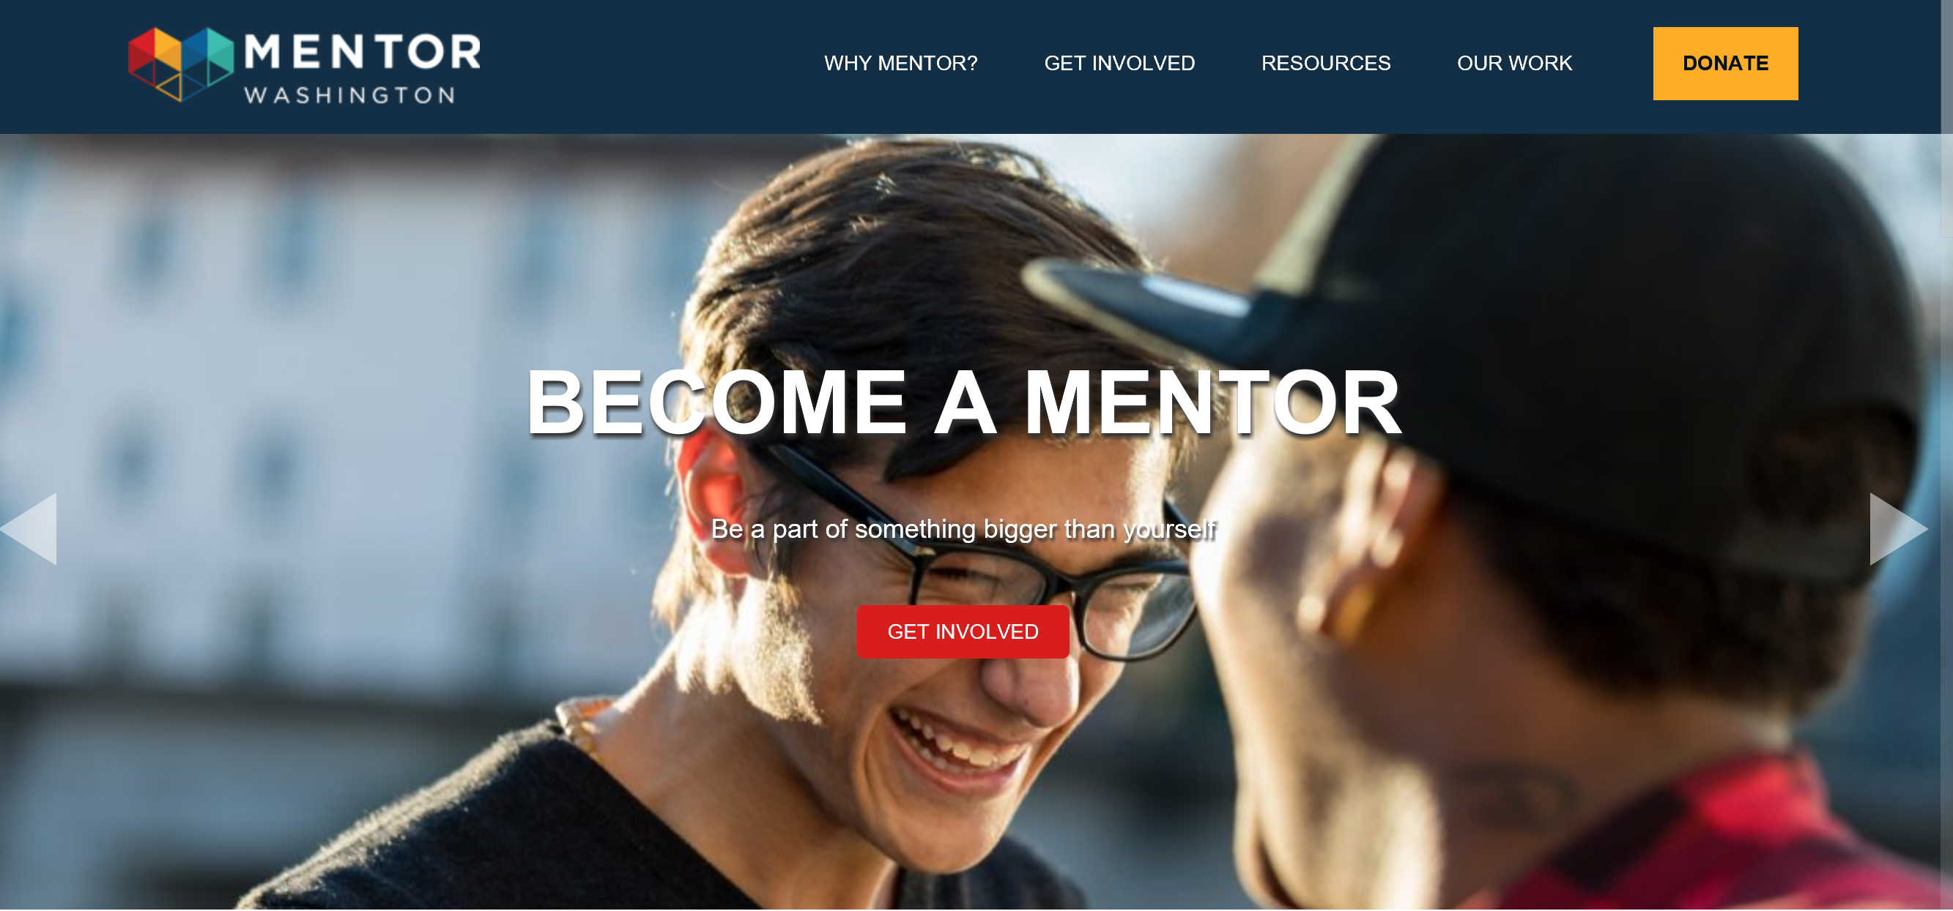
Find a Mentor, Be a Mentor, Mentoring Support
Notes:
Public Private Partnership lead by DCYF: Tom Pennella

Slide 31

Join us in February!
Supporting Our English Learner Students and Families
February 11, 2020
South Puget Sound CC, Lacey

