Slide 1
WASBO Year-End Workshop
August 25, 2020

Slide 2
WASBO Year-End Workshop
Agenda:
            Logging In
            Getting Started
            Import Data
            Input Data
            Run Edits
            Print Reports
            Update Status
            Certification
            Notes to Financial Statement Templates
            Final Thoughts

Slide 3
WASBO Year-End Workshop
The F-196
Annual Financial Statement
2019–2020 User Guide

Slide 4
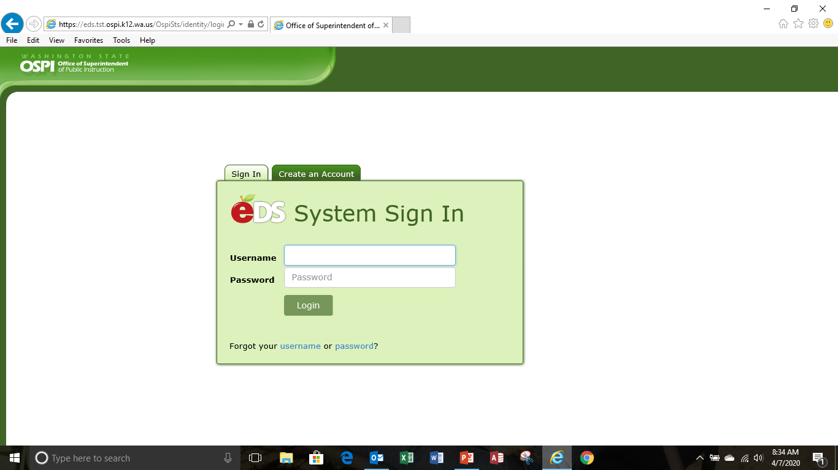
The F-196-Log In
Logging Into SAFS (All Users)
Go to the EDS Login screen, type your user name and password, then click Login.
Note: The URL to use is:
https://eds.ospi.k12.wa.us/Login.aspx

Slide 5
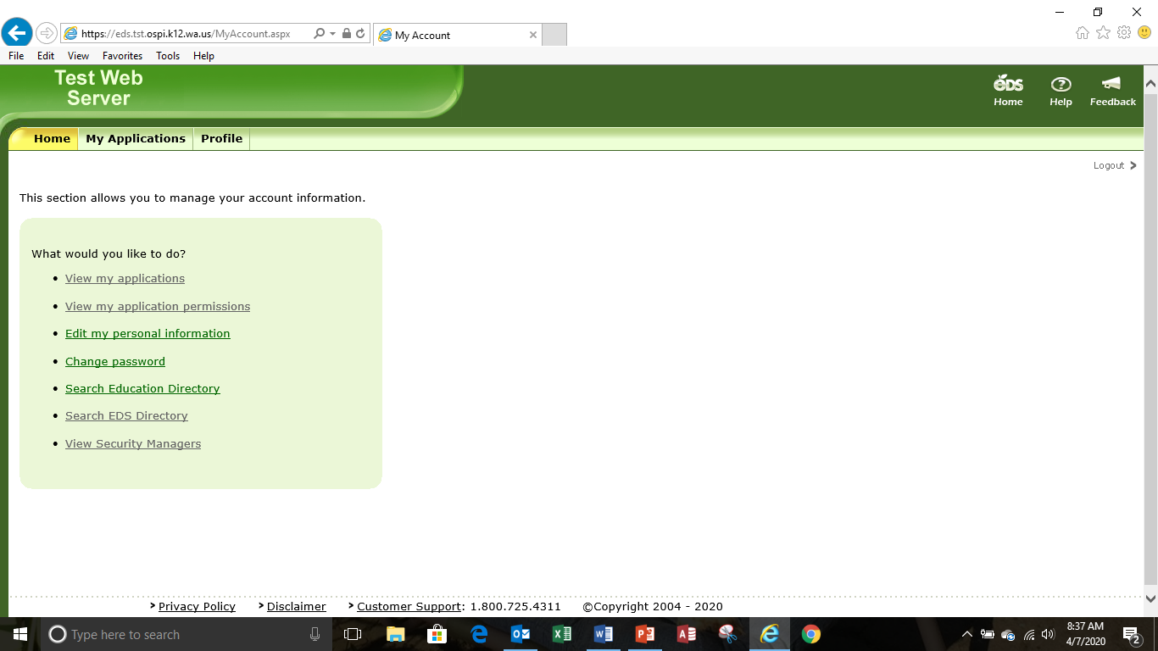
The F-196-Log In
From the Home screen click on the
My Applications tab

Slide 6
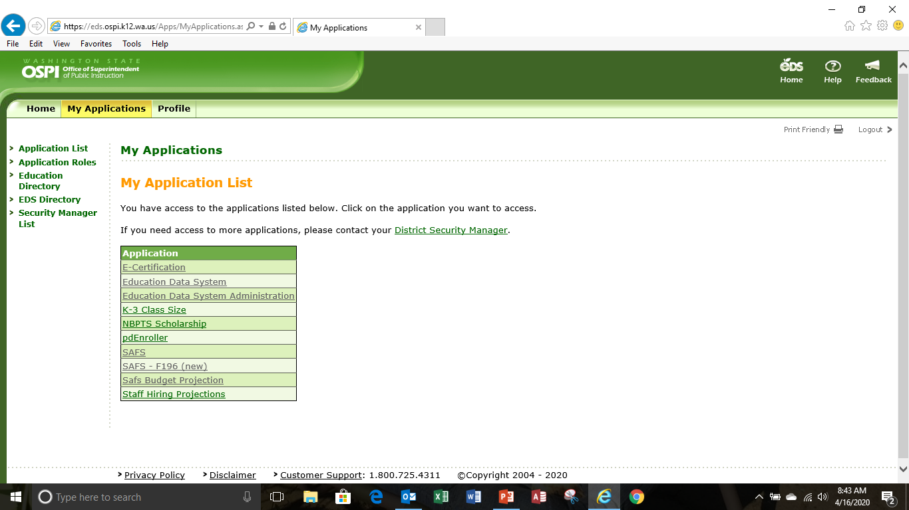
The F-196-Log In
From the My Applications screen,
click on the link to the
SAFS-196 (new) application.
This is direct access to the F-196.
Do Not Select “SAFS”
Notes:
This is direct access to the F-196, no need to used the secondary tool bar on top of the page. If you select SAFS you will go to the old F-196 version.

Slide 7
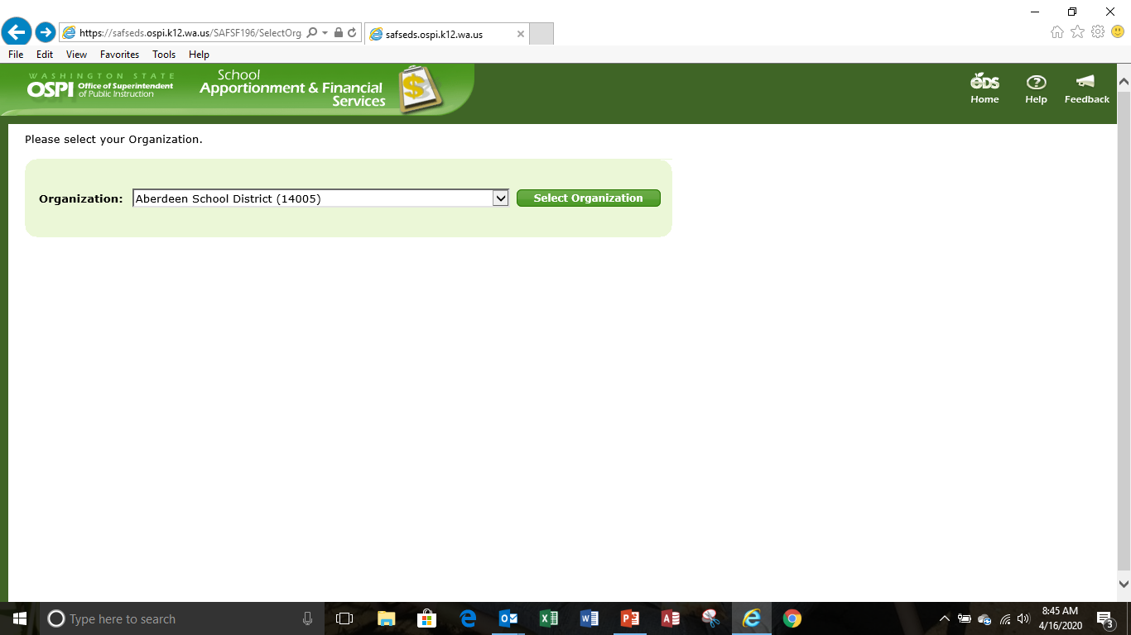
The F-196-Log In
Select your district or organization by clicking select organization.
Note: The EDS applications are designed to use Internet Explorer as the Web browser. It is best not to use other browsers.
Notes:
Again this is a direct access to the F-196 application.

Slide 8
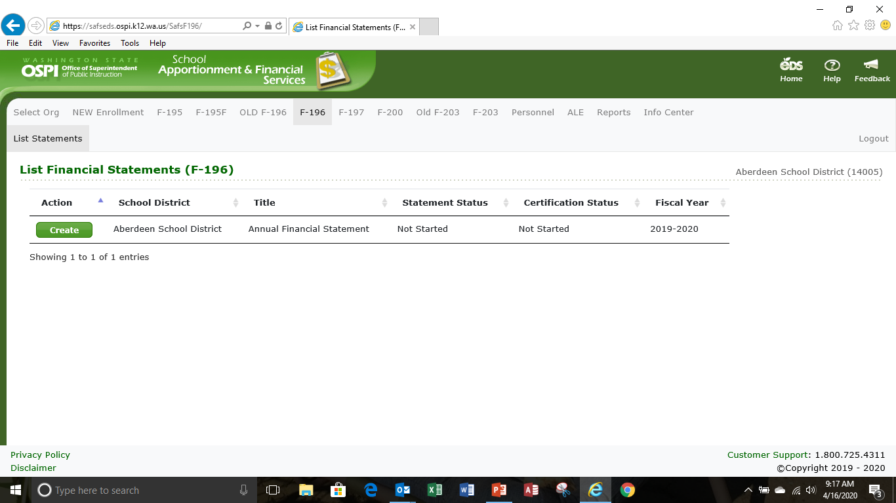
The F-196 Getting Started
The first screen you will see in the F-196 application is the List Financial Statements screen. To start the financial statement, click Create

Slide 9
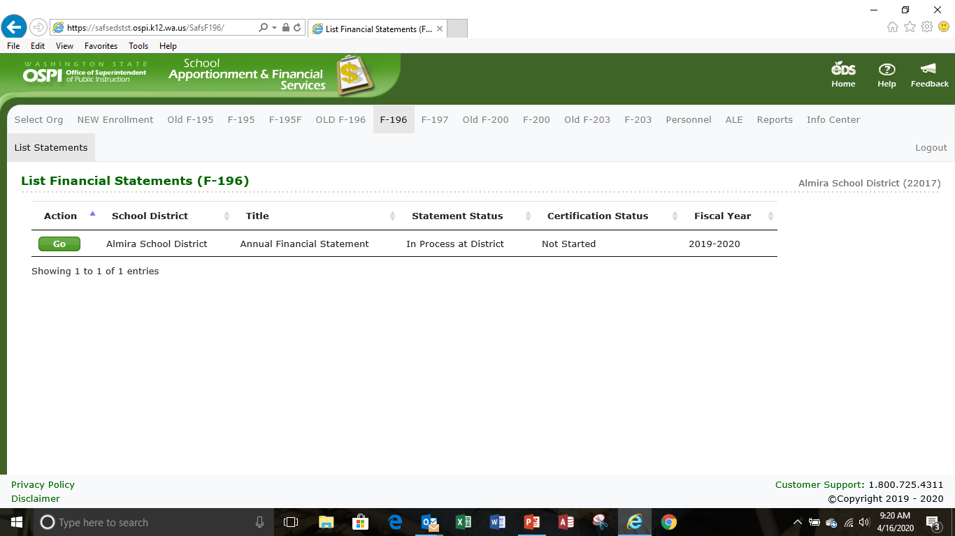
The F-196 Getting Started
The first screen you will see in the F-196 application is the List Financial Statements screen. To create the financial statement, click GO

Slide 10
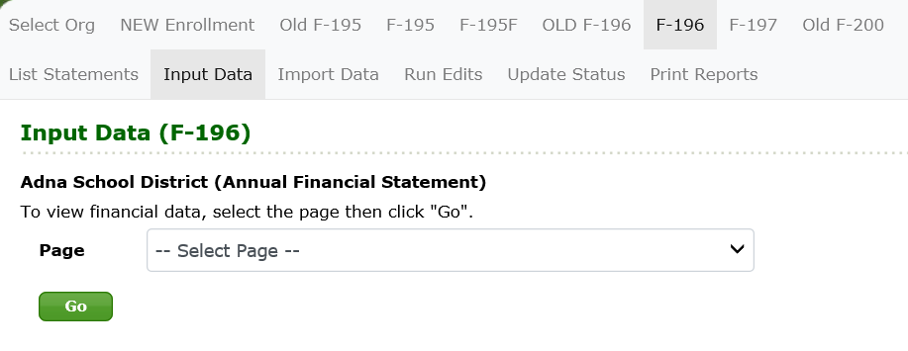
The F-196 Getting Started
When you click Go from the List Statements screen, you are taken to the Input Data screen. To import data into the F-196, click on the Import Data tab in the secondary navigation bar

Slide 11
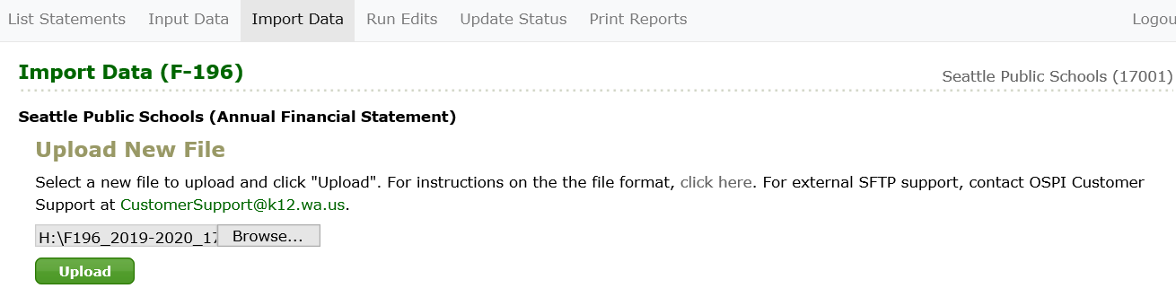
The F-196 Import Data
Select a new file to upload and click “Upload”
Note: If you are a district that uses WSIPC and have not extracted a data file, you will need to do this first before importing. Any data file that meets specifications can be imported. Your service provider can contact us for assistance in setting up files that can be imported.
Notes:
Importing is basically the same way that was done before. If you are not a WSIPC district check with your software provider for file upload instructions. This is very important with the expanded data requirements doing the financial statements by hand entry will be difficult if not impossible.

Slide 12
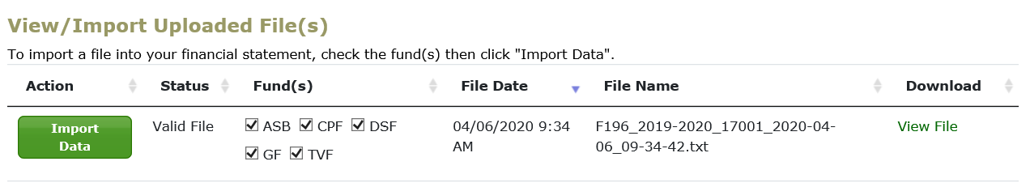
The F-196 Import Data
To import data, check the fund (or funds) that you wish to import and click the Import Financial Data button for that file. The import may take a few seconds. After it is done, you will see a message that says 'Financial statement data imported.'
Notes:
You can do one fund at a time or multiple funds

Slide 13
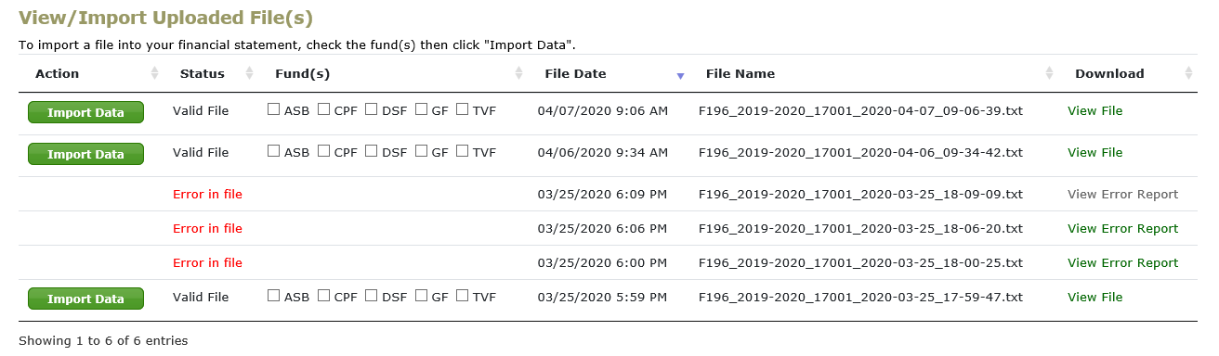
The F-196 Import Data-Error Report
If there is an error in the file it will not import. To see what the problem is click on view error report.
Note: As shown here files can be
Imported multiple times.
Notes:
Most data will be overridden with the new data. Some is saved and not overridden. Make sure you check the data.

Slide 14
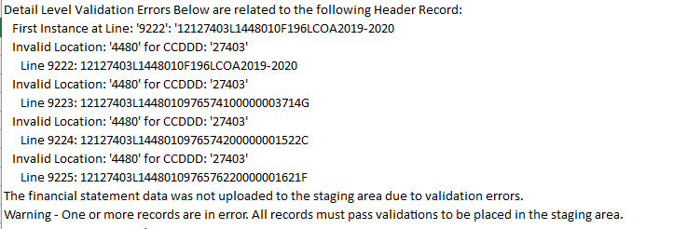
The F-196 Import Data-Error Report
This error report shows that location 4480 is invalid. Incorrect location numbers seem to be the #1 reason for files not importing. Check and make sure that the correct location numbers are being used. In this case the accounting records need to be updated with the correct location number.

Slide 15
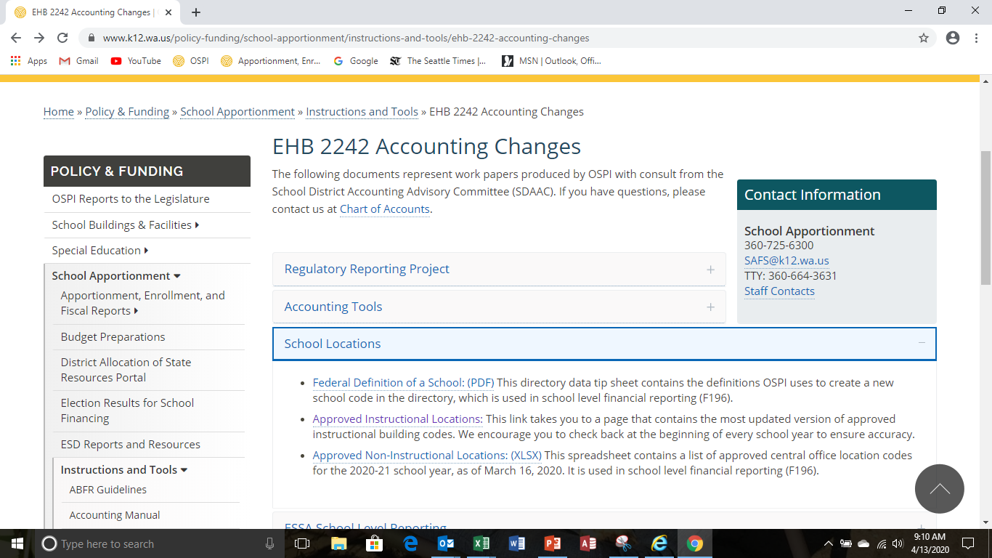
The F-196 Import Data-Error Report
The current instructional and non-instructional location numbers can be found in the EHB 2242 Accounting Changes webpage under school locations.

Slide 16
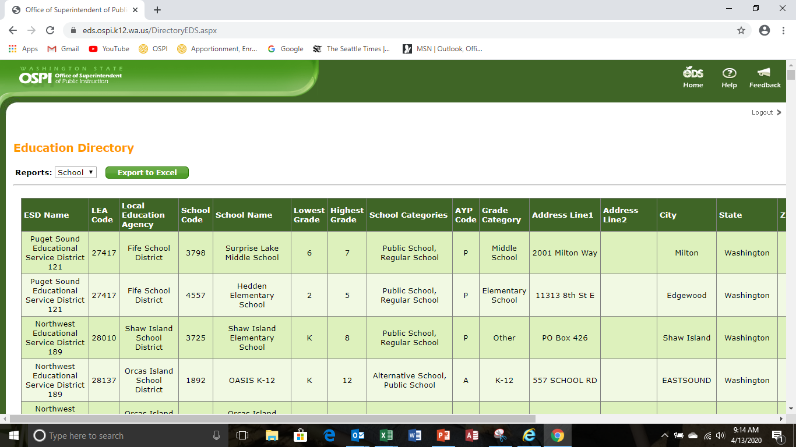
The F-196 Approved Locations
After approved locations is selected, select school in the drop down menu. The listing of schools will appear. Export this to excel and the sort by district to see all the approved instructional locations. Each location will have its own number.
Each district will have one number for all non-instructional locations. See the separate listing for approved non-instructional locations,

Slide 17
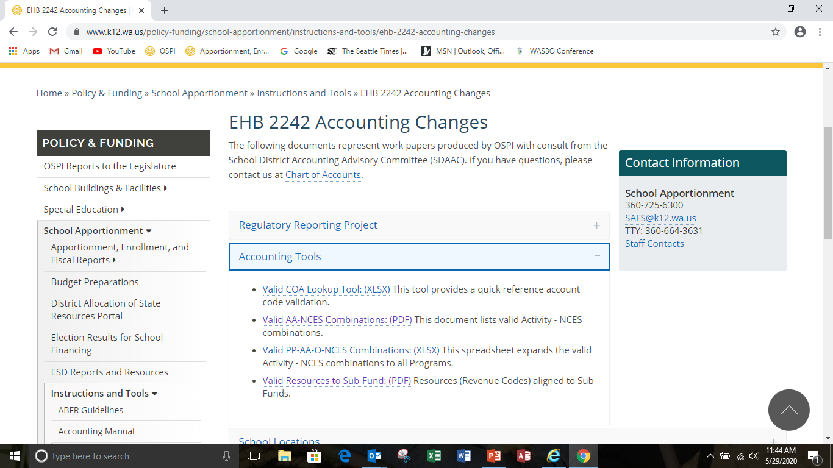
The F-196 Input Data-NCES Code Combo
The second reason why files are not importing correctly is invalid PP/AA/O/NCES code combinations
To review valid code combinations go to the EHB Accounting Changes webpage and select Valid COA lookup tool.

Slide 18
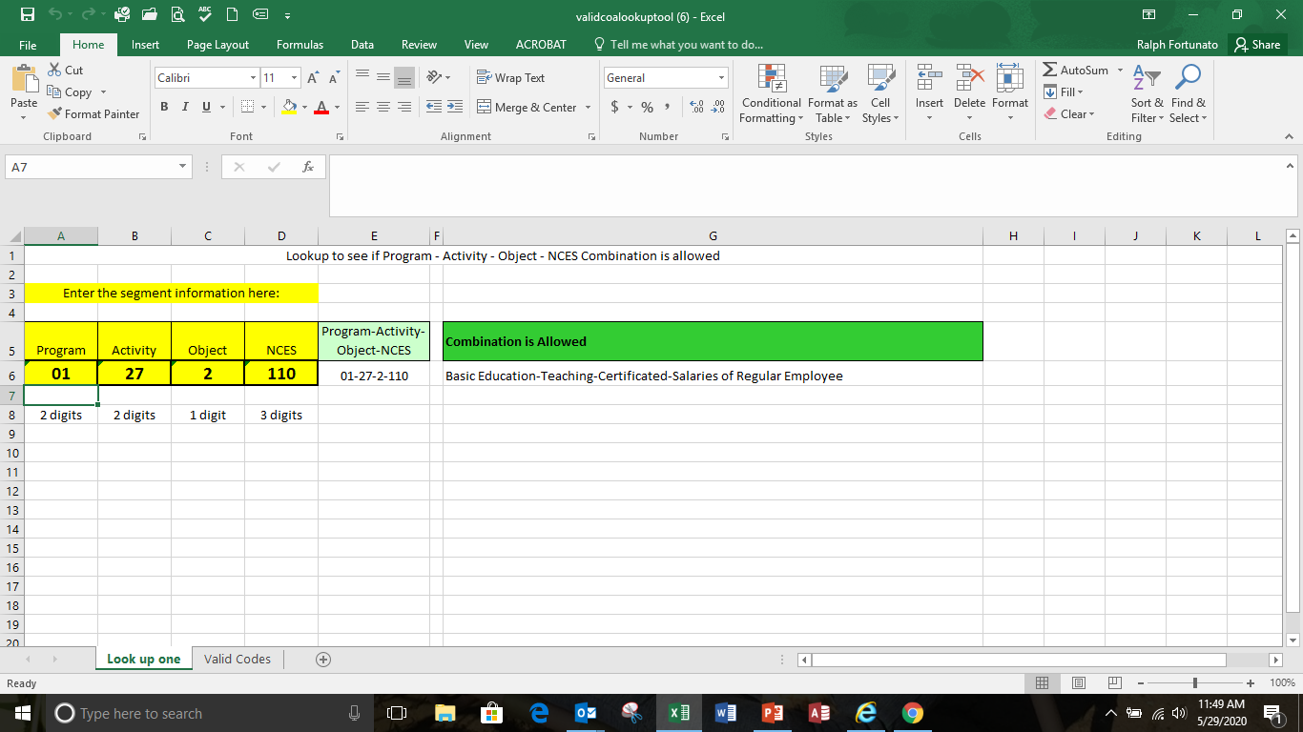
The F-196 Input Data NCES Code Combo
The second reason why files are not importing correctly is invalid PP/AA/O/NCES code combinations
To review valid code combinations go to the EHB Accounting Changes webpage and select Valid COA lookup tool.
Notes:
This is the major change to the F-196. This program matrix is greatly expanded. It is by program, sub-fund and each location. Within the matrix are the activities in the columns and the NCES codes are the rows. This could be entered by hand if there is one or two location and not too many programs other than that entering by hand will be very time consuming if not almost impossible. That is why the data within the system has to be correct for importing. If not, errors will occur and the system will not import. Do not wait until September to make sure your data is correct. The location numbers are listed in the EHB 2242 webpage in the Instruction/Tools section. The instructional location numbers are the ones that are used for P223 reporting. Each district has been assigned one number for non-instructional locations. Make sure non-instructional locations are cross walked to the assigned number.
This data can be downloaded into excel if one desires. Just click on the export button and that page will go to excel in a csv file. One there it can be customized by the user for their needs.
The program matrix in the old F196 is now a report and not an input screen. The data will come from the new program matrix.

Slide 19
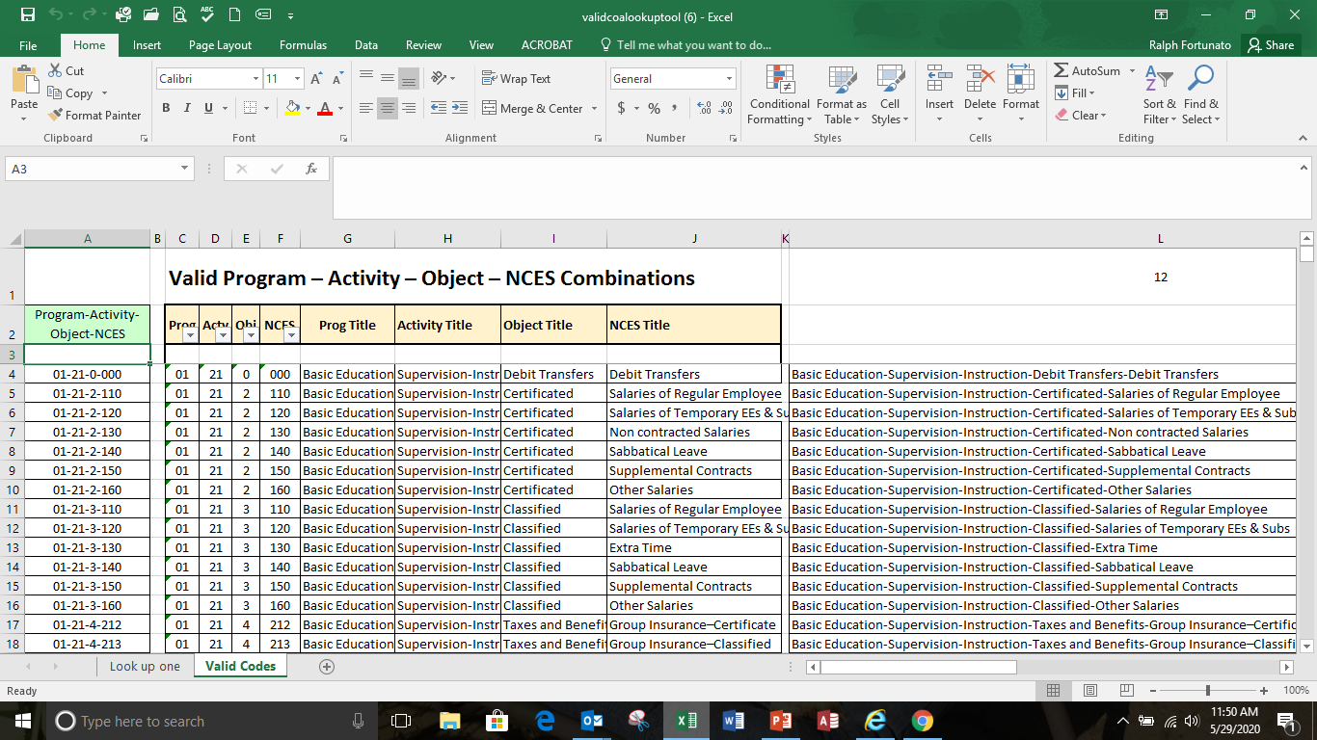
The F-196 Input Data NCES Code Combo
The second reason why files are not importing correctly is invalid PP/AA/O/NCES code combinations
To review valid code combinations go to the EHB Accounting Changes webpage and select Valid COA lookup tool.

Slide 20
Poll Question #1
True or False: You can only import one fund at a time.
  True
  False

Slide 21
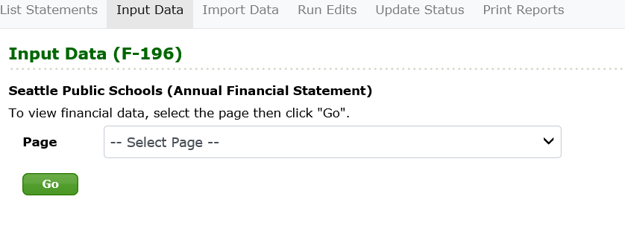
The F-196 Input Data
Click on the Input Data tab in the secondary navigation bar to go to the Input Data screen. Select the page you want in the dropdown, and click the Go button to bring up that page.

Slide 22
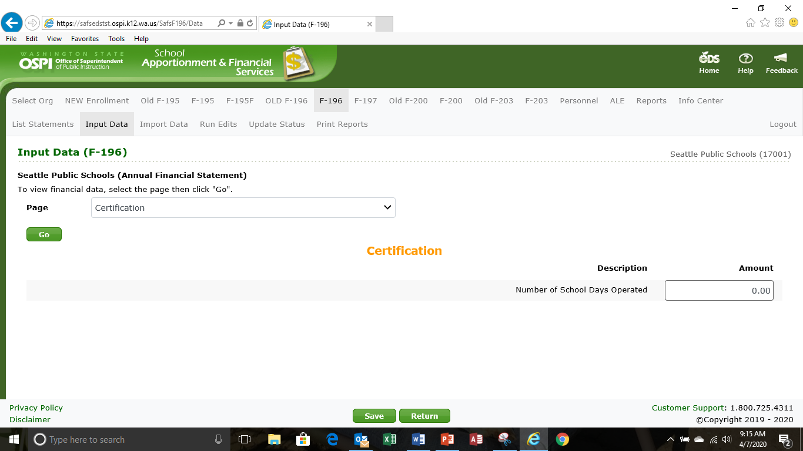
The F-196 Input Data
On the Certification page, indicate the number of school days operated during the school year. Click Save to save your changes.
Note: Data calculations are made when you do a save. It may take a few seconds to perform the calculations and save data (particularly in the General Fund).
Notes:
VERY IMPORTNANT FOR 2019-20. Districts that have a waiver for the number of school days operated from the Washington State Board of Education will enter the number of days school was operated. Send (email attachment) a copy of the waiver letter to Ralph Fortunato at OSPI. These waiver days are not the ones granted by OSPI due to inclement weather or COVID-19. Districts should only enter less than 180 days if they missed days and did not receive a waiver.

Slide 23
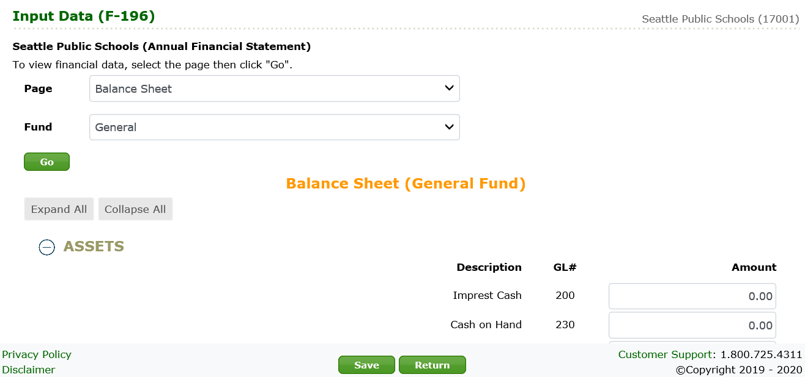
The F-196 Input Data
On the Balance Sheet, enter or update data for each fund. Use the fund drop-down to select a fund, then click Go to bring up that page. Be sure to click Save after making any changes.
Note: Use the Tab key to move forward through the screen fields. Use Shift+Tab to move backward.
Note: For some pages, you must also select the fund

Slide 24
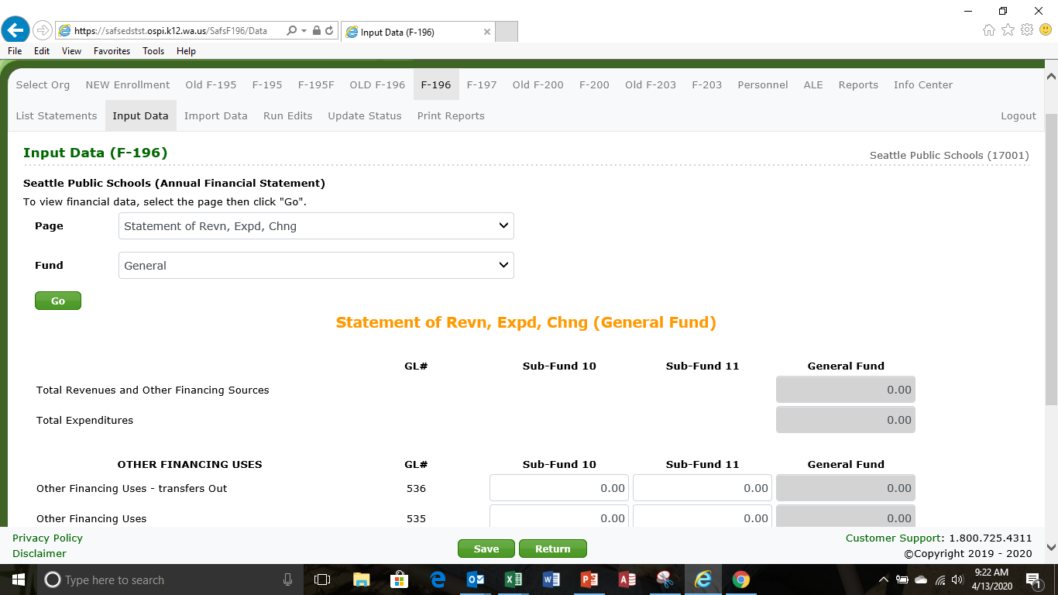
The F-196 Input Data
On the Statement of Revenues, Expenditures and Changes in Fund Balance, enter or update other financing uses, and enter the beginning balance for each fund. For the General Fund enter the amounts for each sub-fund.
Note: Fields with a gray background are display only and show calculated totals.
Notes:
The general fund uses the sub funds. Enter the amounts for each sub-fund. The other funds do not use the sub-funds enter like before

Slide 25
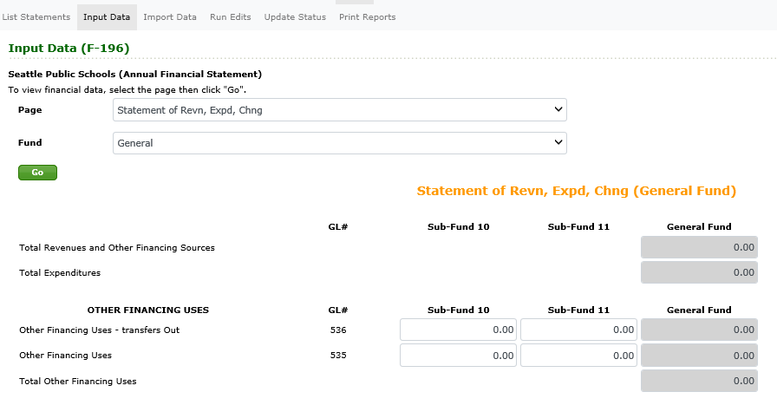
The F-196 Input Data
On the Statement of Revenues, Expenditures and Changes in Fund Balance, enter or update other financing uses, and enter the beginning balance for each fund. For the General Fund enter the amounts for each sub-fund.
Note: Fields with a gray background are display only and show calculated totals.
Notes:
The general fund uses the sub funds. Enter the amounts for each sub-fund. The other funds do not use the sub-funds enter like before

Slide 26
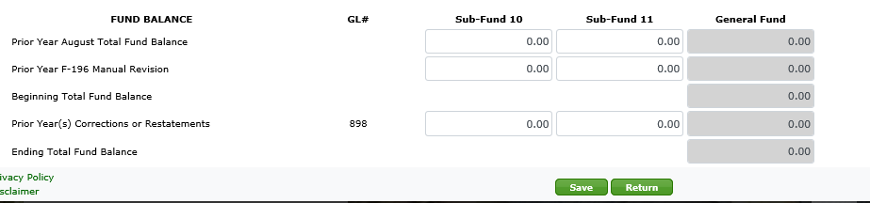
The F-196 Input Data
On the Statement of Revenues, Expenditures and Changes in Fund Balance, enter or update other financing uses, and enter the beginning balance for each fund. For the General Fund enter the amounts for each sub-fund.
Note: Fields with a gray background are display only and show calculated totals.
Notes:
Here is the fund balance section for the statement. For the general fund again enter the amounts for beginning fund balance. Utilize the fund balance reporting tool in helping to determine the beginning fund balance for each sub-fund. In subsequent years this beginning fund balance will be carried over from the previous year.

Slide 27
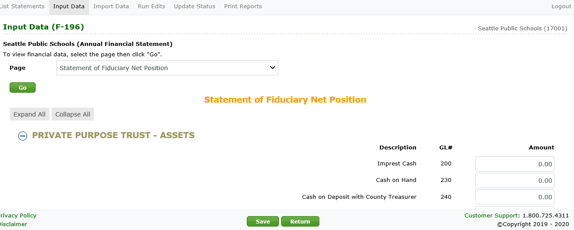
The F-196 Input Data
On the Statement of Fiduciary Net Assets, enter the assets and liabilities for the Private Purpose and Other Trust Funds.
Notes:
. The Fiduciary funds are a manual entry, data will not import.

Slide 28
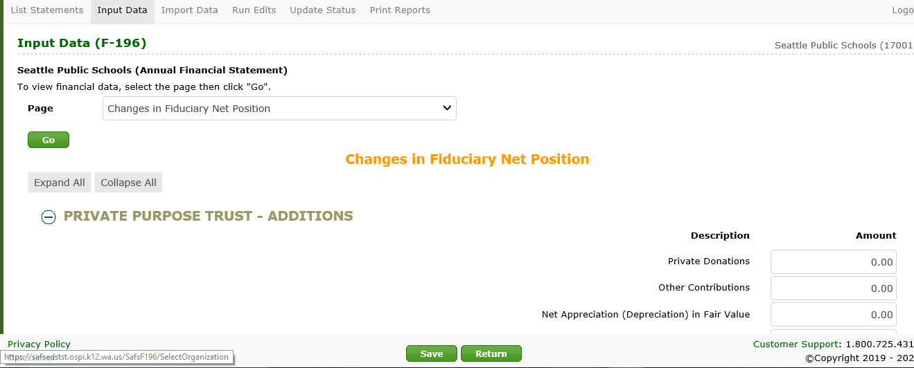
The F-196 Input Data
On the Changes in Fiduciary Net Assets, enter any additions or deletions to the Private Purpose or Other Trust Funds.
Notes:
. The Fiduciary funds are a manual entry, data will not import.

Slide 29
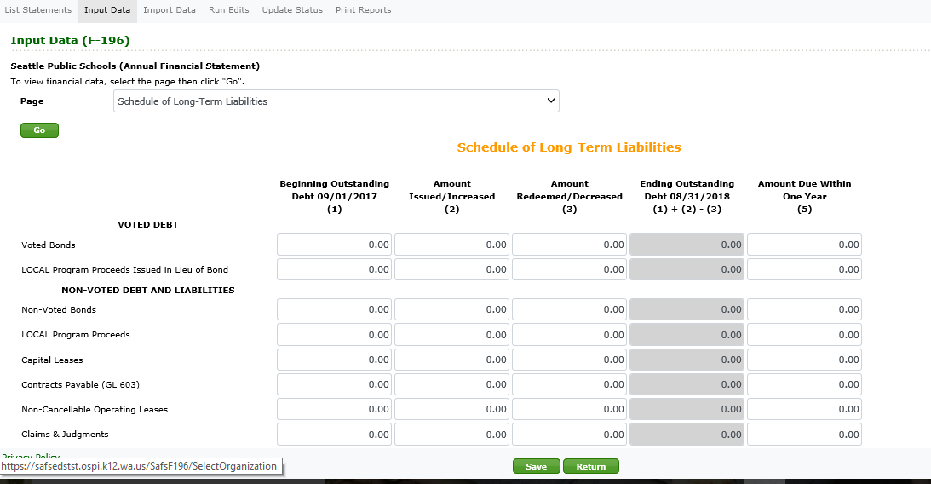
The F-196 Input Data
On the Schedule of Long- Term Liabilities, enter amounts for any bonds or other long-term liabilities.
Notes:
If a manual revision was made to the previous years’ F-196 make sure to enter the revised amount(s) for the beginning outstanding amounts.

Slide 30
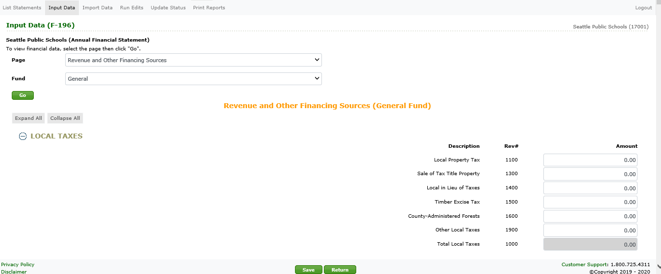
The F-196 Input Data
On the Revenues and Other Financing Sources, enter or update revenue amounts for each fund.
Notes:
In Other Financing Sources transfers have been broken down. 9900 is for redirection of apportionment and 9901 is for other resources. These are now in the general, debt service, capital projects and transportation vehicle funds.

Slide 31
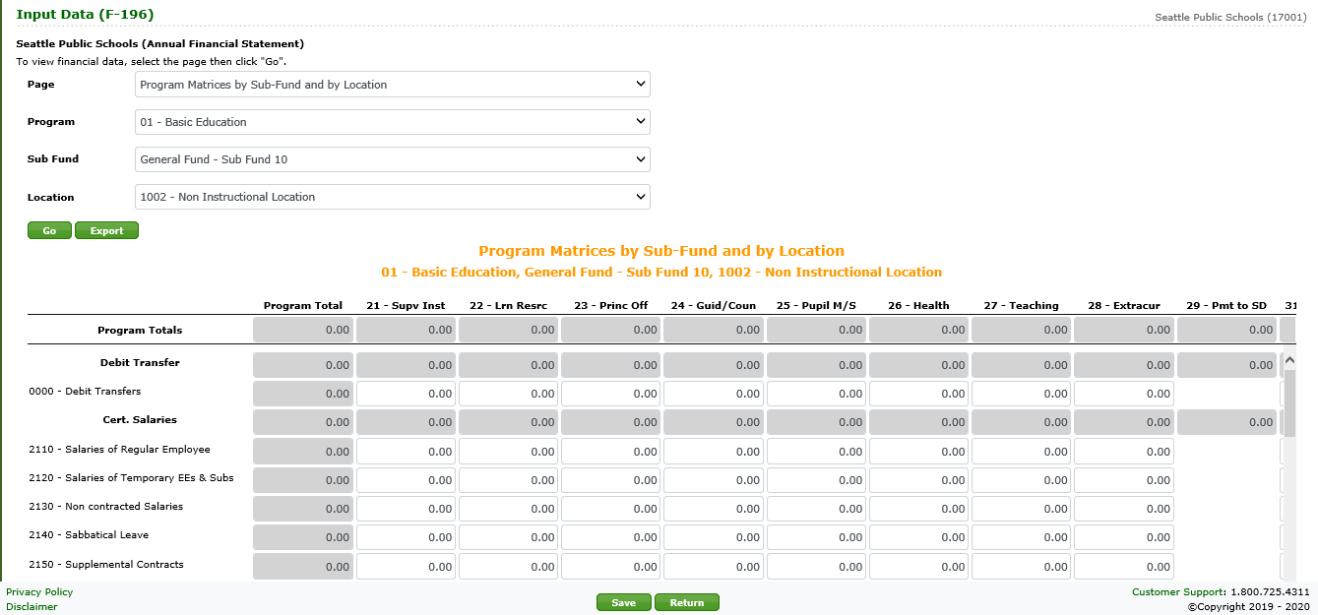
The F-196 Input Data
On the Program Matrices, enter or update the expenditures for each program activity and object/NCES in each location and sub-fund. To go to another program, use the dropdown to select the program, sub-fund, location and click Go. The data can be exported to an excel csv file by clicking the export button
Notes:
This is the major change to the F-196. This program matrix is greatly expanded. It is by program, sub-fund and each location. Within the matrix are the activities in the columns and the NCES codes are the rows. This could be entered by hand if there is one or two location and not too many programs other than that entering by hand will be very time consuming if not almost impossible. That is why the data within the system has to be correct for importing. If not, errors will occur and the system will not import. Do not wait until September to make sure your data is correct. The location numbers are listed in the EHB 2242 webpage in the Instruction/Tools section. The instructional location numbers are the ones that are used for P223 reporting. Each district has been assigned one number for non-instructional locations. Make sure non-instructional locations are cross walked to the assigned number. The data can be exported to an excel csv file by clicking the export button.
This data can be downloaded into excel if one desires. Just click on the export button and that page will go to excel in a csv file. One there it can be customized by the user for their needs.
The program matrix in the old F196 is now a report and not an input screen. The data will come from the new program matrix.

Slide 32
Poll Question #2
True or False: The number one reason for files not importing correctly is incorrect location numbers.
  True
  False

Slide 33
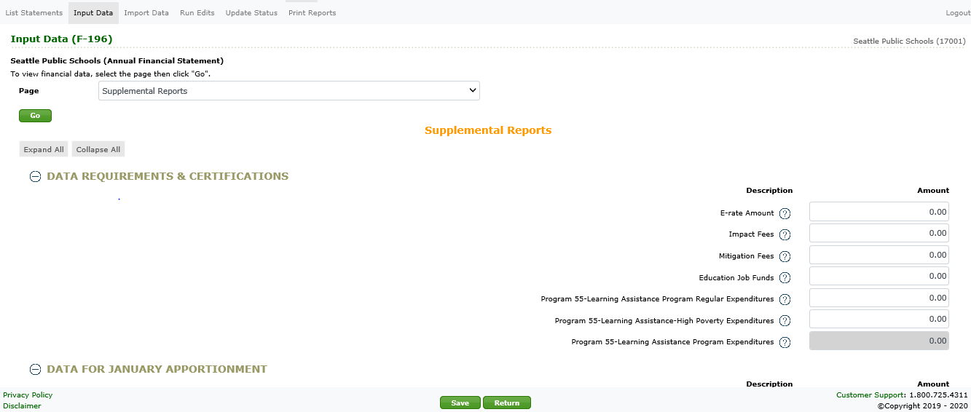
The F-196 Input Data
On the Supplemental Reports, enter or update data as appropriate.

Slide 34
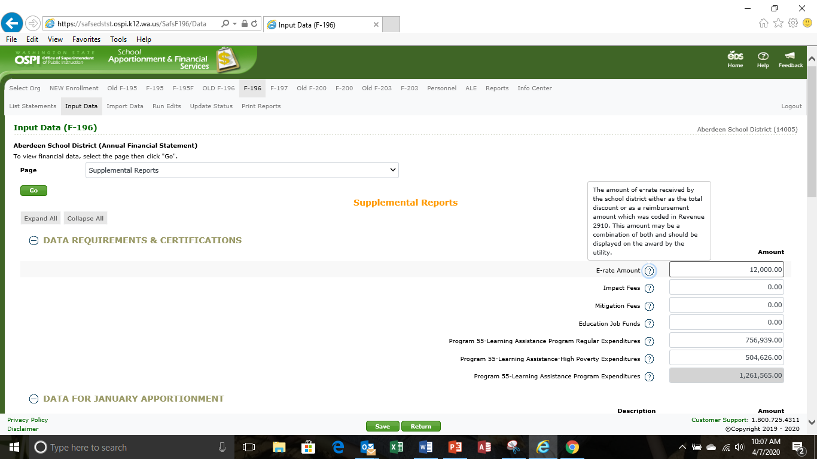
The F-196 Input Data
If you need more information about what data should be entered for an item, click the question mark next to the item description and a block of text will display with more details. Click the description again to hide the text.

Slide 35
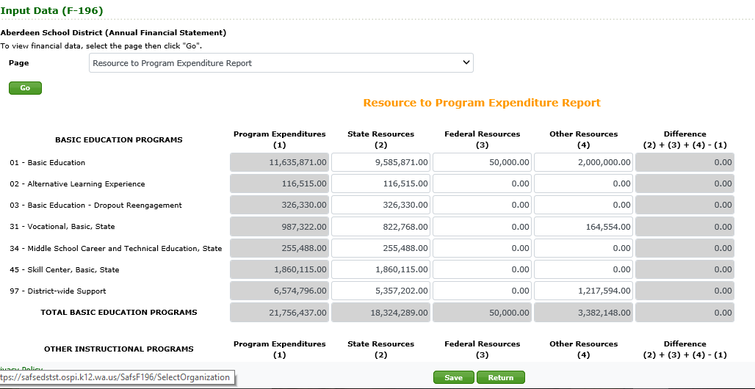
The F-196 Input Data
On the Resource to Expenditure Report, enter the state, federal, and other resources for each program.
Note: When you enter state, federal, or other resources and click 'Save', the difference column is calculated. The difference must be zero to pass edits.
Notes:
The resource to program expenditure report show the color of money. The sub-funds do not play a part here. If it is a state dollar then it belongs in the state resources column. For example., LEA is in sub-fund 11, however, in this report it belongs in the state resource section since it is a state dollar. The same goes with federal funds.

Slide 36
Poll Question #3
In the Resource to Program Expenditure Report, how is Local
Effort Assistance Classified?
  Federal Resources
  Other Resources
  State Resources
  None of the above, since not all districts receive Local Effort Assistance

Slide 37
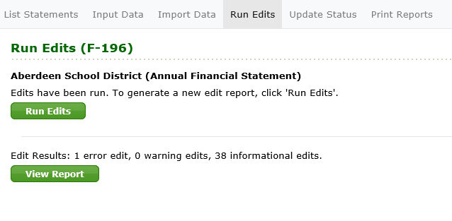
The F-196 Run Edits
To run edits, click the Run Edits button. It may take a few seconds for this process to run. After it does, the status column will show the number of information and error edits found. To see the results, click the View Report button. It may take another few seconds for the report to display
Note: You can run edits at any time. This can be done after importing data, or it can be done later.

Slide 38
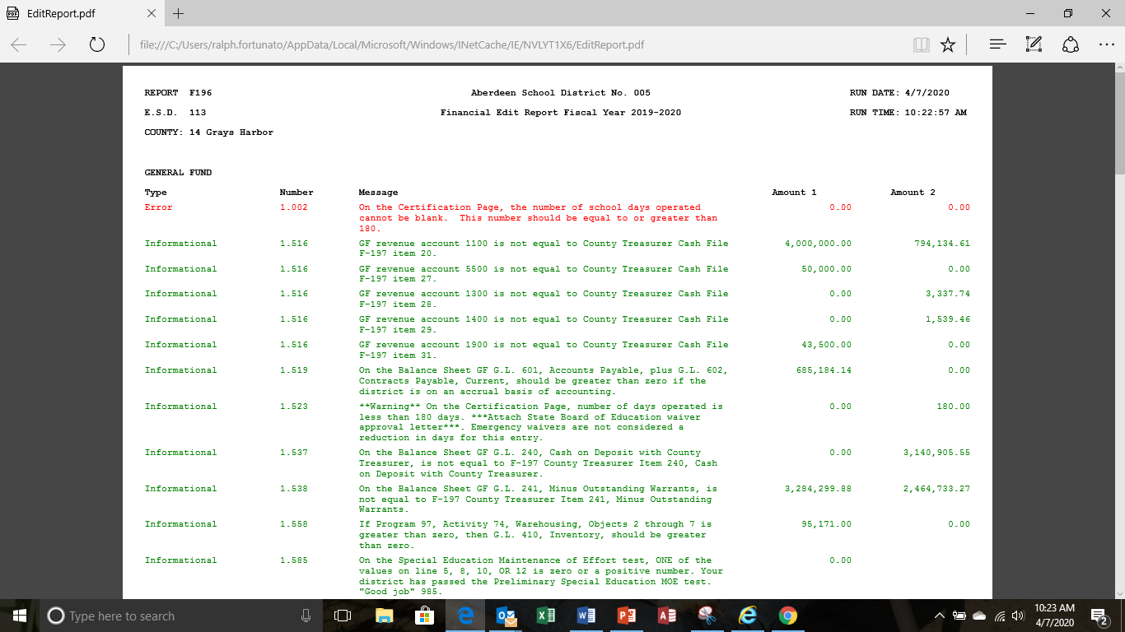
The F-196 Run Edits
The edit report displays within a report viewer frame. You can review the information online it will default to a pdf that can be printed.
Notes:
All error edits have to be cleared before the F196 is transmitted to OSPI

Slide 39
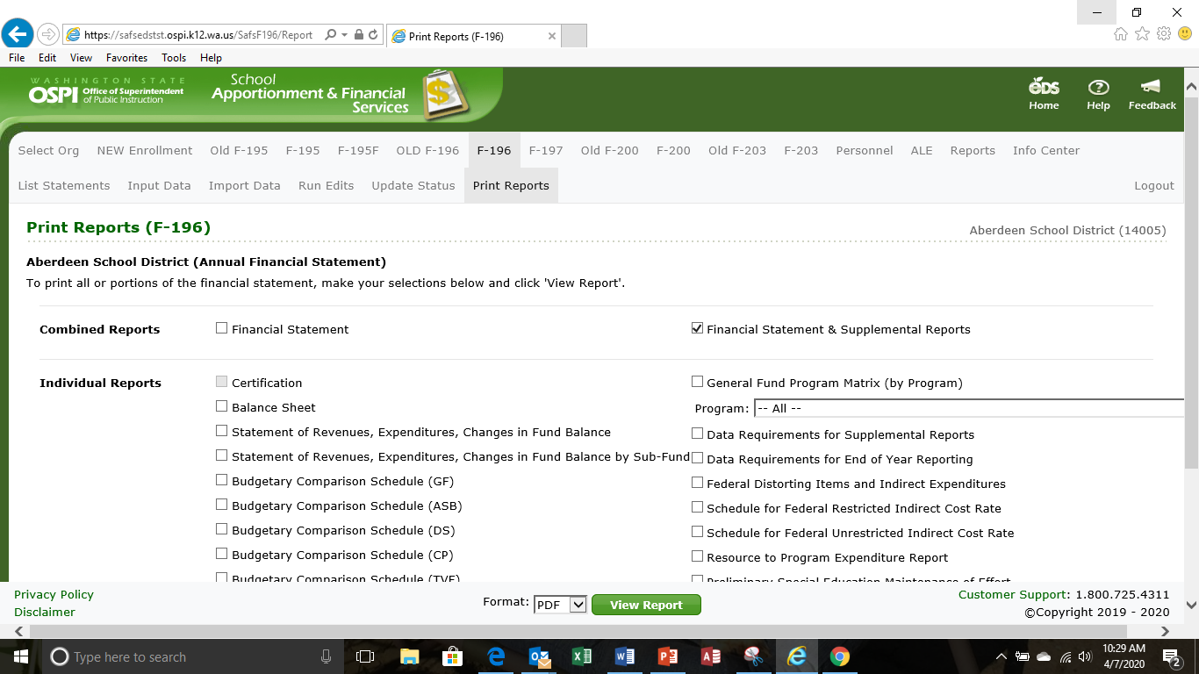
The F-196 Print Reports
To print the financial statement, click the Print Report tab in the secondary navigation bar. You can print all or portions of the financial statement. Check the box (or boxes) you want and click View Report. If you print the entire financial statement, it may take a few seconds for the report to display. Note: The Certification page is grayed out and cannot be printed until the status is 'Ready for OSPI review'.

Slide 40
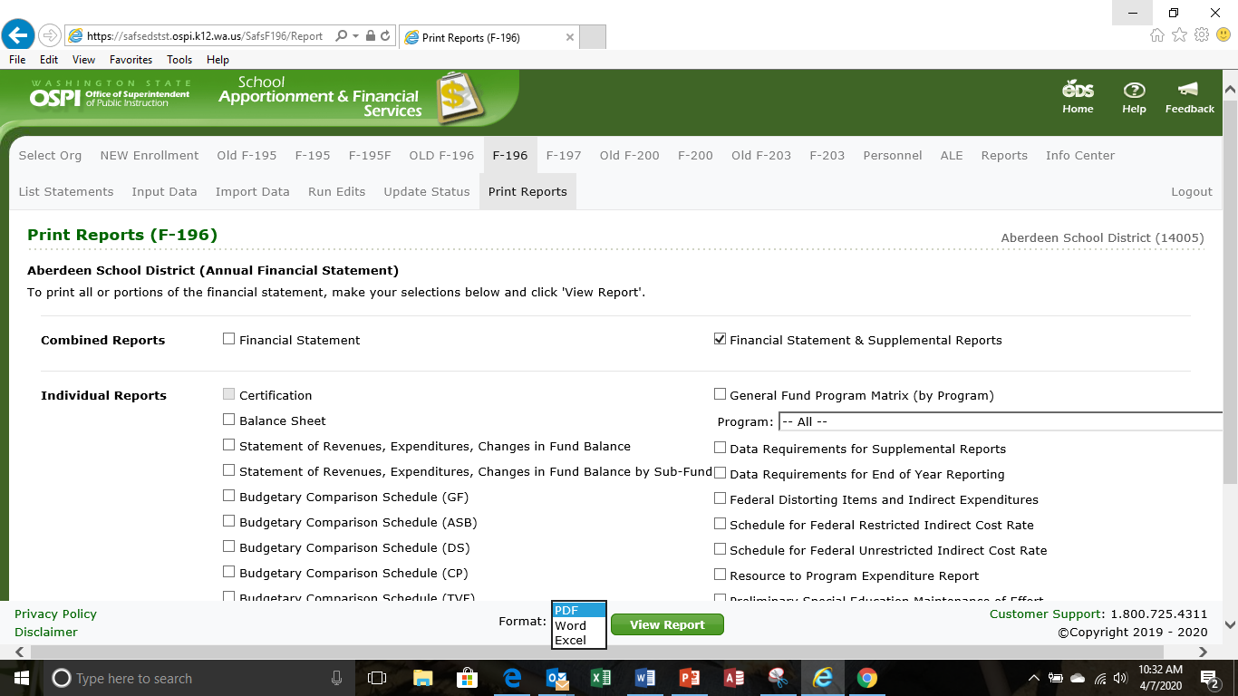
The F-196 Print Reports
To print the financial statement, click the Print Report tab in the secondary navigation bar. You can print all or portions of the financial statement. PDF is the default for printing, however, reports can be printed In Word and Excel formats.

Slide 41
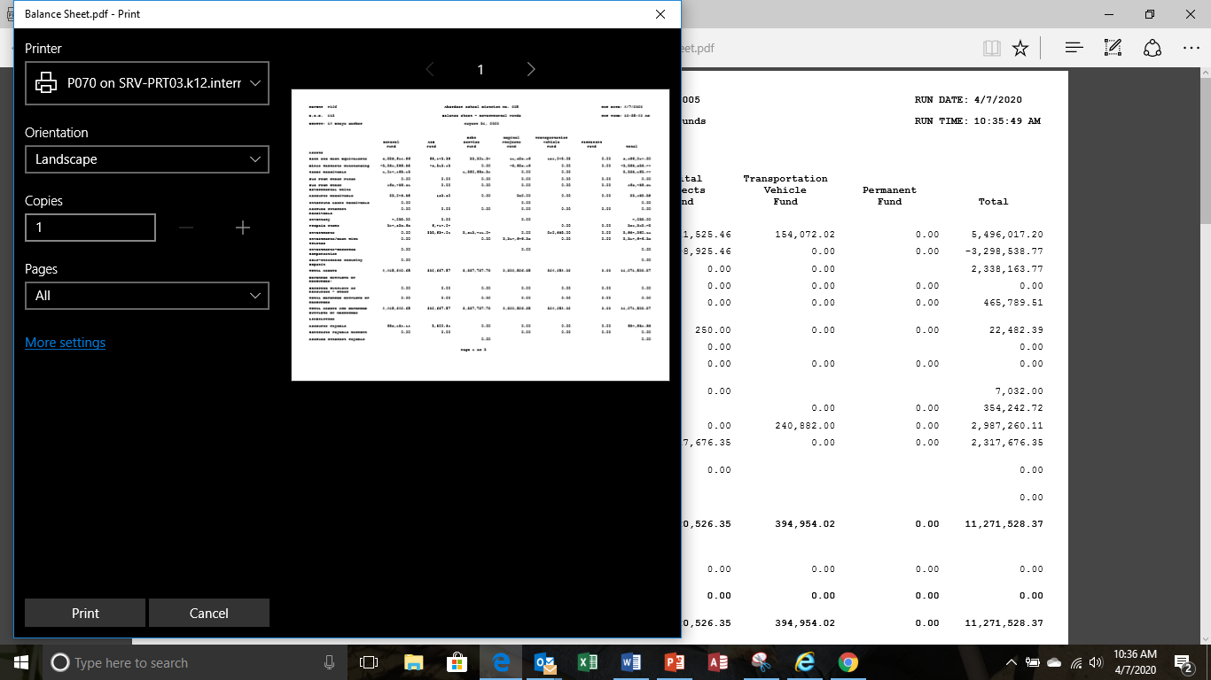
The F-196 Print Reports
To print a paper report, select the printer, orientation, and number of copies. Click OK to print the report. Go to more settings if you want to print on both sides of the page to save paper.

Slide 42
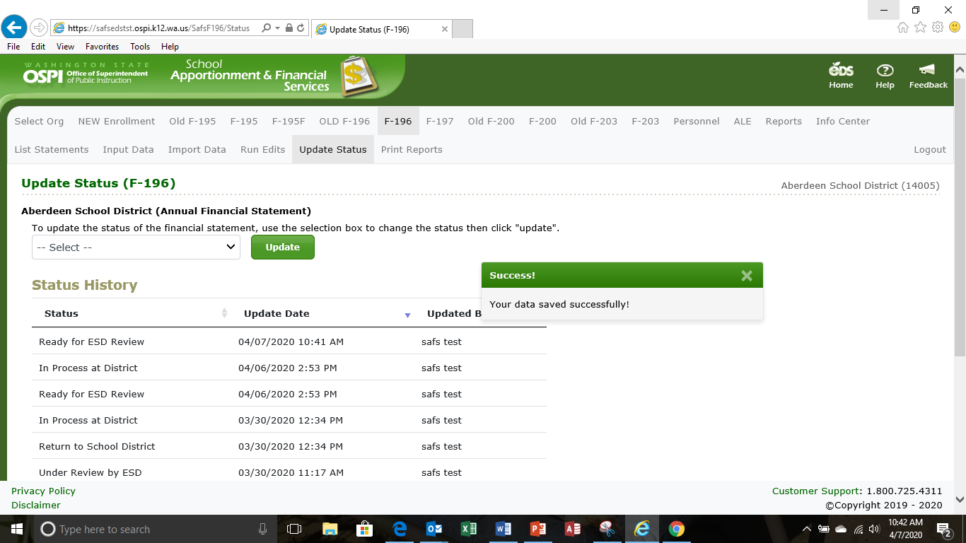
The F-196 Update Status
Click the Update Status tab in the secondary navigation bar to go to the Update Status screen. From the drop down arrow select the status change and click update. The screen displays a history of changes – each prior status, the date the status was changed, and the user who made the change.

Slide 43
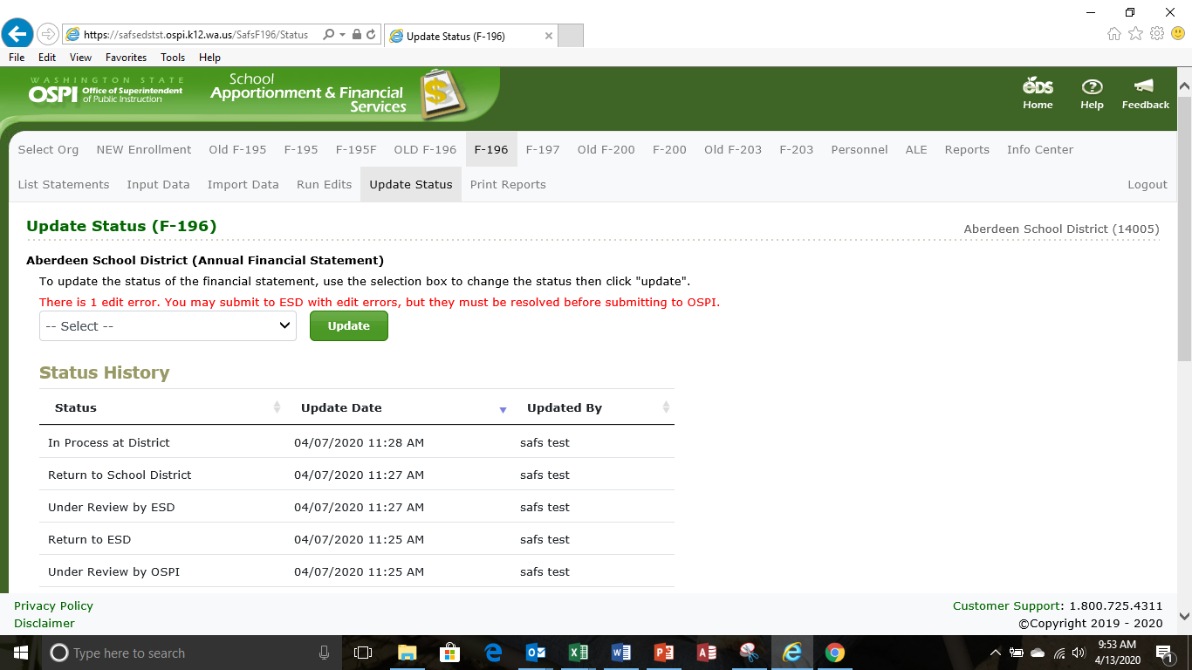
The F-196 Update Status
The F-196 may be submitted to the ESD with errors, however, all error edits must be cleared before submission to OSPI.

Slide 44
Poll Question #4
True or False: The F-196 file can be submitted to the ESD with errors.
  True
  False

Slide 45
The F-196 Certification Process
When status is changed to “Ready for OSPI Review” the certification is ready for the electronic signature via DocuSign.
There is a new role for those who can sign the certification page. An organization should have more than one person authorized to sign.
The certification page will be visible to SD and ESD users who have that role.

Slide 46
The F-196 Certification Process
Email Notifications:
  When status is changed to “Ready for OSPI Review” SD users with certify role will be notified.
  ESD users with certify role will be notified when status is “Ready for OSPI Review” and SD had signed.
District will sign the page before ESD.
ESD signs then F-196 goes to OSPI
Certification must start over every time financial statement status is changed (Return to ESD, Return to District)

Slide 47
The F-196 Certification Process
Signed certification page is frozen/locked when status is changed to “Accepted by OSPI.”
For any revisions to the F-196 a paper signed certification page will be submitted.

Slide 48
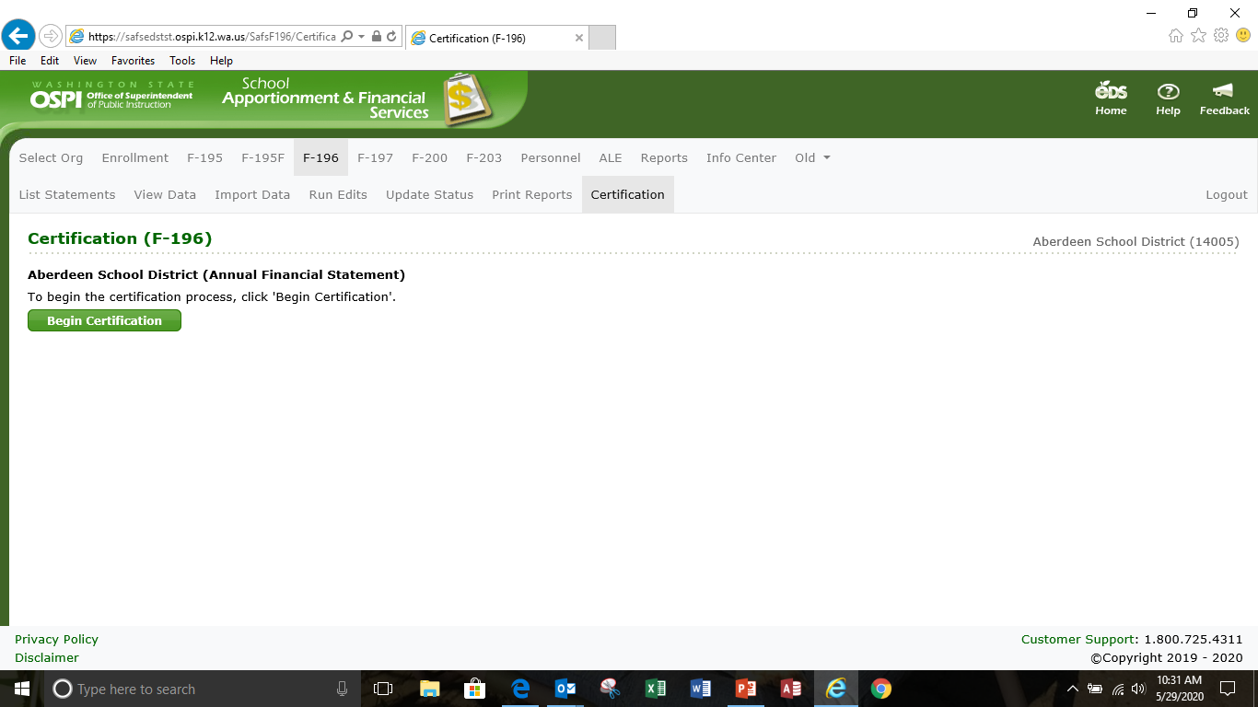
The F-196 Certification Process
Click on certification tab in the secondary navigation bar to begin the process, then click Begin Certification

Slide 49
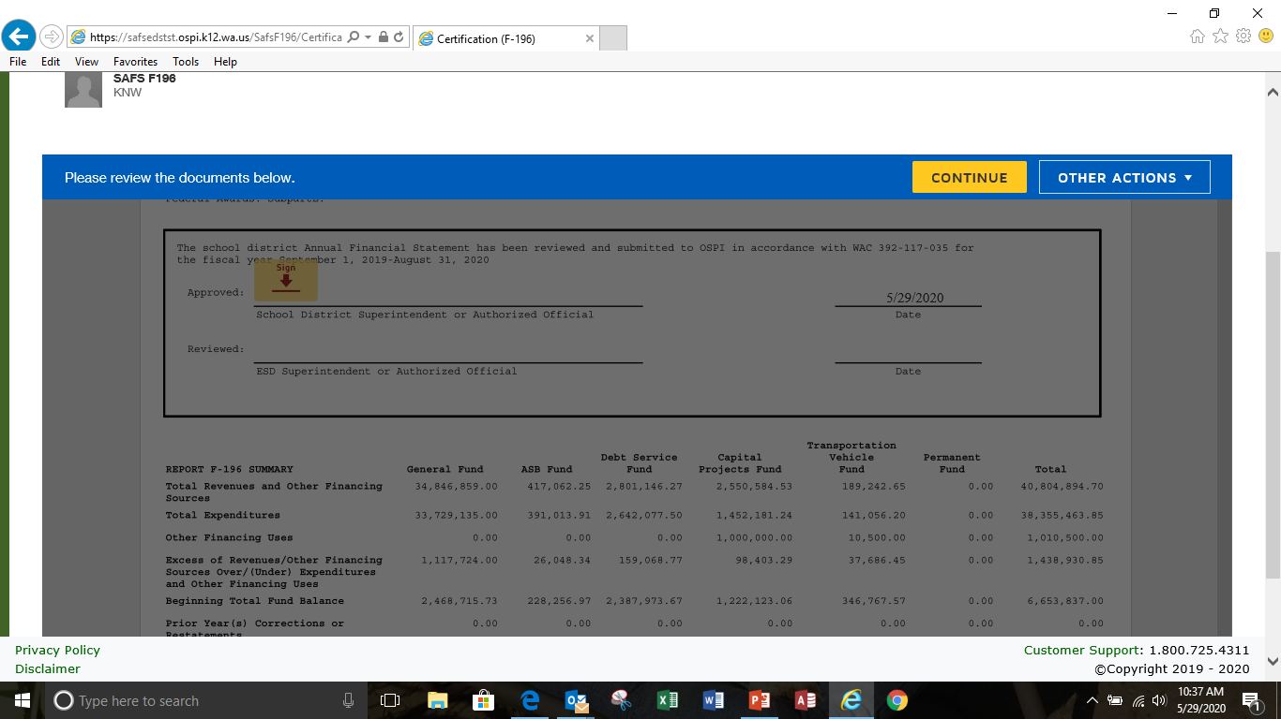
The F-196 Certification Process
  Authorized signer will then click on continue

Slide 50
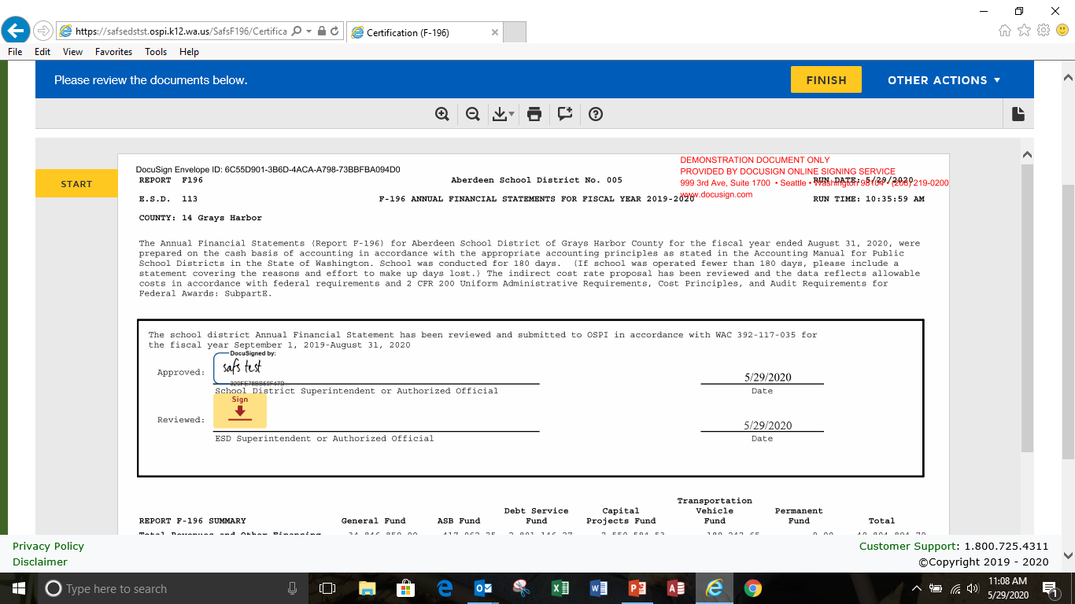
The F-196 Certification Process
  Authorized signer will then click start and then sign the certification page

Slide 51
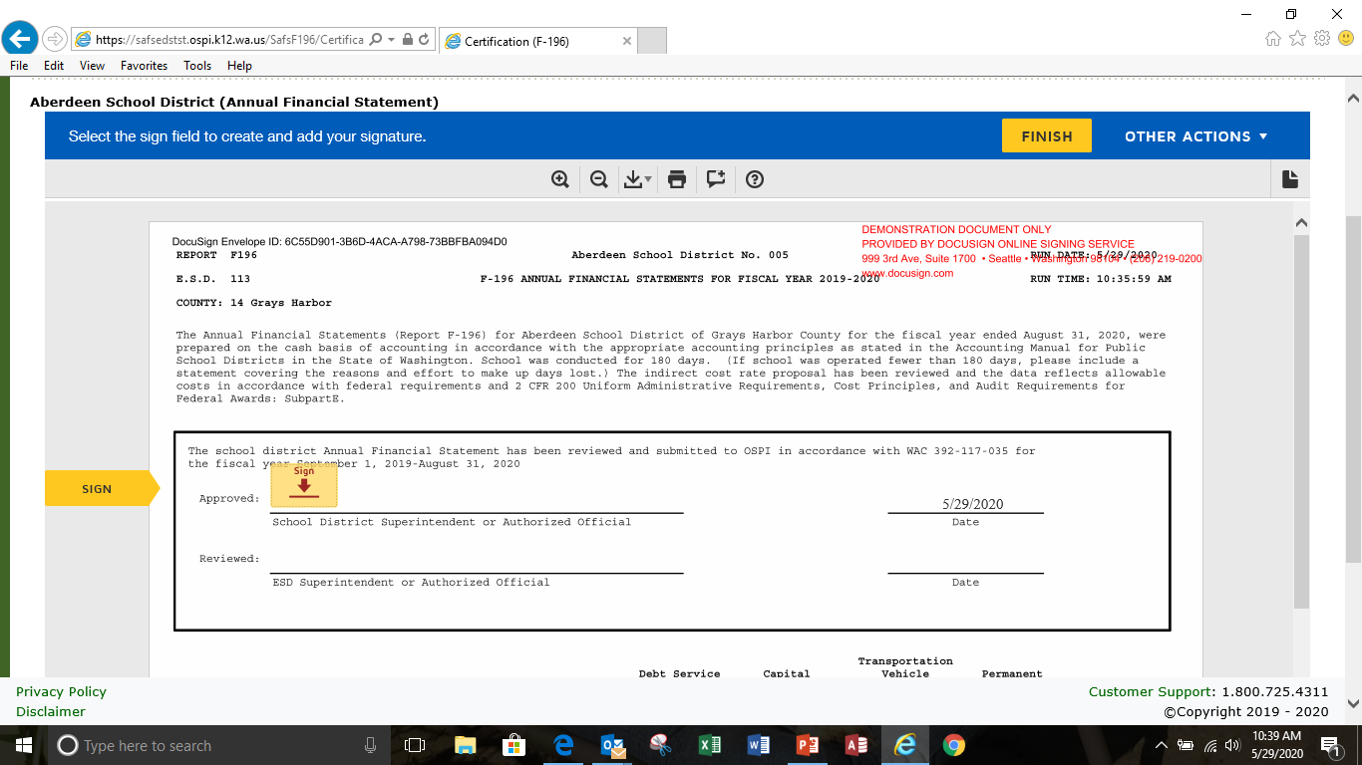
The F-196 Certification Process
  Authorized signer will then click start and then sign the certification page

Slide 52
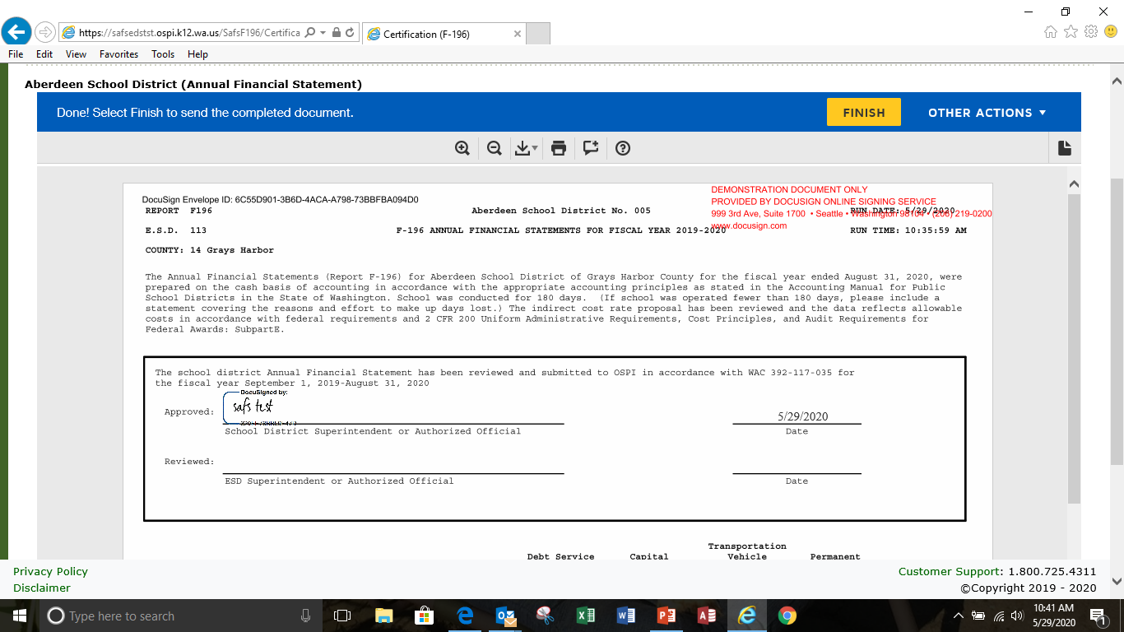
The F-196 Certification Process
  Authorized signer signature will appear on the signature line, then click finish

Slide 53
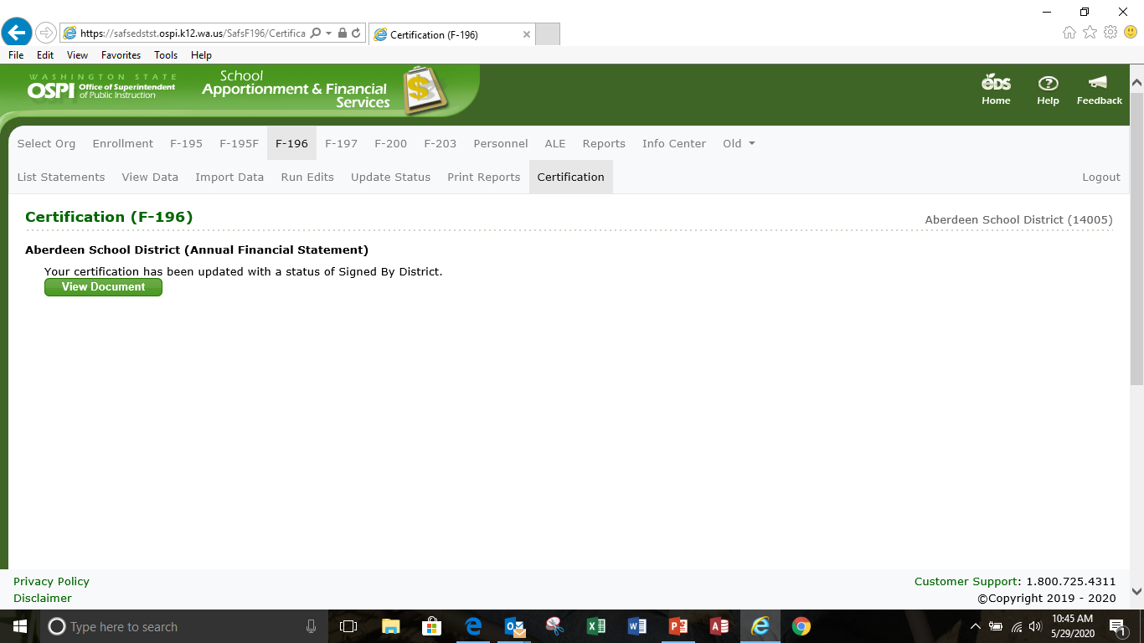
The F-196 Certification Process
  The certification process is complete for the district, the ESD now will certify.

Slide 54
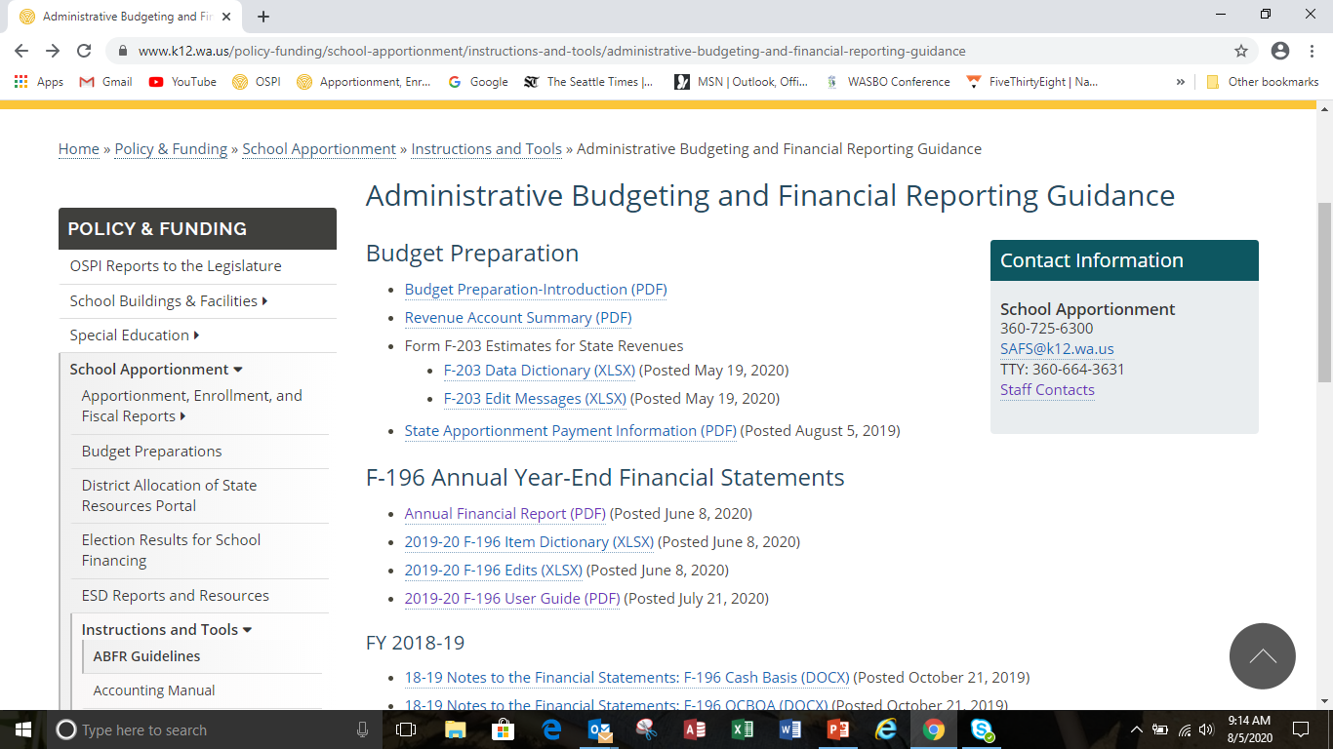
F-196 Additional Resources

Slide 55
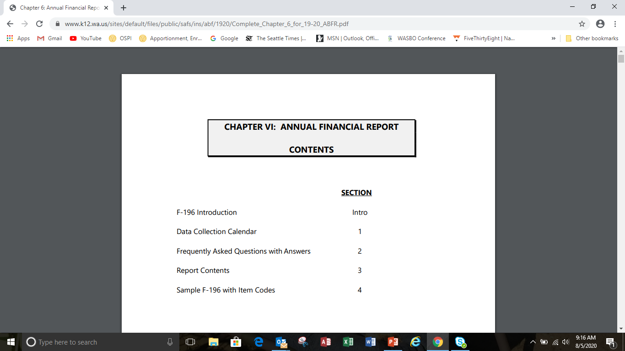
F-196 Additional Resources

Slide 56
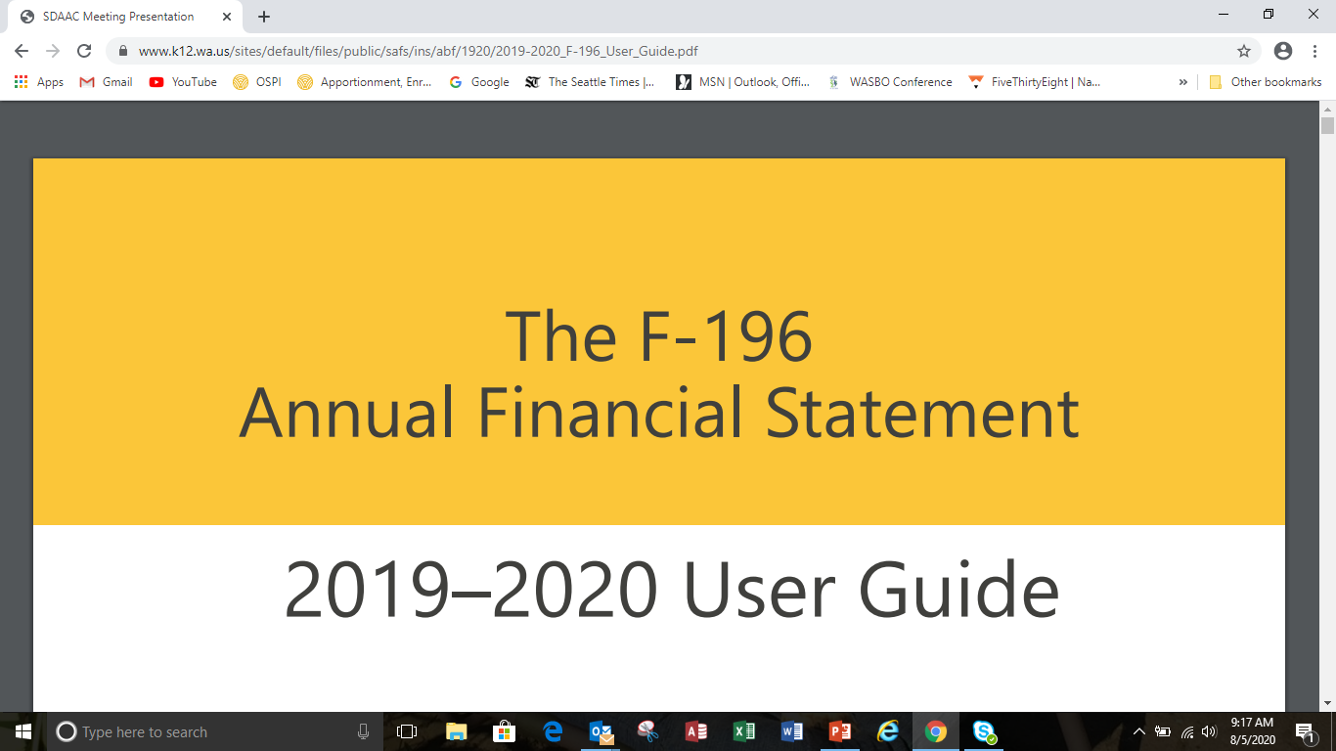
F-196 Additional Resources

Slide 57
Notes to the Financial Statements

Slide 58
Notes to the Financial Statements
Notes are not part of the F-196 and thus not submitted to OSPI.
The Notes become part of the district’s financial statement and subject to
audit.
They are essential in explaining significant accounting policies and circumstances.
The are the responsibility of the district
ABFR Handbook has the note templates
    Delete notes that do not apply-you do not have to use every note
    Note templates are considered the minimum requirement for disclosure
    Should not include negative disclosures such as“District had no subsequent events.”
Chapter 8 of the accounting manual for more information.

Slide 59
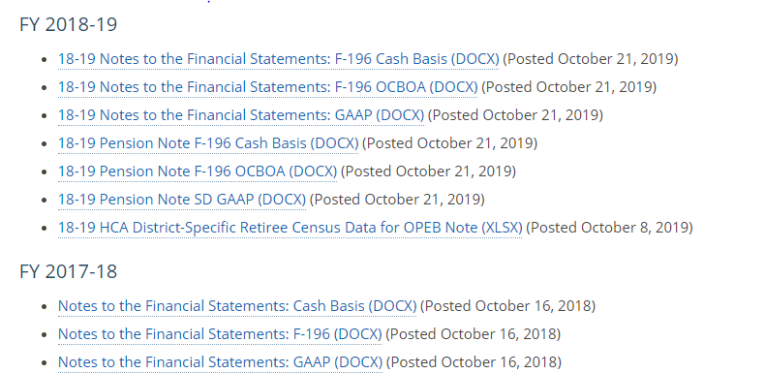
Notes to the Financial Statements
Administrative Budgeting and Financial Reporting Guidance

Slide 60
Poll Question #5
True or False: The Notes to the Financial Statements must be submitted to OSPI.
  True
  False

Slide 61
F-196 Final Thoughts
  Utilize the fund balance reporting tool to help determine the beginning fund balances for general fund sub-funds.
  Check PP/AA/O/NCES code combinations-no 2000, 3000 etc., check the crosswalks
  Check for correct instructional and non-instructional numbers.

Slide 62
WASBO Year End Workshop
Ralph Fortunato
Supervisor, School District Financial Reporting
360-725-6304
Email: Ralph.Fortunato@k12.wa.us
The School Financial Services Update of Accounting Changes, prepared by the Office of Superintendent of Public Instruction is licensed under a Creative Commons Attribution 4.0 International License

