Slide 1
Washington State Science Assessment Updates
WSTA/OSTA Conference
October, 2020
Notes:
Hello, and welcome to this WSTA/OSTA presentation about updates to the Washington State Science Assessment, which is called the Washington Comprehensive Assessment of Science, or WCAS.

Slide 2
Land Acknowledgement
School District & Nearest Federally Recognized Tribes
Washington Tribes Map
Notes:
We would like to acknowledge that the science team is facilitating today’s session on the traditional lands of the Squaxin Island Tribe.
We acknowledge the Tribes commitment to the resurgence of their traditional ways and their respect and protection of all people, not only those who are living, but also those who have gone before and who are yet to be born. We pay our respect to the elders both past and present and to the valued resource the Tribe has defined as their children. They are the Tribes future.
We ask that the participants of this meeting also honor the Tribal lands on which each of you are located today.
A resource you might consider for your location are the linked School District & Nearest Federally Recognized Tribes document or the Washington Tribes map.
Best practice is for districts to engage in tribal consultation with the tribes nearest their district to determine their historical lands. Each tribe are the experts of their history.

Slide 3
Science Assessment Office Staff
General e-mail account
science@k12.wa.us
Dawn Cope—Science Assessment Lead
dawn.cope@k12.wa.us
Jacob Parikh—Science Assessment Specialist
jacob.parikh@k12.wa.us
Korey Peterson—Science Assessment Specialist
korey.peterson@k12.wa.us
Jessica Cole—Program Specialist
jessica.cole@k12.wa.us
Notes:
My name is Dawn Cope, and I am the Science Assessment Lead at OSPI, and I am joined by the rest of the science team. The science team consists of Jacob Parikh and Korey Peterson, both Science Assessment Specialists and Jessica Cole, our Program Specialist.
The slide contains our contact information. If you have questions for us, please email the general science assessment email account

Slide 4
Welcome!
Who is with us today?
Please take a moment to introduce yourself using the Chat function.
Name, Location (City, State), Role
Example: Korey, Centralia, WA, Science Assessment Specialist
Notes:
Who is with us today?
Please take a moment to introduce yourself using the Chat function.
Name, Location (City, State), Role (e.g., 5th grade teacher, middle school principal, HS physics teacher)

Slide 5
Logistics
Presentation
Questions, Comments
Evaluation
Notes:
Today’s presentation will be available through WSTA/OSTA following the conference.
We will also post the PPT, with notes, to the OSPI science assessment website. We’ll need about a week to make sure the presentation is ADA compliant.
Please be sure to add questions and comments using the Chat function. We’ve built several pauses into the presentation where we can address them.
Please complete the evaluation that will be made available to you at the end of this WSTA/OSTA session.

Slide 6
Today’s Topics
Current State Science Tests
WCAS Design
WCAS Development
WCAS Features
Assessment Resources
Notes:
Today we are going to talk about:
Current State Science Tests,
The WCAS Design, Development Cycles, and Online Features, with a focus on how the science team incorporates best practices to make the tests as equitable and as accessible as possible,
And where to find Science Assessment Resources

Slide 7
Current State Science Tests

Slide 8
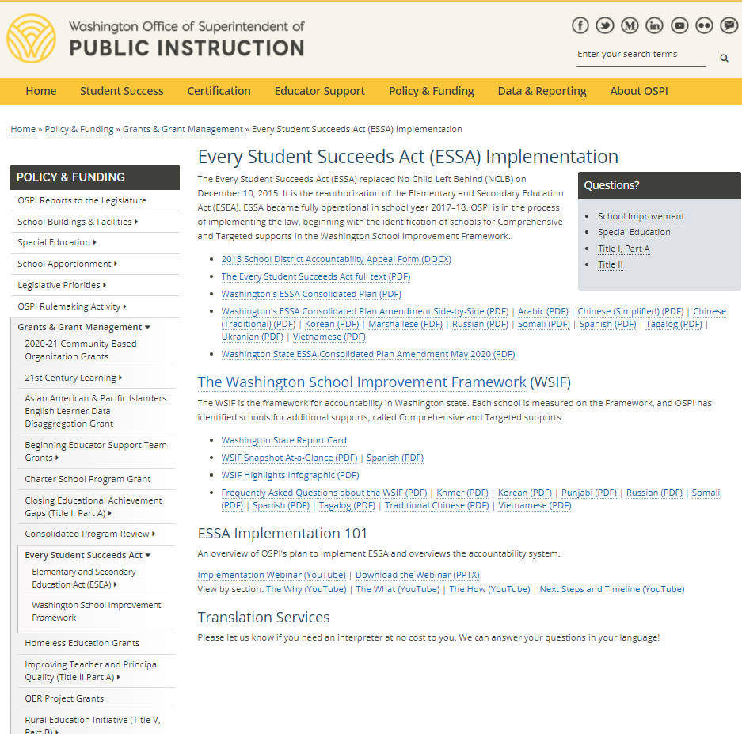
Why do we have state tests?
Every Student Suceeds Act
Notes:
The Every Student Succeeds Act (ESSA) replaced No Child Left Behind (NCLB) in late 2015. ESSA continued the NCLB requirement that we administer a state science test once in elementary school, once in middle school, and once in high school.
We have added a link to the part of the OSPI website that include information on ESSA.
State law directs that a comprehensive science test is administered in grades 5, 8, and 11, and the Washington Comprehensive Assessment of Science (WCAS) fulfills this requirement. The results are intended to be one of many signals to educators, students, and families about what students know and can do.

Slide 9
House Bill (HB) 1599 - Graduation Pathways
State Board of Education Graduation Requirements
OSPI-Graduation Requirements HB 1599
Notes:
In 2019, the Washington State Legislature passed House Bill (HB) 1599 which removed assessment graduation requirements in math, ELA, and science, and expanded the ways Washington students can show their readiness for their next step after high school.
Students now have multiple pathways to graduation. The Smarter Balanced assessments in ELA and math continue to be one of several pathway options that could fulfill the graduation requirements. The Washington Comprehensive Assessment of Science (WCAS) is currently not a part of a graduation pathway.
We have added links to the part of the State Board of Education website and to the OSPI website that include the latest information on graduation requirements.

Slide 10
WCAS—2021 Spring Testing Plan
Mode | Testing Window
Online | 5, 8, & 11: April 12 – June 4
Accommodated Paper Form | 5, 8, & 11: April 12 – May 21
Accommodated paper testing is available only to support large print, braille, and standard print (English and Spanish) forms for students whose IEP or 504 plan states paper.
The student to Test Administrator (TA) ratio should be no greater than 3 students to 1 TA when administering the WCAS accommodated paper form.
Testing Timeline
Notes:
All state testing was cancelled in spring 2020 due to COVID-19.
Currently, the WCAS is planned to be administered to students in spring 2021. Test windows are published on OSPI’s State Testing website—link provided here.
You’ll notice we have an online testing window and an accommodated paper window.
We are excited to have expanded the high school testing windows to match the elementary and middle school windows. We hope this will help improve high school participation rates.
In 2018 and 2019, Grade 5 and Grade 8 Participation was around 95% to 98%. High school was around 65%.
Most students take the online form of the test. The accommodated paper form is available only to support large print, braille, and standard print English and Spanish forms for students whose IEP or 504 plan states paper. The student to Test Administrator (TA) ratio should be no greater than 3 students to 1 TA when administering the WCAS accommodated paper form.
We are currently working on an accommodated paper training test form for grades 5, 8, and 11 that should be available in early 2021.

Slide 11
WCAS Design
Notes:
The WCAS is a state-specific test that is developed in Washington in coordination with science educators throughout the state. Washington is one of a handful of states with an operational science test aligned to three-dimensional standards. We’ll now share some information about the design of the WCAS.

Slide 12
Washington State 2013 K-12 Science Learning Standards
Washington State 2013 K-12 Science Learning Standards
Next Generation Science Standards
Notes:
In October 2013, Washington adopted the Next Generation Science Standards as our state science standards. We changed the name of the standards to the Washington State 2013 K-12 Science Learning Standards (WSSLS). The WCAS assess these standards.
The standards are sets of Performance Expectations that are distinct from prior science standards in three ways.
They state what students should be able to do in order to demonstrate that they have met the standard. Formerly, students demonstrated what they know.
Each Performance Expectation incorporates all three dimensions: a science or engineering practice, a disciplinary core idea, and a crosscutting concept.
Each set of Performance Expectations lists connections to other ideas within the disciplines of science and engineering, and with Common Core State Standards in Mathematics and English Language Arts.
Here, we have provided a link to the OSPI standards page which is hosted by our Science Learning and Teaching Team. You can find more information about the adoption and implementation of the standards.
The NextGen.org link will take you to the standards. There are many tools and resources on the site.

Slide 13
Learning and Teaching Science
Ellen Ebert, Science Director
ellen.ebert@k12.wa.us
Kimberly Astle, Elementary Science Specialist
kimberly.astle@k12.wa.us
Elizabeth Schmitz, Environmental and Sustainability Program Supervisor
elizabeth.schmitz@k12.wa.us
Notes:
If you have any questions about the standards as they pertain to learning and teaching, we provided the email addresses of the Science Learning and Teaching team.
Ellen Ebert is the Director of Science Learning and Teaching, and is joined by Kimberly Astle, Elementary Science Specialist, and Elizabeth Schmitz, Environmental and Sustainability Program Supervisor.

Slide 14
WCAS Development Goals
Including WA educators in assessment development.
Design an assessment that reflects how science content is taught and tested in the classroom.
Develop high quality item clusters and standalone items that achieve alignment three-dimensional standards.
Design an assessment that allows for valid and reliable inferences to be drawn from the results.
Design an assessment that ensures the fair and accurate assessment of all students.
Notes:
Once the Science Standards were adopted, we needed to develop a new state science assessment. Because the standards are significantly different from prior standards, we know the assessments would be significantly different from prior assessments. In addition, the new assessments would be given primarily online—a big shift from the former test—the Measurements of Student Progress (MSP) and the Biology End-of-Course exam (EOC).
This slide details our main goals as we embarked on the work. We wanted to maintain our tradition of including WA educators at every level of assessment development: from initial planning meetings to annual item development meetings, to special events that only happen when a new test is developed. The special events included the writing of achievement level descriptors, a contrasting groups study, an achievement level setting, and an alignment study.
Please raise you hand if you’ve joined us for any of these types of meetings.
Involving educators every step of the way and incorporating sound development practices were key to achieving the rest of the goals listed here:
Designing an assessment that reflects how science content is taught and tested in the classroom;
Designing an assessment that allows for valid and reliable inferences to be drawn from the results;
And that ensures the fair and accurate assessment of all students.

Slide 15
Learning Standards Assessed
Washington State 2013 K-12 Science Learning Standards
Next Generation Science Standards (NGSS)
Grade 5 | Grade 8 | Grade 11
3-5 band | Middle School band | High School band
Notes:
The next few slides provide information about the test design that emerged after several years of planning and development.
First, as mentioned earlier, the WCAS is administered to students in grades 5, 8, and 11.
In elementary school the WCAS assesses the 3-4-5 band of the standards in grade 5. The WCAS assesses the entire middle school band of standards in grade 8 and the entire high school band of standards in grade 11.

Slide 16
High-Level WCAS Blueprints
Reporting Area | Grade 5 | Grade 8 | Grade 11
Science and Engineering Practices and Cross-Cutting Concepts in Physical Sciences | 17 Performance Expectations 40% ~14 pts | 19 Performance Expectations 35% ~14 pts | 24 Performance Expectations 36% ~16 pts
Science and Engineering Practices and Cross-Cutting Concepts in Life Sciences | 12 Performance Expectations 29% ~10 pts | 21 Performance Expectations 38% ~15 pts | 24 Performance Expectations 36% ~16 pts
Science and Engineering Practices and Cross-Cutting Concepts in Earth and Space Sciences | 13 Performance Expectations 31% ~11 pts | 15 Performance Expectations 27% ~11 pts | 19 Performance Expectations 28% ~13 pts
Total Points | 35 | 40 | 45
Engineering Design (ETS) Performance Expectations are assessed but not included here.
Notes:
The WCAS are comprehensive and cover the entire set of standards (or Performance Expectations) for each grade.
The table gives a high-level view of the test blueprint for each grade.
The grade 5 WCAS is worth a total of 35 points every year. The grade 8 WCAS is worth a total of 40 points every year. The grade 11 WCAS is worth a total of 45 points every year. The points are distributed among three dimensional domains that match the structure of the Science Standards for each grade level.
For example, in grade 5, there are 42 Performance Expectations in the domains of the Physical, Life, and Earth and Space Sciences. 40% of those have Physical Science disciplinary core ideas, 29% of those have Life Science disciplinary core ideas, and 31% have Earth and Space Science disciplinary core ideas. Each year, the grade 5 WCAS matches the distribution of the Grade 5 Performance Expectations.
The percentage distributions for grades 8 and 11 are slightly different as the distribution in the standards is slightly different than in grade 5.
In addition to three-dimensional Physical, Life, and Earth and Space Science Performance Expectations, there are 3 to 4 Engineering Design Performance Expectations at each grade. When an engineering design Performance Expectations is assessed on the WCAS, it is always paired or bundled with a Physical, Life, or Earth and Space Science Performance Expectation.
Each student receives four scores for a WCAS along with an achievement level (1, 2, 3, 4).
There is an overall scale score (e.g., 700, 855), and there are sub scores for the three-dimensional reporting areas:
Science and Engineering Practice and Cross-Cutting Concepts in Physical Sciences,
Science and Engineering Practices and Cross-Cutting Concepts in Life Sciences, and
Science and Engineering Practices and Cross-Cutting Concepts in Earth and Space Sciences
Sub score reporting includes the percentage of points earned in each area, and are classified as above standard, at standard, or below standard.

Slide 17
Item Clusters
Each cluster must include at least one 3-D item for each 3-D PE.
An item may assess dimensions from both Performance Expectations. For example, a 2-D item could assess the CCC of PE 1 and the DCI of PE 2.
Notes:
So now we know the total number and distribution of points for each grade level test, and how student scores are reported. Let’s turn our attention what a student will experience as they make their way through a WCAS.
Item clusters that assess a Performance Expectation bundle make up the core of the WCAS. Item clusters are designed to elicit grade-appropriate responses in which students use multiple dimensions together.
A bundle is generally two or three related Performance Expectations that are used to explain or make sense of a phenomenon or a design problem. A phenomenon or design problem gives an item cluster coherence.
The items within an item cluster are interconnected and focused. Items are also structured to support a student’s progression through the cluster. Students must use the science and engineering practices (SEP), disciplinary core ideas (DCI), and crosscutting concepts (CCC) represented in the bundle as they progress through an item cluster.
The Item Cluster Map on this slide shows how the items in a sample cluster work together to achieve full coverage of the dimensions in a bundle of two Performance Expectations.
Each item within the cluster aligns to two or three dimensions from one or more of the Performance Expectations in the bundle.
Each item is linked to a stimulus or stimuli and to the other items within the item cluster. The stimulus may be interspersed among the items to add information as needed. Student exposure to the stimulus is considered essential in order to respond correctly to any individual item. The items must progress logically and contain internal scaffolding to support the student’s progression to higher levels of complexity.
In grades 5 and 8, a student interacts with 5 item clusters. In grade 11, a student interacts with 6 item clusters.

Slide 18
Standalone Items
Single item that assess two or three dimensions of one Performance Expectation.
Allow more Performance Expectations to be assessed on a WCAS.
Notes:
Each WCAS also includes between 4 to 12 standalones items.
Standalone items assess two or three dimensions of one PE. Standalone items include a stimulus (graphic, graph, table) and 1 to 3 item parts.
Standalone items allow more Performance Expectations to be assessed on a test.

Slide 19
Performance Expectation Coverage
Each WCAS assess 25% to 33% of the Performance Expectations in a grade level each year.
All Performance Expectations in a grade level can be assessed after 3 to 4 years.
Notes:
Between item clusters and standalone items, the WCAS assess 25% to 33% of the Performance Expectations each year, depending on the grade level.
All Performance Expectations in a grade level can be assessed after 3 to 4 years.

Slide 20
Questions and Comments

Slide 21
WCAS Development
Notes:
We are going shift gears now and share information about the how the science team works with educators and test vendors to develop the clusters and standalone items for the WCAS.

Slide 22
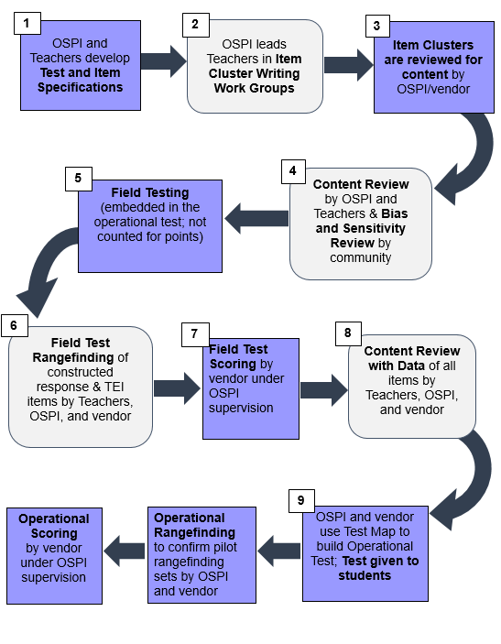
Science Assessment Development Cycle
Notes:
The development of a cluster or item for the WCAS takes about 18 months from item writing to when the materials are field tested. Each grey box in the diagram indicates a step when teachers are involved in the development process.
The first component of the development cycle is the Test and Item Specifications which describe how item clusters and standalone items are developed. The specifications are intended to provide information to educators and item writers. They are revised and updated yearly based on educator feedback during key development cycle meetings. We’ll show you where to find the Test Design and Item Specifications documents later in this presentation.
Step 2 in the cycle is the Item Cluster Writing Work Group, where teams of 2 to 3 educators write item clusters and rubrics designed to validly measure student understanding of the state standards.
In Step 3, the products of the item cluster writing work groups are reviewed for content by OSPI and our test development vendor.
Step 4 is the Content Review Work Group where teams of 5 educators review the products of the item cluster writing work group and ensure every stimulus, item, and rubric is scientifically accurate and gathers appropriate evidence about student mastery of the science standards. At the same time, a separate committee of community members reviews the items and stimuli for any bias and sensitivity issues. Recommendations from the Bias and Sensitivity review are considered by OSPI and the test vendor as the materials continue to move through the development cycle.
In Step 5, the item clusters and standalones are reviewed by OSPI and our test development vendor before;
Step 6 which is Field Testing by students.
Following field testing, Field Test Rangefinding Work Groups are convened, where student responses to the field-tested short answer items are reviewed. Educators look at a range of student responses to each short answer item and decide how to score each response. The scoring rubrics are refined and the materials that will be used to score the pilot/field test items are produced by the work group.
At step 8, all field test items including multiple choice and multiple select are scored by our scoring vendor.
At step 9, data about item performance is seen by another work group of educators during Content Review with Data. Educators use the data, as well as their science content knowledge, to decide if the items should advance into the item bank.
OSPI and our test development vendor build Operational Tests using only items that have been accepted into the item bank.

Slide 23
Work Groups
Events
Item Cluster Writing
Content Review
Field Test Rangefinding
Content Review with Data
Represent
the diversity of schools and students in our state.
small schools and large schools
eastern and western Washington
Notes:
Let’s take a closer look at the 4 educator work groups convened during each Development Cycle which include:
Item Cluster Writing,
Content Review,
Field Test Rangefinding, and
Content Review with Data
A few months prior to a work group convening, the OSPI science team sends an invitation to apply for the work group to the science listserv. Interested educators fill out an online application. They provide details about their education, teaching experience, knowledge of the science standards, and test development experience. The science assessment team evaluates the applications and assembles a work group that represents the diversity of schools and students in our state. The groups include educators from both small schools and large schools, from both eastern and western Washington, and from schools with a range of diversity.
Educators are the experts in the content areas and grade-levels they teach. They are implementing the science standards and know the instructional materials. They know how students think and react to questions. Educator input is critical in maintaining relevant, grade-level appropriate phenomena, design problems, stimuli, and items. Certificated staff who work as classroom teachers, instructional coaches, or have other instructional leadership roles participate in the work groups. Educators who work with career and technical education (CTE) students, special education students, and English learners are also important to the process.

Slide 24
Item Cluster Writing and Content Review Pre-Meeting Training
Provides:
an overview of the current state science assessments.
an overview of the plan for Science Assessment Development Events—the road leading to where we are now as well as upcoming professional development opportunities.
an NGSS 101 to make sure participants are familiar with the Next Generation Science Standards (NGSS) terminology and reference materials.
a set of information and activities to learn how:
Performance expectations are bundled for WCAS item clusters
Phenomena are used to develop an item cluster;
Stimuli and items are written to form an item cluster;
How items and item clusters align to the three-dimensional WCAS Item Specifications and the state science standards
an exploration of the WCAS Training Tests.
Notes:
Prior to their first assessment development convening, participants are required to take a 6-hour Moodle Course called Pre-Meeting Training. The training provides background information that is relevant to the work group.
This training includes:
an overview of the current state science assessments,
an overview of the plan for Science Assessment Development Events,
an NGSS 101 to make sure participants are familiar with the terminology and reference materials for the standards,
a set of information and activities to learn how:
Performance expectations are bundled for WCAS item clusters;
Phenomena are used to develop an item cluster;
Stimuli and items are written to form an item cluster;
How items and item clusters align to the three-dimensional WCAS Item Specifications and the state science standards; and
an exploration of the WCAS Training Tests.

Slide 25
WCAS Nuts and Bolts Moodle Course
An online Moodle course is available to learn how item clusters are developed for the Washington Comprehensive Assessment of Science (WCAS).
Covers most of the material for a Work Group Pre-Meeting training
Should take no more than 6 hours and can be completed in more than one sitting.
Six free STEM clock hours are available upon completion of the course and evaluation. Guidance for obtaining clock hours is embedded in the course.
Keep track of lessons and activities with a lessons and activities checklist.
To access the course:
Go to the WCAS Clusters: Nuts and Bolts course on the Moodle website.
Log in using your existing Moodle account or create a new account.
Notes:
In March 2020, we made a version of the Pre-Meeting Training course available to anyone who would like to take it. The course is called WCAS Nuts and Bolts and covers most of the same material as a Pre-Meeting Training.
Nuts and Bolts should take no more than 6 hours and can be completed in more than one sitting.
Six free STEM clock hours are available and guidance for obtaining clock hours is embedded in the course.
The course can be accessed from the Moodle website, which is linked on this slide along with a checklist for the course, or from the science assessment professional development web page which we will be looking at near the end of the presentation today.

Slide 26
Item Cluster Writing and Content Review In-Person Training
Universal Design Principles
The purpose is to ensure that a fair test is developed that provides an accurate measure of what all assessed students know and can do without compromising reliability or validity.
The principles ensure accessible environments for all through equitable use, simple and intuitive design, effective communication, tolerance for variability, and minimal fatigue.
The application of these principles is defended by research that links them to higher performance for all students.
For more information, see Universal Design, Accessibility, Bias, and Sensitivity Considerations
Notes:
Once a work group convenes, we provide follow-up training specific to the work group. Universal Design for Learning (UDL) principles are considered and applied throughout all WCAS development and delivery processes to help ensure that tests are developed that provide an accurate measure of what all assessed students know and can do.
For more information about UDL principles, please visit the website linked on this slide.

Slide 27
In-Person Training
Performance Expectation Bundle
Does the Performance Expectation bundle reflect how Performance Expectations are presented and taught in classrooms?
Phenomenon
Is the phenomenon appropriate for the Performance Expectation(s) being assessed?
Is the phenomenon engaging, relevant, and grade-appropriate?
Stimuli
Is the content correct in each stimulus?
Do the stimuli provide sufficient information for the phenomenon?
Is the stimulus cohesive?
Is the stimulus as clear and simple as possible.
Is the amount of reading kept to the minimum required to provide students with sufficient information about the phenomenon and context to respond to items.
Items
Is the content correct in each item?
How well is each item aligned to the item specification?
Is each item linked to the stimuli?
Is each item linked to other items in the cluster?
Does each item in the cluster fit within the boundaries described in the NGSS resources?
Is there a variety of item types to provide multiple ways for students to show what they know and can do?
Are the item stems straightforward and do they use simple syntax?
Do the Items clearly indicate what is expected and help students focus their responses?
Do the Items use the simplest language possible (e.g., targeted to earlier grade levels or lower readability) except for necessary scientific terms?
Other Considerations
Do the stimuli and items use engaging, unbiased, grade-level-appropriate language?
Do the stimuli and items model good science education?
What is the acceptable academic vocabulary for each PE in the cluster?
Is the time to complete the item cluster approximately 15 minutes or less?
Notes:
To help adhere to UDL, correct content, and appropriate alignment to the Performance Expectations, item writers and cluster reviewers are asked to focus on the following during their work groups:
Performance Expectation Bundle
Does the Performance Expectation bundle reflect how Performance Expectations are presented and taught in classrooms?
Phenomenon
Is the phenomenon appropriate for the Performance Expectation(s) being assessed?
Is the phenomenon engaging, relevant, and grade-appropriate?
Stimuli
Is the content correct in each stimulus?
Do the stimuli provide sufficient information for the phenomenon?
Is the stimulus cohesive?
Is the stimulus as clear and simple as possible?
Is the amount of reading kept to the minimum required to provide students with sufficient information about the phenomenon and context to respond to items?
Items
Is the content correct in each item?
How well is each item aligned to the item specification?
Is each item linked to the stimuli?
Is each item linked to other items in the cluster?
Does each item in the cluster fit within the boundaries described in the NGSS resources?
Is there a variety of item types to provide multiple ways for students to show what they know and can do?
Are the item stems straightforward and do they use simple syntax?
Do the Items clearly indicate what is expected and help students focus their responses?
Do the Items use the simplest language possible (e.g., targeted to earlier grade levels or lower readability) except for necessary scientific terms?
Other Considerations
Do the stimuli and items use engaging, unbiased, grade-level-appropriate language?
Do the stimuli and items model good science education?
What is the acceptable academic vocabulary for each PE in the cluster?
Is the time to complete the item cluster approximately 15 minutes or less?
The science assessment team is joined by a few staff from the development vendor to help facilitate these two meetings.

Slide 28
Bias and Sensitivity Committee
A team of 5 community members carefully selected to Review field test items and stimuli in terms of bias, sensitivity, language accessibility, and fairness to ensure that the test is not be influenced by disability, ethnicity, gender, or English language ability.
Ensures that the field test items and stimuli are accessible to the widest possible range of students, including those with disabilities and limited English proficiency.
Ensures that field test items and stimuli provide students with a fair opportunity to demonstrate their knowledge and skills, regardless of their race, ethnicity, gender, religion, disability, socioeconomic status, or the region in which they live.
Ensures that the context and language in the field test items and stimuli are not unfamiliar or confusing, as this can lead to accessibility bias.
Ensures that field test items and stimuli do not offend students, parents, or families
Notes:
Before we move on to the last two educator work groups, we want to talk about the bias and sensitivity committee that is convened alongside the content review work groups. This diverse team of 5 community members reviews all of the same items the content review work groups are looking at, but though a slightly different lens. The committee focuses on bias, sensitivity, language accessibility, and fairness to ensure that the test performance is not influenced by disability, ethnicity, gender, or English language ability.
This committees helps to ensure that field test items and stimuli:
are accessible to the widest possible range of students,
provide students with a fair opportunity to demonstrate their knowledge and skills regardless of their race, ethnicity, gender, religion, disability, socioeconomic status, or the region in which they live,
use context and language not unfamiliar or confusing, and
that field test items and stimuli do not offend students, parents, or families

Slide 29
Field Test Rangefinding and Content Review with Data Work Groups
Follow field testing.
Include 5-educator teams for each grade level
Field Test Rangefinding participants review a representative sample of student answers to short answer items to produce training sets for hand-scorers.
Develop a set of anchor papers ( a continuum of student responses from highest scoring to lowest scoring)
Develop a set of practice papers with a variety of score
Finalize scoring rubrics
Content Review with Data participants review student performance data for every field-tested item and make recommendations for the operational item bank based on criteria for acceptable stimuli and items. The data answers questions like:
How many students answered each item correctly?
Which “wrong” answers were chosen by the most students?
Did students of a particular gender or ethnicity answer an item differently than the rest of the students?
Notes:
The field test range finding and content review with data work groups take place after field testing. These two work groups make important decisions based on student data.
Field Test Rangefinding participants review a sample of student answers to short answer items and produce training sets for hand-scorers. The scoring vendor responsible for compiling the student responses to review and who use the materials developed to train the hand-scoring team join us.
Participants look at, score, and order a set of student responses from highest scoring to lowest scoring (eg, highest 2 to lowest 0) to provide a clear set of examples.
Participants use this example set to produce a practice set of student responses.
Participants finalize scoring rubrics.
Content Review with Data participants review student data for every field-tested item and make recommendations for the operational item bank. For this work group we are joined by a psychometrician who provides training about the data the group reviews as well as guidance in its interpretation.
The participants use the data to answer questions like:
How many students answered each item correctly?
Which “wrong” answers were chosen by the most students?
Did students of a particular gender or ethnicity answer an item differently than the rest of the students?

Slide 30
WCAS Events and Opportunities
Event | Timing
Item Cluster Writing | March 2021
Content Review | August 2021
Bias/Sensitivity Review* | August 2021
Field Test Rangefinding | July 2021
Content Review with Data | September 2021
*Community member work group
Notes:
The next round of work groups and committees is listed on this slide.
If all goes as planned, the science assessment team will hold the next item cluster writing in March of 2021. The educator-developed clusters and vendor-developed standalone items would undergo a content review work group in August 2021.
If items are field tested in spring 2021, we will convene a Field Test Rangefinding Work Group in July of 2021, and a Content Review with Data Work Group in September 2021.
As we all know, nothing is certain at this time. Assessment professionals in our state and around the country are working to figure out a best course of action for assessment, accountability, and reporting. We’ll try to remain calm and flexible over the upcoming months and communicate via our listserv as necessary.

Slide 31
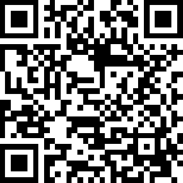
Work Groups-Stay informed and get involved
Sign up for Science Emails or Texts messages
Go to the Subscribe page for GovDelivery. Enter your email address. On the Subscriptions page, select Content Areas > Science, then select Science Assessment for the grade band(s) for which you would like to receive information.
Notes:
If you are not already signed up for the science listserv, we would live to have you join. We send out science updates and invitations to apply for the educator work groups via the listserv.
To receive the notifications via email or test, Go to the Subscribe page for GovDelivery. Enter your email address. On the Subscriptions page, select Content Areas > Science, then select Science Assessment for the grade band(s) for which you would like to receive information. You can also use the QR code to sign up for the science listserv.

Slide 32
Questions and Comments

Slide 33
WCAS Features
Notes:
Now let's take a look at some of the features of the online WCAS that help to make the them as equitable and as accessible as possible.

Slide 34
WCAS Features
All online
Item Types:
Selected Response—multiple choice, multiple select
Constructed Response—short answer
Technology enhanced—ex: drag and drop, drop-down choices, hot text, table input, matching table, simulations
Multi-part items
Parts labeled with letters A, B, and C.
May have a mix of item types. Parts work together. May ask for evidence to support answer in previous part of the item.
Notes:
Most students will take the WCAS online. The WCAS are delivered using the same platform as the smarter balanced math and ELA tests, so many of the features will be familiar to students.
The WCAS uses 9 items types to provide a variety of ways for student to show what they can do.
multiple choice
multiple select
short answer
drag and drop
drop-down choices
hot text
table input
matching table
simulation
Some items are divided into multiple parts. Typically, this includes two parts (part A and part B). Item parts are mutually reinforcing and strengthen alignment to a Performance Expectation.
Multipart items can use different types of interactions in each part (e.g., a multiple choice followed by a drop down). One example of this approach would be an item that asks a student to evaluate a claim in part A, and then in part B asks the student to identify how a particular trend in data or piece of evidence supports their evaluation of that claim.
Multipart items can be worth a single point or each part can be worth one point.

Slide 35
Special WCAS Features
Collapsing stimuli
First stimulus is hidden when second stimulus is provided.
Both stimuli are available to the student.
Locking Items
Student can answer the question only once.
Allows subsequent questions to update with correct information.
An “attention” box warns student that they won’t be able to change their answer.
Notes:
There are some key differences between the WCAS and the Smarter Balanced tests:
Collapsible Stimuli
The WCAS has some item clusters that include more than one stimulus. Each stimulus is delivered along with the items most closely associated to that stimulus. Once a stimulus is presented, it is available to the student throughout the cluster. To minimize vertical scrolling and the need to move back to previous screens within a cluster, a stimulus is collapsed once the next stimulus is provided. A +/- icon in the heading of a collapsed stimulus section allows the stimulus to be hidden from view or expanded to suit a student’s current need.
Locking Items
WCAS clusters include some locking items in which the student cannot change their answer once they have moved on to the next item. A padlock icon next to the item number alerts students that they are answering a locking item. When they start to move on from the item, an “attention” box warns the student that they will not be able to change their answer once they move on. The student can either return to the item or move forward and lock in their answer.
Locking items allow the student to be updated with correct information in subsequent items or stimuli. In addition, locking items help to limit item interaction effects or clueing between items in a cluster.
Students can return and view an item that has been locked. The student will see their answer, but they cannot change their answer.

Slide 36
Tools, Accommodations and Supports
Assessment | Embedded Tools | Non-embedded Tools | Embedded Designated Supports | Non-embedded Designated Supports | Embedded Accommodations | Non-embedded Accommodations
Washington Comprehensive Assessment of Science | Breaks Calculator Digital notepad English glossary Expandable items and passages Highlighter Keyboard navigation Line reader Mark for review Periodic table Strikethrough Zoom | Breaks Graph paper Periodic table Scratch paper Technological assistance with navigation | Color contrast Hybrid masking tool Masking Mouse pointer Stacked Spanish translations test Streamlined interface mode Text-to-speech (student responses) Text-to-speech (test content) Translated test directions Translations glossaries Zoom w/streamline | Amplification Color contrast Color overlays Magnification Medical supports Noise buffers Read aloud English Read aloud Spanish Read aloud student Scribe Separate setting Simplified test directions Translated test directions | Print on demand Speech-to-text | Abacus Alternate response options American Sign Language Braille test booklet Large print test booklet Spanish paper test booklet Speech-to-text Standard print test booklet Translations glossaries (paper test) Word prediction
Tools, Accommodations, and Supports
Notes:
The WCAS may be taken with or without tools, supports, or accommodations, but there are many of these available for students that need them.
This slide summarizes the tools, supports, and accommodations.
Tools are available to all students and can be used at the student's discretion. Embedded means available within the online test engine, and non-embedded means available external to the online test engine.
For example, the calculator and the highlighter are both available within the online test engine and are embedded tools. Scratch paper and graph paper are non-embedded tools.
Designated Supports are available to English language learners and any student with a need identified by an educator. The supports need to be made available through the Test Information Distribution Engine (TIDE) by the school or district staff.
The embedded Text-to-Speech that allows student responses to be read back to the student by the computer is a new support. An example of a non-embedded support is a scribe.
Accommodations are for students who receive special education services with a documented need noted in an IEP or 504 plan.
A new embedded accommodation is the Speech-to-Text that turns a students spoken response into text in a constructed response item. Non-embedded accommodations include paper test booklets.
More information is available in the Guidelines on Tools, Supports, & Accommodations (GTSA) which can be downloaded from the WCAP Portal. Information in this slide is found on p. 15 in that document.

Slide 37
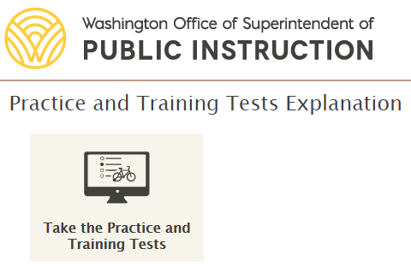
WCAS Training Tests
Grade 5, 8, and 11
Each WCAS training test includes collapsible stimuli, locking items, and almost every item type.
The purpose of the training tests is to help students, teachers, and parents become familiar with the item types, tools, and navigation used in the online testing system.
A Training Test Lesson Plan for each grade that is available through the science assessment website
WCAP Portal
Notes:
Students, families, and educators have access to online WCAS training tests to become familiar with the features and tools of online tests. Training tests are available for grades 5, 8, and 11.
Each WCAS training test includes collapsible stimuli, locking items, and almost every item type and allows for practice with embedded tools, supports, and accommodations.
The training tests can be are accessed through the WCAP Portal or the science assessment website. The science assessment team has produced a Training Test lesson plan for each grade that is available through the science assessment website. These documents include ways to practice using the tools for each item type, an answer key, and science standards alignment for each question on the Training Tests. The links for the science assessment website, the training test lesson plans, and the training tests are included on this slide.

Slide 38
Questions and Comments

Slide 39
Additional Assessment Resources
Notes:
We’ve provided links to several resources throughout of today's presentation, but we want to make you aware of a few others before we close.

Slide 40
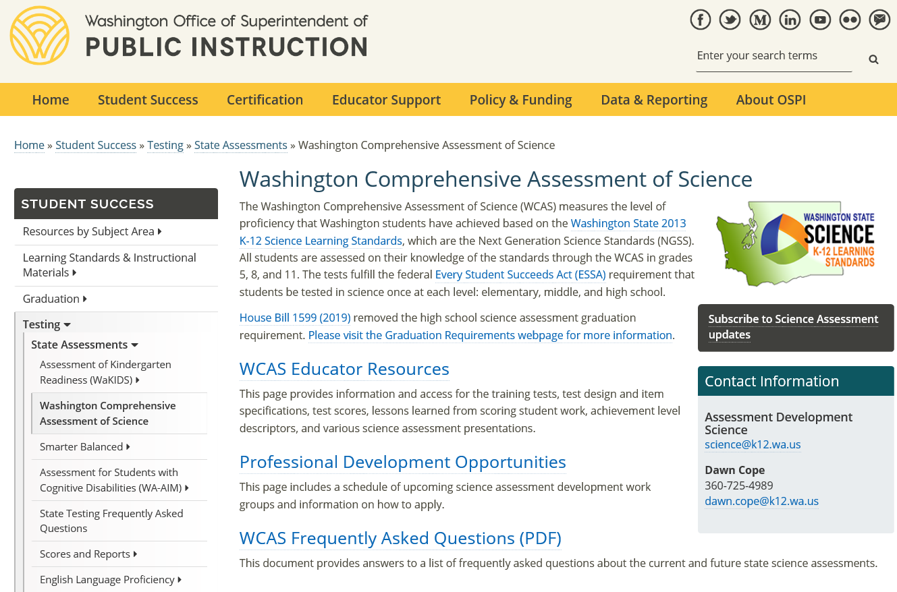
Science Assessment
https://www.k12.wa.us/student-success/testing/state-testing-overview/washington-comprehensive-assessment-science
Notes:
The science assessment landing page links to three additional pages—
A WCAS Educator Resources page
A Professional Development Opportunities page
And an FAQ

Slide 41
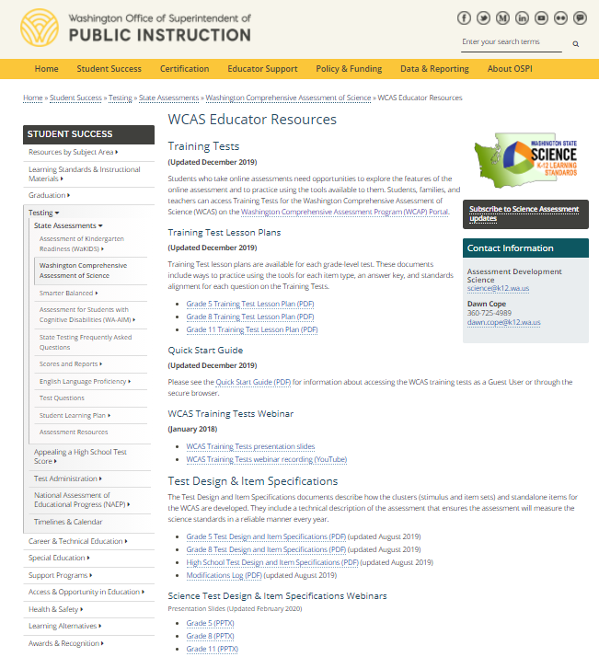
Science Assessment Educator Resources
Notes:
The Educator Resources page includes links to the training test and the training test lesson plans. It also includes links to our Test Design and Item Specifications.

Slide 42
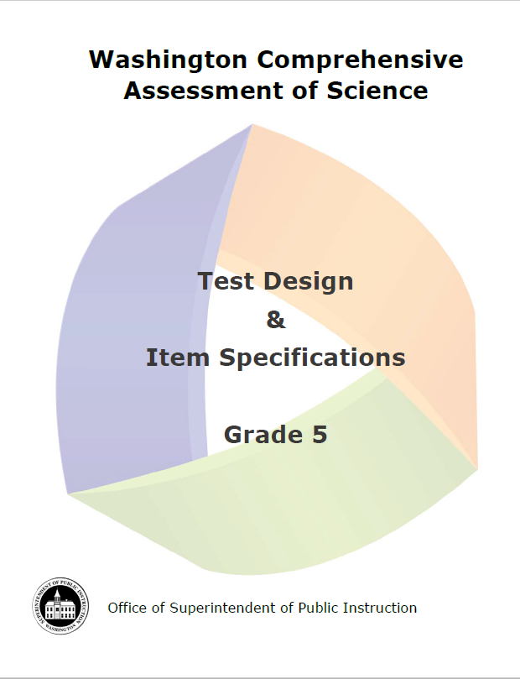
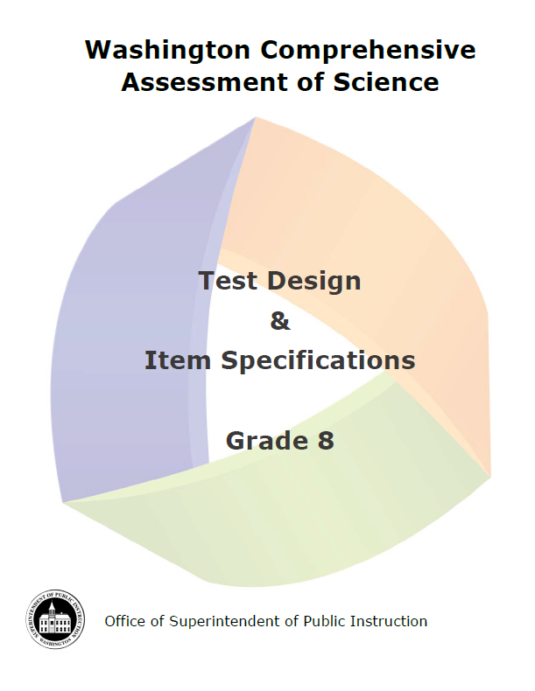
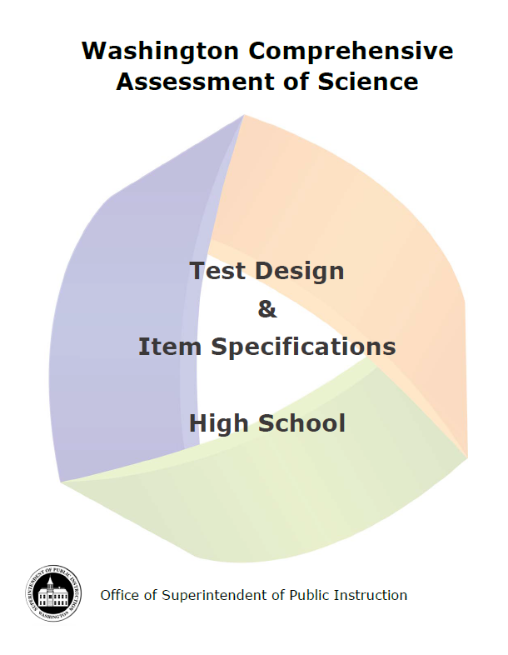
Test Design and Item Specifications
Test Design and Item Specifications
Notes:
Test Design and Item Specifications, linked here, have two sections.
The first section describes the structure and development of the WCAS, including information about item types and NGSS alignment.
The next section includes the Item Specifications for each Performance Expectation.
Item specifications describe how students can demonstrate understanding of a Performance Expectations on the WCAS.
A complete set is provided on the science assessment website for each grade.
The Test Design and Item Specifications are updated annually based on input from Washington educators.

Slide 43
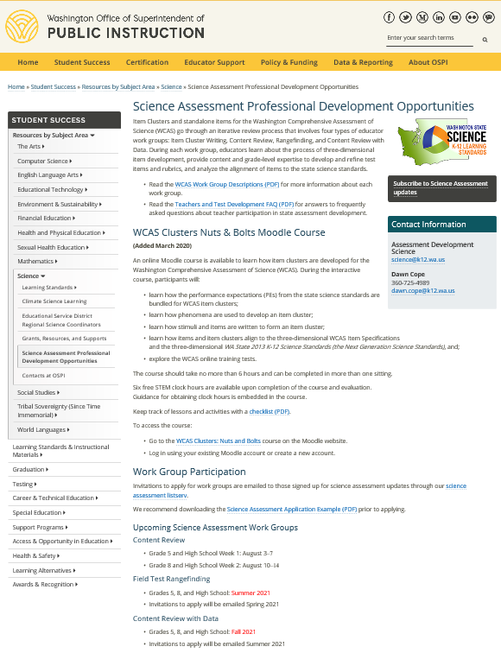
Science Assessment Professional Development Opportunities
Notes:
The Science Assessment Professional Development Opportunities page includes links to the Nuts and Bolts Moodle Course, descriptions of work groups, and information about upcoming work groups..

Slide 44
Questions and Comments

Slide 45
Thank you!
Notes:
Thank you for joining us today. If you have any questions, please reach us at science@k12.wa.us

