Slide 1
Washington Comprehensive Assessment of Science
Test Design & Item Specifications
High School
Science Assessment Development Team
February 6, 2020
Notes:
Hello, and welcome to the High School Washington Comprehensive Assessment of Science Test Design & Item Specifications training. My name is Dawn Cope, and I am the Science Assessment Lead at OSPI.

Slide 2
Logistics
Webinar Recording, PowerPoint slides and FAQ
https://www.k12.wa.us/student-success/testing/state-testing-overview/washington-comprehensive-assessment-science/wcas-educator-resources
Chat Box
pdEnroller
https://www.pdenroller.org
Notes:
The training is being recorded. The recording will be available on the science assessment website in a few weeks. The final PowerPoint slides, with a script in the notes section, will be posted to the Science Assessment webpage by the end of this week.
All participants have been muted. Please submit questions through the Chat box function in the Zoom Meeting. We will compile questions into an FAQ document that will be posted along with the PowerPoint slides on the science assessment webpage. We will not be using the Hand Raise button today.
Additional details about accessing webinar materials will be given at the end of the presentation.
To receive clock hours, sign in to pdEnroller, create an account, if needed, and register for the webinar. If you have not already registered for the webinar in pdEnroller, you can still do so after today’s presentation. You will need to complete a short evaluation of the webinar to receive the clock hours.

Slide 5
Objectives
This presentation contains a script in the notes section. If you are accessing this information with a screen reader, be sure you are reading the notes section as well as the text contained in the slides.
Share the design and development of the Grade 11 WCAS
Share how Grade 11 WCAS items are aligned to and assess the 2013 Washington State K-12 Science Learning Standards which are the Next Generation Science Standards, or NGSS.
5
Notes:
The objectives of this presentation are to:
Share how the Grade 11 WCAS is designed and developed.
Share how Grade 11 WCAS items are written to assess the 2013 Washington State K-12 Science Learning Standards which are the Next Generation Science Standards, or NGSS.
The information we are going to share is found in a document called the High School WCAS Test Design and Item Specifications. The most recent version of the Test Design & Item Specifications document was published in August 2019. This version included item specifications for all 71 PEs.
The OSPI Science Team wants to acknowledge and extend a big THANK YOU to all of the Washington State educators who contributed to the development of the item specifications.
The Test Design and Item Specifications document is always in draft form. We make slight modifications throughout the year as we receive feedback from educators that participate in assessment development work groups like item writing and content review. An updated document is published each fall, accompanied by a modifications log so you can see the changes that were applied.
Please note that the Test Design and Item Specifications document is not intended to guide classroom instruction, but rather, it describes how item clusters (stimuli and items) and standalone items are developed to assess the Washington State K–12 Science Learning Standards (NGSS) on the state summative test.

Slide 6
Contact Information
Dawn Cope—Science Assessment Lead
  dawn.cope@k12.wa.us
Jacob Parikh—Science Assessment Specialist
  jacob.parikh@k12.wa.us
Korey Peterson—Science Assessment Specialist
  korey.peterson@k12.wa.us
Jessica Cole—Program Specialist
  jessica.cole@k12.wa.us
General e-mail account
  science@k12.wa.us
Notes:
I am joined today by Jacob Parikh and Korey Peterson, state Science Assessment specialists.
Korey and Jacob will be presenting the webinar today, and I will be monitoring the chat box. We will pause about mid-way through and near the end of the presentation to address questions as needed.
This slide provides contact information for the science assessment team. Please do not hesitate to contact us with your questions about this training or any other questions you have about the state science assessment.

Slide 7
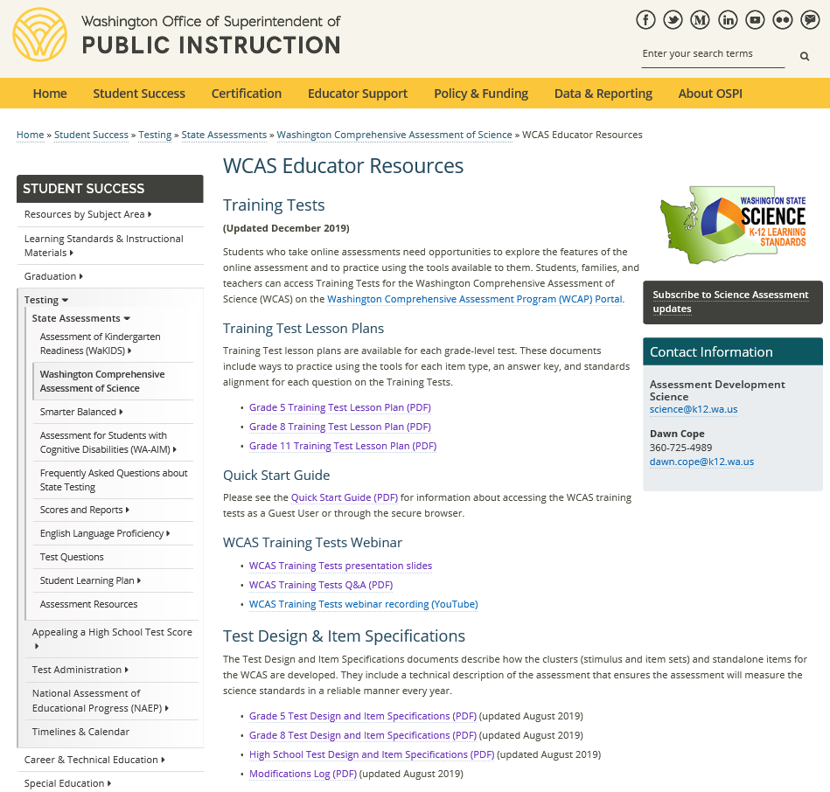
Test Design and Item
Specifications –
High School
https://www.k12.wa.us/student-success/testing/state-testing-overview/washington-comprehensive-assessment-science/wcas-educator-resources
Notes:
You can find the High School Test Design and Item Specifications document by going to the WCAS Educator Resources webpage: https://www.k12.wa.us/student-success/testing/state-testing-overview/washington-comprehensive-assessment-science/wcas-educator-resources
There are separate documents for 5th grade, 8th grade, and high school. Many parts of the documents are similar. Key differences occur on the Test Blueprint pages and the Item Specifications sections of the documents.
This training is for the High School Test Design and Item Specifications document.
[CLICK]
Additional trainings cover the Grade 5 and Grade 8 documents.
Those of you who registered for this webinar were sent a PDF of the High School Test Design and Item Specifications via email yesterday. I am going to pause for one minute so you can access the document in your email or from the Science Assessment Educator Resources page.
We posted a link to the High School document in the chat.

Slide 8
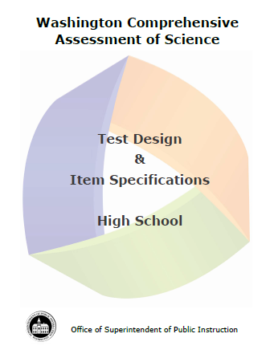
Document Components
Test Design (pages 1-14)
  Development Cycle
  Structure of the Test
  Item Types
  Test Structure
  Standards Overview
  Resources and References
Item Specifications (pages 15-165)
SEP, DCI, and CCC Vocabulary
(pages 166-169)
8
Notes:
The Test Design section of the document (pages 1-14) is an overview of the test design and development. We will be touching on many components of this section during the presentation. The section has the answers to important and commonly asked questions. We encourage you to become familiar with the information the test design section contains.
The second section of the document contains the item specifications (pages 15 to 165). Item specifications describe how items are written for the WCAS. The section has an item specification for each of the 71 Performance Expectations that could be assessed on a Grade 11 WCAS. For a given year, about 25 to 30% of the Performance Expectations are assessed. This will be explained further when we talk about the test blueprint.
The third section of the document contains a list of vocabulary terms (pages 166-169).
As we move through today’s presentation, relevant page numbers for the Test Design and Item Specifications document will be displayed in purple text boxes.

Slide 9
WCAS Development Process
Educator Involvement
Notes:
Pages 1 and 2 of the Test Design and Item Specifications document give an overview of the WCAS development process.

Slide 10
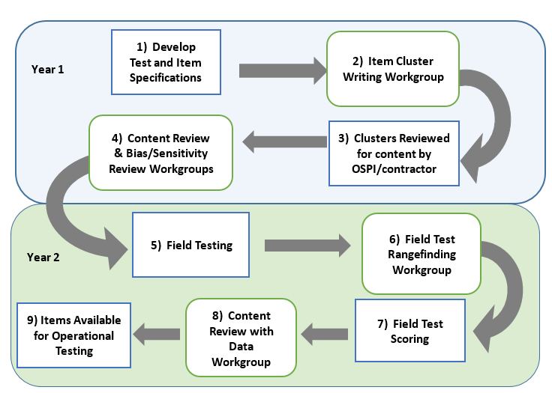
Science
Assessment
Development
Cycle
Pages 1-2
Notes:
Washington educators are heavily involved in this process, which takes place over the course of at least 2 years from when an item is first drafted to when it could possibly be seen by a student and count in their test score.
The Science Assessment Development Cycle graphic is found on page 2.
The first step in the Science Assessment Development Cycle is the development of the Test Design and Item Specifications. The OSPI science team began thinking about Test Design and Item Specifications when the science standards were adopted in 2013 and through each of the development work groups over the past several years. Step 1 occurs during each of the other steps of this process as parts of the Test Design and Item Specifications document is reviewed during each work group.
The second step is the Item Cluster Writing Work Groups. This is where Washington educators work in teams of 2-3 to write stimuli, items, and rubrics for item clusters (a set of stimuli and items), that are designed to measure student understanding of the state standards. The item clusters are then reviewed by the OSPI science team and the development contractors for content, including improvements to the art work (step 3).
In step 4, during Content Review Work Groups, educators review the products of the item cluster writing work group to ensure every stimulus, item, and rubric is scientifically accurate and gathers appropriate evidence about student mastery of the NGSS. At the same time, a separate committee of community members reviews the items and stimuli for any bias and sensitivity issues. Recommendations from the Bias and Sensitivity review are considered by the Content Review work group.
After that the OSPI science team works with the test delivery contractor to put the items and stimuli into the online system for field testing with students (step 5). Students see the Field Test items as part of their operational test, but the items are not counted in a student’s WCAS score.
After student testing is completed, educators meet in Field Test Range Finding Work Groups (step 6) to look at a range of student responses to each short answer field test item and decide how to score the responses. This educator workgroup refines scoring rubrics and produces the materials that will be used to score the short answer field test items. Then, the items are scored by the contractor in step 7. Remember, the field test results do not count toward a student’s WCAS score.
The 8th step in the process is the Content Review with Data Work Group where educators use item performance data (which is a variety of statistics about how students responded to the items), as well as their science content knowledge, to recommend whether each item should advance into the item bank. Educators see data for each item that answers questions like:
How many students answered the item correctly?
Which “wrong” answers were chosen by the most students?
Do students who score high on the test get this item correct?
Did students of a particular gender or ethnicity answer the item differently than the rest of the students?
The OSPI science team use the stimuli and items that have been accepted into the item bank to build the WCAS.
Step 9 takes about 6 months, from the point when the OSPI science team puts a test form together in the fall to when students see the test the following spring.
[PAUSE]
Educators are a critical component of Science Assessment Development, and the OSPI Science team welcomes and encourages your participation.
The OSPI Science Team wants to acknowledge and extend another big THANK YOU to all of the Washington State educators, this time to those who have participated in assessment development work groups and helped the OSPI science team develop every stimulus and item that appears on the WCAS.
10

Slide 11

Join Us!
Science Assessment Professional Development Opportunities
https://www.k12.wa.us/student-success/resources-subject-area/science/science-assessment-professional-development-opportunities
Invitations to apply for work groups are emailed to those signed up for science assessment updates through the science assessment listserv. https://public.govdelivery.com/accounts/WAOSPI/subscriber/new
Notes:
If you are interested in participating in a science assessment development work group, you can find more information on the Science Assessment Professional Development Opportunities webpage. https://www.k12.wa.us/student-success/resources-subject-area/science/science-assessment-professional-development-opportunities
To receive invitations to apply for work groups, as well as receive science assessment updates, be sure to sign up for the science assessment listserv. https://public.govdelivery.com/accounts/WAOSPI/subscriber/new

Slide 12

Washington Standards
Overview
NGSS 101
Notes:
Pages 10 through 12 of the Test Design and Item Specifications document describe how the standards are the basic foundation of the design of the WCAS.
The standards that the WCAS tests are the Next Generation Science Standards or NGSS, which were adopted in fall 2013. OSPI re-named the NGSS as the Washington State 2013 K-12 Science Learning Standards.

Slide 13
NGSS High School Band
Pages 10-12
Domains
  Physical Sciences (PS)—24 Performance Expectations
  Life Sciences (LS)—24 Performance Expectations
  Earth and Space Sciences (ESS)—19 Performance Expectations
  Engineering Design (ETS)—4 Performance Expectations
  Each Performance Expectation includes a Science and Engineering Practice (SEP), a Disciplinary Core Idea (DCI), and a Crosscutting Concept (CCC)
13
Notes:
The structure of the standards is important to understand before diving into the structure of the WCAS. An overview of the standards is provided on pages 10-12 of the Test Design and Item Specifications document.
The High School Band of standards includes 71 Performance Expectations organized into 4 domains:
Physical Sciences
Life Sciences
Earth and Space Sciences
Engineering Design
Each Performance Expectation provides a statement of what students should be able to do by the end of instruction and includes a Science and Engineering Practice, a Disciplinary Core Idea, and a Crosscutting Concept.

Slide 14
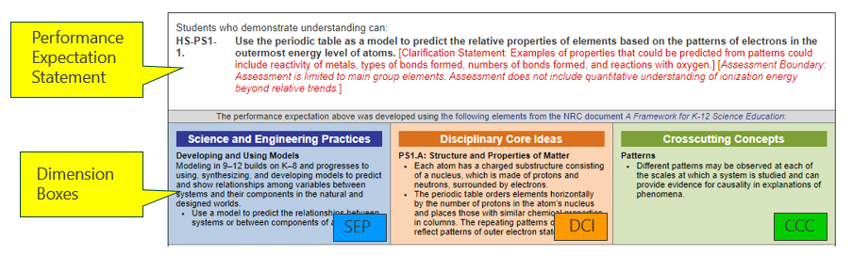
NGSS
Performance
Expectation
Notes:
This slide shows one Performance Expectation, HS-PS1-1. The “HS” tells us that it is a high school Performance Expectation, the “PS1” refers to the overarching concept of “Matter and its Interactions,” and the “-1” tells us that it is the first in a series of high school Performance Expectations about that overarching concept.
The text of the Performance Expectations starts with the Performance Expectation Statement in black font and may be followed by a clarification statement and/or assessment boundary in red font. The clarification statements supply examples or additional clarification to the performance expectations. The assessment boundaries are meant to specify limits to large-scale assessment. They are not meant to put limits on what can be taught or how it is taught, but to provide guidance to assessment developers.
The Performance Expectation statement incorporates three dimensions, shown below in the Dimension Boxes. These include a science and engineering practice (SEP), one or more disciplinary core ideas (DCI), and a crosscutting concept (CCC). The Performance Expectation statement can provide some insight as to how the student is expected to utilize the SEP, DCI, and CCC together to achieve the performance expectation.
We will talk more about this structure when we get to the Item Specifications section of the presentation.

Slide 15
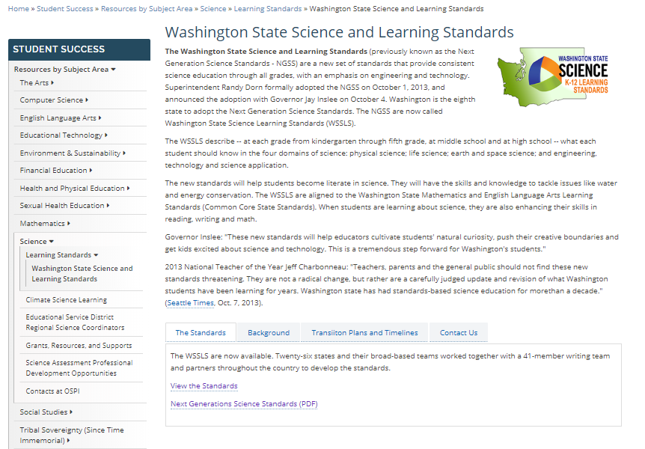
The 2013 Washington State K-12 Science Learning Standards are the Next Generation Science Standards (NGSS)
OSPI Science Standards Webpage
https://www.k12.wa.us/student-success/resources-subject-area/science/science-k%E2%80%9312-learning-standards/washington-state-science-and-learning-standards
Next Generation Science Standards https://www.nextgenscience.org/search-standards
Get to Know the Standards
https://www.nextgenscience.org/get-to-know
Understanding the Standards: https://www.nextgenscience.org/understanding-standards/understanding-standards
Notes:
This slide provides you with a link to the OSPI Science Standards [CLICK] webpage as well as additional NGSS resources.

Slide 16
Test Structure
Notes:
Pages 3-9 of the Test Design and Item Specifications document describe the structure of the WCAS.
The WCAS is composed of item clusters and standalone items that align to the NGSS Performance Expectations. It will take us a few slides to build the full picture of how item clusters and standalone items are carefully put together to compose a test form.

Slide 17
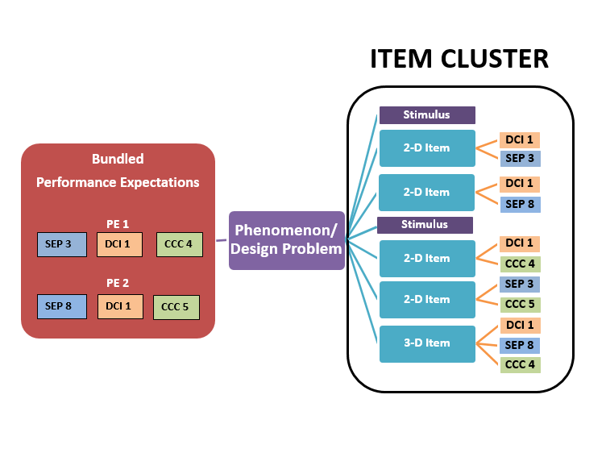
Cluster
Map
Page 3
Notes:
The graphic on this slide models the structure of an item cluster and can be found on page 3 of the Test Design & Item Specifications document.
Let’s start with the phenomenon or design problem that is used to give the cluster coherence.
[CLICK]
The use of phenomena or design problems in item and cluster development provides:
a context in which to demonstrate transfer of knowledge and skills,
a focus for combining knowledge and abilities from multiple dimensions, and
an element of interest and motivation for students.
Next, a Performance Expectation bundle is generally two related Performance Expectations that are used to explain or make sense of a scientific phenomenon or a design problem.
[CLICK]
Performance Expectations may be bundled across domains (for example., Life Science and Earth and Space Science PEs) or may be domain-specific (for example., all Life Science).
Performance Expectations may be bundled that have dimensions in common (for example, all Performance Expectations have the modeling SEP) or bundled to include a range of dimensions (for example, the Performance Expectations have no SEP, DCI, or CCC in common).
Some Performance Expectations may be robust enough to support an entire item cluster on their own, but most bundles will consist of two Performance Expectations. An individual Performance Expectation may be used in more than one bundle, but care will be taken to ensure that no Performance Expectation will be over-represented on a WCAS form.
The item cluster is carefully constructed such that:
[CLICK]
each item is linked to a stimulus or stimuli and to the other items within the item cluster,
each item is aligned to at least two dimensions from the PE bundle,
at least one item is three-dimensional,
all items support the phenomenon or design problem identified, and
the items progress logically and contain internal scaffolding to support the student’s progression to higher levels of complexity.
In addition,
Stimuli are interspersed among the items to add information as needed.
Some items have more than one part (ex: Part A, Part B) in order to achieve 2 or 3-dimensional alignment.

Slide 18
Standalone Items
Use a single item to address two or three dimensions of one PE
Stimulus and question/questions
Notes:
A standalone item is a focused measurement tool that uses a single item to address two or three dimensions of one Performance Expectation. Standalone items allow for increased Performance Expectation coverage on a given administration of the WCAS. A standalone item includes a stimulus and a question. Standalone items can have more than one part (e.g., Part A, Part B).

Slide 19
Grade 11 Blueprint
Pages 8-9
Reporting Area | Percentage of PEs per Science Domain in the Standards | Percent Range for the WCAS per Science Domain | Score Point Range for WCAS per Science Domain
Practices and Crosscutting Concepts in Physical Sciences | 36% | 31-41% | 14-18
Practices and Crosscutting Concepts in Life Sciences | 36% | 31-41% | 14-18
Practices and Crosscutting Concepts in Earth and Space Sciences | 28% | 23-33% | 11-15
45 Total points
6-12 standalone items
6 clusters
Estimated testing time: 150 minutes
ETS PEs are assessed but not reported separately.
Notes:
The Grade 11 blueprint is found on page 9 of the Test Design and Item Specifications document, and shows how clusters and standalone items are put together for a test.
The number of Performance Expectations in three of the domains (physical sciences, life sciences, and Earth and space sciences) in the high school band of the standards were used to find the percentage of Performance Expectations per domain. See the second column. Approximately 36% of the standards are from the physical sciences domain, 36% of the standards are from the life sciences domain, and 28% of the standards come from the Earth and space sciences domain.
The WCAS will include a similar percentage of items per domain. That is what you see in the third column. The last column takes the 45 total points for the grade 11 WCAS, and breaks them out by those percentages.
A student receives an overall scale score on the WCAS, and a sub-score for each of three reporting areas: practices and crosscutting concepts in physical sciences, practices and crosscutting concepts in life sciences, and practices and crosscutting concepts in Earth and space sciences.
The Engineering Design (ETS) Performance Expectations are always bundled with a Physical Sciences, Life Sciences, or Earth and Space Sciences Performance Expectation for the WCAS, but are not reported in a separate reporting area.

Slide 20
Performance Expectation Coverage
Pages 8-9
Item Clusters
  3-6 items per cluster
  6 clusters per operational form
  At least one PE from each domain (PS, LS, ESS, and ETS) represented
  A minimum of 3 different SEPs across the clusters
  A minimum of 3 different CCCs across the clusters
Stand Alone items
  6-12 items per operational form
  Each item must assess 2 or 3 dimensions of a single PE
  Increases DCI, SEP, and CCC coverage for the whole test
Notes:
As students work their way through the Grade 11 WCAS, they will first encounter 6 to 12 standalone items.
After the standalone items, the test turns to item clusters. There are 3 to 6 items per cluster.
The grade 11 assessment has 6 clusters. There will be at least one cluster on the test that assesses each domain (physical, life, and Earth and space sciences, as well as engineering design). There will be a minimum of 3 different Science and Engineering Practices across the clusters, and a minimum of 3 different Crosscutting Concepts across the clusters.
Approximately 1/4 to 1/3 of the 71 Performance Expectations can be covered on a given year’s WCAS. This means that, with careful planning and test building, all of the high school performance expectations can be assessed over 3-5 administrations.
If it feels like you are starting to put together a 4-D puzzle in your head with all of these requirements….you are on the right track for what test building feels like.

Slide 21
Structure and Administration
Pages 8-9
Structure
  Operational Section
    Counts toward a student’s score
    Fixed form
  Field Test Section
    Embedded in the online administration
    Does not count toward a student’s score
    A cluster or several standalone items
Administration
  Can be administered in multiple sessions like the Smarter Balanced ELA and Math tests
  1 to 3 sessions recommended
Notes:
Remember, there are items field-tested on each years’ WCAS. They are embedded in the online test and do not count toward a student’s score. The field test items are either a cluster of items, or several standalone items. We need students to put forth as much effort into field test items as they do for the operational items to get as accurate information as possible about how the field test items function.
Like the Smarter Balanced tests, the WCAS can be given to students over multiple test sessions. We recommend 3 sessions maximum. Remember, each time a student starts a session, they have to go through the log in procedures that add to total testing time. Information about splitting the test into multiple sessions is included in the Test Administrators Manual available through the WCAP Portal. https://wa.portal.cambiumast.com/

Slide 22
Features & Item Types
Pages 4-7
Features
  Collapsible Stimuli
  Locking items
  Multipart items
  Animation
  Periodic Table https://wa.portal.airast.org/
  Calculator https://www.desmos.com/testing/washington
Item Types
  Multiple Choice
  Multiple Select
  Short Answer
  Drag and Drop
  Hot Text
  Table Match
  Table Input
  Edit Task Inline Choice
  Simulation
Notes:
Pages 4 through 7 of the Test Design and Item Specifications document give details about the features and item types on the WCAS.
Standalone items fill the entire screen.
For item clusters, stimuli and items are presented side-by-side—with stimuli on the left and items on the right.
For an item cluster that has more than one stimulus, each stimulus is delivered along with the items most closely associated to that stimulus. Once a stimulus is presented, it is available to the student throughout the cluster. To minimize vertical scrolling and the need to move back to previous screens within a cluster, a stimulus is collapsed once the next stimulus is provided. A +/- icon in the heading of a stimulus section allows the stimulus to be hidden from view or expanded to suit a student’s current need.
WCAS clusters include some locking items in which the student cannot change their answer once they have moved on to the next item. A padlock icon next to the item number alerts students that they are answering a locking item. When they start to move on from the item, an “attention” box warns the student that they will not be able to change their answer once they move on. The student can either return to the item or move forward and lock in their answer.
Locking items allow the student to be updated with correct information in subsequent items or stimuli. In addition, locking items help to limit item interaction effects or clueing between items in a cluster.
Students can return and view an item that has been locked. The student will see their answer, but they cannot change their answer.
A periodic table is embedded in the online platform for all items in the WCAS for grade 8 and high school. A printable version of the periodic table can be downloaded for classroom use on the WCAP Portal. https://wa.portal.airast.org/
A scientific calculator is embedded in the online platform for all items in the WCAS for grade 8 and high school. Students should be familiar with the functionality of the calculator prior to using it on the assessment. The calculator is available online and as an app for practice. For more information about the calculator available during testing, visit the Desmos.com State Assessments webpage https://www.desmos.com/testing/washington

Slide 23
WCAS Training Tests
Grades 5, 8, 11
Accessed through the WCAP Portal
https://wa.portal.airast.org/training-tests.stml
Grade 5 Lesson Plan
https://www.k12.wa.us/sites/default/files/public/science/pubdocs/LessonPlans5-FINAL%20DRAFT.pdf
Grade 8 Lesson Plan
https://www.k12.wa.us/sites/default/files/public/science/pubdocs/LessonPlans8-FINAL%20DRAFT.pdf
Grade 11 Lesson Plan
https://www.k12.wa.us/sites/default/files/public/science/pubdocs/LessonPlans11-FINAL%20DRAFT.pdf
Quick Start
https://www.k12.wa.us/sites/default/files/public/science/pubdocs/OnlineTrainingTestQuickStart-FINAL_DRAFT.pdf
Notes:
The WCAS is delivered online using the same platform as the Smarter Balanced tests and may look familiar to students. However, students who take online assessments need opportunities to explore the features of the online assessment and to practice using the tools available to them.
The WCAS training tests were expanded in December 2019. The training tests are available through the WCAP Portal. https://wa.portal.cambiumast./training-tests.stml
The Grade 5 and Grade 8 training tests each have two new standalone items.
The Grade 11 training test has three new standalone items and one new item cluster.
All standalone items and item clusters on the training tests were developed by Washington educators and successfully field tested with Washington students. The standalone items and item clusters were carefully chosen for the training tests to represent a variety of online question types and features. All students can access all three training tests, if desired.
Training Test Lesson Plans for each grade-level training test are available on the WCAS Educator Resources webpage.
https://www.k12.wa.us/student-success/testing/state-testing-overview/washington-comprehensive-assessment-science/wcas-educator-resources
The documents include descriptions of ways to practice using the tools for each item type, an answer key, and information about the standards alignment for each question.
Grade 5 lesson Plan
https://www.k12.wa.us/sites/default/files/public/science/pubdocs/LessonPlans5-FINAL%20DRAFT.pdf
Grade 8 Lesson Plan
https://www.k12.wa.us/sites/default/files/public/science/pubdocs/LessonPlans8-FINAL%20DRAFT.pdf
Grade 11 Lesson Plan
https://www.k12.wa.us/sites/default/files/public/science/pubdocs/LessonPlans11-FINAL%20DRAFT.pdf
A separate Quick Start Guide includes information about accessing the training tests as a guest user or through the secure browser.
Quick Start Guide
https://www.k12.wa.us/sites/default/files/public/science/pubdocs/OnlineTrainingTestQuickStart-FINAL_DRAFT.pdf

Slide 24

Q&A
Notes:
We are going to stop here for a few minutes and answer some questions that have come in.

Slide 25
Item Specifications
Notes:
Now we are going to move into the Item Specifications part of the presentation.
The science assessment team at OSPI worked with Washington State educators and assessment research and development partners to produce item specifications that will support multi-dimensional item development.
The following two slides represent an item specification. We are going to use Performance Expectation HS-LS2-6 as the example. It can be found on pages 92 and 93 of the High School Test Design and Item Specifications document.

Slide 26
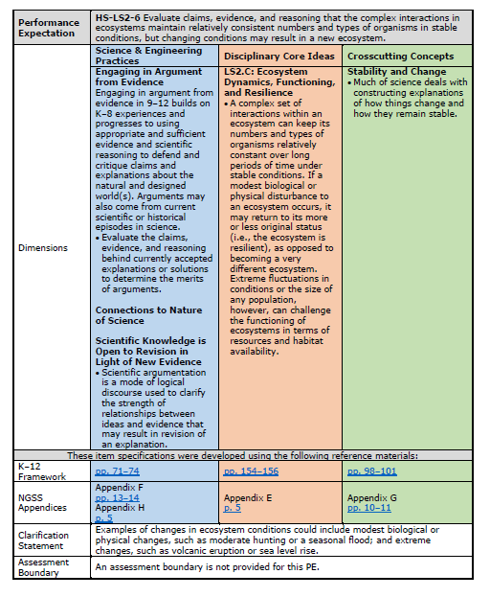
HS-LS2-6
Pages 92-93
Front Page
Notes:
The Item Specification has two pages.
Most of the first page is language copied from the NGSS.
For example, the Performance Expectation statement [CLICK]
And the dimensions information
The Science and Engineering Practice in blue [CLICK]
The Disciplinary Core Idea in orange [CLICK]
And the Crosscutting Concept in green [CLICK]
Come directly from the Performance Expectation.
While the performance expectations can stand alone, a more coherent and complete view of what students should be able to do comes when the performance expectations are viewed in tandem with the contents of the dimensions boxes.
Let’s read these four pieces together to see how this works.
HS-LS2-6 Evaluate claims, evidence, and reasoning that the complex interactions in ecosystems maintain relatively consistent numbers and types of organisms in stable conditions, but changing conditions may result in a new ecosystem.
Science & Engineering Practices: Engaging in Argument from Evidence
Engaging in argument from evidence in 9-12 builds on K-8 experience and progresses to using appropriate and sufficient evidence and scientific reasoning to defend and critique claims and explanations about the natural and designed world(s). Arguments may also come from current scientific or historical episodes in science.
Evaluate the claims, evidence, and reasoning behind currently accepted explanations or solutions to determine the merits of arguments.
Scientific Knowledge is Open to Revision in Light of New Evidence
Scientific argumentation is a mode of logical discourse used to clarify the strength of relationships between ideas and evidence that may result in revision of an explanation.
Disciplinary Core Ideas:
LS2.C: Ecosystem Dynamics, Functioning, and Resilience
A complex set of interactions within an ecosystem can keep its numbers and types of organisms relatively constant over long periods of time under stable conditions. If a modest biological or physical disturbance to an ecosystem occurs, it may return to it more or less original status (i.e., the ecosystem is resilient), as opposed to becoming a very different ecosystem. Extreme fluctuations in conditions or the size of any population, however, can challenge the functioning of ecosystems in terms of resources and habitat availability.
Crosscutting Concepts: Stability and Change
Much of science deals with constructing explanations of how things change and how they remain stable.
Next, you’ll find links to the exact pages in the K-12 Framework for Science Education [CLICK] and the NGSS Appendices [CLICK] where more information about each dimension can be found.
The K-12 Framework for Science Education is the foundational document for the NGSS. It is grounded in the most current research on science and science learning and identifies the science all K–12 students should know upon completion of high school. https://www.nap.edu/catalog/13165/a-framework-for-k-12-science-education-practices-crosscutting-concepts
The NGSS Appendices provide background and detail about the standards. https://www.nextgenscience.org/resources/ngss-appendices
We won’t explore these links today, but this feature of the item specifications provides a quick way to access this helpful information.
Finally, the first page lists the clarification statement [CLICK] and assessment boundary [CLICK] which also include language directly from the Performance Expectation.
For this Performance Expectation, these statements tell us that the “Examples of changes in ecosystem conditions could include modest biological or physical changes, such as moderate hunting or a seasonal flood; and extreme changes, such as volcanic eruption or sea level rise.” and that “An assessment boundary is not provided for this PE.”

Slide 27
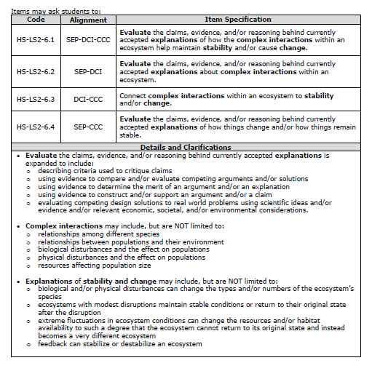
HS-LS2-6
Pages 92-93
Back Page
Notes:
The back page is specific to the WCAS and always starts with a table of four Item Specifications [CLICK].
The first item specification has a code with a “.1” added onto the end of the Performance Expectation number. The code for the first item specification here is HS-LS2-6.1 The first item specification describes how a three dimensional item is written to assess the SEP, DCI, and CCC of the Performance Expectation.
The second item specification listed--has a code with a “.2” added onto the end of the Performance Expectation number. The second item specification describes how a two dimensional item is written to assess the SEP and DCI of the Performance Expectation.
The third item specification listed--has a code with a “.3”. The third item specification describes how a two dimensional item is written to assess the DCI and CCC of the Performance Expectation.
The fourth item specification listed--has a code with a “.4”. The fourth item specification will describe how a two dimensional item is written to assess the SEP and CCC for the Performance Expectation.
When you read each of the four specifications, you’ll notice key words bolded.
The “Details and Clarifications” section includes information that helps unpack the those key words. [CLICK]
It is important to note that the details and clarifications section provides EXAMPLES only, NOT exhaustive lists.
If I want to write a three dimensional item, I would use item specification HS-LS2-6.1 as a guide, and then use the details and clarifications section to help put the pieces together. The other three item specifications would guide the development of two-dimensional items.
I can see from the first set of bullets in the details and clarifications section that there are several ways to assess the SEP “Engaging in Argument from Evidence”. For example, I could write an item in which students are :
describing criteria used to critique claims
using evidence to compare and/or evaluate competing arguments and/or solutions
using evidence to determine the merit of an argument and/or an explanation
using evidence to construct and/or support an argument and/or a claim; or
evaluating competing design solutions to real world problems using scientific ideas and/or evidence and/or relevant economic, societal, and/or environmental considerations.
I am not limited to “Engaging in argument from evidence.” like the blue box on the first page indicated.
The second set of bullets gives some examples of complex interactions such as:
relationships among different species
relationships between populations and their environment
biological disturbances and the effect on populations
physical disturbances and the effect on populations
resources affecting population size
And the third set of bullets gives some examples of explanations of stability and change such as:
biological and/or physical disturbances can change the types and/or numbers of the ecosystem’s species
ecosystems with modest disruptions maintain stable conditions or return to their original state after the disruption
extreme fluctuations in ecosystem conditions can change the resources and/or habitat availability to such a degree that the ecosystem cannot return to its original state and instead becomes a very different ecosystem
feedback can stabilize or destabilize an ecosystem

Slide 28
Item Specification Activity
Notes:
Now we are going to use the Coral Bleaching cluster found in the Grade 11 WCAS Training Test to connect the item specification we just looked at to item development for the WCAS.
Please note that for of this next part of the presentation, even though the cluster is available online in the Grade 11 WCAS training test, we are not going to look at the cluster in the online platform. Instead, the science team has come up with a way to show alignment between the items and the performance expectation bundle using static images.

Slide 29
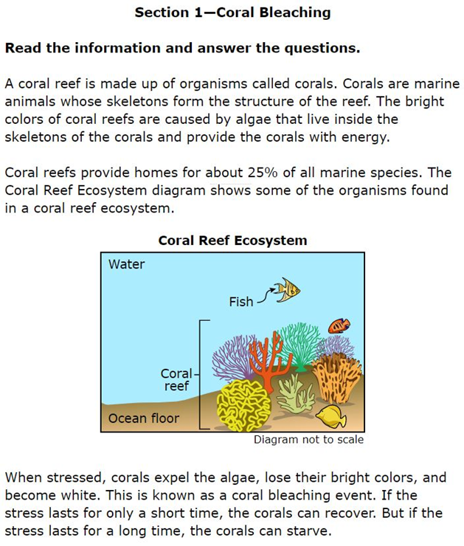
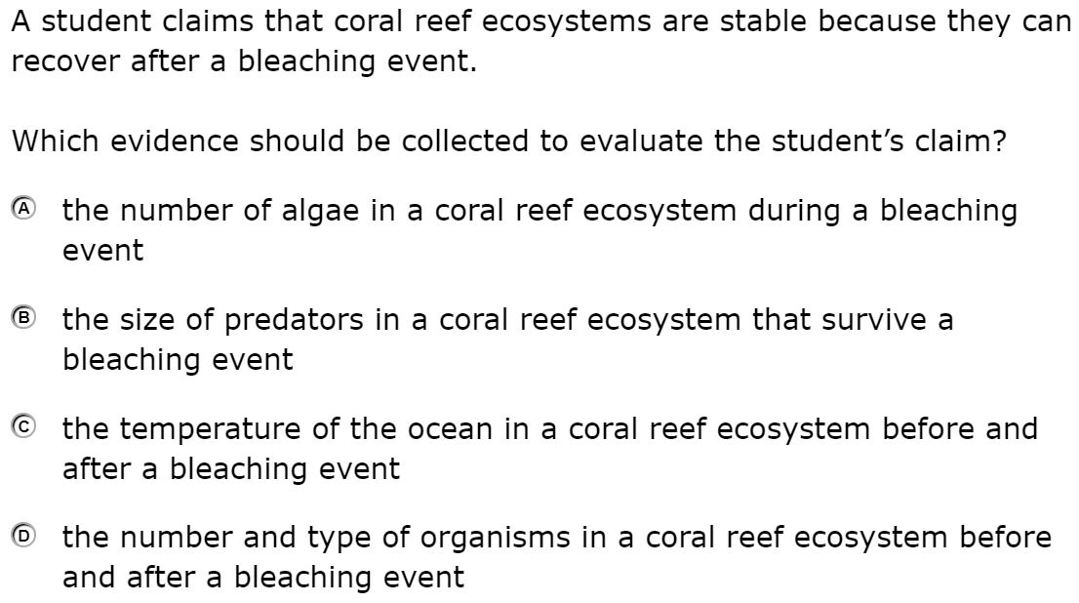
Item 1
Notes:
This is the first stimulus section for Coral Bleaching.
It reads:
“Coral Bleaching. Section 1. Read the information and answer the questions. A coral reef is made up of organisms called corals. Corals are marine animals whose skeletons form the structure of the reef. The bright colors of coral reefs are caused by algae that live inside the skeletons of the corals and provide the corals with energy.
Coral reefs provide homes for about 25% of all marine species. The Coral Reef Ecosystem diagram shows some of the organisms found in a coral reef ecosystem.”
Below the diagram it reads: “When stressed, corals expel the algae, lose their bright colors, and become white. This is known as a coral bleaching event. If the stress lasts for only a short time, the corals can recover. But if the stress last for a long time, the corals can starve.”
The first item in the Coral Bleaching cluster reads:
“A student claims that coral reef ecosystems are stable because they can recover after a bleaching event. Which evidence should be collected to evaluate the student’s claim?”
A the number of algae in a coral reef ecosystem during a bleaching event
B the size of predators in a coral reef ecosystem that survive a bleaching event
C the temperature of the ocean in a coral reef ecosystem before and after a bleaching event
D the number and type of organisms in a coral reef ecosystem before and after a bleaching event

Slide 30
Item 1
Notes:
Here is the correct answer for item 1. [PAUSE]
This item was developed to align to HS-LS2-6, the Performance Expectation we just looked at. The next question is—Which item specification does the item align to: HS-LS2-6.1, .2, .3, or .4?

Slide 31
Item 1
Notes:
Here is the set of item specifications and details and clarifications again for HS-LS2-6.
Thinking about what students are asked to demonstrate in item 1, which specification does this item most closely align to?
If they are being asked to “Evaluate the claims, evidence, and/or reasoning behind currently accepted explanations of how the complex interactions within an ecosystem help maintain stability and/or cause change.” then this is a three-dimensional item aligned to HS-LS2-6.1.
If they are being asked to “Evaluate the claims, evidence, and/or reasoning behind currently accepted explanations about complex interactions within an ecosystem.” then this is a two-dimensional item aligned to HS-LS2-6.2.
If they are being asked to “Connect complex interactions within an ecosystem to stability and/or change.” then this is a two-dimensional item aligned to HS-LS2-6.3.
If they are being asked to “Evaluate the claims, evidence, and/or reasoning behind currently accepted explanations of how things change and/or how things remain stable.” then this is a two-dimensional item aligned to HS-LS2-6.4.
Take a few moments to decide which item specification you think this item is aligned to. [PAUSE]
If you chose HS-LS2-6.1, then you agree with the educator work groups that developed and reviewed this item.
Students describe evidence to evaluate a claim (SEP) about an interaction in an ecosystem (DCI) that can affect the stability of that ecosystem (CCC). All three dimensions are assessed in this item.
This is a locking item. There is information in the 2nd stimulus sections or items later in the cluster that could clue the answer to this item. Once students answer the question and move on, they can return to the item and the stimulus, but they cannot change their answer.

Slide 32
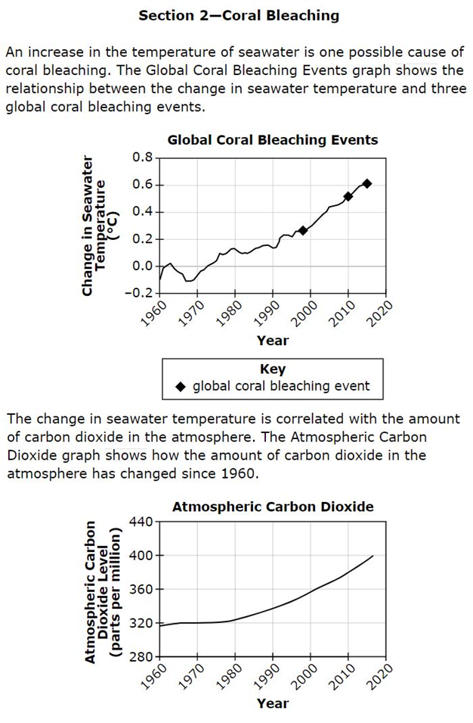
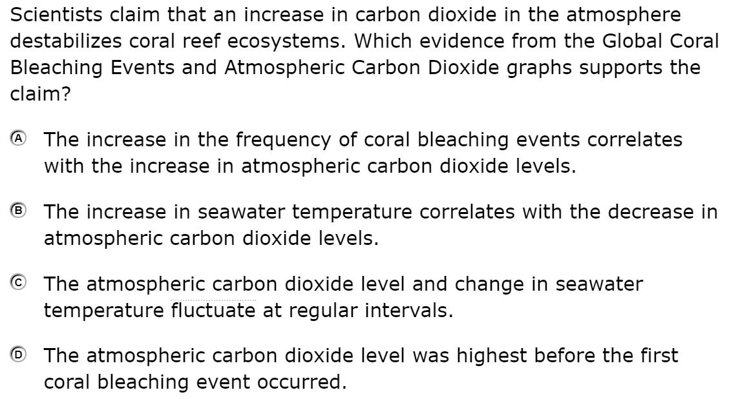
Item 2
Notes:
“Section 2. An increase in the temperature of seawater is one possible cause of coral bleaching. The Global Coral Bleaching Events graph shows the relationship between the change in seawater temperature and three global coral bleaching events.”
Below the first graph, it reads “The change in seawater temperature is correlated with the amount of carbon dioxide in the atmosphere. The Atmospheric Carbon Dioxide graph shows how the amount of carbon dioxide in the atmosphere has changed since 1960.”
Item 2 reads:
“Scientists claim that an increase in carbon dioxide in the atmosphere destabilizes coral reef ecosystems. Which evidence from the Global Coral Bleaching Events and Atmospheric Carbon Dioxide graphs supports the claim?
A The increase in the frequency of coral bleaching events correlates with the increase in atmospheric carbon dioxide levels.
B The increase in seawater temperature correlates with the decrease in atmospheric carbon dioxide levels.
C The atmospheric carbon dioxide level and change in seawater temperature fluctuate at regular intervals.
D The atmospheric carbon dioxide level was highest before the first coral bleaching event occurred.”

Slide 33
Item 2
Notes:
Here is the correct answer for Item 2. [PAUSE]
This item was also developed to align to HS-LS2-6

Slide 34
Item 2
Notes:
Here is the set of item specifications and details and clarifications again.
Take a few moments to decide which item specification you think this item is aligned to. [PAUSE]
If you chose HS-LS2-6.1, then you agree with the educator work groups that developed and reviewed this item.
Students describe evidence that supports a claim (SEP) about an interaction in an ecosystem (DCI) that results in the stability of that ecosystem (CCC).
Item 2 is also a locking item.

Slide 35
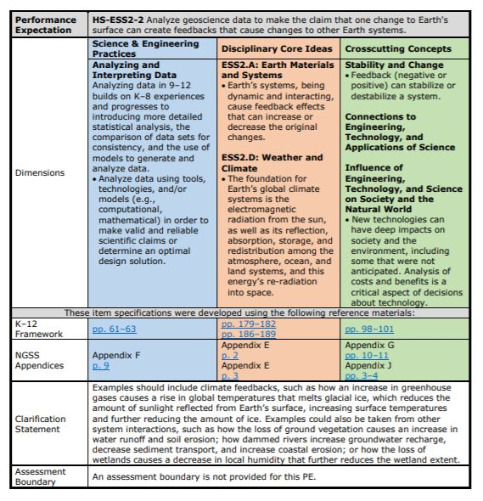
HS-ESS2-2
Pages 132-133
Front Page
Notes:
The next two items in the Coral Bleaching Cluster are aligned to HS-ESS2-2. Let’s take a look at the item specification for that Performance Expectation. As we read through this one, please note how the format is the same as that for HS-LS2-6. All item specifications are formatted the same way.
First, the performance expectation statement: Analyze geoscience data to make the claim that one change to Earth’s surface can create feedbacks that cause changes to other Earth systems.
Then, the Science & Engineering Practices: Analyzing and Interpreting Data
Analyzing data in 9-12 builds on K-8 experiences and progress to introducing more detailed statistical analysis, the comparison of data sets for consistency, and the use of models to generate and analyze data.
Analyze data using tools, technologies, and/or models (e.g., computational, mathematical) in order to make valid and reliable scientific claims or determine an optimal design solution.
The Disciplinary Core Ideas:
ESS2.A: Earth Materials and Systems
Earth’s systems, being dynamic and interacting, cause feedback effects that can increase or decrease the original changes.
ESS2.D: Weather and Climate
The foundation for Earth’s global climate systems is the electromagnetic radiation from the sun, as well as its reflection, absorption, storage, and redistribution among the atmosphere, ocean, and land systems, and this energy’s re-radiation into space.
and the Crosscutting Concept: Stability and Change
Feedback (negative or positive) can stabilize or destabilize a system.
This is the same crosscutting concept as we had for HS-LS2-6, however, the bulleted statements are different between the two Performance expectations.
Influence of Engineering, Technology, and Science on Society and the Natural World
New technologies can have deep impacts on society and the environment, including some that were not anticipated. Analysis of costs and benefits is a critical aspect of decisions about technology.
Next, are the links to the exact pages in the K-12 Framework for Science Education and the NGSS Appendices where more information about each dimension can be found.
For this Performance Expectation, the clarification statement tell us that the “Examples should include climate feedbacks, such as how an increase in greenhouse gases causes a rise in global temperatures that melts glacial ice, which reduces the amount of sunlight reflected from Earth’s surface, increasing surface temperatures and further reducing the amount of ice. Examples could also be take from other system interactions, such as how the loss of ground vegetation causes an increase in water runoff and soil erosion; how dammed rivers increase groundwater recharge, decrease sediment transport, and increase coastal erosion; or how the loss of wetlands causes a decrease in local humidity that further reduces the wetland extent.
An assessment boundary is not provided for this PE.
Remember, all of the information on this page (with the exception of the links) is taken directly from the NGSS.

Slide 36
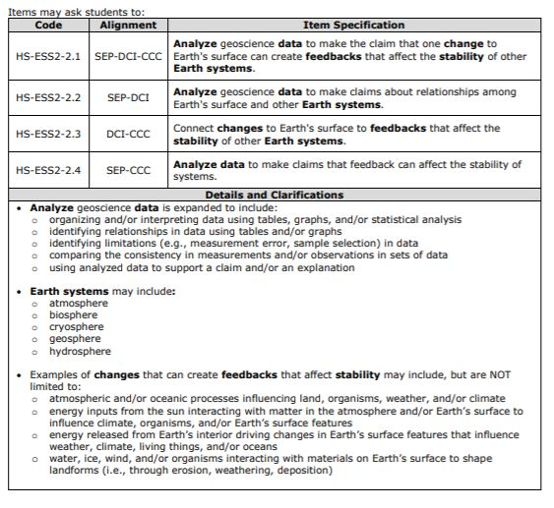
HS-ESS2-2
Pages 132-133
Back Page
Notes:
On the back of the page, we start with the table of item specifications [CLICK] , just like with HS-LS2-6.
HS-ESS2-2.1 describes how a three-dimensional item is written to assess the SEP, DCI, and CCC.
.2 describes how a two-dimensional item is written to assess the SEP and DCI.
.3 describes how a two-dimensional item is written to assess the DCI and CCC.
.4 describes how a two-dimensional item is written to assess the SEP and CCC.
And below the item specification we have the details and clarifications [CLICK].
The first set of bullets identifies different ways to assess the Analyzing and Interpreting Data SEP, including:
organizing and/or interpreting data using tables, graphs, and/or statistical analysis
identifying relationships in data using tables and/or graphs
identifying limitations (e.g., measurement error, sample selection) in data
comparing the consistency in measurements and/or observations in sets of data; and
using analyzed data to support a claim and/or an explanation
The second set of bullets lists the eligible Earth systems :
atmosphere
biosphere
cryosphere
geosphere
hydrosphere
The third set of bullets gives some examples of changes that can create feedbacks that affect stability, like:
atmospheric and/or oceanic processes influencing land, organisms, weather, and/or climate
energy inputs from the sun interacting with matter in the atmosphere and/or Earth’s surface to influence climate, organisms, and/or Earth’s surface features
energy released from Earth’s interior driving changes in Earth’s surface features that influence weather, climate, living things, and/or oceans
water, ice, wind, and/or organisms interacting with materials on Earth’s surface to shape landforms (i.e., through erosion, weathering, deposition)
Remember, the details and clarifications section provides EXAMPLES only, NOT exhaustive lists.

Slide 37
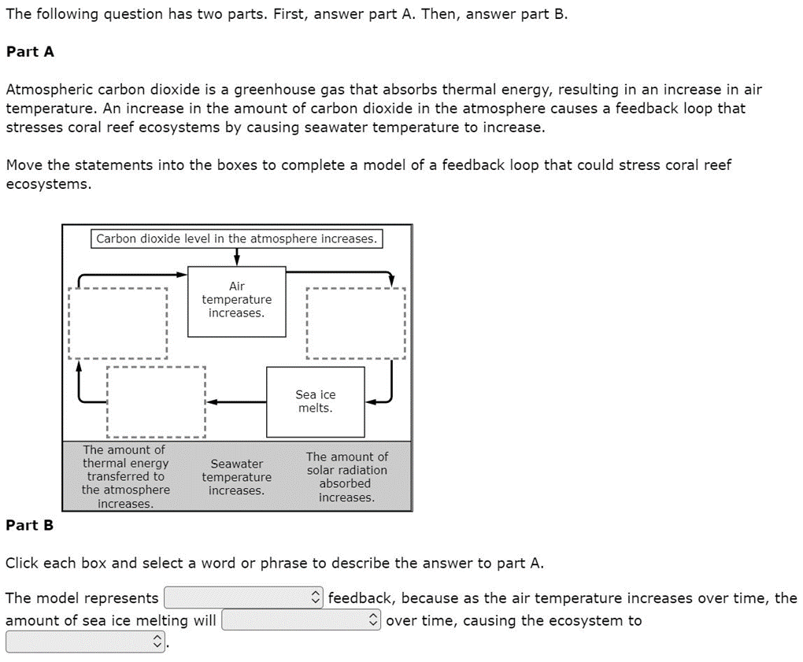
Item 3
Notes:
Now, back to the Coral Bleaching Cluster.
The third item uses the Section 2 stimulus. Item 3 reads “The following question has two parts. First, answer part A. Then, answer part B.
Part A.
Atmospheric carbon dioxide is a greenhouse gas that absorbs thermal energy, resulting in an increase in air temperature. An increase in the amount of carbon dioxide in the atmosphere causes a feedback loop that stresses coral reef ecosystems by causing seawater temperature to increase.
Move the statements into the boxes to complete a model of a feedback loop that could stress coral reef ecosystems.”
Two components of the feedback loop are filled in: “Air temperature increases.” and “Sea Ice Melts.”
The statements that students use to complete the model are: “The amount of thermal energy transferred to the atmosphere increases.”, “Seawater temperature increases.”, and “The amount of solar radiation absorbed increases.”
Part B reads:
“Click each box and select a word or phrase to describe the answer to part A. The model represents (positive or negative) feedback, because as the air temperature increases over time, the amount of sea ice melting will (increase, decrease, or become constant) over time, causing the ecosystem to (stabilize or destabilize).”

Slide 38
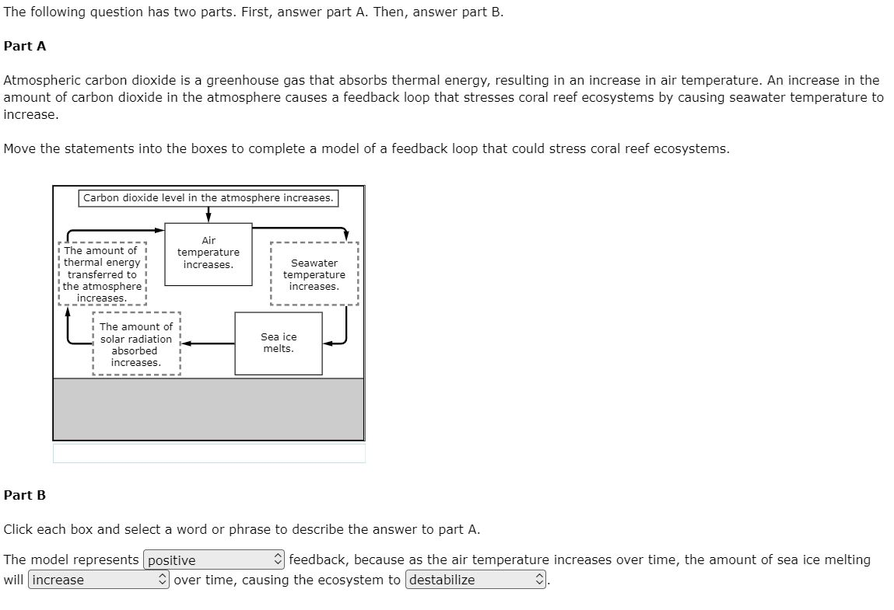
Item 3
Notes:
Here are the correct answers for part A and part B for Item 3. [PAUSE]
This item was developed to align to HS-ESS2-2.
When we have a multipart item such as this, we consider part A and part B together when making alignment judgements.

Slide 39
Item 3
Notes:
Here is the set of item specifications and details and clarifications again for HS-ESS2-2.
Thinking about what students are asked to demonstrate in this item, which specification does this item most closely align to?
If they are being asked to “Analyze geoscience data to make the claim that one change to Earth’s surface can create feedbacks that affect the stability of other Earth systems.” then the item is three dimensional and aligned to HS-ESS2-2.1.
If they are being asked to “Analyze geoscience data to make claims about relationships among Earth’s surface and other Earth’s systems.” then the item is two dimensional and aligned to HS-ESS2-2.2.
If they are being asked to: “Connect changes to Earth’s surface to feedbacks that affect the stability of other Earth systems.” then the item is two dimensional and aligned to HS-ESS2-2.3.
If they are being asked to: “Analyze data to make claims that feedback can affect the stability of systems.” then the item is two dimensional and aligned to HS-ESS2-2.4.
Take a few moments to decide which item specification you think this item is aligned to. [PAUSE]
If you chose HS-ESS2-2.1, then you agree with the educator work groups that developed and reviewed this item. Part A asks students to describe relationships that result in a feedback loop (DCI), based on section 2 data and information (SEP). In part B students describe the type of feedback and how it affects the stability of the ecosystem (CCC).
This is a locking item. You’ll see why when we look at item 4.

Slide 40
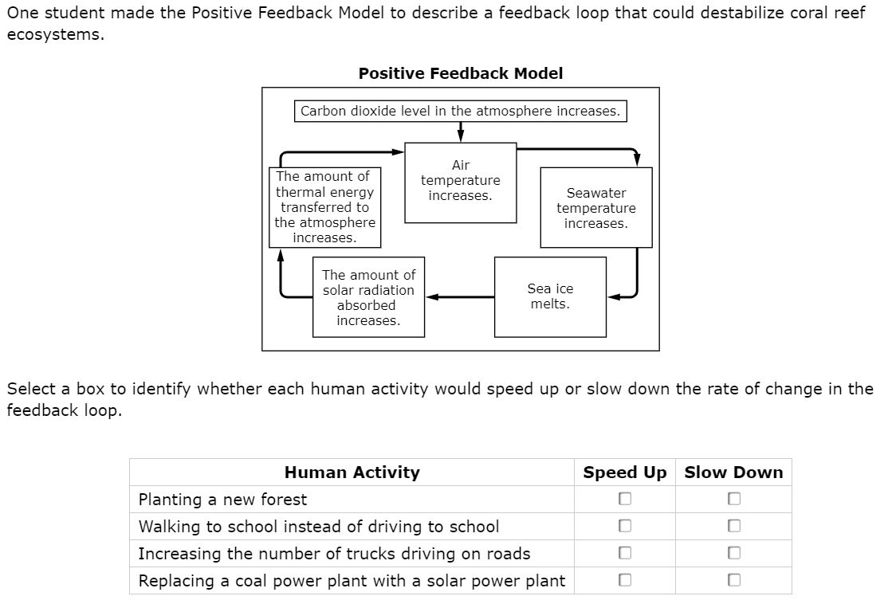
Item 4
Notes:
The fourth item again uses the same Section 2 stimulus, and provides an update to Item 3. If the student did NOT complete the feedback loop correctly, that error is not carried forward to item 4.
The item reads: “One student made the Positive Feedback Model to describe a feedback loop that could destabilize coral reef ecosystems.”
The model shows the completed positive feedback loop.
“Select a box to identify whether each human activity would speed up or slow down the rate of change in the feedback loop.”
The human activities read “Planting a new forest.”, “Walking to school instead of driving to school.”, “Increasing the number of trucks driving on roads.” , and “Replacing a coal power plant with a solar power plant.”

Slide 41
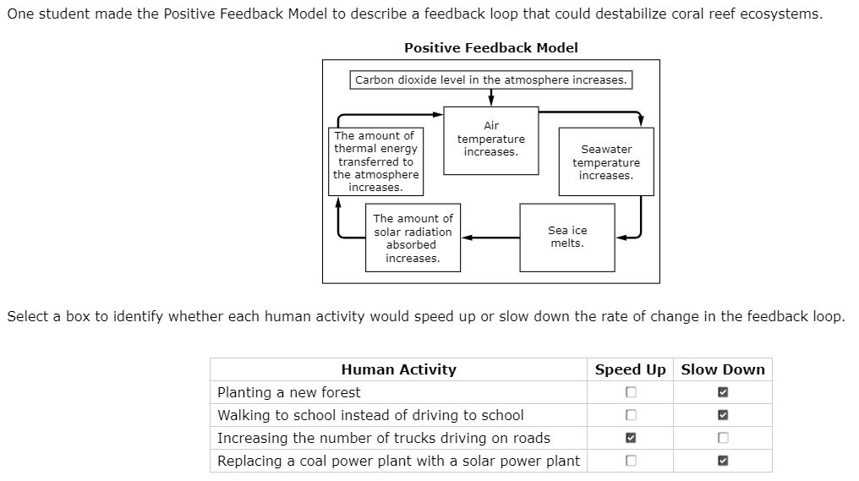
Item 4
Notes:
Here is the correct answer for Item 4. [PAUSE]
This item was also developed to align to HS-ESS2-2.

Slide 42
Item 4
Notes:
Here is the set of item specifications and details and clarifications again for HS-ESS2-2.
Take a few moments to decide which item specification you think this item is aligned to. [PAUSE]
If you chose HS-ESS2-2.3, then you agree with the educator work groups that developed and reviewed this item.
This item asks students to connect changes caused by human activities to a feedback that affects Earth systems. (DCI and CCC alignment). Because students are not asked to analyze data, the item is not aligned to the SEP.

Slide 43
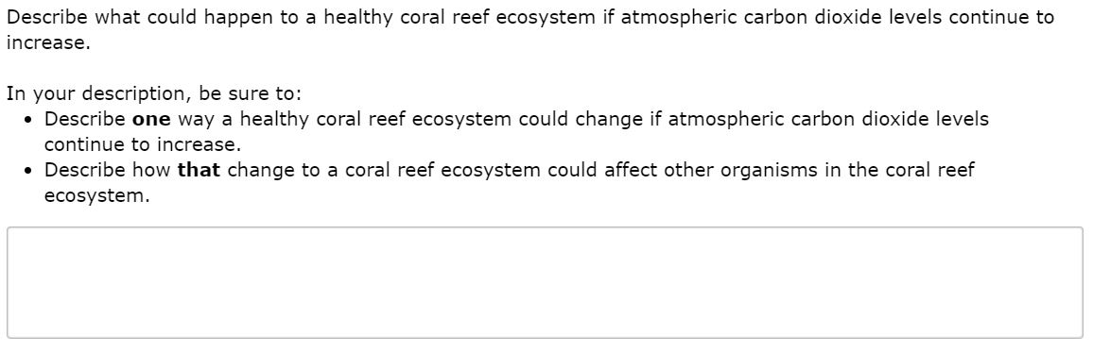
Item 5
Notes:
The final item in the Coral Bleaching cluster uses the same Section 2 stimulus.
The item reads: “Describe what could happen to a healthy coral reef ecosystem if atmospheric carbon dioxide levels continue to increase. In your description, be sure to: Describe one way a healthy coral reef ecosystem could change if atmospheric carbon dioxide levels continue to increase. Describe how that change to a coral reef ecosystem could affect other organisms in the coral reef ecosystem.”

Slide 44
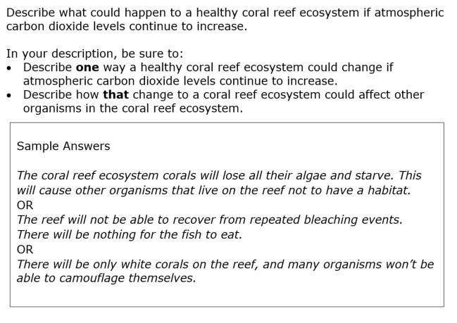
Item 5
Notes:
Here are a few sample answers for Item 5. There are other creditable answers. [PAUSE]
This item was developed to align to HS-LS2-6, the first Performance Expectation we looked at.

Slide 45
Item 5
Notes:
Here is the set of item specifications and details and clarifications again for HS-LS2-6.
Which specification does this item most closely align to? Take a few moments to decide.
If you chose HS-LS2-6.1, then you agree with the educator work groups that developed and reviewed this item.
Students use evidence given in the stimulus to construct an argument (SEP) about how a change (CCC) could affect the relationships between different species in an ecosystem (DCI).
This brings us to the end of our alignment activity. Alignment judgements are made and revisited during each step of the science assessment development process, and Washington educators are a key part of these discussions. Although making some alignment judgements is more clean cut than making others, we are confident in the process, documentation, and decisions that are used for aligning the WCAS items to the NGSS.
The alignment activity can be repeated using the three standalone items and the Competing Forces cluster from the Grade 11 Training test. Performance Expectation and answer key information for all of the training test items is found on page 7 of the Grade 11 Training Test Lesson Plan mentioned on slide 23.

Slide 46
Vocabulary Terms
Notes:
You’ll find a list of expected SEP, DCI, and CCC vocabulary terms on the last three pages of the Test Design and Item Specifications document.

Slide 47
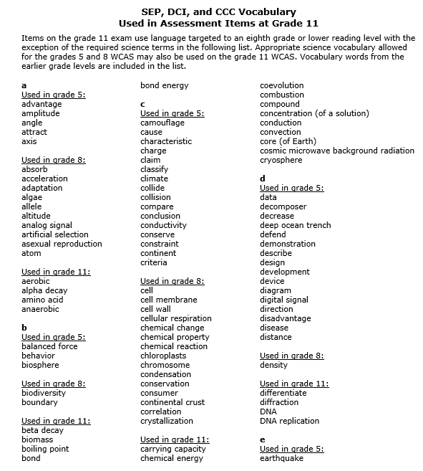
Expected SEP, DCI, and CCC Vocabulary
Pages 166-169
Notes:
WCAS stimuli and items use language targeted to the previous grade level or lower readability with the exception of the required SEP, DCI, and CCC terms that are included in the vocabulary list. Students are expected to know the meaning of these words when they take the WCAS, even though the words may be above grade level.
Notice that the list includes the science words required for grades 5 and 8 . High School students are expected to know these words also.
OSPI cannot endorse any particular resource or curriculum, therefore we can’t point to a particular source for definitions.

Slide 48
Q&A
Notes:
We are going to stop here and answer a few more questions that have come in.

Slide 49
Reminders & Wrap up
Notes:
Please remember that the Test Design and Items Specifications documents are intended to guide the writing of test items for the state summative assessment.
Classroom instruction should align to the Washington State K–12 Science Learning Standards (NGSS). The Test Design and Items Specifications documents can also serve as another resource, much like the NGSS Appendices, to help clarify understanding of the standards.
The Test Design and Items Specifications documents will be updated through the steps of the assessment development cycle, and a modifications log will be published that shows where changes were made.

Slide 50
Where to find the materials
WCAS Educator Resources Webpage
https://www.k12.wa.us/student-success/testing/state-testing-overview/washington-comprehensive-assessment-science/wcas-educator-resources
  Presentation slides with script 1 week out
  FAQ document with answers to Chat questions 1 week out
  Webinar recording 2 weeks out
pdEnroller
https://www.pdenroller.org/
Notes:
We will post this PowerPoint presentation, including notes with our script, on the WCAS Educator Resources Webpage by a week from today. We’ll put it in the section about the “Test Design and Item Specifications.”
An FAQ with your questions as well as a recording of the webinar will be posted next to the presentation by the end of the following week.
Remember that if you would like to receive clock hours, you need to sign in, register, and complete an evaluation of the webinar through pdEnroller.

Slide 51
Thank You!
Notes:
We will keep the webinar open for a few more minutes to capture any remaining questions you may want to enter into the chat box.
Thank you for joining us this afternoon.

