Slide 1
State Summative Science Test
Year 2
WERA Conference
December, 2019
Washington Comprehensive Assessment of Science (WCAS)
Office of Superintendent of Public Instruction
Chris Reykdal, State Superintendent

Slide 2
Welcome!
Who is with us today?

Slide 3
Science Assessment Office Staff
General e-mail account
  science@k12.wa.us
Dawn Cope — Science Assessment Lead
  dawn.cope@k12.wa.us
Jacob Parikh—Science Assessment Specialist
  jacob.parikh@k12.wa.us
Korey Peterson—Science Assessment Specialist
  korey.peterson@k12.wa.us
Jessica Cole—Administrative Assistant
  jessica.cole@k12.wa.us

Slide 4
Today’s Topics
  Current State Tests
  WCAS Results
  WCAS Design and Features
  Assessment Resources
  Training Test and Item Specifications Activity
  WCAS Development

Slide 5
Current State Tests

Slide 6
Why do we have state tests?
The No Child Left Behind Act (NCLB) and state law require that we give a state science test once each in elementary, middle, and high school for the purpose of school and district accountability.
The Every Student Succeeds Act (ESSA) continues those same requirements.

Slide 7
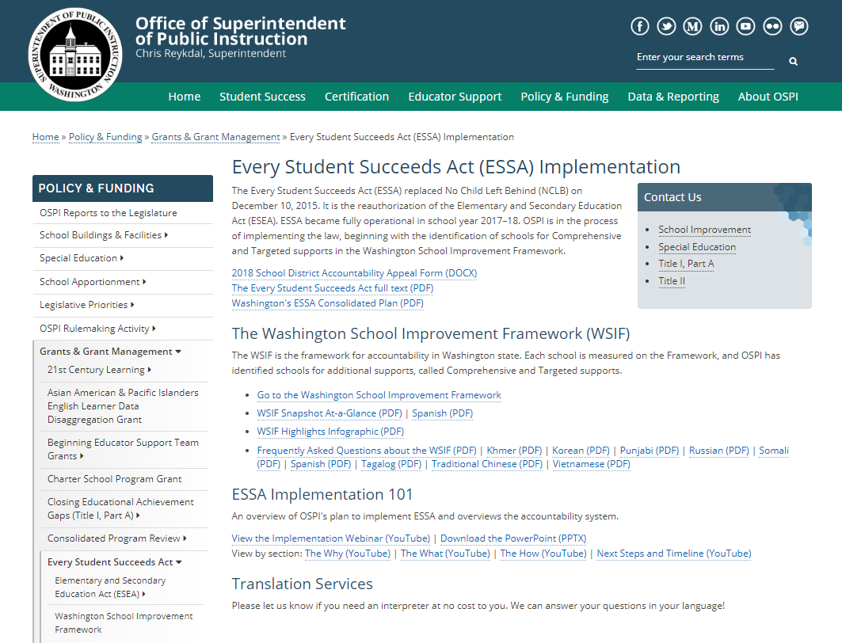
Every
Student
Succeeds
Act
(ESSA)
https://www.k12.wa.us/policy-funding/grants-grant-management/every-student-succeeds-act-essa-implementation

Slide 8
House Bill (HB) 1599
The high school science assessment graduation requirement was removed.
Students need to demonstrate their readiness for post-secondary career or college via one or more pathways. The pathways available to the Class of 2020 are:
  Smarter Balanced or WA-AIM (ELA and math)
  Dual credit courses in English language arts (ELA) and math
  High school transition courses in ELA and math
  C+ in AP, IB, or Cambridge class or achieving certain score on AP, IB, or Cambridge tests in ELA and math
  ACT or SAT score
  COE-Local, if completed during the 2018–19 school year
  Students must demonstrate skills via a pathway for ELA and math. The above options can be used interchangeably to meet both requirements. Alternatively, the following two pathways are considered to meet both ELA and math.
  ASVAB
  CTE Sequence, including completing a Core Plus branded program
Some students with disabilities may demonstrate
  CIA cut-score on Smarter Balanced ("L2 Basic")
  Locally Developed Assessment (LDA)
  Off-grade assessment
OSPI-Graduation Requirements HB 1599

Slide 9

State Science Standards
Washington State adopted the Next Generation Science Standards (NGSS) as science learning standards in October of 2013.
    2013 Washington State K-12 Science Learning Standards
WCAS first administered in Spring 2018
    5, 8, 11

Slide 10

NGSS Resources
Next Generation Science Standards (NGSS)
NGSS Appendices
K–12 Framework for Science Education

Slide 11
Learning and Teaching Science
Ellen Ebert, Director
  Ellen.Ebert@k12.wa.us

Slide 12
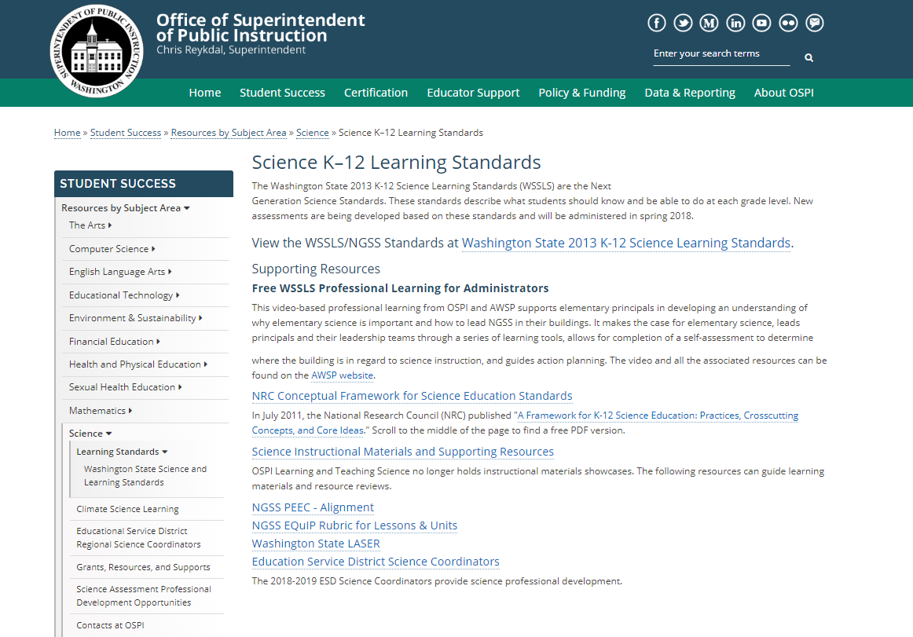
2013
Washington
State K-12
Science
Learning
Standards
https://www.k12.wa.us/student-success/resources-subject-area/science/science-k%E2%80%9312-learning-standards

Slide 13
Washington Comprehensive Assessment of Science (WCAS)
Washington State 2013 K-12 Science Learning Standards Next Generation Science Standards (NGSS)
Grade 5 | Grade 8 | Grade 11
3-5 band | Middle School band | High School band
http://www.k12.wa.us/Science/Standards.aspx

Slide 14
2020 WCAS Test Windows
Grades | Requirement | Testing Window
5 & 8 | Required for federal and state accountability | Online: April 13 – June 5 Accommodated Paper Form: April 13 – May 22
11 | Required for federal and state accountability | Online: May 4 – June 5 Accommodated Paper Form: May 1 – May 22
Accommodated paper testing is available only to support large print, braille, and standard print (English and Spanish) forms for students whose IEP or 504 plan states paper.
The student to Test Administrator (TA) ratio should be no greater than 3 students to 1 TA when administering the WCAS accommodated paper form.
http://www.k12.wa.us/assessment/StateTesting/timelines-calendars.aspx

Slide 15
WCAS Accommodated Paper Testing
Standard forms and Spanish forms are shipped back to the vendor for processing and scoring
Large print and braille student responses are transcribed onto a standard print form before being shipped back to vendor for processing and scoring
Resources
  Paper Test Administration Manual (TAM): https://wa.portal.cambiumast.com/resources/user-guides-and-manuals-testc/
  Training Module: https://wa.portal.cambiumast.com/resources/modules-testc/
  Secure TA Script of Student Directions—shipped with test booklets

Slide 16
WCAS Results

Slide 17
Statewide WCAS Results-Grade 5
97% participation
93% participation

Slide 18
Statewide WCAS Results-Grade 8
96% participation
92% participation

Slide 19
Statewide WCAS Results-Grade 11
66% participation
63% participation

Slide 20
2018 Reporting Area Performance
Practices and Crosscutting Concepts in Physical Sciences
Practices and Crosscutting Concepts in Life Sciences
Practices and Crosscutting Concepts in Earth and Space Sciences

Slide 21
2019 Reporting Area Performance
Practices and Crosscutting Concepts in Physical Sciences
Practices and Crosscutting Concepts in Life Sciences
Practices and Crosscutting Concepts in Earth and Space Sciences

Slide 22
Questions to explore…
How much time do kids spend on science?
Is your science curriculum aligned to the NGSS?
When did NGSS implementation occur?
How much training has staff received on the NGSS?
Did students practice with WCAS training tests?
How do your results compare to the state average? Similar districts/schools?
How many students in your school/district participated in the WCAS ?
Are your scores considerably different in one reporting area?

Slide 23
2019 Scale Score Ranges
Washington Comprehensive Assessment of Science
The cut (or threshold) scores for Levels 1, 2, 3, and 4 were developed by Washington educators. These cut scores were adopted by the State Board of Education in August 2018
Grades | Level 1 | Level 2 | Level 3 | Level 4
5 | 375 – 649 | 650 – 699 | 700 – 784 | 785 – 1060
8 | 345 – 649 | 650 – 699 | 700 – 764 | 765 – 1060
11 | 390 – 649 | 650 – 699 | 700 – 790 | 791 – 1190
http://www.k12.wa.us/assessment/StateTesting/ScaleScores.aspx

Slide 24
Scores—Communication Timeline
Scores made available in the Online Reporting System (ORS) on the WCAP Portal in August
Statewide test scores were publically released on Report Card in September
Paper WCAS Individual Score Reports (ISRs) arrived in districts in October

Slide 25
WCAS Design and Features

Slide 26
NGSS Performance Expectations per Grade Band
Reporting Area | Number of Three-Dimensional Performance Expectations
 | 3-5 | Middle School | High School
Physical Science Domain | 17 | 19 | 24
Life Science Domain | 12 | 21 | 24
Earth and Space Science Domain | 13 | 15 | 19
Engineering Domain | 3 | 4 | 4
Total | 45 | 59 | 71
Each Performance Expectation (PE) includes a Science and Engineering Practice,
a Disciplinary Core Idea, and a Cross-cutting Concept

Slide 27
WCAS Reporting Areas
Reporting Area | Grade 5 | Grade 8 | Grade 11
Science and Engineering Practice and Cross-Cutting Concepts in Physical Sciences | 17 Performance Expectations 40% ~14 pts | 19 Performance Expectations 35% ~14 pts | 24 Performance Expectations 36% ~16 pts
Science and Engineering Practice and Cross-Cutting Concepts in Life Sciences | 12 Performance Expectations 29% ~10 pts | 21 Performance Expectations 38% ~15 pts | 24 Performance Expectations 36% ~16 pts
Science and Engineering Practice and Cross-Cutting Concepts in Earth and Space Sciences | 13 Performance Expectations 31% ~11 pts | 15 Performance Expectations 27% ~11 pts | 19 Performance Expectations 28% ~13 pts
Total Points | 35 | 40 | 45
ETS PEs assessed but not included here.

Slide 28
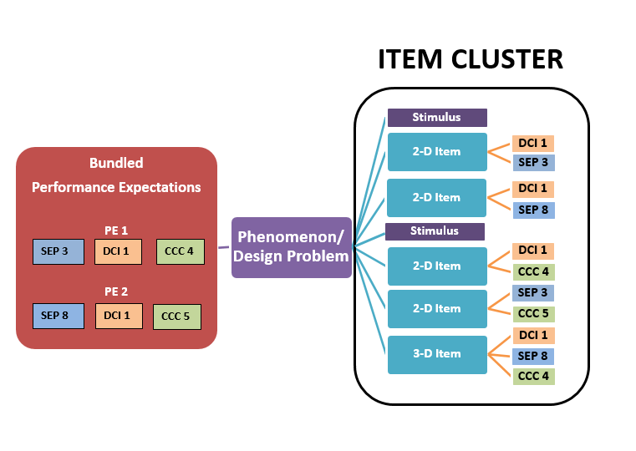
Item Cluster Map
Notes:
An item cluster is composed of stimuli and multi-dimensional items. The cluster is used to explain a phenomenon or solution to a design problem. This example of an item cluster map shows a phenomenon or design problem that incorporates two performance expectations. Each performance expectation has three dimensions. To fully explain the phenomenon or design problem in the item cluster each item aligns to two or more of the dimensions from the bundled performance expectations. In this example the first stimuli is followed by two items, then the students are updated by a second stimuli followed by three more items.

Slide 29
Standalone Items
Allow more PEs to be assessed on a test
Are 2 or 3 dimensional
Can have multiple parts
Computer scored item types only

Slide 30
WCAS Features
All online
Item Clusters and Standalone Items
Item Types:
  Selected Response—multiple choice, multiple select
  Constructed Response—short answer
  Technology enhanced—ex: drag and drop, drop-down choices, simulations
Multi-part items
  Parts labeled with letters A, B, and C.
  May have a mix of item types. Parts work together. May ask for evidence to support answer in previous part of the item.

Slide 31
Structure and Test Length
Structure
  Operational
    Grades 5 and 8: 5 Clusters and 6-12 Standalone items
    High School: 6 Clusters and 6-12 Standalone items
    Counts toward a student’s score
  Field test items
    Embedded in the online administration
    One cluster and/or standalone items
    Does not count toward a student score
  All items are aligned to 2 or 3 dimensions of a PE
Test Length
  Grade 5: 90 minutes
  Grade 8: 110 minutes
  Grade 11: 120 minutes
Administration
  Can be administered in multiple sessions like the Smarter Balanced ELA and Math assessments
  1 to 3 sessions recommended

Slide 32
Special WCAS Features
Collapsing stimuli
  First stimulus is hidden when second stimulus is provided.
  Both stimuli are available to the student.
Locking Items
  Student can answer the question only once.
  Allows subsequent questions to update with correct information.
  An “attention” box warns student that they won’t be able to change their answer.

Slide 33
WCAS Training Tests
Help students become familiar with the features and tools of online tests.
Available on the WCAP portal.
Will be updated in late December 2019

Slide 34
Assessment Resources

Slide 35
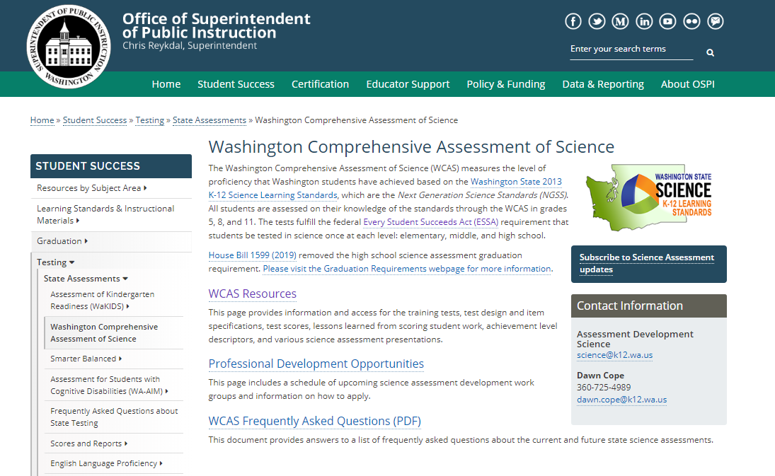
Science Assessment Webpage
https://www.k12.wa.us/student-success/testing/state-testing-overview/washington-comprehensive-assessment-science

Slide 36
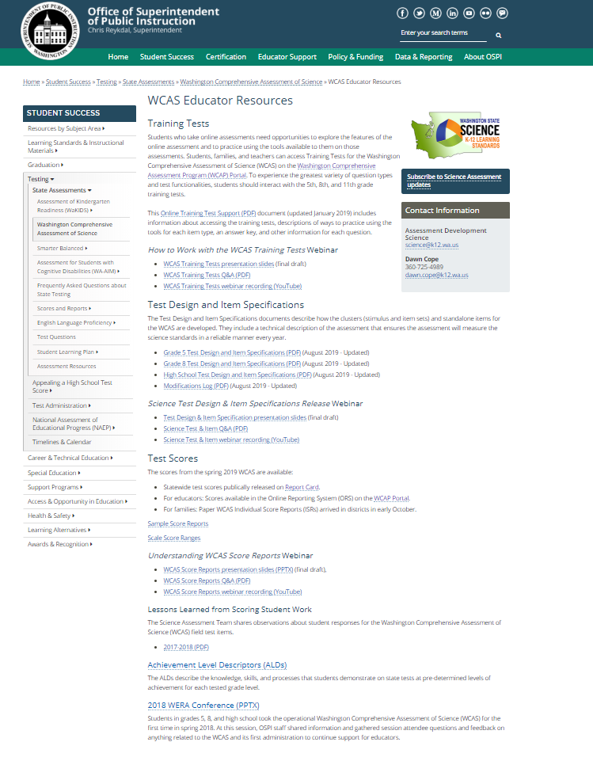
WCAS
Educator
Resources
Webpage
https://www.k12.wa.us/student-success/testing/state-testing-overview/washington-comprehensive-assessment-science

Slide 37
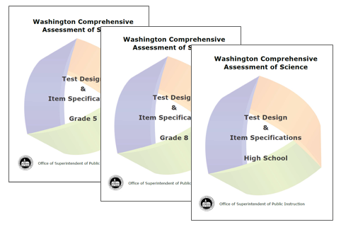
WCAS Test Design and Item Specifications

Slide 38
WCAS Test Design and Item Specifications
Describe how item clusters (stimuli and items) and standalone items for the WCAS are developed to assess the NGSS
Contents
  Structure of the test
  Item Types
  Test organization
  Overview of NGSS
  Item specifications that describe how students can demonstrate understanding of the PEs on the state test.
  Vocabulary word list
The documents will be updated annually based on WA educator feedback.
A modification log will be posted at each subsequent publication.

Slide 39
WCAS Development

Slide 40
Goals for WCAS
Design an assessment that reflects how science content is taught and tested in the classroom.
Use WA educators in assessment development.
Develop high quality item clusters and standalone items that achieve alignment to the SEPs, DCIs, CCCs represented in a PE or PE bundle.
Design an assessment that allows for valid and reliable inferences to be drawn from the results.
Design an assessment that ensures the fair and accurate assessment of students in special populations.

Slide 41
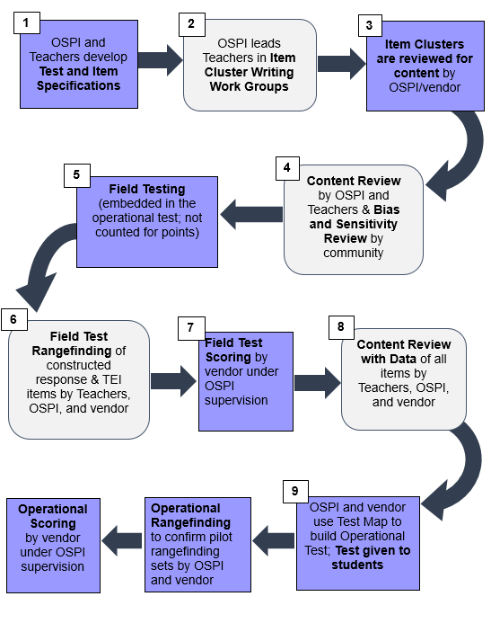
Science Assessment Development Cycle
Notes:
The first step in the development cycle is the Test and Item Specifications. The test and item specifications are revised and updated yearly, so the document is always a working draft. The first public draft of the specifications for the WCAS was published in fall 2017. The specifications provide valuable information for several audiences, including educators and item writers. All of the meetings in the development cycle provide insight into updates of the specifications.
The next step is item cluster writing. In an Item Cluster Writing Work Group, teams of 2-3 educators write stimuli, items, and rubrics designed to validly measure student understanding of the state standards.
The products of the item cluster writing work groups are reviewed for content by OSPI and our test development vendor.
During Content Review, educators review the products of the item cluster writing work group to ensure every stimulus, item, and rubric is scientifically accurate and gathers appropriate evidence about student mastery of the NGSS. At the same time, a separate committee of community members reviews the items and stimuli for any bias and sensitivity issues. Recommendations from the Bias and Sensitivity review are considered by the Content Review work group.
The items (clusters and standalones) are reviewed by OSPI and our test development vendor before Field Testing.
The next step for field-tested constructed response items (like short answer questions) and technology enhanced items (like graphs) is Field Test Rangefinding. Educators look at a range of student responses to each item and decide how to score each response. The scoring rubrics are refined and the materials that will be used to score the pilot/field test items are produced by this work group.
Next, field test items (including multiple choice and multiple select) are scored by our scoring vendor.
After that, data about the item performance is seen by another work group of educators during Content Review with Data. Educators see data for each item that answers questions like:
How many students answered each item correctly?
Which “wrong” answers were chosen by the most students?
Did students of a particular gender or ethnicity answer an item differently than the rest of the students?
The work group will use all of the data, as well as their science content knowledge, to decide if the items should advance into the item bank.
OSPI and our test development vendor use the Test Map to build Operational Tests using only items that have been accepted into the item bank.

Slide 42
Educator Work Group Descriptions
(2) Item Cluster Writing Workgroup: Teams of 2-3 educators write stimuli, items, and rubrics designed to validly measure student understanding of the NGSS.
(4) Content Review Workgroup: Educators review the products of the Item Cluster Writing Workgroup to ensure that every stimulus, item, and rubric is scientifically accurate and gathers appropriate evidence about student skill with the NGSS. At the same time, a separate committee of community members reviews the items and stimuli for any bias and sensitivity issues. Recommendations from the Bias/Sensitivity Review Workgroup are considered by the Content Review Workgroup.
(6) Field Test Rangefinding : Educators look at a range of student responses to each short answer item and decide how to score each response. This educator workgroup refines scoring rubrics and produces the materials that will be used to score the field test items.
(8) Content Review with Data Workgroup: Educators use item performance data, as well as members’ science content knowledge, to decide whether each item should advance into the item bank.

Slide 43
Upcoming Professional Development Opportunities
Event | Timing
Item Cluster Writing | March 2020
Field Test Range Finding | July 2020
Content Review | August 2020
Content Review with Data | September 2020

Slide 44
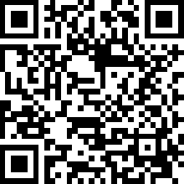
Stay informed and get involved
Sign up for Science Emails or Texts messages
  Go to the Subscribe page for GovDelivery. Enter your email address. On the Subscriptions page, select Content Areas > Science, then select Science Assessment for the grade band(s) for which you would like to receive information.

Slide 45
Thank you!

