Slide 1

Welcome
While others are logging on, please introduce yourself by entering the following into chat:
Your Name, School District, Position and...
If you made one, your new year’s resolution!
Notes:
Pd Enroller description and registration: https://ncesd.zoom.us/webinar/register/WN_tQ8oQ-tNR4eXtWIq1H9oPQ
Darcey will send a panelist email link for January 14th
Jen?

Slide 2

Land Acknowledgement
Notes:
Today, those of us representing OSPI respectfully acknowledge that the agency is located on the traditional lands of the Squaxin Island Nation - Descendants of the maritime people who lived and prospered along the shores of the southernmost inlets of the Salish Sea. We ask each of you to show gratitude to the Tribal Nations where you are currently located.
We acknowledge the commitment of all Pacific Northwest Tribes to the resurgence of their traditional ways and their respect and protection of all peoples, not only those who are living, but also those who have gone before and who are yet to be born. We pay our respect to the elders both past and present and to a valued resource the Tribes have defined as their children. They are the Tribes future. They are the future for us all.
We raise our hands to all sovereign Tribes who have stewarded these beautiful lands throughout the generations.
Jen

Slide 3
Cultural Acknowledgment
We acknowledge the pain and trauma of these past months and over 400 years of racism in the United States.
We stand with our communities of color, especially
those who identify as and/or are categorized as African-American. We also acknowledge the intersectionality of those who identify both as
persons of color and individuals with disabilities.
We commit to centering our work to dismantle systemic racism and disrupt ableist structures.
Notes:
Jen?

Slide 4

AESD/OSPI Webinar Series:
High School & Beyond Plans and IEP Transition Examples
January 14, 2021
Notes:
(START RECORDING)
Good afternoon! My name is Jennifer Story, Special Education Program Improvement Coordinator. Welcome to the second webinar of this monthly series to support inclusive IEPs and instruction in our new world.
Today’s webinar will focus on Highschool and Beyond Plans and IEP transition Plans. We are so excited to be joined today by a District partner, who will introduce themselves in a few moments.
Jen

Slide 5
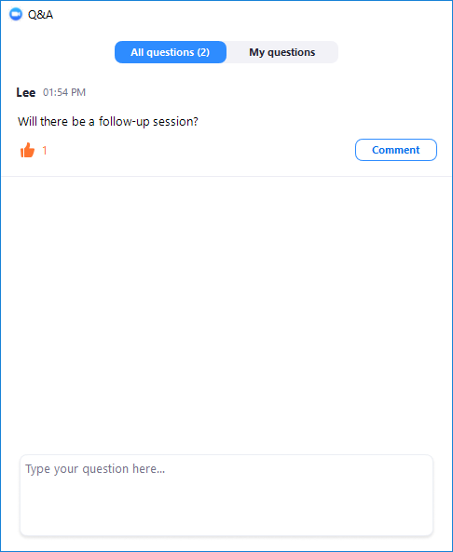
Webinar Engagement Options
Webinar sessions will be recorded
Recordings & Presentations will be added to the OSPI Website HERE
Links will be dropped in chat periodically
Use the Q & A Screen for the following actions:
  Thumbs up (Yes, I have same question)
  Comment on existing question
  Ask a question
  Raise your hand
Notes:
The webinar sessions will be recorded and posted to the OSPI Special Education Monthly Update page, which is linked on this slide. We’ll also share the link a few times throughout today’s session. Please use the Q&A screen to submit your questions at any time.
Jen

Slide 6
AESD/OSPI Monthly Webinar Series:
Feb 11, 3pm:
Integrated Early Learning Environments
Mar 11, 3pm:
Accessibility and Assistive Technology
Registration Link
Registration Link Coming Soon
Webinar Series Flyer Link
Notes:
We are all in this new world together! Join us on the second Thursday of each month from 3:00-4:00 pm for this webinar series. We will focus on supporting special educators, general education partners, and system leaders by highlighting effective strategies for providing inclusive instruction. Planning and delivering inclusive instruction across different reopening models is new and complex! We hope these sessions provide opportunity for questions and answers so participants can apply the learning to their own local contexts. The registration links for the next two sessions are included on this slide, along with the series flyer.
Jen

Slide 7
Webinar Series Learning Objectives:
Learn how to collaboratively provide an inclusive and effective framework for High School and Beyond Planning.
Explore how to align a student's HSBP and IEP transition plan by viewing a sample exemplar.
Discover how to shift the HSBP implementation process to better meet the transition needs of students.
Notes:
The objectives for this monthly webinar include…
Jen

Slide 8
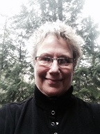

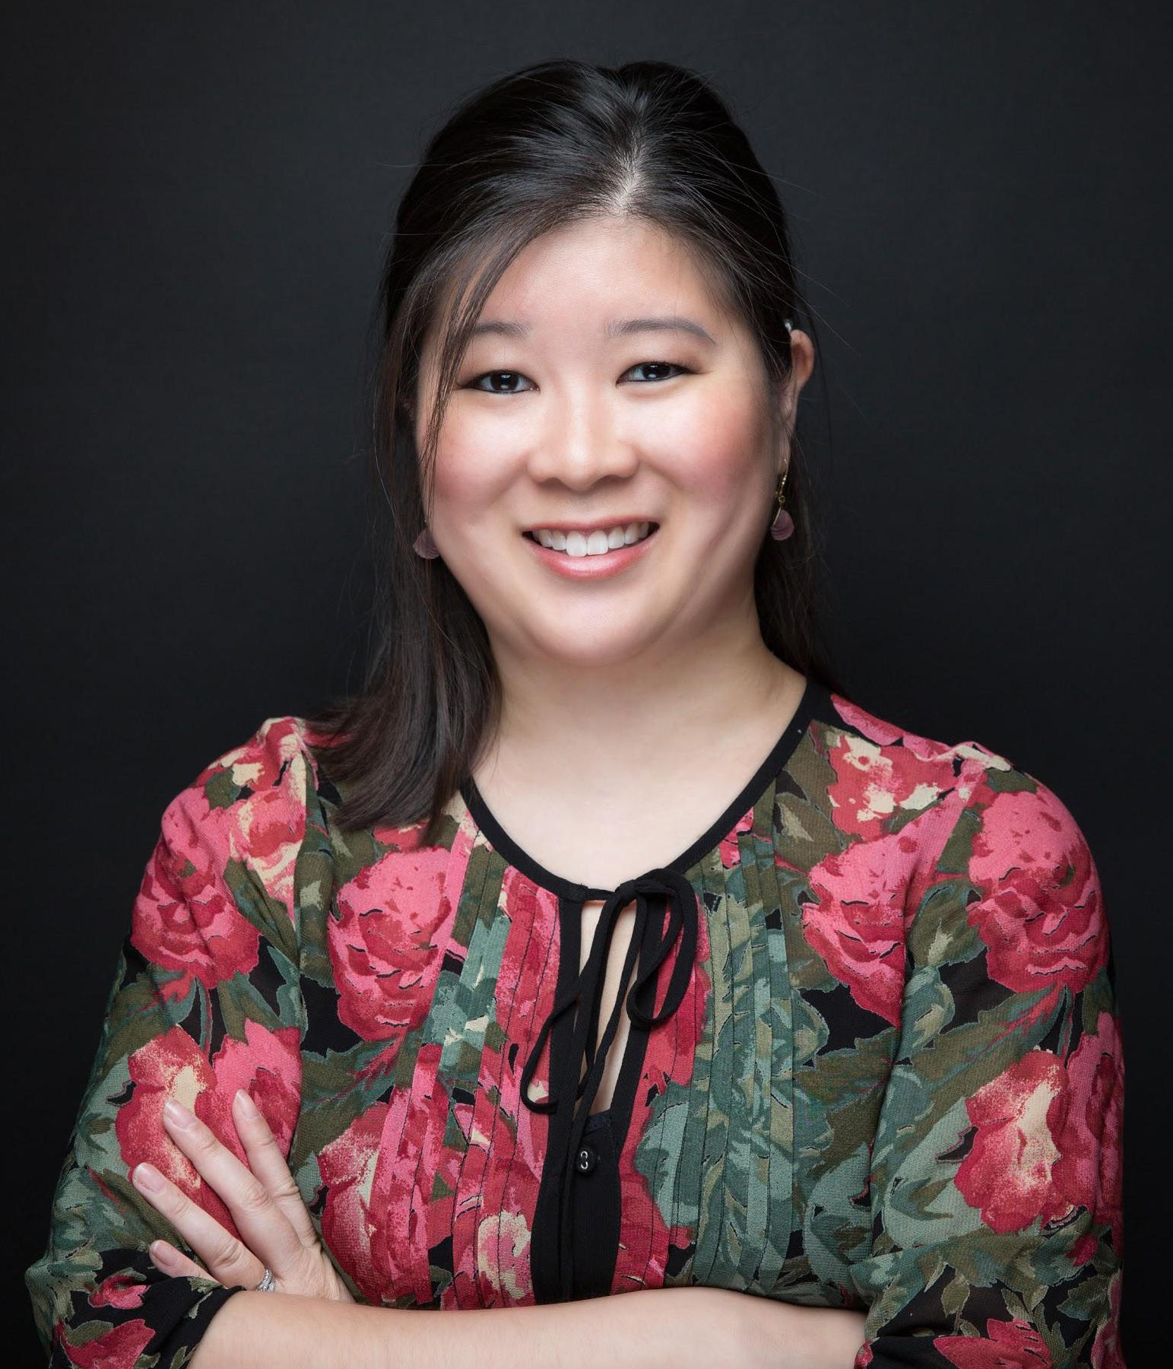
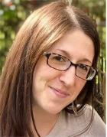
Today’s Presenters
Kris Hirschmann
Director of Transition Services
Center for Change and Transition Seattle University
Alexandra Toney
Special Education
Program Supervisor
OSPI
Kristen Wong Callisto
Director of Special Education
Bellevue School District
Jennifer Strehle Special Ed. Transition Coordinator
Bellevue School District
Notes:
I am so very excited about today’s presenters! Let’s take a moment to have them introduce themselves. We can start with Kris 😊 Thank you so much for joining us today!
Run of show:
Opening (Tania)-5 Minutes
Collaborating and Effective Transition Practices (Kris) : 15 minutes
Dig into Case Study (Alex): 15 minutes
Bellevue Voices from the field on the HSBP process: 25 minutes

Slide 9

Today’s Discussion:
http://clipart-library.com/data_images/141710.jpg
Transition and High School and Beyond
Plans (HSBP)
Dig into an example of an Aligned HSBP
and IEP
Voices from the Field, HSBP Planning
  Kristen Wong Callisto, Bellevue School District
  Jennifer Strehle, Bellevue School District
Notes:
Today;s webinar will have three parts, we will discuss Transition and High School and Beyond Plans, Briefly dig into our newly published case study and then hear from our partners in Bellevue about how they are approaching HSBP Planning.
Jen
Run of show:
Opening (Tania)-5 Minutes
Collaborating and Effective Transition Practices (Kris) : 15 minutes
Dig into Case Study (Alex): 15 minutes
Bellevue Voices from the field on the HSBP process: 25 minutes

Slide 10

Transition and High School and Beyond Plans
https://float-production-blog.storage.googleapis.com/2020/01/cross-collaboration-Float.png
Notes:
How are they alike and different.
How can we collaborate to make the quality documents for students.

Slide 11
What are the basic elements of a Transition Plan?
Age-Appropriate Assessments
Post-Secondary Goals
Transition Services
Course of Study
Annual IEP goals
Agency Connections
Notes:
In the year that a student turns 16, it is required by state and Federal laws that transition services are included in their IEP.
Research shows that there’s a sequence in which transition services should be developed.
This intentional flow starts with the age-appropriate transition assessments.
The results of these assessments inform all the activities that follow: writing measurable postsecondary goals, identifying transition services, writing the course of study and annual goals, and coordinating with adult agencies.
These activities create a viable IEP that is designed by and for the student to make a successful transition to post-school living.
The transition component of the IEP becomes a framework for the rest of the IEP.
And the IEP is revisited and adjusted at each annual meeting based on new data and present levels of performance.

Slide 12
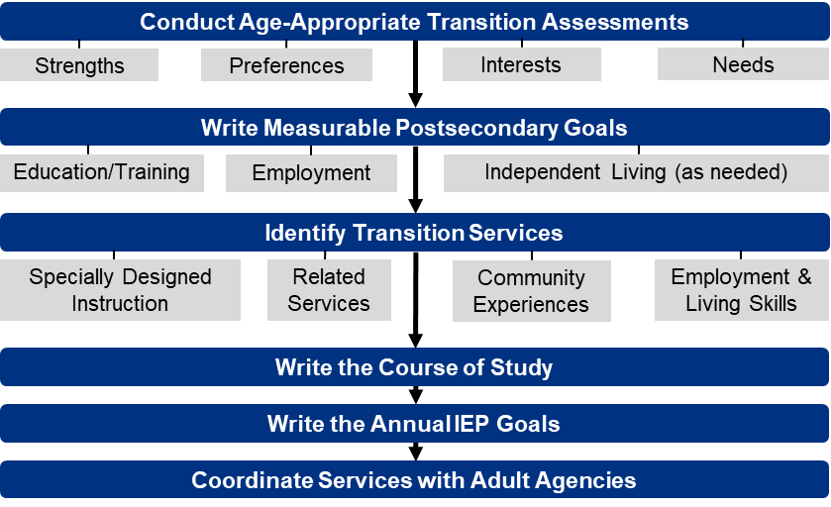
CCTS Transition Services Flowchart (Johnson, 2019)
Notes:
In this slide, we see those transition components assembled into a flowchart.
Dr. Cinda Johnson, Principal Investigator at CCTS developed this flowchart, which forms the underpinnings of all our trainings at CCTS.
These components are intentionally listed in order of implementation
The flowchart also includes several subcomponents that have been added to the first three sections of the sequence.
In conducting the age-appropriate transition assessments, the purpose is to help the student identify their strengths, preferences, interests, and needs.
Under writing measurable postsecondary goals, there need to be goals written in the areas of education and training, employment, and if considered necessary by the IEP team, independent living.
And in the area of identifying transition services, specially designed instruction, any necessary related services, community experiences, and employment and living skills need to be addressed to support the progress toward reaching the student’s postsecondary goal.
The Writing Effective Training Plans training on our website goes into much greater depth https://www.seattleu.edu/ccts/professional-development-and-training/writing-effective-transition-plans/

Slide 13
What is the High School and Beyond Plan (HSBP)?
State graduation requirement
Student-generated
Student-facing
Each student must have a HSBP to guide the student’s high school experience and prepare the student for postsecondary education or training and career (ESHB 2224, Chapter 31, Laws of 2017).
Notes:
The HSBP is a student generated and student facing document that meets one of the state high school graduation requirements. It is designed to help a student plan their school experiences leading up to post secondary education, training and a career.

Slide 14
HSBP Big Picture
HSBP | High School | Beyond
Career | Career interest and skills inventory Identify career goals | Work-based learning experience Job application
College | Identify educational goals Identify financial aid options | Postsecondary program experience (e.g. site visit) Financial aid applications
Life | “Who am I?” “Who will I become?” | Budget for life after high school Volunteer or community service experience
Notes:
The high school and beyond plan addresses three areas, Career, College and Life. Each category is broken into two parts which allows the student to consider what to do while in high school as well as prepare for the activities beyond high school.
The writing of the HSBP is done by the student with engagement from the family. It is reviewed annually and revisions are made when needed. The student drives these activities with the guidance and support of a counselor, teachers and family members.

Slide 15

What are the elements of a HSBP?
Career goals, informed by a Career Interest Inventory
Educational goals
A course-taking plan
Current résumé or activity log
Information on State and Federal Financial Aid
Notes:
an identification of career goals, aided by a skills and interest assessment;
• an identification of educational goals;
• a plan for course-taking that fulfills state and local graduation requirements and aligns with the student's career and educational goals;
• and by the end of twelfth grade, a current resume or activity log that provides a written compilation of the student's education, any work experience, and any community service and how the school district recognized the community service.

Slide 16
Do any of these things sound familiar?
Elements | HSBP | IEP Transition Plan
Assessment | Career Interest Inventory | Age-Appropriate Transition Assessment
Goals | Career and educational | Post-secondary and Annual IEP
Course work | Four-year plan for course-taking | Course of Study
Summary | Current résumé or activity log | Summary of Performance

Slide 17
When, Who, Why and How?
 | HSBP (All students) | IEP Transition Plan
When | Starts in 7th or 8th grade | In the IEP year that the student turns 16
Who | Student-generated/student-facing Usually school counselor or advisor-facilitated | IEP Team
Why | State graduation requirement | Federal requirement (IDEA)
How | Reviewed/updated annually Guides course choices and school/community activities | Reviewed/updated annually Guides all activities of the IEP Measurable outcomes
Notes:
These two are more alike than different. The purpose of each is to provide a plan for achievement of post secondary goals with very distinct pieces that promote student choice and voice.

Slide 18
Strategies/Tips and Tricks (1 of 2)
Help the student and parents visualize the future
Start the conversation early – middle school or before
Prepare the student for independence (self determination, self advocacy, decision making, etc.)
Have high expectations and rigorous curriculum that lead to success
Actively engage students in their learning with post school goals in mind
Teach “soft skills”
Teach students the 28 Skills of a Really Ready Student
Provide opportunities for students to explore careers and their community
Notes:
The question often comes up about what do we do in our classrooms to prepare students for developing their plans - so here are some suggestions that can be used by both the GE and SE teachers.

Slide 19
Strategies/Tips and Tricks (2 of 2)
Access work-based experiences
Think ‘outside the box’ or ‘as if there is no box’
Engage the community – businesses, clubs, activities, etc.
Collaborate with the student and others to support the navigation of their high school opportunities and relationship to their post high school plans
Create opportunities to provide evidence-based practices for post school success for all students
Notes:
28 skills – critical thinking, communication, growth mindset, self directed, social and emotional skills, self awareness, relationship skills, responsible decision making, social awareness and perspective-taking, self management, problem solving, reflection, flexible and adaptable, active learner, nimble, resourceful, project and task management, articulate strengths and areas of need, life management , curious and inquisitive, digital citizens, innovative and entrepreneurial, passionate and positive, embrace failure, analytical and evaluative, grit and perseverance, logic and reasoning, and cross cultural communication

Slide 20
Tools and Resources
28 Skills of a Really Ready Student
Guidelines for Aligning HSBPs and IEP Transition Plans
High School and Beyond Plan IEP Transition Checklists for Educators
National Center on Secondary Education and Transition
OSPI Secondary Transition
Soft Skills to Pay the Bills
T-Folio
Transition Coalition
Zarrow Center Transition Education Resources
Notes:
T-Folio – The T-Folio is a free transition portfolio tool for high school age youth with disabilities. It is designed to guide youth in exploring, identifying, and planning for their desired post-school goals. This tool represents a compilation of activities and products showcasing each youth’s ongoing transition process. It is their individual story of who they are, where they have been, and where they are headed after high school.
Guidelines for Aligning HSBPs and IEP Transition Plans -- The purpose of this document is to provide general information and guidelines to educators, staff, and administrators for developing and aligning the HSBP and the IEP, including suggestions for minimizing duplication.
National Center on Secondary Education and Transition - NCSET coordinated national resources, offered technical assistance, and disseminated information related to secondary education and transition for youth with disabilities in order to create opportunities for youth to achieve successful futures.
OSPI Secondary Transition - Technical assistance resources on this page include research, articles, tools, templates, technical assistance centers, and websites.
Soft Skills to Pay the Bills - "Skills to Pay the Bills: Mastering Soft Skills for Workplace Success," is a curriculum developed by ODEP focused on teaching "soft" or workforce readiness skills to youth, including youth with disabilities.
Transition Coalition - the Transition Coalition, located at the University of Kansas, Beach Center on Disability, has been maximizing professional development opportunities for secondary transition and college and career readiness of youth with disabilities.
Zarrow Center Transition Education Resources - The Zarrow Center for Learning Enrichment facilitates successful secondary and postsecondary educational, vocational and personal outcomes for students and adults with disabilities

Slide 21
What is the T-Folio?
A free digital platform with a series of interactive exercises that helps youth complete the items needed for their transition portfolios and high school and beyond plans through the support of a facilitator.
Schools and counselors are already required to provide planning for transition services and graduation. The T-Folio is a supplemental tool that makes it easier!
Notes:
T-Folio is a free digital platform that helps youth, with the assistance of a facilitator, to complete the items needed for their transition portfolios through a series of interactive exercises. T-Folio aligns with both Individualized Education Program (or IEP) transition planning and the Division of Vocational Rehabilitation’s Pre-Employment Transition Service categories so both educators and agency personnel will find it useful.
Schools and counselors are already required to provide transition services. The T-Folio is a supplemental tool that makes it easier for anyone working with youth on their transition goals.

Slide 22
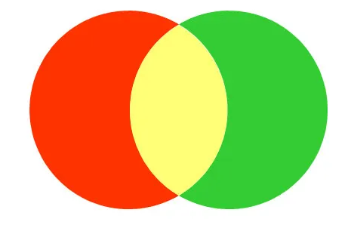
T-Folio aligns with:
Individualized Education Program (IEP) transition planning
High School and Beyond Plans (HSBP)
Division of Vocational Rehabilitation’s Pre-Employment Transition Services.

Slide 23

T-Folio Units
Student-Centered Introduction
Unit 1: Job Exploration Groundwork
Unit 2: Postsecondary Employment and Education Options
Unit 3: Work-based Learning Experiences
Unit 4: Workplace Readiness Training
Unit 5: Self-Advocacy
T-Folio
Photo by Matt Duncan on Unsplash
Notes:
The T-Folio includes a Student-Centered Introduction and five units for a total of 36 lessons.

Slide 24
High School and Beyond Plan
Many T-Folio activities align with the High School and Beyond Plan (HSBP) required for all students for graduation, including:
  Career Interest Inventory (see T-Folio Unit 1, Lesson 3)
  Educational goals (Unit 2, Lesson 2)
  Course planner (Unit 2, Lesson 5)
  Personalized pathway (Unit 2, Lesson 7)
  Resume/activity log (Unit 4, Lesson 2)
Notes:
T-Folio activities can be used to supplement the development of the student’s High School and Beyond Plan. Some of the High School and Beyond Plan components found in the T-Folio include:
Career Interest Inventory (T-Folio Unit 1, Lesson 3)
Educational goals (Unit 2, Lesson 2)
Course planner (Unit 2, Lesson 5)
Personalized pathway (Unit 2, Lesson 7)
Resume/activity log (Unit 4, Lesson 2)

Slide 25

HSBP Case Study:
Kaleb, Adult Student with Transition Supports
Guidelines for Aligning HSBP and IEP Transition Plans Document Suit
Appendix B: Sample HSBPs and IEP Transition Plans
Notes:
Our First Case Study is for Kaleb, This example is based on an IEP and HSBP received as part of safetynet, names and some content have been changed but this is an exemplar from the field. Kaleb is 20 year old student who has Autism and Cerebral Palsy and has some intensive support needs. He is currently receiving transition services at high school and one of his goals is to get a job in an office setting . Our case study will walk through what an aligned IEP and HSBP looks like for Kaleb and how it will help him reach his goals. The content is not intended to be an overview of HSBP or graduation requirements but we will touch on some. The links to the case study are on this slide and we will drop them into chat as well so that you can follow along.
(1 minute)

Slide 26
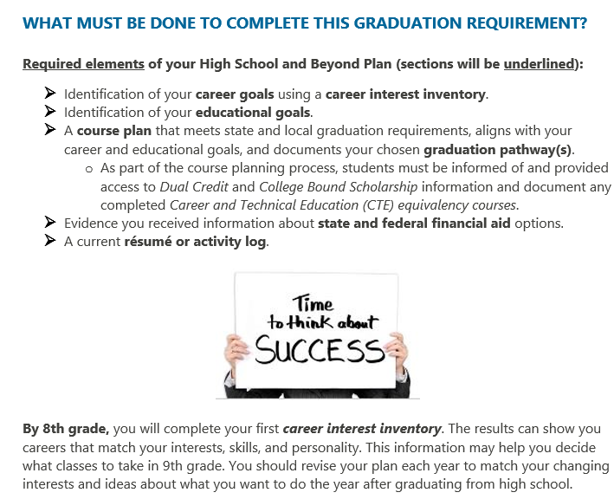
High School and Beyond Plan Template
High School and Beyond Template-Class of 2020 and Beyond
Notes:
So before we dig into the case study I wanted to link everyone to the optional HSBP template that is available on the OSPI webpage. System can use this template or develop their own template that meets state requirements. The case study we are walking through today uses the OSPI provided template and you will see some screenshots in the following slides. You can see here that the template has a overview of the requirements on the first page shown which is helpful.

Slide 27


IEP Symbol
Notes:
The next thing I wanted to point out is that you may notice that our example includes this IEP symbol, which is a cue for what information in the HSBP needs to be aligned to the IEP. You will see this symbol throughout our case study to highlight where IEP alignment is happening. This symbol may be helpful for your teams, you can add a similar symbol to your own template. We anticipate that this will be included in the next update of the HSBP template

Slide 28
Kaleb’s IEP
Summary of Services Matrix
Service | Frequency | Location
Adaptive | 630 mpw | Special Education
Reading | 150 mpw | Special Education
Writing | 150 mpw | Special Education
Math | 150 mpw | Special Education
Adaptive | 750 mpw | General Education
Communication | 30 mpw | Special Education
Goals are functional in nature
Post Secondary Goals:
  Education/Training: Kaleb will receive on the-job-training in an office setting.
  Employment: Kaleb will obtain employment in an office setting, with job coaching supports.
  Independent Living: Kaleb will independently manage his money
Notes:
Let's first talk about the IEP to get an idea of Kalebs IEP services and transition plan, this is found on Page 22 of the Case Study if you are following along.
(pause)
So you can see here that the student is getting services in Adaptive, Reading, Writing, Math, Speech and he is getting an additional 750 minutes of adaptive support in the community setting to work on being safe, self management, shopping and vocational skills. Kaleb also has para support in both the special education and community setting. Kalebs goals are largely functional and focus on safety, managing time and tasks, shopping, sending information and functional communication
(pause)
On the IEP transition plan you can see that Kaleb's goals for after he graduation high school are to get on the job training in an office setting, to obtain a job in an office setting and to be able to manage his money independently.
This is just a brief overview but Keleb had a really stellar IEP and I recommend checking out this IEP transition plan (SPIN) (page 25) and some of the specific goals he is working on found on page 27 of the case study
PAUSE
Next I am going to walk through his HSBP

Slide 29
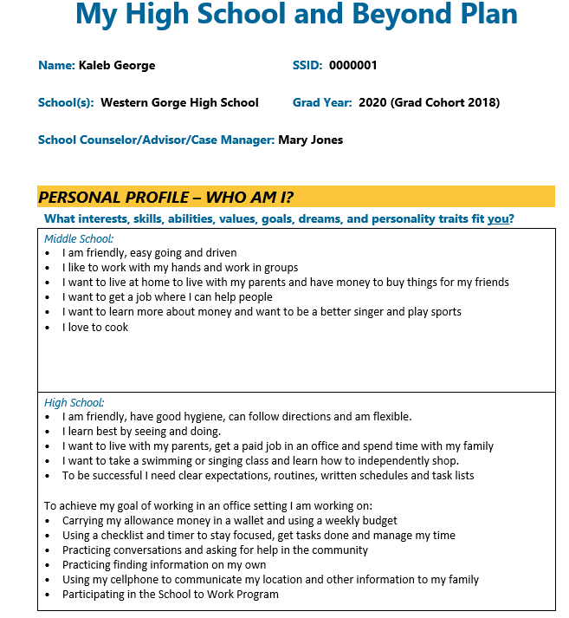
Personal Profile
Student driven and has student first language
Developed collaboratively with the students/young adults
Highlights strengths, dreams and goals
Notes:
So this first section is the Personal Profile, this is on page 3 if you are following along. You can see the students profile in middle school and highschool here which capture a students interests, goals and skills over time. You can see a summary of the goals Kaleb is working on in highschool here as well, all with student first language, so “The goals I am working are…” The goals here came directly out of his IEP (which was developed in alignment with the HSBP and in collaboration with the student). You will notice many of the goals and profile information were identified in the student activities we will show in the following slides, these activities helped the student identify areas were he wanted to focus and some of his goals
PAUSE
Lets go to the next slide so you can see some of the student activities that were part of Kalebs HSBP experience

Slide 30
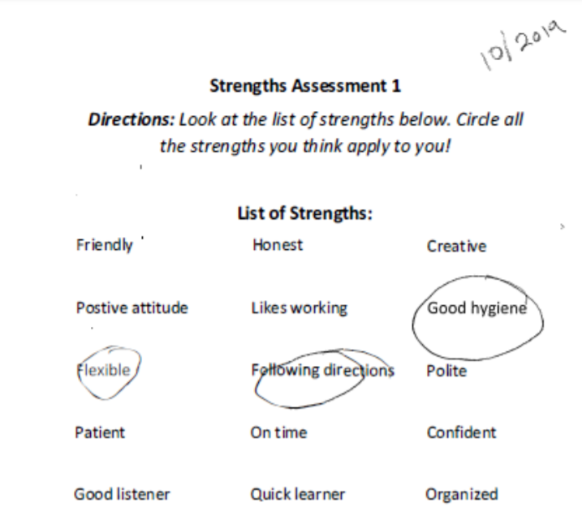
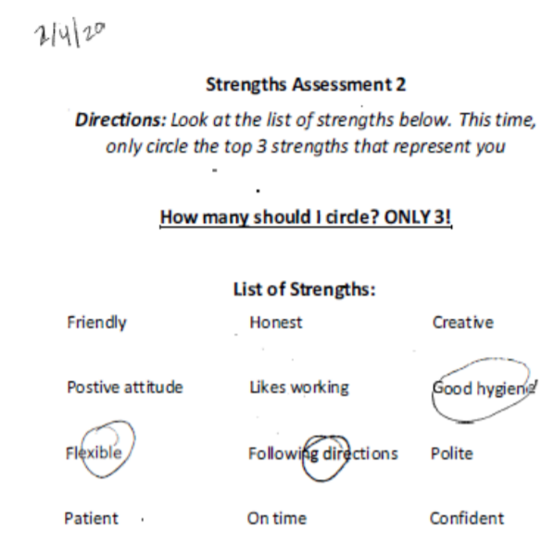
Student Discovery Activities:
Identify Strengths
CCTS: T-folio (transition portfolio tool)
  Strength Assessment
Notes:
These activities focused on identifying strengths. The student completed multiple strength assessments to determine strengths over time. The strength assessments here are adapted from the T-folio, I have included the link to the whole tool (which is free) as well as this exercise at the bottom of this slide.
Lets go to the next slide

Slide 31
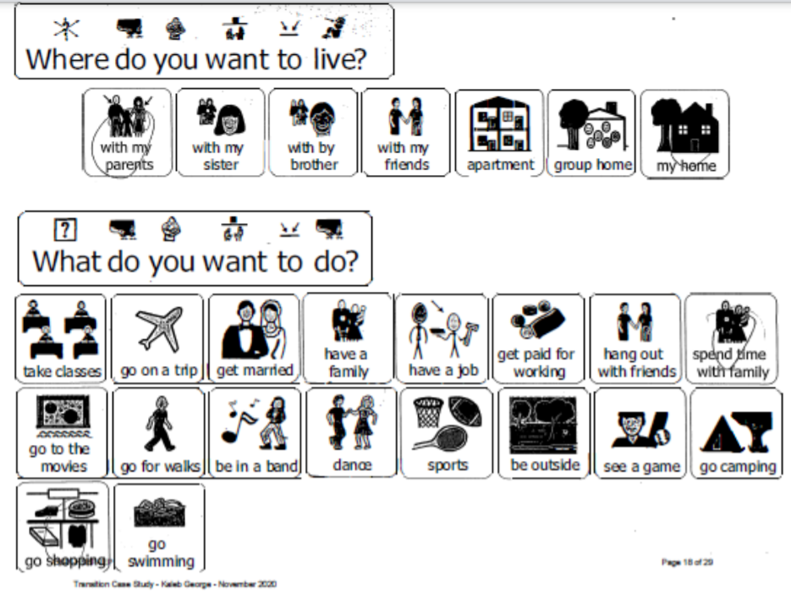
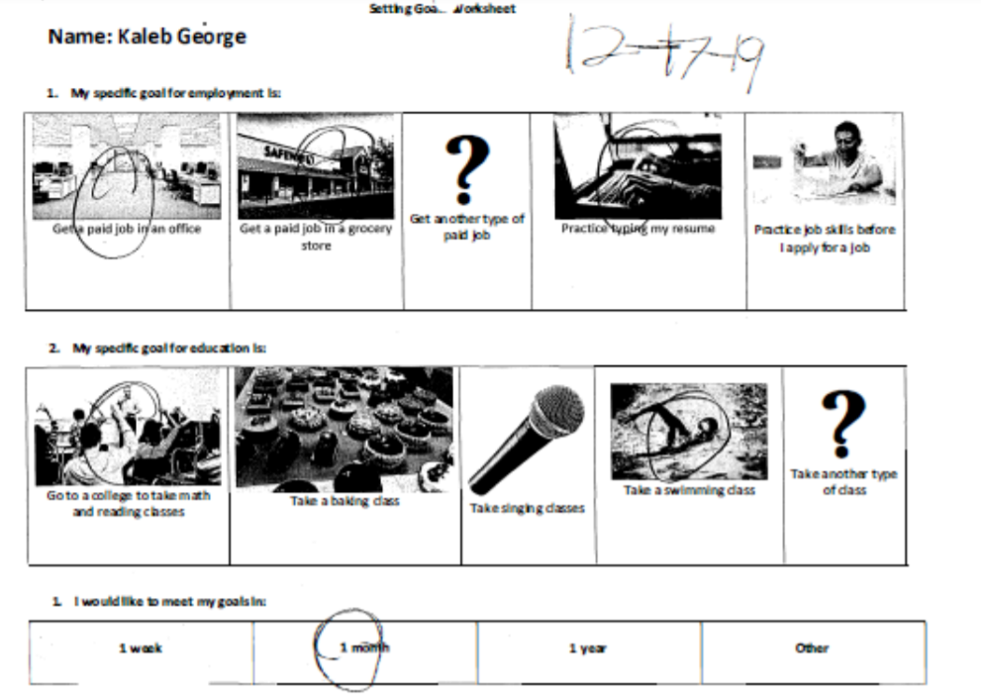
Student Discovery Activities:
Goal Setting
Notes:
The student also completed some goal setting activities that utilize visual aids to support student choice and participation. You can see here that the student wants to live with his parents, spend time with his family and go shopping. These goals are also found in more detail in the IEP and show great alignment. If you remember one of the students independent living goals is to use money independently so this is one of his priorities
Lets go to the next slide

Slide 32
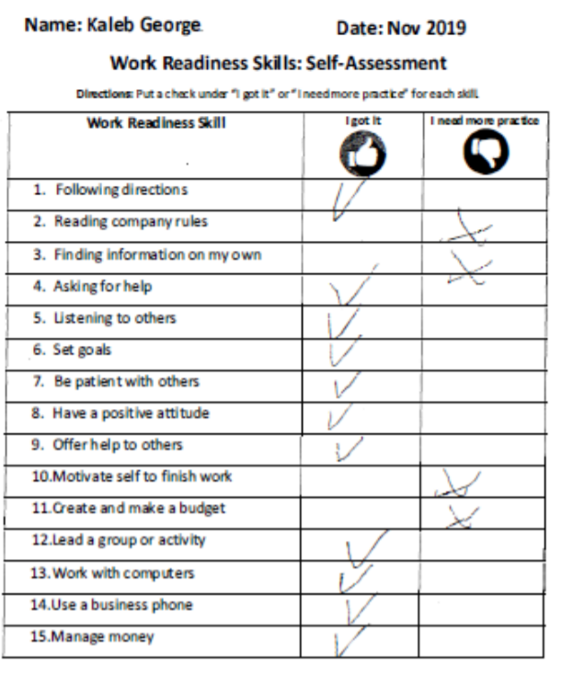
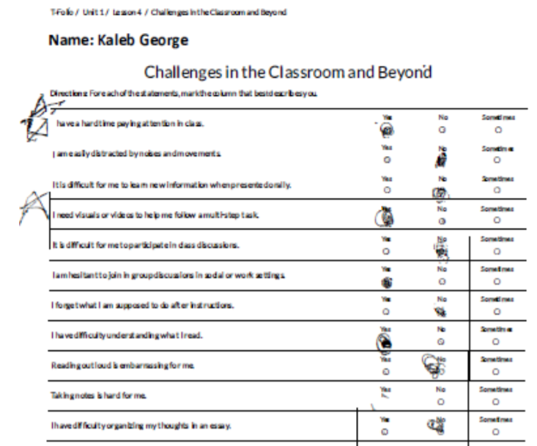
Student Discovery Activities:
Identify Skills and Challenges
CCTS: T-folio (transition portfolio tool)
  Challenges in the Classroom and Beyond
Notes:
You can see here two more activities where the student self identified skills he needs and challenges that he may face in the classroom and beyond, if you are following along these can be seen more clearly on pages 20 and 21. In the first activity the student self identified that he needs more practice reading rules, finding information on his own, finishing work and making a budget, these skills are all being targeted as part of his IEP. The second activity is a challenges self assessment is part of the T-folio and we will drop a link in the chat if you would like to check this out further.
PAUSE
Next slide

Slide 33
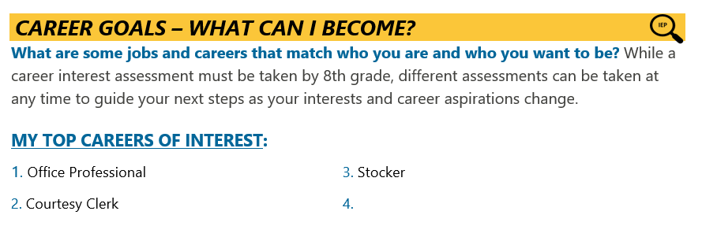
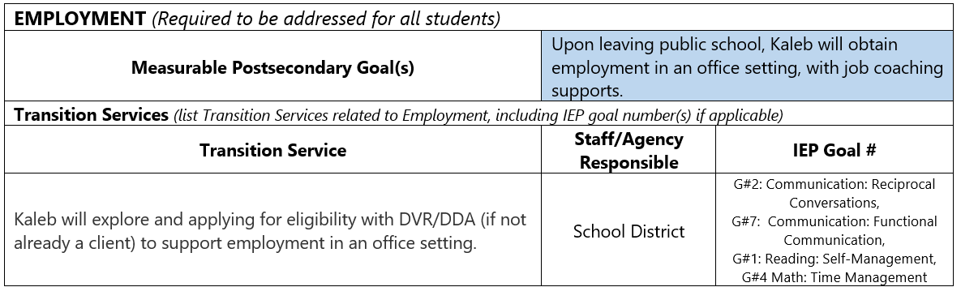
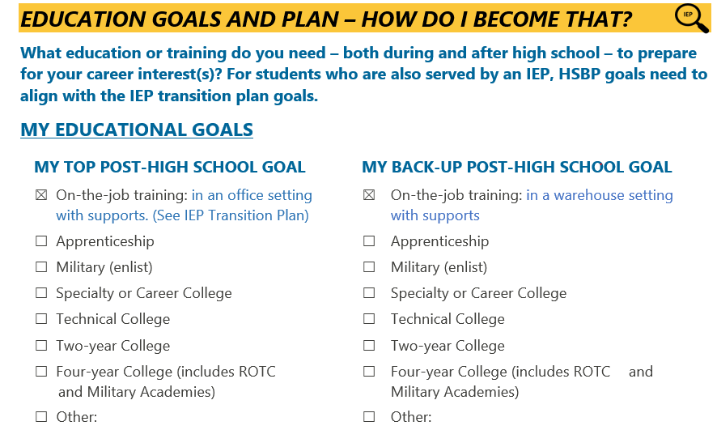
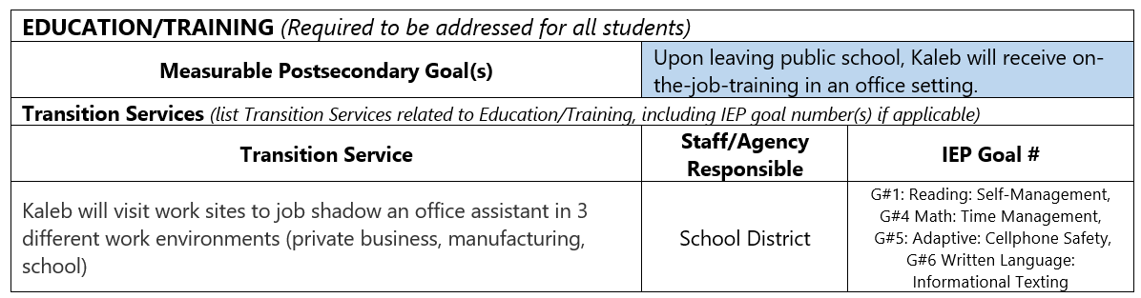
Career Goals and Educational Plan
Notes:
This slide shows what the employment and educational goals look like on the IEP TRANSITION PLAN on the left and how they are shown on the HSBP on the right. Notice the IEP symbol here because this information needs to be aligned. Kalebs completed a career interest assessment and office professional was his top career. You can see that this is shown in both the IEP and HSBP. For education Kaleb’s IEP identifies that he will receive on the job training in an office setting and this information is also on the HSBP.
Pause

Slide 34
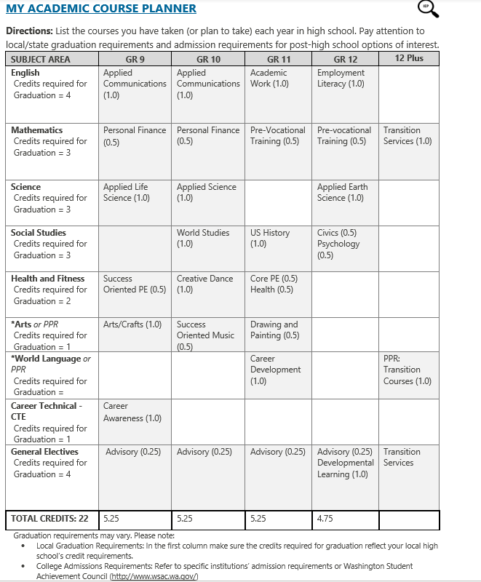
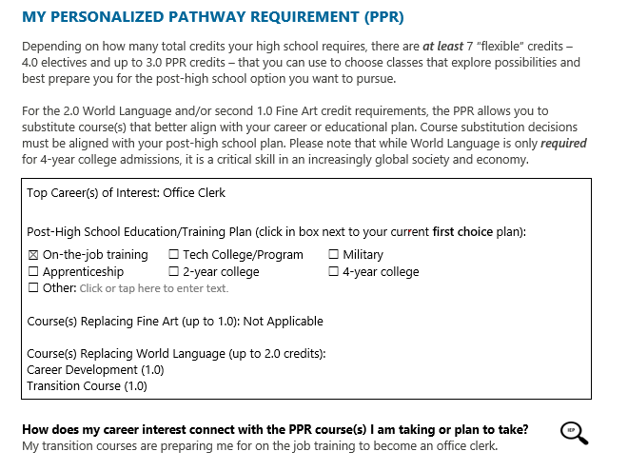
Course Planner
Notes:
This is Kalebs course planner so you can see the courses he has taken over time align with his interest, needs and goals. For example Kaleb loves dancing and he has the opportunity to take some music and dance courses here and has some courses that support his individual goals for example in personal finance, prevocational training. it is important for school teams should work together to determine course selections that meet students needs, align with their goals and interests.
You also will see the IEP symbol is here well because this information aligns with the IEP course of study section. Specific graduation requirements fall outside of the topic of today's webinar but I did want to highlight that Kaleb has used his personal pathway requirement to take Career and Transition courses in place of his world language classes because they better align with his post highschool plan and ihis plan does not include a four year university
(if asked: To learn more about the personal pathway requirement do not hesitate to reach out to OSPI or review the information on the SBE website, Personalized Pathway information found on page 9:https://www.sbe.wa.gov/sites/default/files/public/documents/GradRequirements/GradFAQ062016.pdf)

Slide 35
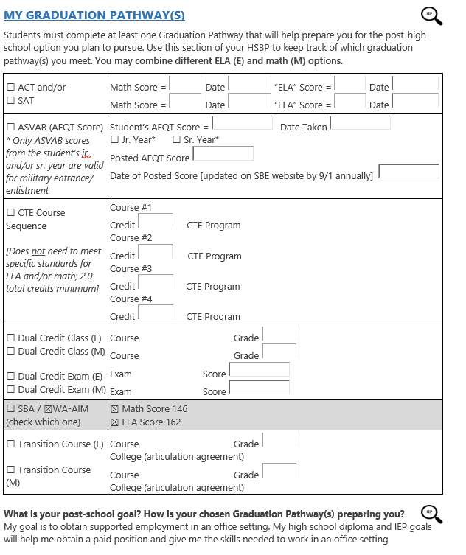

Graduation Pathway
Notes:
Here is a screenshot of page 8 if you are following along showing Kalebs completed graduation pathways. You can see here that he has meet the state assessment pathway by getting a passing score on the WA-AIM assessment and that this pathway is preparing him for his post school goal of working in an office setting. You see the IEP symbol here because the graduation pathway should be aligned to his IEP transition plan goals and the graduation information in the IEP.

Slide 36
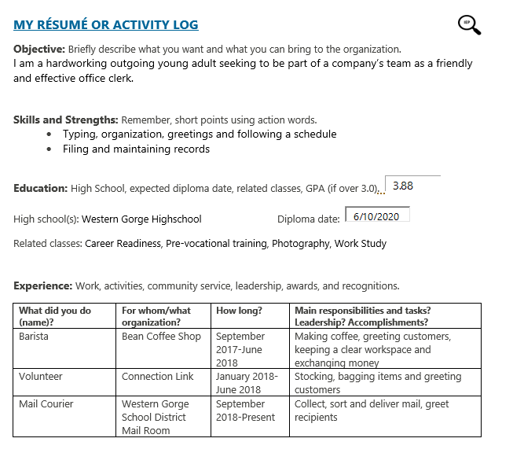

Resume
Notes:
Lastly I wanted to briefly touch show what Kalebs Resume looks like. You can see he as an objective, summary of strength and skills, and a summary of some of the work and community experience he has gained while in high school. Kaleb has had some excellent experience at the school coffee shop, volunteering at a store and serving as a mail courier. This template was updated over time as Kaleb gained new experiences

Slide 37

Questions?
Notes:
This has just been a high level walk through of what an aligned IEP and HSBP look like for an adult student receiving transition services. There is a wealth of content found within the case study pages that I hope can support your teams in making a meaningful HSBP process for all of your students. Before we transition to our Partner from the field who will be sharing their work around HSBPs are there any questions?
Great lets transition to hear from our partners in the field doing some amazing work in this area

Slide 38
Voices from the Field:
Bellevue School District
Kristen Wong Callisto, Ed.L.D.
Jennifer Strehle

Slide 39



Thinking Systemically
Think wide
  Cross-functional collaboration
Think longitudinally
  Starting early
Build capacity
Notes:
Kristen Wong Callisto
The system in which all of this work happens is really important to consider. As a leader, we’re responsible for creating or nurturing the conditions support the thoughtful integration of this work between HSBP and transition plan.
As an administrator, one way to think systemically, is to think wide. What I mean by this is that in larger districts, working across departments/teams. In Bellevue, HSBP and transition plan live in two departments. We have a special education team and a different team that is arguably point on HSBP. Recently, we have even more intentionally increased the number of planned (rather than reactive) cross-functional team meetings that allow for two-way collaboration and coordination. If you’re a smaller district this point around cross functional may not apply to you, since the lead on special education and HSBP might be one person, maybe even you!
Thinking longitudinally. As we all know, ideally we need to be discussing transition discussions earlier is important, but there’s value in the communication around it. Transition is not just about doing it because of compliance but because for all students with disabilities, ensuring that the transition from P-T through is important. As a person with a disability, I can share my own personal experience with our staff about going from HS to Dartmouth. My own transition plan was non-existent and it’s little surprise that my challenges really caught me off-guard and this is despite the wealth of skills and resources I had to soften that transition.
Build capacity. Bellevue is lucky in that our size allows us to have teacher leadership like Jen Strehle, our coordinator for transition, who is a real rock star.
When thinking about building capacity, it’s also important to make sure institutional knowledge is not tied up into a person.
We think about building capacity in three different forms:
Professional Development and Resource Seeding
Coaching
Relevant, Responsive, and Timely Communication
So even if you don’t have the mid-level staffing that we have to support coaching, there’s still building capacity tools you can use. On the next slide, I’ll show you some images from our procedural handbook

Slide 40
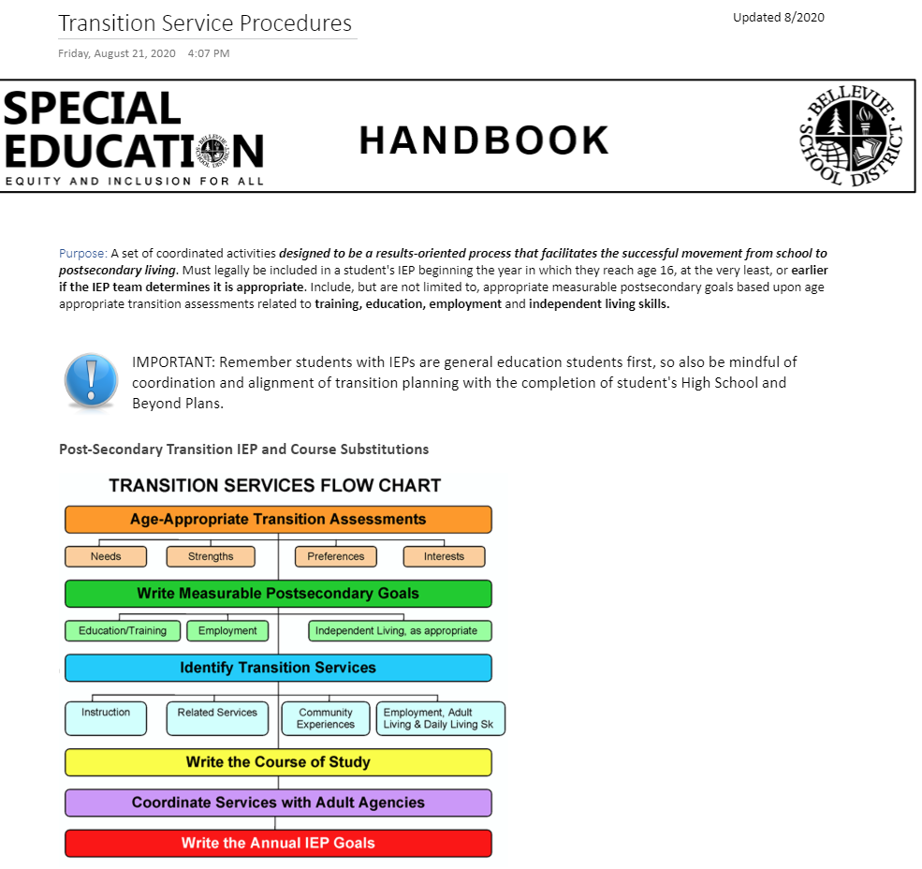
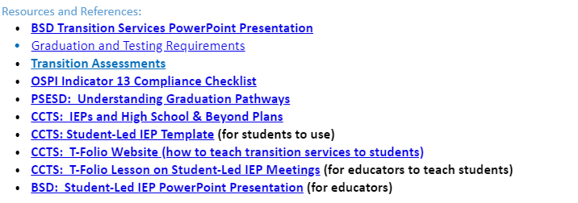
Bellevue Special Education Handbook
Notes:
Kristen Wong Callisto
A little disclaimer - I may be the most passionate person about the handbook in our district. We’ve been steadily working on revising, updating (e.g. we have sections that relate to remote/in-person instruction). I think an current and living handbook is a powerful resource for your staff. In a large system you contend with many “variations of a theme” in application. Depending on how tight or loose you need the procedural integrity to be this variance could be a non issue or a major issue. Sometimes individuals aren’t even consistent with themselves in their own practices. A handbook helps create more consistency in practices. It’s a useful tool for induction and PD.
I wanted to give a brief view into one of our pages in our handbook. This is the Transition Services Procedures in our handbook.
Two of the updates we incorporated into our handbook is that we now have a Purpose statement for every procedure. We think it’s important our staff understand that “why” we’re asking them to do a procedure or process.
The other update is a section for Resources and References. The intention here is to try to reduce friction/create opportunities for staff to go deeper if they are interested by having Resources and References at the bottom of our procedures.
These are some system perspectives, but Jen can take you a little more closer into some of the more practical applications in Bellevue for educators.

Slide 41
What’s Going On In Bellevue
IEP Transition Plan Training co-run with teachers
Work-based learning (jobsites, CTE Programs)
School Counselors engaged in IEP Meetings and working with students and teachers on transition assessments that align with the HSBP
Pre-Voc Classes at the high school
  Students identify and write their own post-secondary goals & C.O.S
  Mock interview practice/resume/cover letter writing
  Career Exploration, and more
Notes:
Jen Strehle
Transition Plan Training co-run by myself and teachers who have written exemplar transition plans for their students and shown cross-functional collaboration on the transition plan and how that supports the HSBP (counselor participation, student centered, using a variety of transition assessments, clearly written and compliant post-secondary goals with a supportive course of study)
Work-based learning for our students who require that hands-on vocational experience that supports their career & educational goals
Both middle school & high school counselors are engaging in IEP meetings and collaborating with teachers on effective career interest inventories (some use naviance but knowing this isn’t appropriate for all students, working with teachers on more effective inventories and surveys).
One thing we’ve really had to strengthen recently was working with our counselors on understanding how to support our students who need high levels of support who may not be on a normal trajectory to graduating at 18. Counselors are literally trained to help students graduate on-time. And while the majority of students do, there are some who need further support beyond 18. I will talk more about this in a few slides.
All of our high schools, in addition to guidance counselors, have College & Career Advisors, who further helps with the identification of career goals, aided by a skills and career interest inventory assessment
Pre-Voc class-initiated by a teacher several years ago who felt that students needed a class that allows them to really dive deep into their transition plans and become an active member of their IEPs

Slide 42
What’s Going On In Bellevue continued...
Wednesday virtual field trips/guest speakers (ie: Colleges, DVR, Jobcorp, etc)
Increase Co-Taught Classes with principles of UDL being applied in classes
  40 at the middle school levels
  50 at the high school levels
High School Special Ed. Lead Teachers trainings quarterly
  DVR
  Share any news with HSBP or Transition Plan updates
  Share new assessments, tools, and instructional supports
Notes:
Jen Strehle
One of our Transition Program teachers organized district-wide field trips every Wednesday (currently all being done remotely) to a variety of post-secondary institutions and community organizations that help with career and employment exploration. It is offered to students in the transition program as well as juniors and seniors in all of our high schools, students in high school work with their teachers to decide if the field trip is something that would be of interest to them and supportive of their transition goals.
Huge increase in co-taught classes district-wide to support inclusionary practice and applied UDL principles so all students can be successful. We have data that shows an increase in grades, test scores, student attendance, and engagement for students with IEPs.
We also started holding quarterly trainings with all of our high school lead teachers to provide opportunities for them to learn about what’s going on across the district in regards to transition services for their students...teachers learning from other teachers is a very powerful strategy. We also invite other members from departments and even the community in to present information such as the CTE director, DVR, etc. We are working on including gen ed voices in these trainings as well.

Slide 43

Starting Early with Meaningful Convos & Plans
While HSBP needs to start in middle school, IEP Transition Planning isn’t required until age 16, however…
The earlier transition planning starts, the better post-secondary outcomes will be
Include the student!!
If college is a desire, then think about how to best prepare (ie: fading para support, having student as an active voice, reflecting on course modifications)
Notes:
Jen Strehle
Cannot stress this enough. While we are still working on this, it’s gotten better. I previously mentioned a few slides back the vital role counselors have in these conversations and planning, making sure their HSBPs are aligned with their transition plans

Slide 44
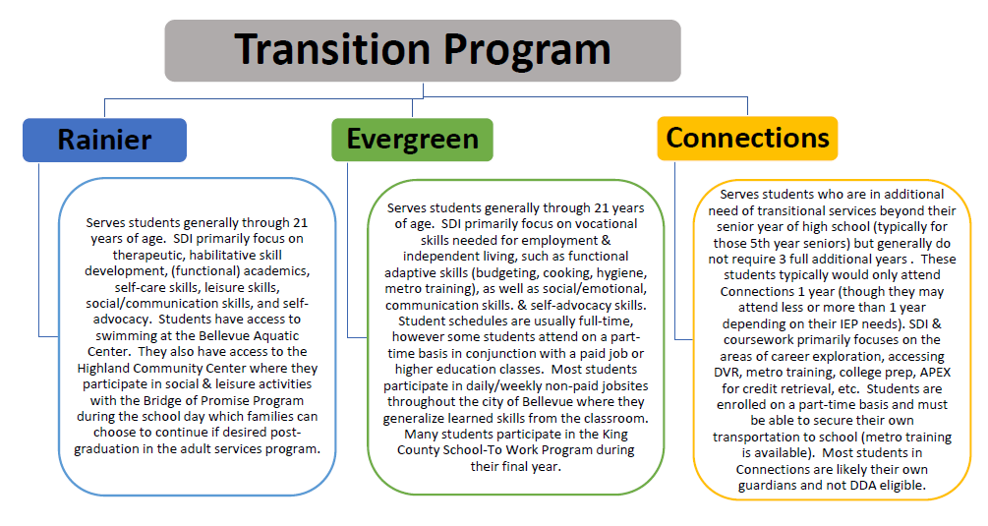
Transition Program Classrooms
Notes:
Jen Strehle
We serve a wide variety of student needs and honor paths other than employment such as college and recreational/leisure. Typically these services are for students who have not met standard on state assessments, required high levels of interventions and academic support in high schools, haven’t met course requirements that enable them to meet the traditional high school graduation timeline
We are participating in the Job Foundations Pilot project with our Schoot-To-Work students which is meant to increase employment outcomes for our students who qualify for DDA in order to support improved transition outcomes for all students including those with significant disabilities requiring high levels of support.

Slide 45

Student-Led IEP Meetings as Post-Secondary Planning Strategies
Participation can vary depending on student’s ability and communication style
Students who actively participate during their IEP meetings are more likely to be employed and/or enrolled in higher education after graduation.​
Helps students who are marginalized to have a voice where they may otherwise not. This supports our equity journey​
Student will develop stronger self-advocacy and self-determination skills (whether at a job or in a college class)​
Student will have a stronger sense of self-confidence. ​
Notes:
Jen Strehle

Slide 46

Austin
Post-Secondary Goals are tied to interests:
Working in the tech field
Going to college ( ROAR) and find tech job
Being able to independently order his own meals at restaurants including estimating tax and tip
Notes:
Jen Strehle

Slide 47
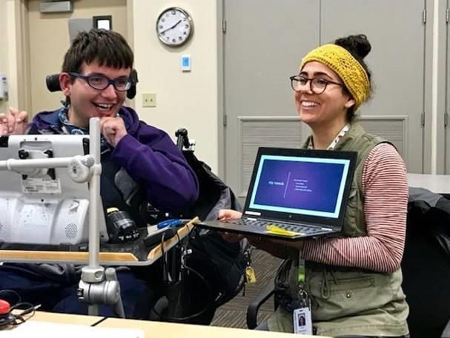
Kyle
Uses Assistive Technology to:
Co-run his IEP meetings and communicate with team members
Greets shoppers using his Dynavox at Trader Joes (his jobsite)
Navigates in his community using his head aray
Notes:
Jen Strehle

Slide 48
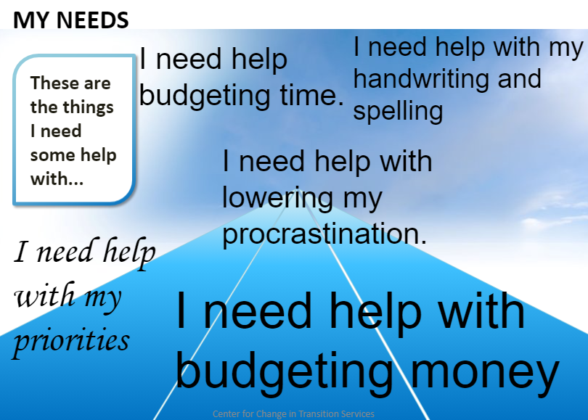
Hunter
Has Measurable Annual IEP Goals in the areas of:
Time Management
Budgeting
Organization
Notes:
Jen Strehle

Slide 49

Person Centered Plan Meetings as a Post-Secondary Planning Tool
PCPs are designed to assist students and their families to plan life and supports after high school and enable individuals with disabilities to increase their personal self-determination and improve their own independence
The Purpose of a Person-centered plan is:
•To assist student in gaining control over their own life
•To increase opportunities for participation in a variety of settings
•To recognize individual desires, interests, and dreams
•Through team effort, develop a plan that turns dreams into reality
Notes:
Jen Strehle
Helps improve post-secondary outcomes to have community members there as well such as the DDA case manager, DVR, Sound Mental Health, and any other partners who can support the student’s post-secdonary plans.

Slide 50

Quote
“When developing educational programs for students with disabilities, we often think first of annual goals and objectives, but it is important to connect short-term objectives (the ”now”) to long-term goals (the “future”).”
-Meadan, Shelden, Appel, & DeGrazia (2013)
Notes:
Jen Strehle

Slide 51

When is a good time to have a PCP?
•When students are moving between levels
•When planning for future life and developing a transition plan where strong guidance is needed
•To support relationship building with families
Notes:
Jen Strehle

Slide 52
Questions
Notes:
We will save today’s chat and the Q&A; for any questions we couldn’t address today, we’ll do our best to incorporate them into the next webinars in the series.

Slide 53

Thank you!
Notes:
Thanks again for joining us today!
webinar will be in the webinar

Slide 54

Copyright Information
Except where otherwise noted, this work by the Office of Superintendent of Public Instruction is licensed under a Creative Commons Attribution License.
This presentation may contain or reference links to websites operated by third parties. These links are provided for your convenience only and do not constitute or imply any affiliation, endorsement, sponsorship, approval, verification, or monitoring by OSPI of any product, service or content offered on the third party websites. In no event will OSPI be responsible for the information or content in linked third party websites or for your use or inability to use such websites. Please confirm the license status of any third-party resources and understand their terms of use before reusing them.

