Slide 1
Aligning HSBPs & IEP Transition Plans:
CTE Pathway Case Study
Alexandra Toney
Special Education
alexandra.toney@k12.wa.us
Renee Lafreniere
Career & Technical Education
renee.lafreniere@k12.wa.us
March 2021
Notes:
Good Afternoon
Today we are going to talk about aligning HSBP and IEP Transition Plans by walking through our recently posted CTE Pathway Case Study.
I am Alexandra Toney a Special Education Program Supervisor and I am joined by my colleague today who I can pause for them to introduce themself,

Slide 2

Today’s Discussion:
http://clipart-library.com/data_images/141710.jpg
Dig into an example of an Aligned HSBP
and IEP for student using a CTE course sequence
Discuss collaboration and crossover opportunities for CTE, School Counselors and Special Education Staff
Notes:
Good Afternoon
We are excited today to show you a Case Study of an aligned HSBP and IEP Transition Plan for a student using a CTE course sequence. We will walk through this document today and share some CTE content and considerations along the way
10 minutes HSBP walk though
10 minutes CTE specific consideration

Slide 3
What is the High School and Beyond Plan (HSBP)?
Student-generated and Student-facing
Academic plan to prepare for post-highschool goal
Personalized career and college exploration
Each student must have a HSBP to guide the student’s high school experience and prepare the student for postsecondary education or training and career (WAC 180-51-220).
Notes:
So before we get started, lets talk about what a HSBP is?
It is a student generated and student facing document that meets one of the state high school graduation requirements. It is designed to help a student plan their school experiences leading up to post secondary education or training and a career.
W ith that in mind lets dig into what it can look like

Slide 4

HSBP Case Study:
Sherrie, 10th Grader using a CTE course sequence graduation pathway
Guidelines for Aligning HSBP and IEP Transition Plans Document Suit
HSBP & Aligned IEP: CTE Course Sequence
Notes:
Our Second Case Study is for Sherrie, This example was created through collaboration of many departments within OSPI and stakeholders in secondary transition to illustrate what an in progress HSBP and aligned IEP can be like.
The links to the case study are on this slide and we will drop them into chat as well so that you can follow along.
(1 minute)

Slide 5
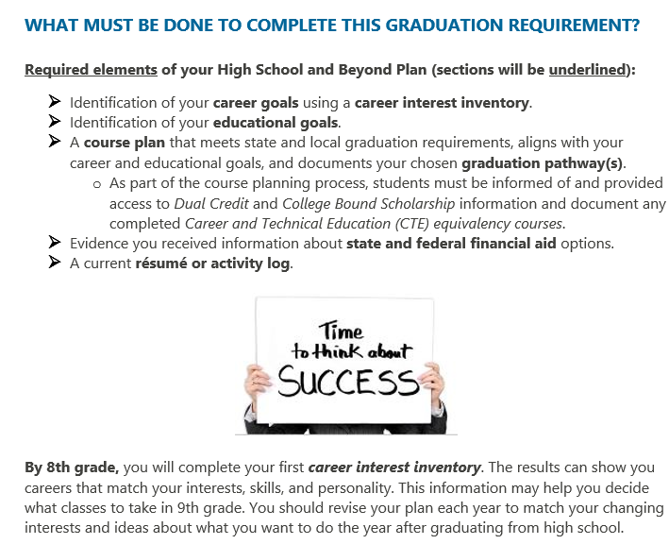
High School and Beyond Plan Template
High School and Beyond Template-Class of 2020 and Beyond
Notes:
So before we dig into the case study I wanted to connect everyone to the optional template that is available on the OSPI webpage. System can use this template or develop their own template that meets state requirements. The case study we are walking through today uses the OSPI provided template and you will see some screenshots in the following slides. You can see here that the template has a overview of the requirements on the first page shown which is helpful.

Slide 6


IEP Symbol
Notes:
The next thing I wanted to point out is that you may notice that our example includes this IEP symbol, which is a cue for what information in the HSBP needs to be aligned to the IEP. You will see this symbol throughout our case study to highlight where IEP connection is happening. We anticipate that this will be included in the next update of the HSBP template

Slide 7
Sherrie’s IEP
Goals focus on reading and writing skills
Post Secondary Goals:
  Education/Training: Sherrie will enroll in a technical college or an art institute to study graphic design.
  Employment: Sherrie will be employed as a graphic designer.
Summary of Services Matrix
Service | Frequency | Location
Reading | 150 mpw | Special Education
Writing | 150 mpw | Special Education
Notes:
Let's first talk about the IEP to get an idea of Sherries IEP services and transition plan, this is found on Page 17-21 of the Case Study if you are following along.
(pause)
So you can see here that the student is getting services in Reading and Writing. Her goals focus on using graphic organizers to enhance comprehension, decoding texts and improving her ability to author text. The IEP also as a wealth of information on her strengths, preferences, interests and also her support needs. This student is very driven, like to be a leader in activities and is most successful when working in applied and creative tasks.
(pause)
On the IEP transition plan you can see that Sherries goals for after she graduation high school are to enroll in a technical college or art institute to study graphic design and to be employed as a graphic designer.
This is just a brief overview of her IEP, there is much more content if you would like to go deeper. CTE and other school staff can always partner with case managers to to better understand a students IEP and support needs.
lets next go to the HSBP so we can see what the alignment looks like

Slide 8
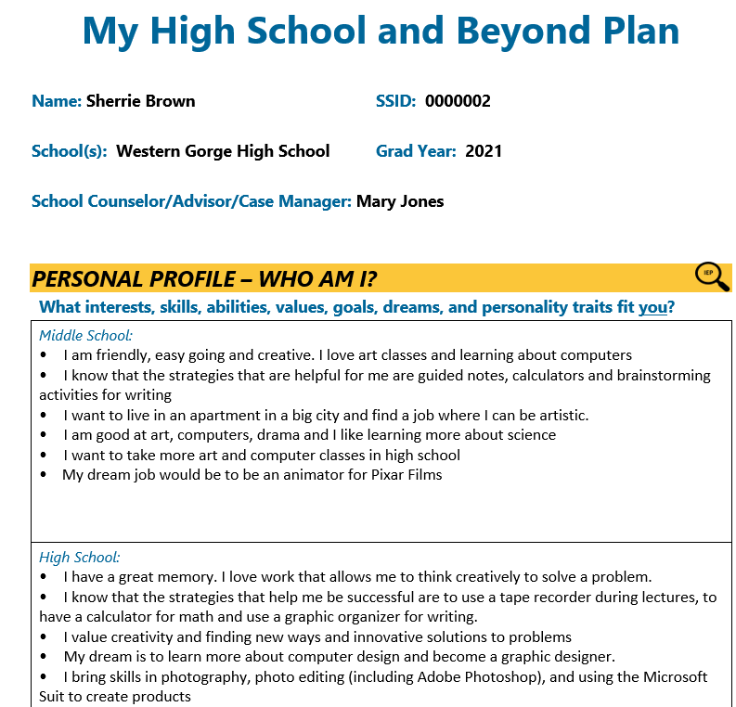
Personal Profile
Student driven and has student first language
Developed collaboratively with the students/young adults
Highlights strengths, dreams and goals
Notes:
So this first section is the Personal Profile, this is on page 3 if you are following along. You can see the students profile in middle school and highschool here which capture a students interests, goals and skills over time. You can see a summary of some of the strategies that are effective for Sherrie here as well, all with student first language, so “The things that help me be successful are using a calculator, recorder and graphic organizer …” The information in this section is very much student driven and aligns with the content IEP
Next Slide

Slide 9
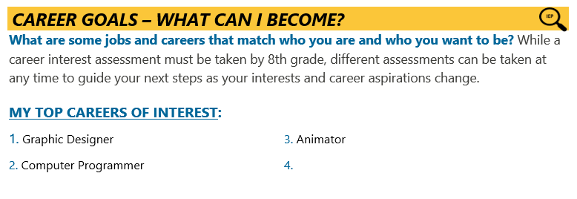
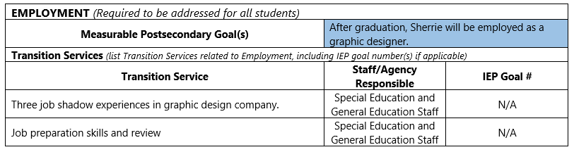
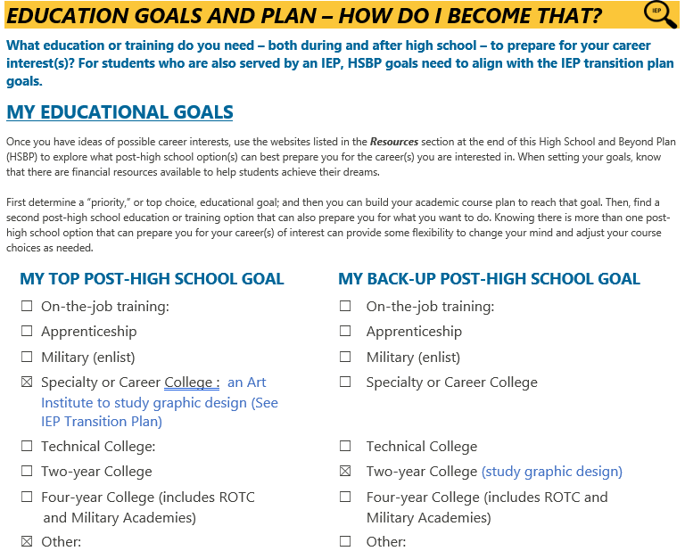
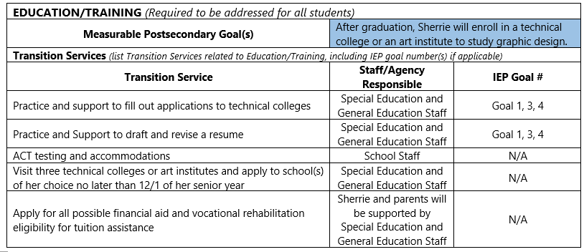
Career Goals and Educational Plan
Notes:
This slide shows what the employment and educational goals look like on the IEP TRANSITION PLAN on the left and how they are shown on the HSBP on the right. Notice the IEP symbol here because this information needs to be aligned. Sherries completed a career interest assessment and graphic designer was her top career but she is also very interested in becoming a computer programer. You can see that this is the same in both documents. For education Sherrie’s IEP identifies that she will to to a technical college to study graphic design and this is also on the HSBP.
Renee:
I would like to add here that there are multiple career exploration, interest inventories and assessment platforms; and, related activities that are available - both cost-based, web-based, and totally free. Several are interactive, as well as grade-level specific, as pointed out under the "Career Goals" section of the plan. Many of you here today are already utilizing some of these--such as KidsKonnect, Kudor, Virtual Job Shadow, Xello, Career Bridge, Career Cruising, CareerExplore, and even ASVAB; and, supporting those programs with activities such as Career Day, Career Cafe, campus tours . . . . lots and lots of different and great ideas.
Pause
Next Slide

Slide 10
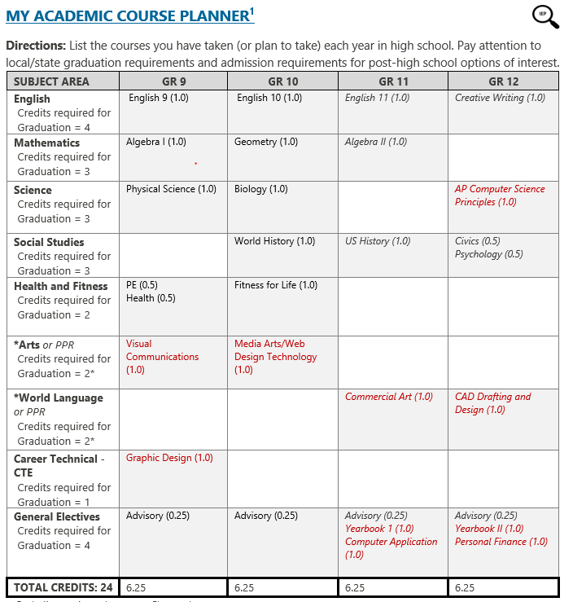
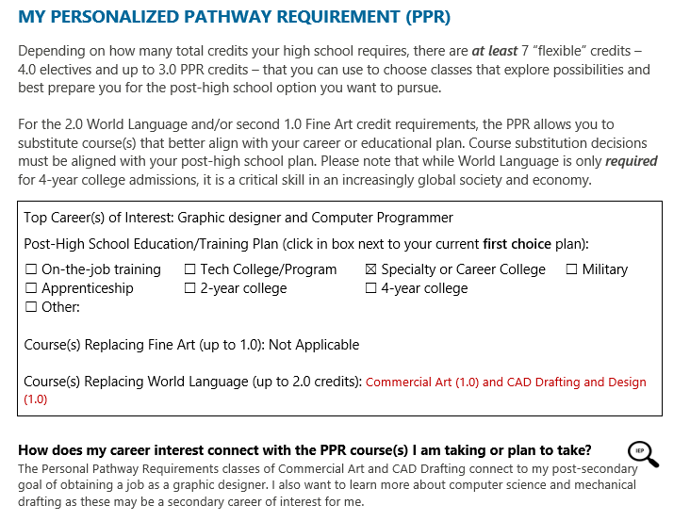
Course Planner
Notes:
This is the course planner, which is on page 5 if you are following along. You can see the courses she has taken over time align with her interest, needs and goals. For example Sherries does best with applied learning and she been able to take a variety of CTE courses, which are shown here in red. Sherrie is a tenth grader so you may notice that grades 11 and 12 are in italics because they are not taken yet.
I wanted to point out that if takes a team to support transition, and this student has some really creative and flexible course planing because of the collaboration between IEP teams, special educators, CTE folks.
You also will see the IEP symbol is here well because this information aligns with the IEP course of study section. Specific graduation requirements fall outside of the topic of today's webinar but I did want to highlight that this student plans to use her personal pathway requirement to take Commercial art and CAD Drafting courses in place of her world language classes because they better align with her post highschool plan and her plan does not include a four year university
(if asked: To learn more about the personal pathway requirement do not hesitate to reach out to OSPI or review the information on the SBE website, Personalized Pathway information found on page 9:https://www.sbe.wa.gov/sites/default/files/public/documents/GradRequirements/GradFAQ062016.pdf)
Lets go to the next slide for a deeper dive into some of the CTE content here

Slide 11
CTE Course Selection/
Pathway Considerations
Meaningful course selection and collaboration
General CTE team consideration (leadership/extended learning connection to work based learning, collaboration)
CTE equivalencies being a strategy for creative course planning to met subject area grad requirements
Notes:
Renee:
"Collaboration" really is key to planning a successful experience for the student. That process must be strategic, comprehensive and individualized actions, rather than "checking the box". We know through data and reporting that CTE programs help students participate, complete, and transition to post-secondary more successfully: interest and relevance = engagement, but also better attendance, lower discipline, and better outcomes.
Another point to consider is the reason that students--especially students with disabilities--often find more success in career programs--it’s based in the standards of our CTE pathways. Critical embedded components such as leadership activities, extended learning, work-based learning, industry guidance, family engagement, dual credit and industry recognized credentials ALL contribute to the meaningful career AND college preparation of students. Ongoing collaboration not only sets up students for the best opportunity to succeed but can ensure equitable access for ALL students to these programs--and ultimately, better preparation, transition and outcomes.
CTE equivalencies, another important component of CTE programs, align the academic content of core courses like math and science, with the technical content of CTE courses, so it can provide an advantage for a student when earning required graduation credits. In this example, Sherrie is taking CTE courses that also count for Arts, an AP Computer Science Principles that counts for Science;; additionally, she has opportunity to take electives relative to either of her top two career goals (Graphic Designer or Computer Programmer). All that combines to provide Sherrie TWO CTE pathways to graduation (we spotlight that in a moment). The equivalency component within CTE programs is yet another opportunity for planning/collaboration, and equivalency expert, Lisa Fish, has been expanding CTE equivalencies fast & furious! So be sure to reach out to her or the website for updates.

Slide 12
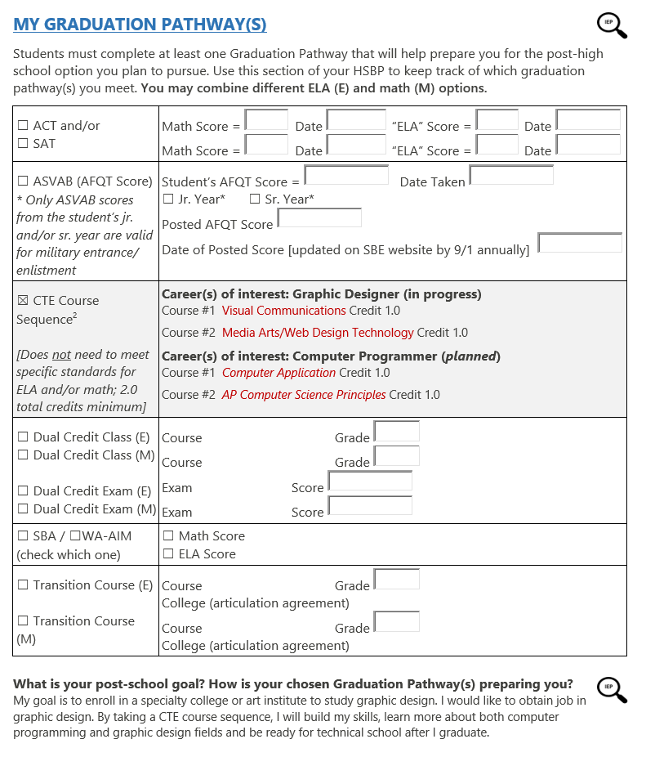

Graduation Pathway
Notes:
Here is a screenshot of page 8 if you are following along showing the students planned and in progress graduation pathways. You can see here that Sherrie has planned to do two difference CTE course sequences to align with each of her career interests. She is currently in progress to meet her CTE course sequence to become a graphic designer and has already planned two additional courses here for her junior and senior year to prepare to be a computer programer
You see the IEP symbol here because the graduation pathway should be aligned to his IEP transition plan goals and the graduation information in the IEP.

Slide 13
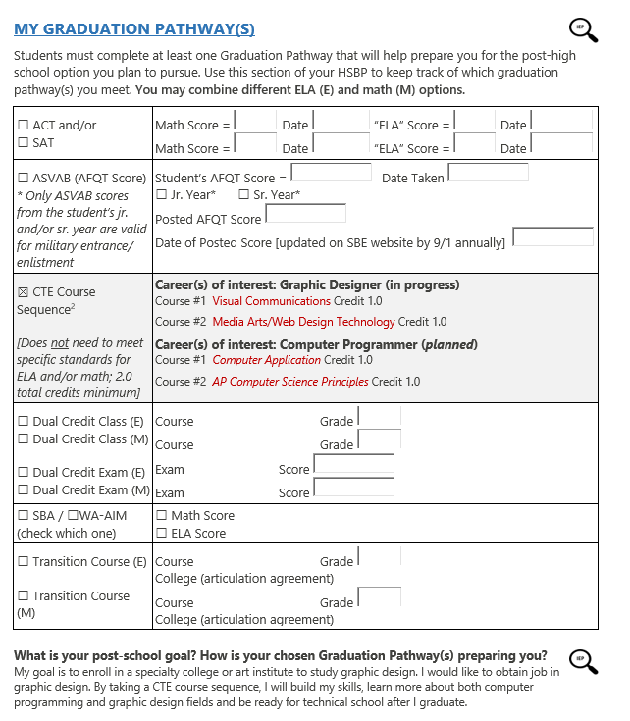
CTE Sequence Graduation Pathway
Collaboration is key
CTE course sequences
Multiple combinations of courses could serve as CTE pathway
Locally approved sequence information
Notes:
RENEE:
At the risk of repeating this too often, Collaboration is key. While the HSBP, most importantly, is student-driven, the adults involved in the process must also have the knowledge, tools and resources in order to provide the best guidance.
This section of the plan reflects how the student meets which graduation pathway--again, remember, the student can meet more than one and can combine different ELA and Math options; however, in the case of CTE Sequence Grad Pathway and this student example, the student does not need to meet additional ELA and/or Math requirements.
In regards to "Locally Approved CTE Sequence Grad Pathways"--I think rather than head down the "how" route, because you are all familiar with the instructions, tutorial, and EDS application system—and, if you are new or still trying to navigate it—please reach out. I’ll just reiterate the "why". The intent of CTE Sequence Grad Pathway, an additional “path” to graduation, was certainly meaningful course planning towards college and career goals; and, flexibility for students was important to the stakeholders that developed it. CTE Pathways have already been designed with lots of research, data, and documentation, AND subsequently, course selection, curriculum, content, assessments, and sequencing; AND, so long as the pathway also lead to dual credit and/or IRCs, they meet the requirements of CTE Sequence Graduation Pathways (in the SAME Program Area).
And at this point, I’d like to give a shout-out and a woohoo to the "best of the best" CORE PLUS programs (woohoo!!), which exemplify MODEL CTE PROGRAMS in our state. And program expert, Angie Mason-Smith, is here to help guide you through that process and continue her work expanding that model to other industries. Be sure to reach out to her or check the website for updates.
However, the sequencing of courses from DIFFERENT Program Areas created a unique "opportunity" in our state. This option was not intended for a mash-up of different course-taking to meet pathway requirements, nor as an "alternative" to graduation; the intent and design of "CTE sequence" AND meaningful planning remains in place—“progression of skill” is still necessary. The combination of course sequencing must still align to careers and occupations that require this particular mix of technical skills and abilities, and at the least, align to a viable in-demand job market and/or potential advantage in entering or advancing in a particular career.
Another strong point why collaboration and meaningful planning remain key throughout a student’s plan. It is of no advantage to a student, especially in their senior year, to try and "make a round peg fit a square hole." Meaning, it is of no benefit to Sherrie to take a Foods class and a food handler’s permit if her career choice is to be a graphic designer; or to take accounting and a Quickbooks certification if she wants to be a computer programmer. This is not to say that, if Sherrie had room in her schedule or an interest in variety, she couldn’t take a different class(es) as elective, but why not guide her to related courses that could supplement her success and reinforce her specific career goals. A clear, meaningful "path" to her goal is a least 2 credits in the same program area with the potential for multiple equivalencies AND an opportunity to take industry-recognized credentials such as Adobe or C++

Slide 14
Systems Analysis Questions
for CTE & Special Ed and Other Collaborations
Are all counselors, students and parents well informed about the various career pathways at their school?
Have your special education coordinators, students or parents actually walked through your classrooms and labs?
Has your admin ever met/talked with business/industry advisory members?
Do you invite your counselors to attend a program advisory committee meeting?
Do have a detailed, informative CTE catalog or course/pathway selection sheet? Is it accessible electronically? Do you utilize Programs of Study templates?
Is there attention or priority given to ensuring equity and eliminating bias in print & digital materials?
Notes:
We’d like to take this opportunity to offer just a few questions to consider and/or points on which to collaborate . . Tania is going to drop a document in CHAT.
These are just a few important questions and considerations when collaborating to inform adults and students about planning their best "pathway" to transition and graduation.
These are continued onto the NEXT SLIDE

Slide 15
Systems Analysis Questions
for CTE & Special Ed and Other Collaborations
Are your CTE teachers serving on the IEP committees advising and informing about the standards and options available in the student's particular career choice? Or in developing any possible accommodations and/or modifications?
Is there a system of "checks and balances" so to speak--so that both student and teacher are provided supporting resources, or potential adjustments in the classroom considered?
Are the staff and students aware of the various work-based learning, dual credit or IRC opportunities are available to students in the program?
Does everyone know what IRCs are currently offered in each of your programs?
Notes:
PAUSE
I’d like to give participants a few moments to unmute and share, or to drop into CHAT any additional questions or considerations that you would like to add or that you currently use. I realize that some of you may use similar questions as part of your annual Perkins CNLA.
Feel free to send this to the main cte@k12.wa.us if you’d prefer. If there are no further additions at this time, I’d like to turn it back over to Alex.

Slide 16
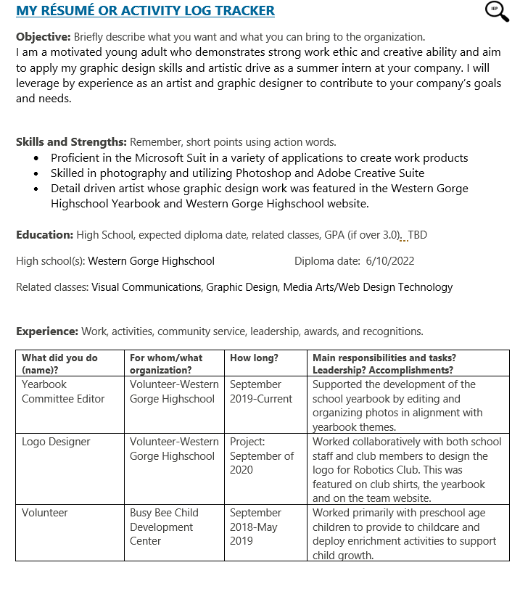

Resume
Notes:
Lastly I wanted to briefly touch show what her Activity log looks like. You can see she as a summary of strength and skills, and a log of the work and community experience she has gained while in high school. Sherrie while only a 10th grader currently has had some excellent experience in the school and community working on the yearbook, designing a logo and volunteering at a childcare center. This template was updated over time as she gained new experiences and will be continued to add to as she progress through highschool.

Slide 17
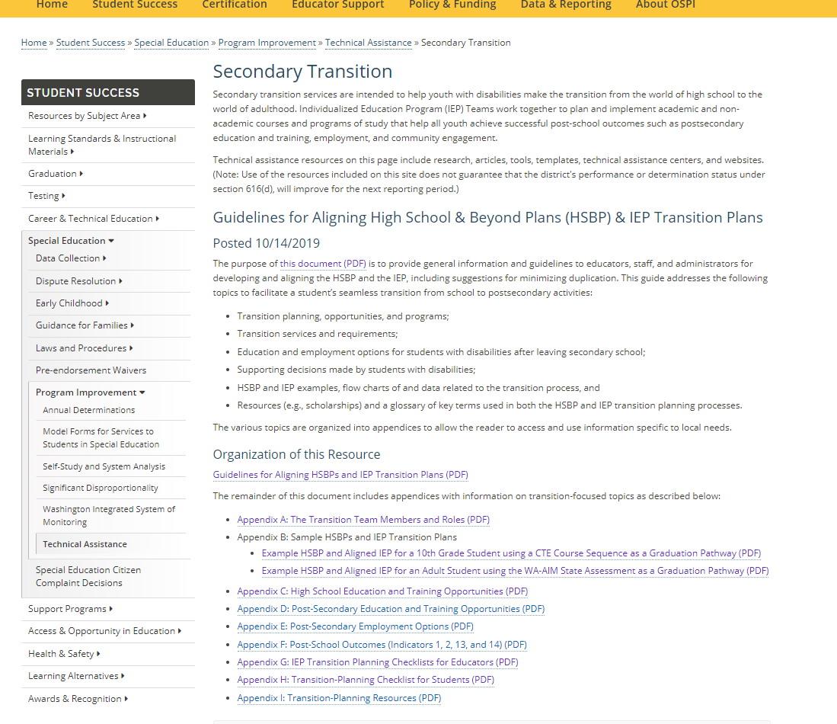
Resources
Please reach out with any questions on today’s content
Alexandra.Toney@k12.wa.us
Renee.Lafreniere@k12.wa.us
Notes:
That concludes our walk through the case study. I wanted to end by sharing the larger guidance document today which is shown in this screenshot. You can see that this is a large document to support transition, it includes two case studys, as well as checklists for educators and students. We will drop this link into chat if you would like to dig deeper into any of this content. Our emails are on this slide, do not hesitate to reach out with any questions.
(next slide)

Slide 18

Thank you!
Notes:
Lets pause the recording and open this up to any questions

Slide 19

Copyright Information
Except where otherwise noted, this work by the Office of Superintendent of Public Instruction is licensed under a Creative Commons Attribution License.
This presentation may contain or reference links to websites operated by third parties. These links are provided for your convenience only and do not constitute or imply any affiliation, endorsement, sponsorship, approval, verification, or monitoring by OSPI of any product, service or content offered on the third party websites. In no event will OSPI be responsible for the information or content in linked third party websites or for your use or inability to use such websites. Please confirm the license status of any third-party resources and understand their terms of use before reusing them.

