Slide 1
AESD/OSPI
LRE Case Studies Series – 3 of 3
September 30, 2020
Tania May
Director
tania.may@k12.wa.us
Ryan Guzman
ECSE/619 Coordinator
ryan.guzman@k12.wa.us
Dr. Rebecca Lynn
Program Supervisor
rebecca.lynn@k12.wa.us
Notes:
Introductions

Slide 2
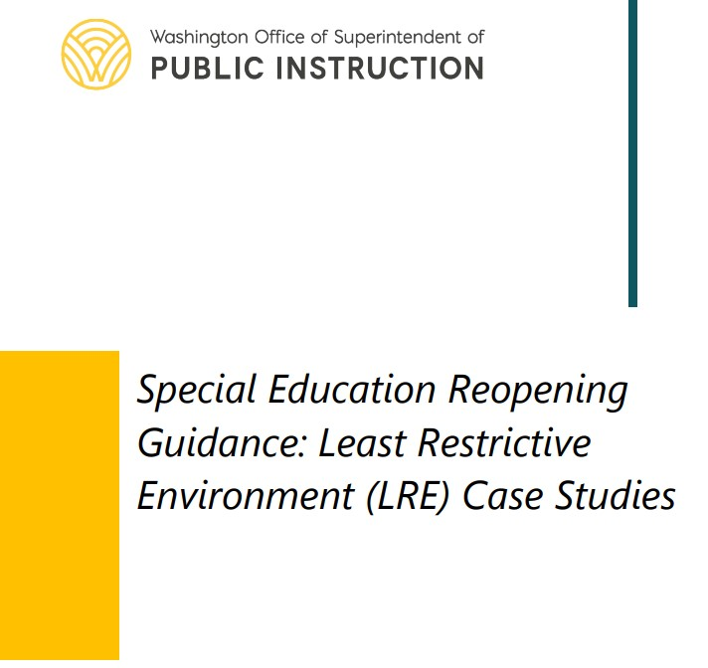
LRE Case Studies Resource
IEP Guidelines
LRE Requirements
Settings across Reopening Models
Accommodations & Modifications
Parent Engagement & Support
LRE Case Studies
  Elementary
  Behavior
  Secondary Transition
  Early Childhood (NEW!)
  LRE FAQ (NEW!)
https://www.k12.wa.us/sites/default/files/public/specialed/pubdocs/LRE-Case-Study.pdf
Notes:
This webinar series is focused on an overview and deeper dive into the case studies from our LRE Case Studies resource. The document is linked on the bottom of this slide. In response to questions we have been receiving about LRE, we are in the process of finalizing an early childhood case study, along with a collection of frequently asked questions; we will post the updated version of our LRE Case Studies resource soon. Today, we will be sharing secondary transition strategies and resources and addressing questions along the way, as time allows. Please feel free to add your questions to the Q&A at any time.

Slide 3
Series Learning Objectives:
Know when an IEP/amendment is necessary (and when it may not be!)
Review strategies for providing instruction and monitoring progress across reopening models
Collaborate to support inclusive access across reopening models, including staff and family supports
Notes:
The objectives for the webinar series include…

Slide 4

Today’s Discussion:
http://clipart-library.com/data_images/141710.jpg
Documenting SDI & LRE
ECSE LRE Case Study-Averie
Ensuring DAP Across Learning Models
Q&A – throughout today’s session
Notes:
Today, we’ll start with some framing and considerations for documenting SDI and LRE across reopening models in early childhood settings. Then, we’ll transition to a deep discussion of the ECSE case study and special considerations for supporting young children and families. We’ll close today’s webinar with strategies and resources to support instructional strategies and progress monitoring. Rather than a closing Q&A, we can pause for questions as we go. So, let’s get started!

Slide 5
Review: LRE, SDI & IEPs Across Reopening Models
IEPs must include the frequency, location, and duration of services.
Location refers to whether the setting is special education or general education (not whether instruction is provided online, in person, or live).
In many cases, the IEP can be implemented as written during distance or hybrid instruction.
  IEPs and IEP amendments should document updated present levels, additional need for services, and changes to frequency, location, and duration.
  In some cases, an amendment may not be necessary.
Notes:
During the first webinar of this LRE Case Studies series, we started with an overview of least restrictive environment (LRE) and specially designed instruction (SDI) across school reopening models. As a quick review:
IEPs must include the frequency, location, and duration of services.
Location refers only to whether a setting is special education or general education (not online vs distance vs hybrid, nor synchronous vs asynchronous).
We have been receiving a lot of questions about whether the IEP needs to document the reopening model. That’s important information for all students and families to have, including families of students with disabilities, but it is not information required to be on the IEP service matrix.
IEPs must document the offer of a free and appropriate public education (FAPE); in many cases, the IEP can be implemented as written across reopening models. There may be situations where an IEP amendment is not required to change from in-person services to hybrid learning or to distance learning. As always, local decisions about when and if and how to document IEP changes should be discussed with your district leadership!

Slide 6
Identifying Settings Across Reopening Models
When calculating LRE, setting is based solely on the level of access to the student’s peer group.
  Setting is ONLY determined by the access to the peer group, not the instructor nor the content nor the method of delivery.
In situations where all students in a school or district are participating in distance learning, the student's home is the setting from which all students are accessing their instruction. Therefore, the student's home is typically considered a general education setting.
IMPORTANT: When children with disabilities are placed in developmental preschool programs, their peers are typically other students with disabilities. Any asynchronous activities completed in the home might then be considered a special education setting.
See additional guidance from the IDEA Data Center, an OSEP-funded technical assistance center.
Notes:
Considerations for identifying settings across reopening models are based on guidance from the IDEA Data Center, and the original resource is linked at the bottom of this slide. We’re going to walk through several key points here…
Most importantly… when calculating LRE, setting is based solely on the level of access to the student’s peer group. To repeat, setting is ONLY determined by the access to the peer group, not the instructor nor the content nor the method of delivery.
In situations where all students in a school or district are participating in distance learning, the student's home is the setting from which all students are accessing their instruction. Therefore, the student's home is typically considered a general education setting.
Whether services are distance or in-person, synchronous or asynchronous, at home, in a district developmental preschool classroom, or in a community-based early childhood setting, just ask yourself: What is the level of access to the peer group during this instruction, service, or activity? Your answer will determine the setting.
Related to that point, when children with disabilities are placed in developmental preschool programs, their peers are typically other students with disabilities. Any asynchronous activities completed in the home might then be considered a special education setting. Let’s take a look at some examples of settings across early childhood reopening models.

Slide 7
Settings Across Early Learning Reopening Models
 | General Education | Special Education
Synchronous | Morning meeting and singalong in Head Start, via Zoom, with peers with & without disabilities. | Small group Zoom session on social emotional learning with children with disabilities and the ECSE teacher.
Asynchronous | Asynchronous learning activities accessed by children with and without disabilities (e.g., a story read along at PBS Kids Read-Alongs). | Asynchronous OT exercises completed by the student with family support, recorded with a cell phone and sent to the OT for review.
In-Person | Itinerant, small-group speech services provided in the ECEAP classroom. | Adaptive SDI embedded into whole-group instruction in a developmental preschool classroom.
See additional guidance from the IDEA Data Center, an OSEP-funded technical assistance center.
Notes:
Synchronous means occurring at the same time, and asynchronous means not occurring at the same time. Remember that the definitions of SDI and LRE are not impacted by whether learning is synchronous or asynchronous, nor whether services are provided in person or through distance learning. SDI can be provided in a general education setting or a special education setting, through synchronous or asynchronous delivery.
This table shows a few examples for how we can think about setting/location across early childhood reopening models. Whether instruction is synchronous or asynchronous, the key factor is whether the participating peer group includes only (or primarily) students with disabilities.
I think now is a good time to pause for questions about identifying and documenting settings across reopening models. Ryan will now walk us through the early childhood case study...

Slide 8

Preschool Case Study: Averie
Notes:
Say:
Now, on to our PreK case study. I’m going to walk us through the case of Averie to highlight the how an IEP teams can maintain DAP across all learning models, while including families in the planning and implementation process.
We will review the special considerations IEP teams might take on when creating a specialized learning plan for a student participating in a PreK program, and share examples of daily schedules, and instructional strategies to promote learning in both distance and hybrid settings.

Slide 9
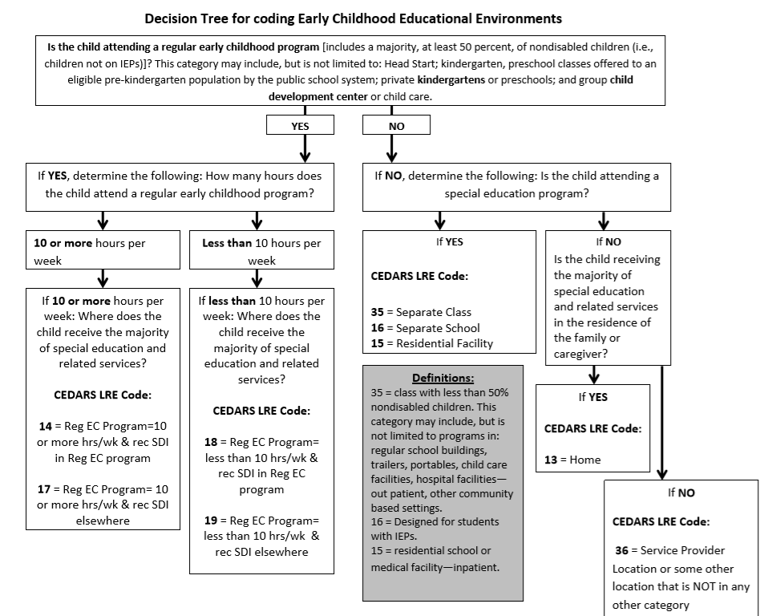
LRE & the Continuum of Placement Options
Placement options for a child entering an early childhood program might include:
ECEAP
Head Start
Community PreK
Child Care
Developmental PreK
Title I PreK
Transitional Kindergarten
Notes:
Averie is coming to us from an early intervention program. She was diagnosed with Cerebral Palsy at 13 months and after a being referred to her local school district for continued services, was found eligible for Part B, IDEA.
After reviewing current data from Averie’s early intervention provider agency (EIPA), parent report, and assessment data gathered by the school district’s assessment team, it was determined by her IEP team that the most appropriate placement option for Averie was the school district’s developmental preschool program.
Currently, the developmental preschool school program enrolls both students with and without disabilities, with a ratio of 8 SWD-4 SwoD, which does not meet the definition of a regular early childhood program (RECP).

Slide 10
Special Considerations for ECSE:
Developmentally appropriate practice (DAP) is a framework designed to promote young children’s optimal learning and development. To make decisions that reflect best practices, educators take into consideration what they know about
Child development and learning
Each child as an individual
Each child’s social and cultural context
Notes:
Averie’s local community has experienced an outbreak of COVID-19 in recent months and is planning to be prepared with multiple operational models for the start of the 2020-21 school year.
Her IEP has been amended to plan for FAPE across all reopening models.
The IEP team has adopted several strategies to ensure that DAP will be offered across all learning models

Slide 11
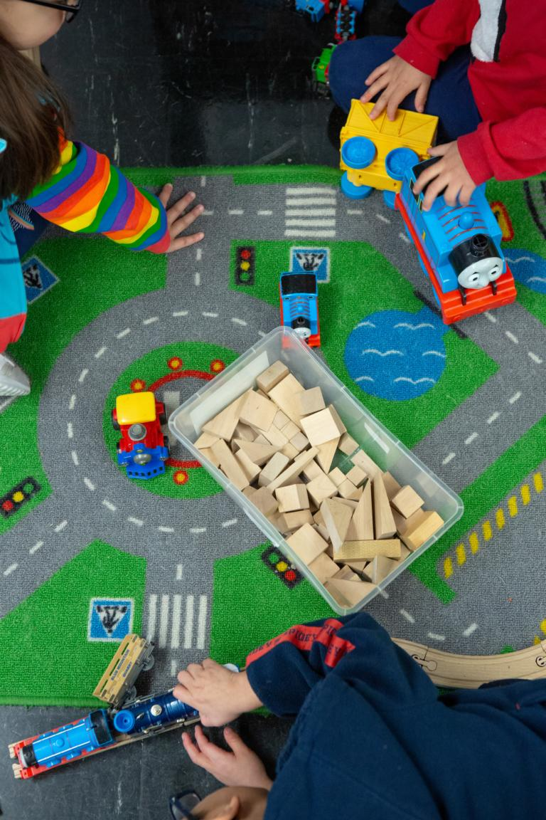
The ECSE IEP Team will :
Involve Averie’s family in scheduling decisions and establish a predictable schedule for disseminating information.
Engaging Averie’s family in collecting evidence (work samples, photographs, videos) of her progress toward learning goals, inviting them to participate in the process of documenting their child’s learning.
Notes:
Strategies identified by Averie’s IEP team included:
Identifying goals that were important to her family.
Read slide
Use state early learning guidelines to discuss what children of a similar age are learning and doing.
Read slide
Be cautious not to pressure or suggest that families are expected to contribute. Not all families will have the capacity to support their child’s learning program in the same way.

Slide 12
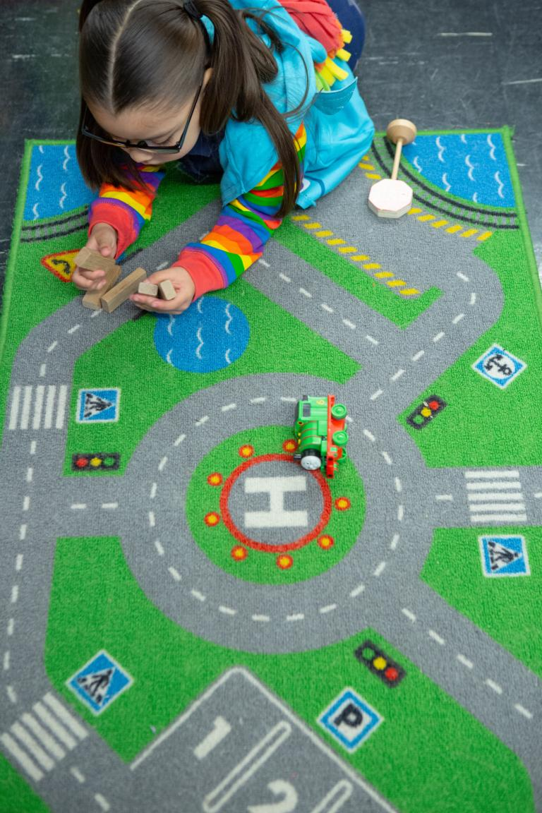
The ECSE IEP Team will :
Scaffold the length of the session to support the needs of Averie and her family (e.g.; A 20-minute OT session will begin with a 10-minute parent orientation with student followed by observation of student with family).
Review with Averie’s family recommended environmental setups, including:
  what might be too stimulating,
  what tools may need to be made available, and
  how they might use adult proximity to support the learning.
Notes:
Additional strategies suggested by the IEP team included:
Read slide

Slide 13
Sample Schedule: Distance & Hybrid Learning
PreK-ECSE | Mon/Wed Whole Group Engagement | Tues/Thurs SDI Progress Monitoring | Ongoing Staff Priorities:
9:30-9:50 | Live Circle Time (whole group) | Live Circle Time (small group skill building & progress monitoring) | Parent Training and Family Conferences
10:00-10:10 | Brain Break! | Brain Break! | IEP & Evaluation Development
10:10-10:30 | Live Social-Adaptive Group (whole group) | Live Social-Adaptive Group (small group skill building & progress monitoring) | IEP Team MDT meetings
10:30-10:45 | Live Closing Circle Time (Adaptive, SE) | Communication (SLP tele-session) T OT (OT tele-session) R | Planning Preparation and Communication
ECSE Engagement Tips:
Offer rapid transitions.
Use break out rooms to maintain engagement.
Include short chunking of tasks (10 minutes live instruction, 5 minutes off camera).
Brain breaks with physical movement integrated into live learning opportunities.
Increased opportunities for students to respond.
Notes:
At the start of the 2020-21 school year, Averie’s classroom teacher shared a proposed schedule for both hybrid and distance learning with their families.
It was decided by the ECSE program team that:
Students would engage in distance learning no more than 90 minutes per day,
Session would be capped at 20 minutes, with no more than 3 ‘meet ups’ in a day,
Students would engage in either small or large group instruction with their peers, and
Time was would set aside for the delivery and monitoring of student progress, 1:1 instruction for specialists (OT, SLP), and brain breaks.
The classroom teachers also identified engagement strategies to ensure that the delivery of instruction was developmentally appropriate.

Slide 14
Case Study¹: Averie, ECSE PreK
Case Study: Averie is enrolled in a developmental preschool program and receives early childhood special education services in the areas of cognition, communication, social-emotional development, fine motor, and adaptive/self-help. She has an annual IEP due January 8, 2021, noting the following services:
Service Area | Frequency |  | Location (setting) | Duration
Cognitive | 160 mpw |  | Special Ed | to 1/8/21
Communication | 20 mpw |  | Special Ed | to 1/8/21
Adaptive | 90 mpw |  | Special Ed | to 1/8/21
Social Emotional | 180 mpw |  | Special Ed | to 1/8/21
OT | 30 mpw |  | Special Ed | to 1/8/21
Total instructional minutes per week: 480 |  | LRE Code: 35 (separate class)
¹Adapted from the NASDSE Brief: LRE in the Wake of COVID-19
Notes:
Say? Our case study for Averie is adapted from an LRE brief developed by the National Association of State Directors of Special Education (NASDSE).
Start here:
Averie is starting her second-year developmental preschool, and her district has chosen to begin with distance learning and is planning ahead for hybrid instruction. Her annual IEP, which was developed before COVID hit, includes…
As distance learning persists, the IEP team is working to create a high-quality early learning program that supports Averie’s ability to engage in distance learning in the home environment.

Slide 15
Averie’s Present Levels Update:
It was reported by Averie’s family, that she enjoyed the online and offline learning tasks that occurred in the spring but that she was not able to engage for more than 5 minutes at a time and required constant adult supervision.
Identified priorities include; maintaining regular check ins with Averie’s family to assist the IEP team in the assessment of progress towards her IEP goals, along with the facilitation of parent training to ensure a better understanding of how to engage Averie in learning tasks in the home environment.
Notes:
Say:
Averie’s IEP team has worked very hard to maintain a strong connection to Averie and her family, with weekly check in’s that are centered on Averie, her progress towards IEP goals and the integration of service delivery activities into the family’s daily routines.
Read Slide:

Slide 16
School Reopening Models
Distance Learning:
Students will participate in a distance learning model for educational services through November 2020 for all students. Instruction will be accessed from the home, with synchronous and asynchronous options, online, and with paper-based and project-based activities.
Averie will participate in a distance learning model with her developmental preschool classmates.
Hybrid Learning:
Students will follow an alternating schedule of 2 days per week in person with physical distancing procedures. The remaining 2 days will be distance learning.
  Students groups of no more than 10, with minimal transitions.
  Implemented for selected students starting in November 2020, if permitted by health guidelines.
Averie will attend in person 2 days per week and continue with virtual learning 2 days per week.
Notes:
Averie will start with a distance learning format and transition to in-person services 2 days per week starting in November, if permitted by health guidelines. She will continue with distance learning 2 days per week once the school district transitions to a hybrid, in-person model.

Slide 17
IEP Team Planning for Averie’s Distance Learning
Cognitive SDI will include synchronous and asynchronous group virtual instruction (large and small) with the special education teacher and classmates with and without disabilities in collaboration with family.
Communication SDI will be provided in small-group 1:1 virtual sessions with the SLP and asynchronous instruction in collaboration with family.
Notes:
Each of the LRE case studies has included considerations and decisions made by the IEP team regarding student services. The case studies include examples across reopening models that highlight service areas and modality; accommodations and/or modifications; parent coaching/support; and progress monitoring considerations.
In this example, you will see that Averie’s goals related to Cognitive, Social Emotional, and Adaptive skills will be delivered within an integrated learning model that includes access to high quality core instruction in small and large groups with her same aged peers.
Instruction and progress monitoring for communication and OT will follow a similar model as well, with specially designed instruction taking place in 1:1 virtual sessions and asynchronous learning with family collaboration.

Slide 18
IEP Team Planning for Averie’s Distance Learning
Accommodations: Verbal, visual, and/or physical prompts to increase on-task behavior with frequent checks for understanding.
Parent support: Bi-weekly planning sessions to share ideas and approaches the IEP team has developed for teaching content that families can support at home.
Progress monitoring: IEP goal progress, anecdotal notes, work samples, and progress on the adapted online curriculum(s).
Notes:
Review slide:

Slide 19
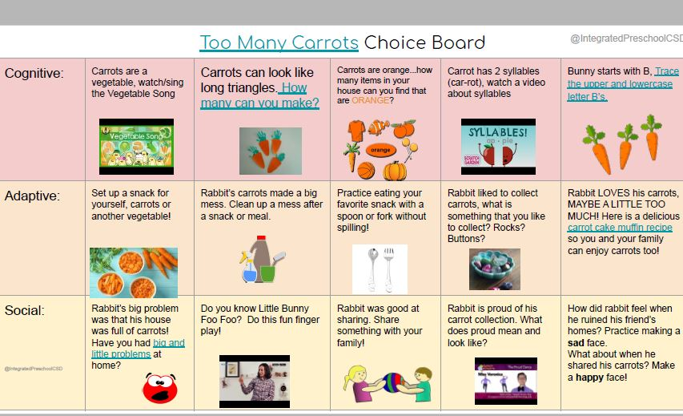
Engaging Activities During Distance Learning
Source: @IntegratedPreschoolCSD; Drew, P., Christensen, K., Ham, C., & Munden, E.
Notes:
Averie’s preschool teachers created choice boards to share with families during the spring school facility closure and will continue to use this strategy to support asynchronous learning through the 2020-21 school year.
Credit Camas SD
Portia Drew
KC Christensen
Christen Ham
Erica Munden

Slide 20
Amending Averie’s IEP
From Averie’s amended IEP, dated 8/6/2020:
Service Area | Frequency |  | Location (setting) | Duration
Cognitive | 100160 mpw |  | Special Ed | to 1/8/21
Communication | 20 mpw |  | Special Ed | to 1/8/21
Adaptive | 8090 mpw |  | Special Ed | to 1/8/21
Social Emotional | 100180 mpw |  | Special Ed | to 1/8/21
OT | 30 mpw |  | Special Ed | to 1/8/21
Total instructional minutes per week: 480 |  | LRE Code: 35 (separate class)
NOTE: Averie’s IEP team determined the asynchronous services will be considered a Special Education setting, unless the student ratio described for a regular early childhood program (50/50 students with disabilities vs. students without disabilities) is met.
Notes:
For Averie’s case, the total number of weekly minutes of SDI will change due to the ECSE programs decision to ensure the distance learning experience continue to be developmentally appropriate.
Reminder that the ECSE program team decided that:
Students would engage in distance learning no more than 90 minutes per day,
Session would be capped at 20 minutes (no more than 30 minutes), with no more than 3 ‘meet ups’ in a day,
...while engaging in During distance learning.
Note that red text is included to call out specific information, such as a change in setting/location across reopening models.
Again, because of this, the IEP team have determined an IEP amendment is necessary on the service matrix. Though, this change will not affect her LRE code.

Slide 21
IEP Team Planning for Averie’s Hybrid Learning
Cognitive SDI will include synchronous and asynchronous group instruction and in-person instruction with the special education teacher and classmates with and without disabilities in collaboration with family.
Communication SDI will be provided in small-group in-person session with the SLP.
Accommodations, Parent support, and Progress monitoring will continue as planned during distance learning.
NOTE: No IEP amendment needed; 8/6/2020 amendment remains in effect.
Notes:
As Averie transitions to hybrid learning starting in November, the majority of her services will be provided in-person, 2-days per week.
Distance learning will occur 2-days a week with synchronous and asynchronous instruction (one day per instructional mode).
Because of this the total instructional and SDI minutes per week remain the same and her fall IEP amendment remains in effect.

Slide 22
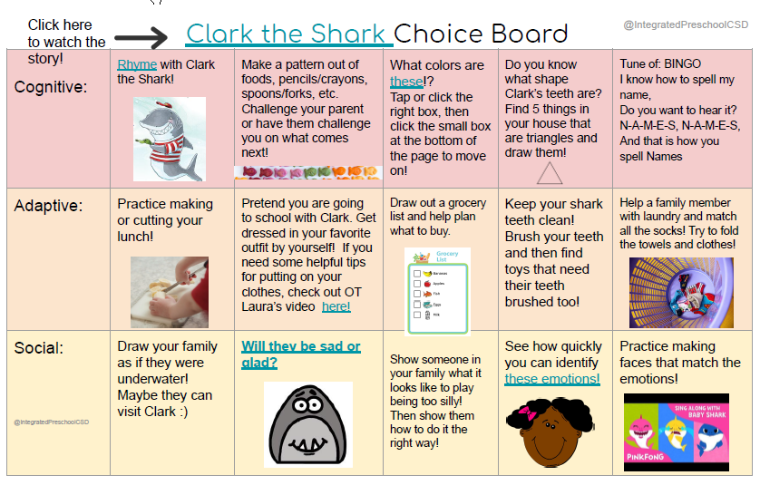
Choice Board Example
Source: @IntegratedPreschoolCSD; Drew, P., Christensen, K., Ham, C., & Munden, E.
Notes:
Let's stop here for questions before turning the presentation over to Dr. Rebecca Lynn, who will continue to share how we can create inclusive, developmentally appropriate learning experiences across the reopening models shared today.

Slide 23
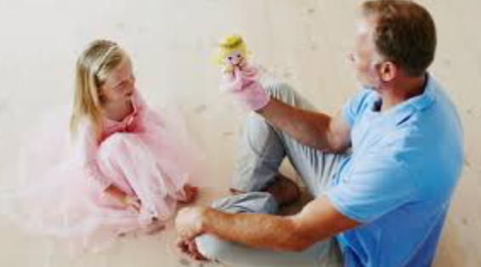

Continuous Distance Learning in ECSE
Build capacity in families to support continuous learning in the home
Model for parents how they can help their children learn through activities and everyday routines.
Pre-record videos or allow zoom instructions to be videotaped to demonstrate teaching strategies.
Allow time for family to share parenting needs and challenges, and provide coaching and resources.
Shift from direct services to transdisciplinary and consultation model to streamline interventions.
Reduce emotional stress on the child and family by simplifying and scaffolding work/teaching demands.
When developing plans for family as instructional partners, co-create schedules and provide clear directions.
Look for opportunities to access peer models and socialization online or in community
Collaborate with preschools for opportunities to join online / group activities and lessons.
Schedule structured and supervised online "play time" with peers.
Pre-select videos on YouTube of children playing and learning to view alongside child and share observations.
Take walks or visit public spaces with peers social distancing and engaging in facilitated activities (leaf collection, etc).
Notes:
Families are essential partners for continued learning in an early childhood distance or hybrid model. Service providers may need to communicate and collaborate with families more to provide the guidance and coaching needed to teach and maintain IEP goals, but also in best practices for teaching young children. Families will need models for following through with intervention in the home within everyday routines. Guidance and modeling can be provided online or in pre-recorded videos. A transdisciplinary approach streamlines the service provision to minimize the consultation load on families, and requires advanced collaboration and planning by the team. It is important to acknowledge the stress that children and families may be experiencing, and make tasks doable. Instructional plans can be modeled but should also be written and emailed to include the goal, materials, and steps for modeling and facilitating learning.
Access to peers can also be facilitated by the family online and in the community. Help connect them with preschools that offer online or in-person activities, help create structured online play time with peers, and consider exploring YouTube videos of young children playing and learning to watch with the child and use as tool for language and learning.

Slide 24
Embedded Home-based Intervention Matrix
Review the daily routines with the family and choose together where the family might work on goals, asking:
What are the typical activities, routines, and transitions that occur each day?
What learning opportunities are there across typical activities, routines, and transitions?
What goals could the family target during these activities?
Is it a natural and logical time to teach?
How many opportunities throughout the day will the child need to practice?
 | Cognitive | Social | Adaptive
Waking up | Making predictions – morning story - day events | Social-communication skill for greetings | Choose clothing to wear by type (pants, shirt, etc)
Breakfast | Naming / identifying objects at the table | Receptive and expressive language prompting "more" "done" | Independence with breakfast routine and clean up
Learning time | Structured time with technology online with teacher or parent to work on sequencing | Online with peer(s) or viewing pre-selected videos of peers with adult -directed questions/comments | Prompts toward independence with technology, with organization of toys/materials

Slide 25

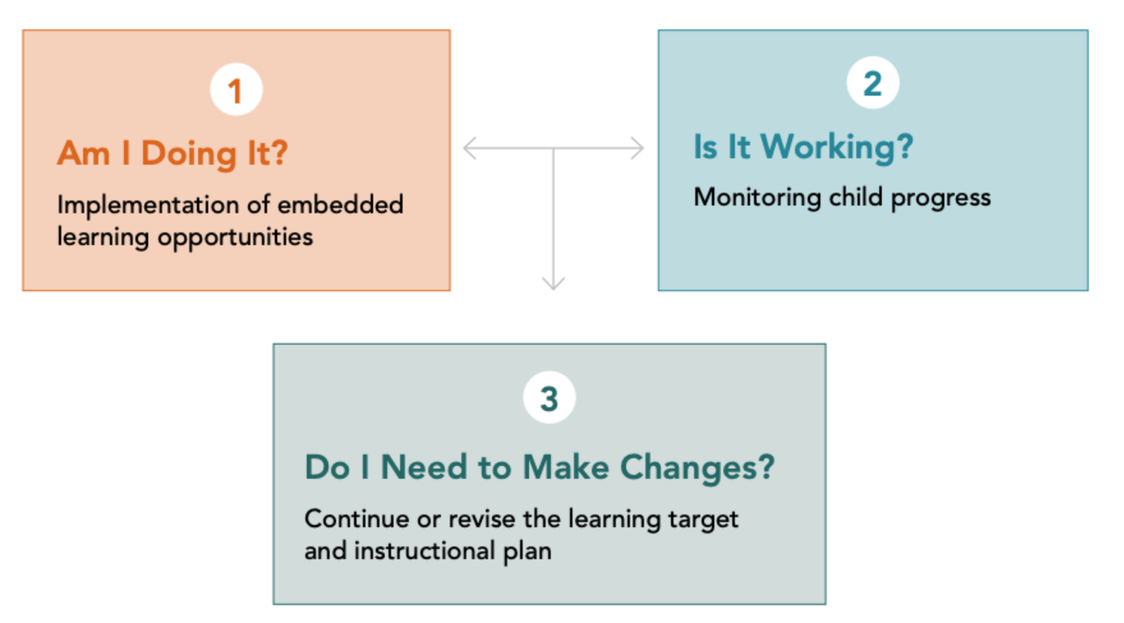
ECSE Progress Monitoring of Embedded Learning
Am I doing it? Are learning opportunities embedded and/or implemented as planned or intended to include instructional sequence and strategies?
Is it working? Is data collected on frequency of opportunities and child response showing progress?
Do I (we) need to make changes? How did child progress based on both implementation / intervention and response data and what changes need to be considered by the team? ( progress monitoring).
Adapted from Head Start Center for Inclusion: Embedded Interventions
Notes:
Families will also be essential partners in monitoring progress on goals and facilitating changes in instruction that foster continuous growth and improvement. A simple process such as this one provided by Head Start Center for Inclusion on Embedded Intervention can be easy to follow for families and provide the structure for gathering data.

Slide 26
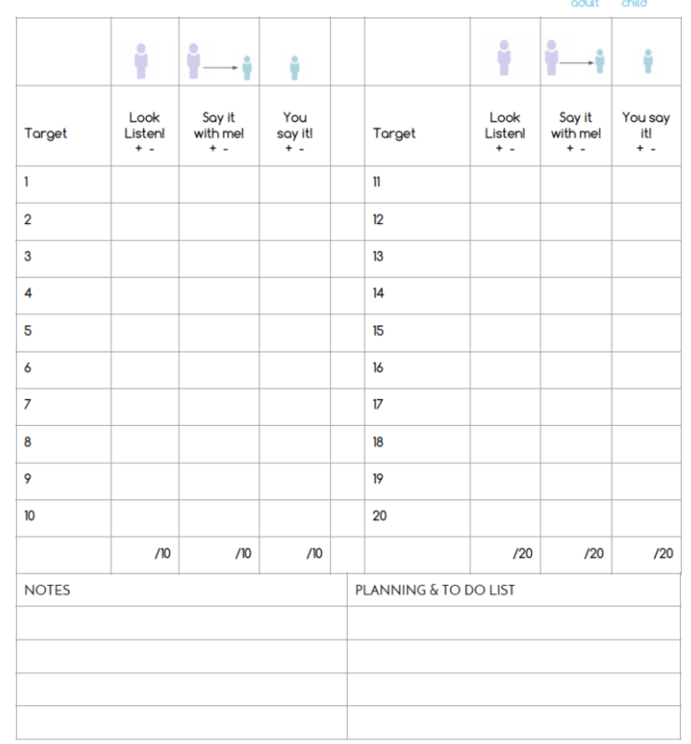
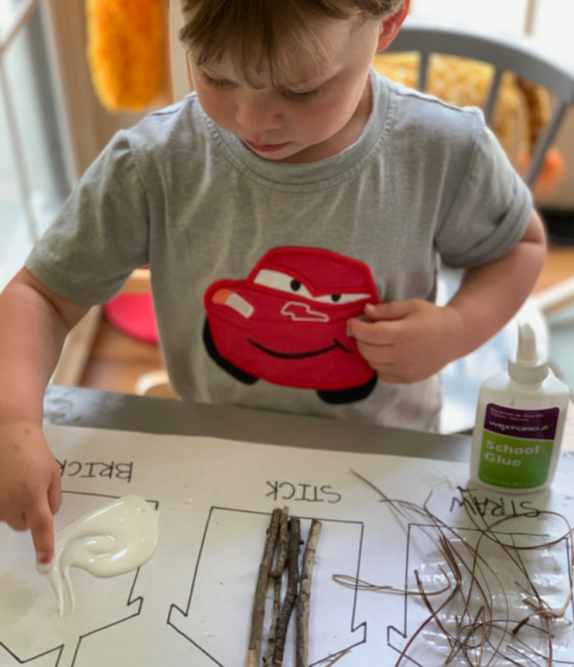
Progress Monitoring IEP Data Collection
Collect data: Combination of quantitative and narrative data to evaluate student progress in delivery model, to document IEP progress, to revise services as needed, and to determine the need for change.
Data sources: Observations, parent report, documentation from digital and print-based sources such as tally sheets, samples of work, video, audio, photos of work or actions.
Review of previous data: Past observations, parent report, informal assessment data, formal assessment data, district or site-based assessments, educator-made assessments.
Note: Spring 2020 data related to IEP goals and remote participation can be used for planning and progress monitoring.
Adapted from: IDEA Best Practices during the Covid-19 Crisis
Notes:
There are many resources for collecting data, documenting with data, and reviewing data, even with distance learning.
Qualitative data is the process of counting the number of times a behavior or response is observed, the frequency of a response, or the time engaged in an activity. Qualitative data is a narrative that describes details not easily captured in quantitative methods. A combination is often best for capturing a complete picture of what is happening in order to make changes or continue with what is working.
Data is all around, but progress monitoring pays attention to data that corresponds to an IEP goal or a particular question about how the student responds to instruction. At the very least, data should be collected about the amount and types of SDI you are providing. Identify goals for progress monitoring, explore sources of data and create forms for documenting new data, then review frequently to monitor the progress and make instructional changes.

Slide 27
Key Practices to Support Online Learning for Students with Disabilities
Ensure digital equity and orientation to tools and platforms.
Maintain reciprocal communication with students and families related to schedules, routines, and expectations, to promote understanding.
Review and reinforce predictable routines for delivering SDI and engagement in synchronous and asynchronous learning.
Develop flexible distance learning and assessment plans based on individual student strengths and needs.
Establish partnerships with families and provide training as well as ongoing support to ensure access to continuous learning.
Collaborate with general education partners to ensure access to general education instruction and inclusive peer interactions.
Adapted from: NCII Supporting Students with Disabilities at School and at Home
Notes:
This list of key practices can be a checklist for educators when developing a distance learning model, and when reviewing and evaluating that model. Consider equity and orientation to the tools to ensure access to instruction.
Ensure students and parents have the resources and the skills to participate in online learning.
Reciprocal communication with the student and families is the best way to share plans and schedules and to learn what works for them.
Predictable routines are good for everyone to maintain a flow that instruction and activities can fall into on a regular basis (one less thing to worry about)
Learning and assessment plans should be flexible so the content or format can be modified for individual students
Parent training and coaching is essential for continuous learning between school and home.
Finally, collaboration with general education preschool partners (and related service providers) is essential for streamlining services and creating access to learning alongside peers

Slide 28
ECSE Distance Learning Resources
ECTA Remote Service Delivery and Distance Learning (OSEP)
DEC Resources for COVID (CEC)
DAP in the time of COVID (NAEYC)
DaSy. The Center for IDEA Early Childhood Data Systems (OSEP)
Head Start Center for Inclusion: Embedded Interventions
Early Childhood Recommended Practices Modules

Slide 29
ECSE Program Team Resources:
Reopening Washington Schools 2020: Early Learning Planning Guide
Considering student placement options in PreK: Placement, Short-and-Sweet
ECTA, Functional IEP training
NCMPI, COVID-19-Helping Children & Families Cope

Slide 30
LRE Case Studies Webinar Series
Sept 16, 3pm:
Elementary
& Behavior
Sept 23, 3pm:
Secondary Transition
Sept 30, 3pm:
Early Childhood
Recording & Slides
These Recordings & Slides will be posted soon!
Notes:
The first webinar in this LRE series reviewed the elementary and middle/behavior case studies. The recording and slides have been posted from the first webinar, and they are linked on this slide. We will post the recording and slides for today’s webinar as soon as we can.
Next week, our third and final LRE webinar will focus on early childhood, with our ECSE Coordinator, Ryan Guzman. The registration link is also included on this slide.

Slide 31

AESD/OSPI Monthly Webinar Series:
Oct 8, 3pm:
Inclusionary Practices Across Reopening Models
Nov 12, 3pm:
Progress Monitoring & Collaboration
Dec 10, 3pm:
Family & Community Partnerships
Registration Link
Registration Link
Registration Link
Webinar Series Flyer: https://drive.google.com/file/d/1g24Vb5DCNxCB3sUrcMAryg7eyNbwQ-Eo/view
Notes:
The first webinar in this LRE series reviewed the elementary and middle/behavior case studies. The recording and slides have been posted from the first webinar, and they are linked on this slide. We will post the recording and slides for today’s webinar as soon as we can.
Next week, our third and final LRE webinar will focus on early childhood, with our ECSE Coordinator, Ryan Guzman. The registration link is also included on this slide.

Slide 32

Questions?
Notes:
We will save today’s chat and the Q&A; for any questions we couldn’t address today, we’ll do our best to incorporate them into the next webinars in the series.

Slide 33

Thank you!
Notes:
Thanks again for joining us today! We look forward to continuing these LRE discussions during our upcoming webinars focused on secondary transition and then early learning. The registrations links for each webinar are included on this slide.

Slide 34

Copyright Information
Except where otherwise noted, this work by the Office of Superintendent of Public Instruction is licensed under a Creative Commons Attribution License.
This presentation may contain or reference links to websites operated by third parties. These links are provided for your convenience only and do not constitute or imply any affiliation, endorsement, sponsorship, approval, verification, or monitoring by OSPI of any product, service or content offered on the third party websites. In no event will OSPI be responsible for the information or content in linked third party websites or for your use or inability to use such websites. Please confirm the license status of any third-party resources and understand their terms of use before reusing them.

