Slide 1
Proposed Meeting Structure for GATE Advisory 2021-2022
Best Practices Keynote or Panel
Collective impact issues: Engagement, Mental Health & Social Emotional Support, Community & Coalition Development
Collaborative Discussion Groups Protocol
Performance measures and benchmark creation and measurement
Professional Development Sharing and Collaboration Opportunities
“We want to cosponsor an event”
Legislative focus group recommendations: Opportunities to grow, barrier reduction, resources
Opportunities for joint funding
“We want to amplify an event”
Fiscal, legal, and regulatory barriers to program collaboration
Recommended Measures and benchmarks
Meeting Dates
October 19 (school climate & engagement), December 14 (SEL), April 19 (pathways academic) second Tuesdays 9-12pm
12/13/2021 | 1

Slide 2
Run of Show Notes
Breakouts – Same Groups of 3
Slide 16: 5 minutes 30 second transition
Polling
Slide 23 – How Prepared
Slide 33: 14 minutes 30 second transition
Slide 34: 14 minutes 30 second transition
Slide 35: 14 minutes 30 second transition
Slide 39 (depending on time) 3 minutes
Slide 43 - Eval
Move people around until there’s 3 active people in each room

Slide 3
Aspirational Agenda
Time | Topic | Speakers
9:00 | Welcome | Michaela Miller, Deputy Superintendent for at OSPI
9:15 | Vision mission, Objectives, intros | Kefi Andersen, System Improvement Program Supervisor Lead at OSPI
9:25 | Get to know your group | Kefi Andersen, System Improvement Program Supervisor Lead at OSPI
9:35 | About Building Bridges & Washington data to establish why | Dixie Grunenfelder, Executive Director for Student Engagement & Supports at OSPI
9:40 | Modeling Best Practices: PUSH for Dreams Partnership with Hilltop Heritage Middle School | Dr. Timmie Foster, College Readiness Program Supervisor Lead at OSPI Dr. John Gaines, Founder of PUSH for Dreams Geno Munoz, Counselor at Hilltop Heritage Middle School
10:15 | Break
10:25 | Discussion group protocol | Kefi Andersen, System Improvement Program Supervisor Lead at OSPI
11:30 | Sharing Events and Needs | Dixie Grunenfelder, Executive Director for Student Engagement & Supports at OSPI
11:45 | Resources & Evaluation | Dixie Grunenfelder, Executive Director for Student Engagement & Supports at OSPI

Slide 4

YouTube
We are recording today!
We should be starting in a few minutes!
Subscribe! Youtube.com/waOSPI
Notes:
---
Let audience in at 8:55.
Music: Surfaces Sunday Best
Chat: Subscribe to our YouTube channel to get the latest content from OSPI: Youtube.com/waOSPI

Slide 5

Welcome to GATE Advisory!
Focus:
Responding to the COVID-19 Pandemic
Graduation A Team Effort
Notes:
Welcome to the Graduation A Team Effort (or GATE) Advisory!
I’m Kefi Andersen, System Improvement Program Supervisor Lead and today we are talking about Responding to the COVID 19 Pandemic
This meeting is being recorded and should be available on YouTube following our meeting. Closed Captions are available in the menu if you want to take advantage of that.
The PowerPoint is going to be shared in the chat.
---
RECORD

Slide 6

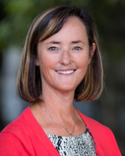
Welcome
Dr. Michaela Miller
Deputy Superintendent
Notes:
We’d like to welcome our OSPI Deputy Superintendent, Dr. Michaela Miller to start us off today.
Turn off the slides
---
Michaela:
Welcome! Your voice matters so much, thanks for being here
We’re stronger together. For those of you who are new to the GATE Advisory, this is a powerful group.
Your recommendations have the power to steer how we support graduation, community based organizations, and how we do business as state agencies.
Through this work we know we can have a lasting impact to reduce barriers and to prove our impact using shared measures of success.
--

Slide 7
Notes:
This meeting is brought to you through the Office of Student Engagement & Supports within the Office of the Superintendent of Public Instruction.
At OSPI we believe each student needs to be prepared for post-secondary pathways, careers, and civic engagement.

Slide 8
Notes:
I want to share with you our OSPI Equity Statement.
The GATE Advisory group was created to help eliminate barriers to graduation and increase educational equity.
We are bringing together educational, state, and community leaders to develop an understanding of historical contexts and engage you as partners in decision making.
We want to examine policies, practices and systemic barriers so that each student has access to the instruction and support they need to be successful in Washington schools.

Slide 9
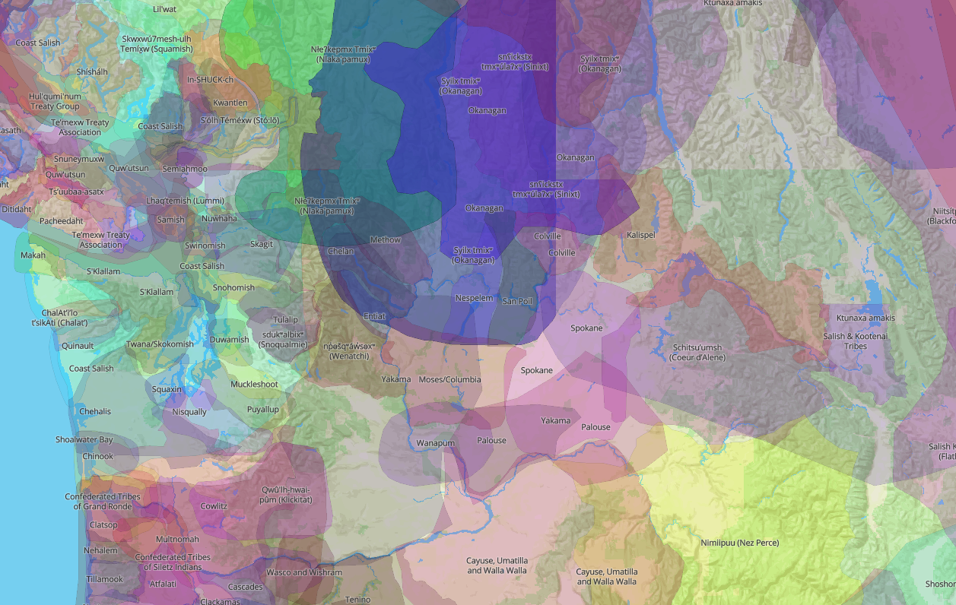
Ancestral Lands Map
Ancestral Lands
Share your location in the Chat
Ancestral Lands Map | 12/13/2021 | 9
Notes:
I want to share with you this ancestral lands overlapping map. I like this map because it’s more informative about the lands we live on in Washington and provides additional context for our communities to consider. I love the nuance of seeing that these lands are often shared by multiple groups and that the borders overlap.
We ask that the participants of this meeting honor the traditional lands on which each of you are located today. We’ll paste some links in the chat to help.
In my life I mostly travel around the intersection of the traditional lands of the Squaxin Island, Coast Salish, Cowlitz, and Nisqually Tribes.
I would like to acknowledge the indigenous people who have stewarded this land since time immemorial and who still inhabit the area today.
Tribal Consultation is a great way to partner with your local tribes and begin relationships that benefit students and their families and if you’d like to know more about it, we’d love to connect you with our Office of Native Education.
---
Chat Links:
Text the name of a city & state to 907-312-5085 to learn about the tribal nearest you.
School District & Nearest Federally Recognized Tribes: https://www.k12.wa.us/sites/default/files/public/indianed/tribalsovereignty/partnering/SD-Nearest%20Tribe%20List.pdf
Overlapping Map: https://native-land.ca/

Slide 10
Equity Pause
Who will my decision affect?
What is my locus of control?
Which actions will have the largest impact?
What’s a step I can take right away?
Notes:
I want to take this opportunity to acknowledge the diversity in this room. We all know that our public school system isn’t perfect and that students need more from us.
OSPI is trying to walk the equity walk in a variety of ways. This month our entire staff participated in the first of five all day trainings to help us get a shared foundation on diversity, equity and inclusion. This kind of concrete action gives me hope.
Every person who was invited to this meeting is here because they’re a leader. You have the power to signal other people with the where you choose to focus, the language you use, and when you choose to speak up or stay quiet.
You are educational change makers. We know that facilitating positive relationships with youth and caring adults is one of the most important protective factors there is.
This meeting is a chance for you to exercise your influence by sharing what you know from your unique perspective. We hope that you take the initiative to share the opportunities you see and that you challenge yourself to think deeply about real solutions so that we can take real steps to supporting Washington’s youth.
There’s a Margaret Mead quote that I think is particularly important to our work that I want to share:
“Never doubt that a small group of thoughtful, committed citizens can change the world; indeed, it's the only thing that ever has.”
I have faith that we can be this group.
I’m grateful for the opportunity to meet with you and am excited to amplify your ideas for how to eliminate gaps in graduation.

Slide 11

Objectives
Modeling Best Practices
Collaborative Discussion Groups
What are our performance measures and benchmark creation and measurement?
What are the fiscal, legal, and regulatory barriers to program collaboration?
What are the opportunities for joint funding?
Collaboration Opportunities
Learn from John Gaines, Founder of PUSH for Dreams and Geno Munoz from Hilltop Heritage Middle School
How can we work together?
12/13/2021 | 11
Notes:
We chose to focus this discussion around recovering from the impacts of the COVID 19 pandemic.
We thought it would be helpful to our discussions if we shared some of Washington’s data around graduation.
As well as giving you a best practices model from PUSH for Dreams’ work with Hilltop Heritage Middle School.
We’ll be running a protocol for discussion groups later on in the meeting, where we’ll be collecting your feedback on how you’re measuring your impact, the barriers that you’re seeing, and your ideas for policies and funding that will help our students get to graduation.
We also want you to keep in mind, that a part of this group meeting is to think collaboratively about ways we could work together.
To close our meeting today we’ll be sharing events, regional Professional Development, Partnership needs, or Joint Funding opportunities.
We would also welcome sharing resources that might benefit the group.

Slide 12
Duties
for the reduction of fiscal, legal, and regulatory barriers that prevent coordination of program resources across agencies at the state and local level
Develop and track performance measures and benchmarks for each partner agency or organization across the state
Identify research-based and emerging best practices regarding prevention, intervention, and retrieval programs
Legislative Recommendations
Performance Measures
Best Practices
including performance measures and benchmarks based on student characteristics and outcomes specified in RCW 28A.175.035(1)(e)
12/13/2021 | 12
Notes:
(2) To assist and enhance the work of the programs established in RCW 28A.175.025,
Recommendations
(a) Identify and make recommendations to the legislature for the reduction of fiscal, legal, and regulatory barriers that prevent coordination of program resources across agencies at the state and local level;
Performance Measures
(b) Develop and track performance measures and benchmarks for each partner agency or organization across the state including performance measures and benchmarks based on student characteristics and outcomes specified in RCW 28A.175.035(1)(e); and
Best Practices
(c) Identify research-based and emerging best practices regarding prevention, intervention, and retrieval programs.
Annual Report
(3) The advisory committee shall report to the appropriate committees of the legislature and the governor on an annual basis beginning December 1, 2007, with proposed strategies for building K-12 dropout prevention, intervention, and reengagement systems in local communities throughout the state including, but not limited to, recommendations for implementing emerging best practices, needed additional resources, and eliminating barriers.

Slide 13
Facilitators
Kefi Andersen
System Improvement Program Supervisor Lead
OSPI
kefi.andersen@k12.wa.us
Dixie Grunenfelder
Executive Director of Student Engagement & Support
OSPI
dixie.grunenfelder@k12.wa.us
Dr. Timmie Foster
College Readiness Program Supervisor Lead
OSPI
timmie.foster@k12.wa.us
12/13/2021 | 13
Notes:
I’m one of your facilitators today, I’m Kefi Andersen.
I’m a System Improvement Program Supervisor Lead at OSPI, and I’m joined by my co-facilitators, Dixie Grunenfelder, OSPI Executive Director of Student Engagement and Support
As well as Dr. Timmie Foster, our College Readiness Program Supervisor Lead.

Slide 14
GATE Advisory Committee Membership
K-12 and state agencies that work with youth who have disengaged or are at risk of disengagement with school.
The following agencies shall appoint representatives to the advisory committee:
The office of the superintendent of public instruction
Workforce training and education coordinating board
Department of children, youth, and families
Jess Lewis or Greg Williamson
Employment security department
State board for community and technical colleges
Department of health
Community mobilization office
Children's services and behavioral health and recovery divisions of the department of social and health services
A statewide organization representing career and technical education programs including skill centers
Juvenile courts or the office of juvenile justice, or both
Washington association of prosecuting attorneys
Washington state office of public defense
accredited institutions of higher education
educational service districts
area workforce development councils
parent and educator associations
educational opportunity gap oversight and accountability committee
office of the education ombuds
local school districts; agencies or organizations that provide services to special education students
community organizations serving youth
*Building Bridges Grantees
federally recognized tribes and urban tribal centers
each of the major political caucuses of the senate and house of representatives
Minority commissions
*Senate Staff: Ben Omdal
12/13/2021 | 14
Notes:
This committee includes a broad variety of educational change makers. We’re relying on each of your voices so that we can truly create a collective impact for our state and put our collective minds to the task of collaboration and breaking silos and practices that no longer serve our youth.
--
Ref:
RCW 28A.175.075
Representative Steve Bergquist; Hawkins

Slide 15
Renaming Convention
Name & pronouns
Organization
Right click your picture and rename to include:
Notes:
Over the course of the year we hope you get to know other organizations and agency staff. It’s a big help to relationship building if we know one another’s names, pronouns, and organizations.
So we’d like to invite you to rename yourself now if you haven’t done so already. If you do need help with this, Bonnie Zimmerman is supporting our session today and she can help you too.

Slide 16
Getting to Know One Another
Name
Role
Organization
A recent win
Notes:
You’re going to be in this small group throughout the meeting.
Part of the potential power of this group is networking, so although I know we could all check email right now ;) I want to challenge you to take advantage of the contact.
If you have the bandwidth, we encourage you to turn your cameras on and get to know one another.
While you’re there each one of you will get about a minute to introduce yourselves. Please include your name, role, organization, and a recent win.
For example,
Kefi Andersen, I use she her pronouns, and I’m a System Improvement Program Supervisor Lead at OSPI. One of my recent wins is getting funding through ESSER 2 dollars to run a Ninth Grade Success Project that’s close to my heart.
So we’re going to go to breakouts for 5 minutes. It may take a moment to get in there.
--
Breakouts:
Groups of 3: 5 minutes
--
Thanks for participating, we appreciate your willingness to participate.

Slide 17
Building Bridges
Formed in 2007
Building Bridges Grants & Capacity Building Grants
Shared goals & comprehensive student support system
Reengagement System
Supporting students furthest from educational justice to graduate
Notes:
The GATE Advisory is a part of a larger initiative, Building Bridges.
It was formed in 2007 to support students furthest from educational justice to get to graduation.
As a part of the Building Bridges project, we’re offering community based organization grants to support their work and build capacity.
We’re charged with creating shared goals for a comprehensive student support and engagement system as well as with creating a reengagement system for students that are have stopped attending school.

Slide 18
GATE Advisory Purpose
Collective Impact
Agencies & Youth Serving Organizations
Barrier Reduction through Alignment
Legislative Recommendations
Networking Best Practices
12/13/2021 | 18
Notes:
We’ve gathered you today because we want to create a Collective impact that spans the state.
We have with us a variety of youth serving agencies and organizations along with educational leaders.
We’re here to reduce barriers to graduation by aligning our work and making legislative recommendations.
And we all will benefit from making connections with one another and through the sharing of best practices and resources.

Slide 19
GATE Advisory Activities
(4) State agencies in the advisory committee shall work together, wherever feasible, on the following activities to support school/family/community partnerships engaged in building K-12 dropout prevention, intervention, and reengagement systems:
Providing opportunities for coordination and flexibility of program eligibility and funding criteria;
Providing joint funding;
Developing protocols and templates for model agreements on sharing records and data;
Providing joint professional development opportunities that provide knowledge and training on:
Research-based and promising practices
The availability of programs and services for vulnerable youth
Cultural competence
12/13/2021 | 19
Notes:
(4) State agencies in the advisory committee shall work together, wherever feasible, on the following activities to support school/family/community partnerships engaged in building K-12 dropout prevention, intervention, and reengagement systems:
(a) Providing opportunities for coordination and flexibility of program eligibility and funding criteria;
(b) Providing joint funding;
(c) Developing protocols and templates for model agreements on sharing records and data;
(d) Providing joint professional development opportunities that provide knowledge and training on:
(i) Research-based and promising practices;
(ii) The availability of programs and services for vulnerable youth; and
(iii) Cultural competence.

Slide 20

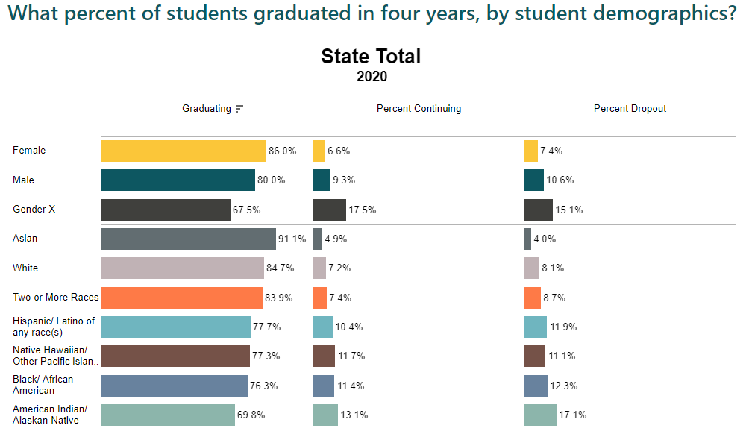

Statewide Trends
83%
Graduated in 4 years Class of 2020
OSPI Report Card | 12/13/2021 | 20
Notes:
Each year we’re seeing increases in graduation.
However, there are still notable gaps in our student groups.

Slide 21
Implications for Recovery & Acceleration
Many students will be struggling to graduate
No Harm grading has created “incomplete” overload
Students need more support than ever before
School staff are overloaded with needs
12/13/2021 | 21
Notes:
With COVID 19, OSPI we’ve seen an uptick in students with Incomplete grades.
Students need more support than ever both academically and with social emotional needs.
We know school staff are already over capacity with so many changes.
And that many students are going to struggle to graduate, not just this year but in the years to follow.

Slide 22
Big Ideas
Funding
Mental Health & Supports
Caring Adults
Acceleration
12/13/2021 | 22
Notes:
Throughout our discussion today we want to get you thinking about opportunities where we can help students accelerate, ways we can increase the number of caring adults involved, and the access to mental health and academic supports.

Slide 23

Questions & Polling 1
How prepared do you feel to respond to the needs of youth right now?
Very prepared
Somewhat prepared
Not prepared, but we’re working on it
We need help
12/13/2021 | 23

Slide 24
Modeling Best Practices
PUSH for Dreams & Hilltop Heritage Middle School
Notes:
Turn off the PPT

Slide 25

Push for Dreams Leadership Academy Video
Notes:
Play the video with sound

Slide 26
Panelists
Dr. John Gaines
Founder
Push For Dreams
Geno Munoz
Counselor
Hilltop Heritage Middle School
Notes:
Turn off the slides

Slide 27
Panel Questions
Tell us a little bit about you and your role in your organization
What needs are you seeing with the kids you’re working with and how have you responded?
How are you measuring your success?
What barriers are you running into right now?
What partnerships are you tapping into to support your work?
Where are you heading next?
What advice would you offer to other organizations right now?
Notes:
Turn off the slides

Slide 28
Building Bridges Capacity Grants
Innovative collaboration between OSPI and PUSH for Dreams
Pilot opportunity
Separate from, but aligned to, the traditional Building Bridges grant program
Allows for additional organizational capacity support & resources
PUSH for Dreams
PUSH for Dreams, led by Dr. John Gaines, is a veteran Building Bridges grantee and a leader of racial Diversity, Equity & Inclusion work
Purpose
Serves as a grant intermediary
The goal is to align Building Bridges with PUSH for Dreams plan of increasing racial diversity in schools through community partners

Slide 29
Reflection Time
What’s your big takeaway?
Tell us in the chat!

Slide 30
Break
Bio Break
Refreshments
Tech Check
Let’s meet back at 10:27
12/13/2021 | 30
Notes:
--
Tell them what time to return in the chat

Slide 31
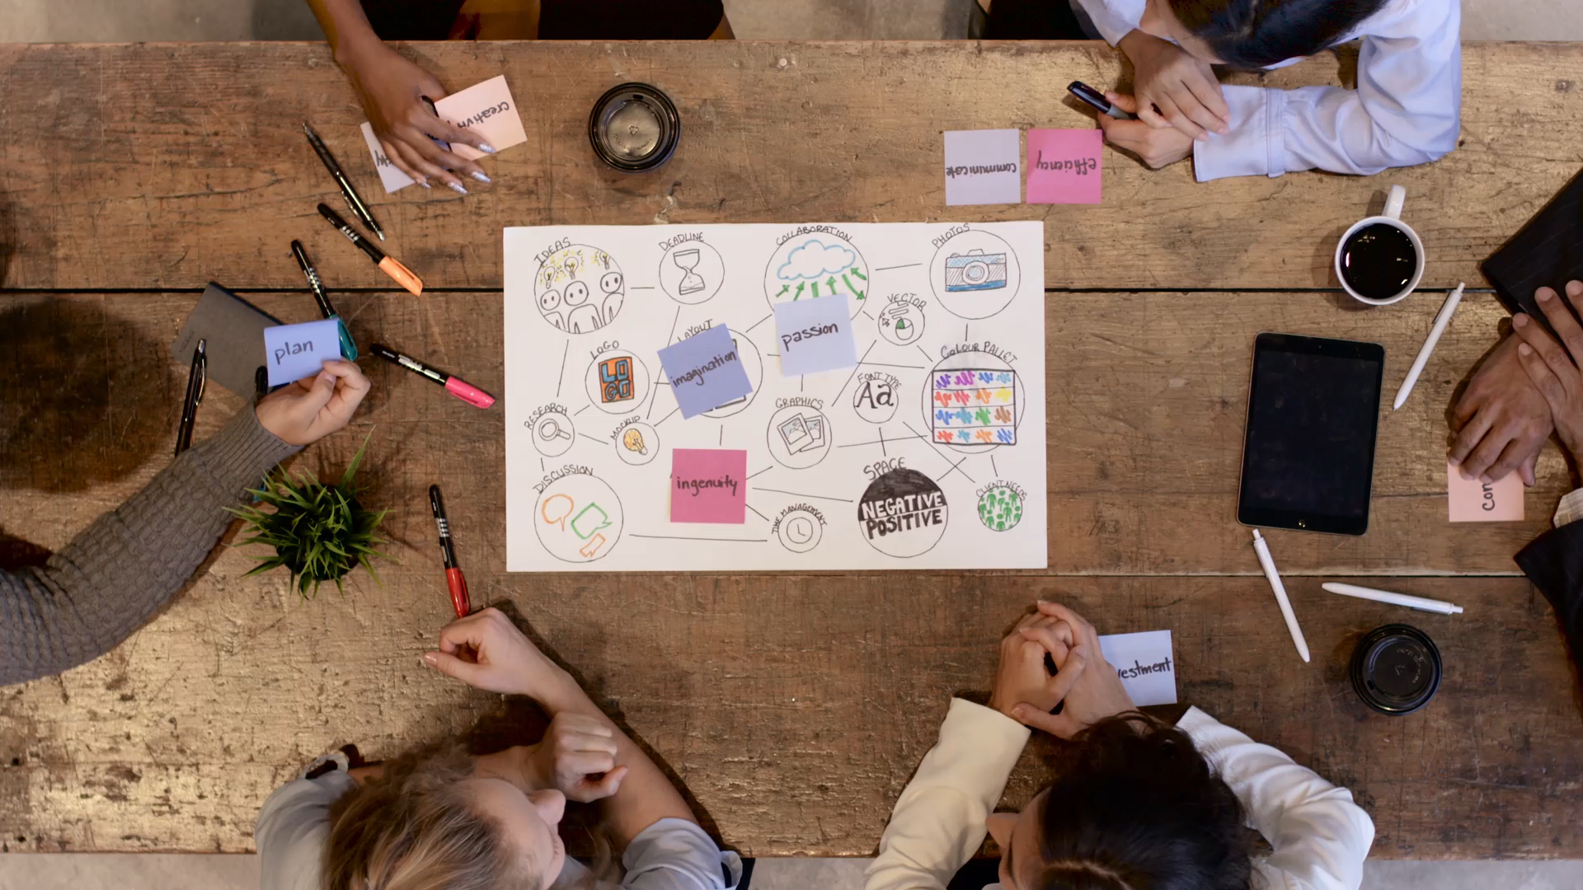
Small Group Discussions
Notes:
Thank you to Dr. Gaines and Mr. Munoz for sharing about their experiences today.
It’s our hope that their discussion can launch us into some group thinking.

Slide 32
Discussion Protocol Big Picture
Triads
Focus questions each round
3 minutes per person
3 rounds
2 minutes think time
Notes:
We’ll be running a Microlab Protocol today.
In the protocol you’ll be with your group. And we’ll have three rounds. We’ll have focus questions for each round. And give you a chance to jot thoughts on our Padlet. Then each person will get 3 minutes to share with the group, and then read and respond to Padlet comments. We’ll time it for you and prompt each part of the protocol.
Writing in the Padlet will help us revisit your ideas, so please do make sure to record your thoughts there. It’s also an artifact that we’ll be able to share with other groups later.
--
Jot thoughts on the Padlet: https://padlet.com/kefiandersen1/mgewq5eoevlh1k80

Slide 33
Round 1
How are you supporting youth right now that’s working?
Can you share your performance measures or benchmarks?
2 minutes:
Jot Thoughts on Padlet
(column 1)
3 minutes:
Person A Shares
3 minutes:
Padlet Reading & Responding
3 minutes:
Person B Shares
3 minutes:
Person C Shares
Notes:
For our first round, we’ll be focusing on these two questions.
How are you supporting youth right now that’s working?
Can you share your performance measures or benchmarks?
Please take a screen shot if that’s helpful, but the question is also on the Padlet for you to respond to.
We’re going to open breakout rooms. Start out by jotting your thoughts in the Padlet.
--
Breakouts: 14 minutes; 30 second transition time
Chat:
Round 1 Questions:
How are you supporting youth right now that’s working?
Can you share your performance measures or benchmarks?

Slide 34
Round 2
What barriers or issues are keeping you from providing supports right now? (fiscal, legal, regulatory)
2 minutes:
Jot Thoughts in Padlet
(column 2)
3 minutes:
Person B Shares
3 minutes:
Padlet Reading & Responding
3 minutes:
Person C Shares
3 minutes:
Person A Shares
Notes:
Welcome back!
For Round two, please take a screen shot if that’s helpful:
What barriers or issues are keeping you from providing supports right now? (fiscal, legal, regulatory)
Start by jotting thoughts in the Padlet, and then if you spoke first last time, you’ll go last.
--
Chat
Round 2 Question: What barriers or issues are keeping you from providing supports right now? (fiscal, legal, regulatory)
Jot thoughts on the padlet: https://padlet.com/kefiandersen1/mgewq5eoevlh1k80

Slide 35
Round 3
What recommendations do you have for policy makers?
What should we be investing in?
What can they do to help you reduce barriers?
2 minutes:
Jot Thoughts on Padlet
(column 3)
3 minutes:
Person C Shares
3 minutes:
Padlet Reading & Responding
3 minutes:
Person A Shares
3 minutes:
Person B Shares
Notes:
Welcome back! Again, if it’s helpful please take a screen shot.
For round 3 – our questions are:
What recommendations do you have for policy makers?
What should we be investing in?
What can they do to help you reduce barriers?
We’re going to start again by jotting thoughts in the Padlet. Thanks for adding to it!
If you haven’t spoken first, it’s your turn to start your group off.
--
Chat
Round 3 Questions:
What recommendations do you have for policy makers?
What should we be investing in?
What can they do to help you reduce barriers?
Jot thoughts on the padlet: https://padlet.com/kefiandersen1/mgewq5eoevlh1k80

Slide 36
Debrief
What worked?
What could we adjust?
Notes:
As a facilitator whenever I run a protocol I like to know if it worked.
This is my first time running this protocol with this many people and I want to know how it went. I’m very open to feedback and want to come up with a protocol that can capture out ideas in an efficient way, so please be as candid as you can so we can practice some continuous improvement.
Padlet Column 4

Slide 37
Collaboration Opportunities

Slide 38
Let’s Do This Together!
Events
Regional Professional Development
Partnership Needed or Joint Funding
Resources
Notes:
Padlet column 5
Raise your hand or unmute.

Slide 39
How can you commit to elevating today’s work?
Discuss your ideas with leadership
Come up with some measures of success
Lead a discussion with colleagues
Do you have a next step? Tell us in the chat!
Notes:
Small group discussion if there’s time

Slide 40
Resources

Slide 41
Resources
Funding
Unlocking Federal & State Program Funds to Support Student Success
Tools & Videos
Websites
Connect with OSPI staff
People
Read & Subscribe to the Engage Newsletter
GATE Advisory page
OSPI Social Emotional Learning Modules: Segment 7
Mentor Washington Elements of Effective Practice for Mentoring
Graduation Equity Webinar Series
12/13/2021 | 41

Slide 42

Next Meetings
Register for:
April 19, 2022
June 21, 2022
9:00 a.m. – 12:00 p.m.
12/13/2021 | 42
Notes:
These links will be in the chat if you want to register now. Please share this link with friends who may be interested!
--
Chat:
Register for April 19: https://us02web.zoom.us/meeting/register/tZAqc-GgpzIsGdcwyvXuR2ouXMwki30MPPb-
Register for June 21: https://us02web.zoom.us/meeting/register/tZUkdO2qrD0pHtfOfiVtAXVSwyXcYDVcpFJq

Slide 43
Evaluation
This meeting was well structured
This presentation was relevant to my work and topics I want to know about right now.
The presenters were content experts
The presentation met the stated learning objectives.
I would recommend participating to a colleague.
I had an opportunity to reflect on my next steps.
12/13/2021 | 43
Notes:
We would like to get more information from our audience about our webinars, so we’re going to try something new this month and run our evaluation as a poll.
Thank you for letting us know what you think! If something comes to you later, you also always have the option to share your thoughts through our web evaluation, which is linked on our webinar reminders.
--
Launch Evaluation Poll

