Slide 1
Revised SGG Module 2B: What do the changes mean for classroom teachers?
This slide presentation contains instructions for facilitators in the notes section* of the file.
*To access the notes, download and save this file to your computer.
Notes:
Facilitator Notes:
This overview is intended for classroom teachers who are evaluated under the Washington State Teacher Evaluation Program (TPEP) per RCW 28a.405.100.
PLEASE NOTE: This module will be most effective if the participants have already seen the OSPI revised rubrics and critical attributes (Student Growth Goal Rubrics for 3.1, 6.1, and 8.1) prior to participating in this session. If participants have no familiarity with the rubrics, they may have difficulty accessing the content in this module.
Each slide contains notes for facilitation in the notes section and links to any resources needed for engaging in the module.
It is recommended that facilitators follow the recommended activities and keep the content of the module as close to the original as possible. Slides that are customizable have been noted as such in the facilitator notes. Facilitators are welcome to add slides as relevant and necessary. Facilitators may adjust activities or strategies for engaging participants with the content, but please do not change the content itself.
Times provided in the Facilitator Outline on the next slide are an estimate and can be adjusted at the facilitator’s discretion.
When italics are used, this indicates a script or language the facilitator might use for the content of that slide.

Slide 2
Facilitator Outline
Activity | Required Slides and Approximate Times | Optional Slides and Times
Introduction | Slides 1, 3-4: 3 minutes
Context and the Big Picture | Slides 5-8: 5-7 minutes
Shifts in Rubrics, Shifts in Mindset | Slides 9-10: 5 minutes | Slide 11 (activity): 10-12 minutes
From “Writing a Goal” to “Designing for Growth” | Slides 12-14: 5-7 minutes | Slide 15: 2 minutes
From “Data Exists” to “Using what the Data Tells Us” | Slides 16-17, 19: 5-7 minutes | Slide 18: 2 minutes
Extending Your Learning | Slide 20: 3 minutes
Notes:
This slide is skipped during the presentation and is intended for the facilitator’s reference.

Slide 3

Land Acknowledgement*
See facilitator notes; edit this slide as appropriate for the context
Notes:
IMPORTANT FACILITATION NOTE: Providing a land acknowledgement is an opportunity to educate as well as to demonstrate honor and respect. It is offered with the goal of making the learning community a safe an inclusive space for all. The development of a land acknowledgement should be done in consultation and collaboration with local tribal communities. Please consult with your sponsoring organization or district about the established practice before including an acknowledgement in your delivery of this or any module.
For your reference, here are some Land Acknowledgement resources:
Text: 855-917-5263 with your zip code OR Native-Land.ca | Our home on native land
OSPI’s Office of Native Education: https://www.k12.wa.us/studentsuccess/access-opportunityeducation/native-education
Example - I am coming to you from the sacred lands of the Spokane Confederated Tribes. Acknowledgment is but a first step. It does not stand in for relationship and action, but can begin to point toward deeper possibilities for decolonizing relationships with people and place.

Slide 4

Today’s Learning:
Identify the changes from the original TPEP student growth goal model to the new, revised version.
Understand how these changes necessitate shifts in our thinking and practices around student growth goal-setting.
Hear about additional resources and learning opportunities for your own student growth goal-setting process.
Notes:
Facilitator Notes:
Suggested Script
In our session today we will be working toward these three learning goals. By no means is this short session “enough” to fully prepare you for your student growth goal-setting process, but today you will begin to learn about the changes that have been put into policy around student growth goals and classroom teacher evaluations, have the opportunity to reflect on how these changes necessitate shifts in our thinking and practices around student growth goal-setting, and be introduced to some tools and resources available from OSPI and WEA to assist you with your student growth goal setting process.

Slide 5
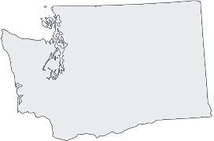

Teacher evaluation policy in Washington State
RCW: legislature
WAC: state agency-OSPI
CBA: locally bargained
Look at your CBA!
Notes:
Facilitator Notes:
Suggested script:
It is important for us to know that the evaluation of classroom teachers in Washington State was established by our state Legislature. The action of the Legislature resulted in the official “law,” which we refer to as the RCW, which stands for Revised Code of Washington. (For teacher evaluation, the law is outlined in RCW 28a.405 and we’ll look at a relevant piece of that on the next slide.)
The state law, then, is further clarified and detailed in what is called WAC, which is Washington Administrative Code. This is created by OSPI, and takes the legal language of the RCWs and establishes the specific rules and procedures that schools must follow to adhere to the law.
At the local level, school districts and local unions can negotiate local rules and procedures to define how the RCW and WAC will be put into practice locally. This is outlined in your Collective Bargaining Agreement (CBA), often just called “the contract.”
What we will look at in this session is based on STATE level policy (RCW and WAC), and applies to you no matter what is in your CBA. Your CBA might have more specifics (dates, procedures, forms), but it cannot contradict what is in RCW and WAC, and thus will not contradict what you learn in this module.
Image Source:
https://commons.wikimedia.org/wiki/File:Washington-state-map_h.svg
Citypeek, Public domain, via Wikimedia Commons

Slide 6
State 8 Teacher Evaluation Criteria
1. Expectations: Centering instruction on high expectations for student achievement.
2. Instruction: Demonstrating effective teaching practices.
3. Differentiation: Recognizing individual student learning needs and developing strategies to address those needs.
4. Content Knowledge: Providing clear and intentional focus on subject matter content and curriculum.
5. Learning Environment: Fostering a safe, positive learning environment.
6. Assessment: Using multiple student data elements to modify instruction and improve student learning.
7. Families & Communities: Communicating and collaborating with parents and the school community.
8. Professional Practice: Exhibiting collaborative and collegial practices focused on improving instructional practice and student learning.
Notes:
Facilitator Notes: [skip if your audience is already well aware of this information]
Suggested script:
As a reminder, at the state level RCW (state law) defines the eight criteria by which all public school teachers in the state of Washington are evaluated. We’re hoping you are familiar with these, but if this is your first time learning about the “State 8,” it will be important that you seek out further learning from a local mentor, Association leader, or district Human Resources to better understand what these criteria mean.
Student growth is connected to criteria 3, 6 and 8, and the rules and rubrics associated with what evaluating student growth looks like are uniform across the state, regardless of what district you are in.
(Different districts might bargain particular timelines and procedures, but state policy applies the same to all of us.)

Slide 7
Teacher Evaluation and Student Growth:
The Law
RCW 28a.405.100 2(f): Student growth data that is relevant to the teacher and subject matter must be a factor in the evaluation process and must be based on multiple measures that can include classroom-based, school-based, district-based, and state-based tools. Student growth data elements may include the teacher's performance as a member of a grade-level, subject matter, or other instructional team within a school when the use of this data is relevant and appropriate. Student growth data elements may also include the teacher's performance as a member of the overall instructional team of a school when use of this data is relevant and appropriate. As used in this subsection, "student growth" means the change in student achievement between
two points in time.
Notes:
Facilitator Notes:
Suggested script:
This is the state law (RCW) governing the student growth goal portion of our evaluation. Key things to notice:
Student growth data that is used in our evaluation must be…
“relevant to the teacher and subject matter,” meaning that you are evaluated upon growth over which you have direct influence, not a PE teacher being evaluated on building wide literacy scores.
“based on multiple measures,” which means that a single data point, such as how many students pass a standardized test, cannot be used in your evaluation
and student growth is defined as “the change in student achievement between two points in time,” which means that you demonstrate your impact on student learning at two points in the student learning process. Note that the law does not define when these two points take place. We will talk more about that in a few minutes.
There is a lot that this law about student growth does not dictate. Note:
It does not dictate how much time must pass between the “two points”
It does not define what the “multiple measures” must be
It does not define what “student achievement” means

Slide 8
What’s Changing? What’s Not Changing?
For more information about why these changes are taking place, how the revisions came about, and other background details, see “Module 1: SGG Overview” on the OSPI Student Growth Goal Webpage
Notes:
Facilitator Notes:
This slide helps transition from the big picture to how policy changes are impacting teachers.
Suggested script:
Now that we have that brief background, we’re going to focus in on what is changing and what is not changing. For deeper and more detailed learning about why and how these changes are taking place, see “Module 1: SGG Overview” on the OSPI Student Growth Goal Webpage.

Slide 9



What IS NOT Changing:
Student Growth 3.1:
Designing Growth Experiences for Subgroups of Students
Student Growth 6.1:
Creating Growth Experiences for a Whole Class of Students
Student Growth 8.1:
Collaboration around Student Growth Goal Setting
THE INPUTS
Student Growth 3.2:
Outcomes from Subgroup Experiences
Student Growth 6.2:
Outcomes from Whole Class Experiences
THE OUTPUTS
Notes:
Facilitator Notes:
This slide is animated.
Suggested script:
What isn’t changing:
Teachers are still assessed on three student growth goal-setting rubrics: goals for subgroups, goals for a whole class (roster), and our collaboration in designing goals. We commonly refer to these as the “inputs” because these are about the choices we “put into” the system: the goals we set, the plans we make, the instructional methods we choose, etc.
We are also still assessed on two “output” rubrics: the impact of our goals on the subgroup and the impact of our goals on the whole class. There is no output for the collaborative rubric (because not all instructional staff necessarily have the same student growth goals as their team).

Slide 10
What IS Changing: the inputs
Designing Student Growth Goals (The “Inputs”)
Emphasizes planning for student growth more than a “goal statement.”
New critical attributes to define a growth focus
Emphasizes our knowledge of our students’ cultural and academic assets
Notes:
Facilitator Notes:
This slide is animated by line.
Suggested script:
What is changing:
For the “inputs”
The new rubrics emphasize planning for how you will foster student growth more than a singular “goal statement.” In terms of the work that teachers will do around student growth goal setting, this is more significant that it sounds, and we will come back to that shortly.
Also, there are key concepts (terms) that show up in the rubrics. These are called “critical attributes,” and documents from OPSI help to define these.
Importantly, this process also emphasizes how we use our knowledge of our students’ cultural and academic assets in how we plan to facilitate their growth: simply put, it asks us to consider what we know about our students as people and as learners before we create growth goals for them.
For the “outputs”
The new model de-emphasizes how many students met or exceeded the goal (which would often lead to teachers writing simple goals that their students were basically guaranteed to meet), but now instead
emphasizes how we examine data or information about the students who exceed, meet, or don’t meet our goals… and what we then do with that data to analyze their learning and determine what we need to do next in order to foster their growth.

Slide 11
What IS Changing – the outputs
The Results Of Your Efforts (The “Outputs”)
De-emphasizes “how many students met/exceeded the goal”
Emphasizes how we examine data or information, and what we do with it to analyze student progress
and plan for next steps
Notes:
Facilitator Notes
This slide is animated by line.
Suggested script:
For the “outputs”
The new model de-emphasizes how many students met or exceeded the goal (which would often lead to teachers writing simple goals that their students were basically guaranteed to meet), but now instead
emphasizes how we examine data or information about the students who exceed, meet, or don’t meet our goals… and what we then do with that data to analyze their learning and determine what we need to do next in order to foster their growth.

Slide 12
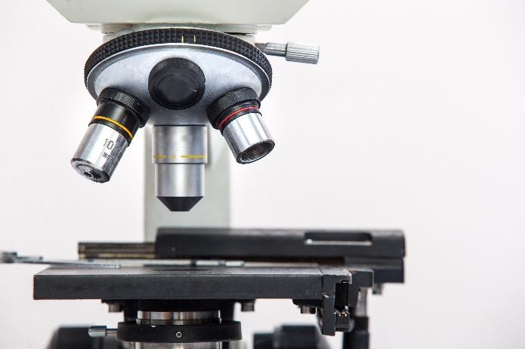
A New Emphasis
Observe and Discuss:
What sorts of thinking around “student growth” do the new Proficient rubrics emphasize that was not explicitly called out in the previous version?
Examine the one-pager with the shifts in 3.1, 3.2, 6.1 and 6.2.
★ Have one breakout group member be the “reporter” who will drop a shared observation in the chat when we return to the main room.
Notes:
Facilitator Notes:
This activity will only be effective if the participants have already seen the OSPI revised rubrics and critical attributes: Student Growth Goal Rubrics for 3.1, 6.1, and 8.1
[~2 min] In whole group:
Solo Think: Have participants read over Comparing the .1s and .2s [Google Doc], which sets proficient “P” language in the old and new next to each other.
[~6 min] In breakout groups/table groups:
Small Group Sync: Open discussion in small groups
→ What sorts of thinking around “student growth” do the new proficient rubrics emphasize that were not explicitly called out in the previous version? Have one breakout group member be the “reporter” who will drop a shared observation in the zoomchat or bring up to the whole room when we finish small group discussion.
[~2 min] Return to whole group:
Group reporters share observations from the small group discussions.
NOTE→ If your audience is predominantly new teachers who never experienced the previous rubrics, have them examine Revised 3.1 and 3.2 [Google Doc], focusing on ONLY 3.1, and discuss the differences between basic, proficient, and distinguished in the new rubrics.

Slide 13
KEY SHIFT: The Inputs
WRITING A GROWTH GOAL STATEMENT
DESIGNING A GROWTH EXPERIENCE
Notes:
Facilitator Notes:
Suggested script:
To put it simply, in the old model, we were basically just writing a goal statement. In the new model, we are designing the whole experience. Thus, it is highly unlikely that you’ll be able to “write a proficient growth goal” in a single statement or sentence.

Slide 14
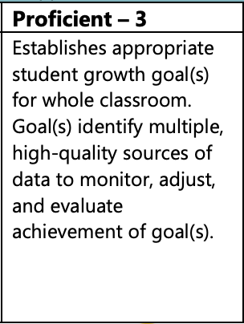
The Previous Rubric
From October-May, my 2nd grade students will make measurable progress of at least one comprehension level as measured by a pre- and post- comprehension assessment created by my PLC. I will utilize the rubrics and common formative assessments created by my PLC to measure progress, and will offer all students feedback to assist in their growth.
Notes:
Facilitator Notes:
Suggested Script:
That shift, from writing a goal statement to designing a growth experience is not necessarily going to impact how we teach, but it will impact how we communicate about our growth goals.
Here on the screen is a goal that is potentially proficient under the old model. It identifies the group, it states that there will be pre and post comprehension assessments, that there are common formative assessments, and that all students will make measurable growth of at least one level on the team rubrics.
It is possible that this goal might have been proficient… a lot would depend on what those formative assessments are, the quality of the rubric, etc., but those are things that hopefully were artifacts shared in the process or were examined through learning-focused conversations with the evaluator.

Slide 15
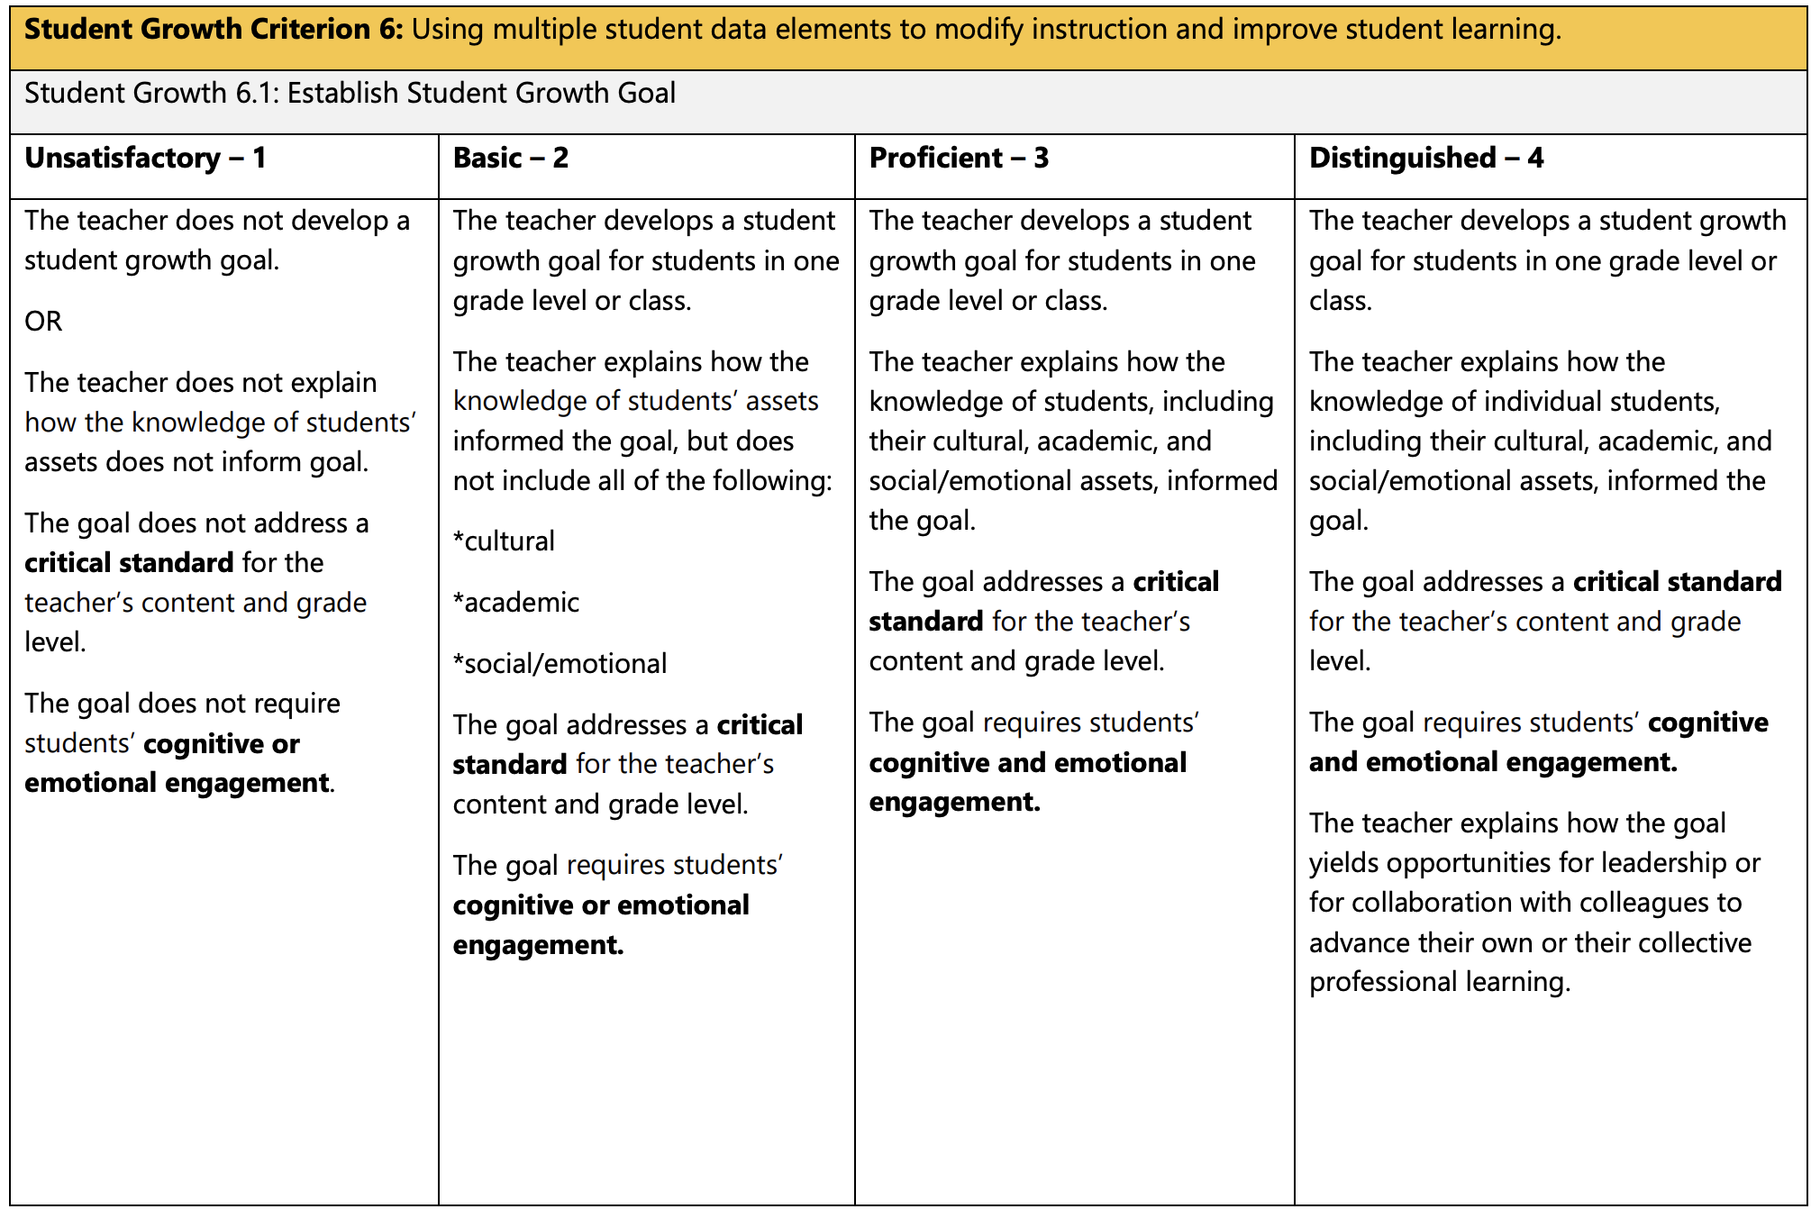
Same Goal… New Rubric:
What other info is needed?
From October-May, my 2nd grade students will make measurable progress of at least one comprehension level as measured by a pre- and post- comprehension assessment created by my PLC. I will utilize the rubrics and common formative assessments created by my PLC to measure progress, and will offer all students feedback to assist in their growth.
Notes:
Facilitator Notes
Suggested Script:
If we consider that same goal through the lens of the new rubric, that same goal could still work. HOWEVER, what is different is the kind of supporting artifacts and documentation that might be necessary, or the content of learning-focused conversations that occur between the teacher and their evaluator.
What this asks us to really focus on in our goal design has shifted a little. Instead of designing a goal that just names the assessments and measurement tools, our focus now is on:
how this goal is responsive to what we know about our students as individuals and as learners, and
how we envision fostering cognitive and emotional engagement as we support students toward this goal.
To try to pack that all into a SMART goal or succinct goal statement is not particularly feasible.
Ultimately, it is not a about a single “ideal” goal statement, it is about the thoughtful planning behind the design of the goal. This thoughtful planning and deliberate practice is best illustrated during a learning-focused real-time conversation between the teacher and their evaluator.

Slide 16
What about SMART Goals?
SMART, H.A.R.D., DWHH, or other goal statement constructs are perfectly fine to use…
But it isn’t about a GOAL STATEMENT, it is about the practice surrounding that goal.
A goal statement alone is not necessarily sufficient, no matter what construct or pattern you use.
FORMATIVE AND SUMMATIVE ASSESSMENT
STUDENT ENGAGEMENT IN ASSESSMENT
ESSENTIAL STANDARD
SMART GOALS
✓
FEEDBACK
FROM STUDENTS ON THEIR EXPERIENCE
KNOWLEDGE
OF
STUDENTS
COGNITIVE AND EMOTIONAL ENGAGEMENT
Notes:
Facilitator Notes:
This slide contains animation
Suggested script:
What about SMART goals?
SMART = Specific, Measurable, Appropriate, Referenced to Criteria, and Time-Bound (or other variations)
HARD = Heartfelt, Animated, Required, and Difficult
DWHH = Do (Bloom’s or Webb’s verb of cognition), What (learning or skill), How₁ (how will they show their learning) and How₂ (how will you know growth occurred)
Participants may be familiar with other constructs as well.
Many districts have “required” SMART goals (or similar constructs). SMART goals CAN work, smart goals are NOT a requirement in the law… and in the new rubrics, even the most well-designed SMART goal doesn’t quite go far enough.
Click to animate: You can certainly use a SMART goal for this, but remember, it is not just about the goal itself.
Click to animate: The goal is only as good as the practices in which it is embedded…these practices are clearly called out in the rubrics and don’t necessarily fit nicely into a discrete “goal statement.”
→ The new process is less about a goal statement and more about the process of how you foster growth.
It is not about whether you can write a good goal.
It is about how we plan for and implement practices that promote meaningful growth.

Slide 17
KEY SHIFT: The Outputs
YEP, THERE’S DATA.
WHAT CAN I DO WITH
THE DATA?
Notes:
Facilitator Notes:
Suggested script
As for the outputs, the previous version was very much about numbers and data. The new model is much more about our reflection and how we use information from our assessment process. The new process is much more about what we do with the data, regardless of whether it is “good or bad.” Anyone can “produce data.” Proficient or distinguished teachers know how to examine and use that data to do something better with their instruction.

Slide 18

Reflection > Data
Unique to 3.2 (Subgroup):
The teacher reflects with supervisor on learning progress for the individual students in this group. The reflection includes an analysis of why students did or did not make progress, and next steps for each student.
Unique to 6.2 (Whole Class):
The teacher reflects with the supervisor on learning progress for three groups of students:
• Students who exceeded the learning goal
• Students who met or nearly met the learning goal
• Students who did not yet meet the learning goal
The reflection includes an analysis of why students did or did not make progress, and next steps for each group.
Notes:
Facilitator Notes:
This slide is animated.
Suggested Script:
Just as the creation of the growth goal is no longer just about writing a sentence or two, the output data is no longer just about the numbers of students who met the goal.
When we look at the language for the outputs, the .2s, we see that no where are teachers evaluated solely on how many students met the goal. Instead, we are evaluated on how we make sense of student growth data, how we interpret what it means, and what it tells us we need to do next in order to advance student learning.
[click to bring in clip-art] This should be happening in a real-time learning-focused conversation between the teacher and their evaluator.
Image source:
https://commons.wikimedia.org/wiki/File:Speaking.svg
MScharwies, CC BY-SA 4.0 <https://creativecommons.org/licenses/by-sa/4.0>, via Wikimedia Commons

Slide 19
FORMATIVE ASSESSMENT
TEACHER REFLECTION &
PLANNING FOR FUTURE INSTRUCTION
FEEDBACK TO STUDENTS, TEACHER REFLECTION &
ADJUSTMENTS TO INSTRUCTION
SUMMATIVE ASSESSMENT
FORMATIVE ASSESSMENT
FEEDBACK TO STUDENTS, TEACHER REFLECTION &
ADJUSTMENTS TO INSTRUCTION
Notes:
OPTIONAL
This slide contains a visual of a formative assessment → feedback → formative assessment → feedback → summative assessment → reflection cycle.
Emphasize that our student growth goal process now includes explicit references to the feedback we give to students and how we adjust instruction based on information we get from our assessments.

Slide 20
What this means for teachers:
Shifting our thinking from writing a goal to designing a growth experience based on our knowledge of students and fostering engagement.
Shifting our focus from gathering data that shows growth to analyzing how the data informs us about student progress and the next steps we need to take for them.
Shifting the evaluation dynamic from forms and artifacts to learning-focused and reflective conversations with our evaluators.
Notes:
Facilitator Notes:
This slide is animated.
Suggested Script:
What this means for teachers? Three big things to remember:
It means shifting our thinking from writing a goal to designing a growth experience based on our knowledge of students and fostering engagement. A goal statement is not what matters in our work: what matters in our work is how we design and implement experiences for kids in order to promote meaningful growth.
It means shifting our focus from gathering data that shows growth to analyzing how the data informs us about student progress and the next steps we need to take for them. Simply producing “good data” is not sufficient, and too often teachers feel pressured to design goals that will get good data rather than goals that actually stretch students toward meaningful growth. By emphasizing reflection on the data rather than the data itself, the professional skill of analytical reflection upon assessment data becomes our focus.
It is about shifting the evaluation dynamic from forms and artifacts to learning-focused and reflective conversations with our evaluators. To keep this process authentic and meaningful, we must focus on the conversations that examine our practice. When “doing student growth goals” is about filling out forms and submitting paperwork, we’ve missed the opportunity to focus on the real goal of TPEP, which is the continually refine and improve teaching practice.

Slide 21
Extending Your Learning
WEA Professional Learning
WEA offers TPEP learning for teachers, or for teachers and administrators learning together. Request a training: mjohnson@washingtonea.org
  Writing Student Growth Goals (one session, three hours)
    Exploration of Critical Attributes, Knowledge of Students, and a guide for designing your Student Growth Goal process
  Writing Student Growth Goals Cohort Series (three sessions, each two hours)
    A deeper dive into Critical Attributes, Knowledge of Students, and a guide for designing your Student Growth Goal process, including opportunities for collaboration and peer feedback
  TPEP Artifacts and Evidence (one session, two hours)
    Deepening your understanding of TPEP in general and the role of artifacts and evidence in your evaluation process
Notes:
Facilitator Notes:
Suggested Script:
By no means is this brief session enough to really get you well-versed in the work that may be needed to make those shifts. OSPI and WEA are each creating resources and providing opportunities that will help you deepen your learning about these new practices.
→ Read over the points listed on the slide
WEA offers professional learning in the new student growth goals, and in TPEP Artifacts and Evidence, which includes the fundamentals of the TPEP system. Please contact WEA Education Policy and Practices Coordinator Maren Johnson at mjohnson@washingtonea.org if you would like to schedule a training.

Slide 22
Thank you!
Notes:
For more information on Student Growth, please visit the TPEP Website for resources to support implementation of the revised Student Growth Goals.
This module was made in partnership between WEA an OSPI’s Educator Effectiveness Office. Please feel free to reach out to the TPEP office with any questions or requests.

