Slide 1
SGG Module 5 –
Emotional Engagement
These modules are offered to help deepen understanding of the Critical Attributes listed in the revised Student Growth Goal rubrics. The purpose is to open understanding and discussion, not calibration. The learning in these slides offers an opportunity for groups to make collective meaning around the Critical Attributes to use the revised rubrics and engage in an evaluation process in a way that promotes learning, growth and reflection for students and educators.
This slide presentation contains instructions for facilitators in the notes section* of the file.
*To access the notes, download and save this file to your computer.
Notes:
Facilitator Notes:
The purpose of this module is to help unpack the Critical Attribute of “Emotional Engagement” as it is used in the revised Student Growth Goal rubrics. It is recommended that facilitators follow the activities and keep the content of the module as close to the original as possible. It is encouraged that the facilitator add and personalize slides to make connections and forge alignment with other initiative and work with which the participants in the professional learning may be familiar.
Times provided are an estimate and can be adjusted at the facilitator’s discretion. The structure of the activity may also be adjusted for context and audience.
Information in italics are suggested language/directions for the facilitator to use with participants when leading the learning. Other notes to the facilitator are in bold or plain type.

Slide 2









SGG Module Map
Overview: Module 1
What does this mean for evaluators: Module 2A
What does this mean for teachers: Module 2B
Critical Standard: Module 3
Cognitive Engagement: Module 4
Emotional Engagement: Module 5
Formative & Summative Assessment: Module 6
Student Engagement in Assessment: Module 7
Feedback from Students: Module 8
Notes:
Facilitator Notes:
This slide shows the modules available to support implementation of the revised Student Growth Goals. This slide may be included or omitted at the facilitator’s discretion.
These modules are offered to help deepen understanding of the Critical Attributes listed in the revised Student Growth Goal rubrics. The purpose is to open up understanding and discussion, not calibration. The learning in these slides offers an opportunity for groups to make collective meaning around the Critical Attributes in order to use the revised rubrics and engage in an evaluation process in a way that promotes learning, growth and reflection for students and educators.
These modules are available on the OSPI-TPEP website: https://www.k12.wa.us/educator-support/teacherprincipal-evaluation-program/policy-and-resources/training-modules
This slide shows the modules available to support implementation of the revised Student Growth Goals. This slide may be included or omitted at the facilitator’s discretion.

Slide 3
Facilitator Outline
Activity | Slides & Approximate Times
Introduction | 1 through 9 = 15-17 minutes
Unpacking Emotional Engagement | 10 and 11 = 18 minutes
Embedding Emotional Engagement | 12 = 20 minutes
Connecting to the Instructional Framework | 13 = 10 minutes
Key Considerations | 14 = 15 minutes
Additional resources | 15 = 5 minutes
Closure | 16 and 17 = 5 minutes
Notes:
Facilitator Notes:
Total time for all sections of this module as they are designed = 1 hour and 35 minutes
The module is designed with flexibility in mind based on available time and options for asynchronous reading or viewing prior to meeting.
Materials needed:
Copy of instructional frameworks
Facilitator packet (contains links and reading excerpts)
Revised Student Growth Goal rubrics, available at https://www.k12.wa.us/educator-support/teacherprincipal-evaluation-program/frameworks-and-student-growth/student-growth

Slide 4

Learning Targets
Understand what emotional engagement is and how it impacts student learning
Identify where emotional engagement connects to your instructional framework to move learning forward
Describe how to embed emotional engagement in your instructional practice
Understand the key considerations for teachers/administrators to engage in student growth conversations focused on emotional engagement
Notes:
Review learning targets

Slide 5

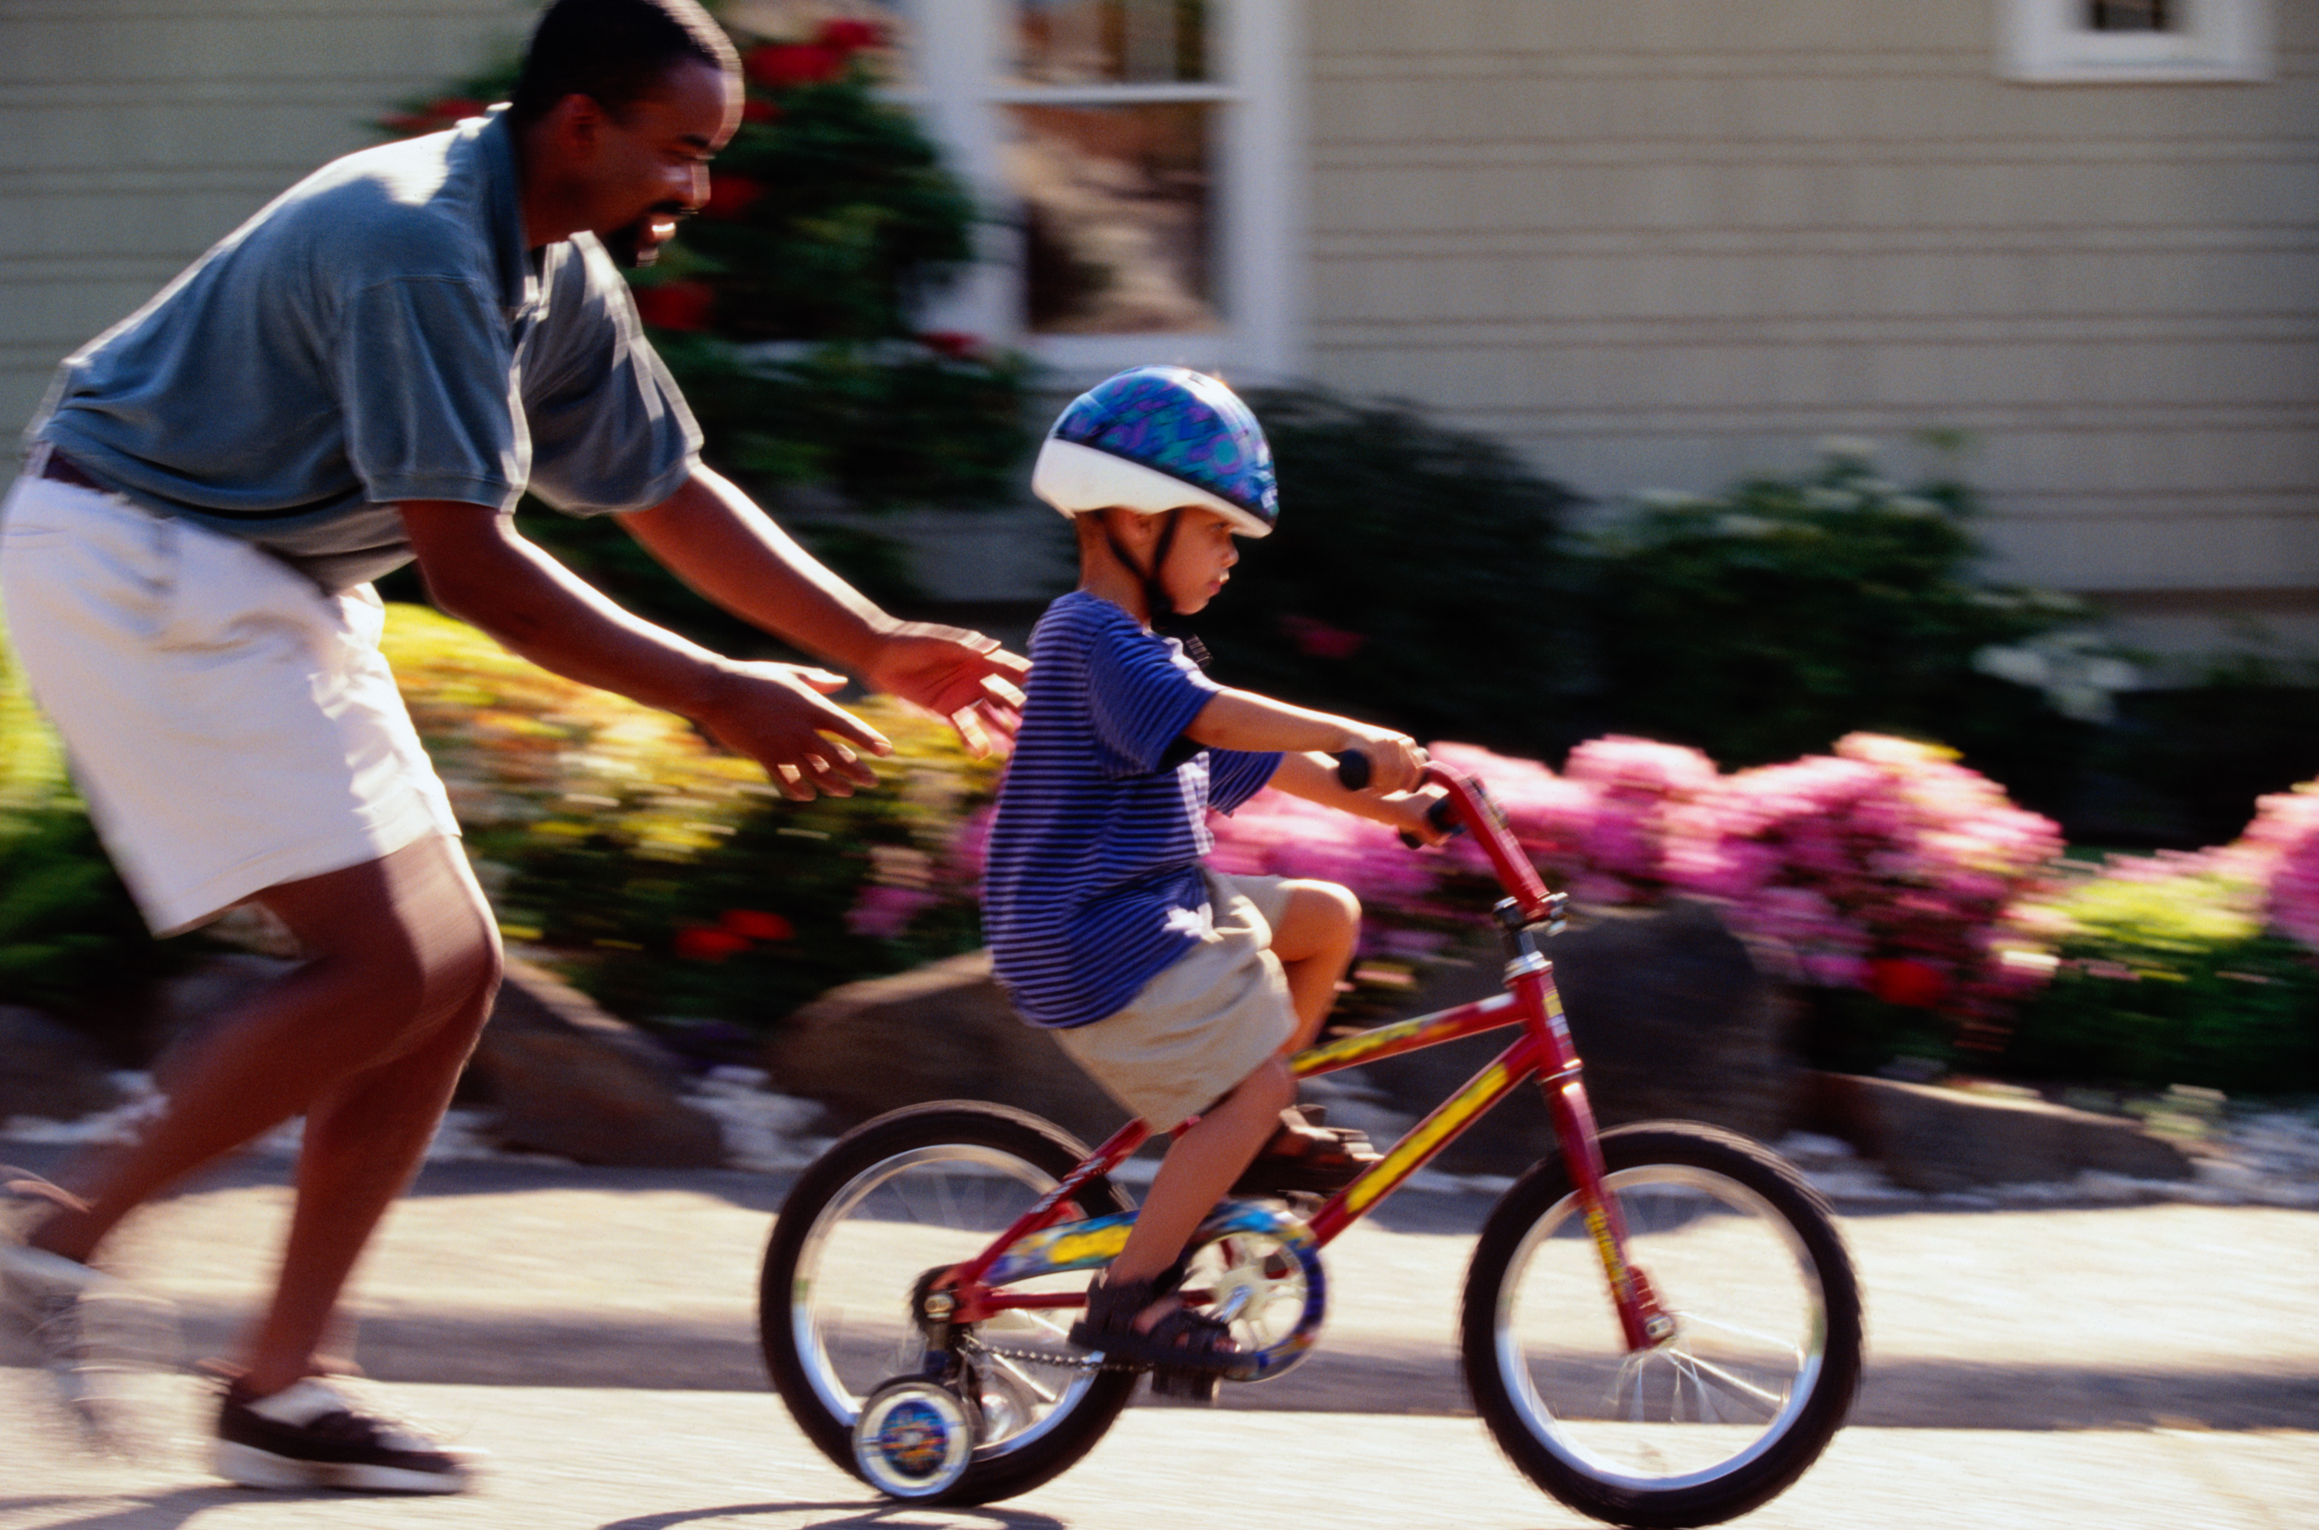
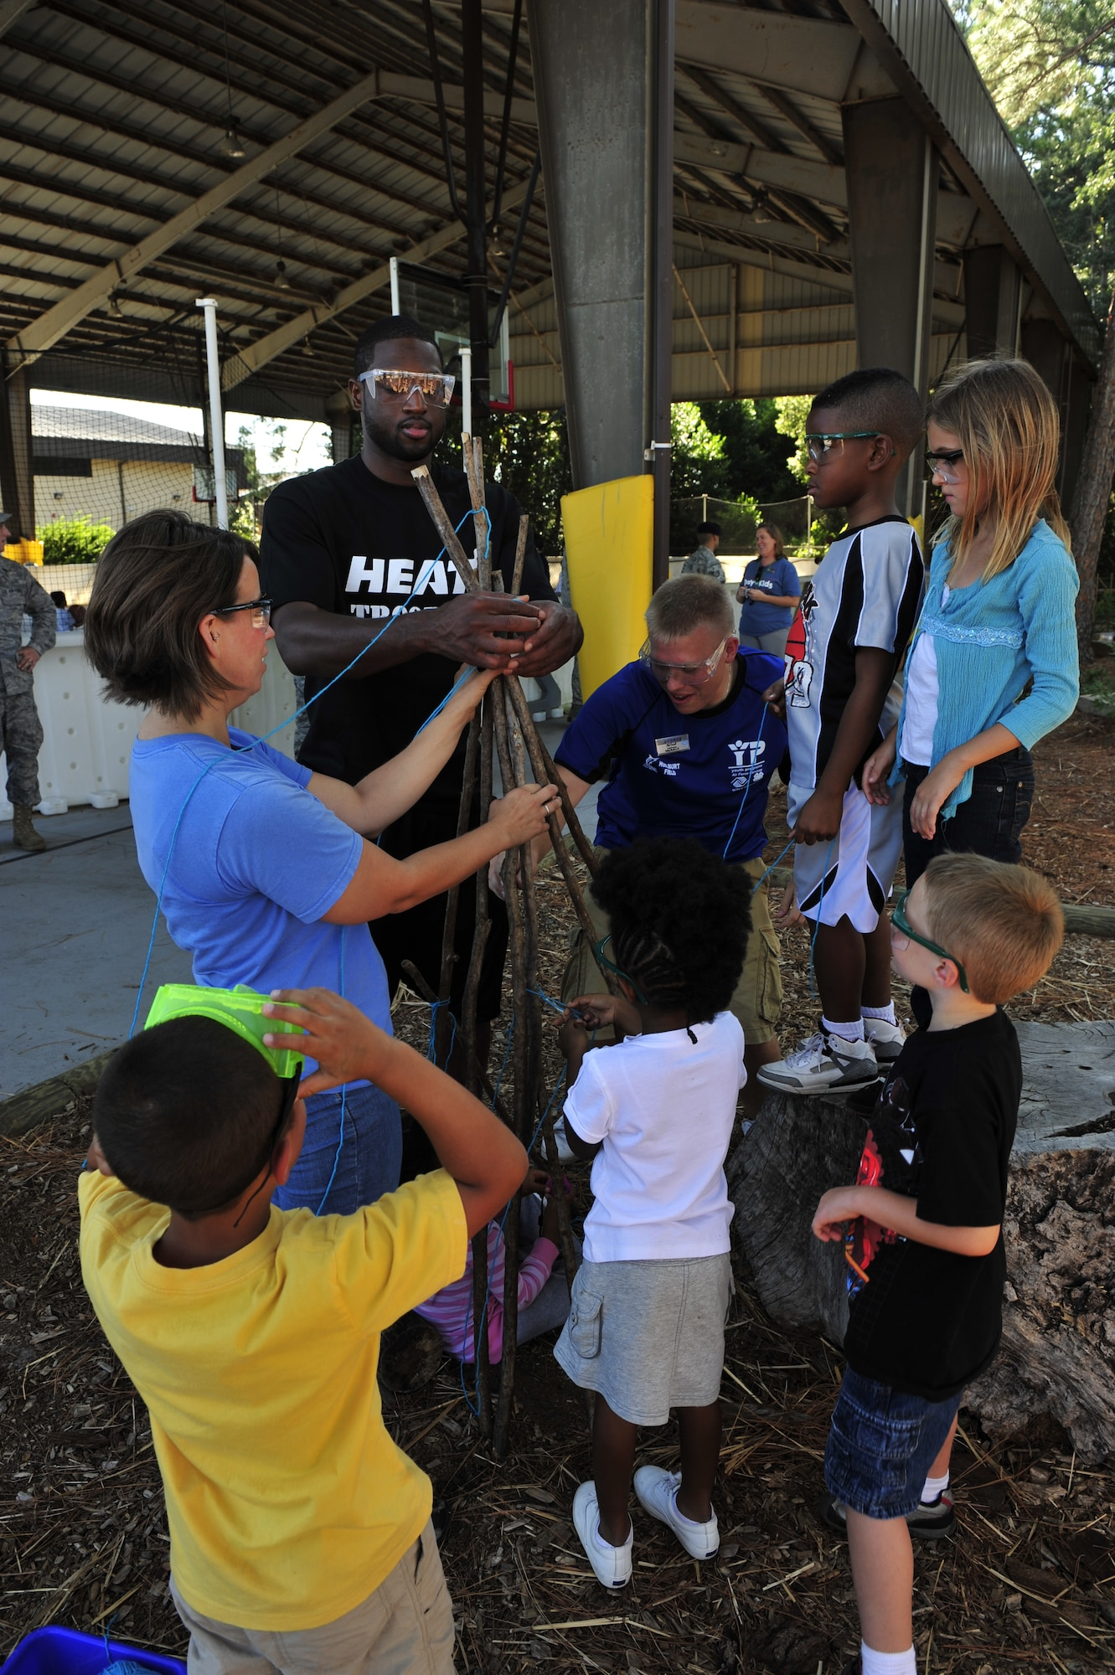
Activator
What is something important you remember learning?
How did you feel during that experience?
Notes:
Facilitator Notes:
Provide some “private think time” for participants to think of something important they remember learning. Prompt them to write or consider the experience… who was teaching them? Where were they when they were learning? What do they remember seeing or hearing? Why was this learning important?
Next, prompt them to remember how they felt during that experience.
As is appropriate, engage them in sharing their response to the prompts in pairs (5 min).

Slide 6
“The Engagement Illusion”
Neil Gupta/Douglas B. Reeves
“The research reveals two forms of student engagement: (1) the student's behaviors, emotions, and thought processes, and (2) the student's intellectual response to the challenge of the material.”
“Many students know how to "play school": Be quiet in class, take notes when anything is written on the board, smile, and nod now and then. The engagement illusion can also exist when students appear diligent and on task by quietly working on a digital device, but the human interaction that is essential to learning might be so minimal that it disengages the student from active learning.” (Turkle, 2016)
“Student engagement is ‘the energy and effort that students employ within their learning community, observable via any number of behavioral, cognitive, or affective indicators across a continuum.” (Bond et al., 2020, p. 3).
Notes:
Facilitator notes:
In the past we have defined engagement as intellectual and behavioral. Our revised Student Growth Goal rubrics expand the definition to emphasize the importance of emotional engagement.
“The Engagement Illusion” Neil Gupta/Douglas B. Reeves (available at https://www.ascd.org/el/articles/the-engagement-illusion) Turkle and Bond quote are noted in this article.

Slide 7

Emotional Engagement
Invites students’ attention to the learning through their interests, active learning and/or sense of belonging.
Support students’ ownership for their learning, making space for student voice and empowerment.
Develops students’ self-driven effort, persistence, and concentration.
Notes:
Facilitator notes:
This information on Emotional Engagement is found page 1 of SSG Rubric, available at https://www.k12.wa.us/educator-support/teacherprincipal-evaluation-program/frameworks-and-student-growth/student-growth
Engagement in our new rubrics calls out cognitive engagement, emotional engagement, student engagement in assessment and student feedback in their learning.

Slide 8

Culturally Responsive Education in the Classroom: An Equity Framework for Pedagogy
“Affective engagement can be thought of as the emotional investments that students make in their learning in ways that yield greater care on their part regarding outcomes and, thus, a greater likelihood for sustained interest in the learning beyond the assessments given by teachers.”
Dr. Adeyemi Stembridge p. 72
What connections can you make to:
Something that you already “knew” or
Something that is “new” for you or
Something that “renews” a previous experience or belief
Notes:
Facilitator Notes: Slide 8 = 5mins
Dr. Adeyemi Stembridge’s work through his book and through is work in our state has had a major influence in the revision of the Student Growth Goal rubrics.
Connection Activity: 2 minutes
As you read the quote, what connections can you make to something that
you already “knew” or
something that is “new” for you or
Something that “renews” a previous experience or belief?
Share out: 3 minutes

Slide 9

Planning with Equity in Mind
Question One: What do I want students to understand?
Question Two: What do I want students to feel?
Question Three: What are the targets for rigor?
Question Four: What are the indicators of engagement?
Question Five: What are the opportunities to be responsive?
Dr. Adeyemi Stembridge, Culturally Responsive Education in the Classroom
Notes:
Facilitator notes:
These questions are from Dr. Stembridge’s book Culturally Responsive Education in Chapter 4, pgs 116-148.
As we begin to unpack what emotional engagement means, let’s keep in mind what Dr. Stembridge says on p. 116: “Planning with a Culturally Responsive Education (CRE) mindset draws on relationships with students as well as their unique identities in order to engineer moments of authentic rigor and engagement.”
Notice how his Planning Questions 2 & 4 connect with students’ emotional engagement. (Question 4 also connects with their cognitive engagement, which is advanced through higher cognitive rigor.)
In Chapter 4, Page 141 of Culturally Responsive Education Dr. Stembridge writes, “The five CRE planning questions allow us to get inside of the concepts we want to teach with greater focus and clearer intentions in order for us to facilitate more powerful understandings. When we plan with these questions - with our CRE lens - planning for understandings that entail the deliberate attention to both the skill and content-based understandings we want for students and also the affective context in which they learn, we are more likely to develop lessons that honor the full humanity of our students in ways that invite their identities and cultural fluencies to the table.”

Slide 10
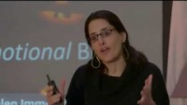
Unpacking Emotional Engagement
How do children’s identities impact learning?
What are you thinking more about in your own practice?
Notes:
Facilitator’s Notes: Slides 10 and 11 = 18 min
Video is approximately 7 minutes long
Offer the prompt before viewing to help frame the learning.
Link to the video: https://www.youtube.com/watch?v=DEeo350WQrs
Invite participants to share their responses to the prompt after the video either as a whole group or through a turn and talk

Slide 11

Read and Reflect
Choose between one of these two texts to read:
Excerpt: Culturally Responsive Education in the Classroom, page 72 “Affective Engagement (2nd paragraph)” and “What do I want students to feel?”
OR
Article: “Eight Ways to Increase Engagement with your Students”
Reflection Question:
Based on the definitions provided and these texts, what does emotional engagement require of us as we plan to make an impact on student learning?
Notes:
Facilitator notes: Slide 12 = 12 min
Provide individual reading time: 5 mins
Provide time for participants to consider their answer: 2 mins
Discussion time in person small groups or breakout rooms: 5 mins
Materials:
From the facilitator packet, pages 128 (second paragraph), 129 and 130 (stop at Question 3 “What are the Targets for Rigor”)
Link to article: 8 Ways to Increase Engagement with Your Students - Corwin Connect (corwin-connect.com)
NOTE: If time is limited, the facilitator might choose from among the options on slides 11 & 12, considering who’s in the room (eg. if I am doing this PD for an elementary school, I might not have them read “The Code”. Or maybe the resources/activities on slides 11 and 12 are combined and it can be either facilitator or participant choice.

Slide 12



Embedding Emotional Engagement in Instructional Practice
Watch a video
Read an article
Private Think Time
What connections did you make to emotional engagement?
How will you embed emotional engagement into your practice?
Notes:
Facilitator notes: Slide 12, 20 mins
For this slide, choose one of the videos and one of the articles that is most responsive to the participants’ needs and context.
Step 1 - Watch a video
Full-time Classroom Teachers Discuss What Matters Most
https://www.youtube.com/watch?v=zQvuEfirYXc 1:59 (Secondary focus)
OR
Building a Belonging Classroom: https://www.youtube.com/watch?v=Q6niuYToam4 (4:17) (Elementary/Secondary focus)
Step 2 - Read an article: 10 minutes
The Code for Student Engagement - https://www.ascd.org/el/articles/the-code-for-student-engagement (Secondary focus)
OR
Teaching Strategies That Support Students’ Individuality - https://www.edutopia.org/article/teaching-strategies-support-students-individuality (Elementary focus)
(M.J. Fievre, author of Raising Confident Black Kids and the widely acclaimed, best-selling book series Badass Black Girl)
Step 3 - Reflection questions – provide alone time to consider thoughts 2 minutes
Step 4 - Discuss questions in small groups 6 minutes

Slide 13

Connections: Instructional Frameworks
Where does emotional engagement live within your instructional framework?
Using your Instruction Framework handout, highlight where you see connections to emotional engagement.
Notes:
Facilitator Notes: Slide 13, 10 mins
5 minutes to highlight or identify places in the instructional framework that connect to emotional engagement
5 minutes to share with elbow partner or in small groups: Have participants discuss what connections they found and any patterns that they noticed.
Instructional Framework links:
CEL 5D+ available at https://info.k-12leadership.org/5-dimensions-of-teaching-and-learning?_ga=2.125490318.507568460.1499115926-1715267409.1499115926
CEL Framework
Danielson available at https://www.k12.wa.us/sites/default/files/public/tpep/frameworks/danielson/2011_danielson_smart_card.pdf
**NOTE – after Spring 2022, we will update this link with the updated Danielson Framework**
Danielson Smart Card -needs to be updated
Marzano available at https://www.k12.wa.us/sites/default/files/public/tpep/frameworks/marzano/Marzano%20at%20a%20Glance%202020.pdf
Marzano at a Glance

Slide 14

Key Considerations: Emotional Engagement
If you are a teacher:
When you are in a student growth conversation with your administrator, what will you communicate on how you have embedded emotional engagement into your instructional practice?
If you are an administrator:
When you are in a student growth conversation how will you encourage dialogue with a teacher about how they are embedding emotional engagement into their instructional practice?
Notes:
Facilitator notes: Slide 14, 15 min
In using the revised Student Growth Goals, it is an opportunity to re-think how we collect artifacts and evidence. This may come during a classroom observation, a PLC observation, a collaborative examination of student work, etc. The focus is to naturally harvest what is embedded in the teaching and learning and not to create or compile additional artifacts solely for this purpose. The focus of using the revised Student Growth Goal rubrics is to have conversations. Given that emotional engagement may be a new concepts for us, it is even more important that there are opportunities for teachers and administrators to have conversations about what emotional engagement is and how it is showing up in the instruction that is planned to help students reach the student growth goal.
Provide individual reflection time, 5 minutes
Provide small group discussion time (consider if you want to group by job-alike or mixed groups, depending on audience), 10 minutes

Slide 15

Additional Readings and Resources
Notes:
Facilitator notes: Slide 15
This is a compilation of additional resources that you are welcome to share, use as part of this module or to inform professional learning, or for your own development and understanding. It is not required that you share or use these resources. As always, it is recommended that you read/view the resources in advance and procure the appropriate permissions for using these resources in your professional learning. It is not an exhaustive list, and we encourage you to include current and vetted resources relevant to your context and work.
Ron Berger in “Ron Berger on the Power of ‘Beautiful Work’” by Sarah Gonser
Edutopia, September 20, 2021 available at Ron Berger on the Power of ‘Beautiful Work’ | Edutopia
“The Engagement Illusion” by Neil Gupta and Douglas Reeves in Educational Leadership, December 2021/January 2022 (Vol. 79, #4, pp. 58-62); the authors can be reached at neil.gupta@creativeleadership.net and douglas.reeves@creativeleadership.net. Available at The Engagement Illusion – ASCD
Vignettes from the TPEP Student Growth Resources page https://www.k12.wa.us/educator-support/teacherprincipal-evaluation-program/frameworks-and-student-growth/student-growth
Chart from Inspired Teachers pgs 5-6 (Emotional Engagement) available white-paper-engagement-1.pdf (inspiredteaching.org)
Eight Ways to Increase Engagement with your Students - John Almarode, available at 8 Ways to Increase Engagement with Your Students - Corwin Connect (corwin-connect.com)
Emotional Engagement in Learning - Mark Thompson, video available at Emotional Engagement in Learning | Mark Thompson | TEDxLSSC – YouTube
The Power of Relationships in Schools - Edutopia , video available at The Power of Relationships in Schools - YouTube

Slide 16


Closure: Why We Teach
Notes:
Facilitator notes: Closure slides 5 mins
These videos are entirely optional to use in the module. Please feel free to substitute your own closure activity as appropriate.
Video: 2:14 - Why We Teach: https://www.youtube.com/watch?v=h0yI6xQRsng
Video: 1:36 - Teachers, we do more than just teach: https://youtu.be/9d2zPypEiok

Slide 17

The Code For Engagement
“Students get to decide when and how to invite us in. We need to accept the invitations. Embracing kids—understanding and accepting them—makes possible a more compassionate pedagogy, one that nourishes and guards more authentically.”
Chad Prather
Notes:
Facilitator notes: Closure Slide 17 - quote/questions/links/contacts
If helpful, please feel free to share the url for the TPEP website:https://www.k12.wa.us/educator-support/teacherprincipal-evaluation-program
And the direct link to the Student Growth Goals page: https://www.k12.wa.us/educator-support/teacherprincipal-evaluation-program/frameworks-and-student-growth/student-growth
And contact information for Katie Taylor, Director in the Educator Effectiveness Office: Katie.Taylor@k12.wa.us

Slide 18

Thank you!
We’d like to honor and acknowledge the thought, time and effort that went into creating this module, and offer thanks to developers:
Patricia Beuke, OESD 114 and Danielson Framework Specialist
Joy Lansdowne, formerly ESD 101 and Marzano Framework Specialist
In appreciation for their work and in acknowledgement to others who have contributed.

