Slide 1
SGG Module 6 – Formative and Summative Assessment
These modules are offered to help deepen understanding of the Critical Attributes listed in the revised Student Growth Goal rubrics. The purpose is to open understanding and discussion, not calibration. The learning in these slides offers an opportunity for groups to make collective meaning around the Critical Attributes to use the revised rubrics and engage in an evaluation process in a way that promotes learning, growth and reflection for students and educators.
We recommend that Module 6, 7 and 8 are presented and learned in sequence, starting with Module 6 as the learning in modules 7 and 8 builds on the activities and learning contained in Module 6.
This slide presentation contains instructions for facilitators in the notes section* of the file.
*To access the notes, download and save this file to your computer.
Notes:
Facilitator notes
The purpose of this module is to help unpack the Critical Attribute of “Formative and Summative Assessment” as it is used in the revised Student Growth Goal rubrics. It is recommended that facilitators follow the activities and keep the content of the module as close to the original as possible. It is encouraged that the facilitator add and personalize slides to make connections and forge alignment with other initiative and work with which the participants in the professional learning may be familiar.
Times provided are an estimate and can be adjusted at the facilitator’s discretion. The structure of the activity may also be adjusted for context and audience.
Information in italics are suggested language/directions for the facilitator to use with participants when leading the learning. Other notes to the facilitator are in bold or plain type.

Slide 2










SGG Concept Map
Overview: Module 1
What does this mean for evaluators: Module 2A
What does this mean for teachers: Module 2B
Critical Standard: Module 3
Cognitive Engagement: Module 4
Emotional Engagement: Module 5
Formative & Summative Assessment: Module 6
Student Engagement in Assessment: Module 7
Feedback from Students: Module 8
Notes:
Facilitator notes
This slide shows the modules available to support implementation of the revised Student Growth Goals. This slide may be included or omitted at the facilitator’s discretion.
These modules are offered to help deepen understanding of the Critical Attributes listed in the revised Student Growth Goal rubrics. The purpose is to open up understanding and discussion, not calibration. The learning in these slides offers an opportunity for groups to make collective meaning around the Critical Attributes in order to use the revised rubrics and engage in an evaluation process in a way that promotes learning, growth and reflection for students and educators.
These modules are available on the OSPI-TPEP website: TPEP Professional Learning Modules | OSPI

Slide 3
Facilitator Outline
Activity | Slides & Times
Introduction | Slides 1-5=10 minutes
Unpacking Summative Assessment and Formative Assessment & Feedback | Slides 6-9=v30 minutes Slide 10 = Optional/Extension 15 minutes Slides 11-16 = 80 minutes
Embedding Formative & Summative Assessment & Feedback | Slides 17-19 = 45 minutes
Connecting to the Instructional Framework | Slide 20 = 15 minutes
Key Considerations | Slide 21-22 = 1 hr & 20 minutes
Additional resources | Slide 23= 5 minutes
Closure | Slides 24-25 = 5 minutes
Notes:
Facilitator notes
Total time for all sections of this module = 270 minutes + 15 minutes/optional/extension activity
The module is designed with flexibility in mind based on available time and options for asynchronous reading or viewing prior to meeting. Due to the length of this module, it is advised to break this up over several learning opportunities.
Materials needed
Copy of instructional frameworks
SSG rubric
Articles and video links provided in slide notes

Slide 4

Learning Targets
Understand how culture impacts student assessment and feedback
Identify where formative & summative assessment and feedback connects to your instructional framework to move learning forward
Describe how assessment is used to impact instructional decisions
Understand the key considerations for teachers/administrators to engage in student growth conversations focused on assessment and feedback
Notes:
Review learning targets

Slide 5

Activator: Think-Pair-Write
How do you use formative assessment for maximum learning benefit for your students and provide them with supportive and productive feedback?
What does cultural responsiveness have to do with assessment and feedback?
Notes:
Facilitator notes
First Step = Participants read the question, brainstorm with a partner, then each participant writes his/her own response. (5-7 minutes)
Second Step = Each participant gets up and finds another person not at their table and shares their response and identify common themes. (5 minutes) This could be adjusted for virtual learning as needed.

Slide 6
Unpacking Culturally Responsive Assessment & Feedback
“We need to reimagine the way we assess students’ learning and specifically in ways that provide meaningful feedback to teachers and students so that they can have a clearer sense of what is and is not effective in the practices.” Culturally Responsive Education in the Classroom, An Equity Framework for Pedagogy, Dr Adeyemi Stembridge, (p, 214)
“By being mindful of how culture affects students’ meaning-making processes, cognition, and demonstrations of learning, we can better understand and appreciate the learning gains that students make.”
Equity and Assessment: Moving Towards Culturally Responsive Assessment, Erick Montenegro & Natasha A. Jankowski, ( p. 13)
“Assessment that overlooks issues of diversity and equity contributes to inequalities in outcomes. The same can be said for assessment approaches that do not take into account students’ culture.”
Equity and Assessment: Moving Towards Culturally Responsive Assessment, Erick Montenegro and Natasha A. Jankowski, (p. 15)
Notes:
Facilitator notes
Activity: What made you pause and think when reading these quotes and why?
Share your thinking with a partner. (10 minutes)
The source of the quotes is Culturally Responsive Education in the Classroom - An Equity Framework for Pedagogy, by Dr Adeyemi Stembridge, pg 214
Equity and Assessment: Moving Towards Culturally Responsive Assessment, by Erick Montenegro and Natasha A. Jankowski, Pgs 13 & 15 available at
https://files.eric.ed.gov/fulltext/ED574461.pdf

Slide 7
Definitions: Summative Assessment, Formative Assessment and Feedback
Summative assessments may include performance assessment, project-based learning, and other opportunities for students to demonstrate the sum of their learning.
Formative assessments provide information to teachers so they can adjust their instruction and to students so they can adjust their learning strategies.
With formative assessment for maximum learning benefit, students receive feedback or productive and supportive interaction, rather than a score or grade.
Notes:
Facilitator notes
These definitions are from the SGG rubric, available at Final Revised Student Growth Goal Rubrics (ospi.k12.wa.us)
Activity
Have participants identify a word or words that resonate with them and make connections to their own understanding of summative and formative assessment and feedback/interaction. (3 minutes)

Slide 8

Summative Assessment Terms for Student Growth
While many teachers have historically used state summative test results to set student growth goals and collect evidence of growth, the new student growth goal rubrics encourage a shift away from the use of standardized test results for this purpose.
This shift is important because different forms of assessment have different purposes and different appropriate uses. For example, state summative tests were designed for the purpose of providing large-scale information about the educational system as a whole, but not for the purpose of giving teachers detailed information about individual students’ learning or growth.
From Assessment Terms for Student Growth - OSPI p. 1
Notes:
Facilitator notes (2 minutes)
Depending on time, you may want to share the Assessment Terms for Student Growth document in advance of the meeting, during the meeting or as a follow-up resource to explore after the meeting.
Invite volunteers from the participants to read each statement aloud and also refer to the Assessment Terms PDF in the resources for further review.
CRFA Assessment Terms: Assessment Terms for Student Growth Goals (ospi.k12.wa.us)

Slide 9

Activity: Triangle, Square, Circle
“Summing Up”
Summative assessment simply means summing up
– or describing – the learning.
While summative assessments are typically associated with end-of-unit tests, projects, or essays (or even state summative tests), summative assessment doesn’t need to involve scores at all. In fact, a score is a limited, uni-dimensional description of student learning.
Summative assessment can also refer to: any description of the students’ learning based on artifacts, conversations, self-reflections, and observations that take place over a period of time.
Notes:
Facilitator notes
Activity = Triangle, Square, Circle (15 minutes)
Decide how you would like to facilitate this (handout, padlet, etc.) with participants
Each participant completes the activity individually. (5 mins)Then small group share-out. (10 mins)
Reflection questions below:
1. Triangle: Write down three important points from the slide.
2. Square: Write down anything that “squares” with your thinking or you agree with.
3. Circle: Write down anything that is still “circling” in your head or questions you have.

Slide 10
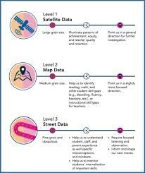
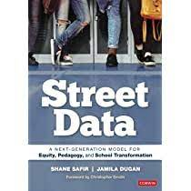
Reimagining Assessment: An Asset-Based Approach
Identify the data sources you currently use that align with the categories below:
Satellite Data
Map Data
Street Data
Notes:
Facilitator notes
This is an optional Activity/Extension (15 mins)
Have participants read Levels of Data that is in the Handout for Module 6, Handout 1 and that appears in the slide notes below (5 mins) and then access prior knowledge to identify data sources they use that align with the categories indicated in the text. (10 mins)
Example: SBA = Satellite Data.
Levels of Data.docx
Street Data: A Next Generation Model for Equity, Pedagogy, and Transformation, Shane Safir/Jamila Dugan, Pages 54-58
Satellite Data: Data that hover far above the classroom and tell an important but incomplete story of equity. Satellite data encompass broad-brush quantitative measures like test scores, attendance patterns, and graduation rates, as well as adult indicators like teacher retention, principal attrition, and parent participation.
Map Data: Data that hover closer to the ground, providing a GPS of social-emotional, cultural, and learning trends within a school community. Map data include literacy levels gathered through “running records” where teachers listen to and code students reading aloud, rubric scores on common assessments, and surveys that reveal student, parent, or staff perception and satisfaction levels.
Street Data: The qualitative, systematic, and experiential data that emerges at eye level and on lower frequencies when we train our brains to discern it. Street data is asset-based, building on the tenets of culturally responsive education by helping educators look for what’s right in our students, schools, and communities instead of seeking out what’s wrong. Street data embodies both an ethos and a change methodology that will transform how we analyze, diagnose, and assess everything from student learning to district improvement to policy. It offers us a new way to think about, gather, and make meaning of data.
Summative assessments relate to satellite data. In order to get to map and street level data, we need to consider the connection to being culturally responsive.

Slide 11

Read & Reflect: Culturally Responsive Assessment
Activity:
Read text
Reflect using questions below
Culturally Responsive Assessment: Goals, Challenges, and Implications
When designing culturally responsive assessments, consider:
• In what ways does the assessment make reference to culture?
• How does the assessment allow students to draw from their cultural fluencies?
• How does the assessment support students in bridging their social/cultural identities with their academic identities?
Notes:
Facilitator notes (25 min)
Activity
Have participants read the text, Culturally Responsive Assessment: Goals, Challenges, and Implications available at: Culturally Responsive Assessment: Goals, Challenges, and Implications (ed.gov) (5 minutes) Module 6, Handout 2
Participants then individually reflect using the questions on the slide (10 minutes)
Small Group share out learnings from reading the text and share reflections on the questions (10 minutes)

Slide 12
Formative Assessment and Feedback
Formative assessments provide information to teachers so they can adjust their instruction for students so they can adjust their learning strategies.
With formative assessment for maximum learning benefit, students receive feedback or productive and supportive interaction, rather than a score or grade.
Notes:
Facilitator notes (2 minutes)
Connect again to the definitions previously shared on slide 7 focused on just formative assessment & feedback. These definitions are from the revised SGG rubric available at Final Revised Student Growth Goal Rubrics (ospi.k12.wa.us)
Have participants identify a word or words that resonate with them and make connections to their own understanding of summative and formative assessment and feedback/interaction.

Slide 13
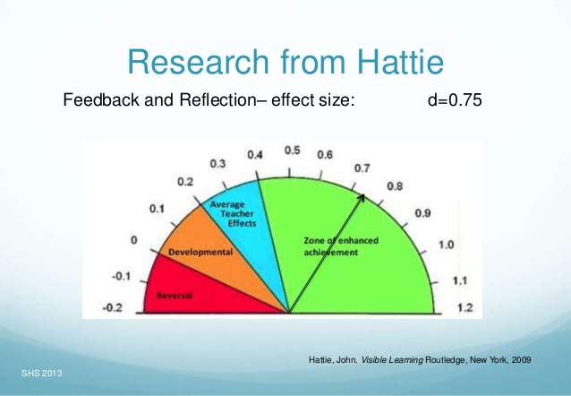
Effective Feedback
Notes:
Facilitator notes (10 minutes)
John Hattie indicates in his research that the average effect size was 0.4, a marker that represented a year’s growth per year of schooling for a student. Anything above 0.4 would have a greater positive effect on student learning. Therefore. effective feedback .73 indicates slightly under two year’s growth per year.
In small groups have participants share how they provide feedback to their students, how they collect student feedback, and how it informs their instruction.
John Hattie resource: https://www.visiblelearningmetax.com/

Slide 14
Feedback - An Essential Practice
“Wise Feedback - a way of giving feedback that reassures students that they will not be stereotyped or doubted as less capable.”
Zaretta Hammond - Culturally Responsive Teaching and the Brain, p.104
“Research by Cohen and Steele (2002) found that students of color often do not receive timely, actionable feedback from teachers either because teachers didn’t want to hurt the student’s feelings or didn’t want to be perceived as prejudiced.”
Boston Public Schools
Notes:
Facilitator notes (2 minutes)
Read quotes and then go to next slide for the activity that supports these quotes.

Slide 15

Feedback Activity - Jigsaw
Partner Read (10 minutes)
Partner 1= Close Read Zaretta Hammond text
Partner 2= Close Read Boston Public School text
Share & Discuss: Each partner shares key points from their text, then together identify common themes and discuss their current practices focused on the statements below:
Identify what key points from the texts align with your feedback processes.
Identify what may need to be more fully developed in your feedback processes.
Notes:
Facilitator notes (25 minutes)
Activity = Partner Read (10 minutes)
Partner 1 reads the Zaretta Hammond’s text, Module 6 handout 3
Partner 2 reads the Boston Public Schools available at Essential_Practice-_Provide_Effective_Feedback.pdf (bostonpublicschools.org) Module 6 Handout 4
Each person shares key points from the text and discuss their current practices focused on the statements in the slide
Share & Discuss (15 minute) Each partner shares key points from their text and then discuss 1. Identify what aligns with your feedback processes and what may need to be more fully developed.

Slide 16
Productive and Supportive Interaction: Pause, Read, Reflect
Feedback isn’t magic!
Formative assessment relies on feedback to improve learning. However, feedback is as complex as the people offering and receiving it. Its effectiveness isn’t just dependent on timing and tone. It’s also highly responsive to the relationships between teachers, students, and skills and knowledge.
For example, an ELA teacher might give feedback to a student writer in an encouraging way, but the student might still feel discouraged and hesitant to write in the future. No one has done anything wrong, but the feedback hasn’t worked. That’s because feedback isn’t magic and can’t be separated from the complex relationships that define teaching and learning.
from Assessment Terms for Student Growth Goals
Notes:
Facilitator notes (15 minutes)
Pause, Read, and Reflect found in the Module 6 handouts – handout 5
Provide an opportunity for participants to share their reflections after reading the examples in the handout.
Assessment Terms for Student Growth Goals is available at: Assessment Terms for Student Growth Goals (ospi.k12.wa.us)

Slide 17
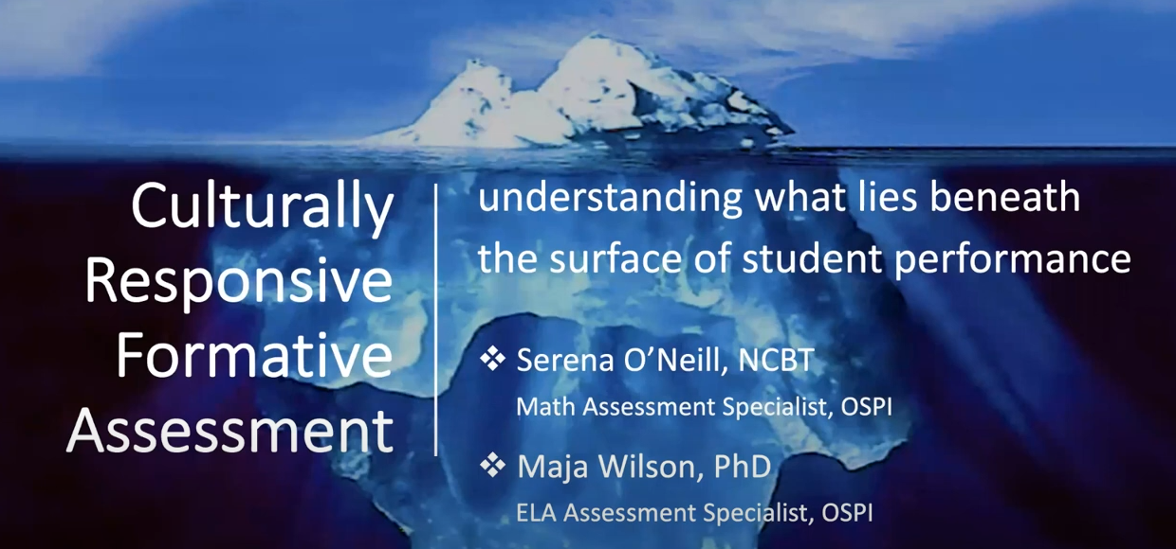
Embedding - Video - Part 1 CRFA Example
Productive and supportive interactions don’t need to involve judgment or feedback at all. Instead, a teacher might set up an experience for a student that allows the student to move forward. Culturally responsive formative assessment gives teachers tools to understand students’ learning without judgment and interact supportively.
Culturally Responsive Formative Assessment Overview - YouTube
Notes:
Facilitator notes (15 minutes)
Culturally Responsive Formative Assessment Video is available at Culturally Responsive Formative Assessment Overview - YouTube
Watch the first 6:47
Before watching, offer the listening prompt - What makes you pause and think?
Discuss these questions after viewing the first 6:47 minutes of the video:
When listening to Serena, what made you pause and think? (Prior knowledge, engagement, student assets and your own learning experiences)
How do you gain understanding of your students’ assets?
How do you access students’ prior knowledge?

Slide 18
Embedding: Video -Part 2 CRFA Example
Culturally Responsive Formative Assessment Overview - YouTube
Notes:
Facilitator notes (15 mins)
Video is available at Culturally Responsive Formative Assessment Overview - YouTube
Watch from 8:54-11:00
Listening prompt - What adds to your thinking from the first video?
Discuss the question after watching this portion of the video, How do you design learning experiences based on what lies beneath the tip of the iceberg?

Slide 19
Embedding: Video -Part 3 CRFA Inquiry Tools
Culturally Responsive Formative Assessment Overview - YouTube
Notes:
Facilitator notes (15 mins)
Video available at Culturally Responsive Formative Assessment Overview - YouTube
Watch from 11:01-14:00
Listening prompt- What connections can you make to this video that adds to your understanding of culturally responsive formative assessment?
Discussion questions
What inquiry tools do you use to understand funds of knowledge, decision making, academic processes and/or conceptual understanding?
Of the tools mentioned, which tool might you like to explore and interact with?

Slide 20

Connections to Instructional Frameworks
Using your Instructional Framework, highlight where you see connections to:
formative and summative assessment
feedback
knowledge of students
assets students bring to learning
What areas in your framework relate to knowledge of students and their asse
Notes:
Facilitator notes (15 minutes)
5 minutes to highlight
10 minutes to share with elbow partner or in small groups: Have participants discuss what connections they found, any patterns that they noticed and answer to the additional question.
Instructional Framework links:
CEL 5D+
CEL 5D+ Teacher Evaluation Rubric | OSPI
Danielson
Charlotte Danielson’s Framework for Teaching | OSPI
Marzano
Marzano’s Teacher Evaluation Model | OSPI

Slide 21
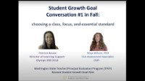
Key considerations - Assessment and Feedback, Part 1
Notes:
Facilitator notes – https://www.youtube.com/watch?v=9ImqCrzvSyY
This is a long activity and could be broken up in between sessions. Please provide participants with the Listening Guide – Module 6 Handout 6
Video 1
Stop video at 5:22: (15 minutes)
1. What might it have felt like in the moment for the teacher when student stated that she doesn’t listen to feedback or revise?
2. How does the teacher use the Questions that Begin Culturally Responsive Formative Assessment Inquiries (ospi.k12.wa.us) (Handout 7) as a tool to understand and respond productively to the student’s statement?
3. What might it have felt like for the student to have a teacher respond to this statement with non-judgmental curiosity and deep listening?
Stop video at the end:
4. How is the conversation in the video similar to or different from your experiences with student growth goal conversations?
5. What questions are coming up for you after watching the rest of the video?

Slide 22
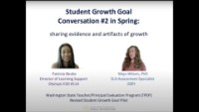
Key Considerations - Assessment and Feedback, Part 2
Notes:
Facilitator notes (45 minutes) - https://www.youtube.com/watch?v=Nzyteuxc7Kw
(See Listening Guide – Module 6 Handout 6)
Stop video at minute 5:50 (15 minutes):
1. How did the teacher design learning experiences based on what lies beneath the surface? (See the iceberg image.)
Stop video at 10:20 (15 minutes):
2. How is feedback demonstrated in different ways in this segment of the video?
Stop video at 14:30 (15 minutes):
3. In your own practice, what could summing up (describing) the learning look like? (artifacts, conversations, reflections and observations)
Stop video at end (15 minutes).
4. Personal reflection: How might this story open up possibilities in your own practice?

Slide 23
Additional Readings and Resources
CRFA Examples: CRFA Examples (ospi.k12.wa.us)
CRFA FAQ: CRFA FAQ (ospi.k12.wa.us)
CRFA Questions: Questions that Begin Culturally Responsive Formative Assessment Inquiries (ospi.k12.wa.us)
Assessment Terms for Student Growth: Assessment Terms for Student Growth Goals (ospi.k12.wa.us)
Culturally Responsive Education in the Classroom - An Equity Framework for Pedagogy -Dr. Adeyemi Stembridge
Street Data: A Next Generation Model for Equity, Pedagogy, and School Transformation https://www.youtube.com/watch?v=69-hTpX9HRw
A Culturally Responsive Classroom Assessment Framework https://www.nciea.org/blog/a-culturally-responsive-classroom-assessment-framework/
Working Toward Culturally Responsive Assessment Practices: https://ncte.org/blog/2020/02/working-toward-culturally-responsive-assessment-practices/
Asset Based Feedback Protocol: https://docs.google.com/document/d/142shKpEzI5LgMZHnl5J5ejfGkI2FqNeeliONmJ3UUls/edit
Street Data: A New Grammar for Educational Equity: https://www.edweek.org/leadership/opinion-street-data-a-new-grammar-for-educational-equity/2019/0
Notes:
Facilitator notes 5 mins to share additional resources/reading.
CRFA FAQ: CRFA FAQ (ospi.k12.wa.us)
CRFA Examples: CRFA Examples (ospi.k12.wa.us)
CRFA Questions: Questions that Begin Culturally Responsive Formative Assessment Inquiries (ospi.k12.wa.us)
CRFA Assessment Terms for Student Growth: Assessment Terms for Student Growth Goals (ospi.k12.wa.us)
Culturally Responsive Education in the Classroom - An Equity Framework for Pedagogy -Dr. Adeyemi Stembridge
Street Data: A Next Generation Model for Equity, Pedagogy, and School Transformation https://www.youtube.com/watch?v=69-hTpX9HRw
A Culturally Responsive Classroom Assessment Framework https://www.nciea.org/blog/a-culturally-responsive-classroom-assessment-framework/
Working Toward Culturally Responsive Assessment Practices
https://ncte.org/blog/2020/02/working-toward-culturally-responsive-assessment-practices/
Asset Based Feedback Protocol: https://docs.google.com/document/d/142shKpEzI5LgMZHnl5J5ejfGkI2FqNeeliONmJ3UUls/edit
Street Data: A New Grammar for Educational Equity
https://www.edweek.org/leadership/opinion-street-data-a-new-grammar-for-educational-equity/2019/0

Slide 24
Culturally Responsive Assessment and Feedback
“Assessment practices do far more than provide information; they shape people’s understanding about what is important to learn, what learning is, and who learners are.”
Assessment, Equity, and Opportunity to Learn, Moss, 2008, p. 254
National Board for Professional Teaching Standards: Knowledge of Students
“Accomplished teachers know that the interests young people share can provide contexts for engaging students in learning.”
Notes:
Facilitator notes (5 minutes)
Read quotes and ask participants, now that they have completed the module: What does culture have to do with assessment and feedback? Design a way to capture their thinking.
https://www.cambridge.org/core/books/assessment-equity-and-opportunity-to-learn/D30F4A0F58FA4E4363315311ADC6FF92
https://www.nbpts.org/

Slide 25

Thank you!
We’d like to honor and acknowledge the thought, time and effort that went into creating this module, and offer thanks to the module developers:
Patricia Beuke, OESD 114 and Danielson Framework Specialist
Joy Lansdowne, formerly ESD 101 and Marzano Framework Specialist
In appreciation for their work and in acknowledgement to others who have contributed:
Maja Wilson, OSPI
Serena O'Neill, OSPI
Notes:
If helpful, please feel free to share the url for the TPEP website: Teacher/Principal Evaluation Program | OSPI
And the direct link to the Student Growth Goals page: Student Growth | OSPI
And contact information the TPEP office at: tpep@k12.wa.us

