Slide 1
SGG Module 7 – Student Engagement in Assessment
These modules are offered to help deepen understanding of the Critical Attributes listed in the revised Student Growth Goal rubrics. The purpose is to open understanding and discussion, not calibration. The learning in these slides offers an opportunity for groups to make collective meaning around the Critical Attributes to use the revised rubrics and engage in an evaluation process in a way that promotes learning, growth and reflection for students and educators.
We recommend that Module 6, 7 and 8 are presented and learned in sequence, starting with Module 6 as the learning in modules 7 and 8 builds on the activities and learning contained in Module 6.
This slide presentation contains instructions for facilitators in the notes section* of the file.
*To access the notes, download and save this file to your computer.
Notes:
Facilitator Notes:
The purpose of this module is to help unpack the Critical Attribute of “Student Engagement in Assessment as it is used in the revised Student Growth Goal rubrics. It is recommended that facilitators follow the activities and keep the content of the module as close to the original as possible. It is encouraged that the facilitator add and personalize slides to make connections and forge alignment with other initiative and work with which the participants in the professional learning may be familiar.
Times provided are an estimate and can be adjusted at the facilitator’s discretion. The structure of the activity may also be adjusted for context and audience.
Information in italics are suggested language/directions for the facilitator to use with participants when leading the learning. Other notes to the facilitator are in bold or plain type.

Slide 2









SSG Concept Map
Overview: Module 1
What does this mean for evaluators: Module 2A
What does this mean for teachers: Module 2B
Critical Standard: Module 3
Cognitive Engagement: Module 4
Emotional Engagement: Module 5
Formative & Summative Assessment: Module 6
Student Engagement in Assessment: Module 7
Feedback from Students: Module 8
Notes:
Facilitator Notes:
This slide shows the modules available to support implementation of the revised Student Growth Goals. This slide may be included or omitted at the facilitator’s discretion.
These modules are offered to help deepen understanding of the Critical Attributes listed in the revised Student Growth Goal rubrics. The purpose is to open up understanding and discussion, not calibration. The learning in these slides offers an opportunity for groups to make collective meaning around the Critical Attributes in order to use the revised rubrics and engage in an evaluation process in a way that promotes learning, growth and reflection for students and educators.
These modules are available on the OSPI-TPEP website: https://www.k12.wa.us/educator-support/teacherprincipal-evaluation-program/policy-and-resources/training-modules
This slide shows the modules available to support implementation of the revised Student Growth Goals. This slide may be included or omitted at the facilitator’s discretion.

Slide 3
Facilitator Outline
Activity | Slides & Times
Introduction | Slides 1-8 15 mins
Unpacking Student Engagement in Assessment | Slides 9-15 90 mins
Embedding Student Engagement in Assessment | Slides 16-19 110 mins
Connecting to the Instructional Framework | Slide 20 15 mins
Key Considerations | Slide 21 15 mins
Additional resources | Slide 22 5 mins
Closure | Slides 23-24 5 mins
Notes:
Facilitator Notes:
Total time for all sections of this module = 255 mins
The module is designed with flexibility in mind based on available time and options for asynchronous reading or viewing prior to meeting. Due to the length of this module, it is advised to break this up over several learning opportunities.
Materials needed:
Copy of instructional frameworks
SSG rubric
Articles and video links provided in slide notes

Slide 4

Learning Targets
Understand the connection between formative assessment and student engagement in assessment and why it is important.
Describe how student engagement in assessment promotes student voice and places students in the driver seat in monitoring, communicating, and promoting their own growth,
Be able to identify strategies that promote student engagement in assessment and incorporate them into your practice.
Identify where student engagement in assessment connects to your instructional framework.
Understand the key considerations for teachers/administrators to engage in student growth conversations focused on student engagement in assessment.
Notes:
Review learning targets
Understand how student engagement in assessment is part of formative assessment
Learn ways to engage students in the formative assessment process
Understand why student matters
Identify where student engagement in assessment connects to your instructional framework
Consider how to discuss and demonstrate student engagement in assessment in conversations between teachers and principals
Understand that formative assessment increases student achievement, improves the quality of instruction, and increases motivation.
Understand that student engagement in assessment includes reflection and self-assessment, use of feedback, goal-setting, revision, and presentation.
Describe how student engagement in assessment promotes student voice and places students in the driver seat in monitoring, communicating, and promoting their own growth,

Slide 5

Activator:
When you think of
Formative Assessment and Student Engagement in Assessment - what comes to mind and how are they related?
Notes:
Facilitator Notes: Activator - (5 mins) This activator is intended to draw a throughline from Module 6 (Summative/Formative assessment and Feedback) to Module 7 Student Engagement in Assessment and continue through Module 8..

Slide 6
Connections to Module 6: Formative Assessment Impacts Achievement, Instruction, and Motivation
Black and Wiliam (1998) found that gains in achievement associated with formative assessment nearly doubled their rate of learning.
2. In Advancing Formative Assessment in Every Classroom, Moss and Brookhart (2009) survey a range of research that supports the powerful effect of formative assessment on teacher efficacy. “In a very real way it flips a switch, shining a bright light on individual teaching decisions so that teachers can see clearly the difference between the intent and the effect of their actions” (p. 10).
3. A similar transformation occurs in the motivation of students when they are taught that intelligence is malleable and growth comes through effort (Dweck, 2006; Vispoel & Austin, 1995).
4. Formative assessment can be used to build confidence and empower student ownership over learning and growth (Yin, Shavelson, Ayala, Ruiz-Primo, Brandon, & Furtak, 2008).
Notes:
Facilitator Notes: Share Research quotes taken from: Why Student-‐Engaged Assessment Matters, Leader of Their Own Learning: Transforming Schools through Student-Engaged Assessment ELE Education.org, 2014.
Facilitator talking point: In Module 6 we covered formative, summative, and feedback. Module 7 is where we can engage students in the assessment process through formative assessment and feedback to encourage student ownership of learning.

Slide 7
Assessment Enhances Learning
There is considerable evidence that assessment is a powerful process for enhancing learning.
Key Factors in the research:
the provision of effective feedback to pupils
the active involvement of pupils in their own learning
adjusting teaching to take account of the results of assessment
recognition of the profound influence assessment has on the motivation and self-esteem of pupils, both of which are crucial influences on learning
the need for pupils to be able to assess themselves and understand how to improve.
Black, P. & William, D. (1998). Inside the Black Box: Raising standards through classroom assessment. London: King's College.
Notes:
Facilitator Notes: Share Key Factors
A key to improved learning is through the intentional use of assessment in the classroom. Assessment includes 3 approaches that together contribute to student learning: assessment for learning, assessment as learning and assessment of learning.
Aspects of assessment

Slide 8
Definitions: Student Engagement in Assessment
Students understand the learning goal and may have been involved in determining the criteria to be used for evaluating it.
Students have an opportunity to assess their own work and/or that of peers using these criteria.
Students monitor their progress on the learning goal
Notes:
Facilitator Notes: These definitions are from the SGG rubric. Have participants identify a word or words that resonate with them and make connections to their own understanding of “Student Engagement in Assessment” (3 minutes)
https://www.k12.wa.us/sites/default/files/public/tpep/studentgrowth/Final%20Revised%20Student%20Growth%20Goal%20Rubrics.pdf

Slide 9
Unpacking: The Power of Student Voice in Everything!
Dr. Qualglia says that it isn't enough to listen....the adults must believe the students have something to offer. Quaglia Institute
“Student voice in its most profound and radical form, calls for a cultural shift that opens up spaces and minds not only to the sound but also to the presence and power of students’ “power” and “authority”. “
Aspects of student voice do raise concerns for some adults, who feel there needs to be more of a distance between themselves and their students. Cook-Sather (2006:366) explores the influence of “powershift” between adults and students: “the shifts in power dynamics between adults and young people and in roles for students are both prerequisites and results of the key premises and practices of student voice work”. This “power shift” can be perceived as threatening to both institution and individual teachers.”
Robertson, G. (2015). Student voice at the "heart of learning". Research in Teacher Education, 5(1), 27–32.
Notes:
Facilitator Notes: Student voice needs to be in everything!
Quaglia Institute

Slide 10
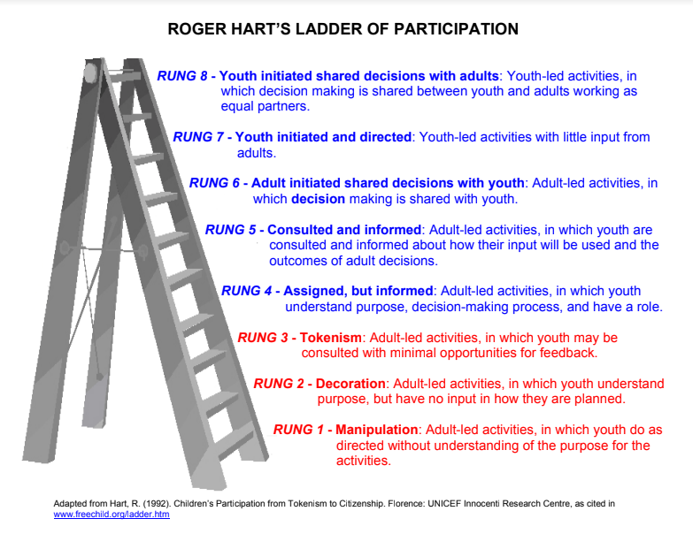
Roger Hart’s: Ladder of Participation
Notes:
Facilitator Notes: (10 mins) Use a protocol such as - See, Think, Wonder followed by discussion. Have a handout of this available for participants
Roger Hart's Ladder of Participation:
Hart, R. (1992). UNICEF, Children’s Participation: from Tokenism to Citizenship. Innocenti Essays. No. 4. Retrieved from: http://www.unicef-i
rc.org/publications/pdf/childrens_participation.pdf

Slide 11
Why Does Student Engagement in Assessment Matter?
Read: Why Student-‐Engaged Assessment Matters
Reflect: Use Connect, Extend, Challenge to process and take notes on the article.
Small Group Discussion
Notes:
Facilitator Notes: Read, Reflect & Discuss - (30 mins) Why Student-‐Engaged Assessment Matters. Have participants process the article: Connections, Extensions and Challenges

Slide 12
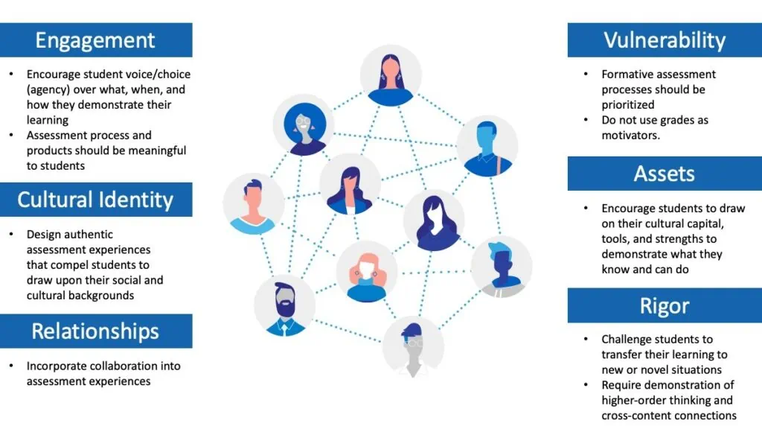
A Culturally Responsive Classroom Assessment Framework
Notes:
Facilitator Notes:
Read Article & Reflect: (10 mins) A Culturally Responsive Classroom Assessment Framework -
A Culturally Responsive Classroom Assessment Framework: The Intersections of Equity, Pedagogy, and Sociocultural Assessment, Carla Evans, Center for Assessment
The six themes of CRE from Dr Stembridge include engagement, cultural identity, relationships, vulnerability, assets, and rigor. These six themes overlap but are listed separately to elucidate the connections with classroom assessment. In practice, they are impossible to separate. The bullets underneath each of the six themes of CRE in the figure are not intended to be an exhaustive list; however, it is difficult to imagine a summary of how the six themes relate to classroom assessment without these bullets being included.
2.Then process in small groups (10 mins) using a protocol of your choice, such as the Final Word Protocol, The Final Word or process with this question: How could you use this framework to improve the cultural responsiveness of your classroom assessments?
3.Make a Connection to Planning with Equity in Mind: Planning Questions (below) that have been utilized in previous modules: (10 mins)
In modules 6,7 & 8 regarding assessments, educators have the opportunity to reflect on their lesson design around the five questions to identify evidence of understanding, feelings, rigor, cognitive/emotional/behavioral engagement and opportunities for responsiveness.
Planning Questions:
Question One: What do I want students to understand?
Question Two: What do I want students to feel?
Question Three: What are the targets for rigor?
Question Four: What are the indicators of engagement?
Question Five: What are the opportunities to be responsive?
“Equity, as an educational concept, is the implementation of an Equity mindset into thoughtful pedagogical design.” p. 1: Dr. Adeyemi Stembridge - Culturally Responsive Education in the Classroom - An Equity Framework for Pedagogy

Slide 13
Hattie’s Greatest Effect size: Self Reported Grades / Student Expectations – How we can apply it in the classroom.
Students can accurately predict how they will perform on a given performance task or assessment and have a clear understanding of what they know. Hattie (2010) describes this phenomenon as “self-reported grades” or “student expectations” and it is one of the most powerful influences in increasing student learning outcomes.
(effect size = 1.44)
Key steps:
Set goals for themselves
2. Predict their performance
3. Self-assessment and sharing rubrics
Notes:
Facilitator Notes: (15 mins) Another aspect of students being engaged in assessment is what used to be referred as self-reported grades from Hattie’s research but is now called student expectations. Please review the 3 Key Steps on this slide and look at the questions that we can ask students on slide 14, and questions we can ask ourselves on slide 15.
Review key steps/slides for 5 minutes then provide time for participants to discuss connections to their classroom practices (10 mins)
Hattie’s Greatest Effect size: Self Reported Grades / Student Expectations – How we can apply it in the classroom.

Slide 14
Application: What are some questions we can ask and challenge our students?
Are you satisfied with your learning?
Are you satisfied that you demonstrated your knowledge and skill?
How does your work compare to the expectations on the rubric?
Which parts of the assignment (project, performance, etc.) were you most satisfied?,
How closely does your work on this assignment (project, performance, etc.) reflect your learning?
Were the strategies that you used effective in helping you reach your goals? ,
On a scale of 1 to 10, how would you rate your effort?
If you were to do this over, how could it be improved?
Notes:
Facilitator Notes: Hattie’s Greatest Effect size: Self Reported Grades / Student Expectations – How we can apply it in the classroom.

Slide 15
Application: What are some questions teachers can ask for their own reflection?
What was the objective/standard I was hoping to teach?
What assignment/prompt/project/activity did I choose to teach the standard/objective?
How successful was the lesson? How do I know?, What evidence do I have? ,
What percentage of students reached the goal or standard?
Which parts of the lesson am I most satisfied?
How will I reteach and/or retest any unsuccessful students?
Notes:
Facilitator Notes: Hattie’s Greatest Effect size: Self Reported Grades / Student Expectations – How we can apply it in the classroom.
Notes - these are a different set of questions than Dr. Stembridge’s Planning questions. Either or both are great tools for teachers to use on reflection of their lessons during the assessment process.

Slide 16
Embedding: Co-Constructing Success Criteria
Read & Reflect:
Build it Together: Co-Constructing Success Criteria with Students | Cult of Pedagogy
Notes:
Facilitator Notes: Read & Reflect: (15 mins)Use a protocol of your choice and have participants make connections to their current practice
In this Embedding section of the module (slides 16-19), provide practical tools aligned with the definitions of the student engagement in assessment critical attribute found in slide 8. (Co-constructing success criteria, self & peer-assessment and student monitoring progress on their learning goal.

Slide 17
Co-Constructing Success Criteria Videos
Choose one of the two videos to watch:
Co-constructing Success Criteria with High School Students - YouTube
Co-Constructing Success Criteria in an Elementary School Classroom - YouTube
Discuss with a partner: How could you co-construct success criteria with your students?
Notes:
Facilitator Notes: Choose video: (7 mins) Discuss with partner (13 mins) How could you co-construct success criteria with your students?

Slide 18
Peer Assessment
Watch the video and read the text:
Video: Peer Assessment: Reflections from Students and Teachers (4:53)
Text: Peer and self-assessment for students
What was affirmed for you in your teaching?
What is your take-away for application?
Notes:
Facilitator Notes: Watch the video and read the text (15 mins) - Discuss: (10 mins) What was affirmed for you in your teaching? What is your take-away for application.

Slide 19
Connecting Kristin’s story from Module 6
Read Kristin’s story: Understanding Kristin’s Resistance
2. Fill out the SGG: Student Engagement in Assessment section of the blank chart by identifying evidence from Kristin’s story.
3 Check your thinking by reviewing the “Unpacking Critical Attributes of Student Growth chart” for only the Student Engagement in Assessment section. Review other parts of the chart to gain further insights.
Notes:
Facilitator Notes: Read story (20 mins) - Fill out chart (10 mins) - Check thinking (10 mins) - Talk about other contents (50 mins)
For this slide, we are using Kristin’s story from Module 6 as an illustration of how the critical attributes, especially student engagement in assessment, connect to one example of a student growth goal, including the expanded definition of summative assessment.
Understanding Kristin's Resistance.docx
SGG Blank Kristin Chart.docx
Unpacking the Critical Attributes of Student Growth through Kristin.docx
How could you use this format for other contents? Mention that ELA standards are identified for all contents. For some other content area examples reference this resource: Self-Reflection and Assessment

Slide 20
Connections to your Instructional Framework
Using your Instructional Framework handout, highlight where you see connections to:
Student Engagement in Assessment
  reflection and self-assessment
  use of feedback
  goal-setting
  revision
  success criteria
  monitoring
  communicating
  promoting their own growth,
Notes:
Facilitator Notes: Connecting to the Instructional Framework - (15 minutes)
5 minutes to highlight
10 minutes to share with elbow partner or in small groups: Have participants discuss what connections they found, any patterns that they noticed and answer to the additional question.
Instructional Framework links:
CEL 5D+
CEL Framework
Danielson
Danielson Smart Card -needs to be updated
Marzano
Marzano at a Glance

Slide 21
Key Considerations: Student Engagement in Assessment
If you are a teacher:
When you are in a student growth conversation with your administrator, what will you communicate on how you have embedded student engagement in assessment into your instructional assessment practices?
If you are an administrator:
When you are in a student growth conversation how will you encourage dialogue with a teacher about how they are embedding student engagement in assessment into their instructional/assessment practice?
Notes:
Facilitator notes: (15 min)
Provide individual reflection time, 5 minutes
Provide small group discussion time (consider if you want to group by job-alike or mixed groups, depending on audience), (10 minutes)

Slide 22
Additional Readings and Resources
Student-Engaged Assessment
Putting Students in Charge of Their Learning | Edutopia
Three Ways to Better Engage Students to Get the Most from Educational Assessments
Involving Students in the Assessment Process
What does Self-Assessment and Self-Reflection bring to the Learning Journey
Why is Self-Reflection a Good Thing for Students to Do? | Colorado Academy News
A Culturally Responsive Classroom Assessment Framework
Simple Ways to Solicit Peer Feedback in High School English Classes | Edutopia
Putting Students in Charge of Their Learning Journey (Video 5:19)
7 Things That Happen When Students Own Their Learning - John Spencer (Video 1:41 & Text)
Self-Reflection and Assessment
How to Get K–12 Students Thinking About Their Own Learning | Edutopia
Video: Dr. Heidi Andrade, Ed.D. Reflects on Self- and Peer Assessment (5:24)
Notes:
Facilitator Notes: There are a lot of short application resources to assist teachers in implementation.

Slide 23
Closing
“To become self-directed learners, students must learn to assess the demands of the task, evaluate their own knowledge and skills, plan their approach, monitor their progress, and adjust their strategies as needed.”
How Learning Works:Seven Research-Based Principles for Smart Teaching 1st Edition: by Susan A. Ambrose (Author), Michael W. Bridges (Author), Michele DiPietro (Author), Marsha C. Lovett (Author), Marie K. Norman (Author), Richard E. Mayer (Foreword)
When students own the assessment process, they grow in self-awareness and intellectual humility. They learn how to engage in goal-setting, how to monitor their progress, and, if this is embedded within PBL, they learn project management. As students assess their strengths and weaknesses and try new approaches, they grow more resilient. They engage in iterative thinking and often come up with novel approaches for problem-solving. When students engage in peer assessment, they learn how to “be a good coach.” They learn how to give and receive feedback. They learn how to collaborate and problem solve. In other words, when we empower students to own the assessment process, we empower students to become lifelong learners.
Five Reasons Students Should Own the Assessment Process, John Spencer
Notes:
Facilitator Notes:
How Learning Works:Seven Research-Based Principles for Smart Teaching 1st Edition: by Susan A. Ambrose (Author), Michael W. Bridges (Author), Michele DiPietro (Author), Marsha C. Lovett (Author), Marie K. Norman (Author), Richard E. Mayer (Foreword)
Five Reasons Students Should Own the Assessment Process - John Spencer

Slide 24

Thank you!
We’d like to honor and acknowledge the thought, time and effort that went into creating this module, and offer thanks to the module developers:
Patricia Beuke, OESD 114 and Danielson Framework Specialist
Joy Lansdowne, formerly ESD 101 and Marzano Framework Specialist
In appreciation for their work and in acknowledgement to others who have contributed:
Kathryn A. Page, Ed.D.
Office of System and School Improvement Partner/Contractor
Gonzaga University Supervisor for Principal Certification
AWSP Mentor
Maja Wilson, PhD OSPI ELA Assessment Specialist, Assessment Development
Serena O’Neil, NBCT OSPII Math Assessment Specialist, Assessment
Development
Notes:
Facilitator Notes: Closure: 5 mins - read quote/questions/links/contacts
If helpful, please feel free to share the url for the TPEP website:https://www.k12.wa.us/educator-support/teacherprincipal-evaluation-program
And the direct link to the Student Growth Goals page: https://www.k12.wa.us/educator-support/teacherprincipal-evaluation-program/frameworks-and-student-growth/student-growth
And contact information for Sue Anderson, Director in the Educator Effectiveness Office: Sue.Anderson@k12.wa.us and Katie Taylor, Associate Director in the Educator Effectiveness Office: Katie.Taylor@k12.wa.us

