Slide 1
SGG Module 8– Feedback From Students on Their Experience of the Learning
These modules are offered to help deepen understanding of the Critical Attributes listed in the revised Student Growth Goal rubrics. The purpose is to open understanding and discussion, not calibration. The learning in these slides offers an opportunity for groups to make collective meaning around the Critical Attributes to use the revised rubrics and engage in an evaluation process in a way that promotes learning, growth and reflection for students and educators.
We recommend that Module 6, 7 and 8 are presented and learned in sequence, starting with Module 6 as the learning in modules 7 and 8 builds on the activities and learning contained in Module 6.
This slide presentation contains instructions for facilitators in the notes section* of the file.
*To access the notes, download and save this file to your computer.
Notes:
Facilitator Notes:
The purpose of this module is to help unpack the Critical Attribute of “Student Engagement in Assessment as it is used in the revised Student Growth Goal rubrics. It is recommended that facilitators follow the activities and keep the content of the module as close to the original as possible. It is encouraged that the facilitator add and personalize slides to make connections and forge alignment with other initiative and work with which the participants in the professional learning may be familiar.
Times provided are an estimate and can be adjusted at the facilitator’s discretion. The structure of the activity may also be adjusted for context and audience.
Information in italics are suggested language/directions for the facilitator to use with participants when leading the learning. Other notes to the facilitator are in bold or plain type.

Slide 2









SGG Concept Map
Overview: Module 1
What does this mean for evaluators: Module 2A
What does this mean for teachers: Module 2B
Critical Standard: Module 3
Cognitive Engagement: Module 4
Emotional Engagement: Module 5
Formative & Summative Assessment: Module 6
Student Engagement in Assessment: Module 7
Feedback from Students: Module 8
Notes:
Facilitator Notes:
This slide shows the modules available to support implementation of the revised Student Growth Goals. This slide may be included or omitted at the facilitator’s discretion.
These modules are offered to help deepen understanding of the Critical Attributes listed in the revised Student Growth Goal rubrics. The purpose is to open up understanding and discussion, not calibration. The learning in these slides offers an opportunity for groups to make collective meaning around the Critical Attributes in order to use the revised rubrics and engage in an evaluation process in a way that promotes learning, growth and reflection for students and educators.
These modules are available on the OSPI-TPEP website: https://www.k12.wa.us/educator-support/teacherprincipal-evaluation-program/policy-and-resources/training-modules
This slide shows the modules available to support implementation of the revised Student Growth Goals. This slide may be included or omitted at the facilitator’s discretion.

Slide 3
Facilitator Outline
Activity | Slides & Times
Introduction | Slides 1-7 18 mins
Unpacking Feedback From Students on Their Experience of the Learning | Slides 8-13 53 mins Slide 8 Optional activity 10 mins
Embedding Feedback From Students on Their Experience of the Learning | Slides 14-17 58 mins
Connecting to the Instructional Framework | Slide 18 15 mins
Key Considerations | Slide 19 15 mins
Additional resources | Slide 20 5 mins
Closure | Slide 21 5 mins
Notes:
Facilitator Notes:
Total time for all sections of this module = 169 mins without optional activity, 179 mins with optional activity
The module is designed with flexibility in mind based on available time and options for asynchronous reading or viewing prior to meeting. Due to the length of this module, it is advised to break this up over several learning opportunities.
Materials needed:
Copy of instructional frameworks
SSG rubric
Articles and video links provided in slide notes

Slide 4

Learning Targets
Understand that providing opportunities for students to share feedback on their learning experiences impacts their own learning, progress, and is part of the formative assessment process.
Understand that using student feedback:
Guides the teacher’s next steps for instruction, and
Effects changes in their own instructional practice and classroom learning environment.
Impacts the emotional engagement for students and teachers
Supports culturally responsive teaching practices
Identify where feedback from students on their experience of the learning connects to your instructional framework.
Understand the key considerations for teachers/administrators to engage in student growth conversations focused on feedback from students on their experience of the learning.
Notes:
Facilitator Notes: Review learning targets

Slide 5

Activator: Reflect and Share
In what ways have you gained feedback from students about their learning experiences?
What emotions, if any, came up for you and/or your students during this experience?
What did you learn about your practice?
Notes:
Facilitator Notes: Activator - (10 mins)
Have participants reflect on the activator questions. Facilitator choice on how participants share their thoughts.

Slide 6

Connections to Module 6 & 7
Obtaining feedback from students is part of the formative assessment process and involves both students’ emotional and cognitive engagement and is culturally responsive.
Kristin’s writing story, referenced in Module 6 and 7, provides us an example of how the teacher changed their unit lesson based on Kristin’s explanation as to her resistance of receiving and responding to revision feedback.
Teacher to student feedback was addressed in Module 7.
In this module, we will be discussing student to teacher feedback.
Notes:
Facilitator Notes: (2 minutes)
Review the content of the slide to make connections between student feedback in Modules 6 Formative & Summative Assessments/Feedback and Module 7, Student Engagement in Assessment.
Facilitators may choose to revisit this article used in previous modules: Why Student-‐Engaged Assessment Matters, Leader of Their Own Learning: Transforming Schools through Student-Engaged Assessment ELE Education.org, 2014.

Slide 7
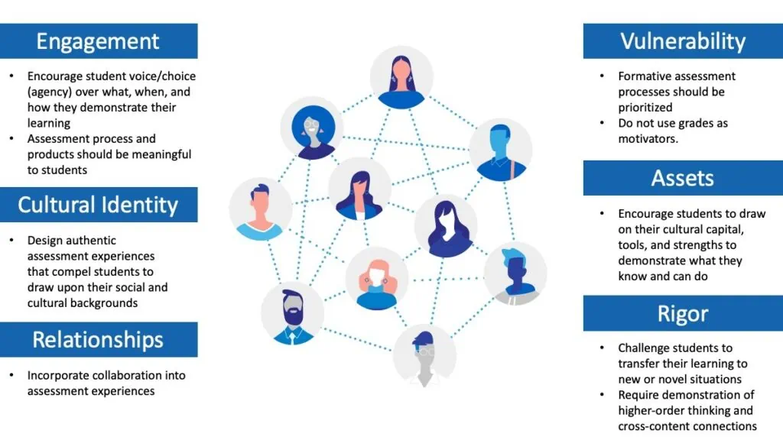
A Culturally Responsive Classroom Assessment Framework
The National Center for the Improvement of Educational Assessment, Inc. - A Culturally Reponsive Classroom Assessment Framework, Carla Evans 2021
Notes:
Facilitator Notes: (2 minutes) This slide is a revisit to the previous module, demonstrating how culturally responsive assessment includes students providing feedback about their learning experiences.
This article from The National Center for the Improvement of Educational Assessment, Inc. was referenced in Module 7: A Culturally Responsive Classroom Assessment Framework - author Carla Evans, September 9, 2021.
A Culturally Responsive Classroom Assessment Framework: The Intersections of Equity, Pedagogy, and Sociocultural Assessment, Carla Evans, Center for Assessment
The six themes of CRE from Dr Stembridge include engagement, cultural identity, relationships, vulnerability, assets, and rigor. These six themes overlap but are listed separately to elucidate the connections with classroom assessment. In practice, they are impossible to separate. The bullets underneath each of the six themes of CRE in the figure are not intended to be an exhaustive list; however, it is difficult to imagine a summary of how the six themes relate to classroom assessment without these bullets being included.
Connections can also be made to Planning Questions with Equity in Mind (below) that have been utilized in previous modules: In modules 6, 7 & 8 regarding assessments, educators have the opportunity to reflect on their lesson design around the five questions to identify evidence of understanding, feelings, rigor, cognitive/emotional/behavioral engagement and opportunities for responsiveness.
Planning Questions:
Question One: What do I want students to understand?
Question Two: What do I want students to feel?
Question Three: What are the targets for rigor?
Question Four: What are the indicators of engagement?
Question Five: What are the opportunities to be responsive?
“Equity, as an educational concept, is the implementation of an Equity mindset into thoughtful pedagogical design.” p. 1: Dr. Adeyemi Stembridge - Culturally Responsive Education in the Classroom - An Equity Framework for Pedagogy

Slide 8
Definitions: Feedback From Students on Their Experience of the Learning
Student feedback invites students’ perceptions of the classroom environment, instruction, and their own learning
Student feedback may be anonymous
Student feedback is part of a teacher’s self-evaluation
(Teachers should discuss general reflections with their evaluators as a matter of course but should have discretion over sharing specific responses/results.)
Notes:
Facilitator Notes: (8 mins) Share definitions - These definitions are from the SGG rubric.
1)Have participants identify a word or words that resonate with them and make connections to their own understanding of “Feedback From Students on Their Experience of the Learning” (3 minutes)
2)Have participants review the rubric below to make connections to the definitions. (5 mins)
Final Revised Student Growth Goal Rubrics
3) Knowing your CBA regarding student feedback is encouraged. If participants are not familiar with this language, allow time for participants to research this information. (Optional activity - 10 minutes)

Slide 9


Why Student Feedback/Voice?
For example:
Students with a strong sense of student voice are 7 times more likely to be academically motivated.
Students with a strong sense of engagement are 16 times more likely to be academically motivated.
Feedback is most powerful when it is from the student to the teacher.
When teachers seek, or at least are open to, feedback from students about what students know, what they understand, where they make errors, when they have misconceptions, when they are engaged; then teaching and learning can be synchronized and powerful.
The benefits of student voice have been measured for decades by experts in the field.
Comparing the Quaglia Institute’s research and that of John Hattie highlights the power involved in feedback and how it impacts student engagement (Hattie, J., & Clarke, S. 2019. Visible learning: Feedback. Routledge).
Notes:
Facilitator Note: (5 mins)This is the rationale as to why obtaining student feedback is beneficial. The next slide identifies an expanded view of this slide conducted by John Hattie/Visible Learning and the Quaglia Institute/Student Voice.
Have participants read the slide or call on participants to take turns reading the points. Ask participants to share something that resonates with them and why.
Additional Resources to go deeper:
Quaglia Institute
Visible Learning MetaX

Slide 10
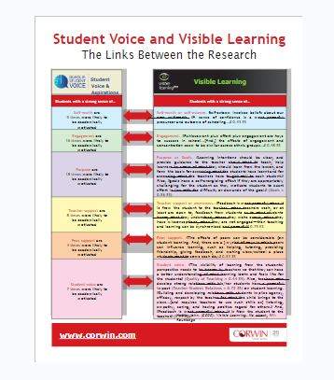
Student Voice & Visible Learning
Research by:
John Hattie/Visible Learning
and
Dr Russell Quaglia/Quaglia Institute of
Student Voice & Aspirations
Student Voice and Visible Learning.pdf.pptx
Notes:
Facilitator note- This is the research that supports the why and benefits of student feedback and supports the previous slide. (3 mins) When clicking on the link you will need to enlarge the view.
Have participants review the links between the research by John Hattie/Visible Learning and Dr Russell Quaglia/Quaglia Institute of Student Voice & Aspirations. Facilitator choice on how participants share their thoughts.
Student Voice and Visible Learning.pdf.pptx

Slide 11


Benefits of Receiving Student Feedback on Teaching and Learning
There are many benefits of receiving student feedback about teacher practice.
Teachers can utilize student feedback on teaching and learning for their professional growth.
Opens new possibilities for conversations with PLCs, evaluators, instructional coaches, mentors or grade level / department teams.
The MOST IMPORTANT: Discussions between teachers and their students.
  Opens avenues for ongoing dialogue and feedback
  Exhibits to students the teacher’s growth mindset
  Creates stronger partnerships with students as initiators of their own learning and growth.
CSTP
Notes:
Facilitator notes: (2 mins) These benefits are outlined in our own Washington State Student Perception Survey | CSTP as well as additional resources that support the use of perception surveys as a tool to gain feedback from students on their experience of the learning.

Slide 12

10 Mindframes for Visible Learning has stemmed from the Visible Learning research conducted by Professor John Hattie and his team, who concluded that one of the most important influences on student achievement is how teachers think about learning and their own role. Hattie and Zierer (2018) define ten behaviours or mindframes that teachers need to adopt in order to maximise student success.
Which mindframes align with your current practice and which ones are a challenge/next step?
10 Mindframes for Visible Learning: Teaching for Success, John Hattie & Klaus Zierer
Notes:
Facilitator Notes: (25 mins)
Give participants time to read 10 Mindframes for Visible Learning - THINKING PATHWAYS (8 mins)
Facilitate discussion on Which mindframes align with your current practice and which ones are a challenge/next step? (10 mins)
In addition, make connections to the critical attributes of SGG: (7 mins)
*Knowledge of Students
*Essential Standards
*Cognitive Engagement
*Emotional Engagement
*Formative and Summative Assessment
*Student Engagement in Assessment
*Feedback From Students on Their Experience of the Learning
Ten Mindframes for Visible Learning: Book by John Hattie & Klaus Zierer

Slide 13

Street Data: Asset-Based and Builds on the Tenets of Culturally Responsive Education
“Street Data” takes us down to the ground to observe, listen to, and gather artifacts from the lived experiences of stakeholders.
Street data are the qualitative and experiential data that emerges at the eye level and on lower frequencies when we train our brains to discern it.
These data are asset based, building on the tenets of culturally responsive education by helping educators look for what’s right in our students, schools, and communities instead of seeking out what’s wrong.
Street data help us reveal what’s getting in the way of student or adult learning, illuminate where the learner is in relationship to a holistic set of goals, and determine what might come next.
Street Data: A Next-generation model for Equity, Pedagogy, and School Transformation,
by Shane Safir and Jamila Dugan
Notes:
Facilitator Notes: (10 mins) Concluding quotes for the Unpacking section of this module from Street Data: a Next-generation model for Equity, Pedagogy, and School Transformation, Shane Safir/Jamila Dugan, pg 57, Ask participants to make connections between “Street Data” quotes and what has been covered in this module on Feedback From Students on Their Experience of the Learning.
Module 6 Connection:
Levels of Data.docx
Street Data: A Next Generation Model for Equity, Pedagogy, and Transformation, Shane Safir/Jamila Dugan, Pages 54-58
Satellite Data: Data that hover far above the classroom and tell an important but incomplete story of equity. Satellite data encompass broad-brush quantitative measures like test scores, attendance patterns, and graduation rates, as well as adult indicators like teacher retention, principal attrition, and parent participation.
Map Data: Data that hover closer to the ground, providing a GPS of social-emotional, cultural, and learning trends within a school community. Map data include literacy levels gathered through “running records” where teachers listen to and code students reading aloud, rubric scores on common assessments, and surveys that reveal student, parent, or staff perception and satisfaction levels.
Street Data: The qualitative, systematic, and experiential data that emerges at eye level and on lower frequencies when we train our brains to discern it. Street data is asset-based, building on the tenets of culturally responsive education by helping educators look for what’s right in our students, schools, and communities instead of seeking out what’s wrong. Street data embodies both an ethos and a change methodology that will transform how we analyze, diagnose, and assess everything from student learning to district improvement to policy. It offers us a new way to think about, gather, and make meaning of data.
Summative assessments relate to satellite data. In order to get to map and street level data, we need to consider the connection to being culturally responsive.

Slide 14

Embedding Strategies for Obtaining Student Feedback
Observing student behavior
Exit tickets
Polls
Individual and/or whole class interviews
Focus groups
Anonymous notes
Student surveys
What are some other strategies?
Notes:
Facilitator Notes: (5 mins)
There are a number of different ways to obtain feedback from students. Considerations for when in a lesson, unit or time of year is important to address with participants. Ask participants if they could add other strategies to this list.

Slide 15

Activity - Student Perception
Choose a resource below to explore:
Student Perception Toolkit - CSTP (Washington State Developed and Piloted)
Student Voice Data Accelerates Teaching And Learning
Continuously Refine Your Practice With Student Feedback | Edutopia
Improving Teaching With Expert Feedback—From Students | Edutopia
UDL Now Chapter 10: Using Student Feedback to Inform Instruction
2. Read and Reflect
3. Small group share
Notes:
Facilitator Notes: While there are many ways to obtain student feedback, there are a lot of educational resources on how to conduct student surveys. (25 mins)
1)Allow participants the opportunity to choose which resource they would like to explore. (10 mins)
2)After reading have participants share about what they learned from the resource they selected. Combining participants who read different resources may be beneficial if the group is large enough. (15 mins)
Possible protocol to use for group discussion: Three Levels of Text Protocol – School Reform Initiative

Slide 16

How Listening to Students with Grace is Important
Give one’s full attention to the speaker and to what is being said
Understand the feeling behind the words and be sensitive to the emotions being expressed
Suspend judgement and listen with compassion
Honor the speaker’s cultural way of communication.
From Zaretta Hammond’s Culturally Responsive Teaching and the Brain, p.78
Notes:
Facilitator Notes (10 mins)
Zaretta Hammond explains how to listen with grace. These are important reminders when collecting feedback from students and allowing them to share themselves with us. This slide supports the following activity where a teacher shares their authentic experience with student feedback. Have the participants share why this is important when receiving feedback from students and any experiences they have had in listening to student feedback.

Slide 17

Video: Getting STUDENT FEEDBACK About Your Teaching
Notes:
Facilitator Notes: (18 mins)
Video 7:32 mins. Watch the video, “Getting Student Feedback About Your Teaching” and then have participants respond by discussing what information stuck with them and why. (10 mins)
Comments from the video author:
In this video, I share how I've dealt with student pushback in my classrooms. I'm looking at pushback as when students just aren't really digging what you're doing in the classroom. It's important to allow students to have a voice in your class, which I do through class debrief. I share how I conduct the debrief as well as times I've changed how I do things based on the feedback and times I stuck to the way I did things.
Cliffs Notes version: 🍎Tell students why you're doing what you're doing 🍎Give them opportunities to give feedback 🍎Don't take the feedback personally and always respond with 'thank you' 🍎Analyze the feedback

Slide 18

Connections to your Instructional Framework
Using your Instructional Framework handout, highlight where you see connections to:
Feedback From Students on Their Experience of the Learning:
Students’ perceptions/feedback:
-of the classroom environment,
-of instruction,
-of their own learning, and
-of their progress
Notes:
Facilitator Notes: Connecting to the Instructional Framework - (15 minutes)
5 minutes to highlight
10 minutes to share with elbow partner or in small groups: Have participants discuss what connections they found, any patterns that they noticed and answer to the additional question.
Instructional Framework links:
CEL 5D+
CEL Framework
Danielson
Danielson Smart Card -needs to be updated
Marzano
Marzano at a Glance

Slide 19
Key Considerations: Feedback From Students on Their Experience of the Learning
If you are a teacher:
When you are in a student growth conversation with your administrator, what will you communicate about accessing feedback from students on their experiences of the learning and how it impacted your instructional decisions and practice over time?
If you are an administrator:
When you are in a student growth conversation how will you encourage dialogue with a teacher on how they are accessing feedback from students on their experience of the learning and what impact has it had or will have on their practice?
Notes:
Facilitator notes: (15 min)
Provide individual reflection time,( 5 minutes)
Provide small group discussion time (consider if you want to group by job-alike or mixed groups, depending on audience), (10 minutes)

Slide 20
Additional Readings and Resources
Early / Midterm Feedback | Derek Bok Center, Harvard University
Collecting and Using Student Feedback Throughout the Year
Why Professors Should Ask Students For Feedback Long Before the Semester Is Over | EdSurge News
Improving Teaching With Expert Feedback—From Students | Edutopia
Why Is Student Voice Important In Education? | Move This World
Gathering student feedback - Center for Teaching and Learning
https://www.youtube.com/watch?v=tANBHAy5DDU&t=51s
UDL Student Feedback Survey
3 Ways of Getting Student Feedback to Improve Your Teaching | Edutopia EL
Formative Assessment During Distance Learning: Recapturing “In-the-Moment” Observations that Inform Instruction
Russ Quaglia - Student Voice
Notes:
Facilitator Notes: Additional reading and resources for further learning. (5 mins)

Slide 21
Closing
If we want students to learn more, teachers must become students of their own teaching. They need to see their own teaching in a new light.”
Tom Kane, Professor of Education and Economics at Harvard’s Graduate School of Education and leader of the MET project
“We need to reimagine the way we assess students’ learning and specifically in ways that provide meaningful feedback to teachers and students so that they can have a clearer sense of what is and is not effective in the practices of schools.”
Dr Adeyemi Stembridge from Culturally Responsive Education in the Classroom - An Equity Framework for Pedagogy, page 214
Notes:
Facilitator Notes: (5 mins), Share quotes
*Tom Kane, Professor of Education and Economics at Harvard’s Graduate School of Education and leader of the MET project
*Pg 214, Culturally Responsive Education in the Classroom - An Equity Framework for Pedagogy - Dr Adeyemi Stembridge

Slide 22

Thank you!
We’d like to honor and acknowledge the thought, time and effort that went into creating this module, and offer thanks to the module developers:
Patricia Beuke, OESD 114 and Danielson Framework Specialist
Joy Lansdowne, formerly ESD 101 and Marzano Framework Specialist
In appreciation for their work and in acknowledgement to others who have contributed:
Jennifer Ireland NWESD 101 Regional Literacy Coordinator & TPEP Lead
Maja Wilson, PhD OSPI ELA Assessment Specialist, Assessment Development
Serena O’Neil, NBCT OSPI Math Assessment Specialist, Assessment Development
Notes:
Facilitator Notes: Closure: (5 mins) - read quote/questions/links/contacts
If helpful, please feel free to share the url for the TPEP website:https://www.k12.wa.us/educator-support/teacherprincipal-evaluation-program
And the direct link to the Student Growth Goals page: https://www.k12.wa.us/educator-support/teacherprincipal-evaluation-program/frameworks-and-student-growth/student-growth
For questions, please contact OSPI at tpep.k12.wa.us

